Slide 1
Java Persistence API

Slide 2
Objectives
Introduction to the java persistence API
JPA entity class basics
JPA Architecture
JPA - Obtaining a JPA Database Connection
Configure JPA with Hibernate Example
JPA Web Application demo
2

Slide 3
JPA - Introduction
a Java EE/Jakarta EE specification for managing relational data in Java.
a standard for ORM (Object-Relational Mapping), which automatically converts data between Java objects (POJOs) and database tables.
JPA allows developers to work with objects instead of SQL statements, with the implementation typically called a persistence provider.
Popular implementations of JPA include: Hibernate (most popular) EclipseLink (official RI of JPA) Apache OpenJPA

Slide 4
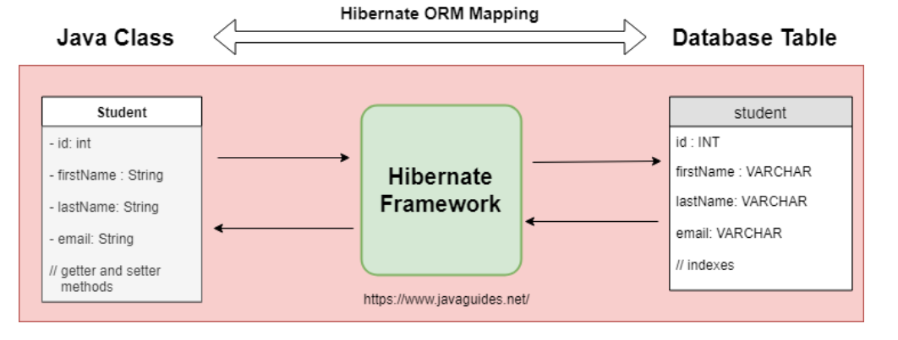
Hibernate ORM mapping

Slide 5
Why use JPA?
Reduce manual JDBC code: No need to write manual SQL for CRUD (Create, Read, Update, Delete).
Easy to maintain, extend: Manage relationships between entities using annotations instead of SQL.
Good integration with Java EE, Spring Boot: Easy to integrate with popular frameworks.
Support cache and high performance: Has a cache mechanism to help query faster.

Slide 6
JPA Entity Class Basics
Defining a JPA Entity Class
A JPA Entity Class is a Java class that is mapped to a table in a relational database.
Each object of this class corresponds to a row in the table.
Requirements for Entity Classes
Must have @Entity annotation → Marks this as an entity.
Must have parameterless constructor → JPA requires to create object from database.Must not declare final → So that JPA can extend or proxy the object.
If transmitted over network (detached object) → Must implement Serializable.
6

Slide 7
JPA Entity Class Basics
Persistent Fields and Properties in Entity Classes
Should be declared as private, protected or package-private.Accessed via getter/setter.
Persistent Fields
Getter/setter methods can be used to map data.
JPA uses the JavaBeans naming convention to map these methods.

Slide 8
JPA Entity Class Basics
Persistent Properties
Using @Entity, @Id, @GeneratedValue, and
@Column annotations for mapping between Java object to database table columns.
Primary Keys in Entities
Use @Id to mark primary keys.
Can use @GeneratedValue to generate values ​​automatically.
Relationship Mapping:
One-to-One (@OneToOne)
One-to-Many (@OneToMany)
Many-to-One (@ManyToOne)
Many-to-Many (@ManyToMany)

Slide 9
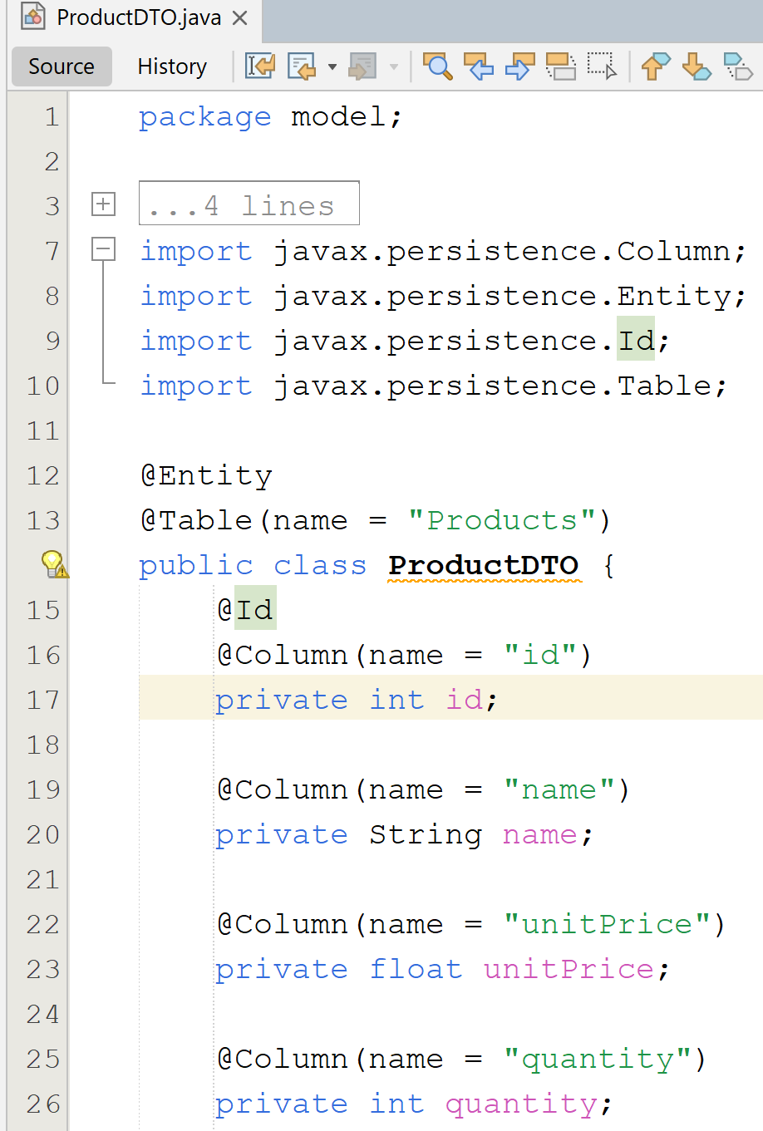
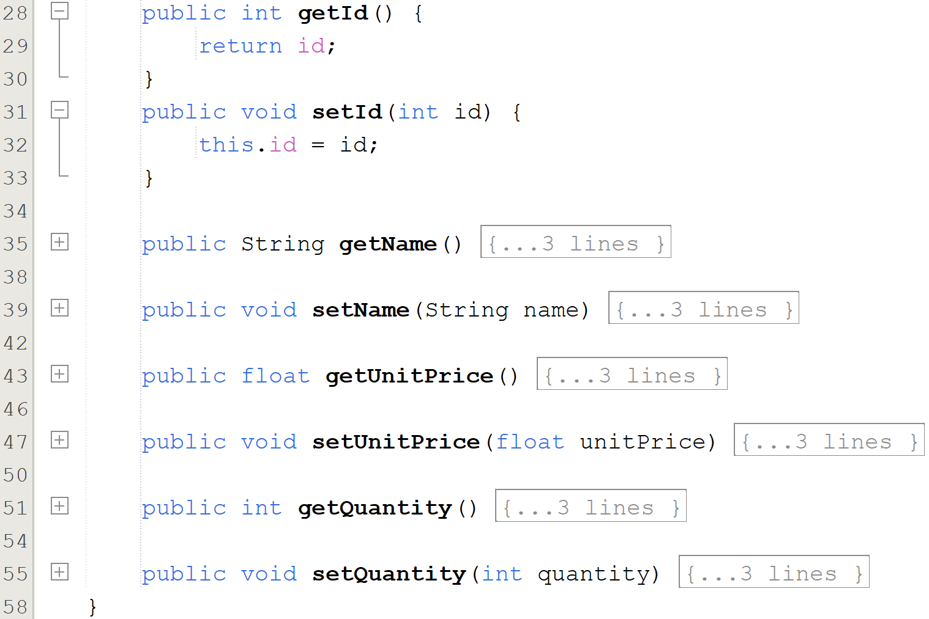
JPA Entity Class Basics

Slide 10
JPA - Architecture
Class Level Architecture
JPA Class Relationships
JPA Simple Example
Usage of EntityManager, EntityManagerFactory and EntityTransaction

Slide 11
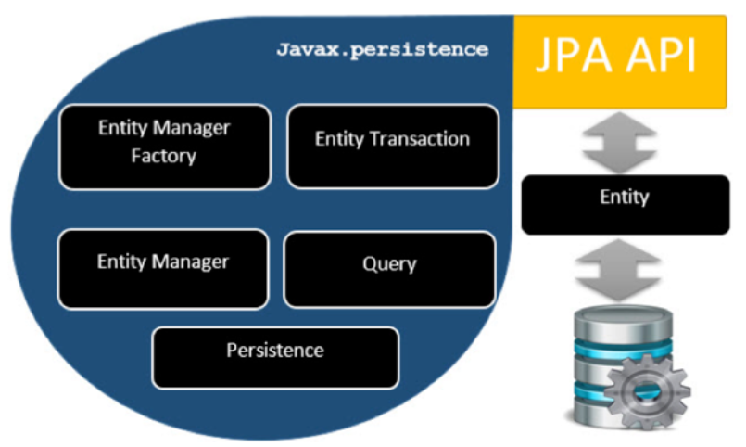
JPA - Architecture
Class Level Architecture

Slide 12
JPA - Architecture
EntityManagerFactory - This is a factory class of EntityManager. It creates and manages multiple EntityManager instances.
EntityManager - It is an Interface, it manages the persistence operations on objects. It works like a factory for Query instance.
Entity - Entities are the persistence objects, stored as records in the database.
EntityTransaction - It has one-to-one relationship with EntityManager. For each EntityManager, operations are maintained by EntityTransaction class.
Persistence - This class contains static methods to obtain EntityManagerFactory instance.
Query - This interface is implemented by each JPA vendor to obtain relational objects that meet the criteria.

Slide 13
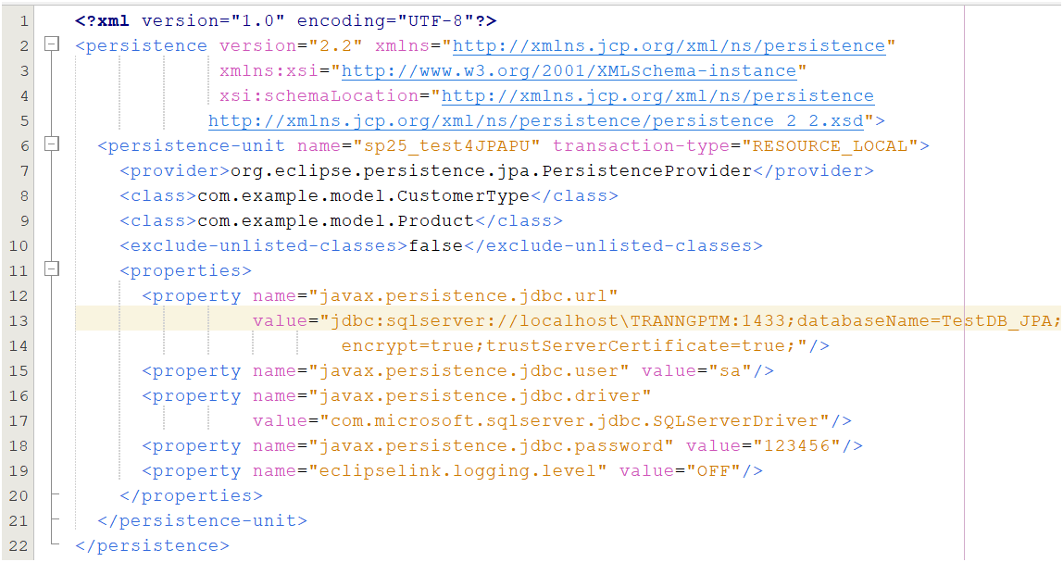
Definition of a persistence unit in an XML file
JPA - Architecture

Slide 14
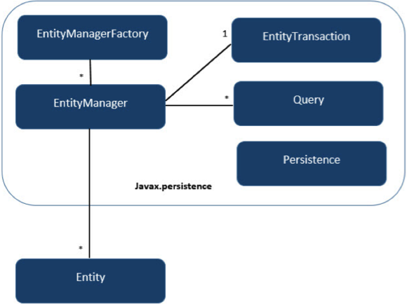
JPA - Architecture
JPA Class Relationships
7/2/2025

Slide 15
JPA - Obtaining a JPA Database Connection
An EntityManager represents a database connection and enables database operations, with each HTTP request in a web app typically using a separate instance.
The EntityManagerFactory efficiently creates multiple EntityManager instances for a specific database.
Database modifications require an active transaction, managed by an EntityTransaction.
Additionally, an EntityManager serves as a factory for Query instances to execute database queries.

Slide 16
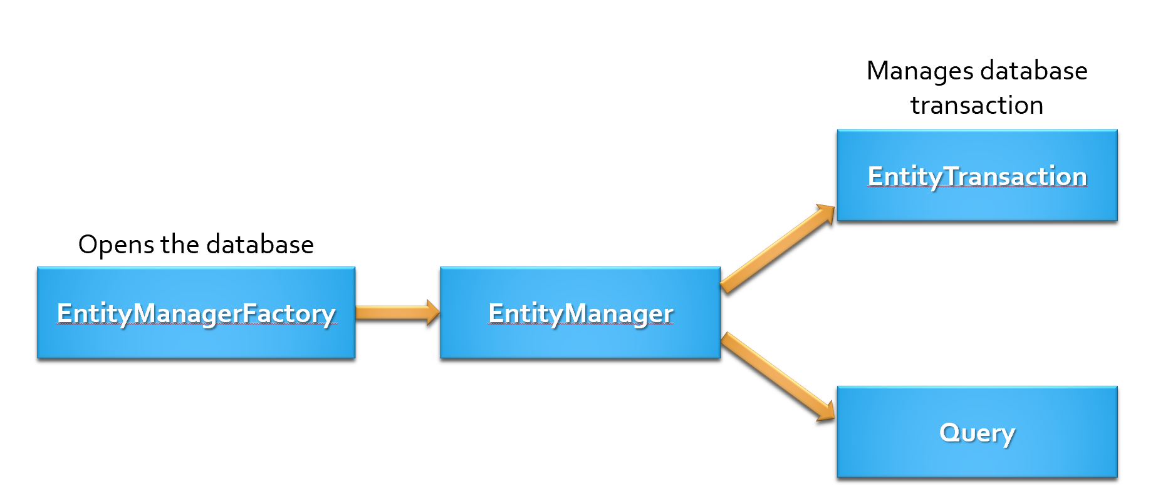
How the EntityManager work ?

Slide 17
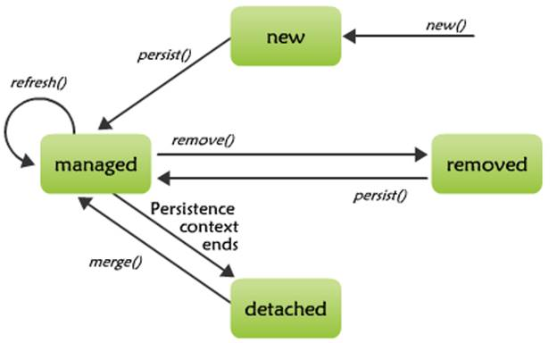
Entity Life Cycle

Slide 18
Common Responsibilities of EntityManager
Create and remove persistent entity instances
Find entities by their primary key
Run JPQL or native SQL queries
Manage transactions (when not using a container)
Synchronize entities with the database

Slide 19
Common methods
Method | Description
persist(Object entity) | Inserts a new entity into the database
find(Class<T> entityClass, Object primaryKey) | Retrieves an entity by its primary key
merge(T entity) | Updates (merges) an entity with the current persistence context
remove(Object entity) | Deletes an entity from the database
clear() | Clears the persistence context (detaches all entities)
createQuery(String jpql) | Creates a JPQL query
createNativeQuery(String sql) | Creates a native SQL query
getTransaction() | Returns the transaction object (for manual transaction control)

Slide 20
How to use JPA ?
Step 1: Add JPA + ORM Dependencies
Step 2: Create persistence.xml
Step 3: Create Entity Class
Step 4: Use EntityManager to interact with DB

Slide 21
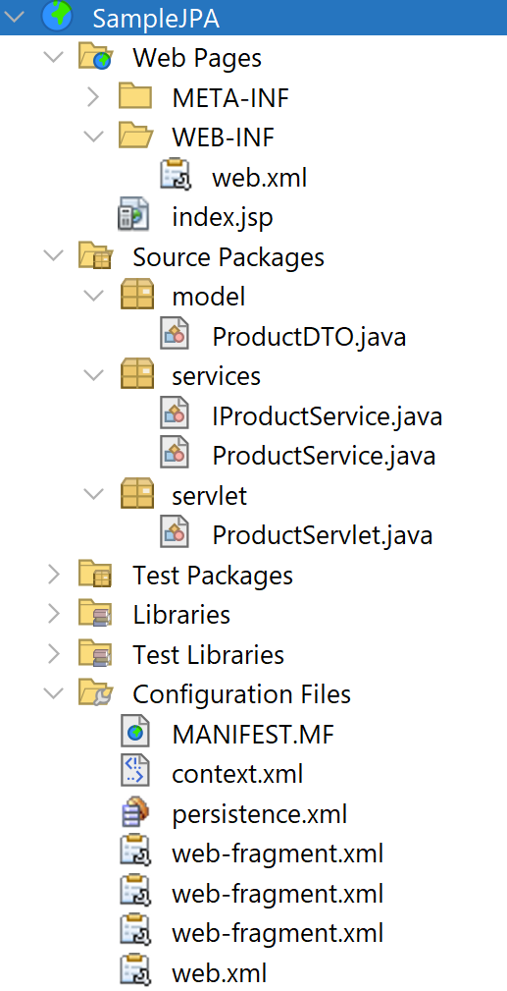
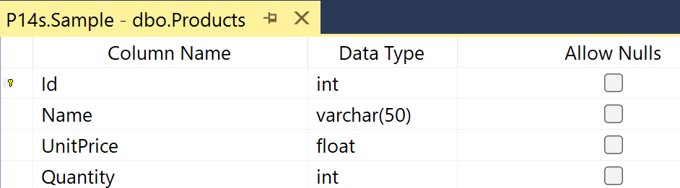
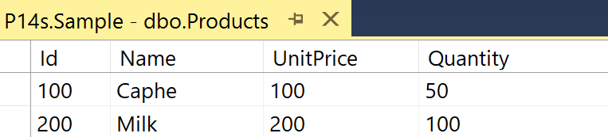
JPA Web Application Demo
#1. Create the web project named SampleJPA and the database named SampleDB as follows

Slide 22
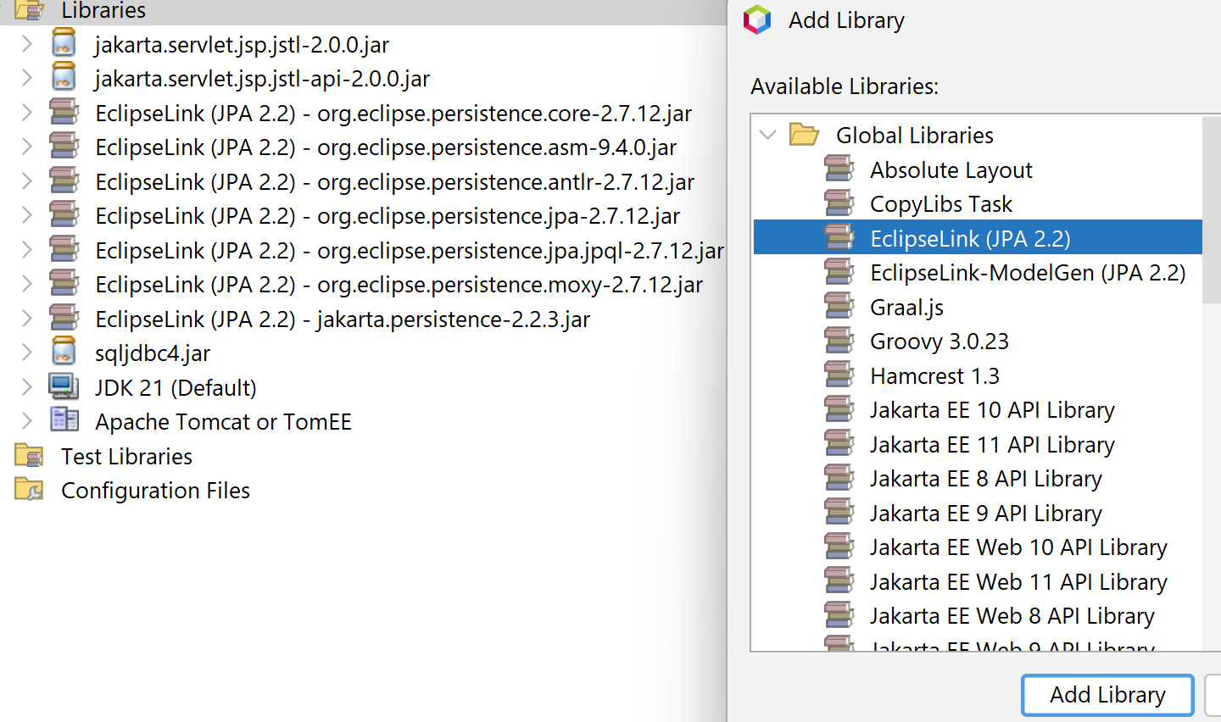
JPA Web Application Demo
#2. Add the Library

Slide 23
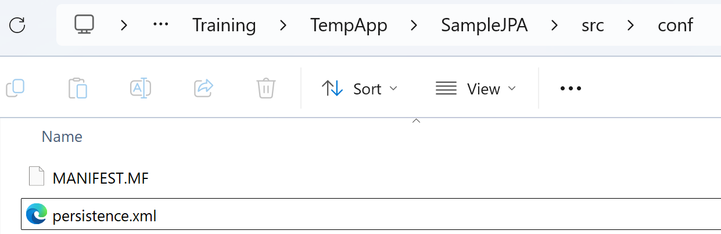
JPA Web Application Demo
#3. Create the persistence.xml on the src/conf folder
<?xml version="1.0" encoding="UTF-8"?>
<persistence version="2.1" xmlns="http://xmlns.jcp.org/xml/ns/persistence"
xmlns:xsi="http://www.w3.org/2001/XMLSchema-instance"
xsi:schemaLocation="http://xmlns.jcp.org/xml/ns/persistence http://xmlns.jcp.org/xml/ns/persistence/persistence_2_1.xsd">
<persistence-unit name="SampleJPA" transaction-type="RESOURCE_LOCAL">
<provider>org.eclipse.persistence.jpa.PersistenceProvider</provider>
<exclude-unlisted-classes>false</exclude-unlisted-classes>
<properties>
<property name="javax.persistence.jdbc.url" value="jdbc:sqlserver://localhost:1433;databaseName=Sample; "/>
<property name="javax.persistence.jdbc.user" value="sa"/>
<property name="javax.persistence.jdbc.driver" value="com.microsoft.sqlserver.jdbc.SQLServerDriver"/>
<property name="javax.persistence.jdbc.password" value="12345"/>
<property name="javax.persistence.schema-generation.database.action" value="create"/>
</properties>
</persistence-unit>
</persistence>

Slide 24
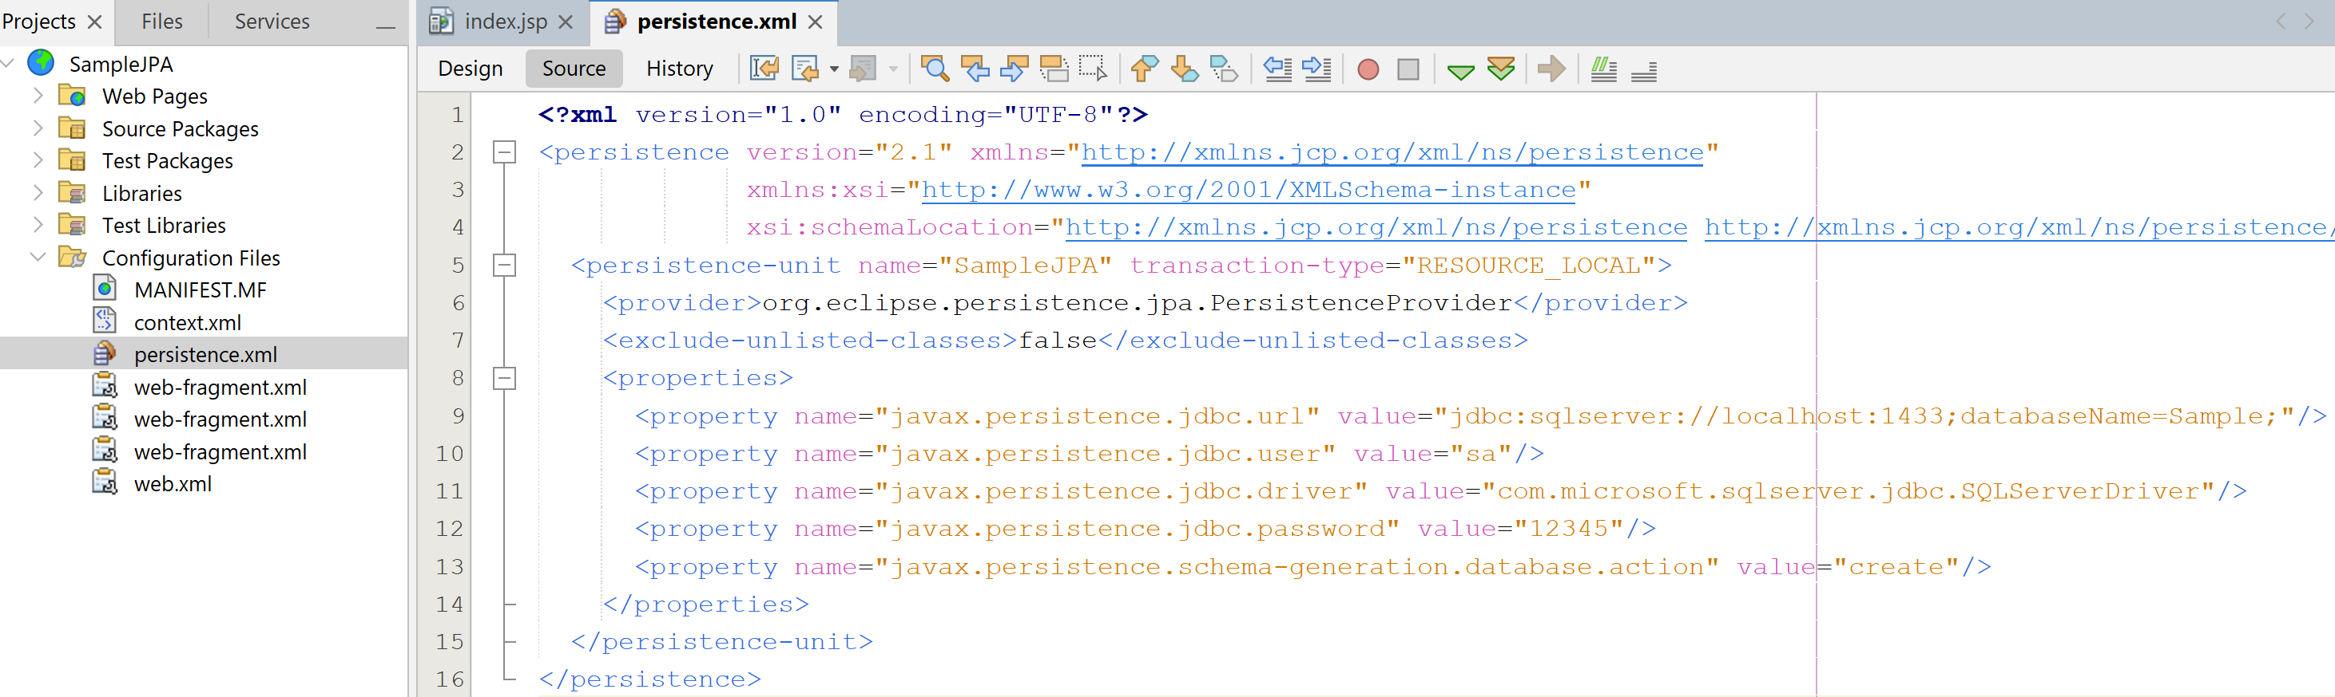
JPA Web Application Demo

Slide 25
JPA Web Application Demo
#4. Write code for ProductDTO.java

Slide 26
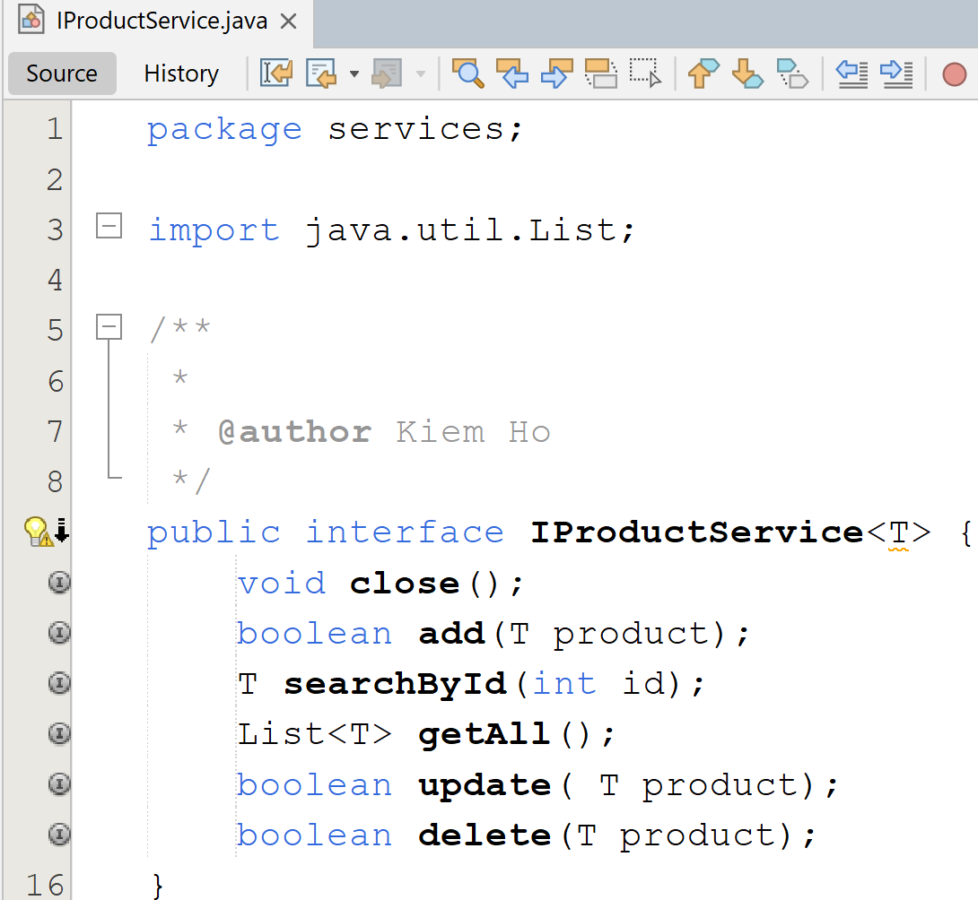
JPA Web Application Demo
#5. Write code for IProductService.java

Slide 27
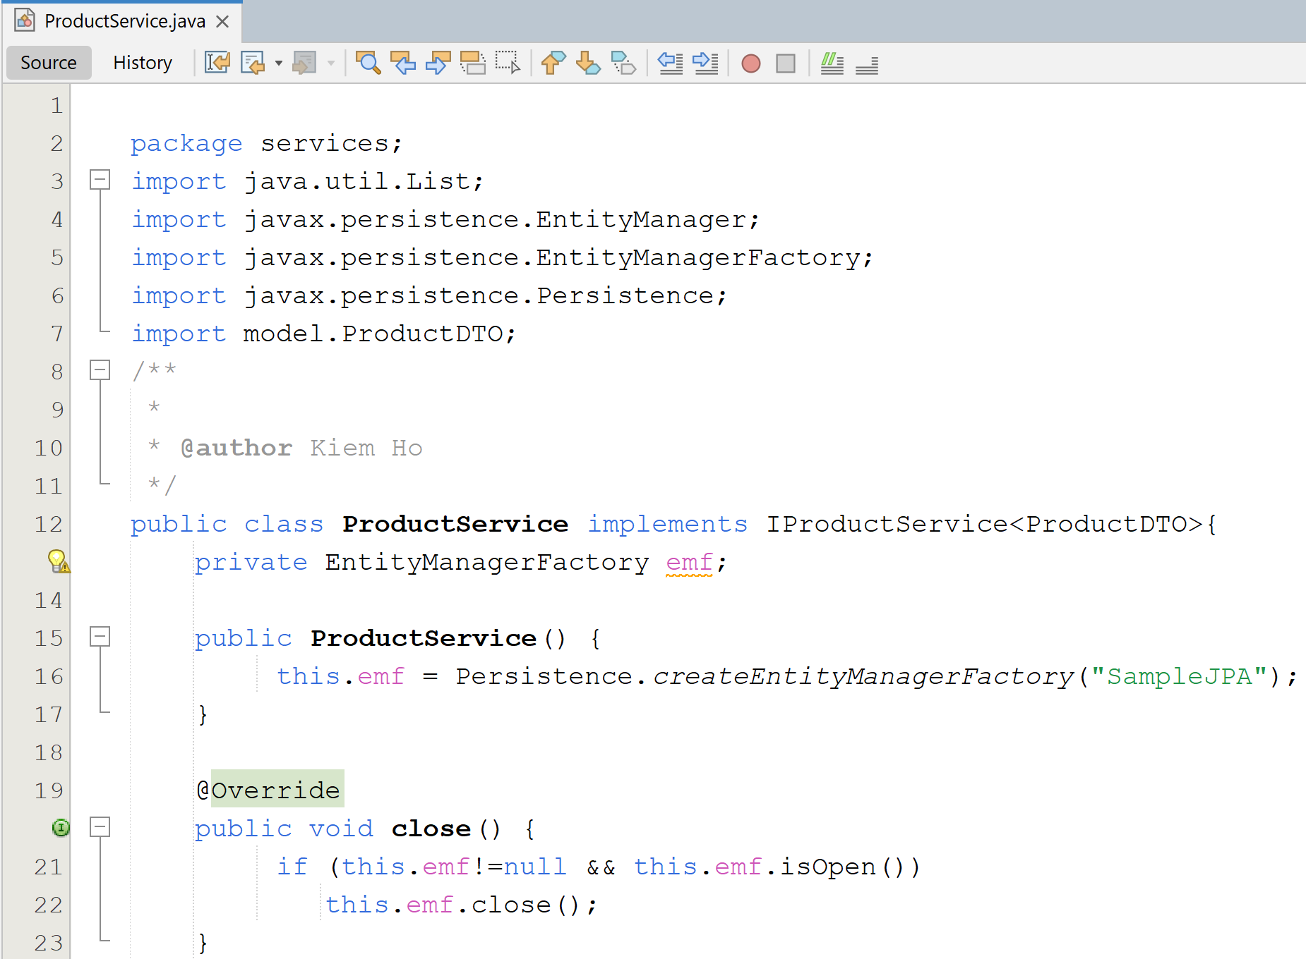
JPA Web Application Demo
#6. Write code for ProductService.java

Slide 28
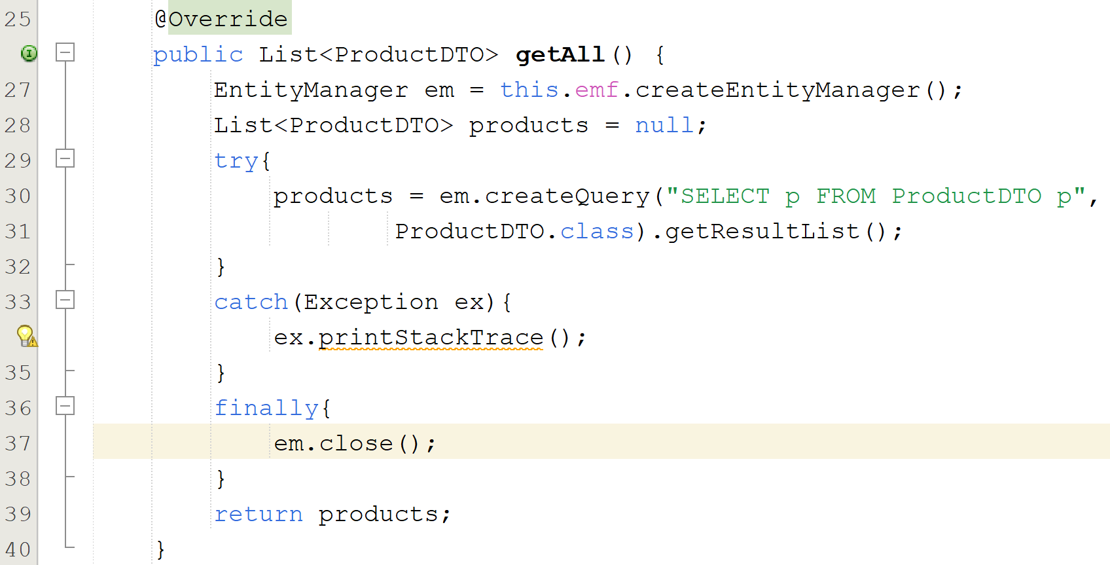
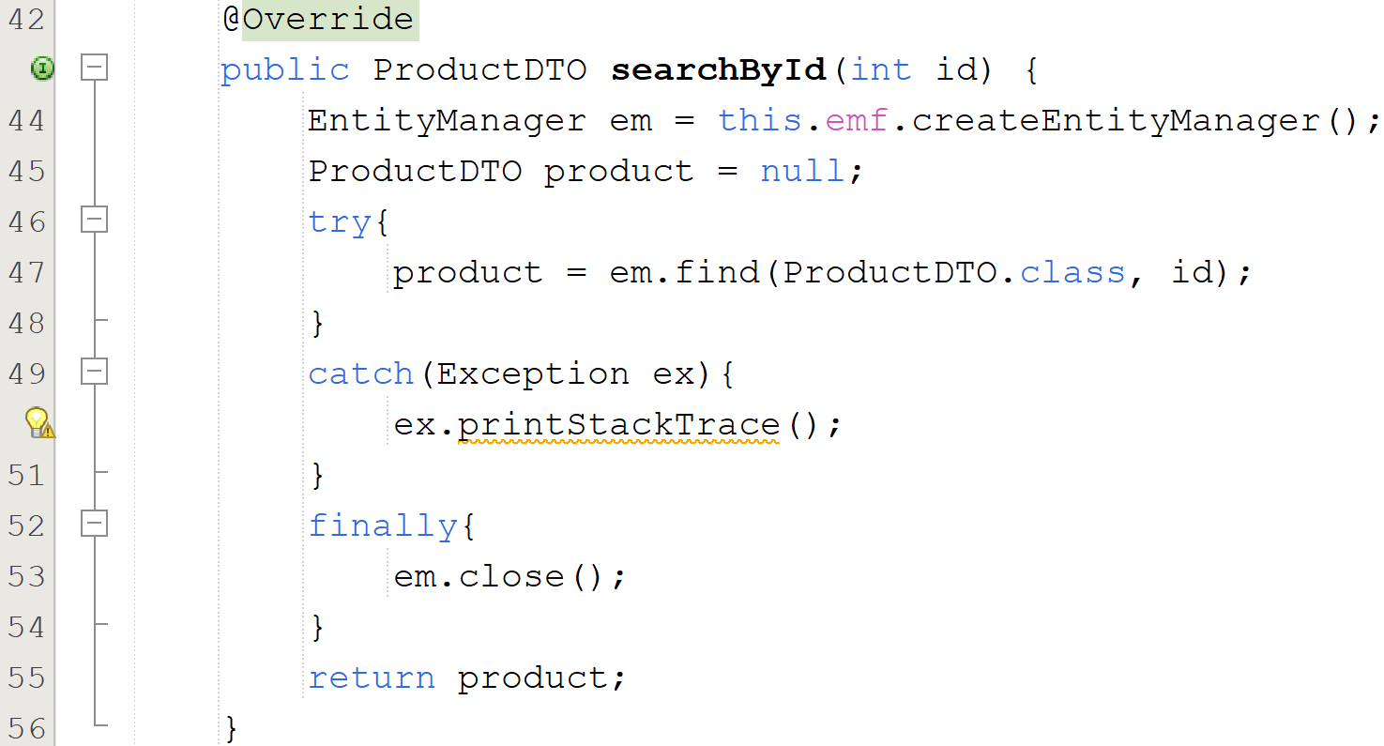
JPA Web Application Demo

Slide 29
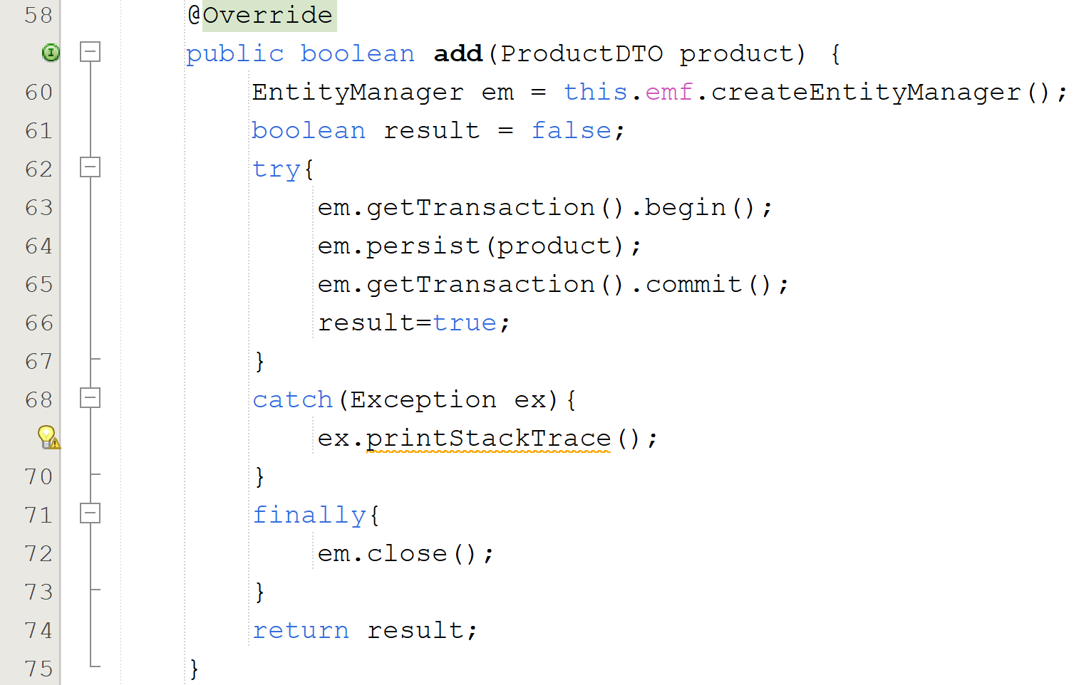
JPA Web Application Demo

Slide 30
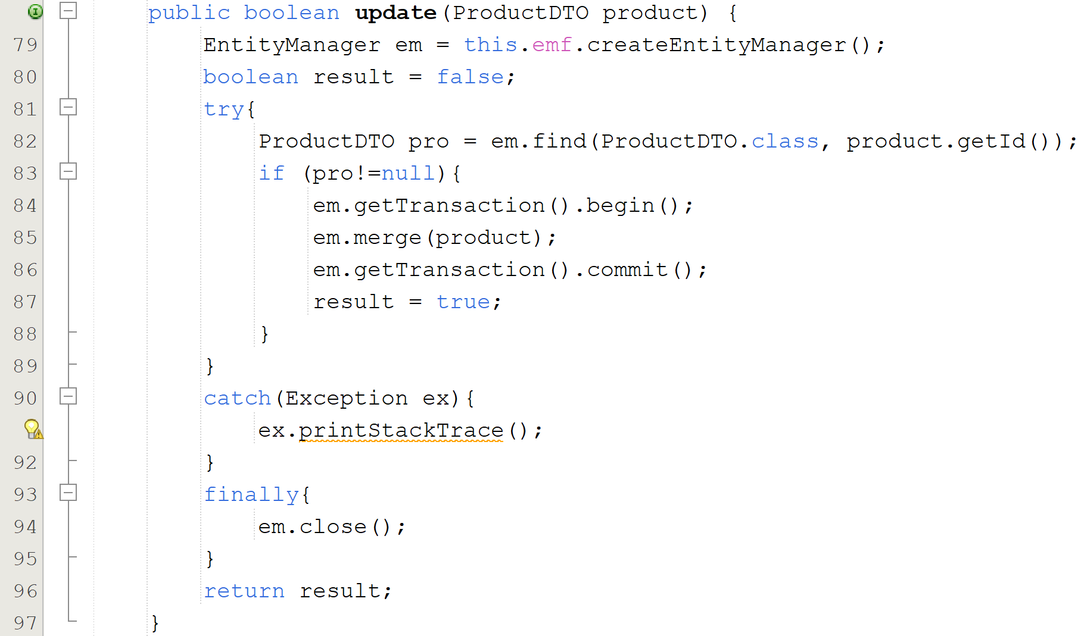
JPA Web Application Demo

Slide 31
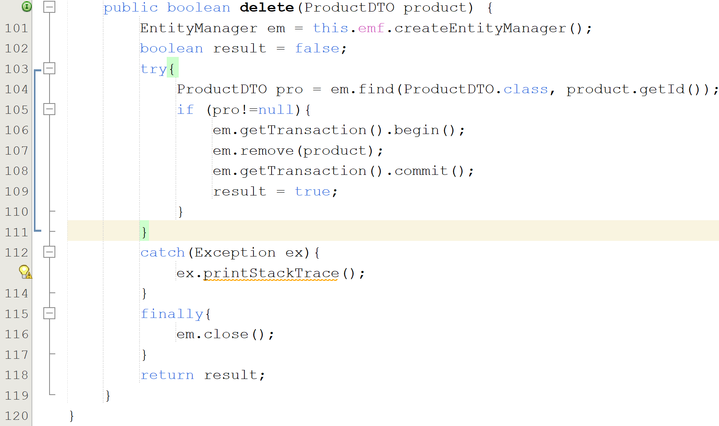
JPA Web Application Demo

Slide 32
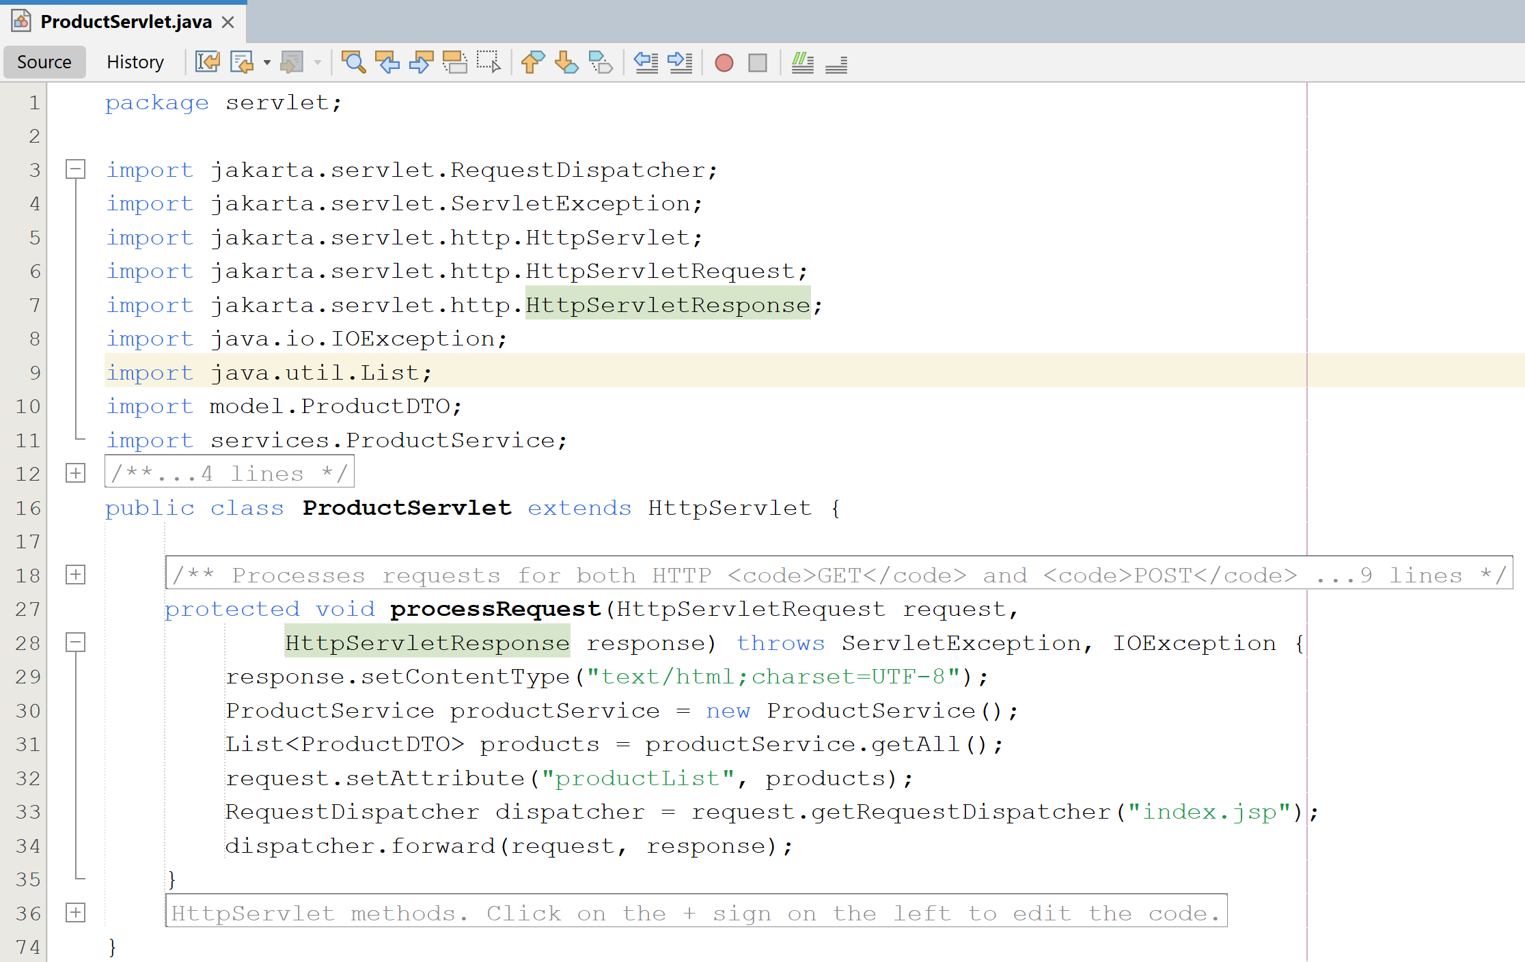
JPA Web Application Demo
#7. Write code for ProductServlet.java

Slide 33
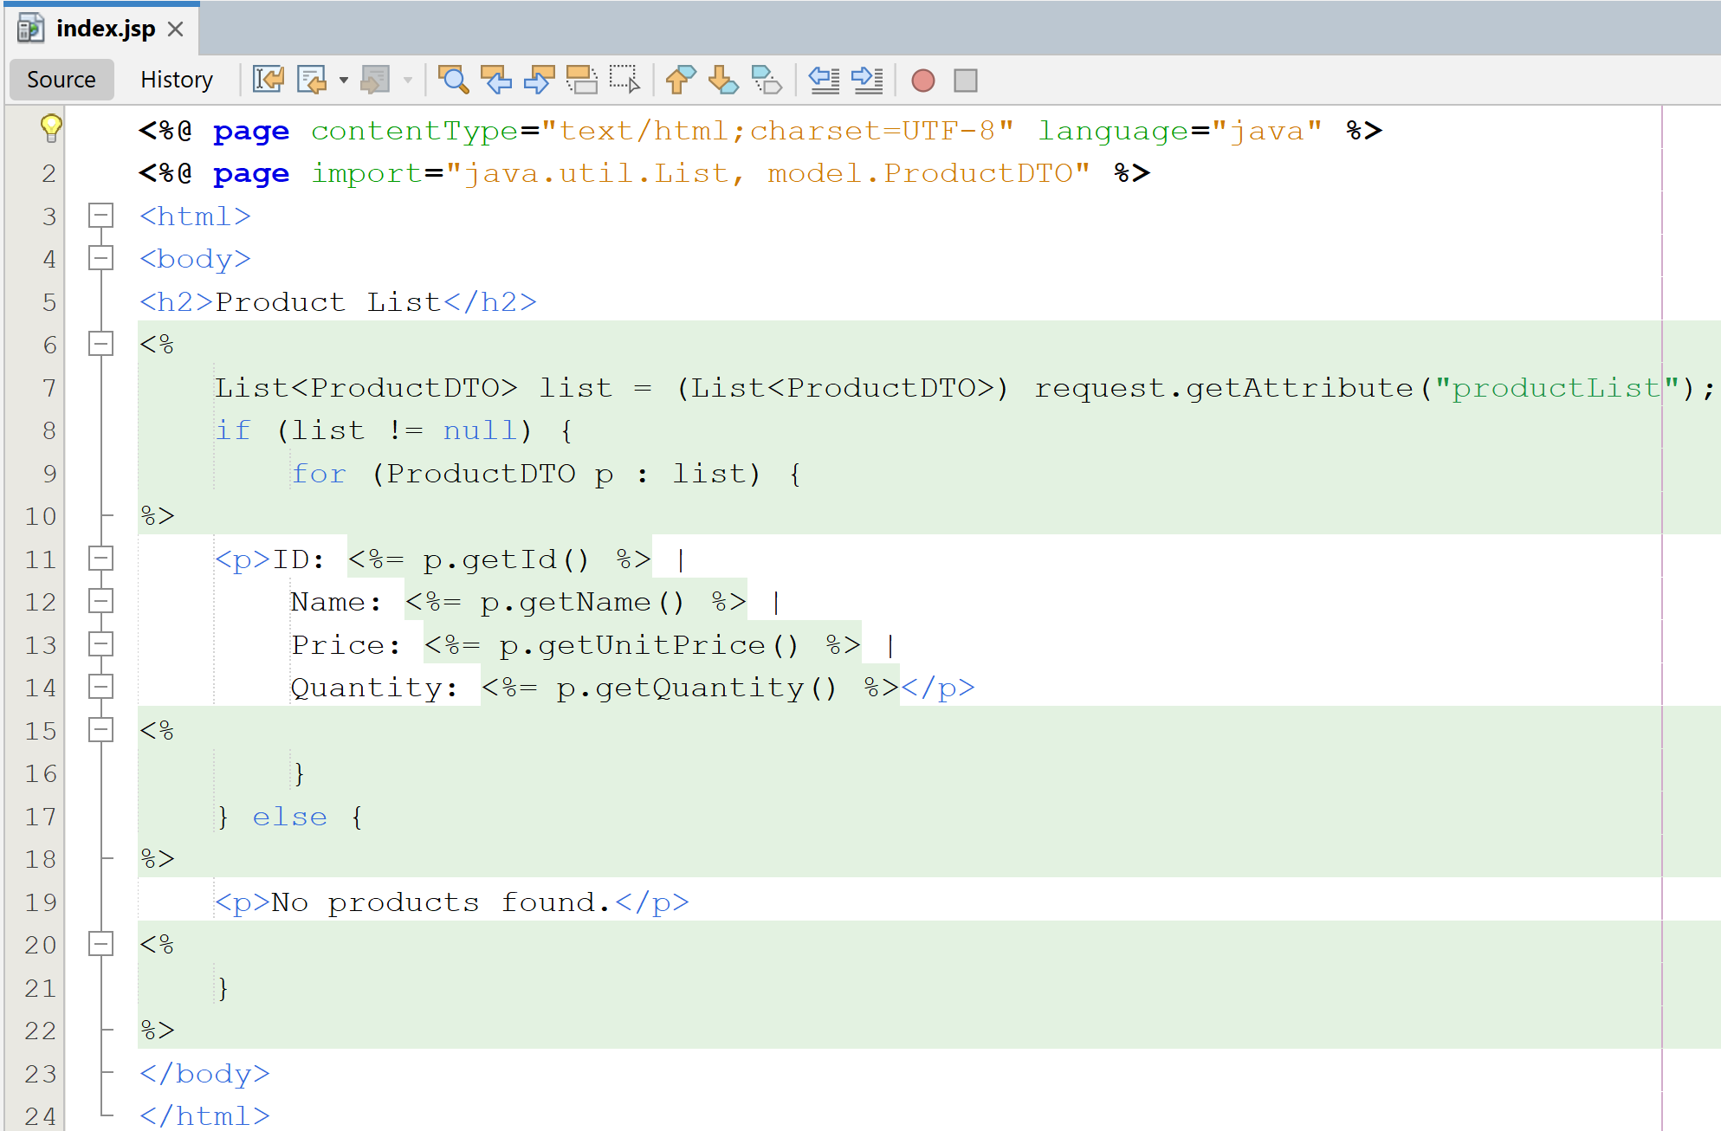
JPA Web Application Demo
#8. Write code for Index.jsp

Slide 34
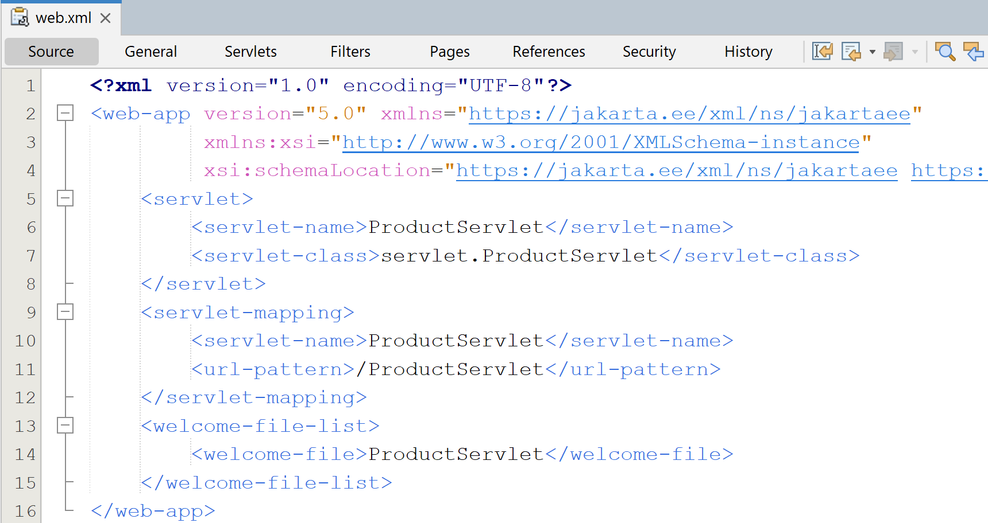
JPA Web Application Demo
#9. Update the web.xml

Slide 35
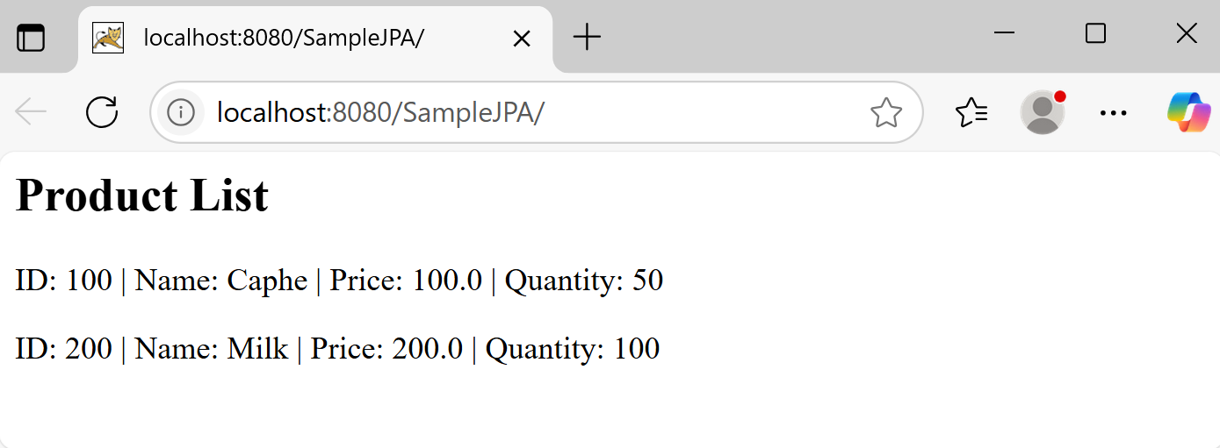
JPA Web Application Demo
#10. Deploy and run the the project

Slide 36
Summary
Java persistence API
JPA entity class basics
JPA Architecture
JPA - Obtaining a JPA Database Connection
Configure JPA with Hibernate Example
JPA Web Application demo

