Slide 1

Fast Sell
marketplace

Slide 2
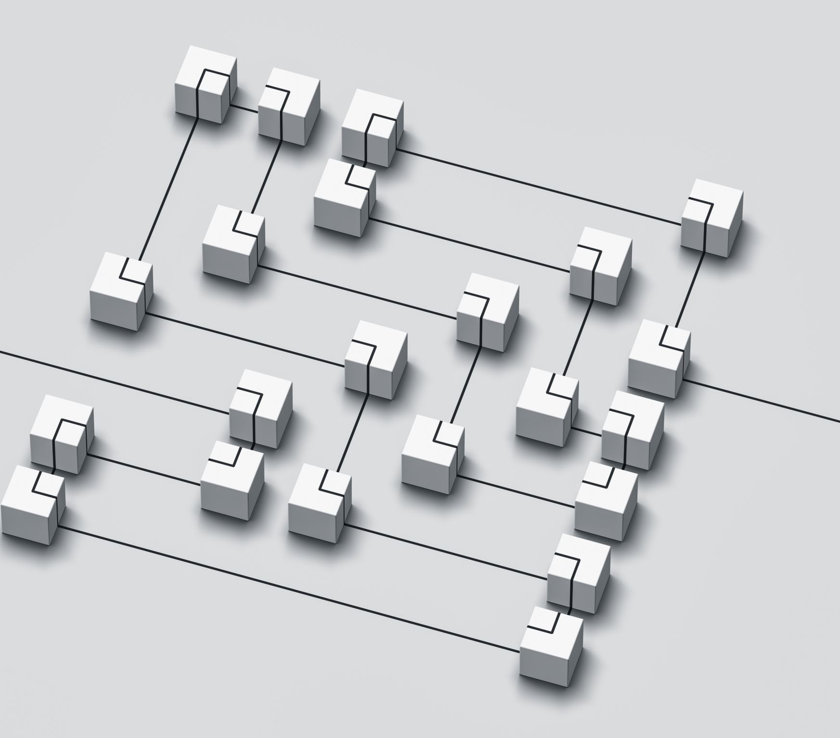
Architecture Overview
Tech stack:
  Frontend: HTML/CSS/JavaScript, Axios
  Backend: Python, Django, Django REST Framework
  Database: PostgreSQL
  Networking: Cloudflare, Nginx

Slide 3
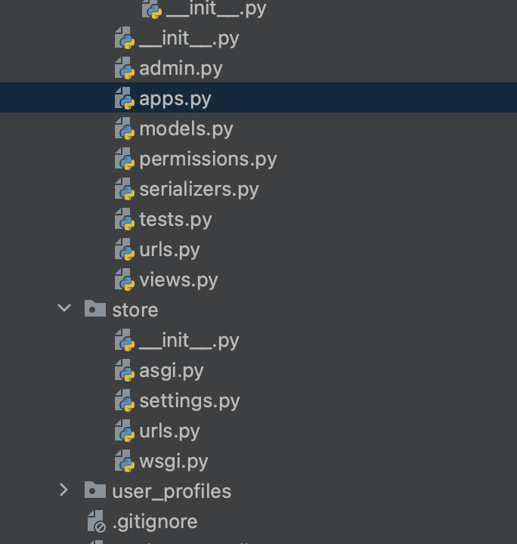
Backend Technologies
Python: Readability, extensive libraries
Django: Web framework, admin panel, ORM
Django REST Framework: API development
PostgreSQL: Reliability, performance in complex queries

Slide 4
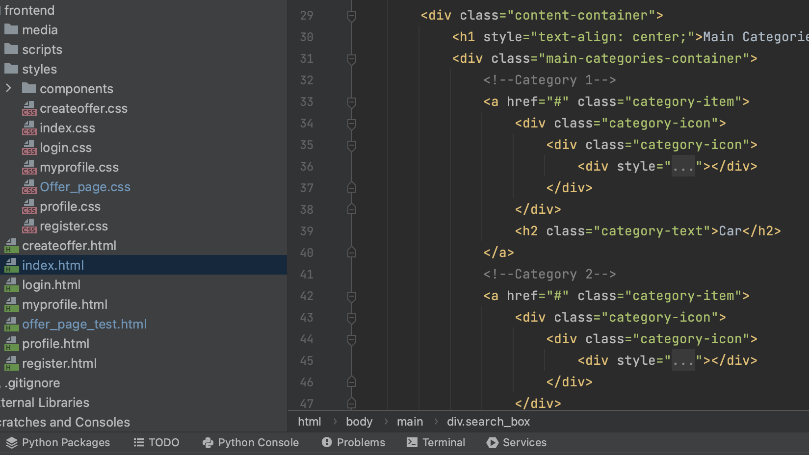
Frontend development
HTML/CSS/JavaScript: Control over UI
Axios: Efficient server request handling
JavaScript Custom Elements: Unique UI components

Slide 5


Networking and hosting
Cloudflare: DNS management, security enhancements
Nginx: Static file hosting, reverse proxy to Gunicorn
Gunicorn: Python WSGI HTTP Server for Django

Slide 6

Overview:
Next, you will see screenshots of our webpage

Slide 7
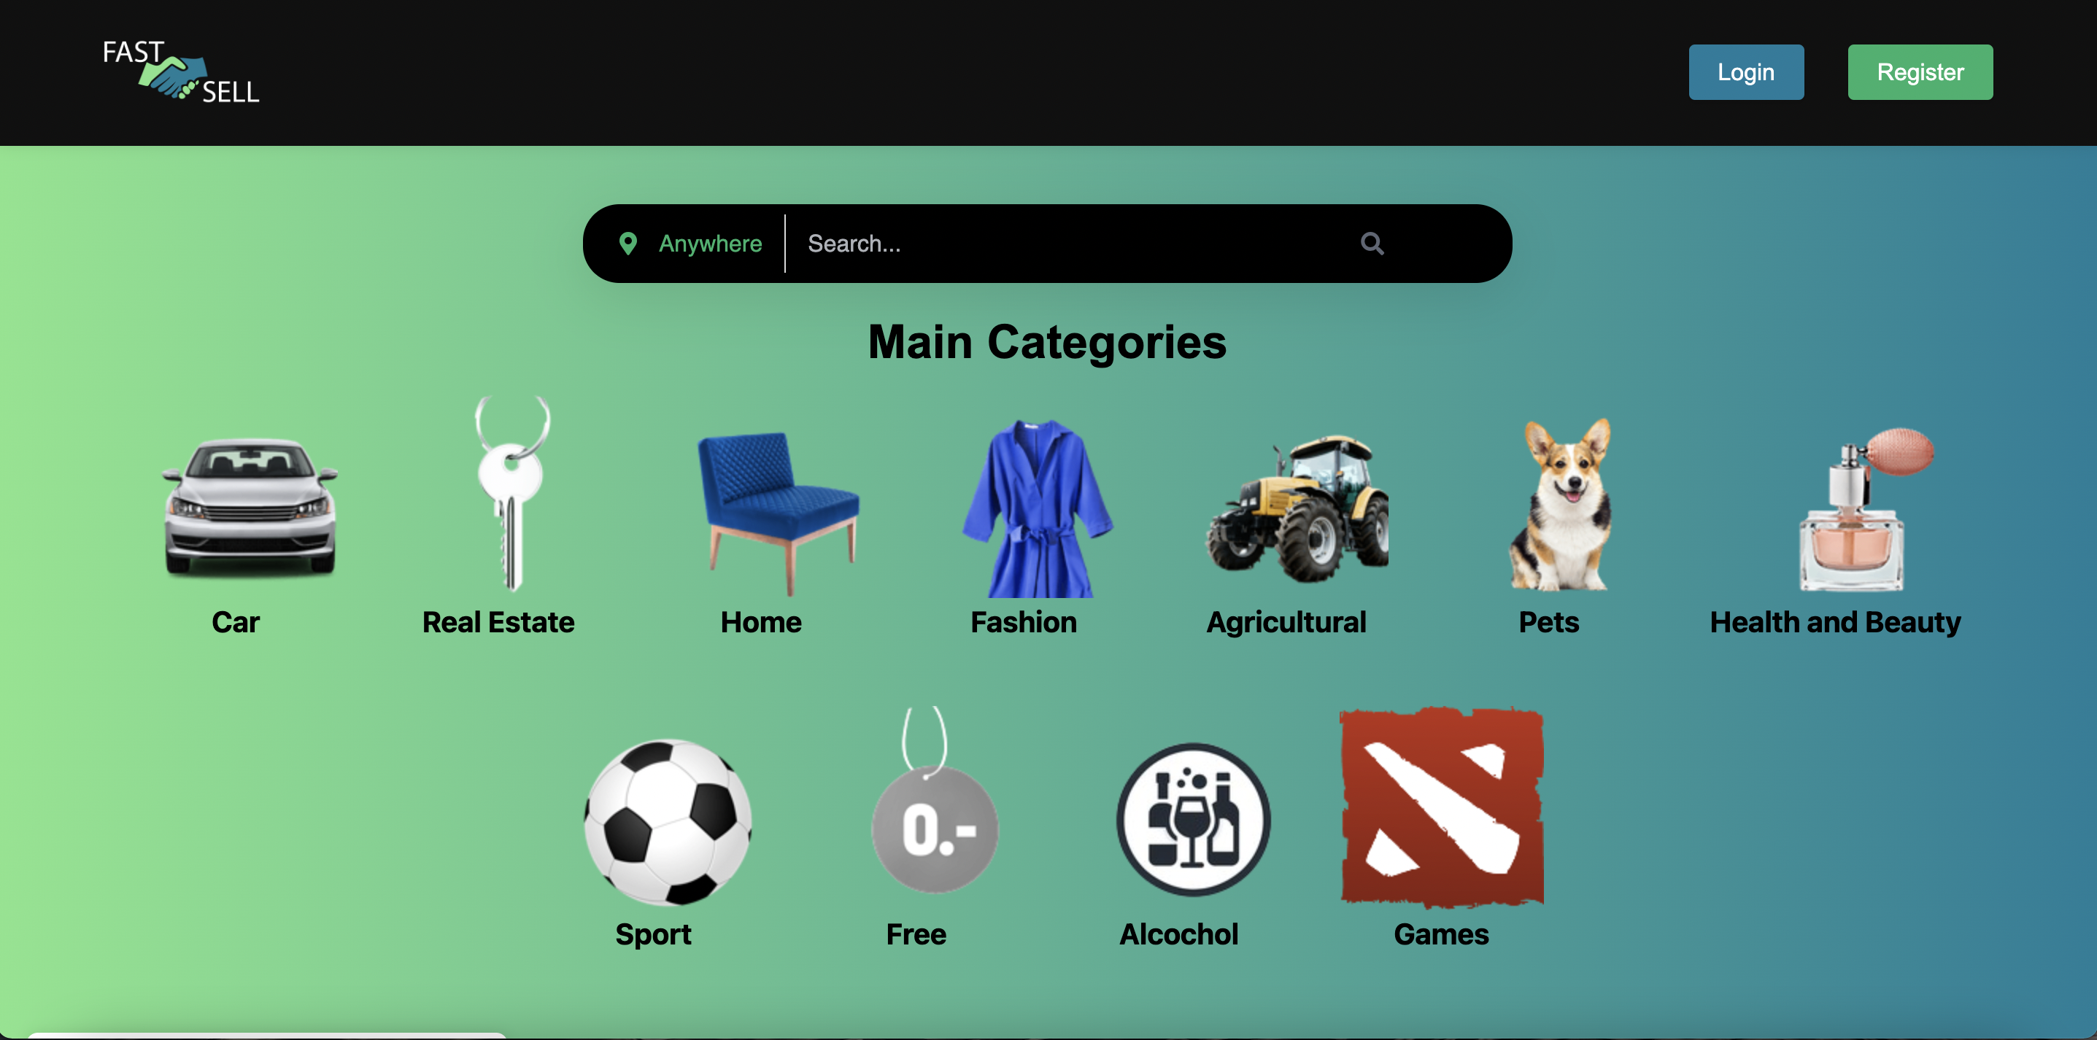
Main Page->

Slide 8
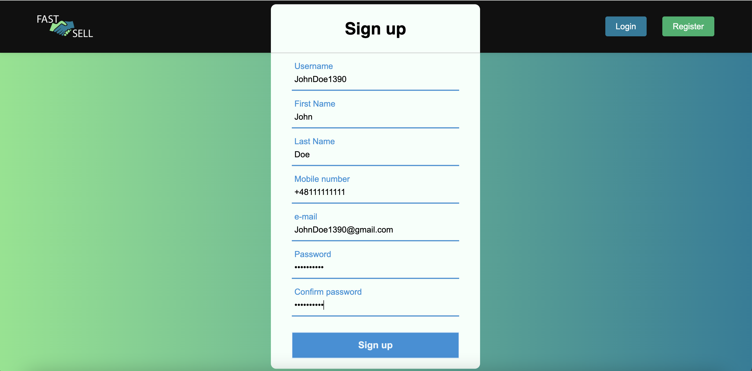
Sign up form ->

Slide 9
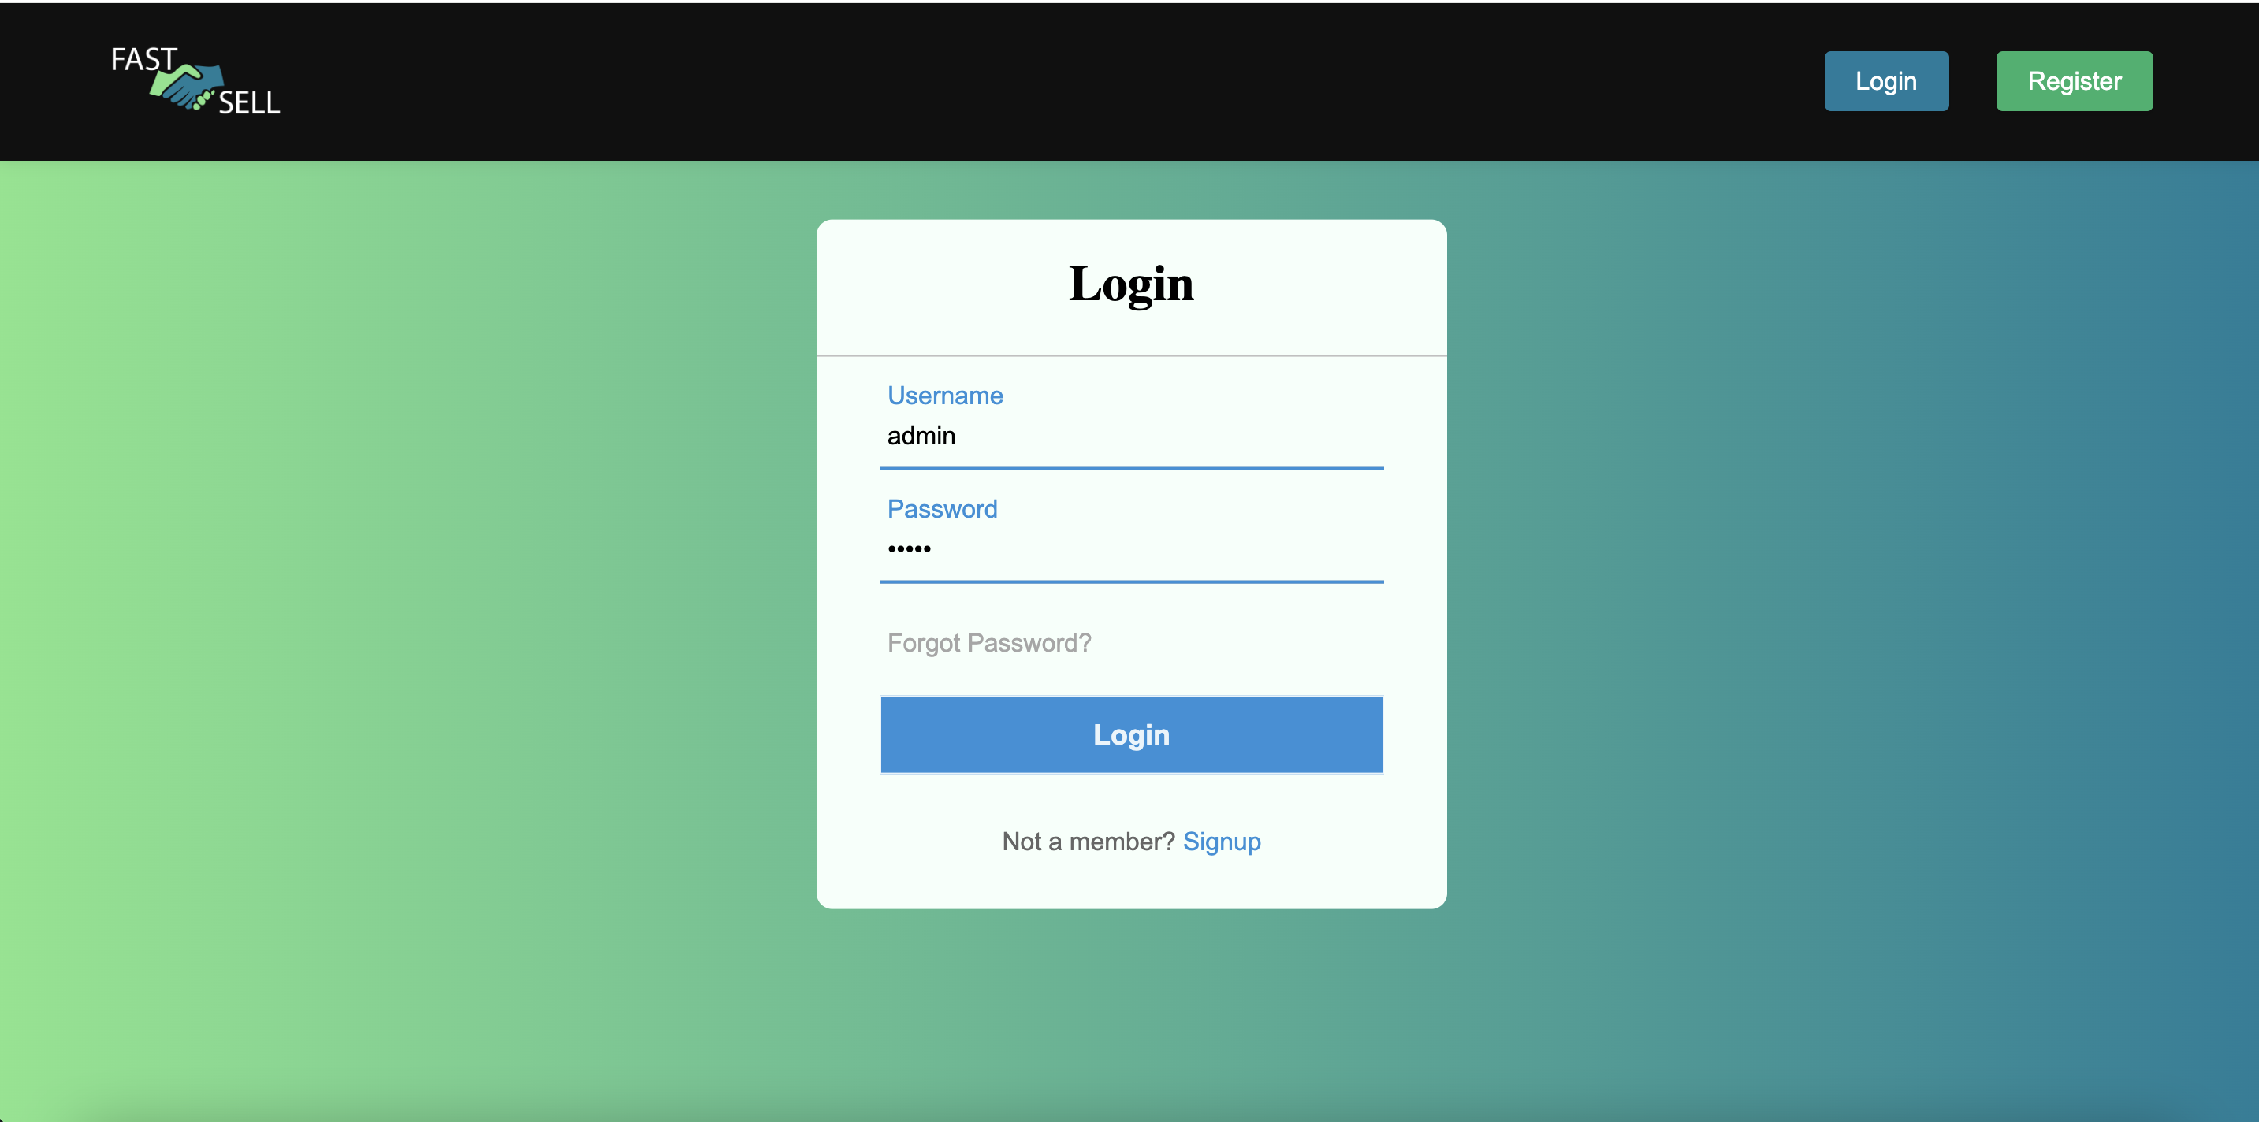
Login form ->

Slide 10

You can check it by yourself https://fastsell.live/

Slide 11

Thank you for your attention!

