Slide 1
Traffic Collisions: Montgomery County Dataset Analysis

Slide 2
Agenda
Meet the team
Project introduction/ Project objective
Dataset Descriptions
Data Architecture
Non-Motorists Insights
Incidents Insights
Summary and Future Work
Drivers Insights

Slide 3
The Team (Group I)
Aasim Inamdar (x23236108)
Waleed Bin Umer (x23187956)
Sana Shafiq Jalgaonkar (x22237941)

Slide 4
Introduction
Traffic Safety is one of the global problem affecting the communities worldwide. Millions of people are impacted by road accidents every year, which leads to serious injuries, casualties and financial expenses.
The Automated Crash Reporting System (ACRS) is one of the ways by which Montgomery county, Maryland, is addressing the global topic of traffic safety.
The ACRS tracks and maintain the details on traffic crashes- including information about incidents, drivers and non-motorists.
This project aims to integrate the main 3 datasets from the ACRS: Crash Reporting: Non-Motorists Data, Crash Reporting: Incidents Data, and Crash Reporting: Drivers Data to perform a detailed analysis on the traffic safety of Montgomery county.
All the 3 datasets are provided on the official site of Montgomery count: https://data.montgomerycountymd.gov/

Slide 5
Project Overview
The main objective of the project is to integrate data from Crash Reporting: Non-Motorists Data, Crash Reporting: Incidents Data, and Crash Reporting: Drivers Data datasets using an Extract, Transform Load method via use of API and file formats.
To analyze these datasets to identify key insights of the data that are associated with the traffic crashes in the Montgomery county.
To provide the practical analysis and suggestions to public safety agencies to reduce the possibility that incidents of the same nature may happen again.

Slide 6
Datasets Description
The datasets used captures the details of all the traffic collisions occurring within the county of Montgomery which is collected with the help of Automated Crash Reporting System (ACRS) of the Maryland state police and reported by Montgomery County Police, Gaithersburg Police, Rockville Police, or the Maryland-National Capital Park Police :
Drivers' dataset keeps the track of each collisions recorded alongside the drivers involved in the incidents. It comprises of total 172K number of rows and 43 columns. Link to dataset- https://data.montgomerycountymd.gov/Public-Safety/Crash-Reporting-Drivers-Data/mmzv-x632/about_data
Incidents dataset provide the in general information about each collision with detail of all traffic collisions occurring on county and local roadways within the county. Link to dataset- https://data.montgomerycountymd.gov/Public-Safety/Crash-Reporting-Incidents-Data/bhju-22kf/about_data . As for the Incidents dataset, it had 97.5K rows and 44 columns.
Non-Motorists datasets records the information about the pedestrians and cyclists involved in the traffic collisions occurring on the county and local roadways with 5650 number of rows and 32 features. Link to dataset- https://data.montgomerycountymd.gov/Public-Safety/Crash-Reporting-Non-Motorists-Data/n7fk-dce5/about_data

Slide 7
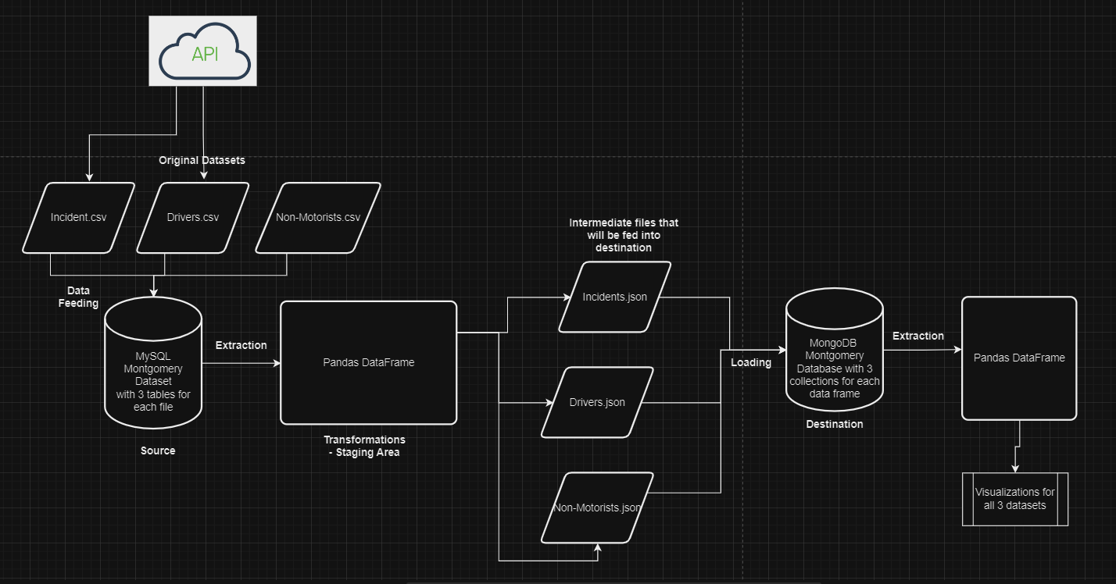
Data Architecture

Slide 8
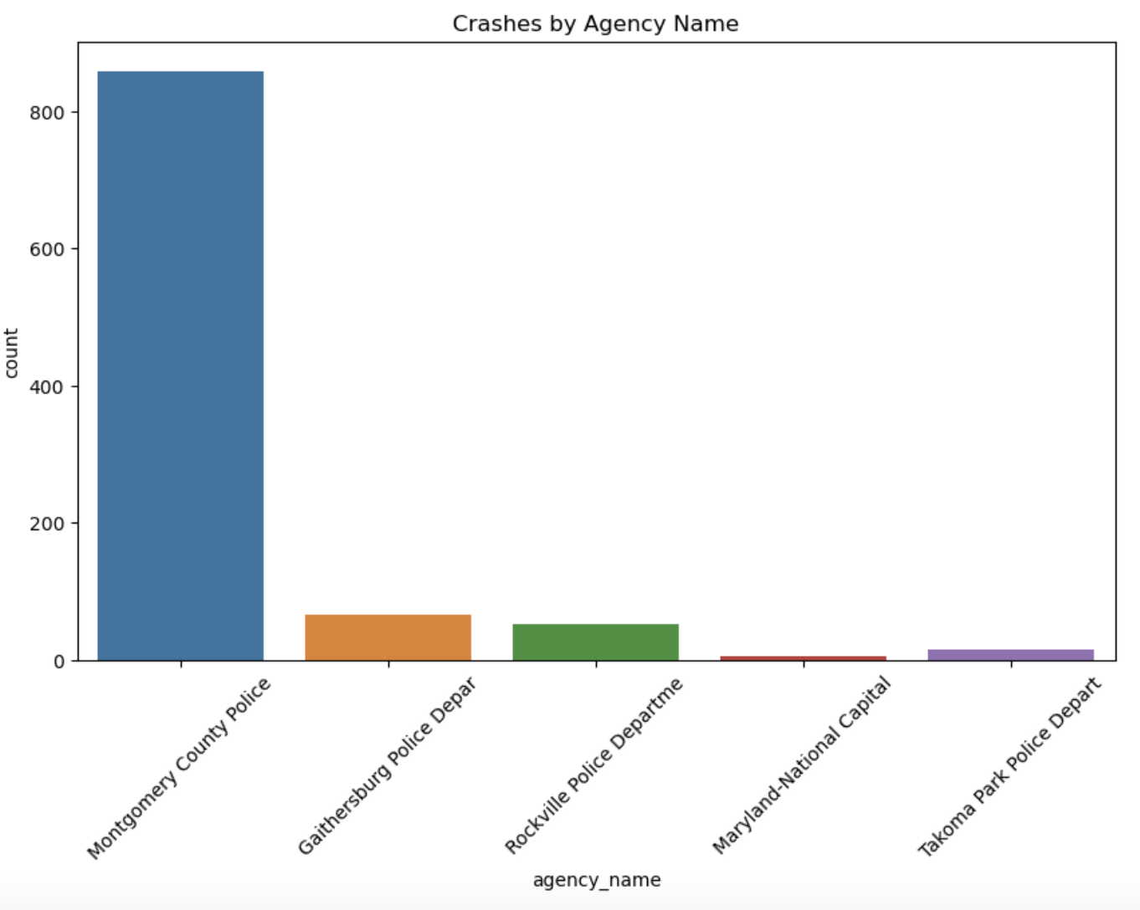
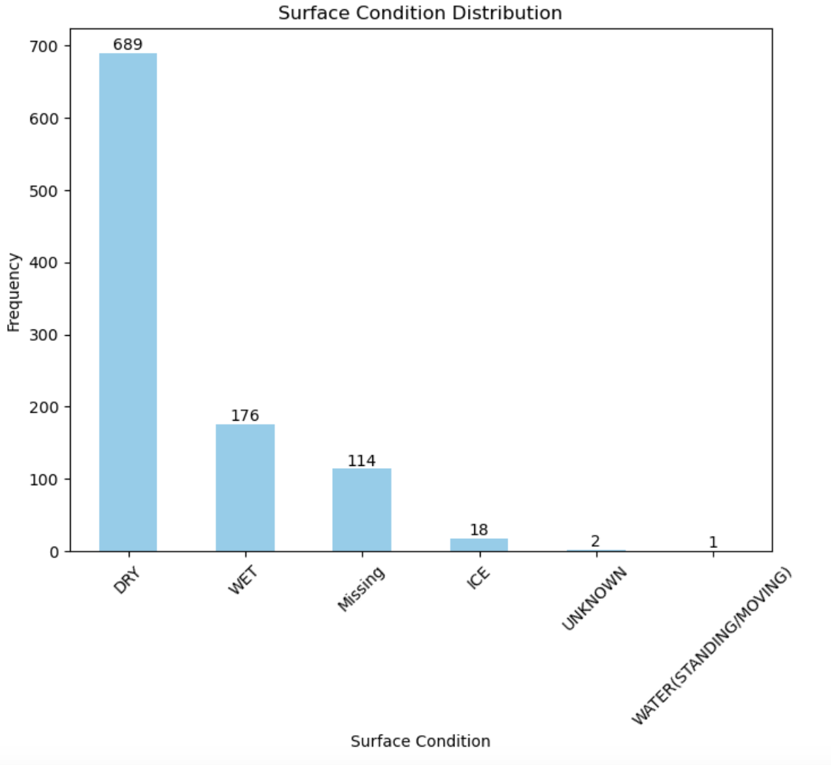
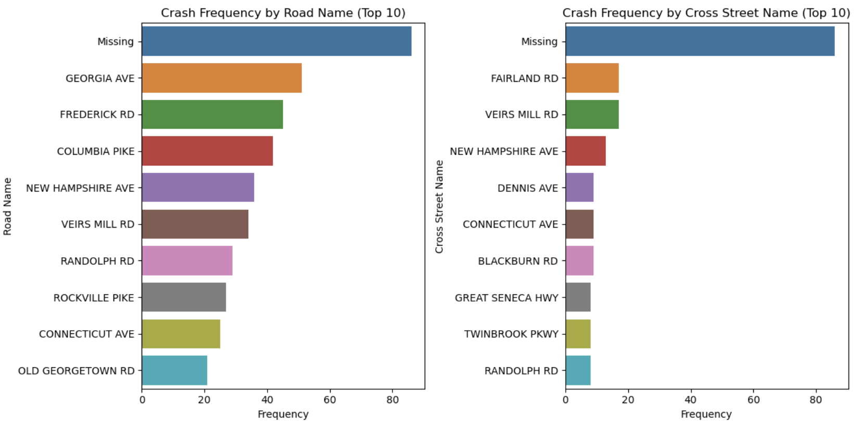
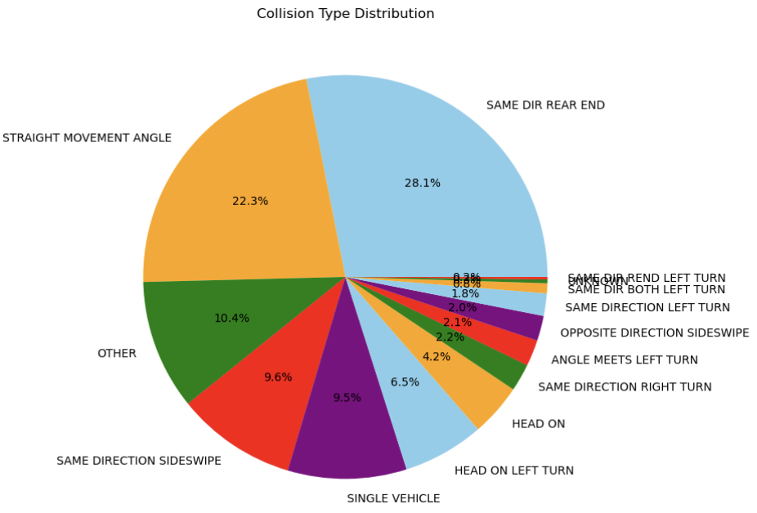
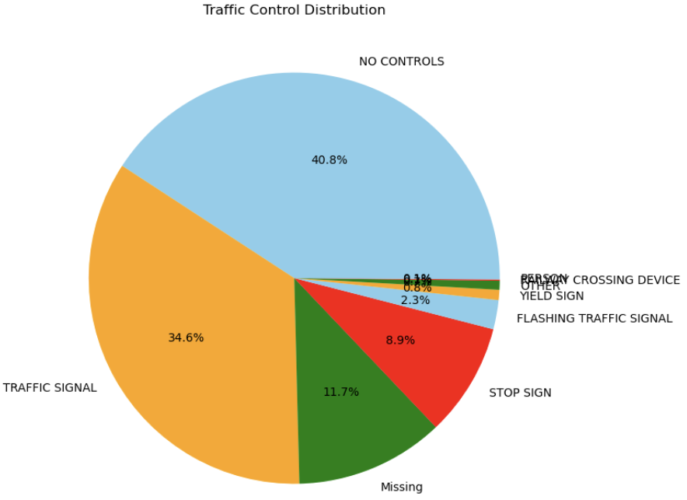
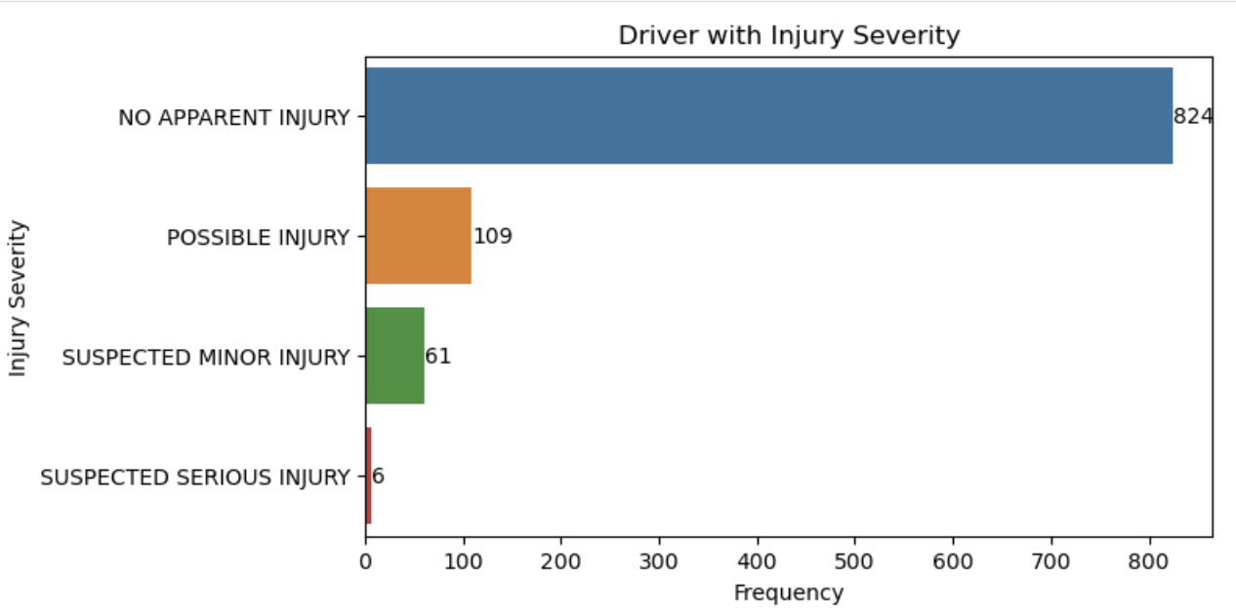
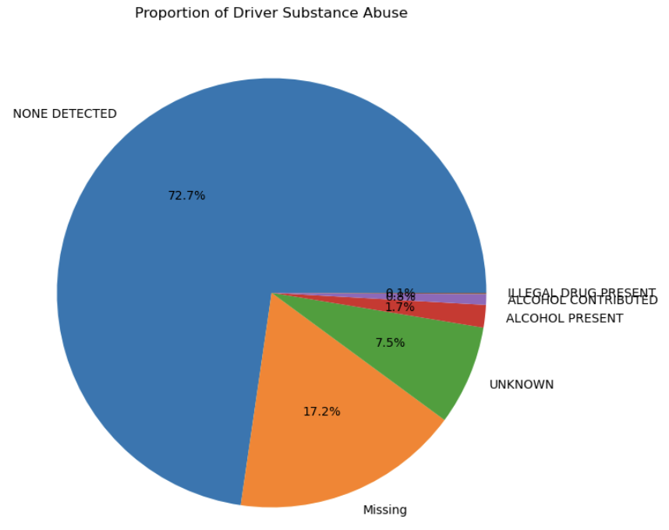
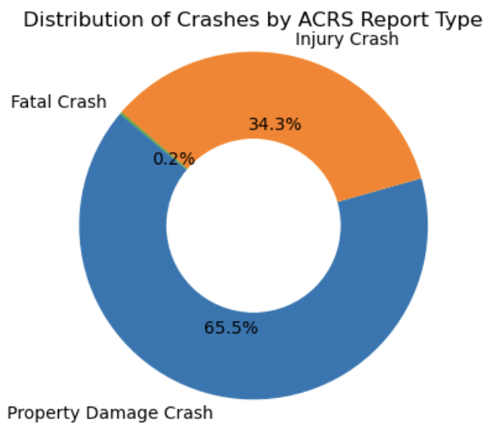
Drivers Insights

Slide 9
Non-Motorists Insights

Slide 10
Incidents Insights

Slide 11

Summary
Your ability to communicate effectively will leave a lasting impact on your audience
Effectively communicating involves not only delivering a message but also resonating with the experiences, values, and emotions of those listening

Slide 12
Future Work
Consistent rehearsal
Strengthen your familiarity
Refine delivery style
Pacing, tone, and emphasis
Timing and transitions
Aim for seamless, professional delivery
Practice audience
Enlist colleagues to listen & provide feedback
Seek feedback
Reflect on performance
Explore new techniques
Set personal goals
Iterate and adapt

Slide 13
Thank you
Group I
x22237941@student.ncirl.ie
x23236108@student.ncirl.ie
x23187956@student.ncirl.ie

