Slide 1
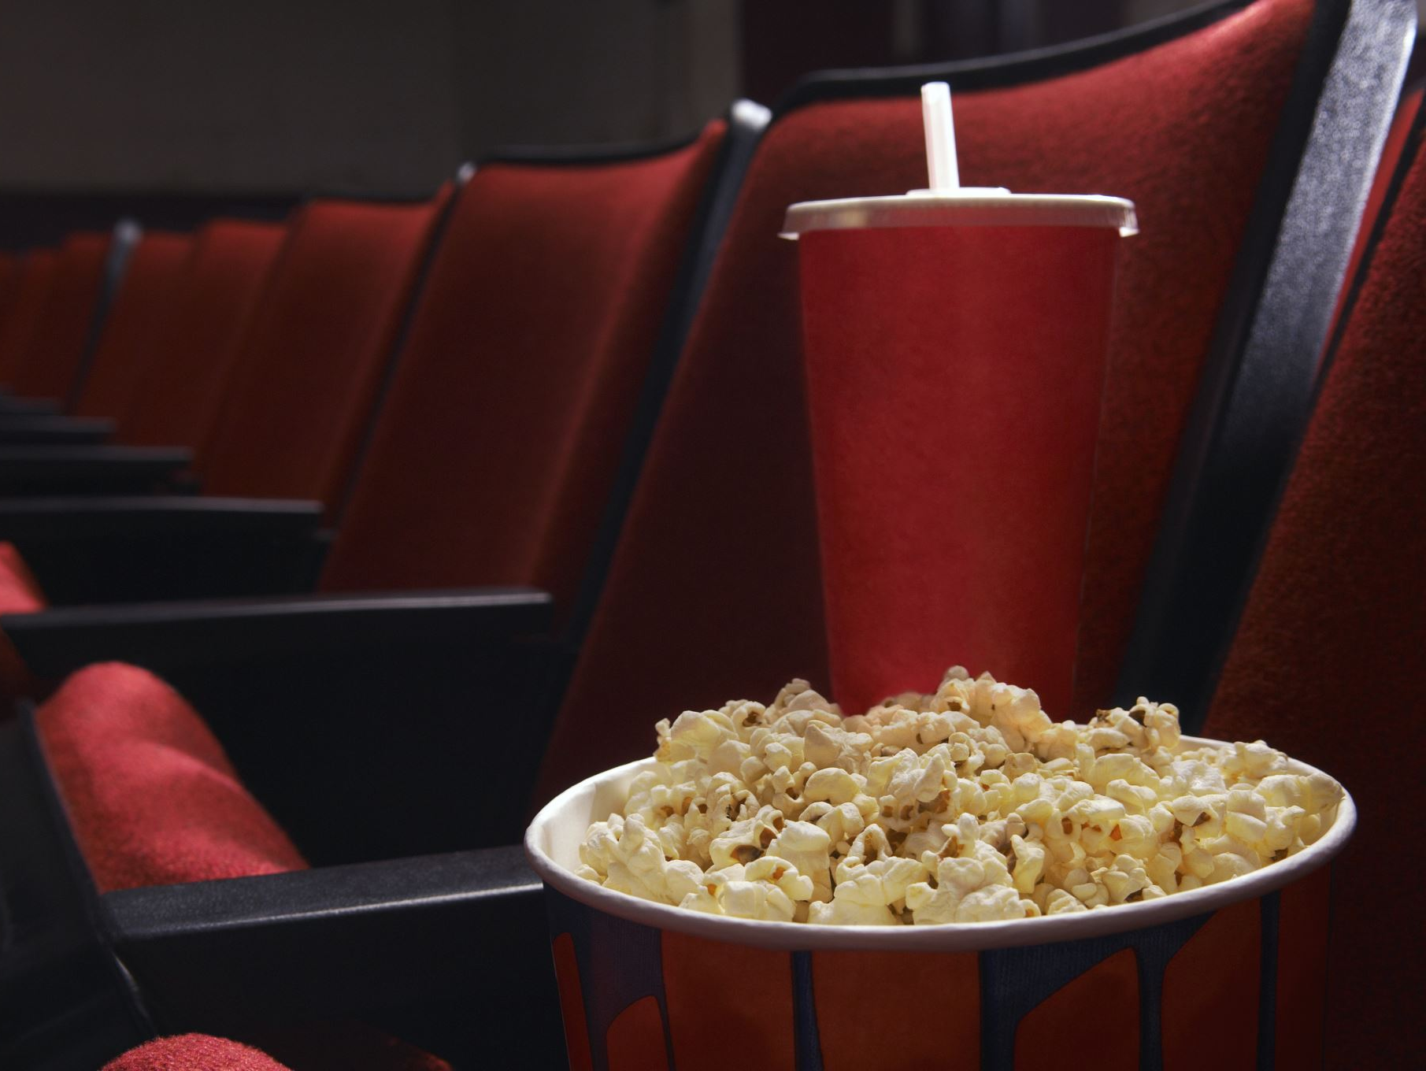
Movie Recommendation System using Heterogeneous GNNs
Nishant Nayak (x22248242)
Supervisor: Prof. Dr. Christian Horn
11.08.2025

Slide 2
Project Objective
• Build a personalized movie recommender using Graph Neural Networks (GNNs)
• Capture user-movie interactions in a heterogeneous graph
• Improve recommendation accuracy and personalization

Slide 3
Tools and Technologies Used
Python (Jupyter Notebook)
pandas, numpy, scikit-learn (data processing)
PyTorch, torch-geometric (deep learning & GNNs)
matplotlib, seaborn (visualization)
torchinfo (model summary)

Slide 4
Research Questions
• Can GNNs outperform traditional recommendation models?
• How do embeddings cluster by user taste or movie genre?
• What can we learn from user activity and genre analysis?

Slide 5
Dataset Preparation
Downloaded MovieLens data (movies.csv & ratings.csv)
Cleaned and merged files, removed outliers
Built a heterogeneous graph of users, movies, and ratings

Slide 6
Code & Model Explanation
Feature engineering: genres, embeddings
Multi-layer Heterogeneous GNN (SAGEConv, Dropout, Linear)
Adam optimizer, ReLU activation
Training with BCE (Binary Cross-Entropy) loss, evaluated with MAE, MSE, RMSE, R², MAPE

Slide 7
Visualization & Analysis
• t-SNE/PCA plots for embeddings
• User activity boxplots, genre heatmaps
• Clustering and outlier analysis

Slide 8
Challenges Faced
Handling large, sparse datasets
Hyperparameter tuning & convergence
Interpreting learned embeddings
Ensuring fairness in recommendations

Slide 9
Results
• High R², low MAE/MSE on validation
• Clear clusters of user and movie preferences
• Robust rating prediction and personalization

Slide 10
Conclusion
• Heterogeneous GNNs boost recommendation quality
• Captured complex user-movie interactions
• Metrics and visualization support strong performance

Slide 11
Future Work
• Add user/item features (demographics, reviews)
• Try advanced GNNs (GAT, Graph Transformers)
• Improve scalability and fairness
• Real-time or streaming recommendations

Slide 12
Acknowledgements
Special thanks to Prof. Dr. Christian Horn for valuable guidance and support.

Slide 13
Questions?
Thank you for your attention!
Any questions or suggestions?

