Slide 1

Brainbeats: Classifying Music Genre with fMRI Connectivity
Research Question: Can we predict music genres based on fMRI connectivity during listening?
A pilot exploration using sub-005 from OpenNeuro ds003720
Chelsea (Xuan) Chen NTU-TW

Slide 2
Dataset Overview
Dataset Source: OpenNeuro ds003720
Nakai, T., Koide‑Majima, N., & Nishimoto, S. (2021). Correspondence of categorical and feature‑based representations of music in the human brain. Brain and Behavior, 11(1), e01936. https://doi.org/10.1002/brb3.1936](https://doi.org/10.1002/brb3.1936
Total Subjects: 5 participants (sub-001 to sub-005), listening to 540 music excerpts spanning 10 genres
Sub-005 Focus: I use only sub-005 since other participants had incomplete event files; manual inspection revealed that only sub-005 had complete and correctly labeled trials, due to inconsistencies in the event files of sub-001 to sub-004.
Clip & Trial Details:
540 clips total → ~54 per genre.
Each clip ≈ 10 seconds; 10 genres (e.g., blues, classical, country, disco, hiphop, jazz, metal, pop, reggae, rock)

Slide 3
Methodology
Brain Parcellation: Used the Schaefer 100-ROI atlas to segment the brain into 100 cortical regions (98 usable after resampling).
Time-Series Extraction: For each music clip (~10s), extracted time-series per ROI based on onset/duration annotations. Trials <2 TRs excluded for reliability.
Connectivity Matrix: Computed Pearson correlations across ROIs → produced a 100×100 matrix per trial.
Feature Engineering: Flattened the upper triangle (4950 features/trial) for model input.
Classification:
Baseline: Multiclass Random Forest on all 10 genres
Enhancement: PCA (n=20) followed by failed binary classification (SVM, KNN for Pop vs Metal)

Slide 4
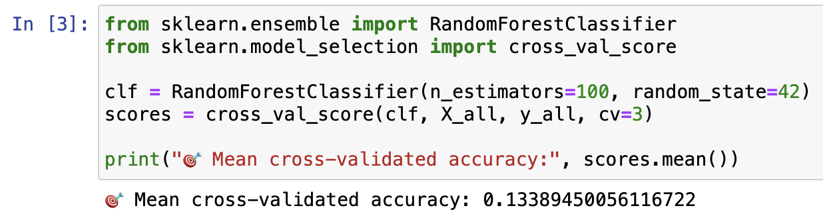
Analysis: What Worked (and What Did Not)
Multiclass accuracy was low (~13%), but still better than random chance with 10 classes (~10%).

Slide 5
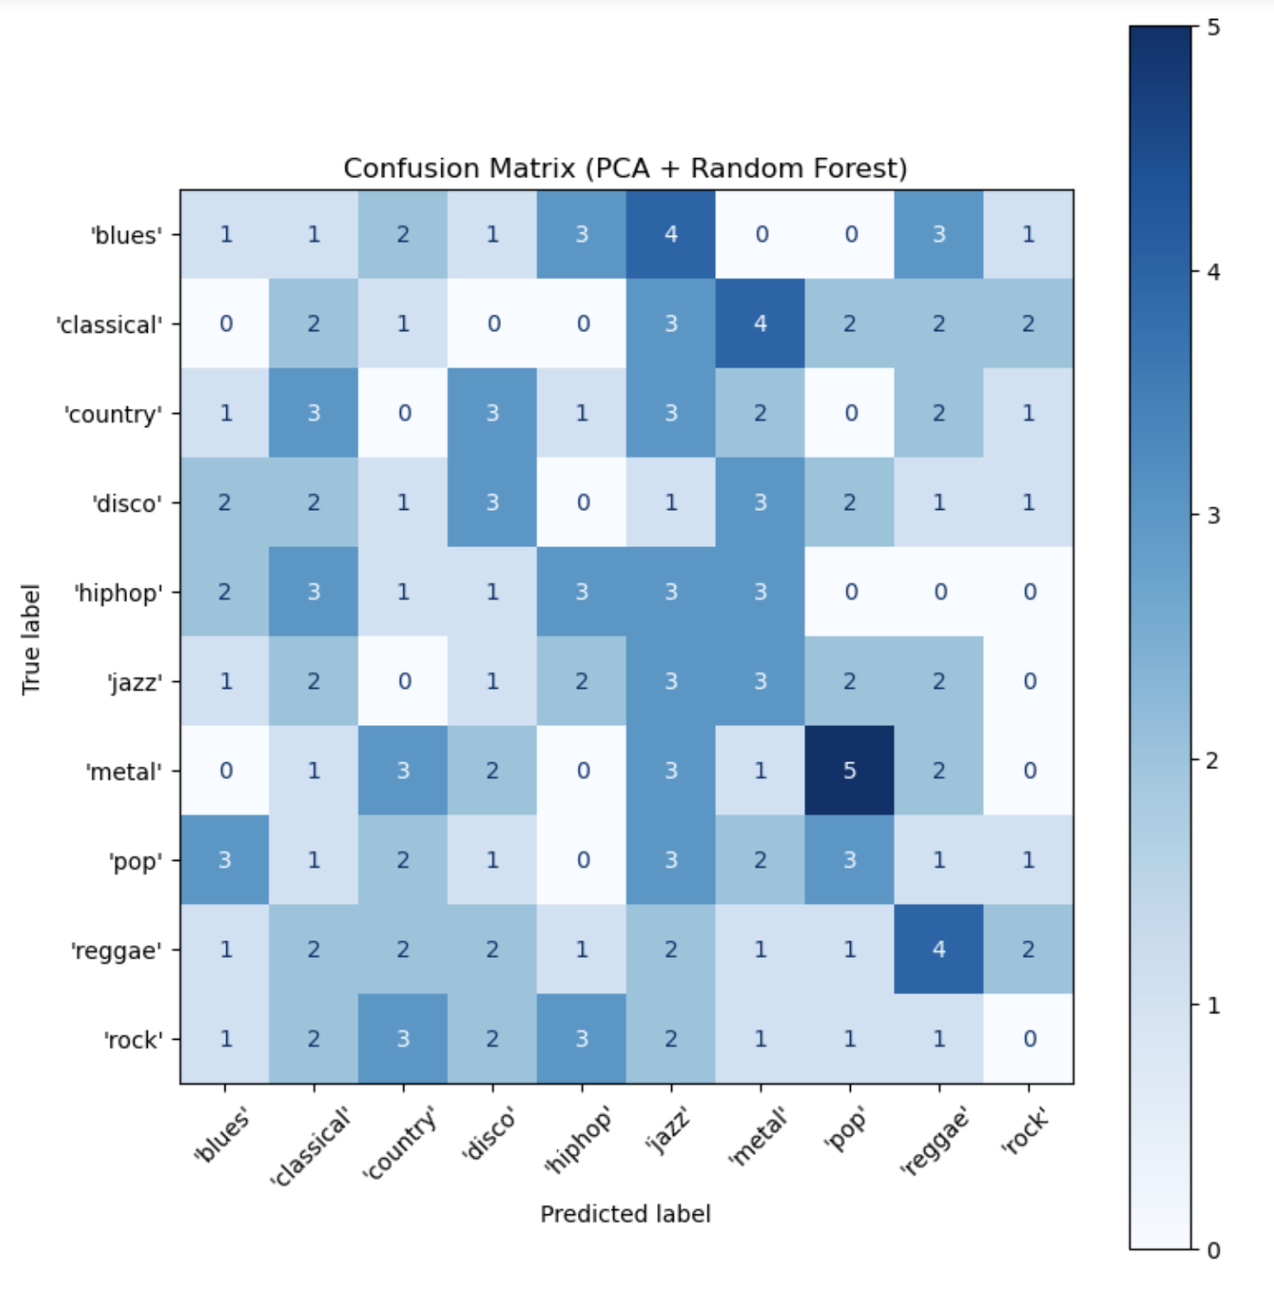
Analysis: What Worked (and What Did Not)
Confusion matrix revealed strong diagonal hits (correctly classified trials) especially for reggae.

Slide 6
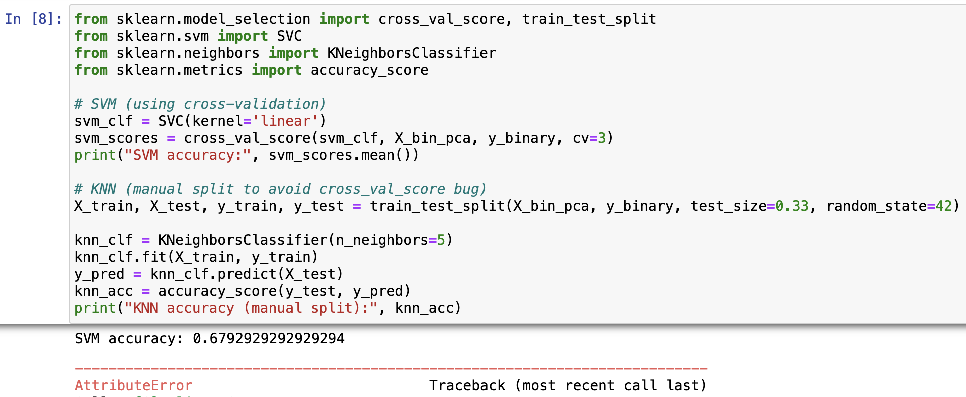
Analysis: What Worked (and What Did Not)
Binary pop vs. metal SVM achieved ~68% accuracy after PCA (20 components), KNN was unable to display due to limited data.

Slide 7
Performance Overview
Analysis Type | Result | Notes
Multiclass RF | ~13% Accuracy | >10% random chance (10 genres)
Confusion Matrix | Reggae stood out | Strong diagonal hits signal some model reliability
Binary SVM (Pop vs Metal) | ~68% Accuracy | After PCA (n=20); KNN failed due to sample limits

Slide 8
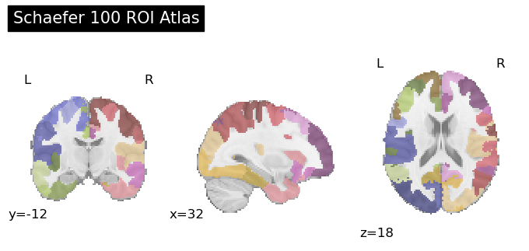
Visualization
Schaefer 100‑ROI atlas maps: Show the colored brain regions, illustrating network parcellation.

Slide 9
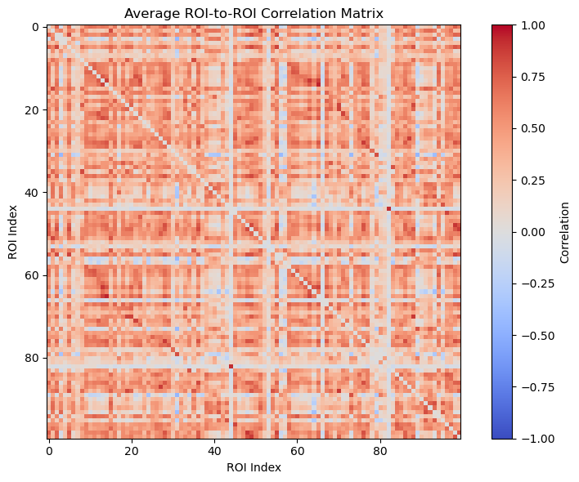
Visualization
Average ROI-to-ROI correlation matrix: Demonstrates connectivity patterns across trials; clear diagonal line shows strong within-ROI correlations.

Slide 10
Reflection & Future Work
What I Learned: Even with a single subject, fMRI connectivity contains genre-relevant structure.
Limitations:
Limited generalizability (only sub-005 used)
High-dimensional features + low trial count → overfitting risk
Inconsistent classifier behavior across reruns
Future Steps:
Validate across multiple participants once data integrity is ensured
Explore alternative parcellation (e.g., 200-ROI)
Apply time-resolved connectivity (e.g., sliding windows)
Integrate music theory or audio features for richer hybrid modeling

Slide 11
Thank You ! / Q & A ?

