Slide 1
On working with LKMs
Using Linux Kernel Modules to quickly export privileged kernel information to ordinary users

Slide 2
Privileged kernel information
Users ordinarily are prohibited from seeing what goes on inside a running Linux kernel
But we can use kernel modules to override normal restrictions on kernel data access
The handiest mechanism for doing this is to employ the so-called ‘/proc’ file system
Linux actually encourages this by offering quite a few examples, built in by default

Slide 3
The ‘/proc’ directory
In addition to the normal files stored on a hard disk, UNIX systems support several types of ‘special’ files:
  Directories and sub-directories (aka ‘folders’)
  Symbolic links (i.e., placeholders for pointers)
  Device files (providing access to ‘peripherals’)
  ‘Pseudo’ files (for data created ‘on-demand’)
Such ‘pseudo’ files are usually in ‘/proc’

Slide 4
The ‘cat’ command
This standard UNIX command offers users a quick way to view the text in a ‘/proc’ file
It’s not necessary to write an application program that will open, read, and display the transient contents of a ‘pseudo’ file
The file-concatenation operation transfers data from any file(s) to ‘standard output’
Example: $ cat /proc/version

Slide 5
More ‘/proc’ examples
$ cat /proc/cpuinfo
$ cat /proc/modules
$ cat /proc/meminfo
$ cat /proc/iomem
$ cat /proc/devices
$ cat /proc/self/maps
[Read the ‘man-page’ for details: $ man proc ]

Slide 6
Our own ‘cat’ workalike
A good technique for understanding how a standard command (like ‘cat’) really works is to re-implement your own version of it
As an illustration of this principle, we have created a demo-program (‘mycat.cpp)
You can copy it from our website to your own current working directory:
    $ cp /home/web/cruse/cs635/mycat.cpp .

Slide 7
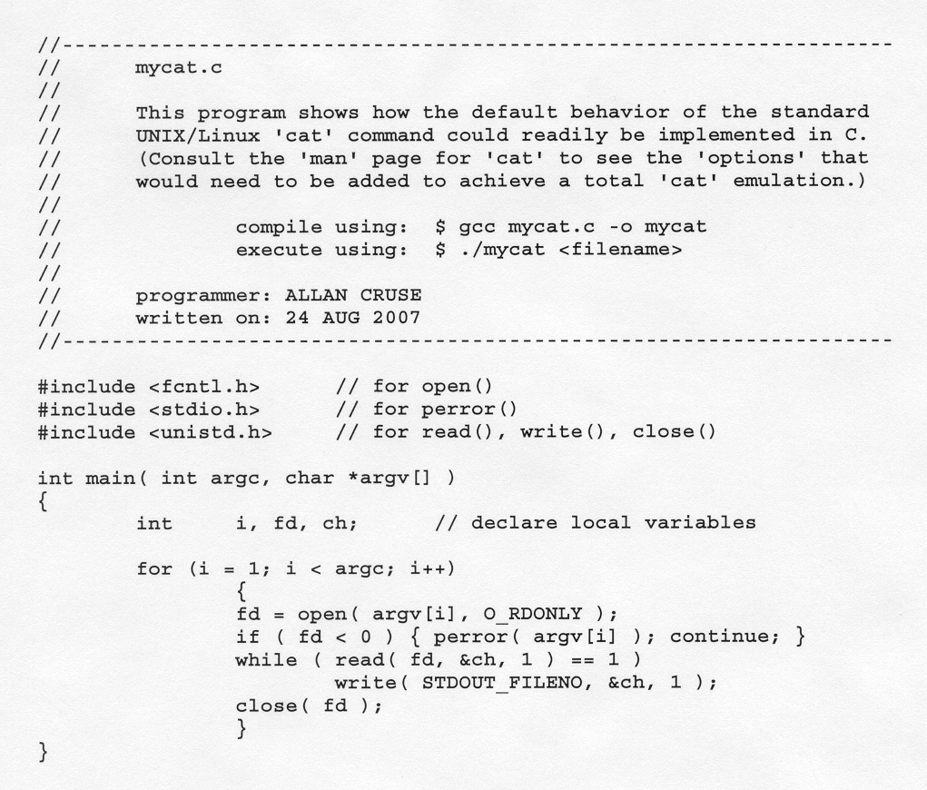
Emulating ‘cat’ command

Slide 8
In-class exercise #1
Compile our ‘mycat.c’ application:
    $ g++ mycat.c -o mycat
Then try using it:
  (1) to view a normal text-file:
    $ ./mycat mycat.c
  (2) to view a ‘/proc’ pseudo-file:
    $ ./mycat /proc/cpuinfo

Slide 9
Creating our own ‘/proc’ files
We can write code to implement our own ‘pseudo’ files, located in ‘/proc’ directory
We do this by adding a ‘payload’ function to a Linux Kernel Module, and by including calls to special kernel-functions within our module-init and our module-exit routines
These special kernel-functions serve to ‘register’, and ‘unregister’, our payload

Slide 10
Our module’s organization
get_info
The module’s ‘payload’
function
module_init
The module’s two required
administrative functions
module_exit

Slide 11
The ‘get_info()’ callback
When an application-program (like ‘mycat’) tries to read our pseudo-file, the kernel will call our ‘get_info()’ function, passing it four function arguments -- and will expect it to return an integer value:
      int get_info( char *buf, char **start, off_t off, int count );
pointer to a kernel buffer
pointer (optional) to module’ own buffer
current file-pointer offset
size of space available in the kernel’s buffer
function should return the number of bytes it has written into its buffer

Slide 12
The ‘sprintf()’ function
The kernel provides a function you module can call to print formatted text into a buffer
It resembles a standard C library-function:
      int sprintf( char *dstn, const char *fmt, <arguments> );
pointer to destination
formatting specification string
list of the argument-values to format
will return the number of characters that were printed to the destination-buffer
Example:
int len = sprintf( buf, “count = %d \n”, count );

Slide 13
register/unregister
Your module-initialization function should ‘register’ the module’s ‘get_info()’ function:
      create_proc_info_entry( modname, 0, NULL, get_info );
Your cleanup should do an ‘unregister’:
      remove_proc_entry( modname, NULL );
the name for your proc file
the file-access attributes (0=default)
directory where file will reside (NULL=default)
function-pointer to your module’s ‘callback’ routine
file’s name
directory

Slide 14
Rapid prototyping
We will write lots of LKM’s during the class
For efficiency we’ve created some utilities:
  ‘newmod.cpp’ (it creates an LKM ‘skeleton’)
  ‘newinfo.cpp’ (it creates a ‘get_info()’ LKM)
Helps to reduce LKM development-time – you just fill in the ‘skeleton’ with your own code for specific desired functionality
These utilities are on our class website

Slide 15
Downloading CS 635 demos
There are various ways you can download program-files from our course’s website
Some are risky (e.g., ‘copy-and-paste’) as they may insert extra ‘invisible’ bytes
Here’s one good way (‘fast’ and ‘clean’) if you are logged in to a classroom machine:
  $ cp /home/web/cruse/cs635/<filename> .

Slide 16
Creating a useful ‘/proc’ file
The ‘get_info()’ function has full privileges!
It executes inside the Linux kernel, where there is no enforced protection against accessing peripheral devices’ hardware
The CPU communicates with devices by using the special ‘in’ and ‘out’ instructions
A kernel header-file defines macros that let you avoid writing assembler language

Slide 17
Non-Volatile Memory
The original IBM-PC had no internal clock
Users had to run a utility program to reset the date and time after any system reboot
That defect was eliminated in the IBM-AT
A special battery-powered peripheral was added to keep track of the time and date
It also provided a small amount of memory which would retain ‘configuration settings’

Slide 18
Motorola’s MC146818A
PC-AT’s Real-Time Clock plus RAM was manufactured by Motorola Corporation
Other companies have ‘cloned’ this chip
Its capabilities are described online in an official datasheet by Dallas Semiconductor (see ‘Maxim’ integrated circuit: DS12887)
You may also get the Motorola datasheet (by writing to its corporate headquarters)

Slide 19
Features of DS12887
Can operate over ten years without power
Counts seconds, minutes, hours, days, day-of-the-week, date, month, and year (with leap-year compensation), valid up until the year 2100 AD, with options for 12/24-hour clock and Daylight Savings
Can use binary or BCD representation
Provides 114 bytes of nonvolatile storage

Slide 20
Programming Interface
The RTC interfaces with system software as an array of 128 bytes, accessed via i/o ports 0x70 and 0x71 using a multiplexing scheme: port 0x70: address-port port 0x71: data-port
Macros make it easy to access such ports:
    #include <asm/io.h>

Slide 21
Ten clock/calendar bytes
0x0
0x1
0x2
0x3
0x4
0x5
0x6
0x7
0x8
0x9
Current seconds
Range is 0..59
Range is 0..59
Range is 0..59
Range is 0..59
Range is 0..23 or 1..12
Range is 0..23 or 1..12
Range is 1..7 (Sunday=7)
Range is 1..31
Range is 1..12 (January=1)
Range is 0..99
Alarm seconds
Current minutes
Alarm minutes
Current hours
Alarm hours
Day-of-the-Week
Date of the Month
Current Month
Current Year

Slide 22
Operating Capabilities
The RTC can be programmed to generate an interrupt under any combination of the following three conditions:
1) time/date counters were updated
2) current time equals the alarm time
3) periodic frequency interval restarts
The frequency of the periodic interrupt is a selectable rate (e.g., from 122 to 500ms)

Slide 23
Four Status/Control bytes
UIP
Divider bits
Rate-Select
0xA
0xB
0xC
0xD
SET
PIE
AIE
UIE
SQWE
DM
24/12
DSE
IRQF
PF
AF
UF
0
0
0
0
VRT
0
0
0
0
0
0
0

Slide 24
Other NVRAM locations
Besides these 14 dedicated RTC bytes, there are 114 byte locations which can serve as nonvolatile storage in whatever manner the system-designer decides
IBM has established some ‘standard’ uses for many (but not all) of these locations
A fairly complete CMOS Memory Map is accessible online (see course website)
(CMOS means “complementary metal-oxide semiconductor”)

Slide 25
Example: Diagnostic Status
Power
Status
failure
Check
Sum
bad
POST
Config
invalid
RAM
Size
wrong
Fixed
Disk
bad
CMOS
Time
invalid
reserved
reserved
0xE
During the Power-On Self-Test, the ROM-BIOS routines
perform tests of the memory and peripheral devices, and
record any failures/errors in this Diagnostic Status byte

Slide 26
In-class exercise #2
Modify our ‘cmos.c’ module’s ‘get_info()’ function by introducing a for-loop so that, in addition to showing the current time, it will also display the full array of 128 bytes currently stored in the CMOS memory
Here’s “C” code to read the N-th location:
{
int datum; // storage for a CMOS data-value
outb( N, 0x70 ); // select cell number N for access
datum = inb( 0x71 ); // input value from selected location
}

