Slide 1
Exploring a modern NIC
An introduction to programming the Intel 82573L gigabit ethernet network interface controller

Slide 2
Token Ring
host-1
host-2
host-3
host-4
Token Ring Media Access Unit
Technology developed by IBM in the 1960s

Slide 3

Ethernet
Technology designed by Bob Metcalf in 1973

Slide 4
Ethernet LAN
host-1
host-2
host-3
HUB
“Collision Domain”
host-4
CSMA/CD = “Carrier Sense Multiple Access/Collision Detection”

Slide 5
Ethernet Versus Token Ring
ETHERNET
Ethernet is the most widely used data sending protocol. Each computer listens to the cable before sending data over the network. If the network is clear, the computer will transmit. If another PC is already transmitting data, the computer will wait and try again when the line is clear. If two computers transmit at the same time a collision occurs. Each computer then waits a random amount of time before attempting to retransmit. The delay caused by collisions and retransmitting is minimal and does not normally affect the speed of transmission on the network.
TOKEN RING
The Token Ring protocol was developed by IBM but it has become obsolete in the face of ethernet technology. The computers are connected so that data travels around the network from one computer to another in a logical ring. If a computer does not have information to transmit, it simply passes the a token on to the next workstation. If a computer wishes to transmit and receives an empty token, it attaches data to the token. The token then proceeds around the ring until it comes to the computer for which the data is meant.
Posted by Heather C Moll (Last Updated March 24 2004)

Slide 6
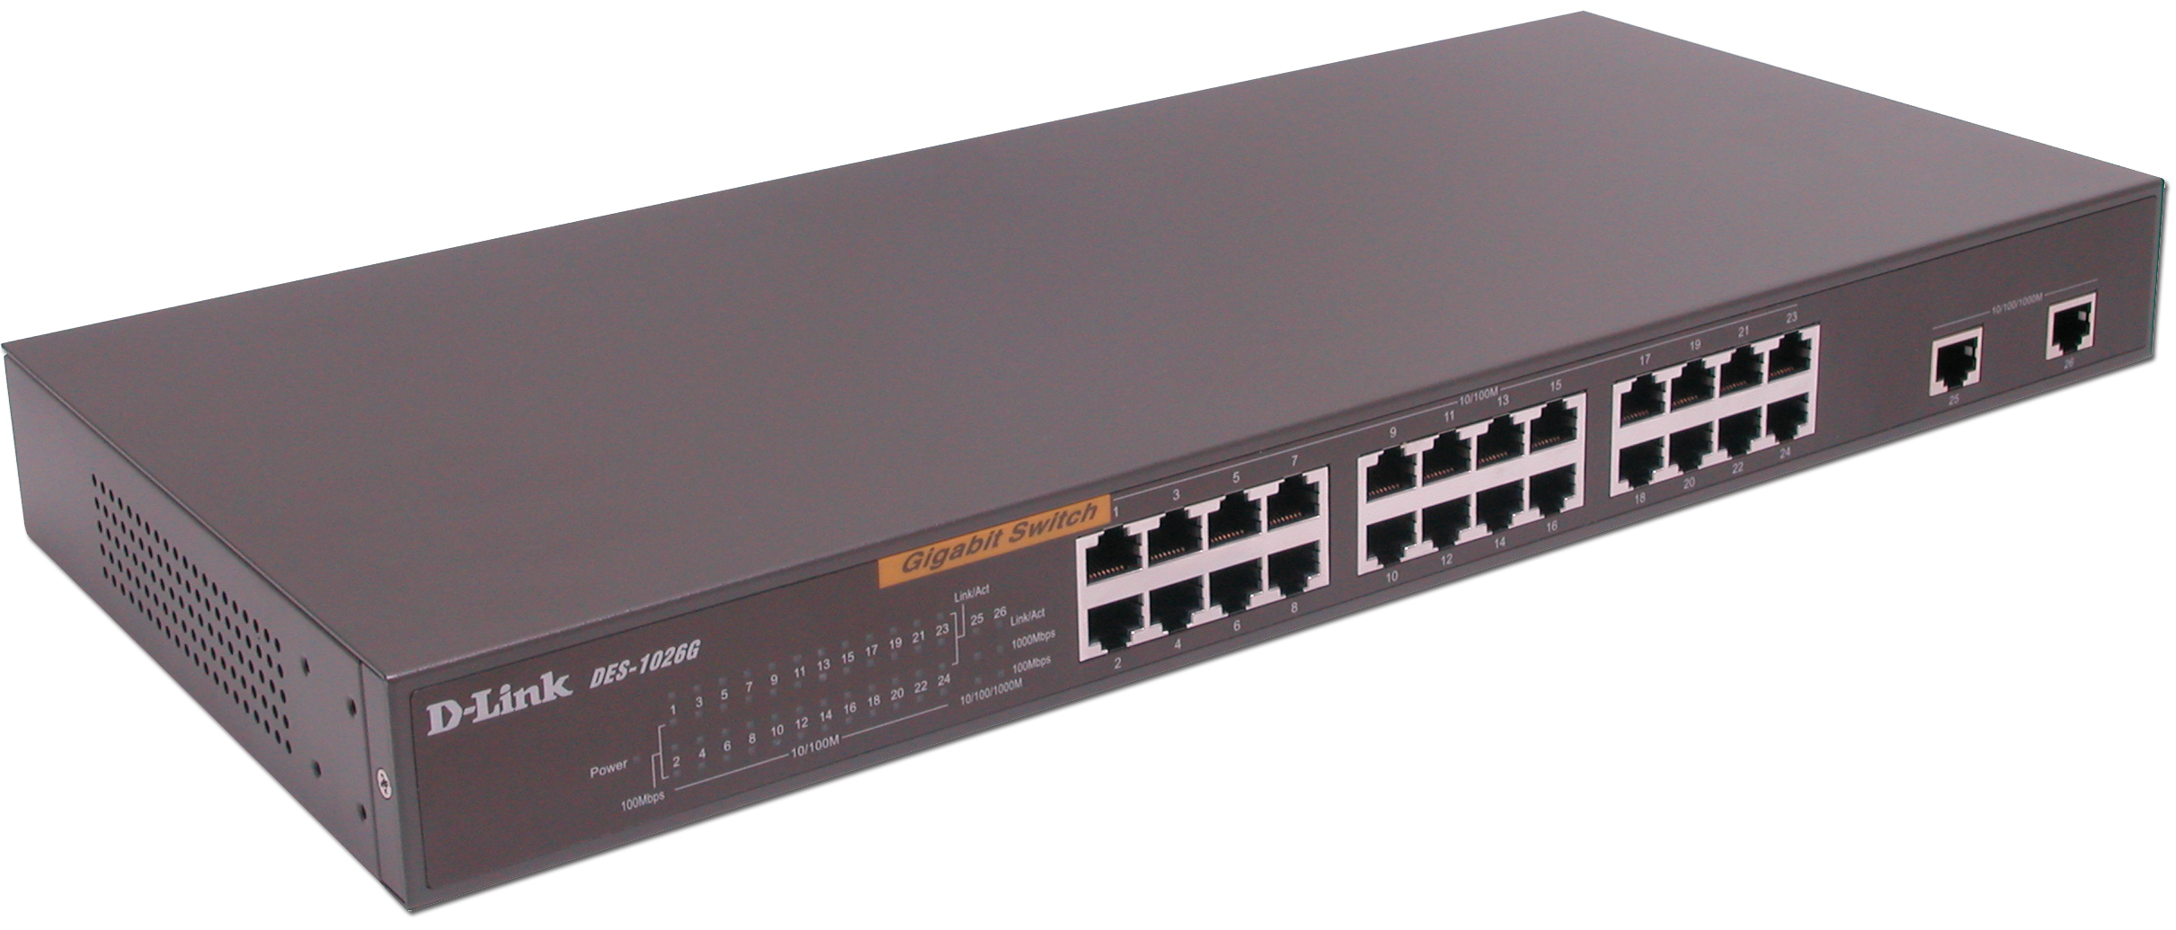
D-Link 24-port GbE Switch
Switched hub implements ‘store-and-forward’ technology

Slide 7
Our ‘anchor’ cluster
computer science department’s Local Area Network
anchor00
anchor02
anchor04
anchor06
anchor01
anchor03
anchor05
anchor07
D-Link 24-port 10/100/1000-Mbps Ethernet Switched Hub

Slide 8
Acronyms
PCI = Peripheral Component Interconnect
MAC = Media Access Controller
Phy = Physical-layer functions
AMT = Active Management Technology
LOM = LAN On Motherboard
BOM = Bill Of Materials

Slide 9
Hardware Features
32K configurable RX and TX packet FIFO
IEEE 802.3x Flow Control support
Host-Memory Receive Buffers 16K/256K
IEEE 802.3ab Auto-Negotiation
TCP/UDP checksum off-loading
Jumbo-frame support (up to 16KB)
Interrupt-moderation controls

Slide 10
External Architecture
MDI interface
10/100/1000 PHY
GMII/MII
interface
MDIO
interface
SM Bus
interface
LED
indicators
MAC/Controller
S/W Defined
pins
EEPROM
Flash
interface
PCI/PCI-e Bus

Slide 11
Access to PRO/1000 registers
Device registers are hardware mapped to a range of addresses in physical memory
You obtain the location (and the length) of this memory-range from a BAR register in the nic device’s PCI Configuration Space
Then you request the Linux kernel to setup an I/O ‘remapping’ of this memory-range to ‘virtual’ addresses within kernel-space

Slide 12
i/o-memory remapping
Local-APIC
APIC registers
IO-APIC
nic registers
1-GB
vram
nic
registers
kernel code/data
user
space
vram
3-GB
dynamic
ram
physical address-space
‘virtual’ address-space

Slide 13
portability syntax
Linux provides device-driver writers with some macros for accessing i/o-memory:
  #include <asm/io.h>
  unsigned int datum;
  iowrite32( datum, address );
  datum = ioread32( address );

Slide 14
module_init()
#include <linux/pci.h>
#include <asm/io.h>
#define E1000_STATUS 0x0008
unsigned int iomem_base, iomem_size;
void *io;
// remap the device’s i/o-memory into kernel space
devp = pci_get_device( VENDOR_ID, DEVICE_ID, NULL );
if ( !devp ) return –ENODEV;
iomem_base = pci_resource_start( devp, 0 );
iomem_size = pci_resource_len( devp, 0 );
io = ioremap_nocache( iomem_base, iomem_size );
if ( !io ) return –ENOSPC;
// read and display the nic’s STATUS register
device_status = ioread32( io + E1000_STATUS );
printk( “ Device Status Register = 0x%08X \n”, status );

Slide 15
Device Status (0x0008)
31 30 29 28 27 26 25 24 23 22 21 20 19 18 17 16
?
0
0
0
0
0
0
0
0
0
0
0
GIO
Master
EN
0
0
0
some undocumented functionality?
15 14 13 12 11 10 9 8 7 6 5 4 3 2 1 0
0
0
0
0
0
PHY
reset
ASDV
I
L
O
S
SPEED
S
L
U
0
TX
OFF
Function
ID
0 0
L
U
F
D
FD = Full-Duplex
LU = Link Up
TXOFF = Transmission Paused
SPEED (00=10Mbps,01=100Mbps, 10=1000Mbps, 11=reserved)
ASDV = Auto-negotiation Speed Detection Value
82573L

Slide 16
Confusion in vendor’s manual?
The manual shows Device Status as a ‘read-only’ register, but later on it states that bit #10 “is cleared by writing 0b to it.”
Bit #31 in Device Status register is marked ‘reserved’ in the Developer’s Manual (with initial value shown as ‘0’), but we observe it’s value being ‘1’ on ‘anchor’ machines
Do these represent errata? omissions?

Slide 17
Quotation
Many companies do an excellent job of providing information to help customers use their
products... but in the end there's no substitute for real-life experiments: putting together the
hardware, writing the program code, and watching what happens when the code executes.
Then when the result isn't as expected -- as it often isn't -- it means trying something else
or searching the documentation for clues.
-- Jan Axelson, author, Lakeview Research (1998)

Slide 18
Development Tool
Our ‘igbe.c’ module creates a pseudo-file that shows register-values of importance in receiving and transmitting data-packets using the Intel GigaBit Ethernet controller
Can be useful for debugging device-driver software – and for gaining insights about confusing issues in the vendor’s manual

Slide 19
In-class exercise
Experiment with writing all 0’s into the nic’s Device Status register, and see if values of any bits actually get changed; then also try writing all 1’s into this register, in order to discover which bits indeed are “read-only”
You can use our ‘gbstatus.c’ module as a starting-point for these experimentations

