Slide 1

Ascii-Art-web
Lejosne Florian
Moigne Théo
Marty Thomas

Slide 2
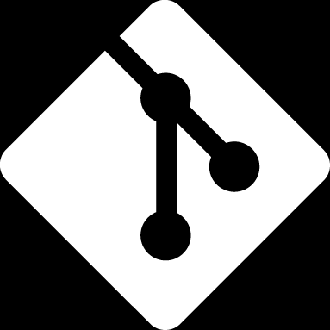
USED TECHNOLOGIES
Programming langage go
Display METHOD
Windows terminal
Version controlling
git

Slide 3
Program structure
ascii-art-web/
standard.txt
shadow.txt
thinkertoy.txt
assets/
doom.txt
banners/
pkg/
→ fonctions for the web project
templates/*.html
→ all html templates
assets/
→ banners format files
→ css
→ img
→ output.txt
output/
output.txt
css/
*.css
templates/
.ttf -- .otf -- .woff -- .woff2
img/
favicon.ico
Index.html
bg.jpg
400.html
capture.png
500.html
404.html
pkg/
ascii.go
openbrowser.go
error.go
handler.go

Slide 4
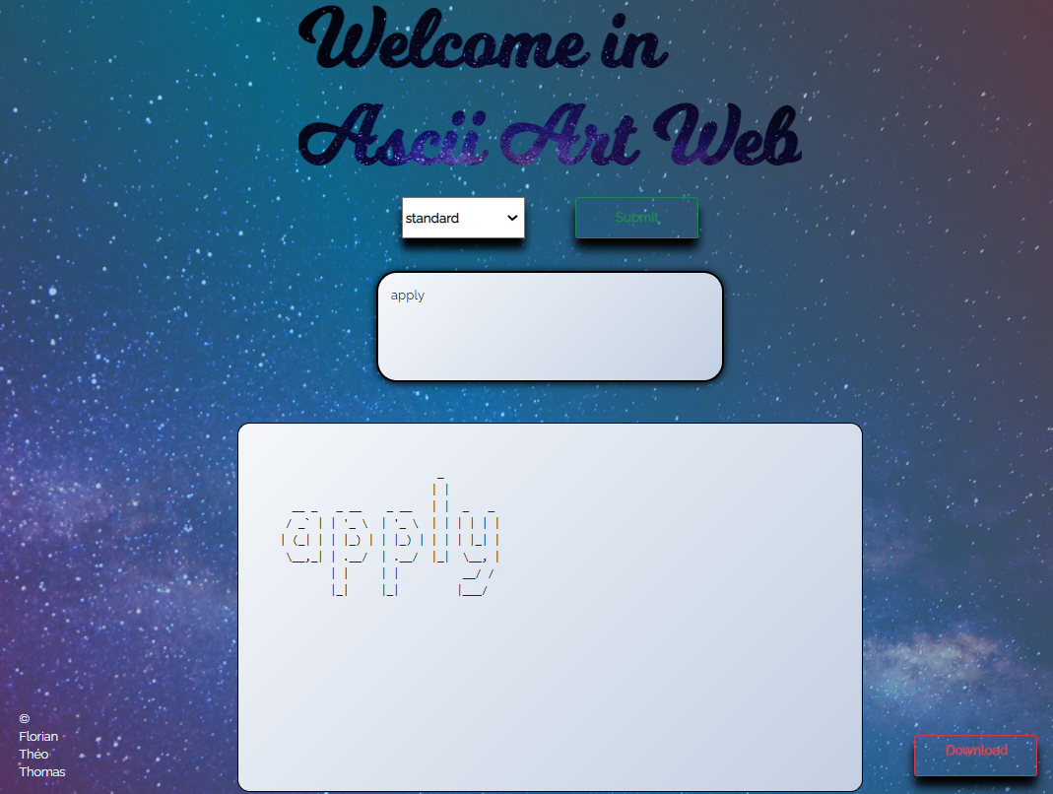
Home page

Slide 5
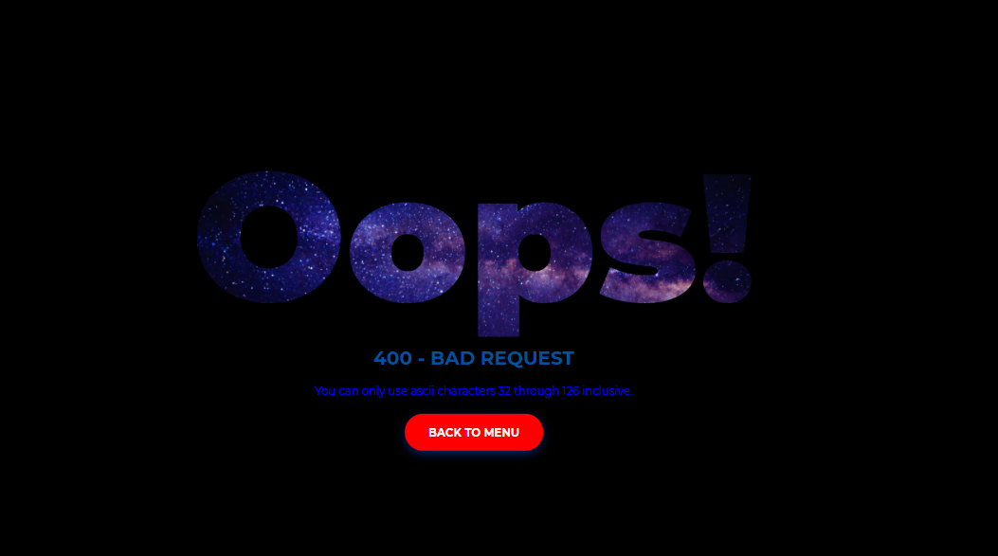
Errors management
With page html

Slide 6


THANKS FOR LISTENING

