Slide 1

Ascii-art
THIEN Anatole
LEJOSNE Florian
MANIXAY William

Slide 2

Used technologies
Programming langage go
Display METHOD
Windows terminal
Version controlling
git

Slide 3
Program structure
ascii-art/
files/
files/utility.go
→ fonctions that make the program work
files/errors.go
→ error management to help the user
format/
→ banner format files
ascii-art.go
utility.go
errors.go
format/
standard.txt
shadow.txt
thinkertoy.txt
doom.txt
ascii-art.exe

Slide 4
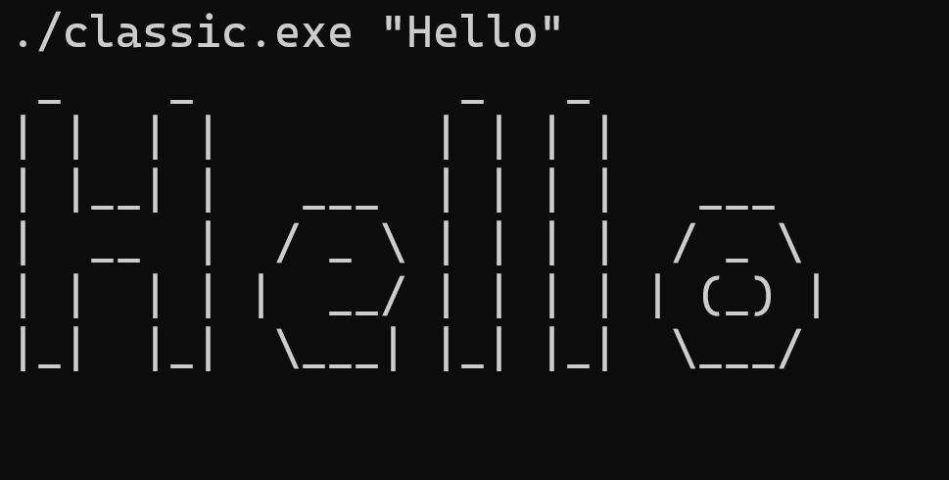
Classic

Slide 5
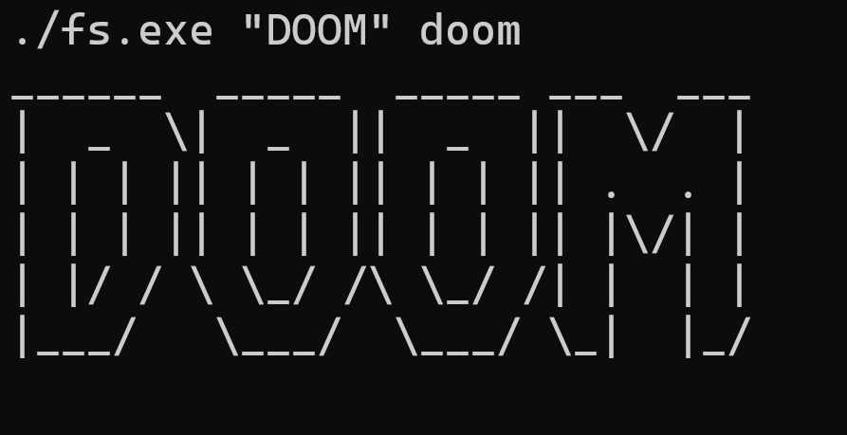
Fs

Slide 6
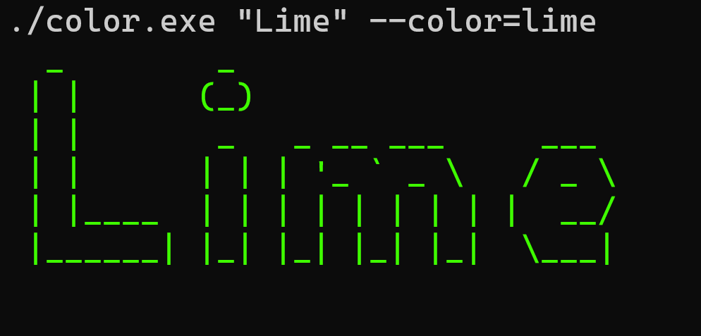
Color

Slide 7
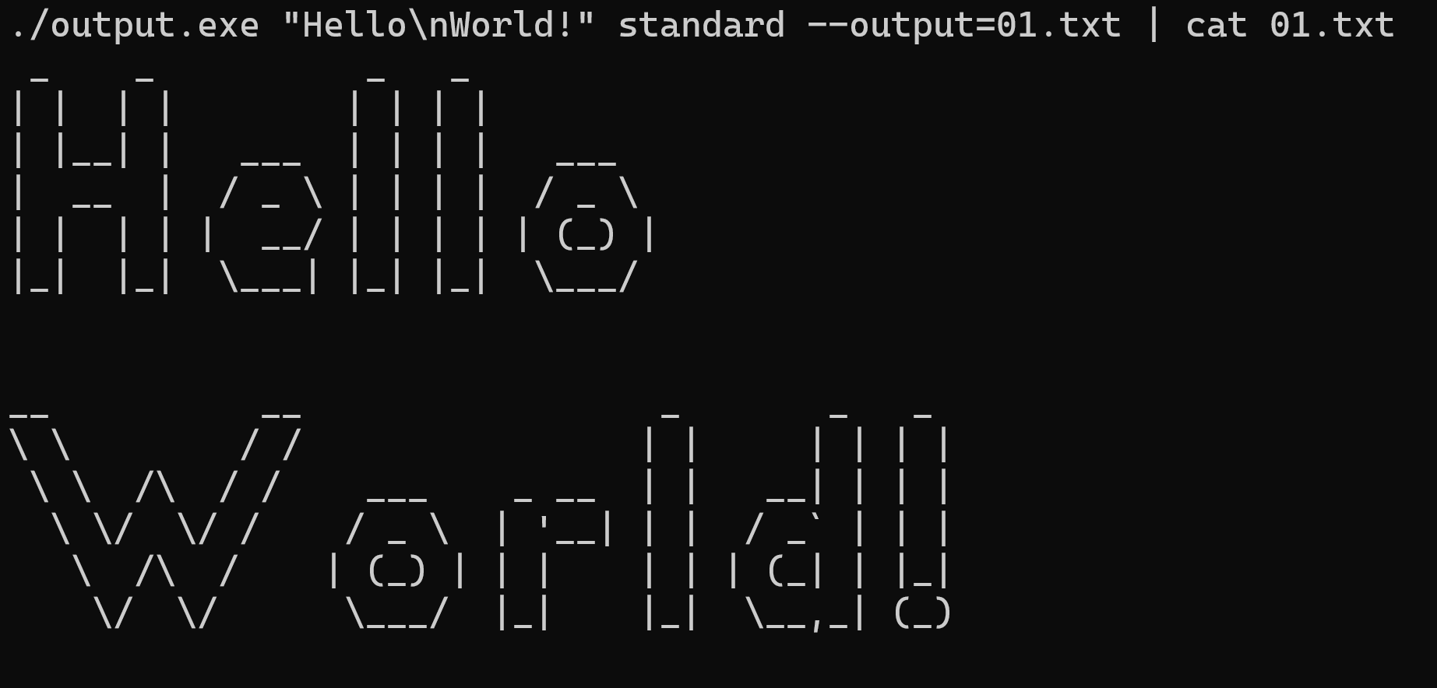
Output

Slide 8
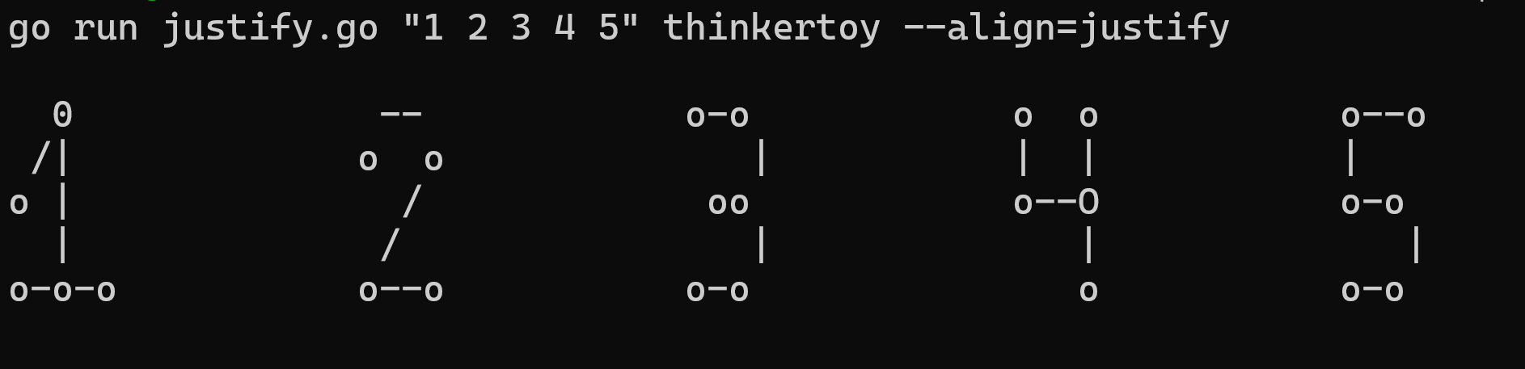
Justify

Slide 9
Methods
Scanner
Takes the name of the format file selected by the user as well as the line required by the function it is called by.
Returns an entire line of the format file, which can be used in a for loop to print entire characters.
os.Open
bufio.NewScanner
Terminal Width
Enters a command to retrieve information about the user’s terminal.
Then converts it into a string before converting it into an int and returning it.
exec.Command
strings.TrimSuffix

Slide 10
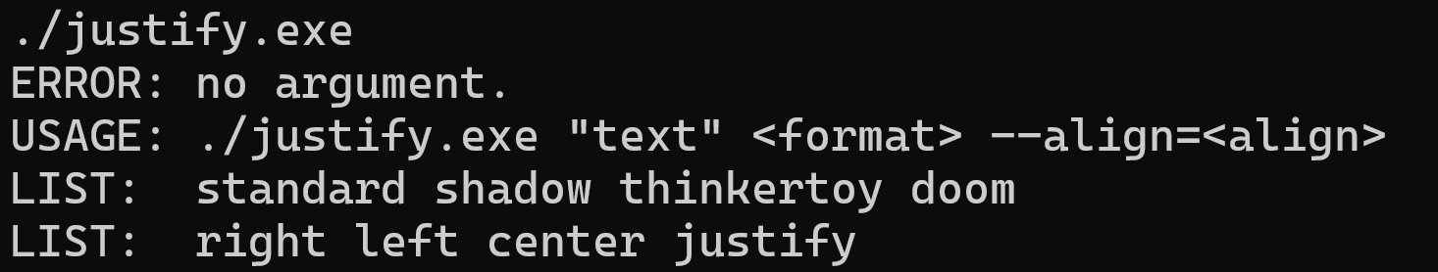
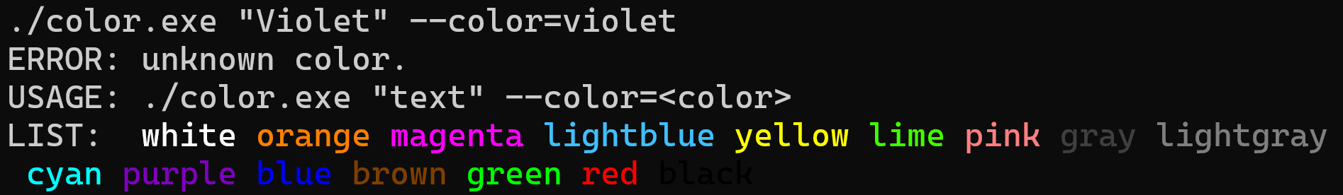
Error management

Slide 11
Merci de votre attention

