Slide 1
Discrete 2D-Fourier Transform in Polar Coordinates
Xueyang Yao
Dr. Natalie Baddour

Slide 2
Outline
Introduction
Definition of discrete 2D-Fourier transform in polar coordinates
Numerical tests
Improvements
Conclusion

Slide 3
Introduction to the Fourier transform

Slide 4
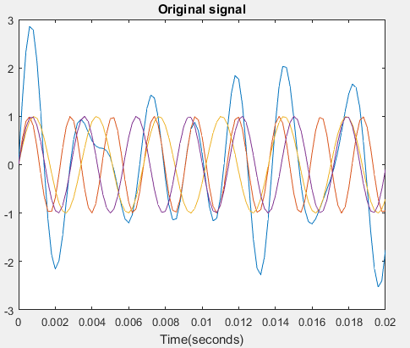
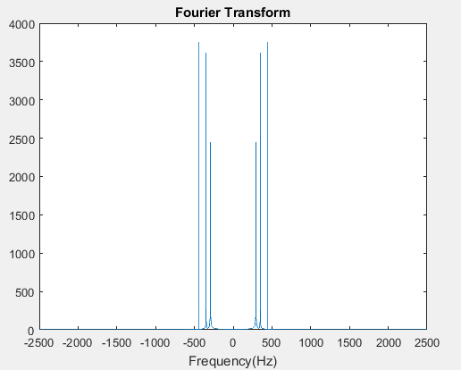
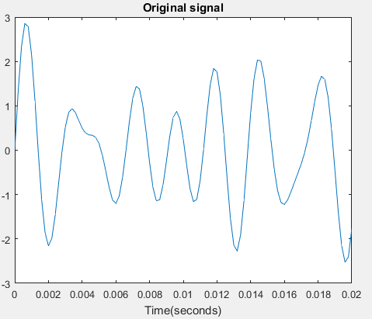
1D-Fourier Transform
Definition
440Hz (A note)
349.23Hz (F note)
293.66Hz (D note)
Fourier Transform finds the frequency content of a signal.

Slide 5
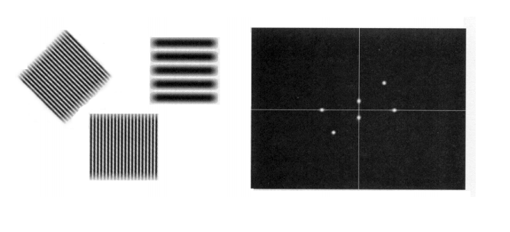
2D-Fourier Transform in Cartesian coordinates
Definition
Original Image
sinusoidal
2D-Fourier Transform
constant
Notes:
Example1:Strips of dark and light: amplitude: intensity of light
Example2:Circular disk->2D-Sinc

Slide 6
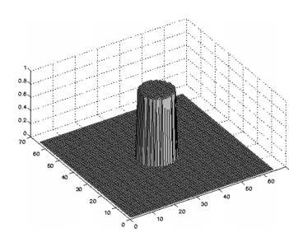
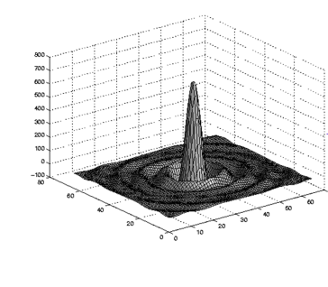
2D-Fourier Transform in Cartesian coordinates
Original function
2D-Fourier Transform
These functions are best described in polar coordinates!
Notes:
Example1:Strips of dark and light: amplitude: intensity of light
Example2:Circular disk->2D-Sinc

Slide 7
Definition of Discrete 2D-Fourier Transform in Polar Coordinates

Slide 8
Definition
Forward:
Inverse:
Original function.
Discrete 2D-Fourier transform
Sample size in radial direction
Sample size in angular direction

Slide 9
Can discrete transform approximate continuous FT?
Forward:
Inverse:
Effective space limit
The lth. zero point of Bessel function with order q
Scaling Factor
Sample Points

Slide 10
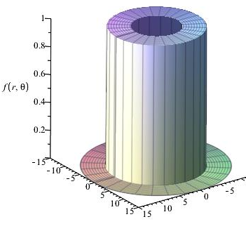
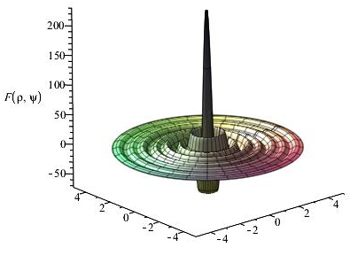
Does this work?
cont. FT
2D DFT

Slide 11
Numerical tests

Slide 12
Accuracy
Dynamic Error:
Unit: dB
is the continuous 2D-Fourier transform
is the discrete counterpart part
Bigger negative value of dynamic error is better.
Notes:
Bigger negative value of dynamic value is better.

Slide 13
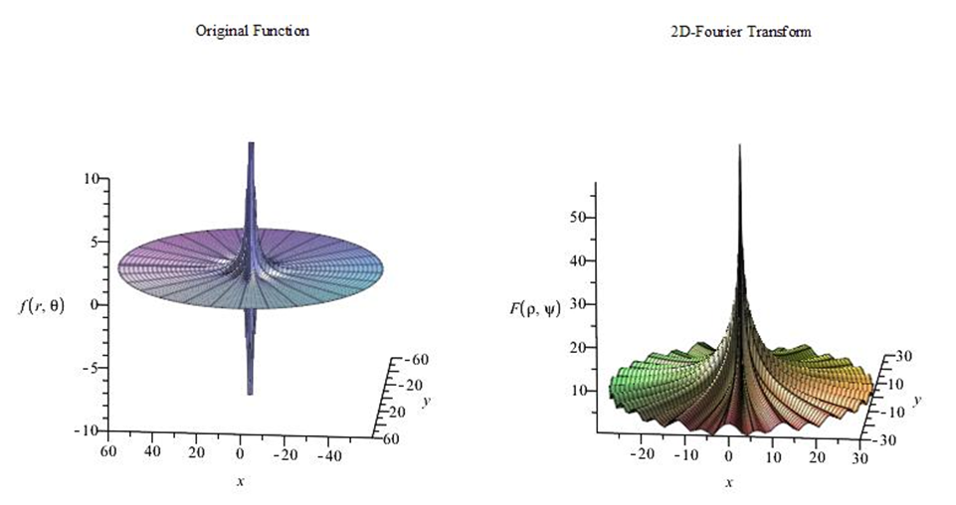
Test Functions
Four-term sinusoid & Modified exponential

Slide 14
Test Functions
Four-term sinusoid & Modified exponential (Forward Transform)

Slide 15
Test Functions
Four-term sinusoid & Modified exponential (Inverse Transform)

Slide 16
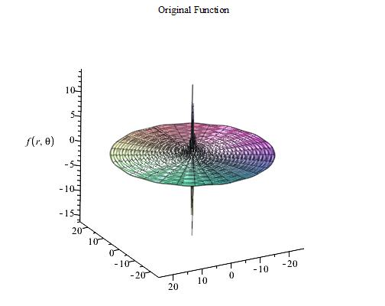
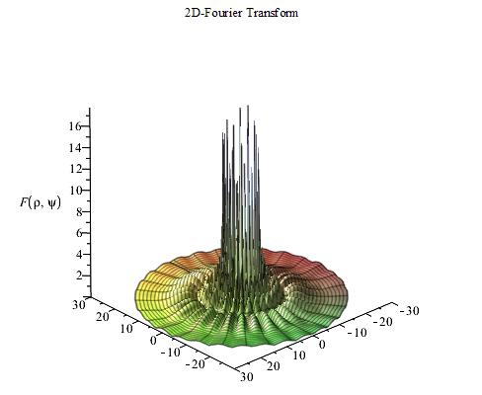
Test Functions
Four-term sinusoid & Sinc

Slide 17
Test Functions
Four-term sinusoid & Sinc (Forward Transform)

Slide 18
Test Functions
Four-term sinusoid & Sinc (Inverse Transform)

Slide 19
Summary of the test results
Dynamic Error (dB) of the three cases
 |  | Four term Sin & Mexp | Four term Sin& Sinc
Forward transform | Emax. | -6.6 | 10.7
 | Eavg. | -29.5 | -38.8
Inverse transform | Emax. | 0.6 | -8.7
 | Eavg. | -68.7 | -37.8
The discrete transform shows good approximation.
The Dynamic error gets larger at the center.

Slide 20
Improvements on Reducing Computing Time

Slide 21
Interpretation of the Transform
Forward Transform
DFT
DHT
IDFT
Inverse Transform

Slide 22
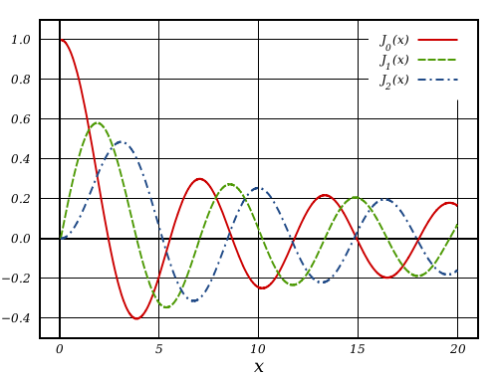
Pre-calculate Bessel zeros
Forward Transform
Calculate Bessel zeros every time takes a lot of time!
Inverse Transform

Slide 23
Improvements on Reducing Computing Time
Computing time of forward transform of Gaussian function
Test cases | Total computing time(seconds)
Case 1 | 3346.5
Case 2 | 321.1
Case 3 | 14.3
Case 1: Run the transform as matrixes in matrix without pre-calculating the Bessel zeros
Case 2: Run the transform as DFT,DHT and IDFT in sequence without pre-calculating the Bessel zeros
Case 3: Run the transform as DFT,DHT and IDFT in sequence with pre-calculating the Bessel zeros

Slide 24
Conclusion

Slide 25
Conclusion
The proposed discrete 2D-Fourier transform showed good accuracy to approximate the continuous Fourier transform.
The computing time has been improved to applicable level.

Slide 26
Thank you!

