Slide 1
Discrete 2D-Fourier Transform in Polar Coordinates
Xueyang Yao
Supervisor: Dr. Natalie Baddour

Slide 2
Outline
Introduction to Fourier transform
Definition of discrete 2D-Fourier transform in polar coordinates
Numerical tests
Conclusion

Slide 3
Introduction to the Fourier transform

Slide 4
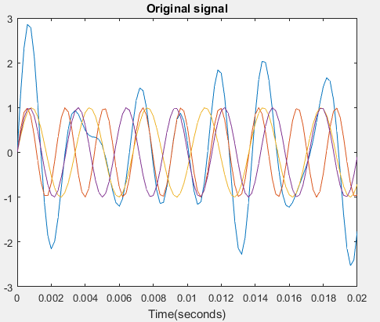
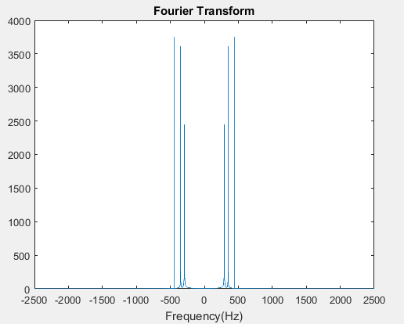
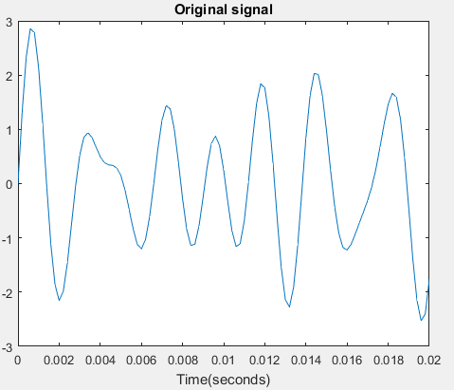
1D-Fourier transform
Forward:
Definition
440Hz (A note)
Inverse:
349.23Hz (F note)
293.66Hz (D note)
Fourier Transform finds the frequency content of a signal.

Slide 5
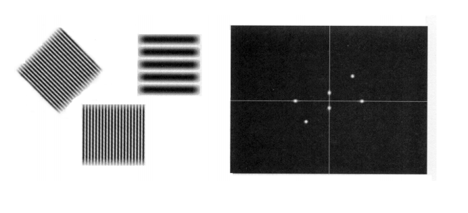
2D-Fourier transform in Cartesian coordinates
Forward:
Definition
Inverse:
Original Image
sinusoidal
2D-Fourier Transform
constant
Notes:
Example1:Strips of dark and light: amplitude: intensity of light
Example2:Circular disk->2D-Sinc

Slide 6
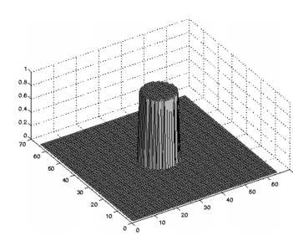
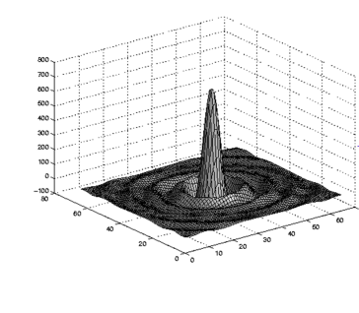
2D-Fourier transform in Cartesian coordinates
Original function
2D-Fourier Transform
These functions are best described in polar coordinates!
Notes:
Example1:Strips of dark and light: amplitude: intensity of light
Example2:Circular disk->2D-Sinc

Slide 7
Definition of Discrete 2D-Fourier Transform in Polar Coordinates

Slide 8
Definition
Forward:
Inverse:
Original function.
Discrete 2D-Fourier transform
Sample size in radial direction
Sample size in angular direction

Slide 9
Can discrete transform approximate continuous FT?
Forward:
Inverse:
Effective space limit
The lth. zero point of Bessel function with order q
Scaling Factor
Sample Points

Slide 10
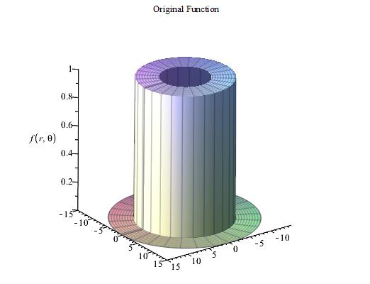
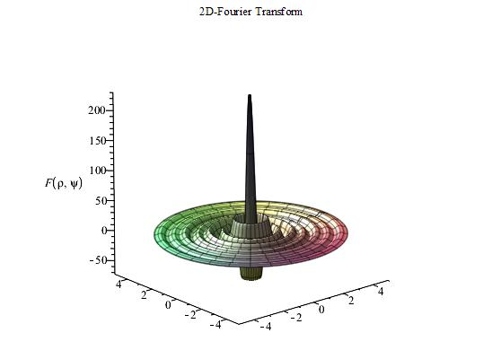
Does this work?
cont. FT
2D DFT

Slide 11
Numerical tests

Slide 12
Accuracy
Dynamic Error:
Unit: dB
is the continuous 2D-Fourier transform
is the discrete counterpart part
Bigger negative value of dynamic error is better.
Notes:
Bigger negative value of dynamic value is better.

Slide 13
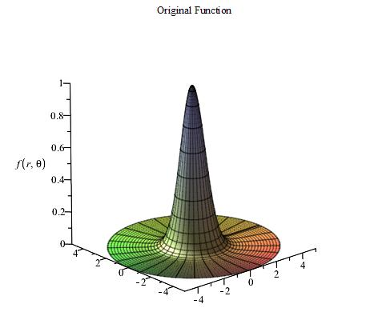
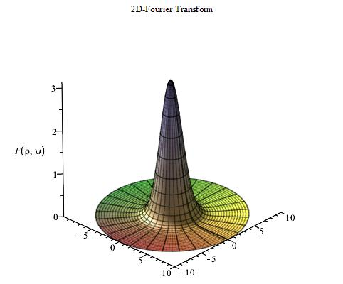
Test functions
Gaussian

Slide 14
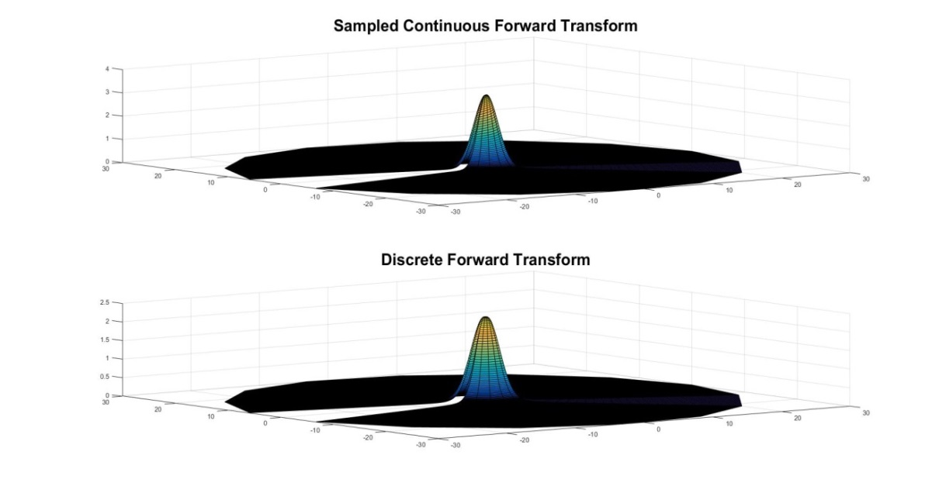
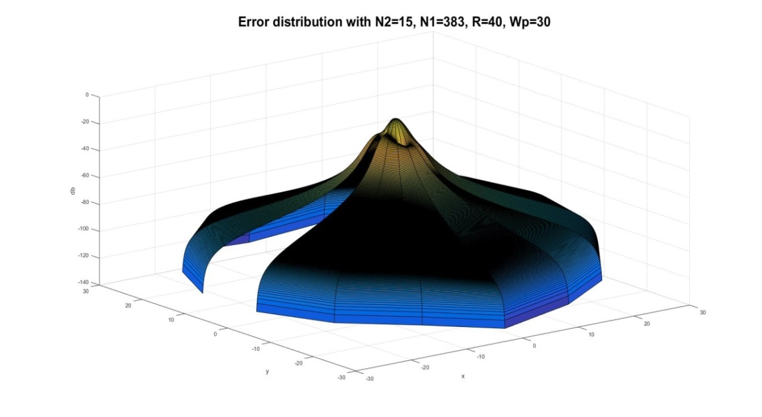
Test functions
Gaussian (Forward Transform)

Slide 15
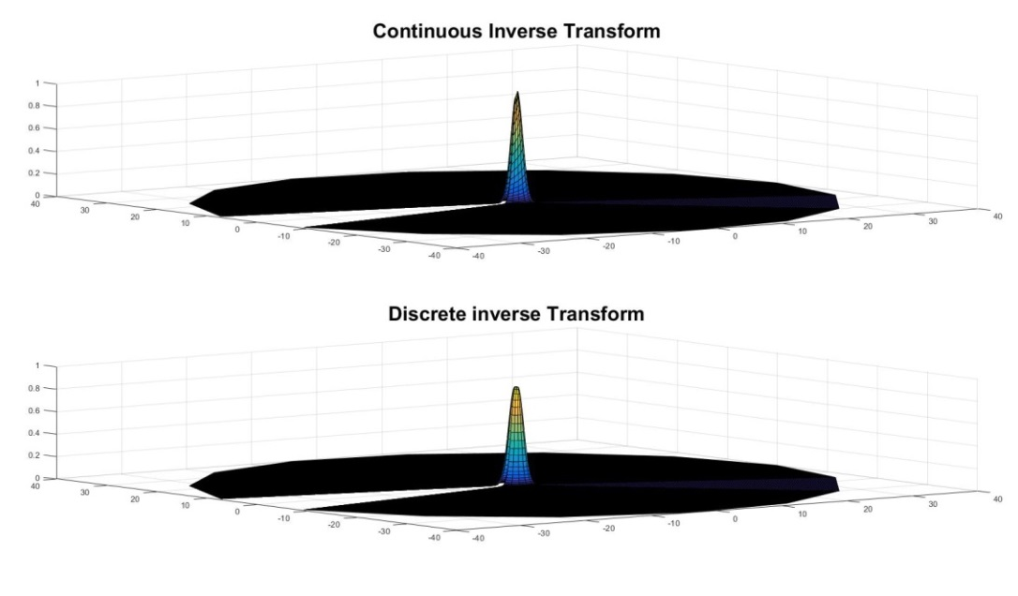
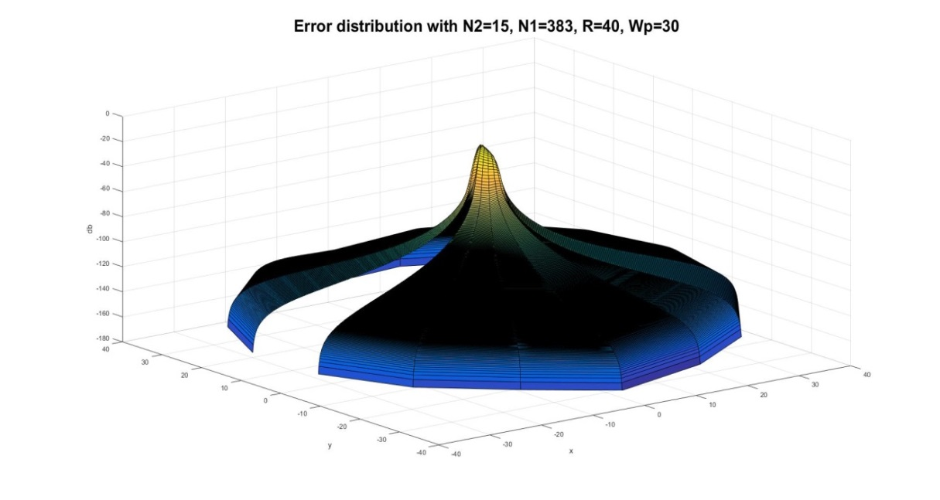
Test Functions
Gaussian (Inverse Transform)

Slide 16
Test Functions
Square Donut

Slide 17
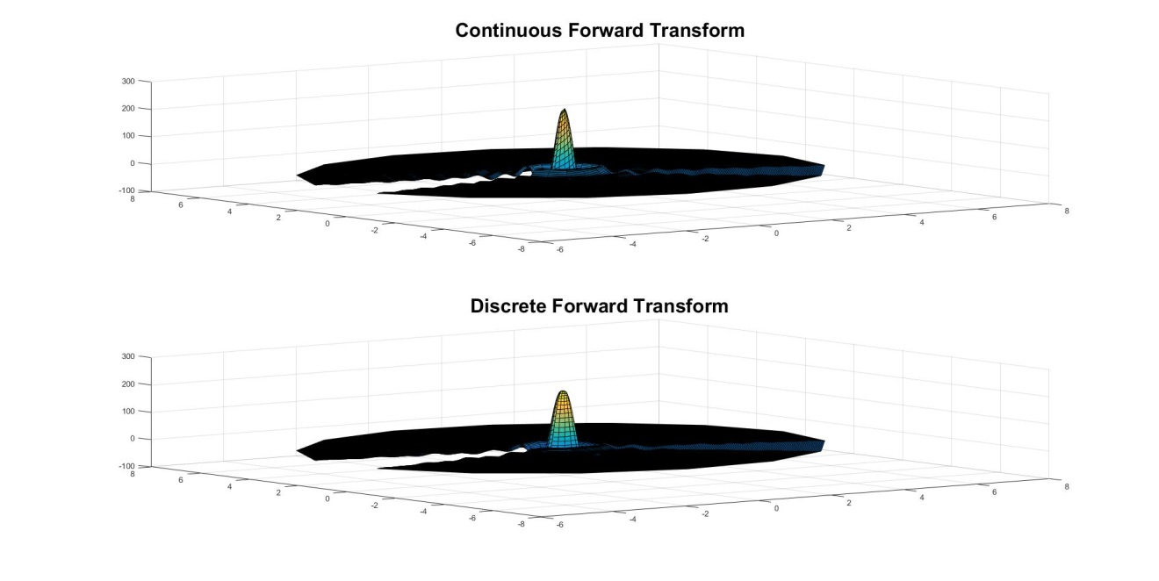
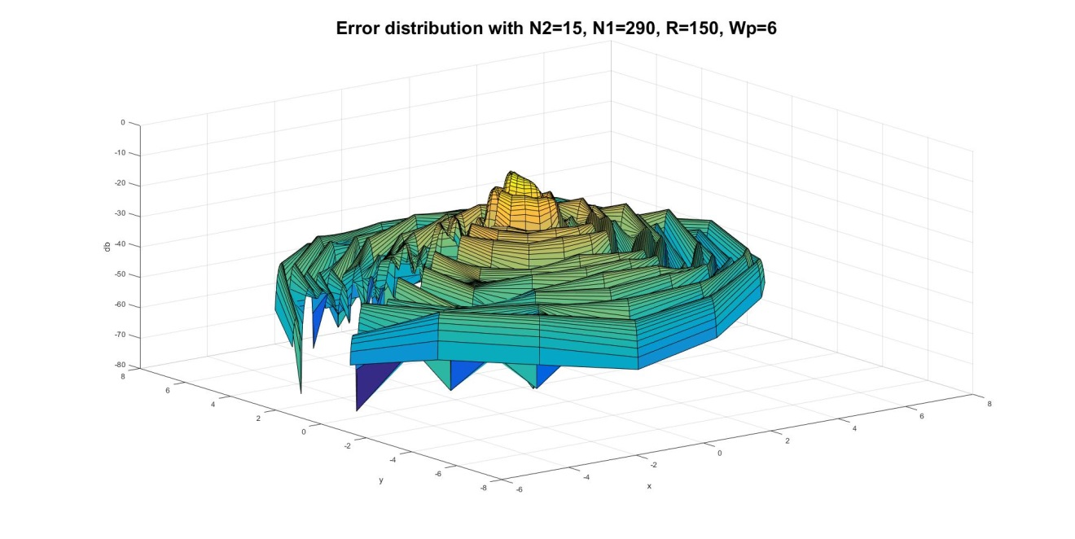
Test Functions
Square Donut (Forward Transform)

Slide 18
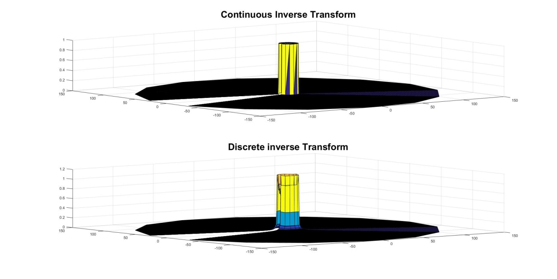
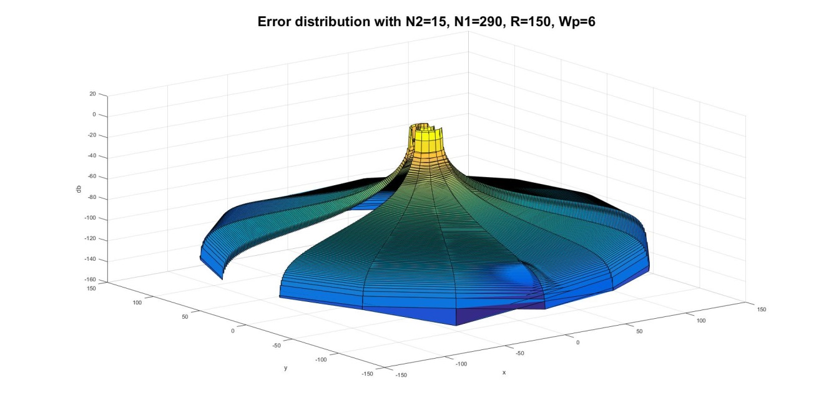
Test Functions
Square Donut (Inverse Transform)

Slide 19
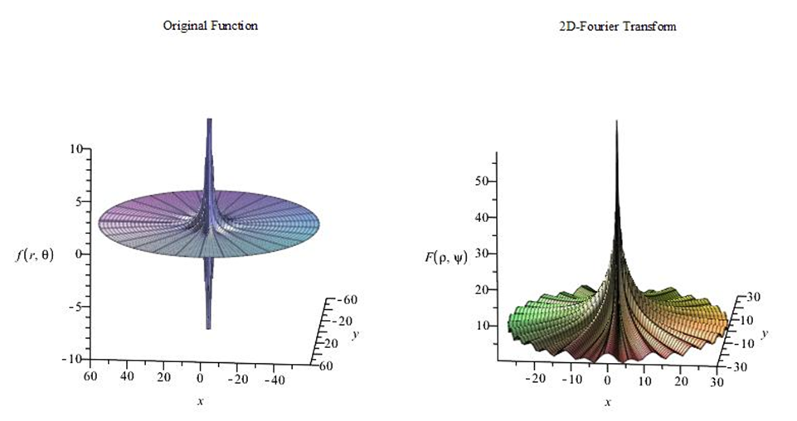
Test Functions
Four-term sinusoid & Modified exponential

Slide 20
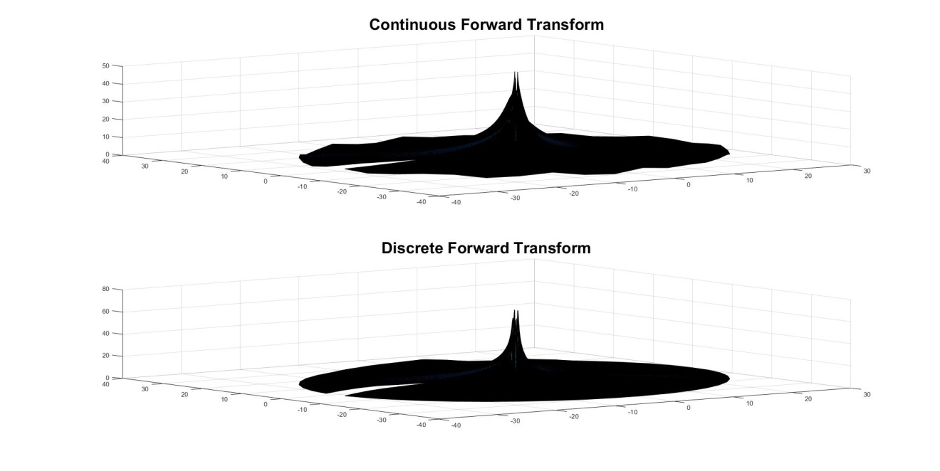
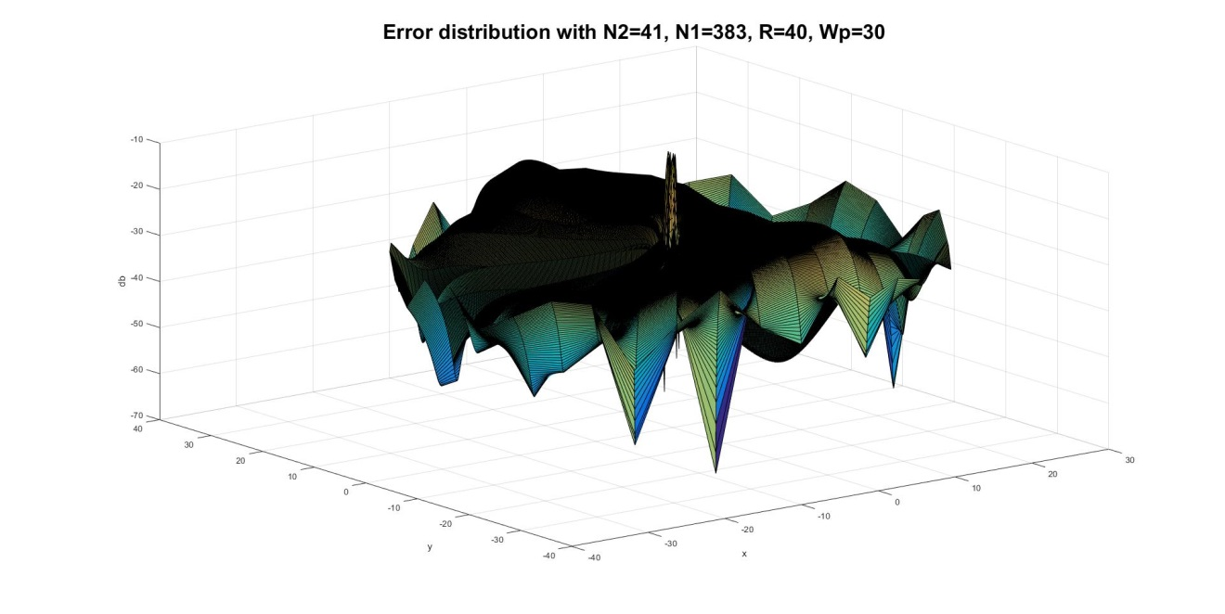
Test Functions
Four-term sinusoid & Modified exponential (Forward Transform)

Slide 21
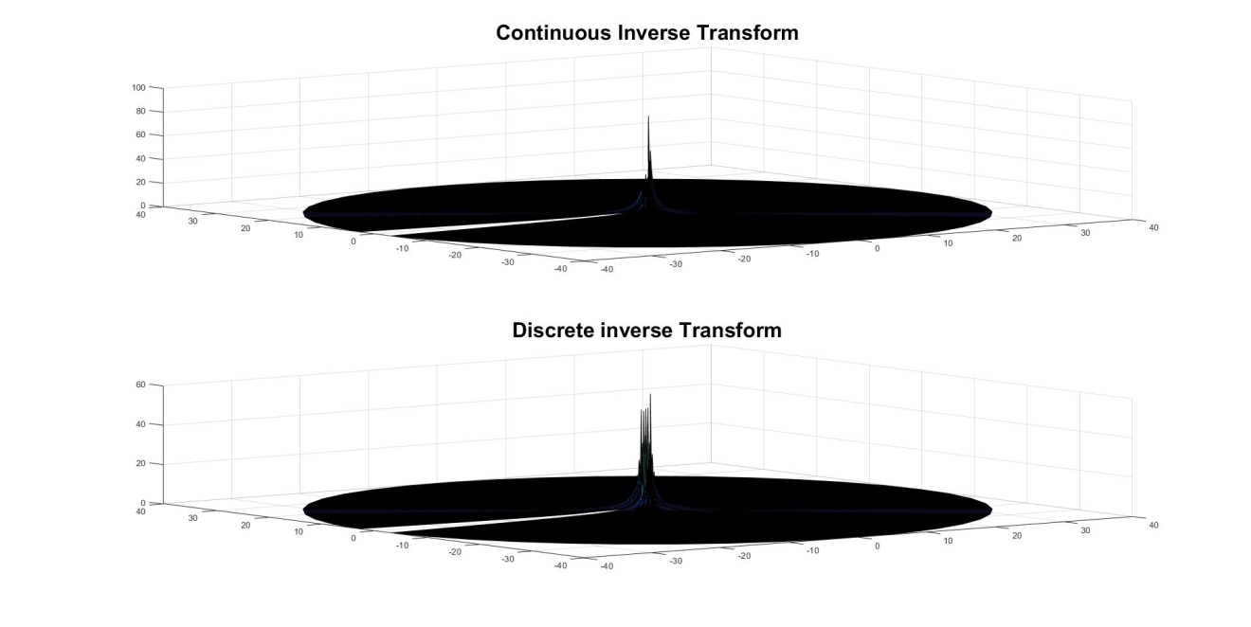
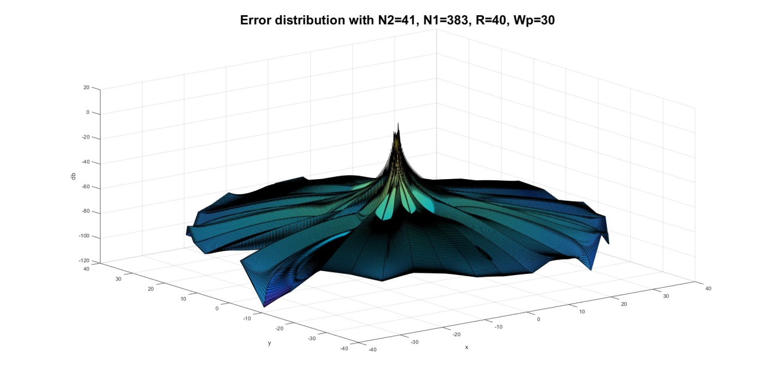
Test Functions
Four-term sinusoid & Modified exponential (Inverse Transform)

Slide 22
Summary of the test results
Dynamic Error (dB) of the three cases
 |  | Gaussian | Square Donut | Four term Sin & Mexp
Forward transform | Emax. | -8.4 | -8.2 | -6.6
 | Eavg. | -63.8 | -34.5 | -29.5
Inverse transform | Emax. | -12.3 | 1.5 | 0.6
 | Eavg. | -98.0 | -73 | -68.7
The discrete transform shows good approximation.
The Dynamic error gets larger at the center.

Slide 23
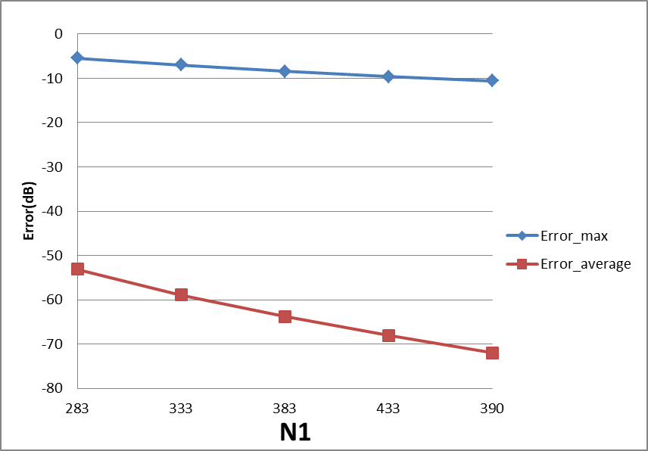
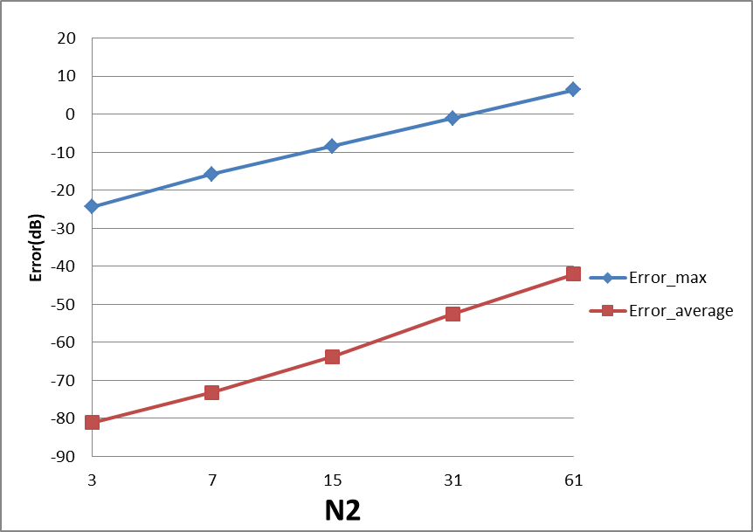
Guidelines of choosing sample size
Dynamic error of forward transform of Gaussian Function
Sample size in radial direction
Sample size in angular direction

Slide 24
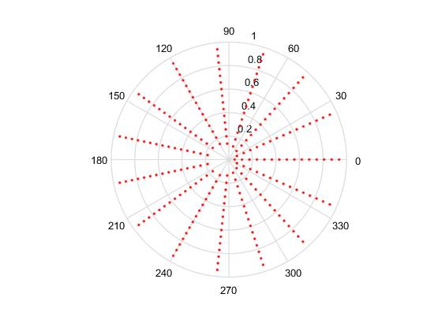
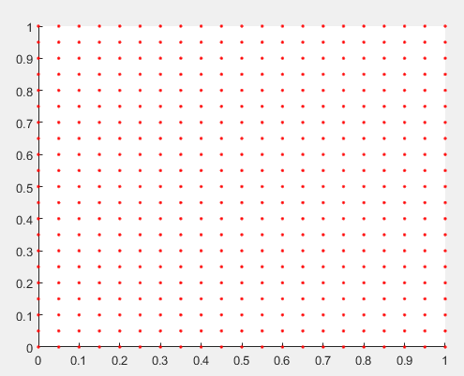
Guidelines of choosing sample size
Sample grid in Cartesian coordinates
Sample grid in polar coordinates
Equally spaced and starts form the origin
Not equally spaced and cannot get to the origin.

Slide 25
Guidelines of choosing sample size
Keep N2 (sample size in angular direction)as small as possible.
Increasing N1 (sample size in radial direction)leads to better result but also costs more computing time.

Slide 26
Conclusion

Slide 27
Conclusion
The proposed discrete 2D-Fourier transform showed good accuracy to approximate the continuous Fourier transform.
Guidelines on choosing sample size have been developed.

Slide 28
Thank you!

