Slide 1

Spaulding Sampling Application
System Overview
presented by: Konrad Lorincz
August 22, 2007
HARVARD UNIVERSITY
Division of Engineering and Applied Sciences

Slide 2

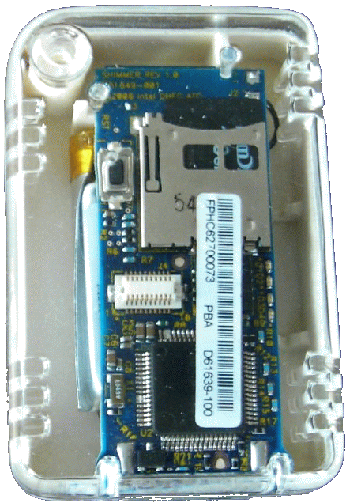
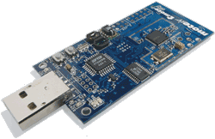
High Level Picture
Commands to Nodes
<Start Sampling>
<Stop Sampling>
<Send SamplingBLock>
Sampling Nodes
(SHIMMER)
TOSBase
Base station
Between Nodes
<FTSP TimeSync>
From Nodes
<Status> (every 10 secs)
<RealTimeSamples> (unreliable, down-sampled)
<SamplingBlock> (reliable)
  BaseStation issues commands: StartSampling, StopSampling, GetBlock
  Nodes send periodic StatusMsgs, sample sensors, and write samples to flash
  FTSP TimeSync keeps nodes time synchronized well within 1 sample period (10 ms)

Slide 3
Node Modules
Driver
<CommandMsg>
Start Sampling
Stop Sampling
<StatusMsg>
RealTimeSamples
<RealTimeSamplesMsg>
GenericComm
(Radio)
<RawSamples>
MultiChanSampling
<RawSamples>
<FetchReplyMsg>
<FetchRequestMsg>
SamplingTo
DataStore
DataStore
<Block>
Get GlobalTime
Get Block
<Block>
TimeSynch
Fetch

Slide 4
MultiChanSampling
MultiChanSampling {
command result_t startSampling(channelID_t channelIDs[],
uint8_t nbrChannels,
uint16_t rateHz);
command bool isSampling();
command result_t stopSampling();
event void dataReady(sample_t samples[],
uint8_t nbrChannels,
result_t result);
}
  Samples each of the specified channels back-to-back every rateHz
  e.g. (sample all sensors at 100Hz)
  channelID_t CHANS[6] = {ACCX, ACCY, ACCZ, GYROX, GYROY, GYROZ};
  call Sampling.startSampling(CHANS, 6, 100);

Slide 5
SamplingToDataStore
MultiChanSampling
<RawSamples>
SamplingTo
DataStore
<Block>
DataStore
MultiChanSampling.dataReady(
sample_t samples[],
uint8_t nbrChannels);
typedef struct SampleChunk {
time_t localTime;
time_t globalTime;
bool timeSynched;
uint16_t nbrMultiChanSamples;
channelID_t channelIDs[MAX_CHANS];
sample_t samples[NBR_SAMPLES];
} SampleChunk;
typedef struct Block {
blocksqnnbr_t sqnNbr;
uint8_t data[BLOCK_DATA_SIZE];
} Block;
localTime and globalTime of
first sample in SampleChunk
  SamplingToDataStore packs raw samples into a
  SampleChunk and then into a Block

Slide 6
DataStore (flash storage module)
FlashInfo
tailBlockID
headBlockID
  Storage unit: Block of 256 bytes
    blockID (4 bytes)
    data[] (252 bytes)
  Maintains a circular buffer of blocks
  Each write increments the blockID
  DataStore keeps track of the head and tail blockIDs
  Persistence across reboots
    First block on flash reserved for FlashInfo
      hash, tailBockID, headBlockID
    Updated every FLASH_INFO_WRITE_PERIOD = 50 writes

Slide 7
Time Synchronization
  Based on the FTSP time synch protocol [Maroti et al, 2004]
    original paper, mica2: less than 67 μsec error
  Basic Operation:
    “Leader node” – defined by FTSP_STATIC_ROOT_ID=10, send periodic time synch messages containing the globalTime
    (leader’s localTime is equal to the globalTime)
    Receivers update their globalTime variable
    Receivers use linear regression to compensate for clock drifts between time synch messages
Notes:
Verified on our testbed: 90th percitile of under 2.1 ms in 5-hop linear network

Slide 8
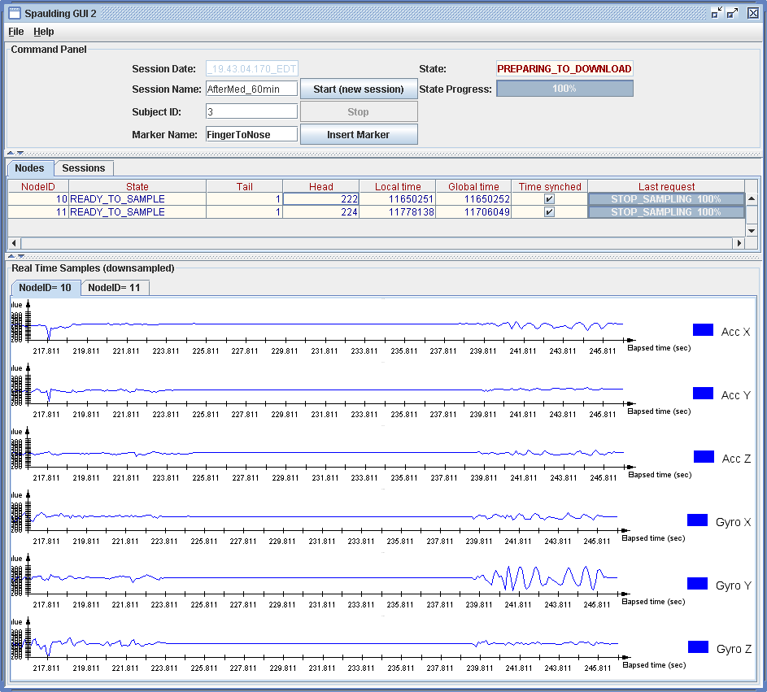
Base Station GUI
Creating a New Sampling Session
Status of each node
RealTimeSamples

Slide 9
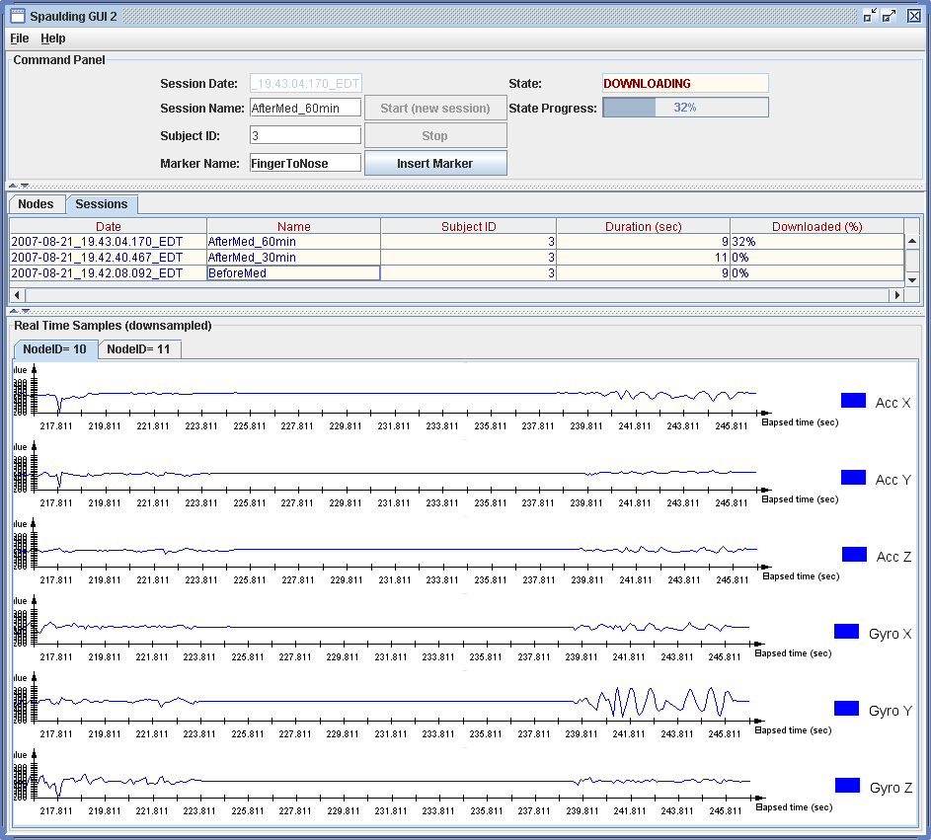
Base Station GUI
State of all sessions
samples for a session can be downloaded anytime
persistent across GUI restarts. State saved in file “savedSessions.ser”

Slide 10
Base Station GUI – Session Files
  Each Session is saved in it’s own directory
spaulding/src/gui/sessions/
savedSessions.ser - state of sessions saved
subj-3_AfterMed_30min_2007-08-21_19.42.40.467_EDT/
sessionInfo.txt - basic session information
markers.txt - time-stamped markers
node-10.raw - hex of Blocks
node-10.data - parsed Blocks
node-10.samples - samples in a convenient format: <time> <sample>
node-11.raw
node-11.data
node-11.damples
subj-3_AfterMed_60min_2007-08-21_19.43.04.170_EDT/
subj-3_BeforeMed_2007-08-21_19.42.08.092_EDT/

Slide 11
Directory Structure & Availability
  Particularly noteworthy directories highlighted
  Download code from SourceForge under
    tinyos/tinyos-1.x/contrib/harvard/spaulding
spaulding/
README - installation instructions
...
src/
Makefile.in - app wide params, such as MSG_SIZE, freqChan, GroupID, etc.
dataStore/ - flash block abstraction
driver/ - sampling Node TinyOS code
fetch/ - reliable transmission
gui/ - GUI java code
lib/
tosBase/ - compile and install this version of TOSBase
...
realTimeSamples/ - downsamples and transmits real time samples
sampling/ - sampling driver and MultiChanSampling module
timeSynch/ - FTSP time synch
...

