Slide 1




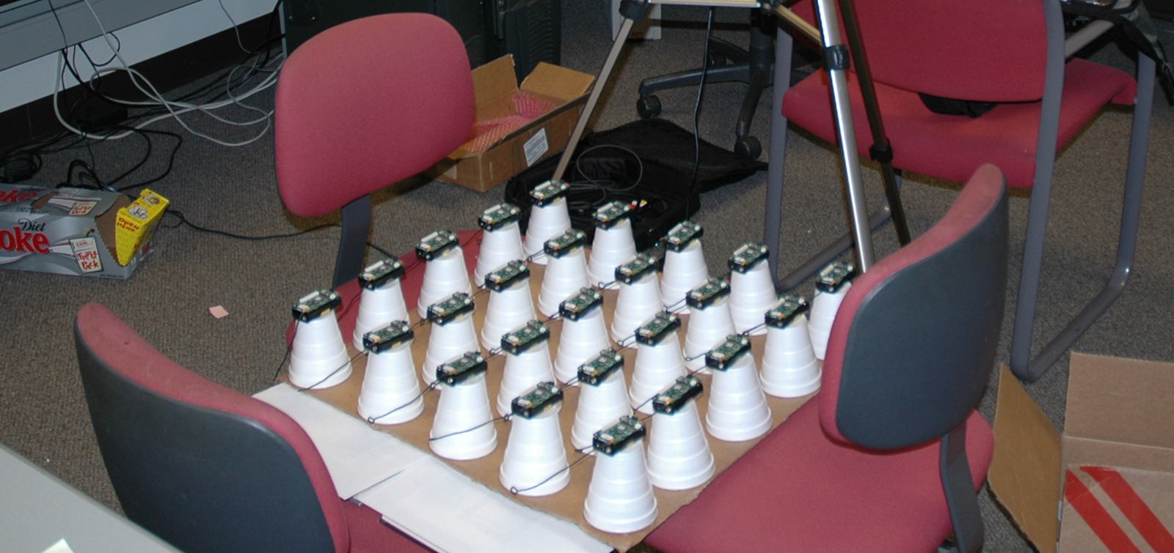
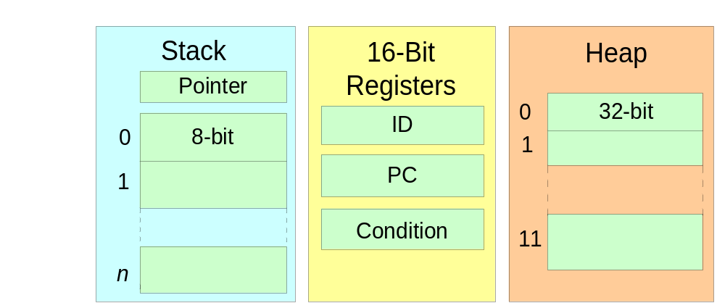
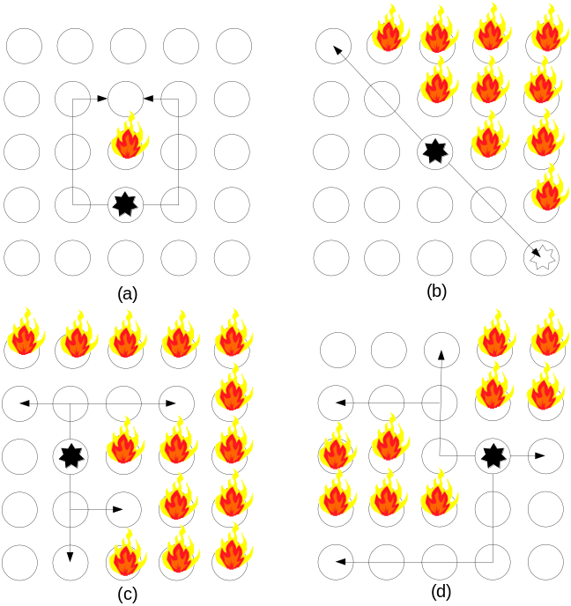
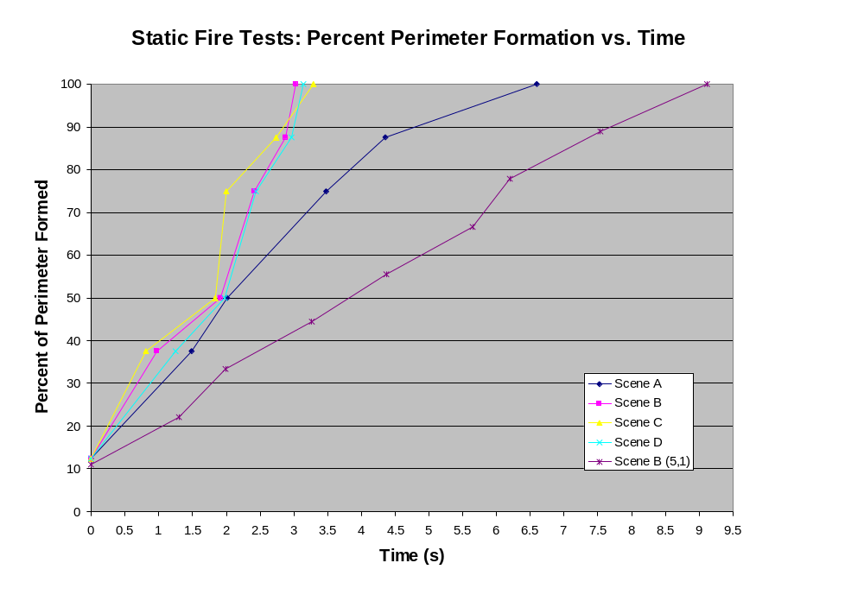
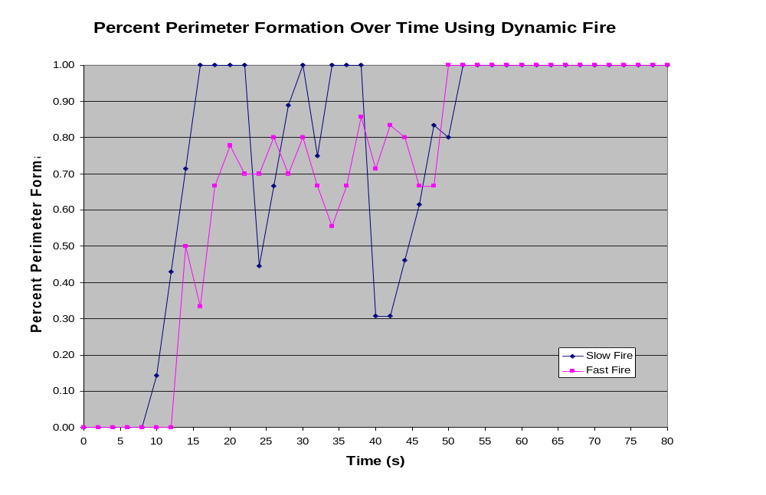
Mobile Agent Middleware for Sensor Networks: An Application Case Study
Chien-Liang Fok, Gruia-Catalin Roman, Chenyang Lu
Washington University in St. Louis
Mobile Computing Laboratory
Agilla Middleware
Fire Tracking Using Mobile Agents
Node (1,1)
Node (2,1)
Agents
migrate
Agents
Neighbors
Tuplespace
remote
access
Tuplespace
Neighbors
Agilla Middleware
Agilla Middleware
TinyOS
TinyOS
Initially patrol the network for fire
  fire encoded by a tuple in the tuple space
Upon detection, enter tracking mode
  periodically check status of neighbors
  clone to all neighbors in fire’s vicinity
  die if its node catches on fire
MICA2 Mote
MICA2 Mote
Mobile agents increase network flexibility
  Proactively move and clone across nodes
  Can adapt to unexpected circumstances
  New agents can be injected
Middleware provides:
  a high-level agent abstraction and language
  context discovery
  multi-hop geographic forwarding
Clone (2,6)
Clone (4,6)
Clone (5,7)
Experimental Setup
Move (3,5)
Agent Architecture
5x5 network of Mica2 Motes
Experimental Results
Stack-based to reduce code size
Move (2,4)
Agilla Programming Language
1: BEGIN pushn fir
2: pushc 1
3: out // insert fire tuple
4: BLINK pushc 25
5: putled // toggle red LED
6: pushc 1
7: sleep
8: rjump BLINK
Static Fire
Mobile agents swarm around a fire forming a perimeter
Epidemically
Spreading Fire
This research was supported by the Office of Naval Research under MURI research contract N00014-02-1-0715 and by the NSF under ITR contract CCR-0325529.

