Slide 1
Rapid Development and Flexible Deployment of Adaptive Wireless Sensor Network Applications
Chien-Liang Fok, Gruia-Catalin Roman, Chenyang Lu
http://mobilab.wustl.edu/projects/agilla
Mobile Computing Laboratory
Distributed Object Computing Laboratory
Department of Computer Science and Engineering

Slide 2
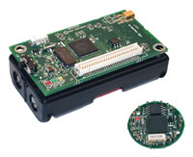
Motivation
Software development for sensor networks is hard
  Limited resources
  Difficult to debug
  Large & highly dynamic network
Existing software lacks flexibility
  Entire network runs just one application
  Cannot adapt to changes in
    the environment
    user requirements

Slide 3





Motivating Example
Three applications: 1) Environmental Monitoring,
2) Fire Detection, 3) Fire Tracking
Notes:
There are two ways we can get this behavior: 1) Use a byte-code distribution engine like Deluge, XNP, or MNP to repogram the network – high overhead & slow, 2) Integrate functionality of all three applications into a single application – NOT flexible!

Slide 4
Agilla: A Flexible Middleware for Sensor Networks
Sensor network as a shared computing resource
  Flexible application deployment
Env. monitoring agent
Fire detection agent
Fire tracking agent

Slide 5

Agilla’s System Architecture
Node @ (1,1)
Node @ (2,1)
Agents
Agents
migrate
remote
access
Neighbor
List
Tuplespace
Tuplespace
Neighbor
List
Middleware Services
Middleware Services
Agilla Middleware
Agilla Middleware
TinyOS
TinyOS
Notes:
Mobile Agent
Inter-Agent coordination
Context Discovery
Location-Based addressing

Slide 6
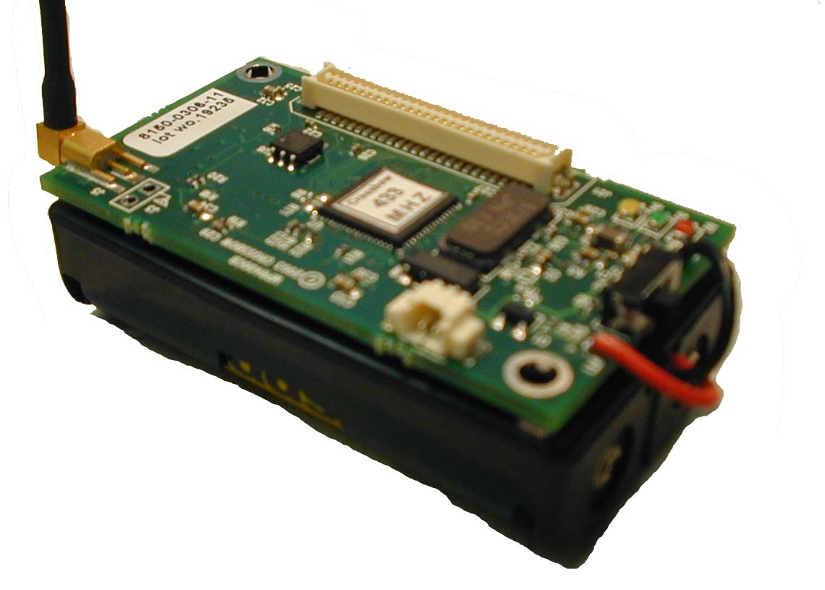
Agilla’s Computational Model
PC
Code
Clone
or
Migrate
Stack
Condition
Codes
Heap
Two variants of each:
1) Strong (code + state)
2) Weak (code only)

Slide 7
Location-Base Addressing
Nodes are addressed by location
(3,3)
(3,1)
(3,2)
(2,2)
clone to (3,1)
clone to (3,3)
Fire Detection
Agent
(1,1)
(1,3)

Slide 8
Tuple Space-Based Coordination
Content-addressable shared memory
  Tuple – A set of data fields
  Template – A pattern that matches particular tuples
Provides spatiotemporal decoupling
“rout”
“in”
“out”
“in”
Tuplespace
Tuplespace

Slide 9
Agilla Tuple Space API
Remotely accessible localized tuple spaces
Stores context information
Facilitates inter-agent communication
out
in
Tuplespace
Local
Remote
out: insert
in: remove
rd: read
inp: probing remove
rdp: probing read
regrxn: register reaction
deregrxn: deregister reaction
rout: insert
rinp: probing remove
rrdp: probing read
rrdpg: probing group read (1-hop)

Slide 10
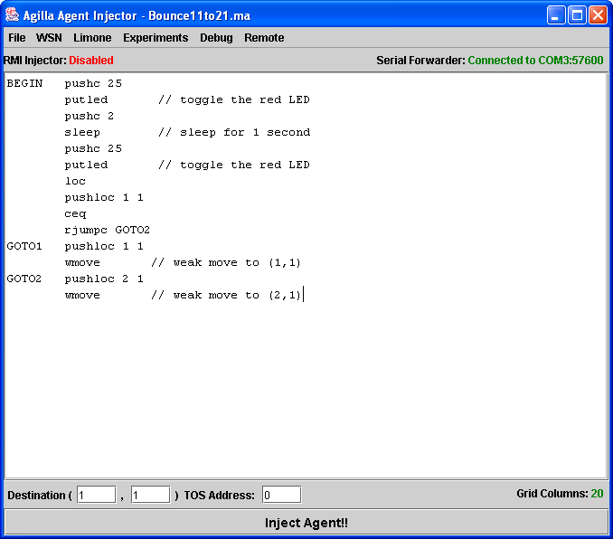
Implementation on TinyOS 1.1.13
Agilla is available for Mica2 and MicaZ motes
  4 agents/node
Agent Injector
  Written in Java
  Remote Injection via RMI
Key Challenges:
  Memory:
    ROM: 54.7KB of 128KB
    RAM: 3.5KB of 4KB
  Message loss

Slide 11
Compact Code: An Example
The fire tracking agent:
1 BEGIN pushn fir
2 pusht LOCATION
3 pushc 2 // push template onto stack
4 pushc FIRE // push reaction’s callback address
5 regrxn // register reaction
6 wait // wait for reaction to fire
7 FIRE pop
8 sclone // clone to node that detected fire
… // fire tracking code
Registers a reaction sensitive to fire alert tuples
Clones itself onto a node that detects fire
Notes:
“without reading the code…we are able to accomplish….in xxx lines of code…”
Change to fire example…

Slide 12
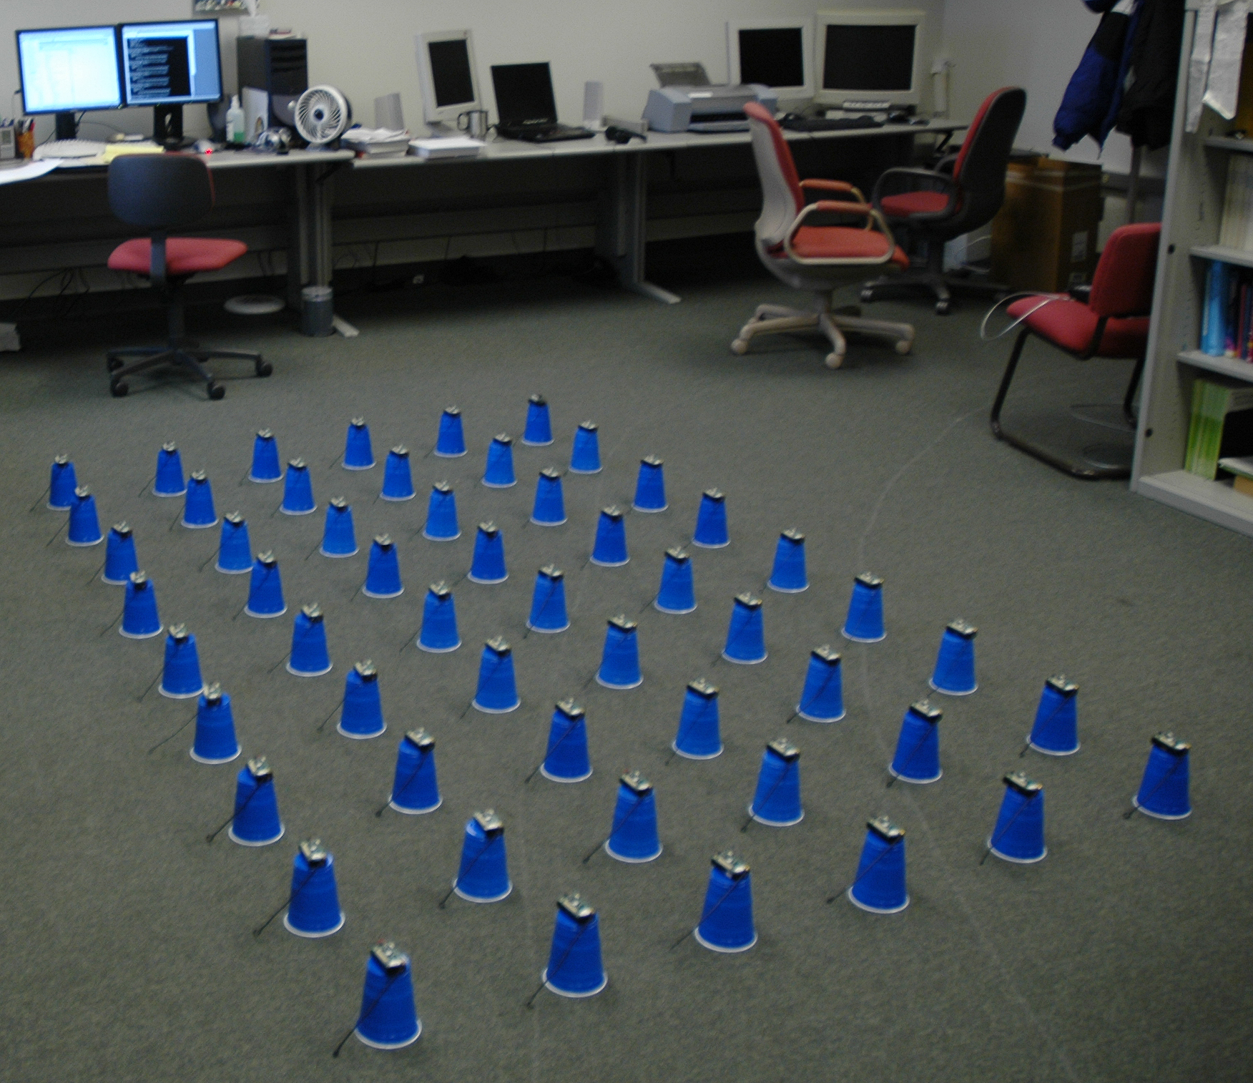
Our Test Bed
6x9 Mica2 Mote
Test Bed
Multi-hop Grid
One base station

Slide 13
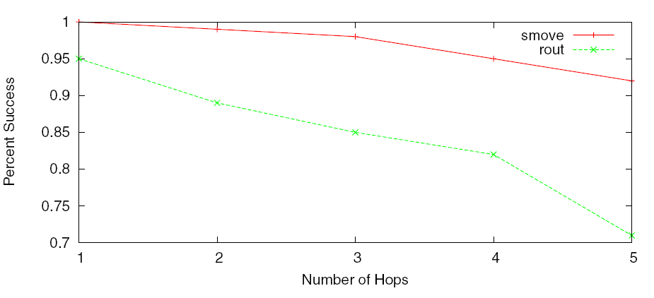
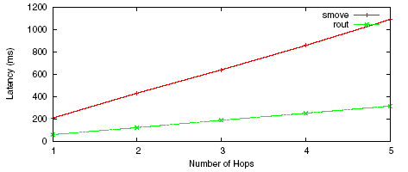
Performance Evaluation: migration vs. remote tuple space access
Migration instructions are more reliable because of hop-by-hop acknowledgements…
…but remote tuplespace operations
have less overhead
Notes:
These are out-dated, motes were tested on table. Reliability GREATLY improved when motes are elevated.
You have to design middleware mech to accommodate different needs… chose diff tradeoffs for diff operations. Say: what’s diff in req & what’s done?
See?? It’s feasible! 200ms/hop, scaleable…good for many apps.

Slide 14
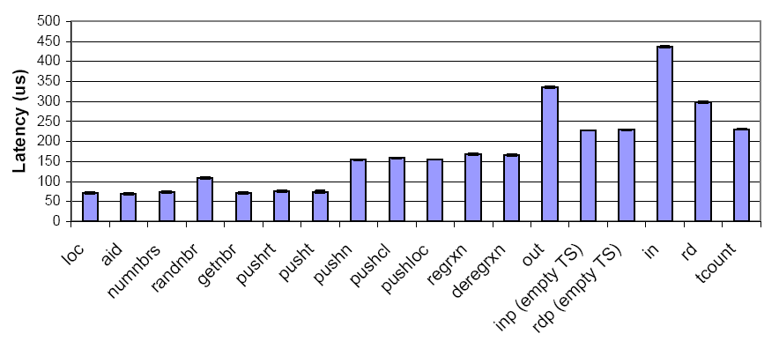
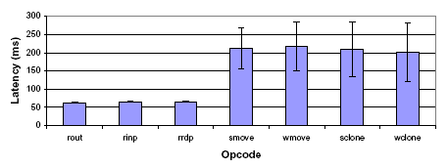
Agilla Instruction Execution Times
Local Operations
Remote Operations
Notes:
“Look, a mobile agent middleware can increase network flexibility without excessive overhead! Local operations take in the 10s-100s of microseconds, remote tuple space operations take in the 10s of milliseconds, and full fledge migration operations take less than ¼ second!”

Slide 15
Initial Experiences
Fire Detection & Tracking
  Presented at IPSN 2005
Intruder Detection and Tracking
  Agents guard network perimeter and follow intruders
  Periodically report intruder location to base station
Cargo & Inventory Management
  In collaboration with Boeing
  Mobile agents load manifests from RFID, find items, detect security breaches, and send alert to Internet gateways.

Slide 16
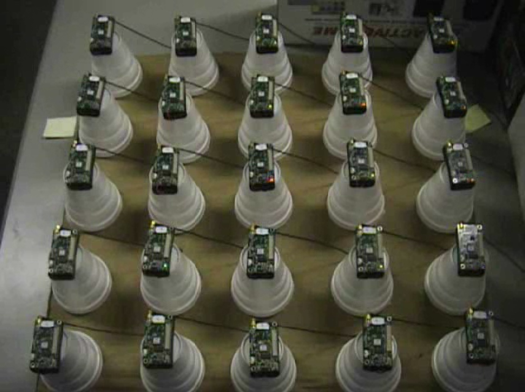
Fire Tracking Video
Video available at: http://mobilab.wustl.edu/projects/agilla

Slide 17
Related Work
Distributing inanimate code modules
  XNP [xbow’03], Deluge [sensys’04], MNP [icdcs’05],
  SOS [mobisys’05]
  Maté/Bombilla [asplos’02]
Mobile Agent-Like Middleware
  Sensorware [mobisys’03]
    Weak migration only
  Smart Messages [Kang‘04]
    No remote interactions
    Single thread per node
Notes:
MNP – Multihop Network programming
SOS – Senornet OS
“Oh and by the way, it’s hard to compare Sensorware and Smart Messages because they’re not implemented on motes.”
-- Sensorware (Mani Srivasta): event based, mobile script, weak migration, direct message passing, TCL-like language
-- Smart Messages (Rutgers??): one thread/node, smart message, strong migration, local non-shared tag space, Java

Slide 18
Conclusions
Mobile agent middleware simplifies application deployment & increases network flexibility
Agilla middleware services:
  Agent Mobility
  Location-centric addressing
  Tuple space-based coordination
  Context Discovery
Empirical results show that deploying sensor network applications via mobile agents is reliable and efficient

Slide 19
Thank you!
Agilla URL: http://mobilab.wustl.edu/projects/agilla
  Source Code
  Documentation
  Tutorials
  Experience Reports

