Slide 1
Event Driven Programming
Embedded Real Time Systems
Ron Barker
25/05/2015

Slide 2
Review
ModelinG with QM – Bomb4

Slide 3

Model SM Bomb4
Insert Initial Transition
Insert States
  Timing
  Setting
Insert Transitions
  TICK
  UP / DOWN
  ARM
Insert UML – Option “Entry”
25/05/2015

Slide 4
Understanding the
State MachiNE Architecture

Slide 5
Understanding the FSM
QEP Event Processor
  Correlates dynamically Events / States
  How?
Next Task
  Explain how this functions
  Use the ICE (µLink2)
  Breakpoint on FSM_Ctor
  Breakpoint on FSM_Dispatch
25/05/2015

Slide 6

FSM Magic
Derived from Meta Class QMs:
  Virtual State Table
    - single dimension with 2 Functions
      Init() – called only to implement the FSM {i} set
      Dispatch() – implemented as opaque pointer
    Event Processor
      Current State
      Temp state
  Where is the Event History??
25/05/2015

Slide 7
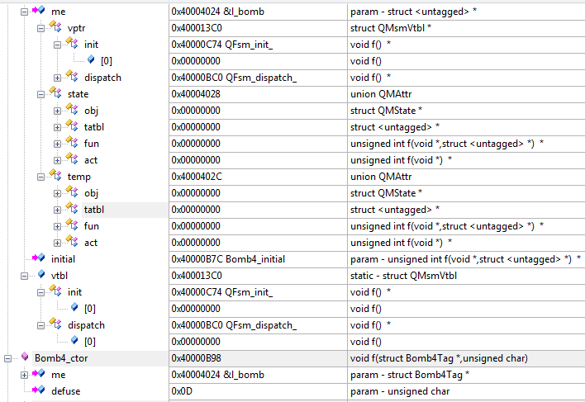
The bomb 4 FSM Data Structures
The State Machine
EventProcessor
EventProcessor
State Tables

Slide 8
Object Oriented Attributes
Combines Data + Functions in single data structure
Encapsulation:
    Opaque pointer me -> l_bomb declared static
    Event Class hidden from SM logic
Polymorphsism-
    Union of Opaque function Pointers
    State Handler Functio Calls transparent to SM logic
    UML Conform Init / Entry / Exit Option
    implements the UML Actions
25/05/2015

Slide 9

Conclusion
The Holy Grail
  Object Oriented
  No OO Language
  Generic Event Processor
  UML Conform
  Small RAM Requiement
  Efficent CPU Utilisation
  Perfect fit to Havard-RISC µP
  Correlates dynamically Events / States
25/05/2015

Slide 10
Blinky Reloaded
QM Blinky

Slide 11
Next Practical Exercise:
Blinky + Framework
Use Blinky2 – State Machine as baseline
Create a QM based UML / FSM Model
Generate State Handler Code
Update BSP
25/05/2015

