Slide 1
Chapter 2
Model Building through Regression

Slide 2
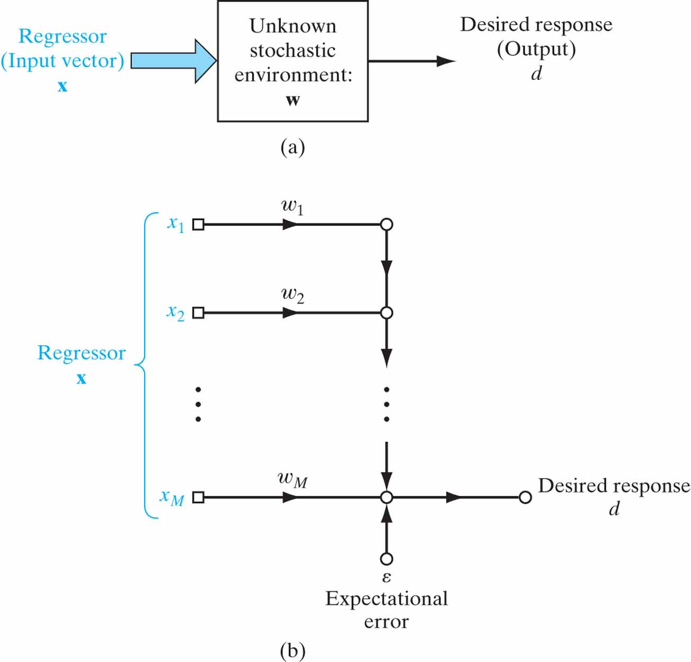
Figure 2.1 (a) Unknown stationary stochastic environment. (b) Linear regression model of the environment.

Slide 3
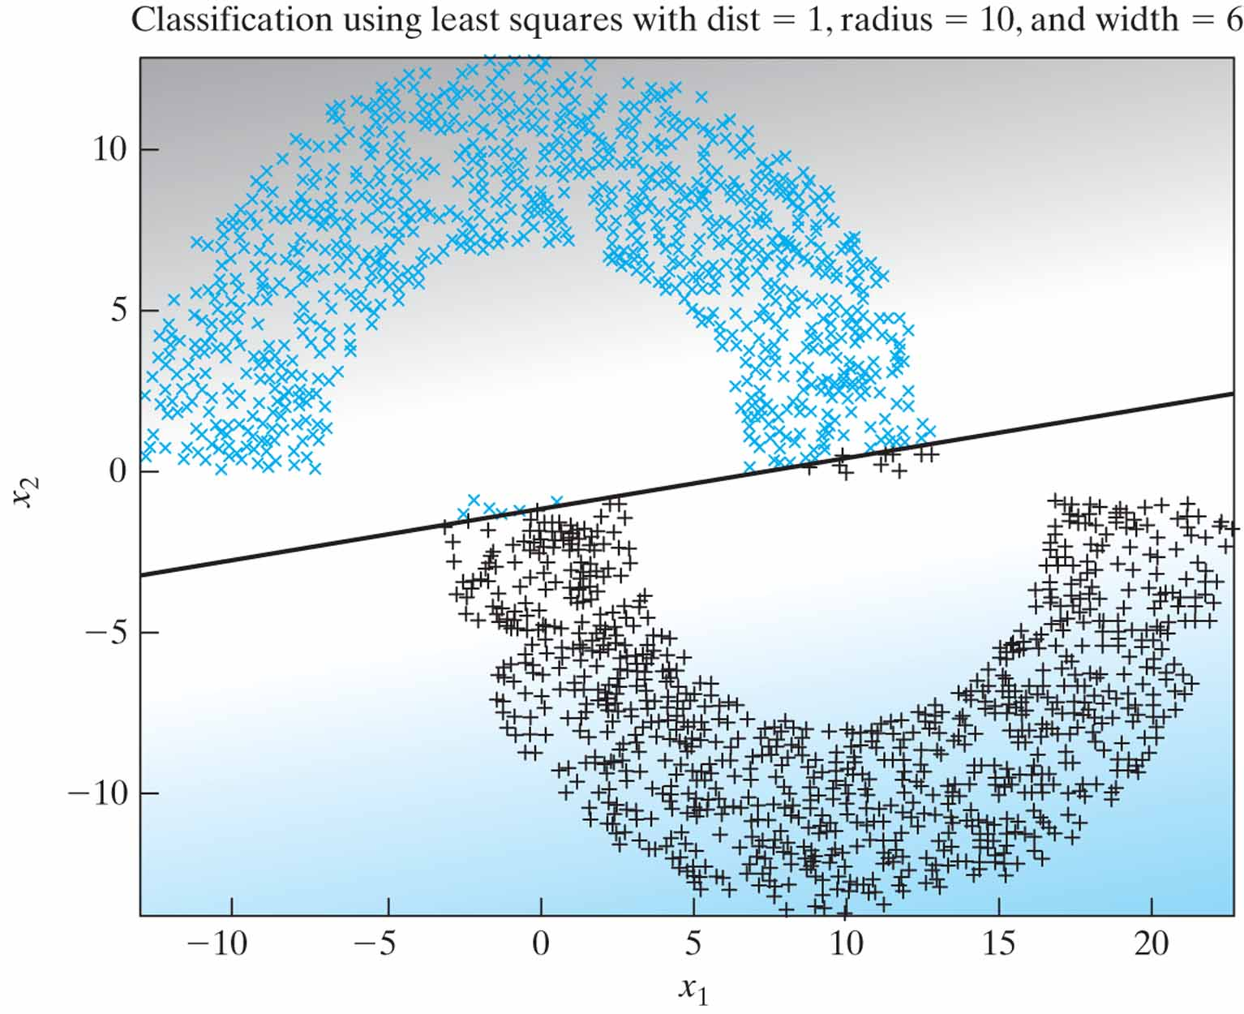
Figure 2.2 Least Squares classification of the double-moon of Fig. 1.8 with distance d = 1.

Slide 4
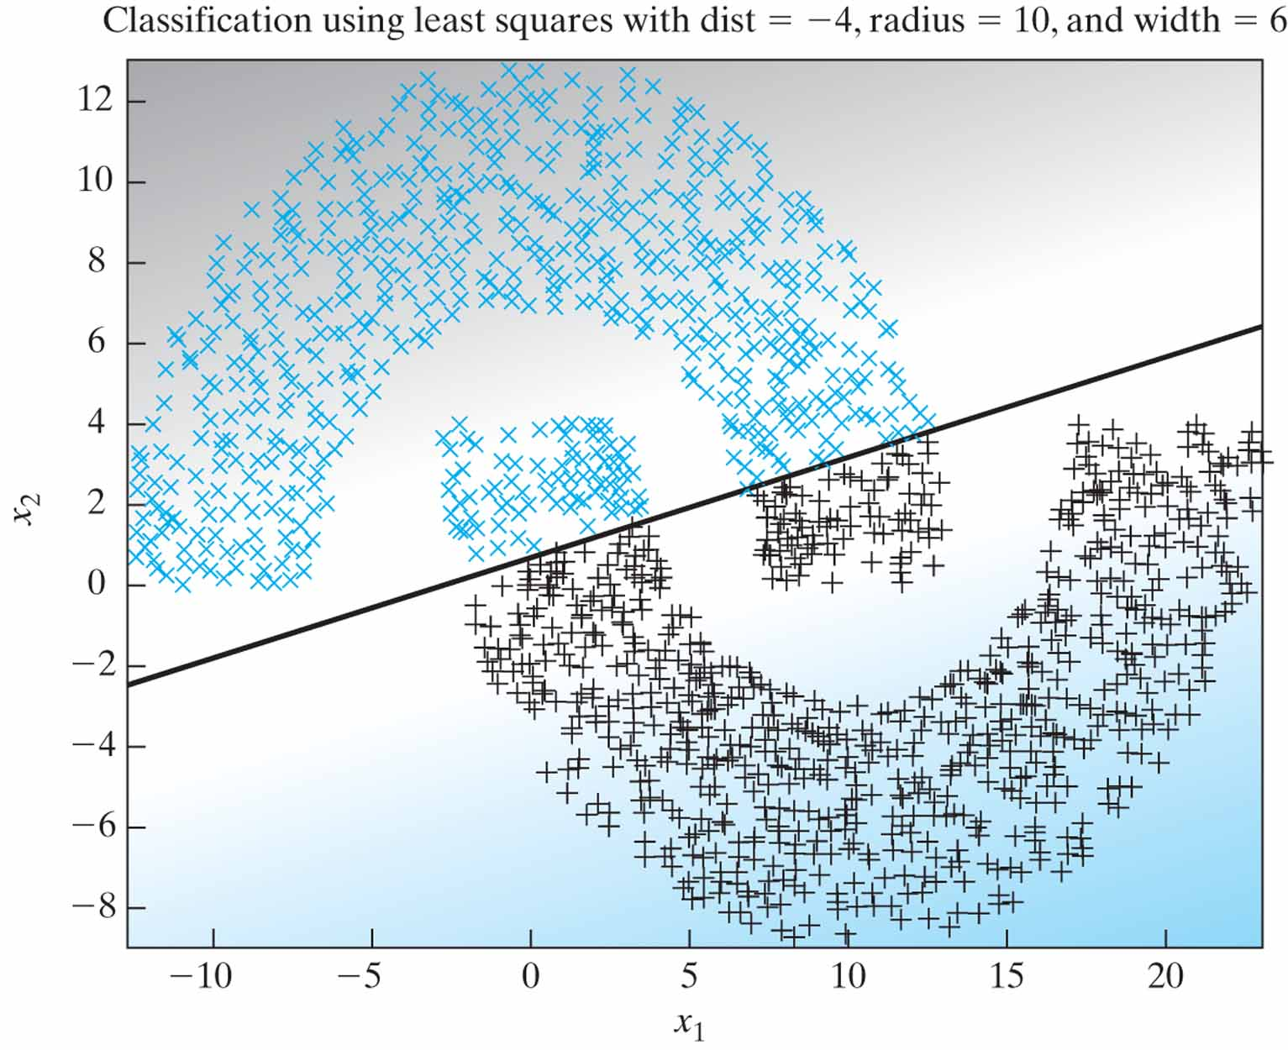
Figure 2.3 Least-squares classification of the double-moon of Fig. 1.8 with distance d = –4.

Slide 5
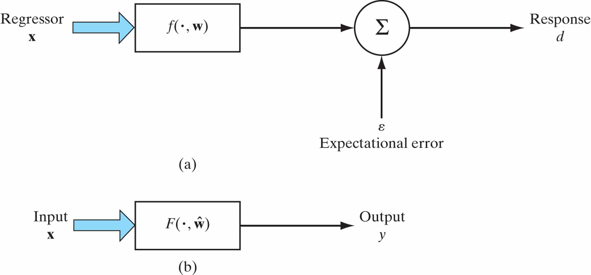
Figure 2.4 (a) Mathematical model of a stochastic environment, parameterized by the vector w. (b) Physical model of the environment, where ŵ is an estimate of the unknown parameter vector w.

Slide 6
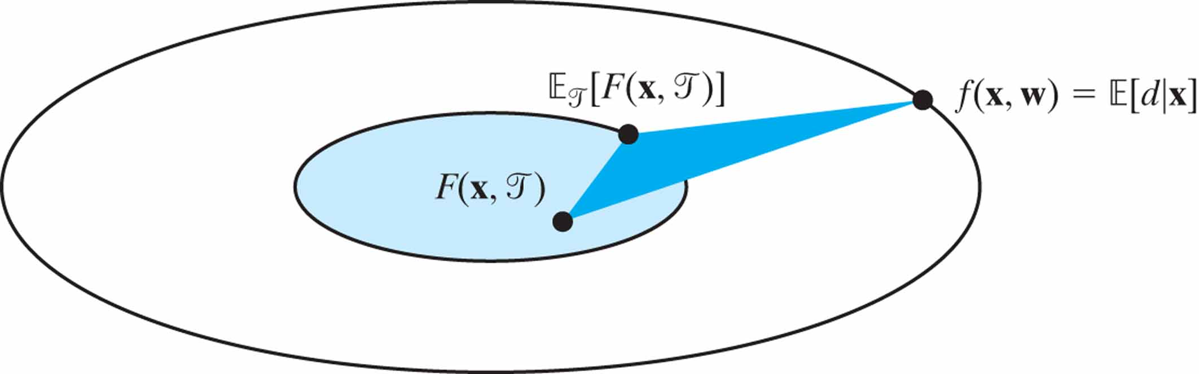
Figure 2.5 Decomposition of the natural measure L_{av}(f(x, w), F(x, ŵ )), defined in Eq. (2.46), into bias and variance terms for linear regression models.

