Slide 1
Chapter 3
The Least-Mean-Square Algorithm

Slide 2
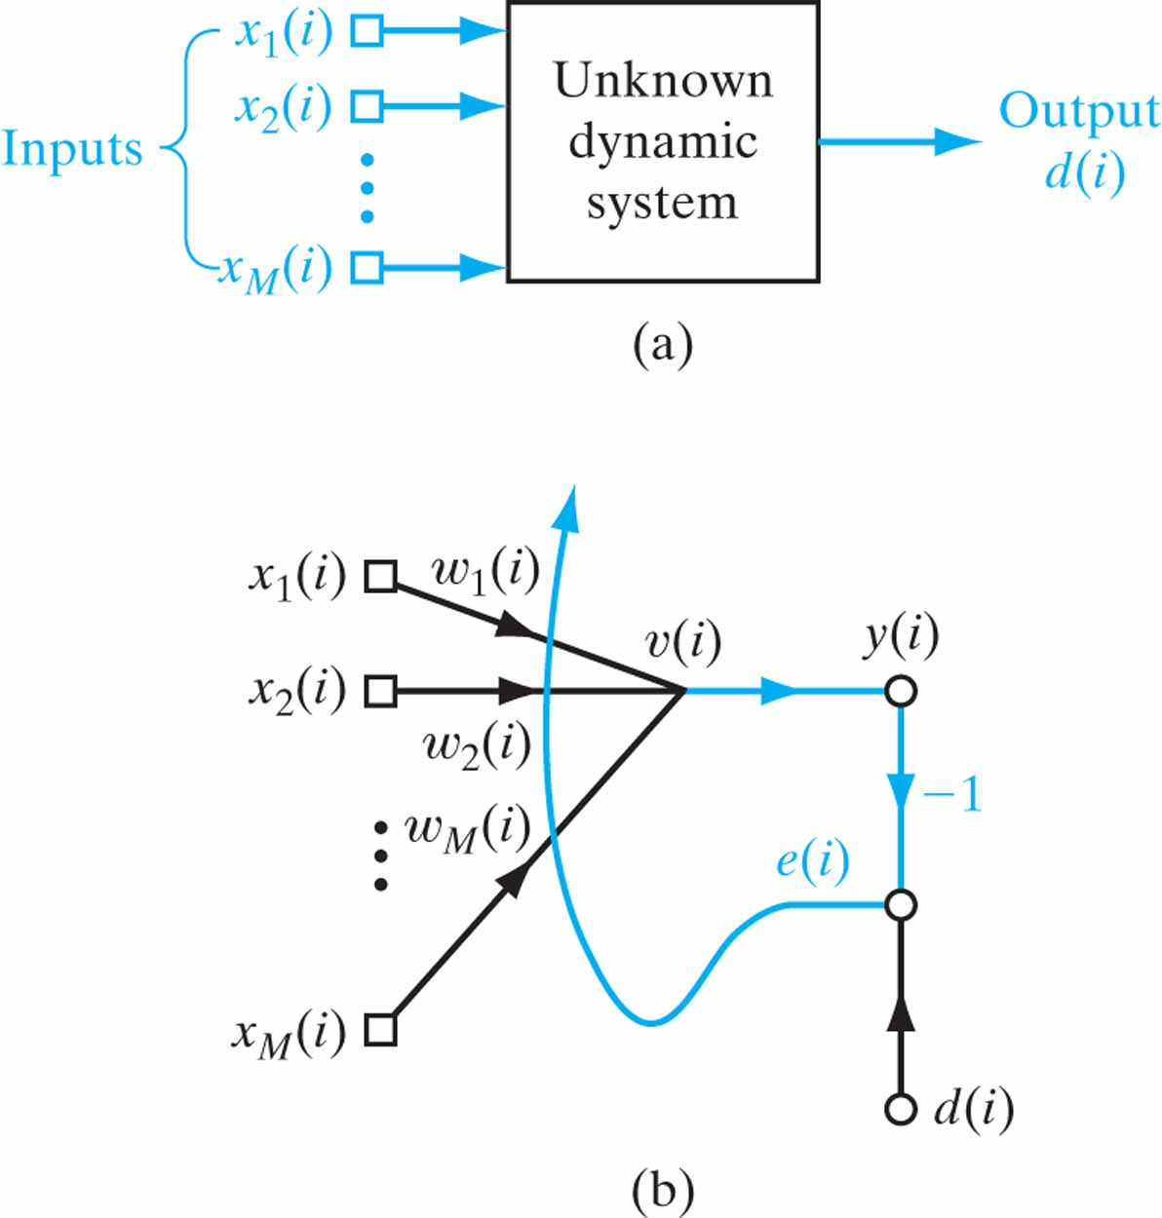
Figure 3.1 (a) Unknown dynamic system. (b) Signal-flow graph of adaptive model for the system; the graph embodies a feedback loop set in color.

Slide 3
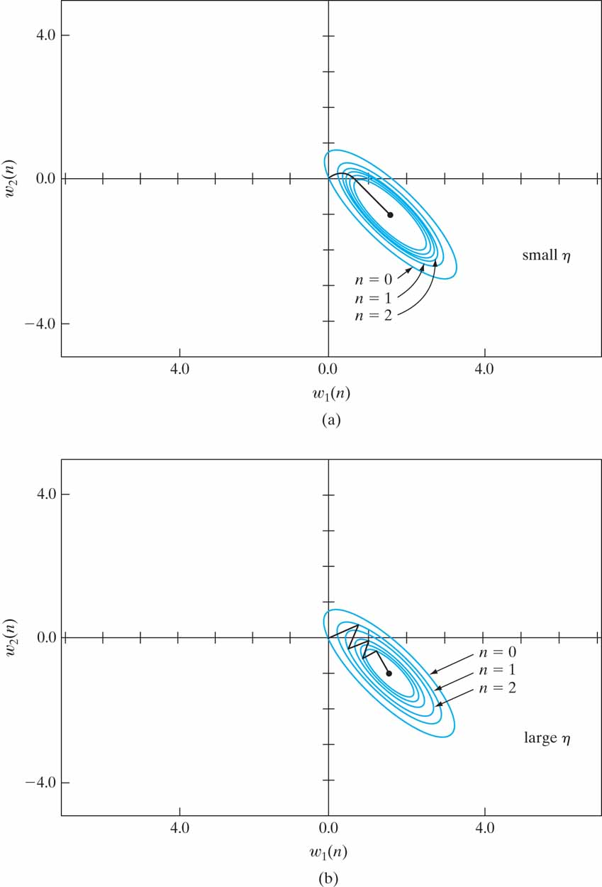
Figure 3.2 Trajectory of the method of steepest descent in a two-dimensional space for two different values of learning-rate parameter: (a) small η (b) large η .The coordinates w₁ and w₂ are elements of the weight vector w; they both lie in the W -plane.

Slide 4
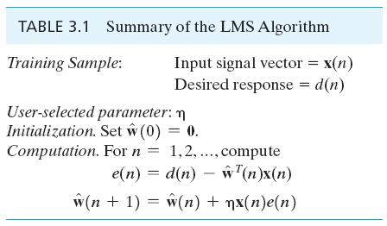
Table 3.1

Slide 5
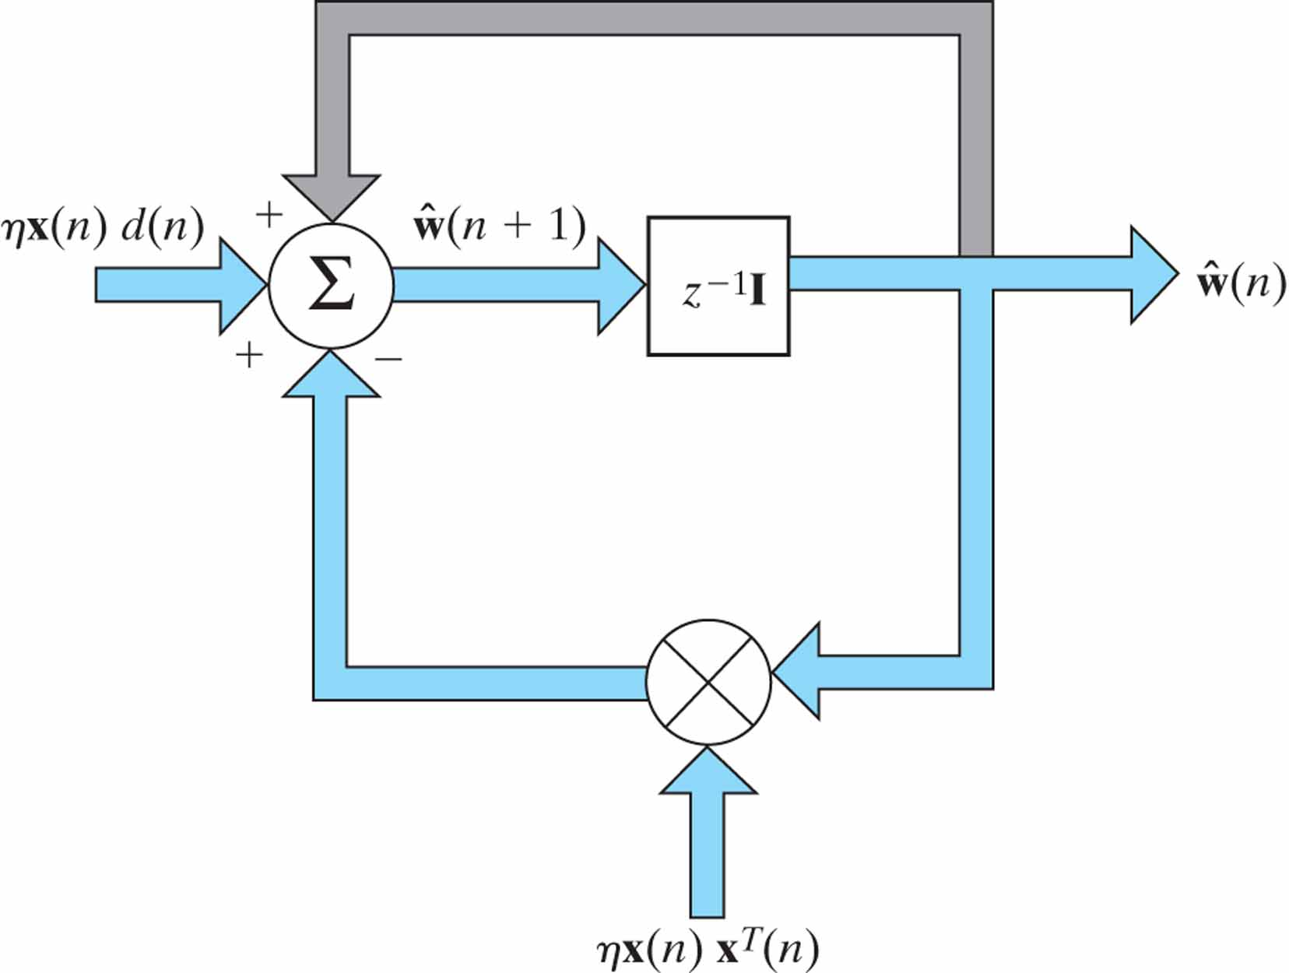
Figure 3.3 Signal-flow graph representation of the LMS algorithm. The graph embodies feedback depicted in color.

Slide 6
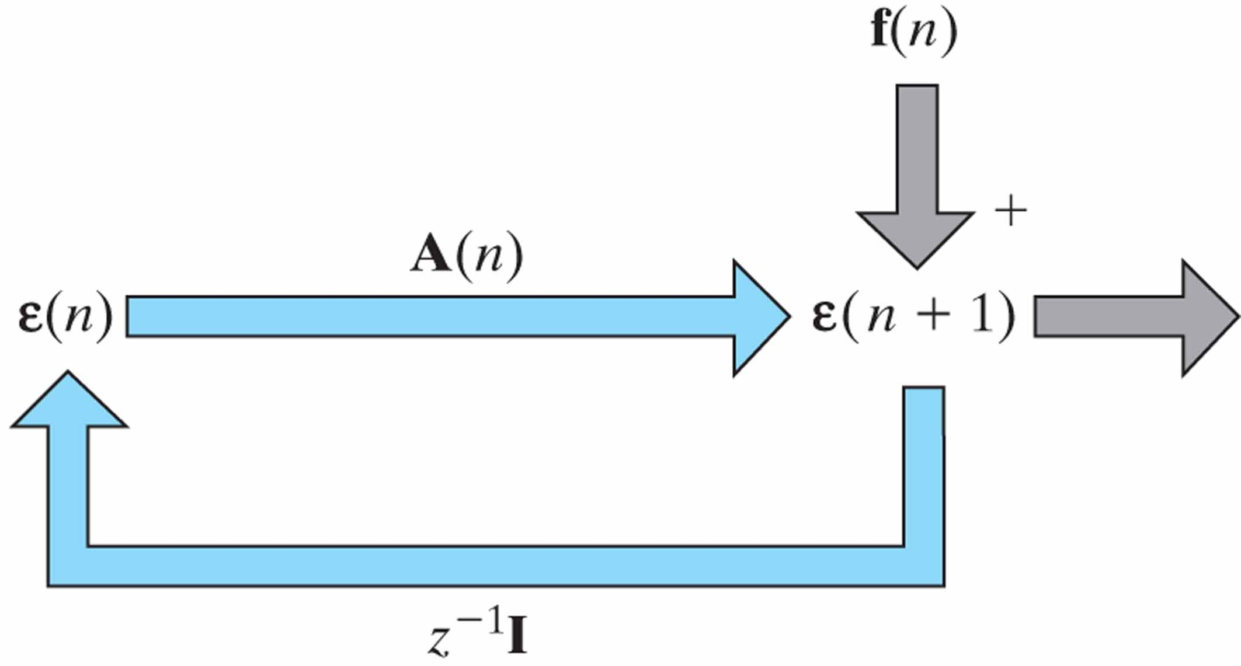
Figure 3.4 Signal-flow graph representation of the Markov model described in Eq. (3.41); the graph embodies feedback depicted in color.

Slide 7
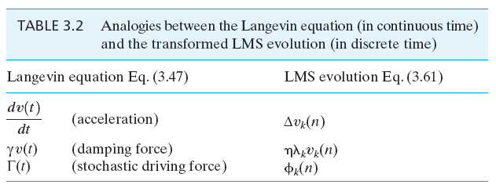
Table 3.2

Slide 8
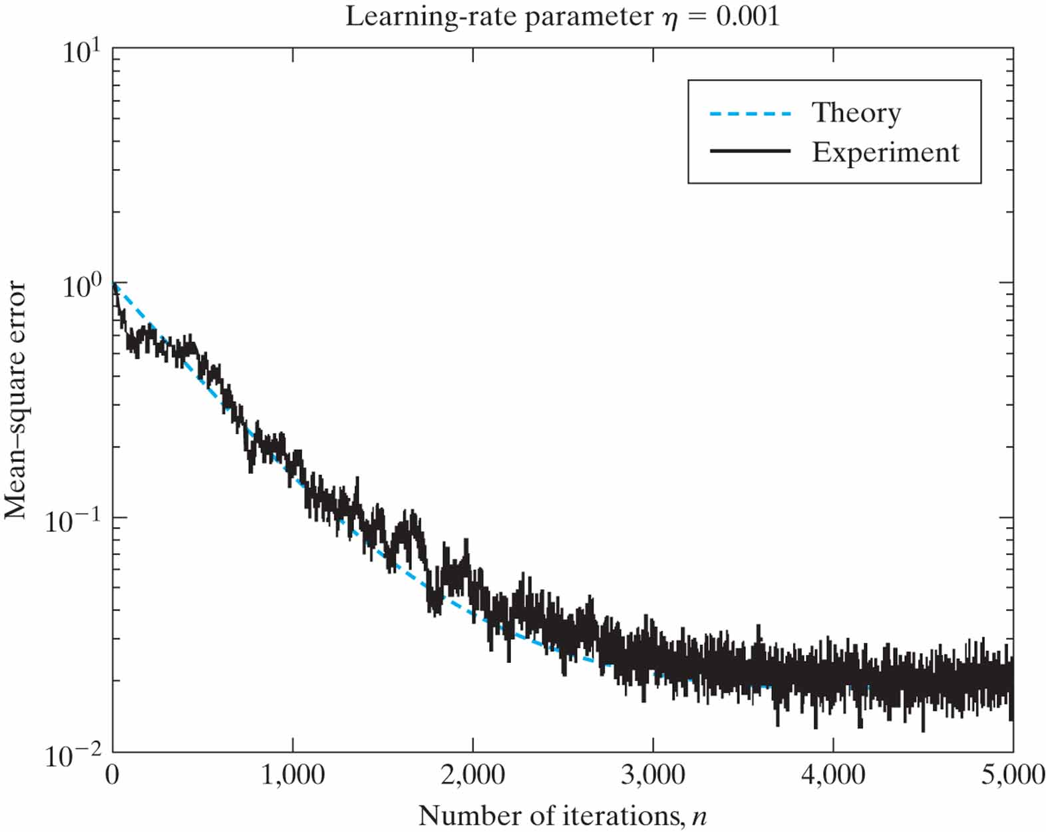
Figure 3.5 Experimental verification of the small-learning-rate-parameter theory of the LMS algorithm applied to an autoregressive process of order one.

Slide 9
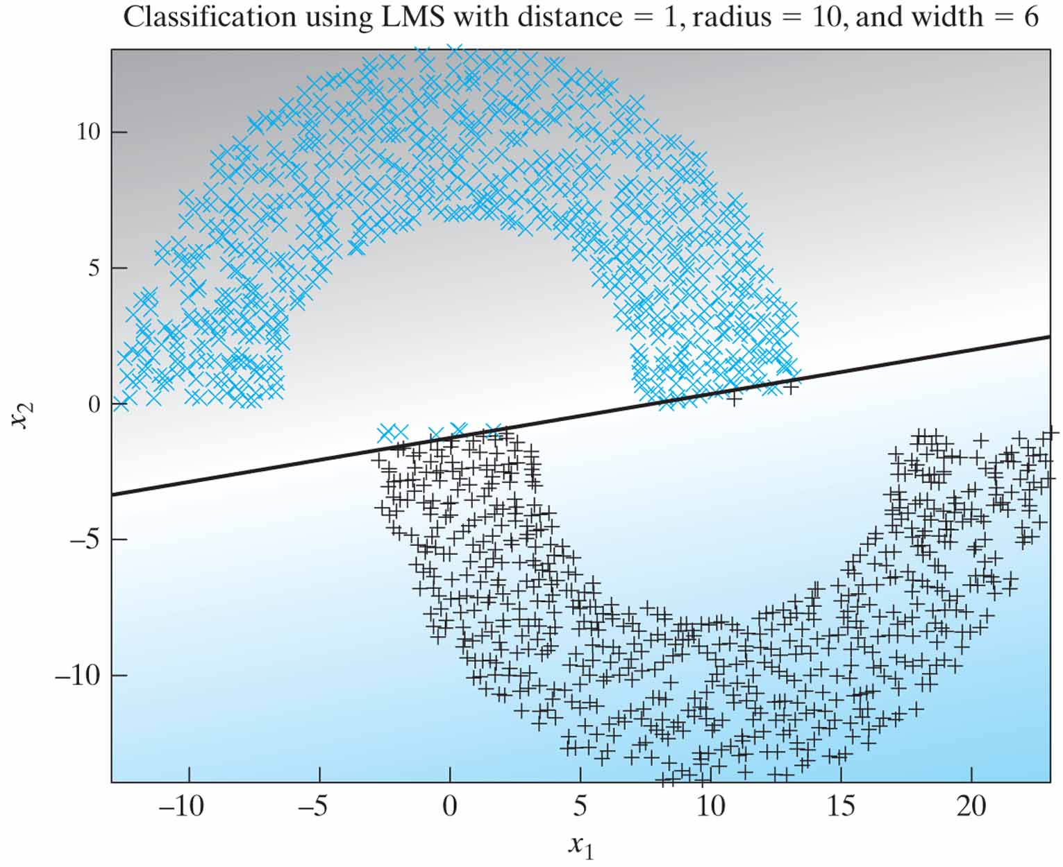
Figure 3.6 LMS classification with distance 1, based on the double-moon configuration of Fig. 1.8.

Slide 10
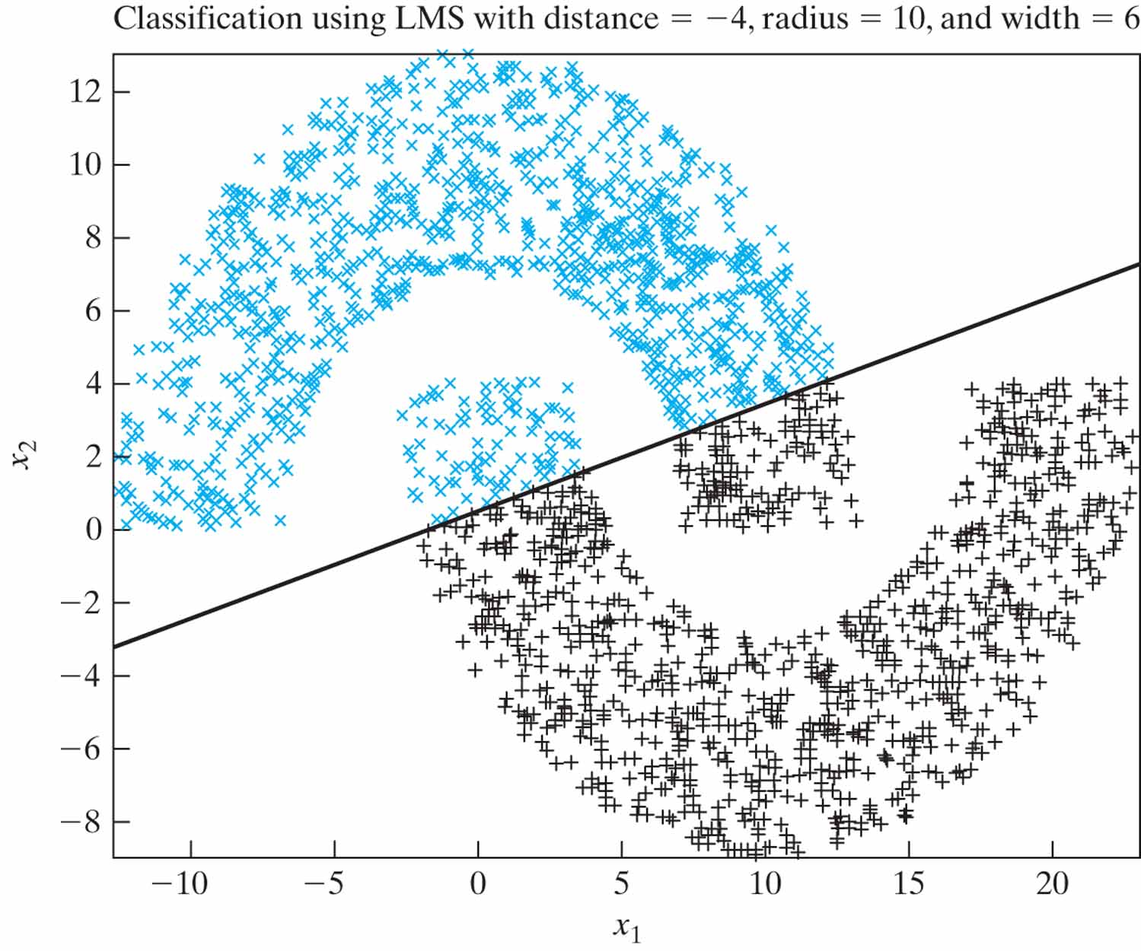
Figure 3.7 LMS classification with distance –4, based on the double-moon configuration of Fig. 1.8.

Slide 11
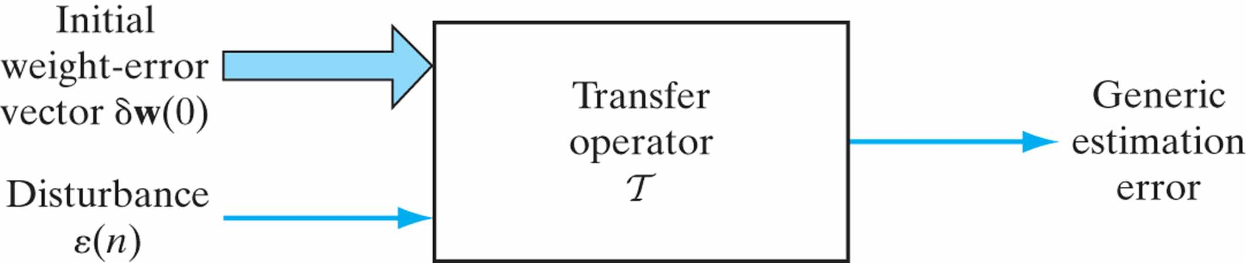
Figure 3.8 Formulation of the optimal H∞ estimation problem. The generic estimation error at the transfer operator’s output could be the weight-error vector, the explanational error, etc.

Slide 12
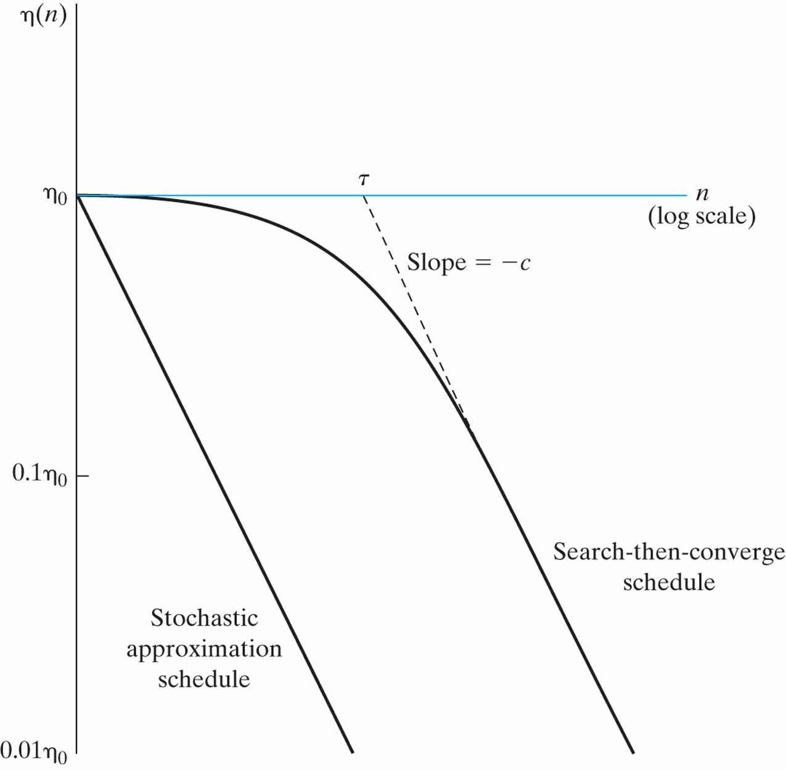
Figure 3.9 Learning-rate annealing schedules: The horizontal axis, printed in color, pertains to the standard LMS algorithm.

