Slide 1
Chapter 4
Multilayer Perceptrons

Slide 2
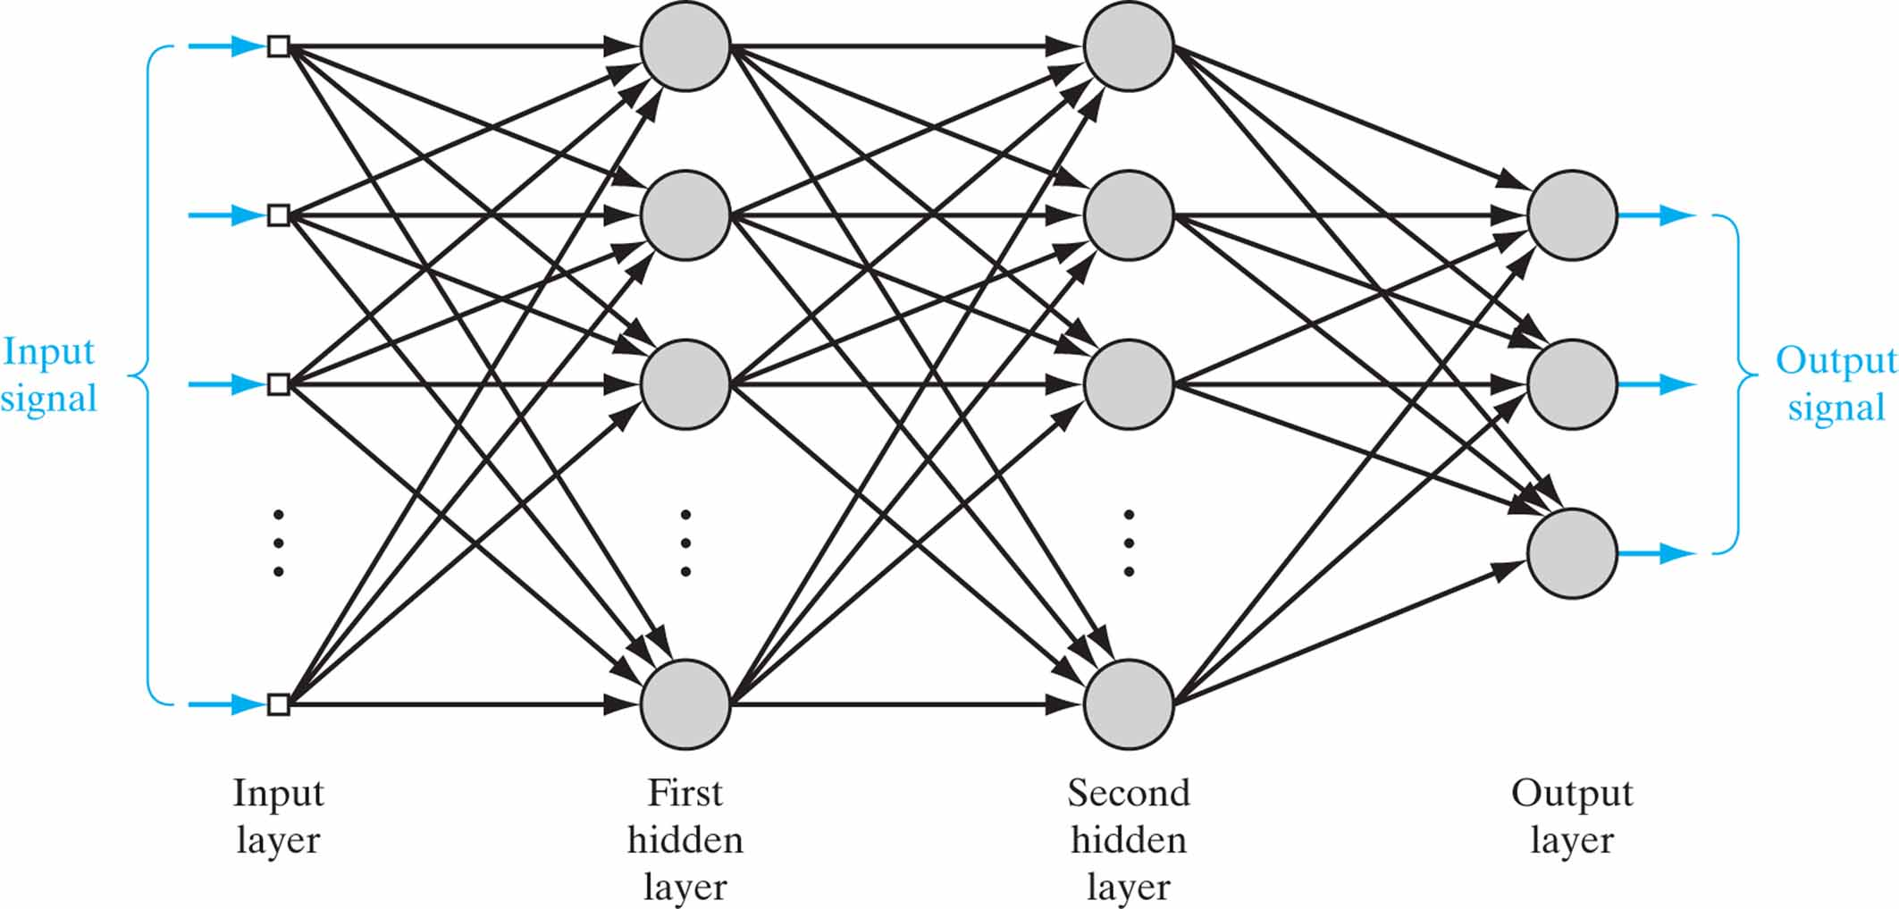
Figure 4.1 Architectural graph of a multilayer perceptron with two hidden layers.

Slide 3
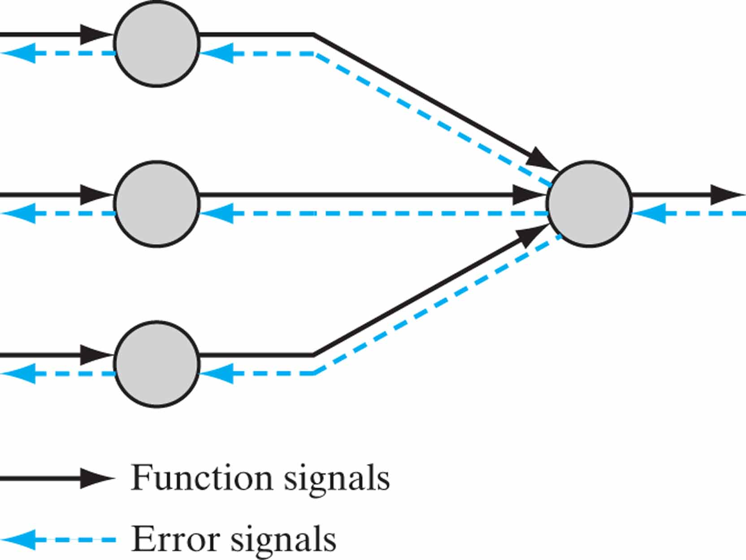
Figure 4.2 Illustration of the directions of two basic signal flows in a multilayer perceptron: forward propagation of function signals and back propagation of error signals.

Slide 4
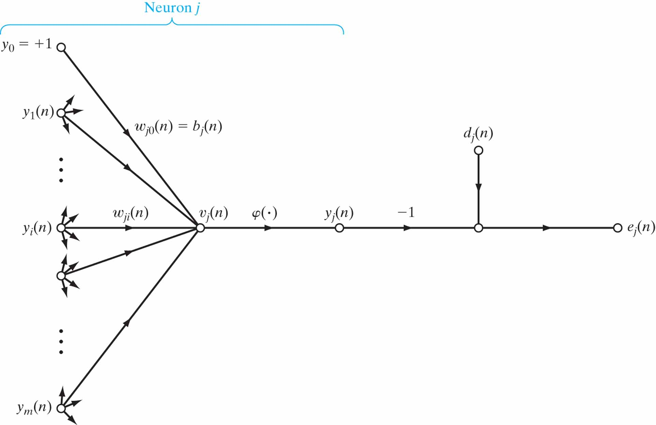
Figure 4.3 Signal-flow graph highlighting the details of output neuron j.

Slide 5
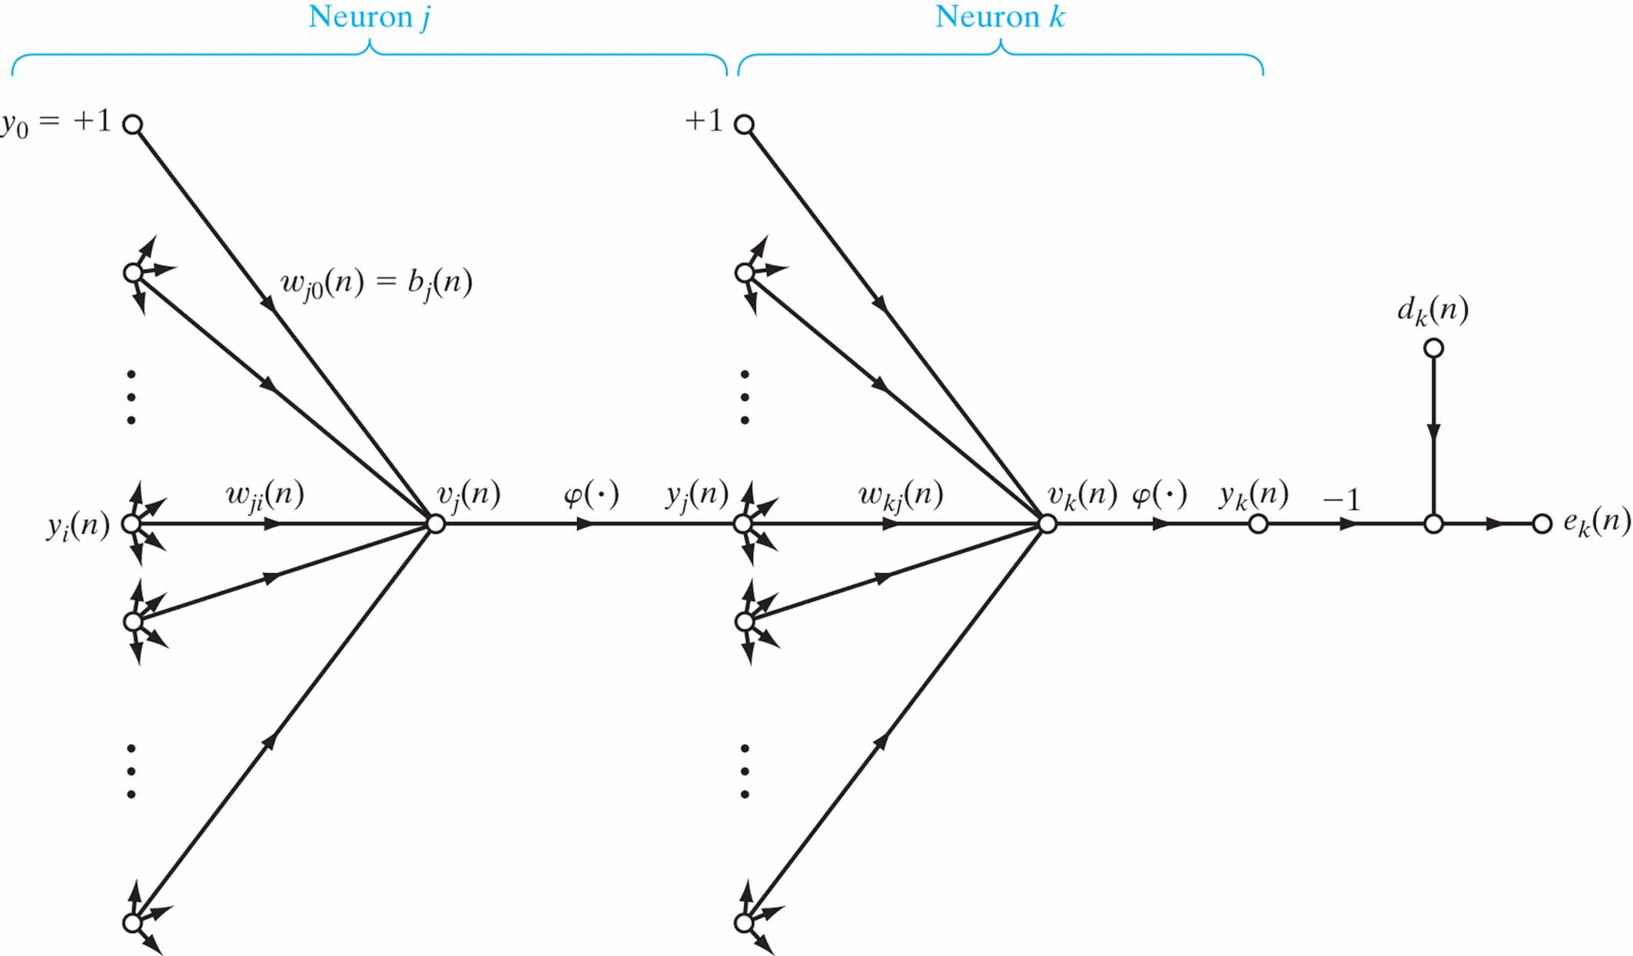
Figure 4.4 Signal-flow graph highlighting the details of output neuron k connected to hidden neuron j.

Slide 6
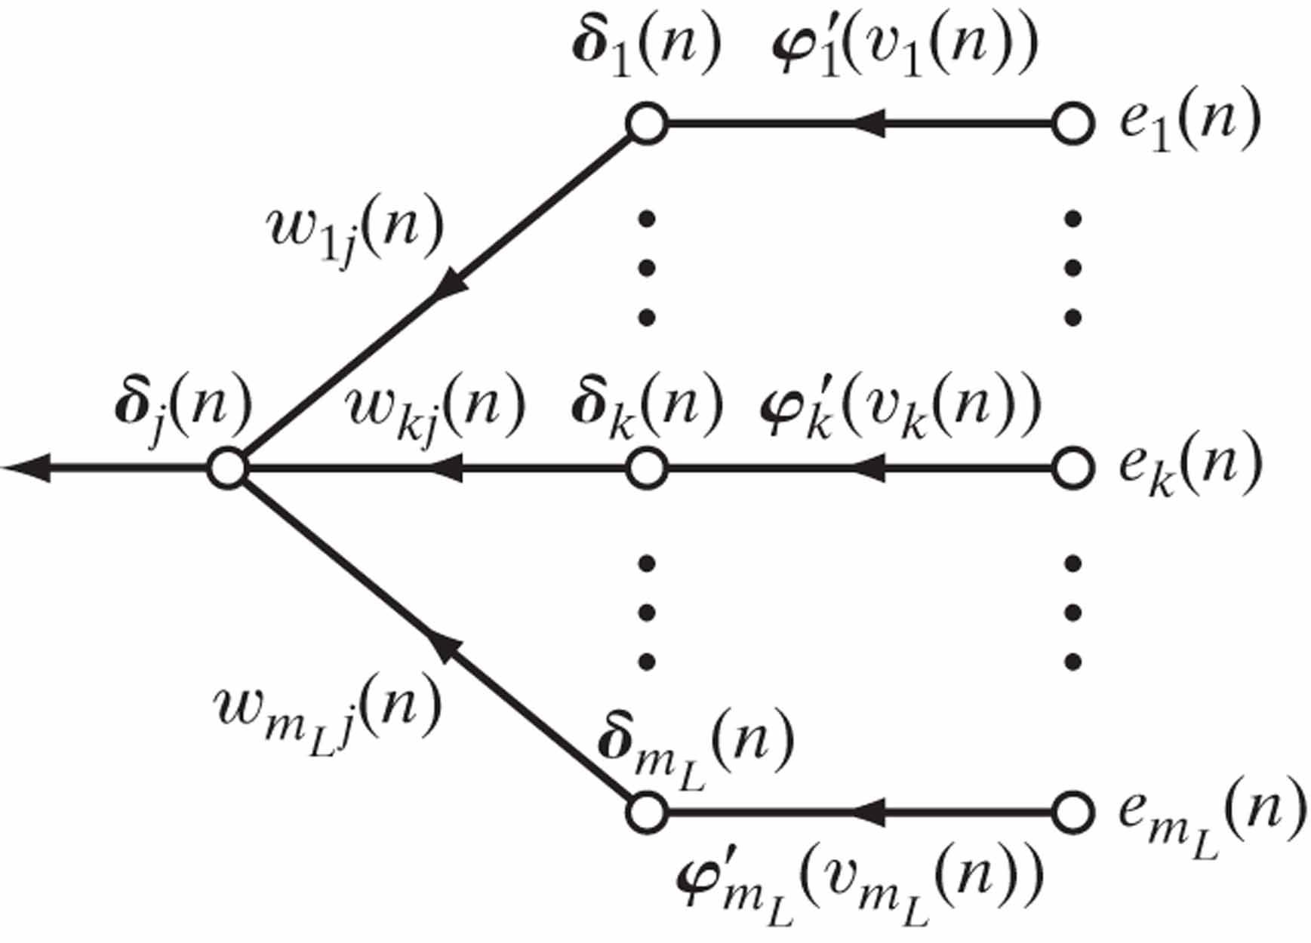
Figure 4.5 Signal-flow graph of a part of the adjoint system pertaining to back-propagation of error signals.

Slide 7
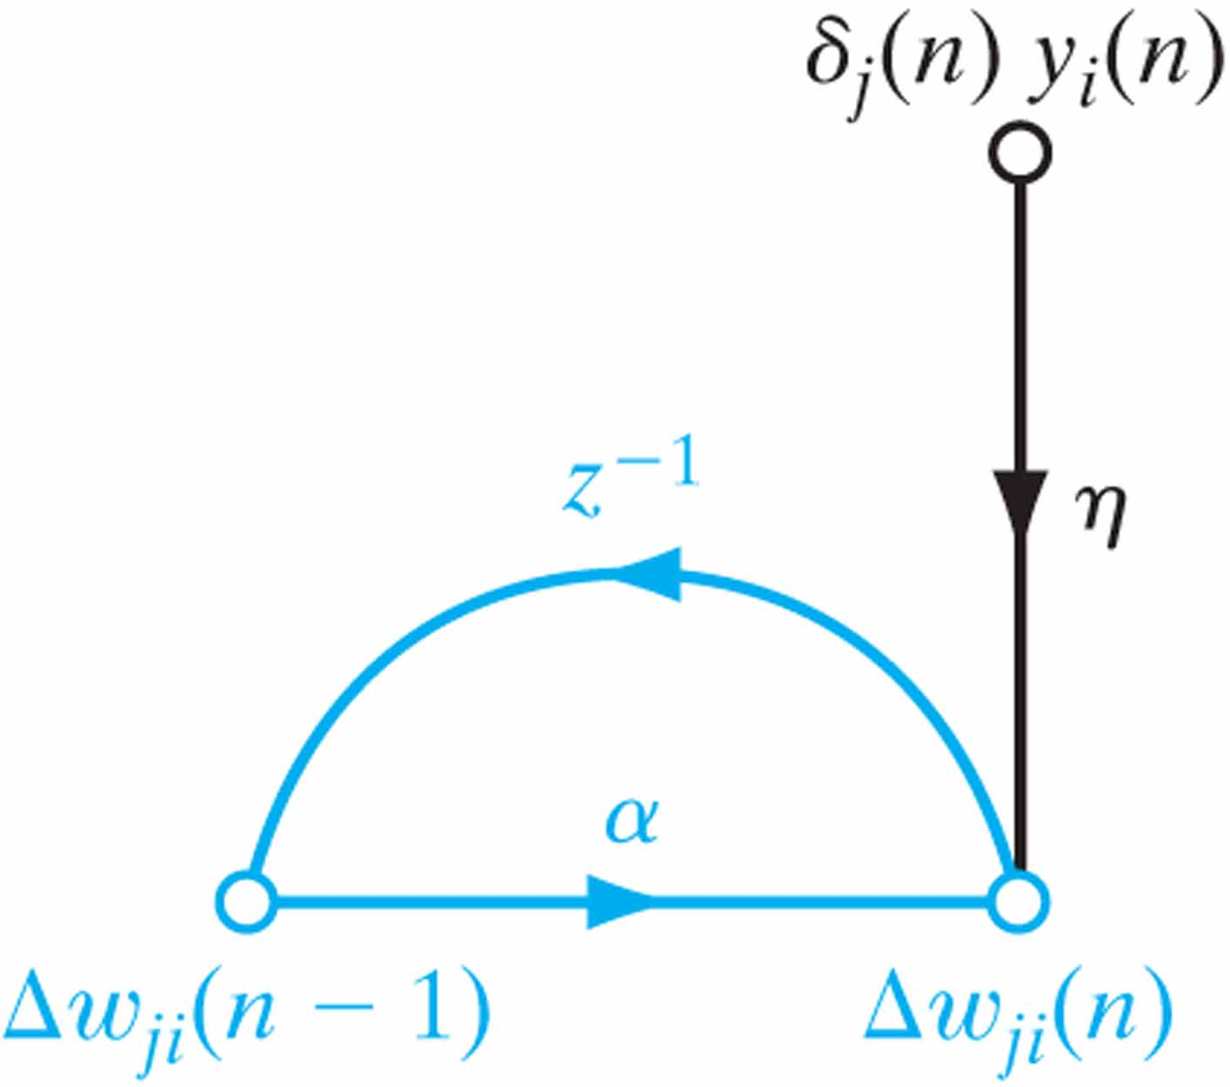
Figure 4.6 Signal-flow graph illustrating the effect of momentum constant α, which lies inside the feedback loop.

Slide 8
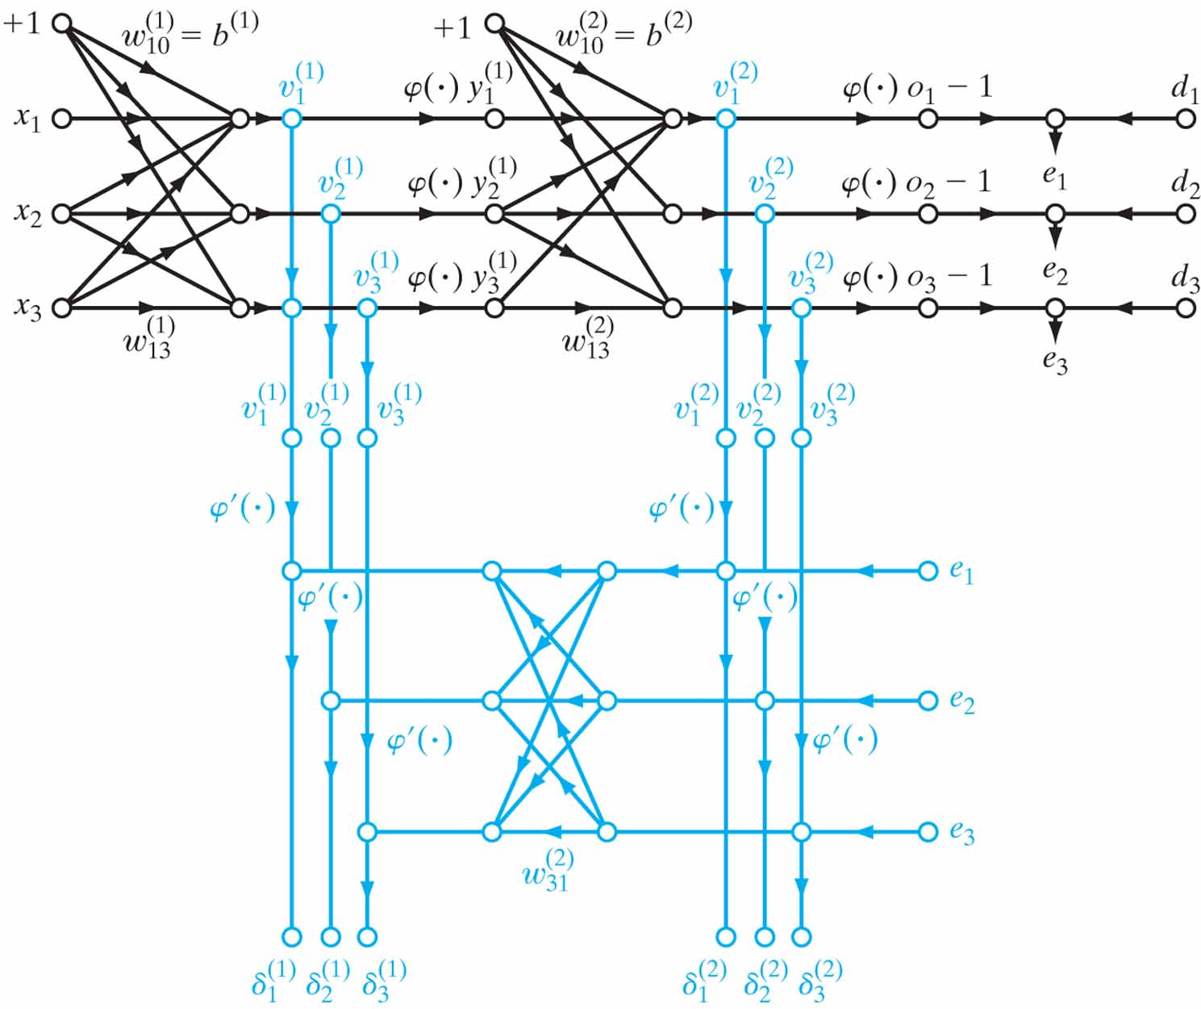
Figure 4.7 Signal-flow graphical summary of back-propagation learning. Top part of the graph: forward pass.
Bottom part of the graph: backward pass.

Slide 9
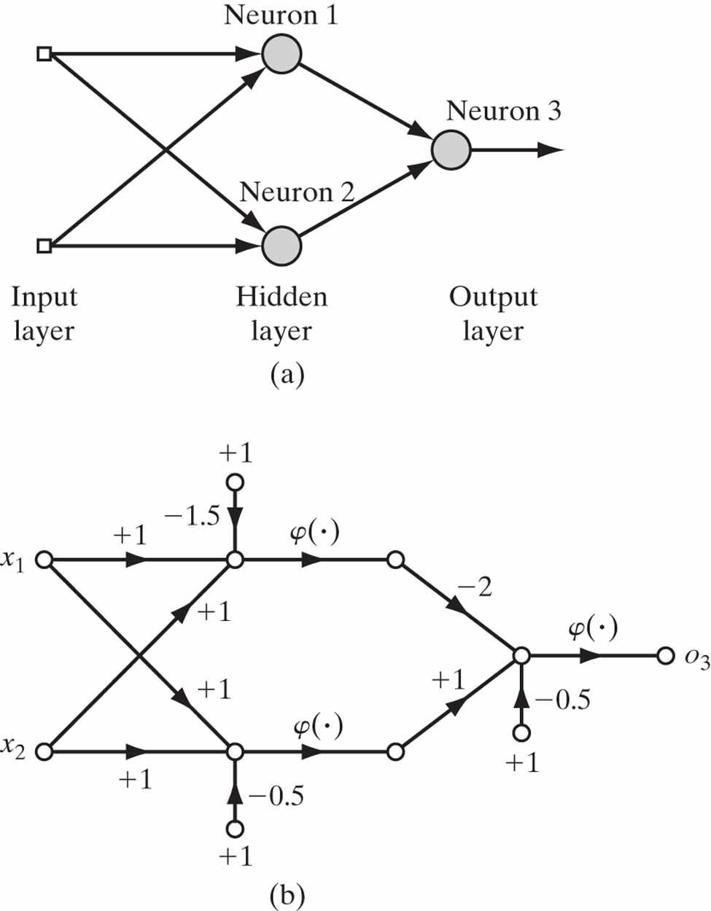
Figure 4.8 (a) Architectural graph of network for solving the XOR problem. (b) Signal-flow graph of the network.

Slide 10
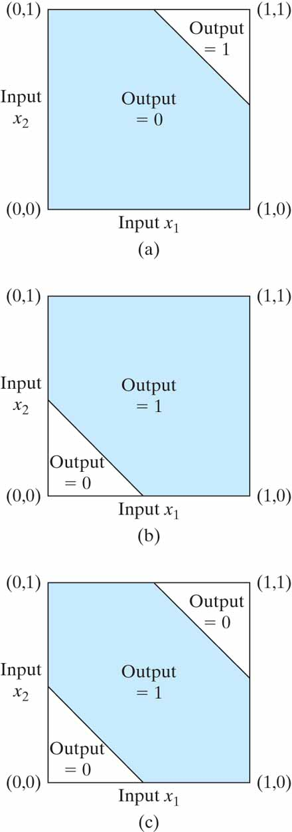
Figure 4.9 (a) Decision boundary constructed by hidden neuron 1 of the network in Fig. 4.8. (b) Decision boundary constructed by hidden neuron 2 of the network. (c) Decision boundaries constructed by the complete network.

Slide 11
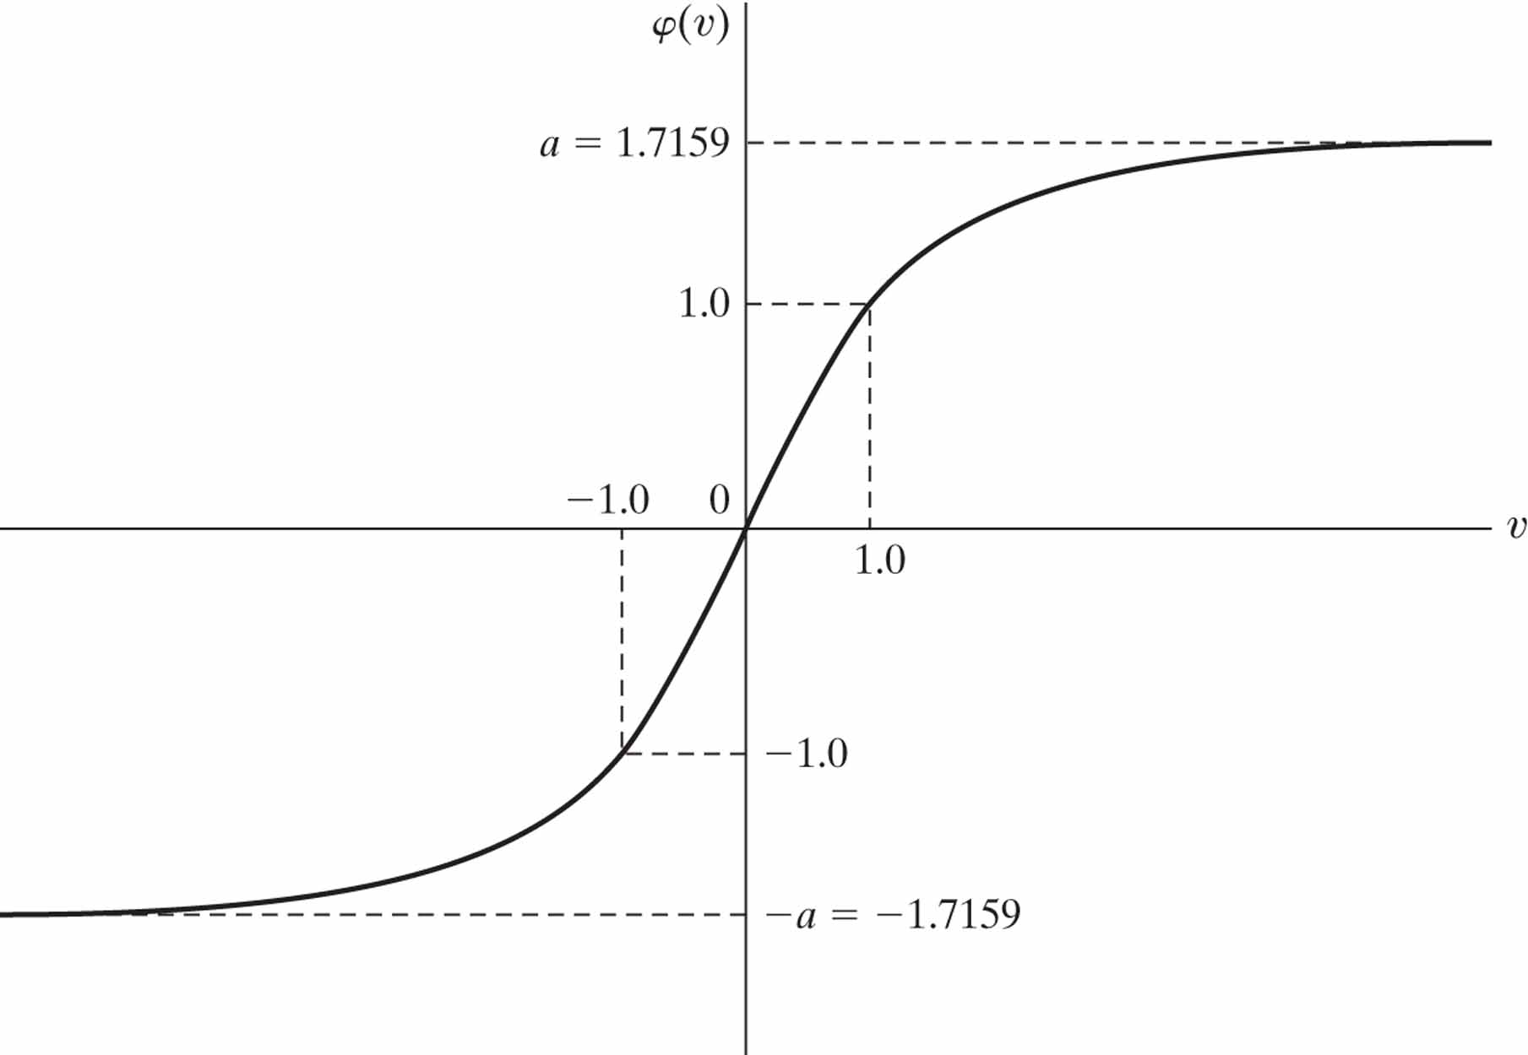
Figure 4.10 Graph of the hyperbolic tangent function φ(v) αtanh(bv) for α 1.7159 and b = 2/3.The recommended target values are +1 and –1.

Slide 12
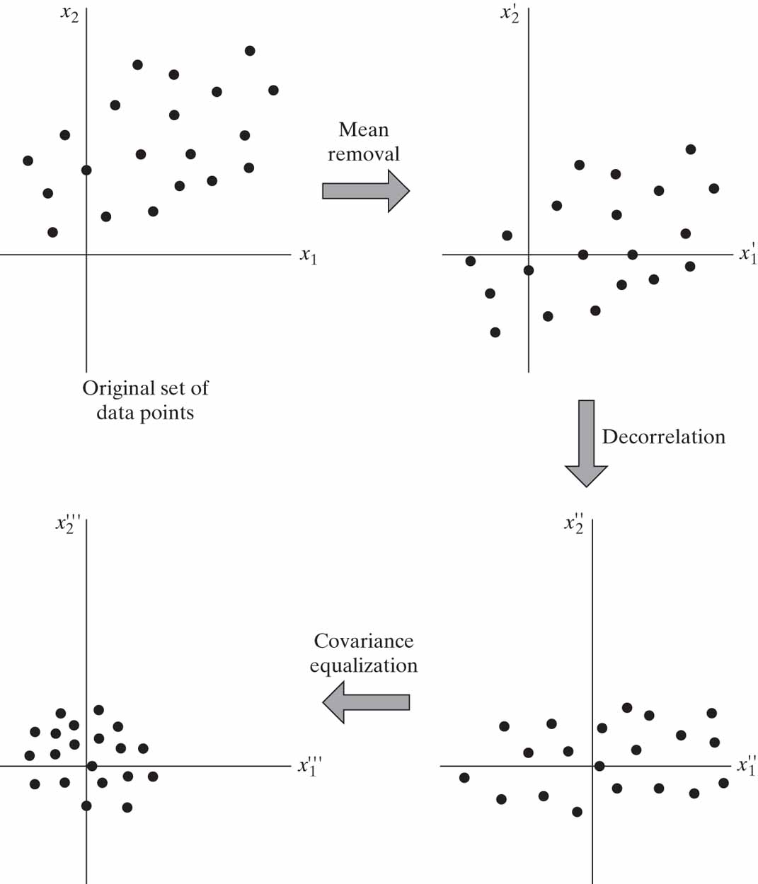
Figure 4.11 Illustrating the operation of mean removal, decorrelation, and covariance equalization for a two-dimensional input space.

Slide 13
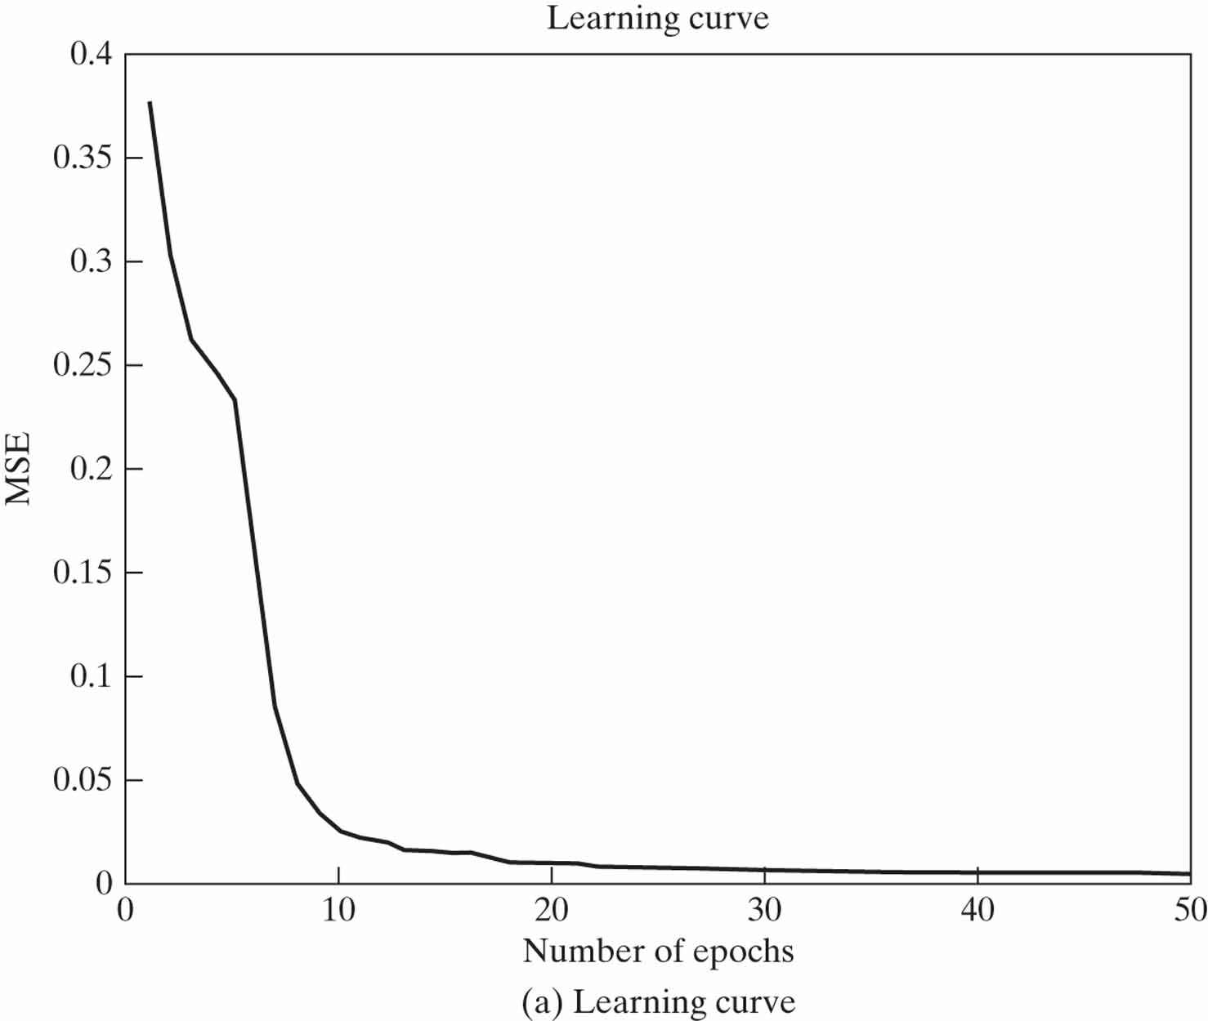
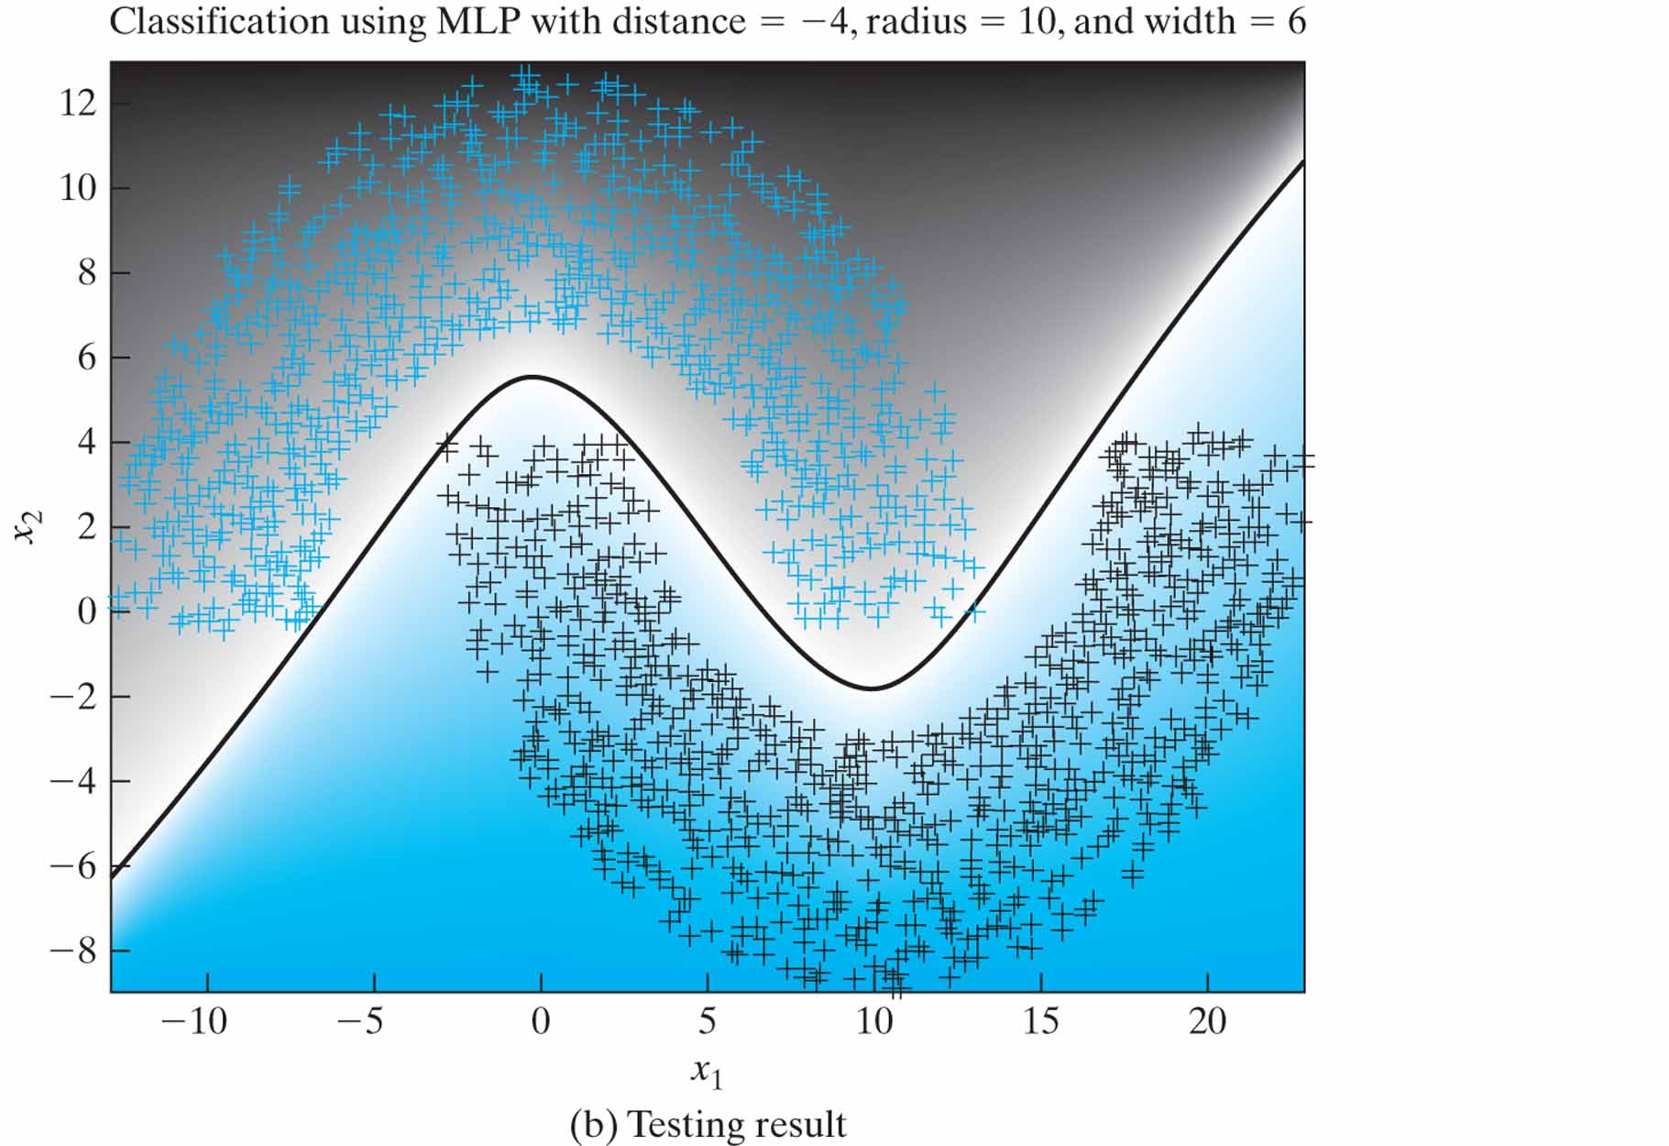
Figure 4.12 Results of the computer experiment on the back-propagation algorithm applied to the MLP with distance d = –4. MSE stands for mean-square error.

Slide 14
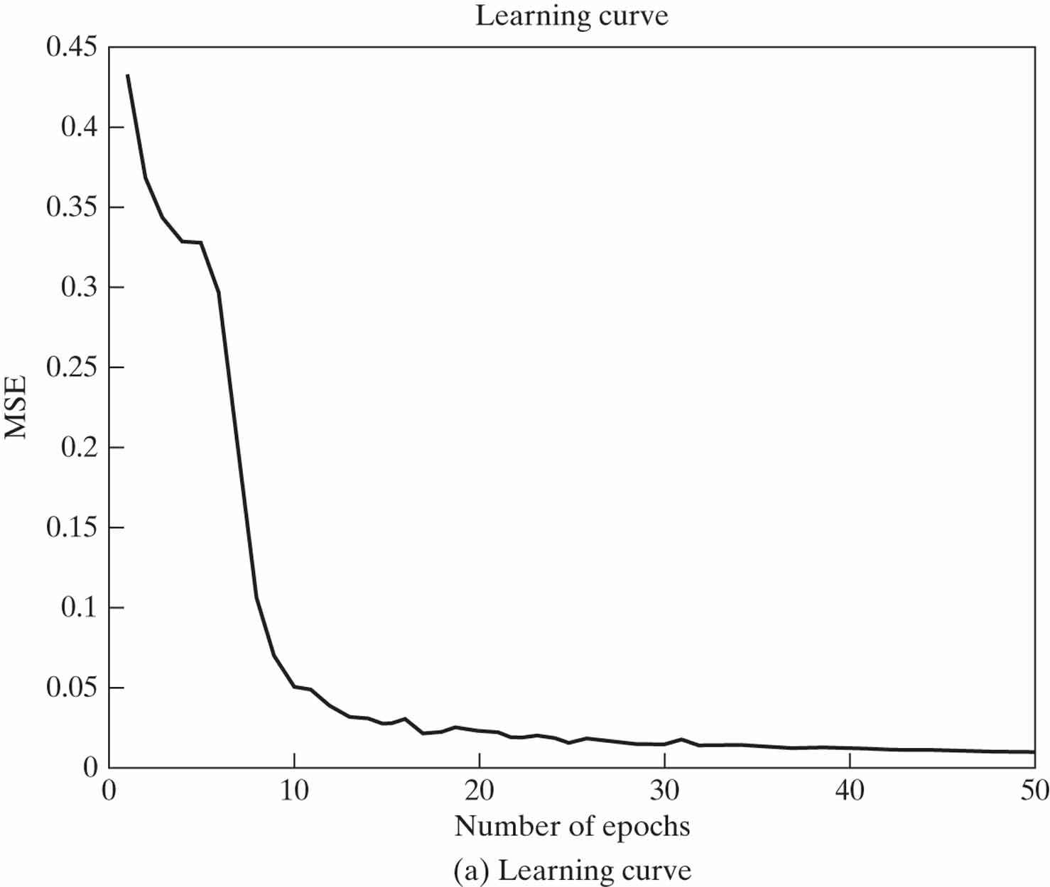
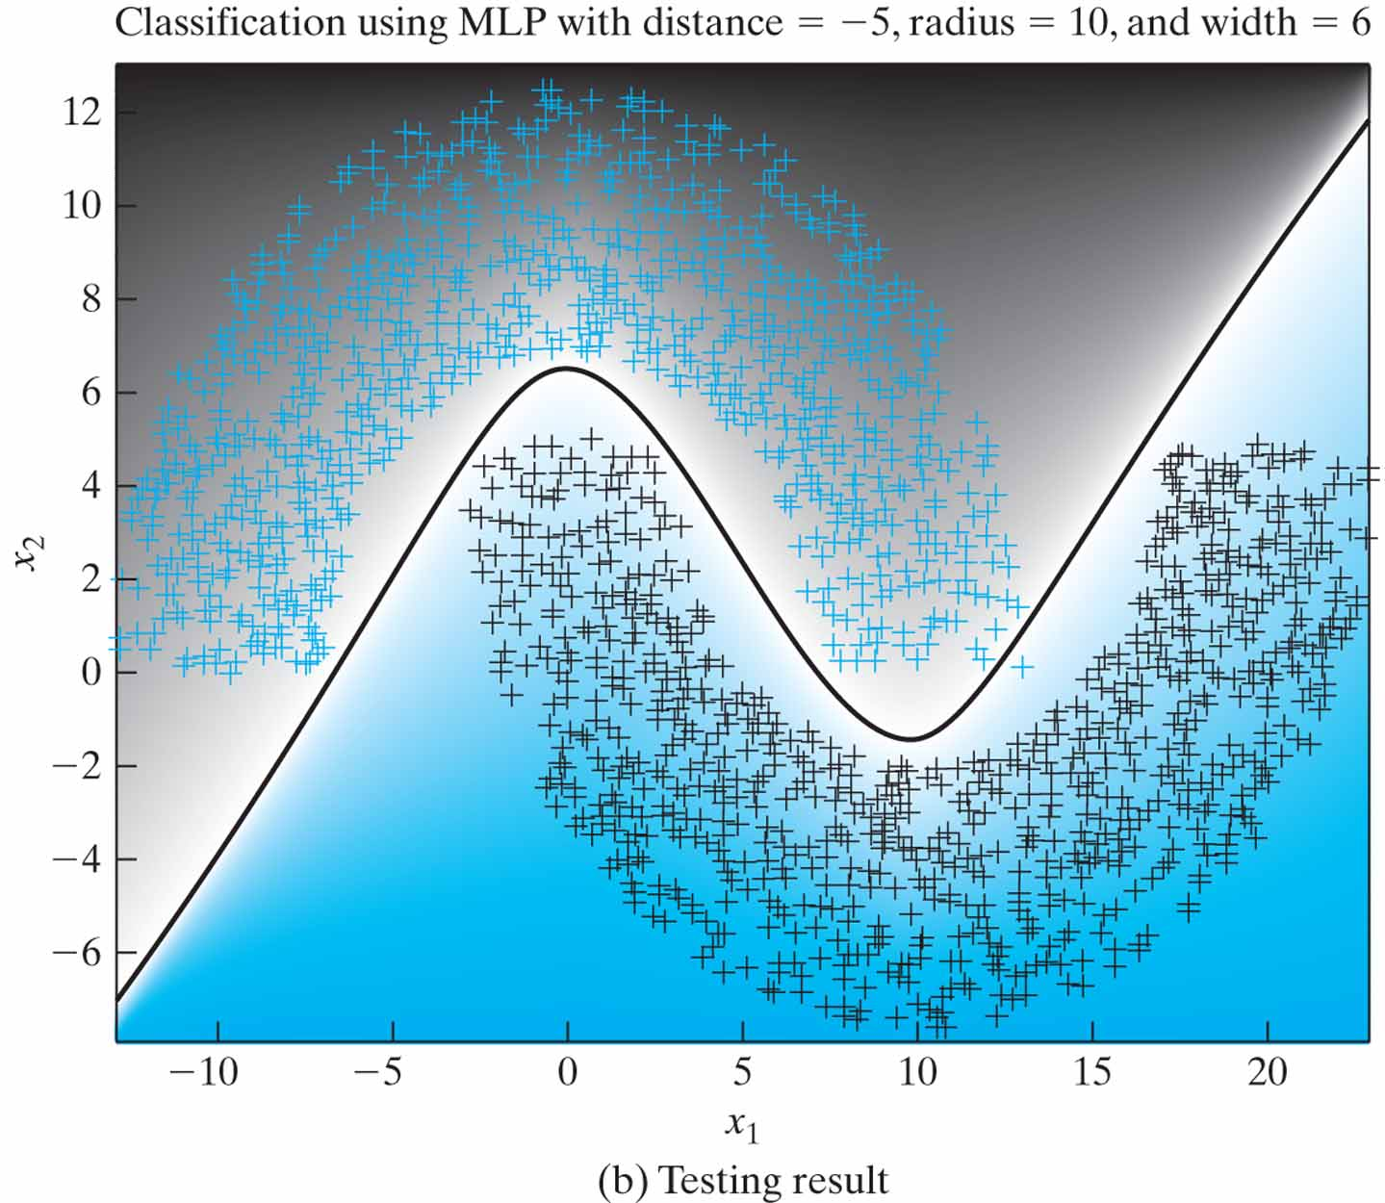
Figure 4.13 Results of the computer experiment on the back-propagation algorithm applied to the MLP with distance d = –5.

Slide 15
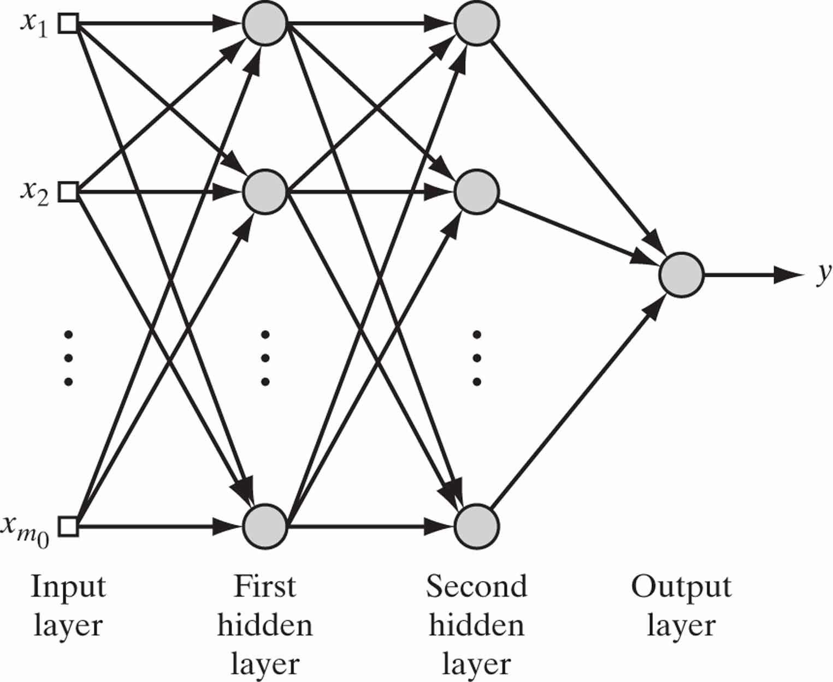
Figure 4.14 Multilayer perceptron with two hidden layers and one output neuron.

Slide 16
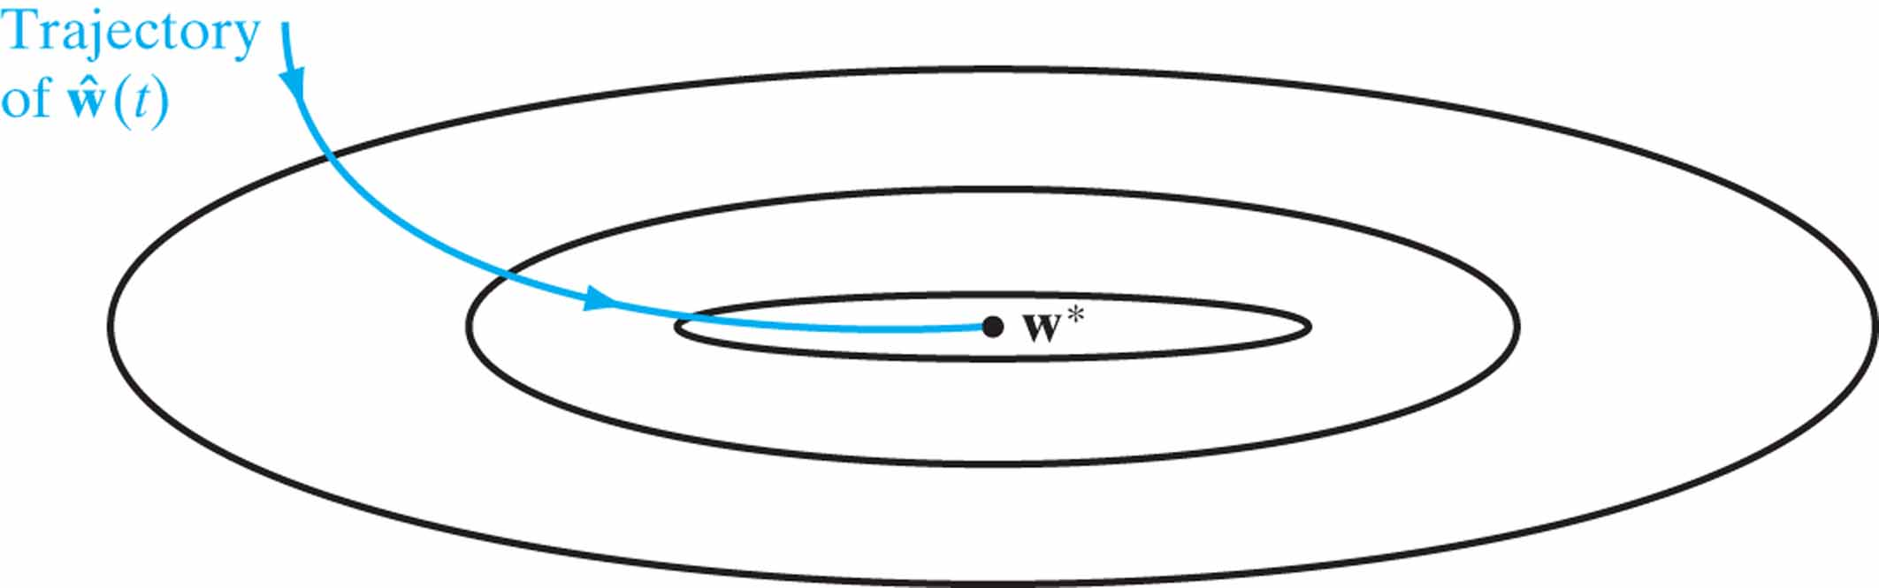
Figure 4.15 The evolution of the estimator ŵ (t) over time t. The ellipses represent contours of the expected risk for varying values of w, assumed to be two-dimensional.

Slide 17
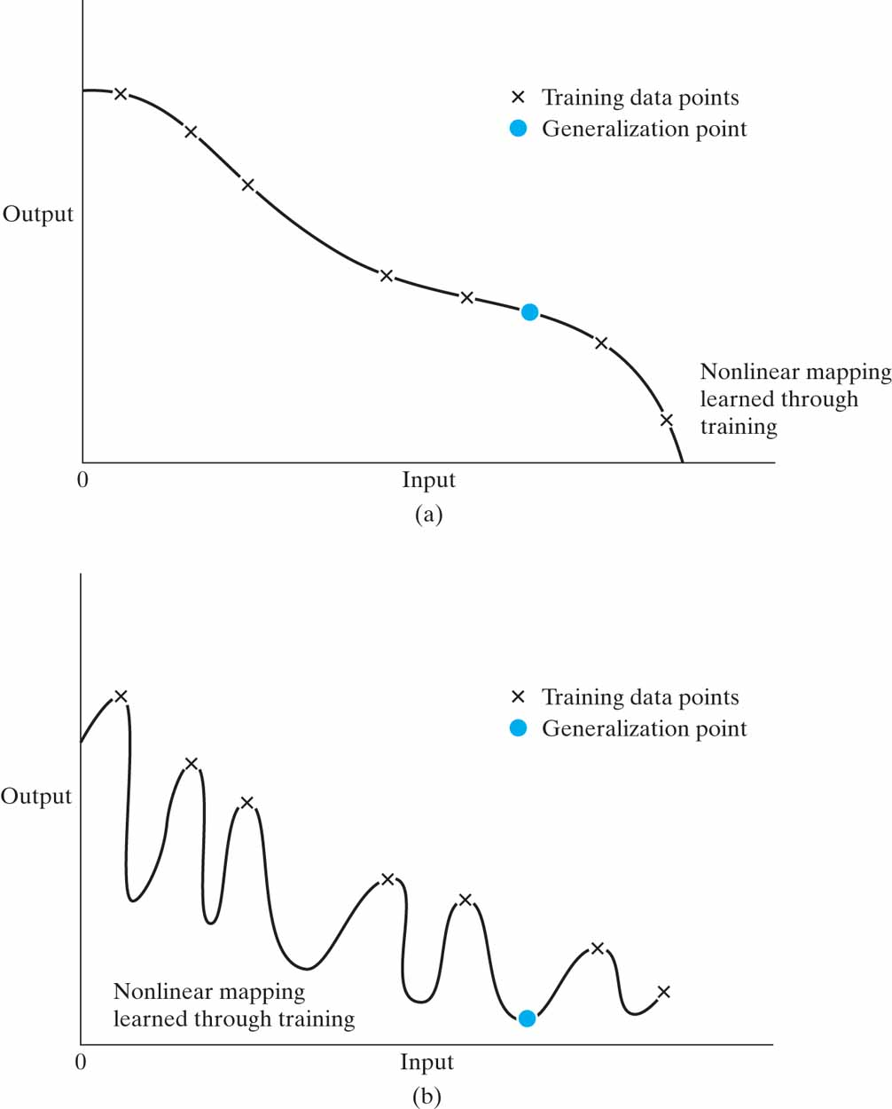
Figure 4.16 (a) Properly fitted nonlinear mapping with good generalization. (b) Overfitted nonlinear mapping with poor generalization.

Slide 18
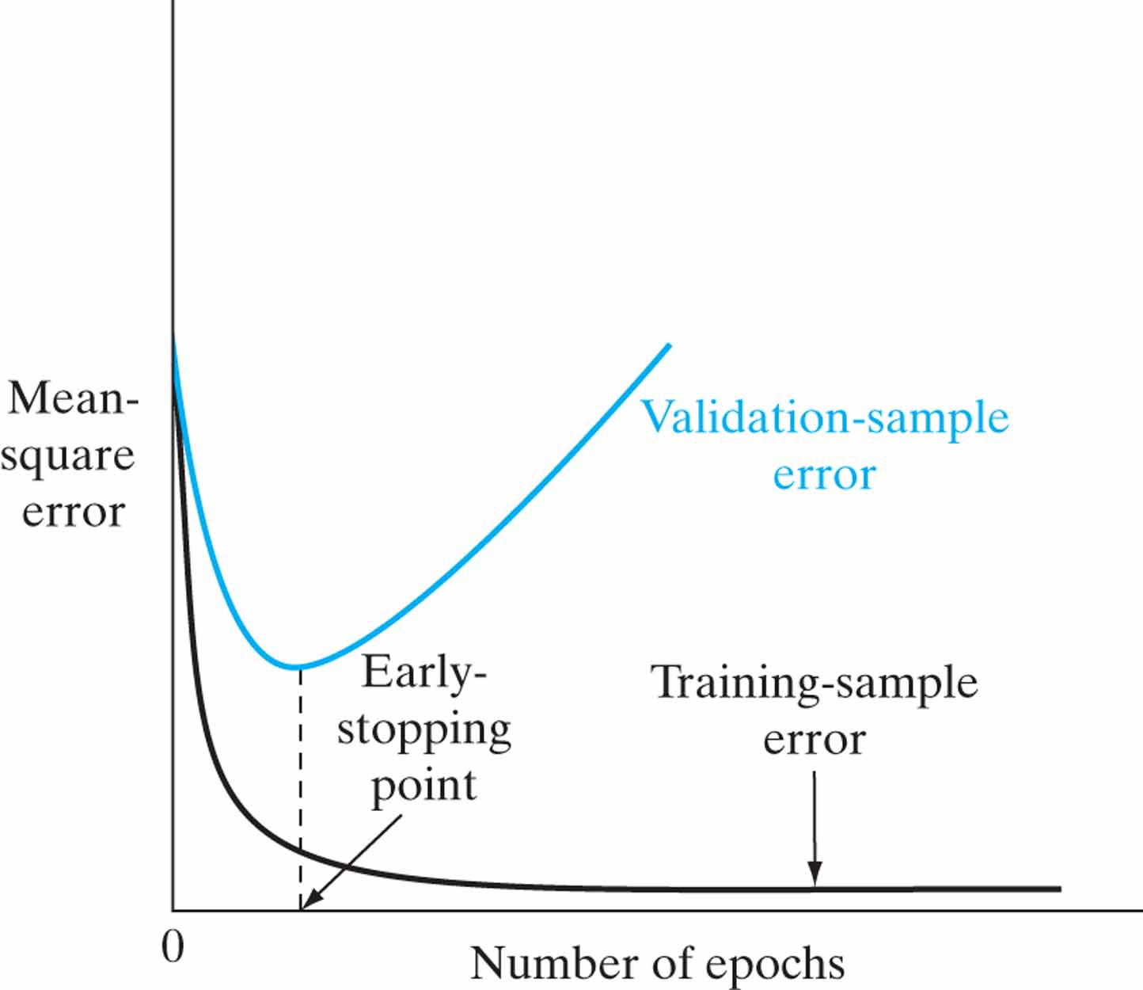
Figure 4.17 Illustration of the early-stopping rule based on cross-validation.

Slide 19
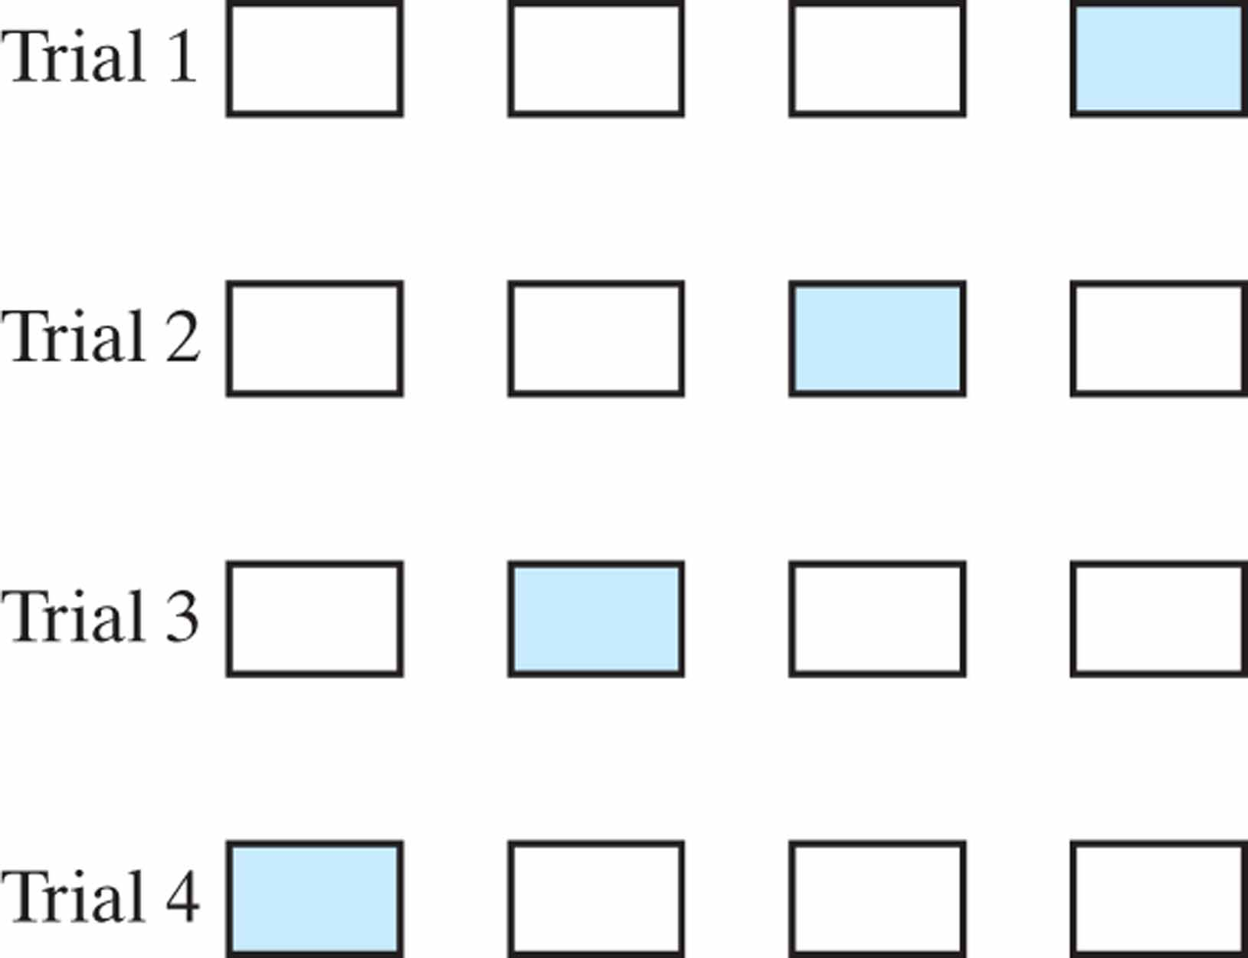
Figure 4.18 Illustration of the multifold method of cross-validation. For a given trial, the subset of data shaded in red is used to validate the model trained on the remaining data.

Slide 20
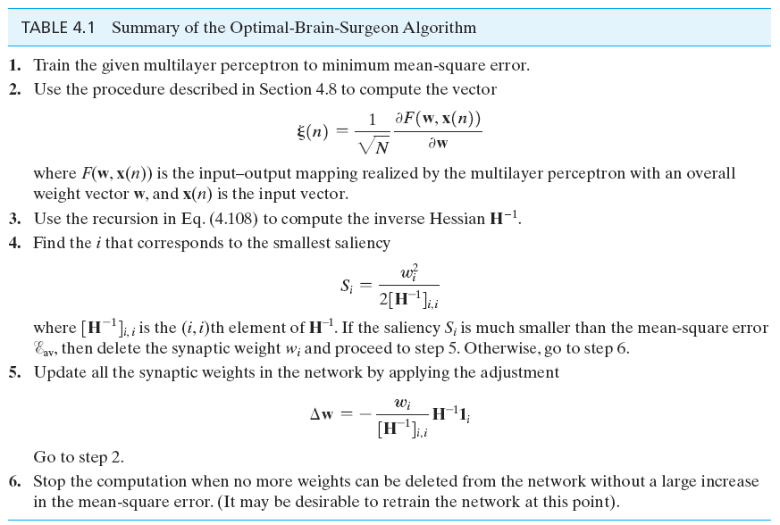
Table 4.1

Slide 21
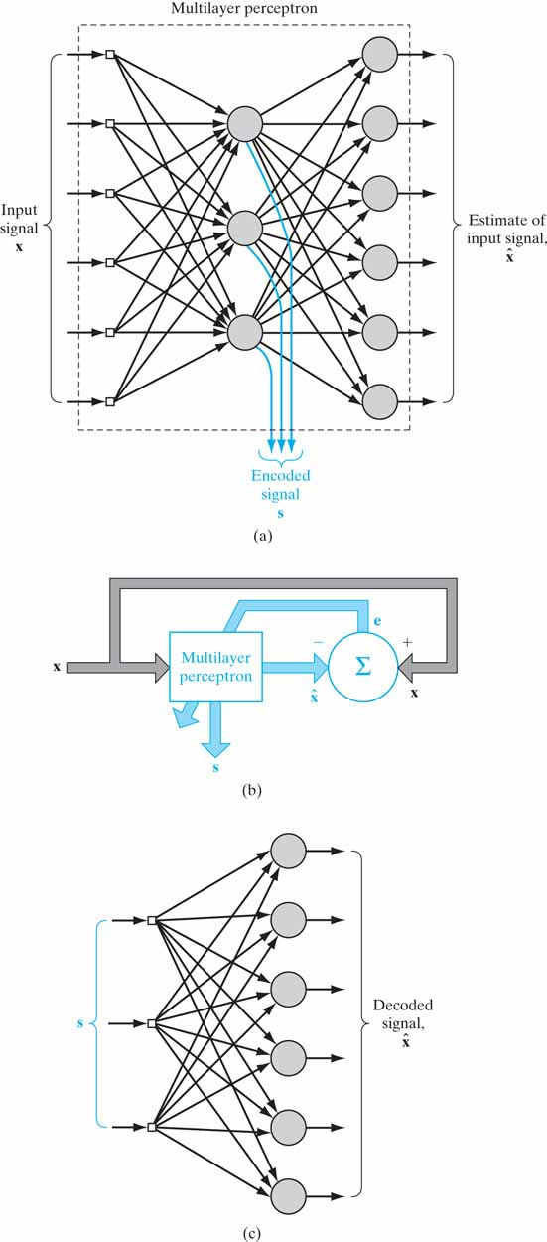
Figure 4.19 (a) Replicator network (identity map) with a single hidden layer used as an encoder. (b) Block diagram for the supervised training of the replicator network. (c) Part of the replicator network used as a decoder.

Slide 22
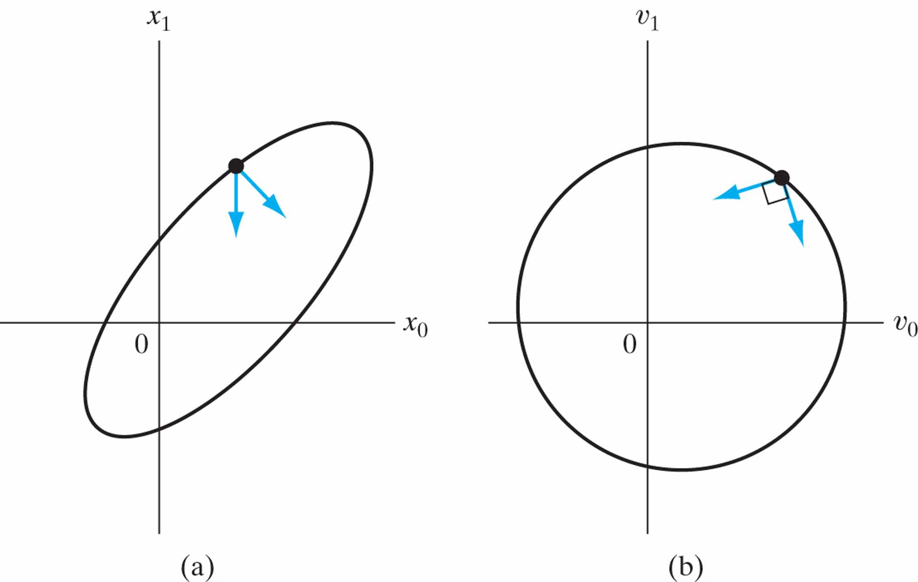
Figure 4.20 Interpretation of A-conjugate vectors. (a) Elliptic locus in two-dimensional weight space.
(b) Transformation of the elliptic locus into a circular locus.

Slide 23
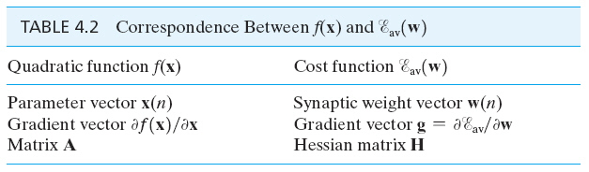
Table 4.2

Slide 24
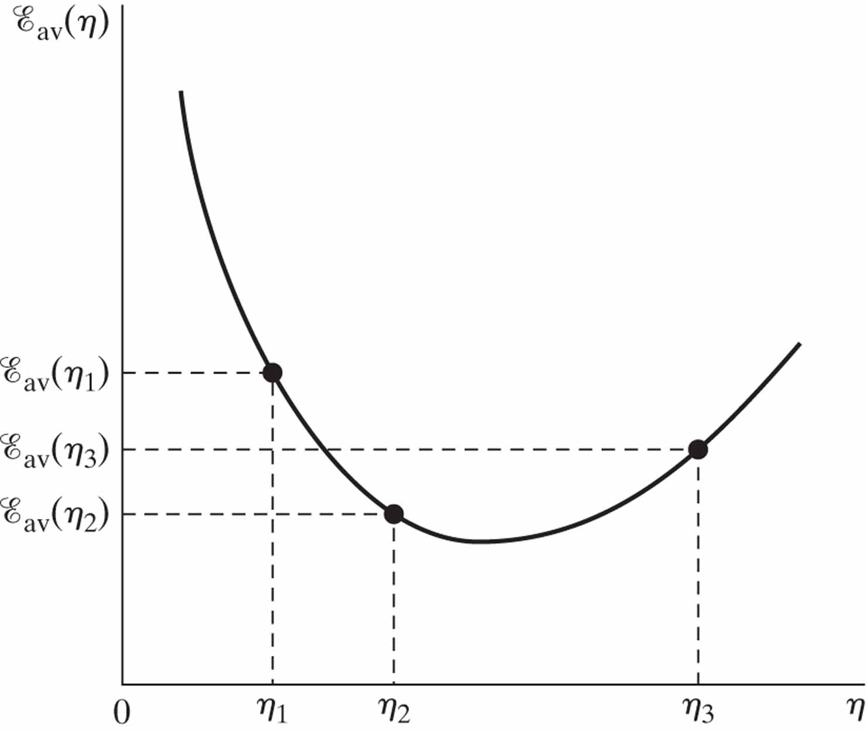
Figure 4.21 Illustration of the line search.

Slide 25
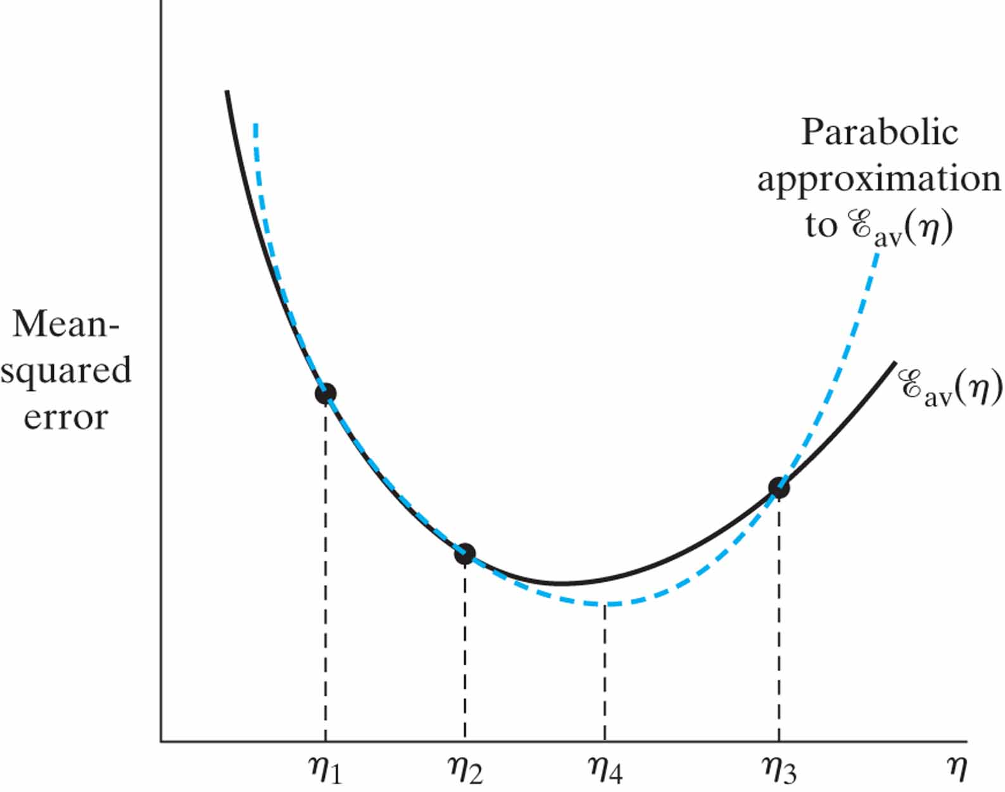
Figure 4.22 Inverse parabolic interpolation.

Slide 26
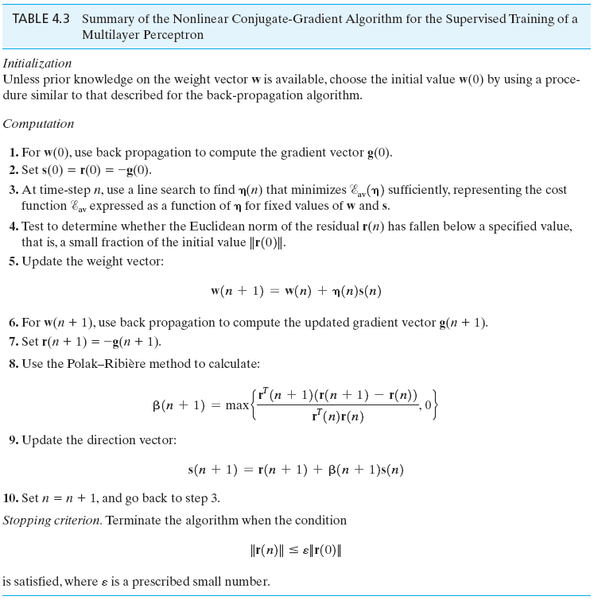
Table 4.3

Slide 27
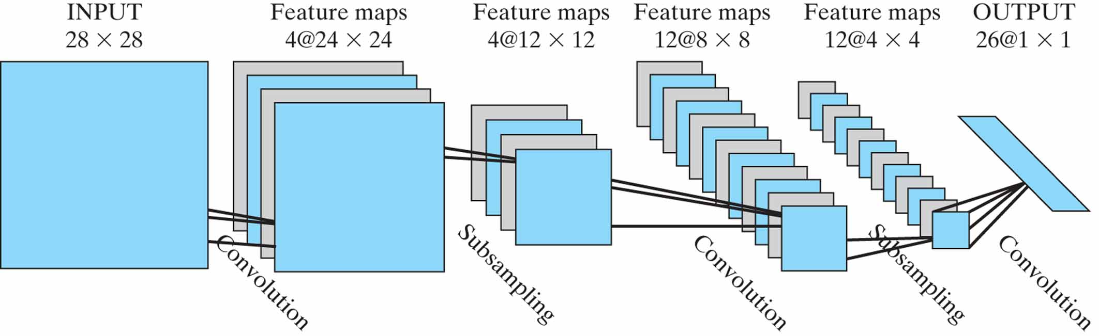
Figure 4.23 Convolutional network for image processing such as handwriting recognition. (Reproduced with permission of MIT Press.)

Slide 28
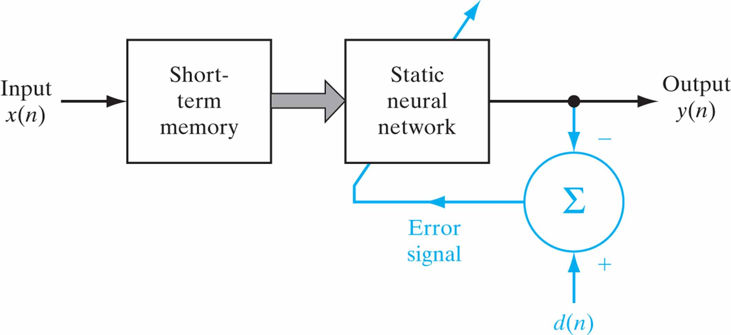
Figure 4.24 Nonlinear filter built on a static neural network.

Slide 29
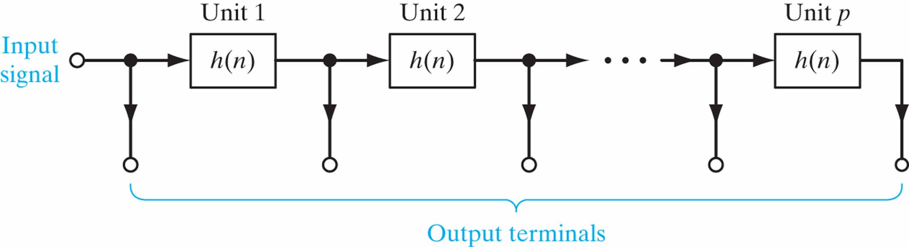
Figure 4.25 Generalized tapped-delay-line memory of order p.

Slide 30
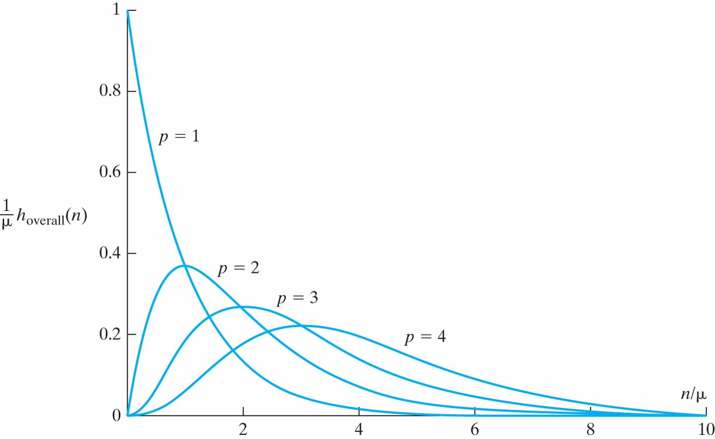
Figure 4.26 Family of impulse responses of the gamma memory for order p 1, 2, 3, 4 and μ = 0.7.

Slide 31
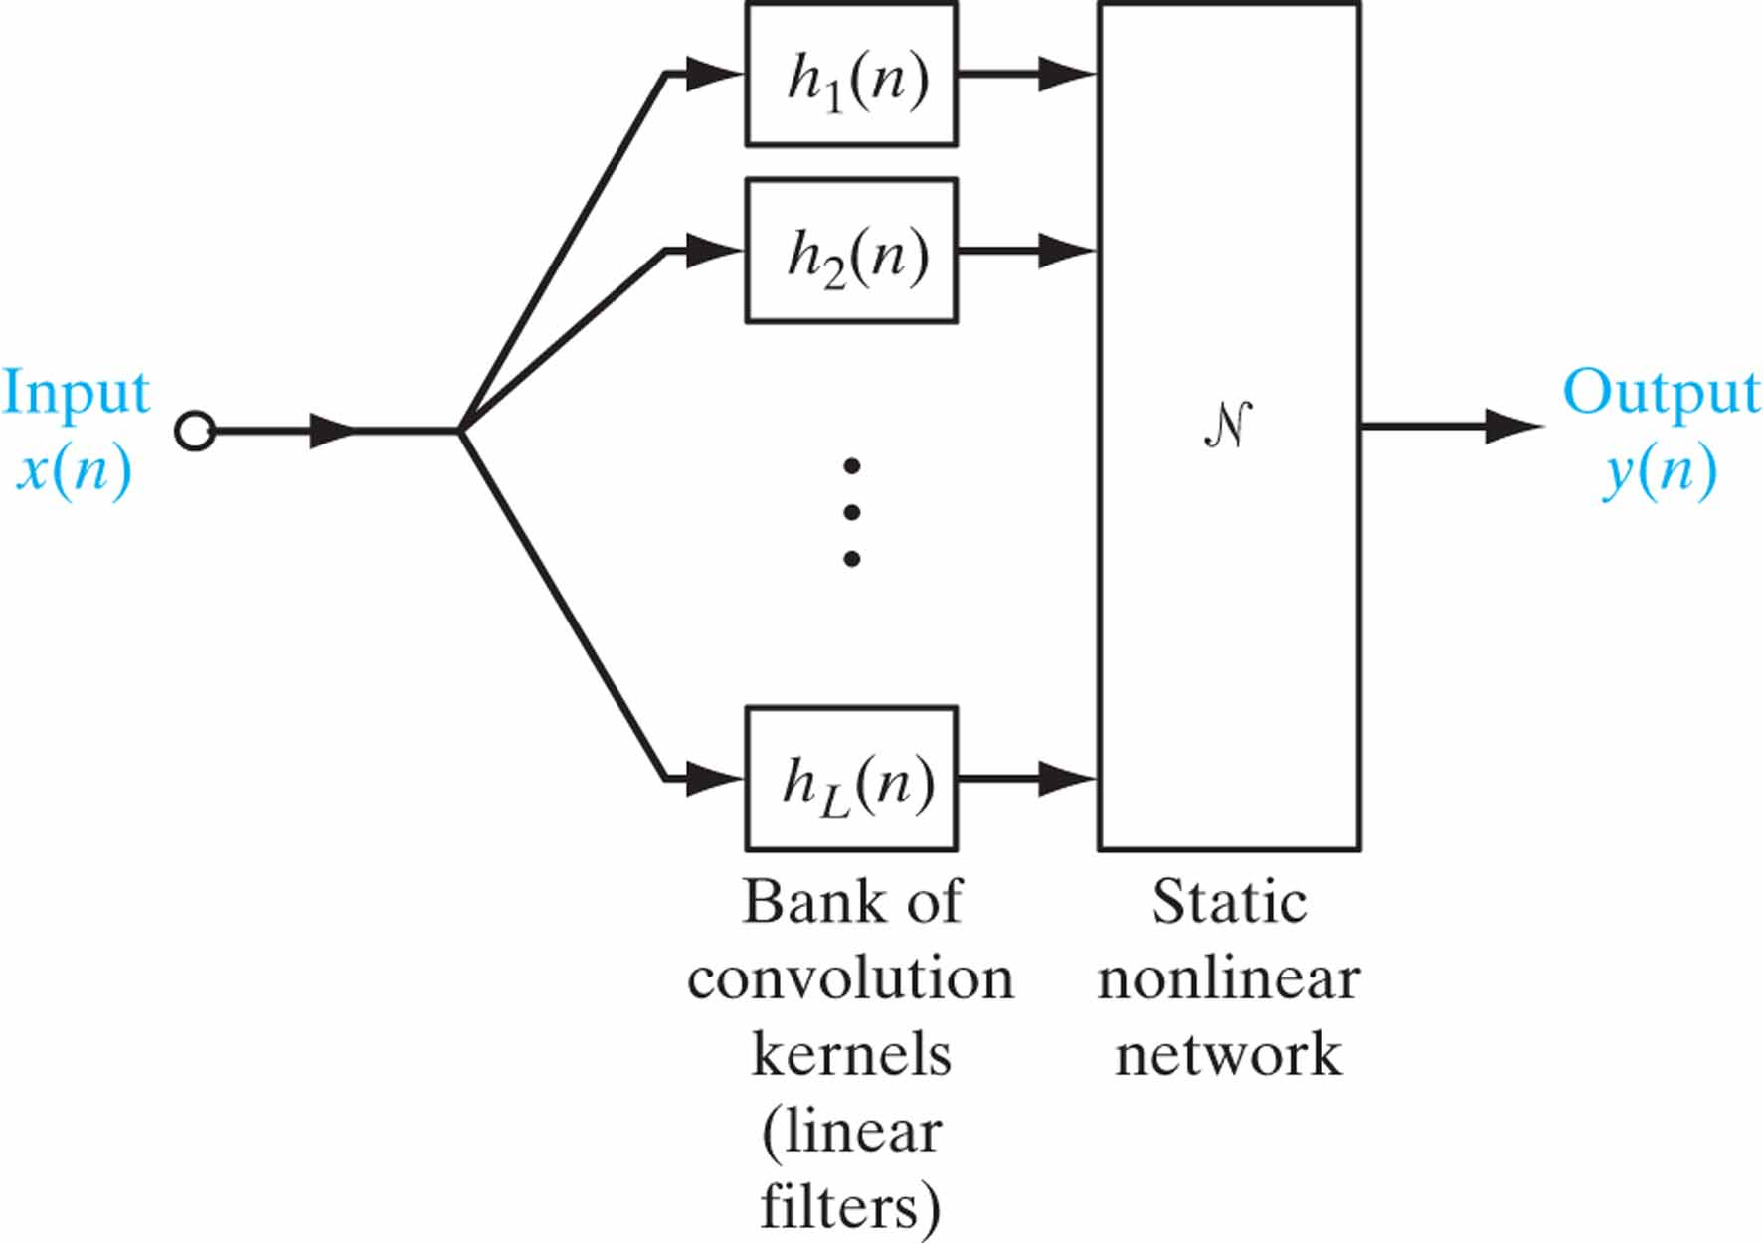
Figure 4.27 Generic structure for universal myopic mapping theorem.

Slide 32
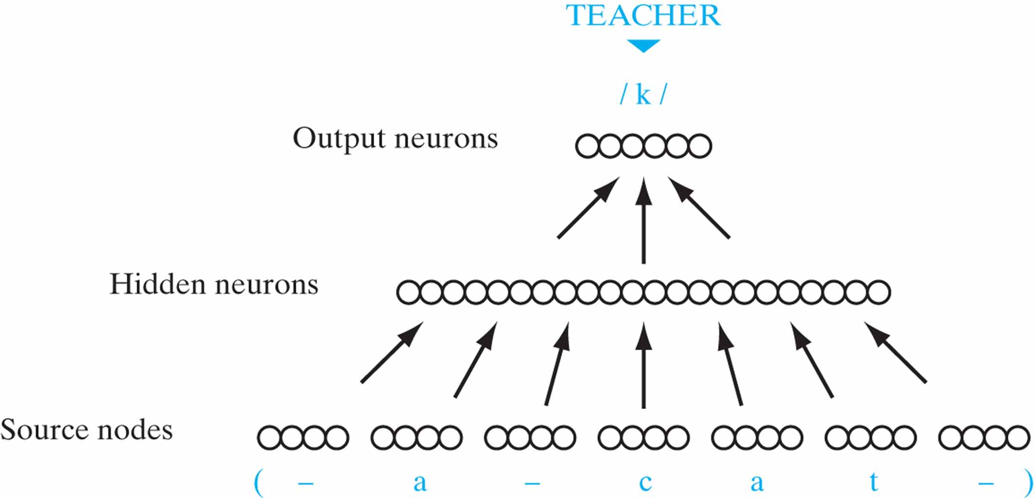
Figure 4.28 Schematic diagram of the NETtalk network architecture.

Slide 33
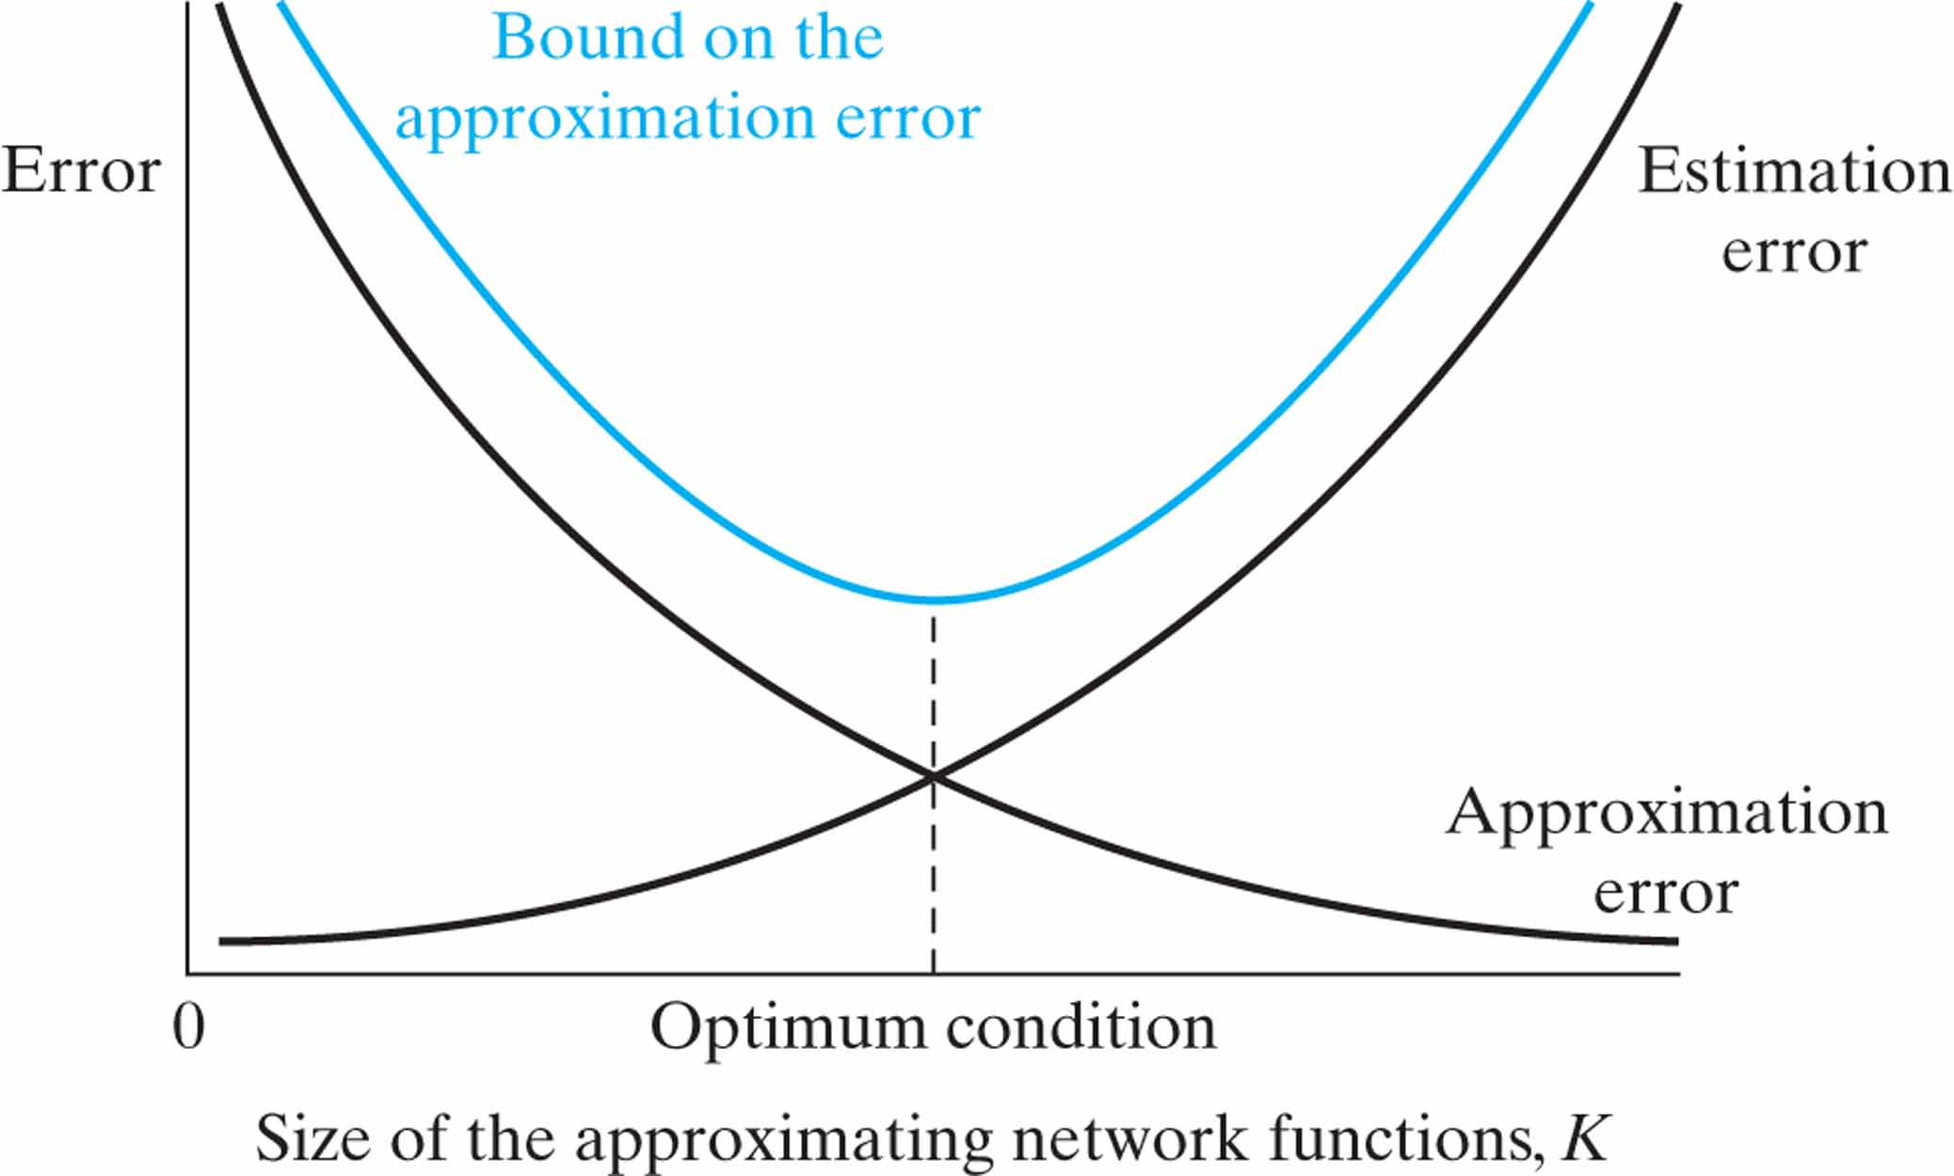
Figure 4.29 Variations of the approximation and estimation errors with the size K.

Slide 34
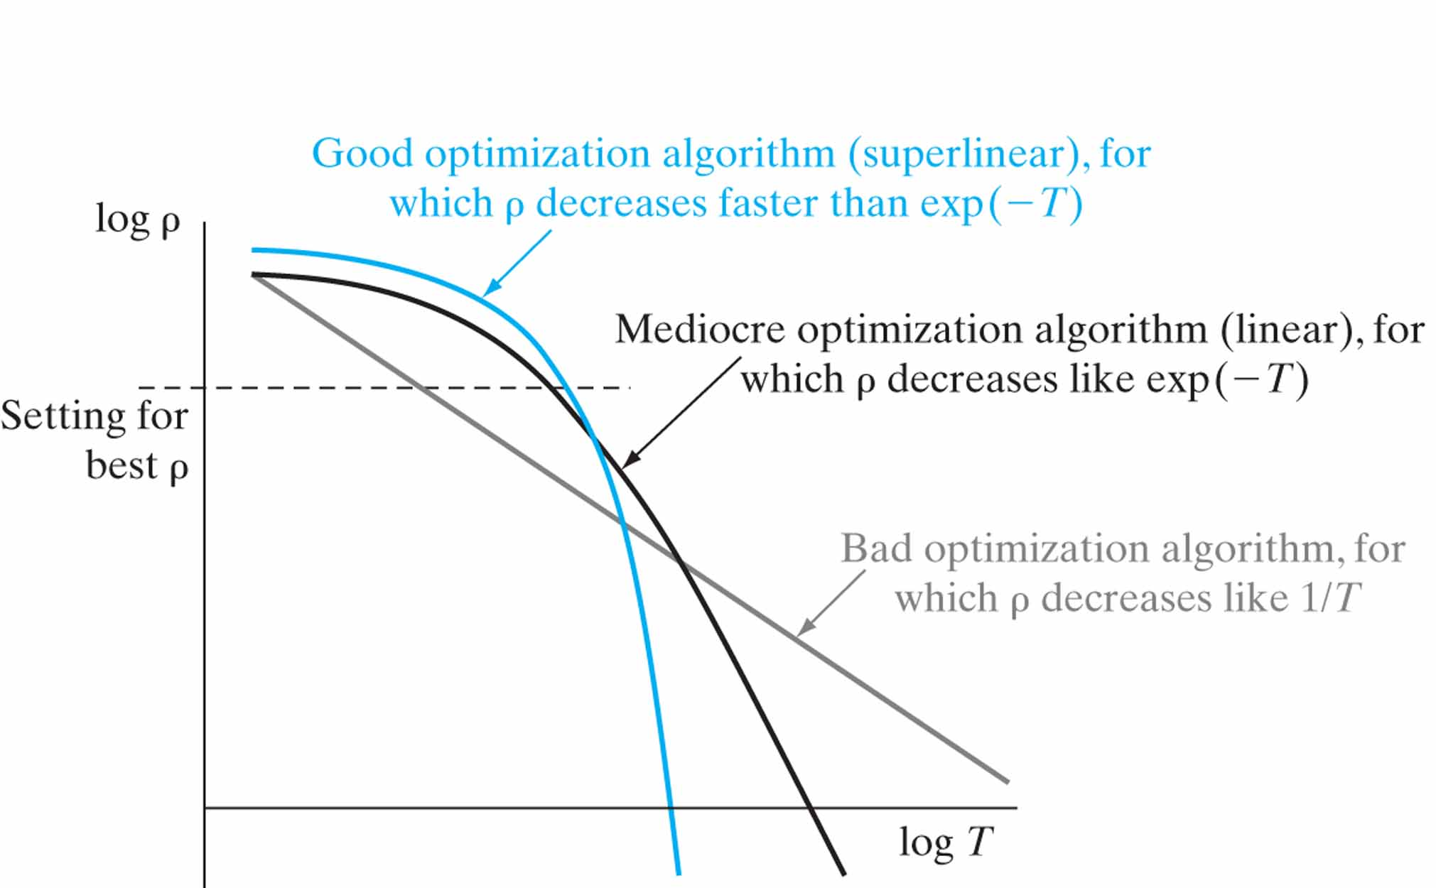
Figure 4.30 Variations of the computational error ρ versus the computation time T for three classes of optimization algorithm: bad, mediocre, and good. (This figure is reproduced with the permission of Dr. Leon Bottou.)

Slide 35
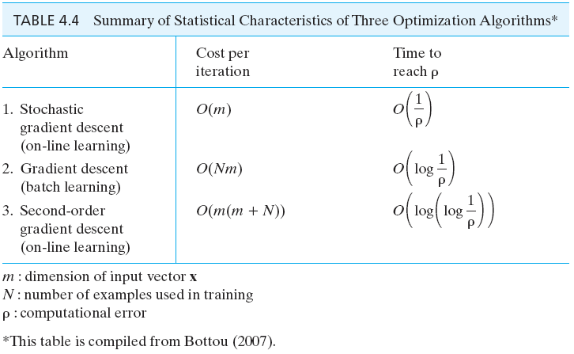
Table 4.4

Slide 36
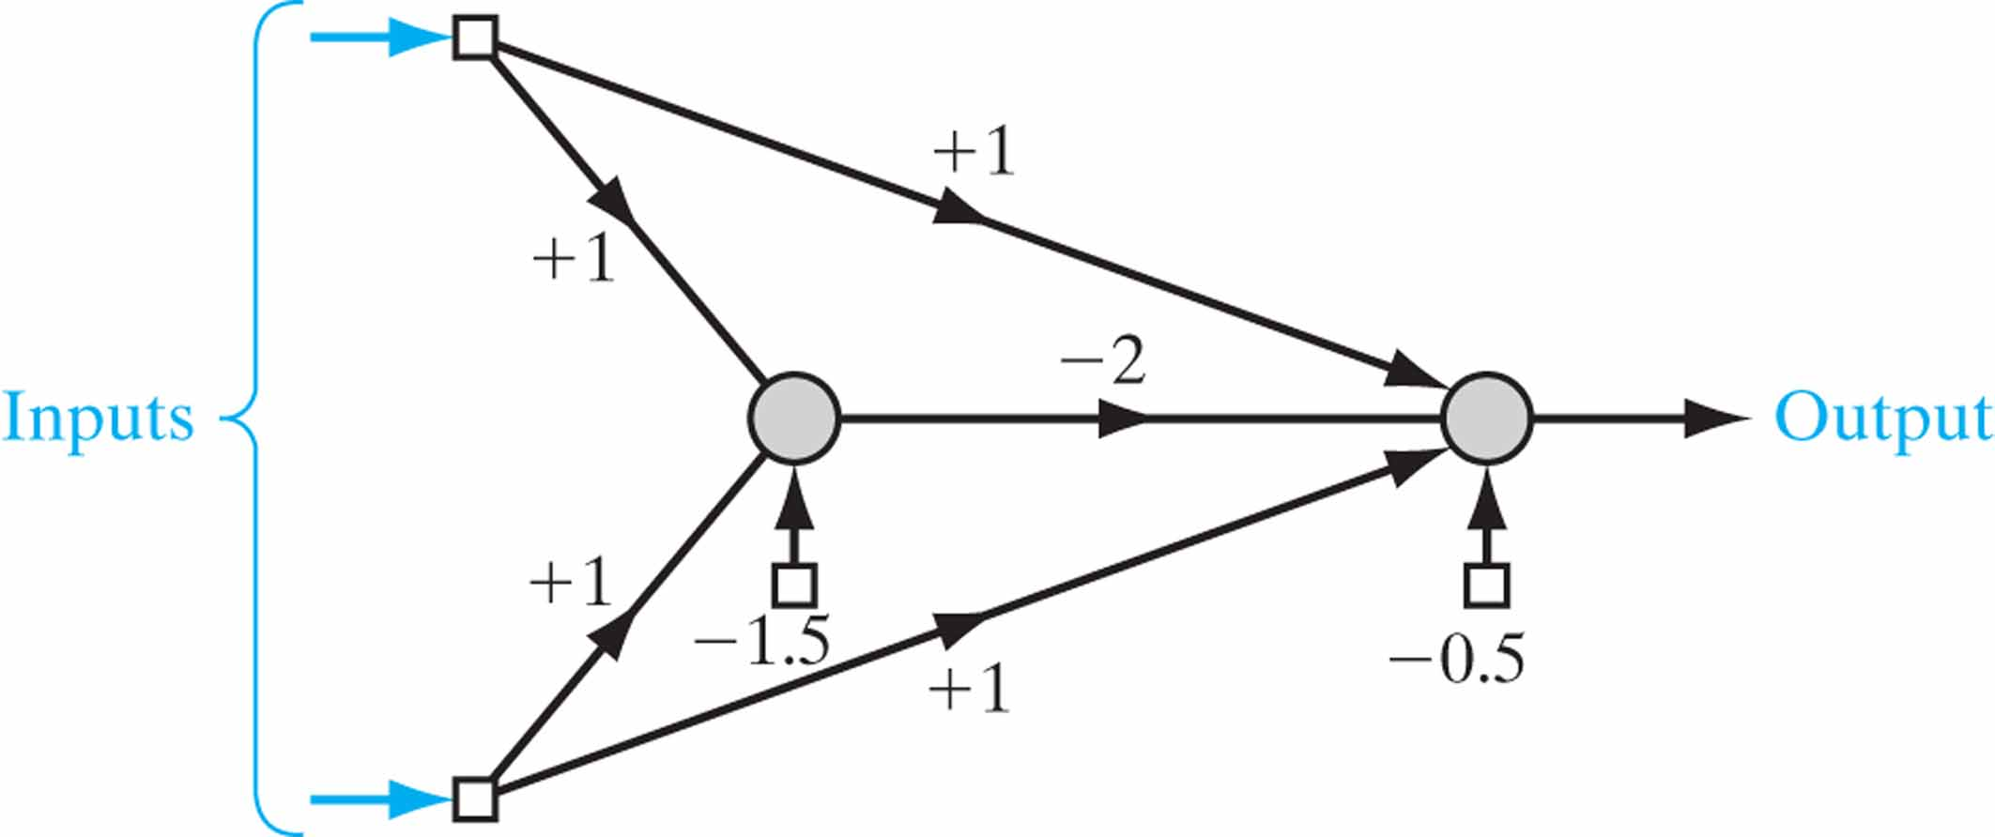
Figure P4.1

Slide 37
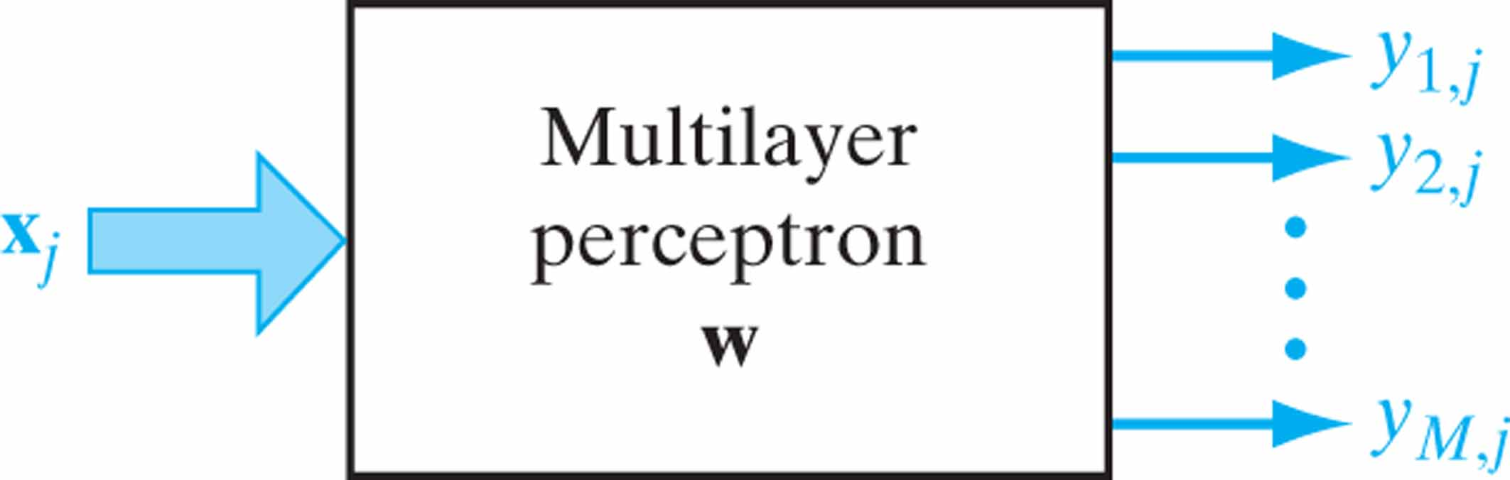
Figure P4.7 Block diagram of a pattern classifier for Problem 4.7.

Slide 38
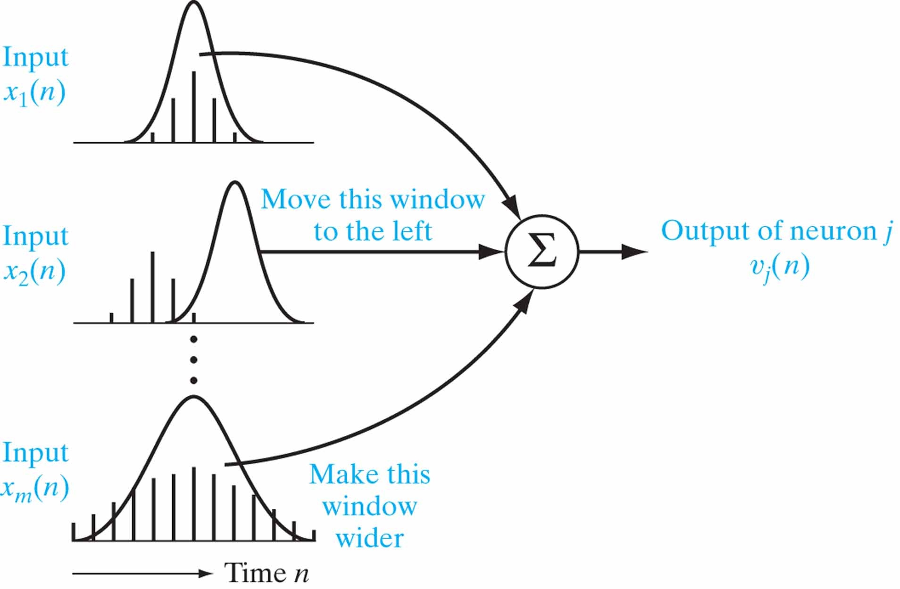
Figure P4.14 Block diagram of a pattern classifier for Problem 4.7.

