Slide 1
Chapter 5
Kernel Methods and Radial-Basis Function Networks

Slide 2
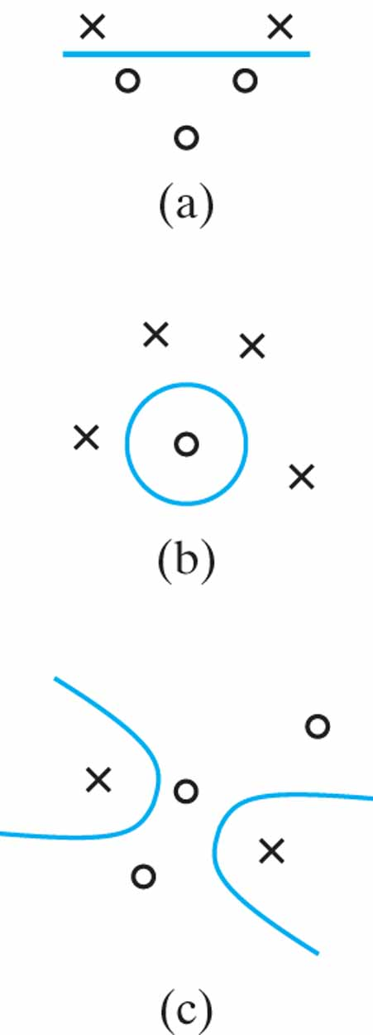
Figure 5.1 Three examples of φ-separable dichotomies of different sets of five points in two dimensions: (a) linearly separable dichotomy; (b) spherically separable dichotomy; (c) quadrically separable dichotomy.

Slide 3
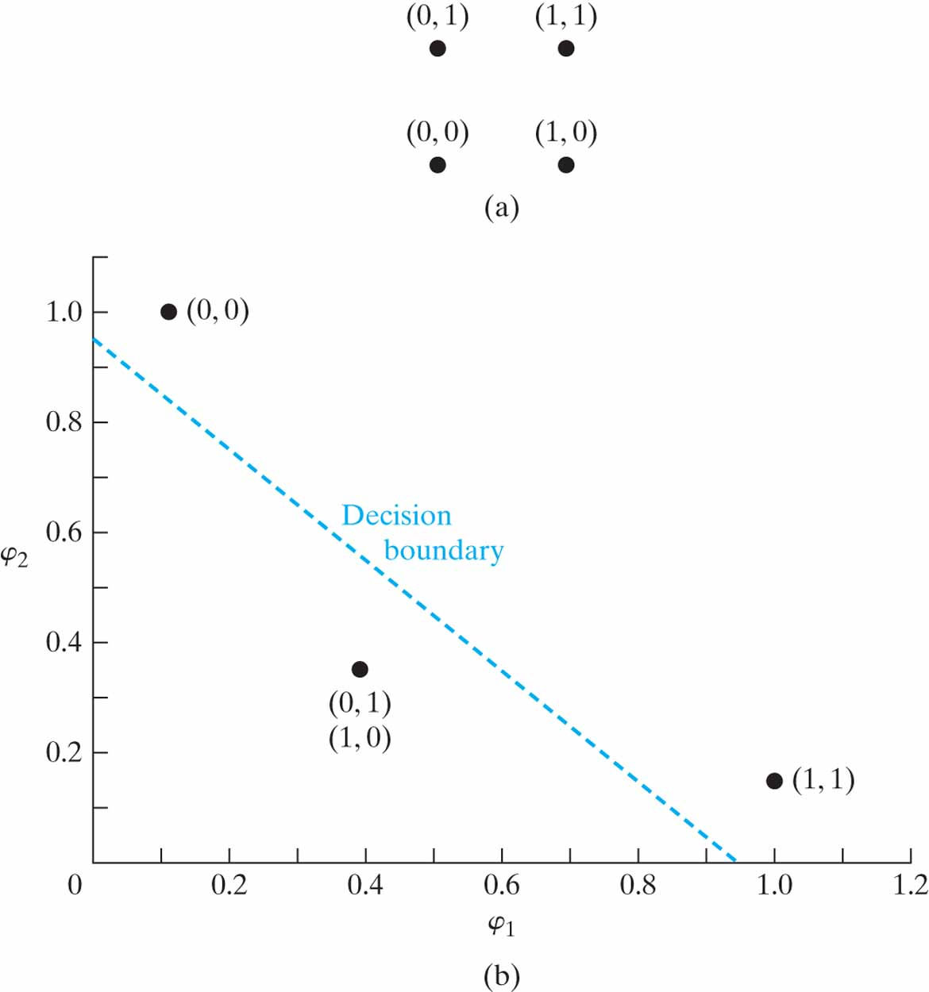
Figure 5.2 (a) The four patterns of the XOR problem; (b) decision-making diagram.

Slide 4
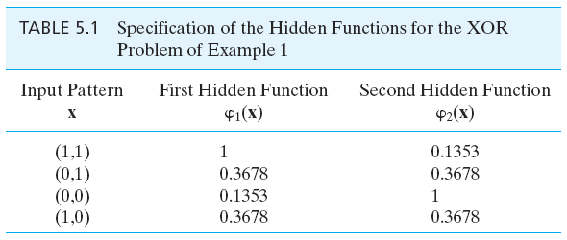
Table 5.1

Slide 5
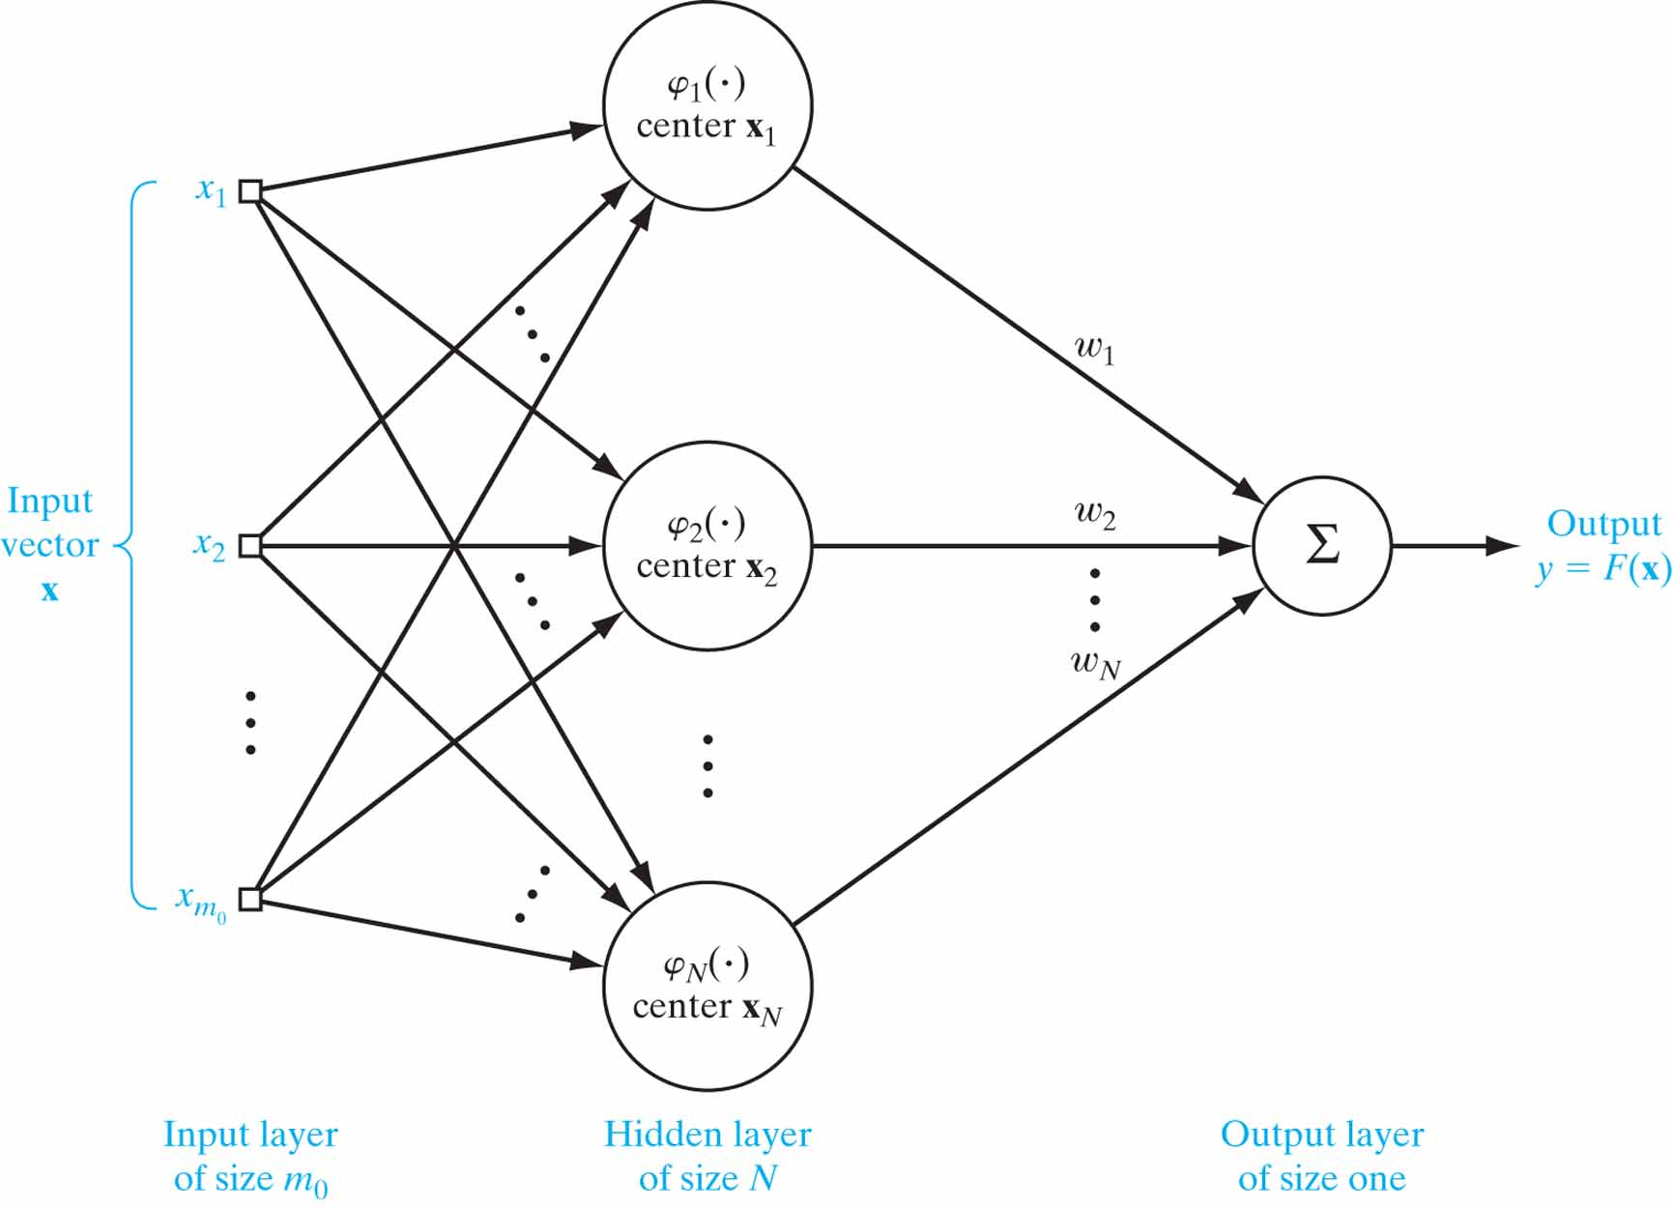
Figure 5.3 Structure of an RBF network, based on interpolation theory.

Slide 6
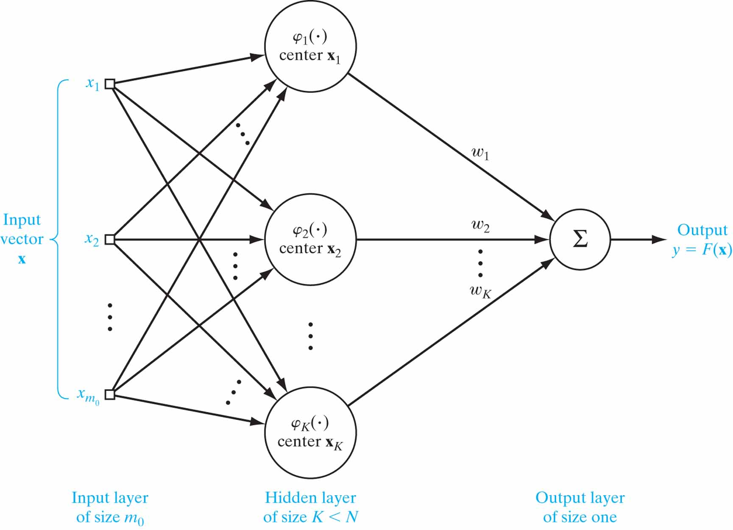
Figure 5.4 Structure of a practical RBF network. Note that this network is similar in structure to that of Fig. 5.3.The two networks are different, however, in that the size of the hidden layer in Fig. 5.4 is smaller than that in Fig. 5.3.

Slide 7
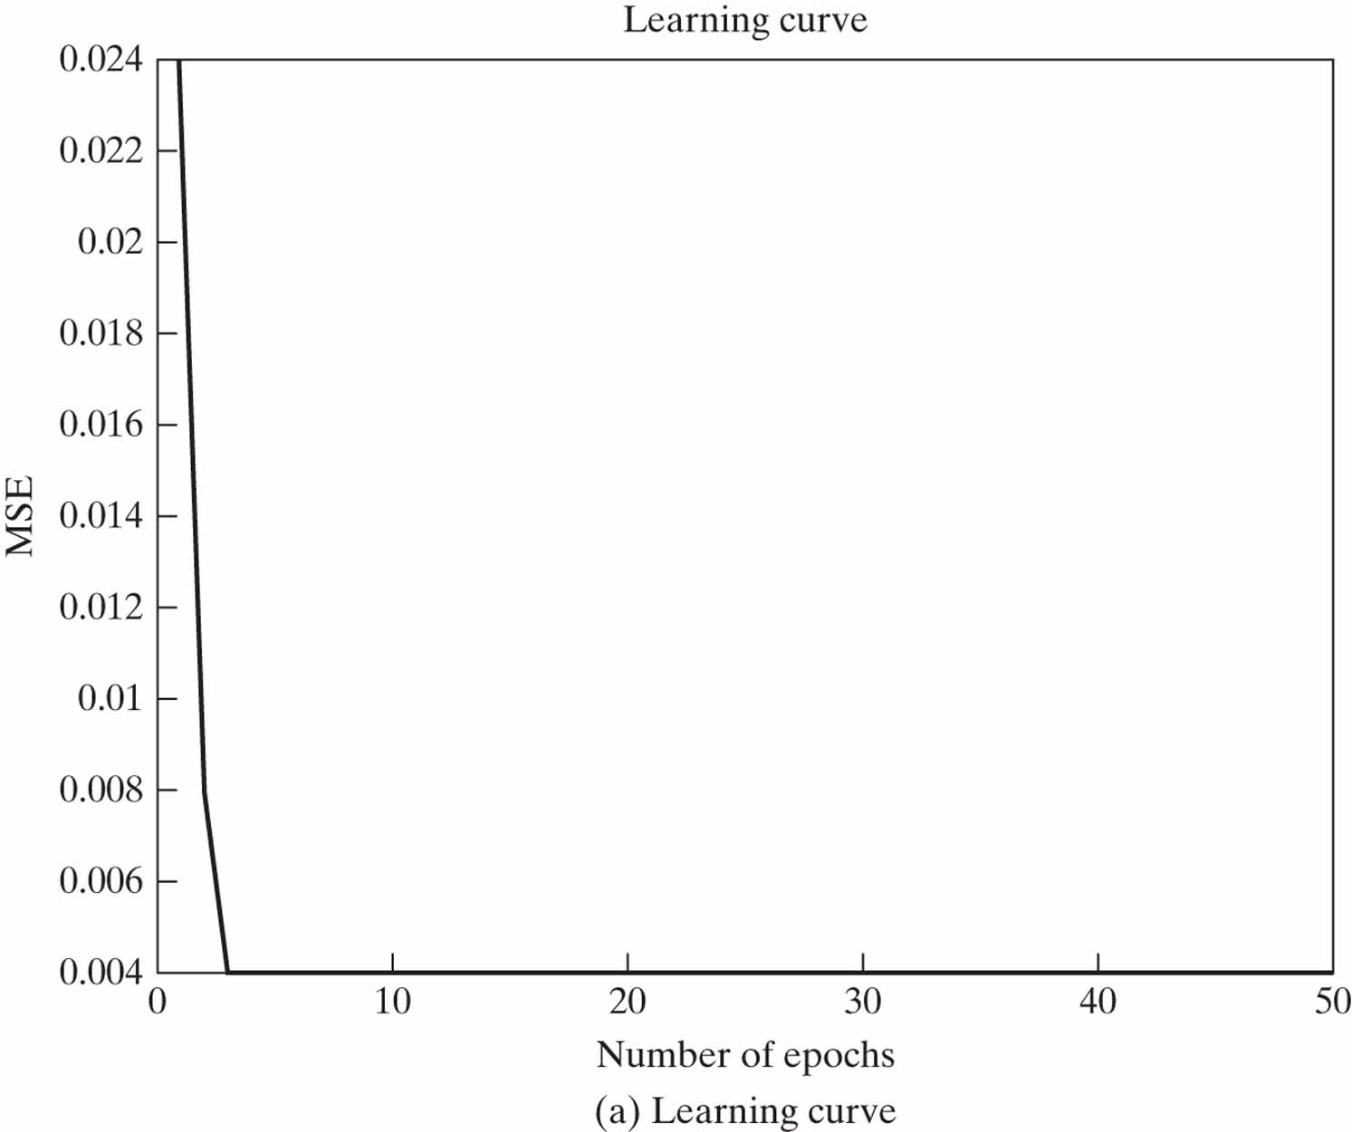
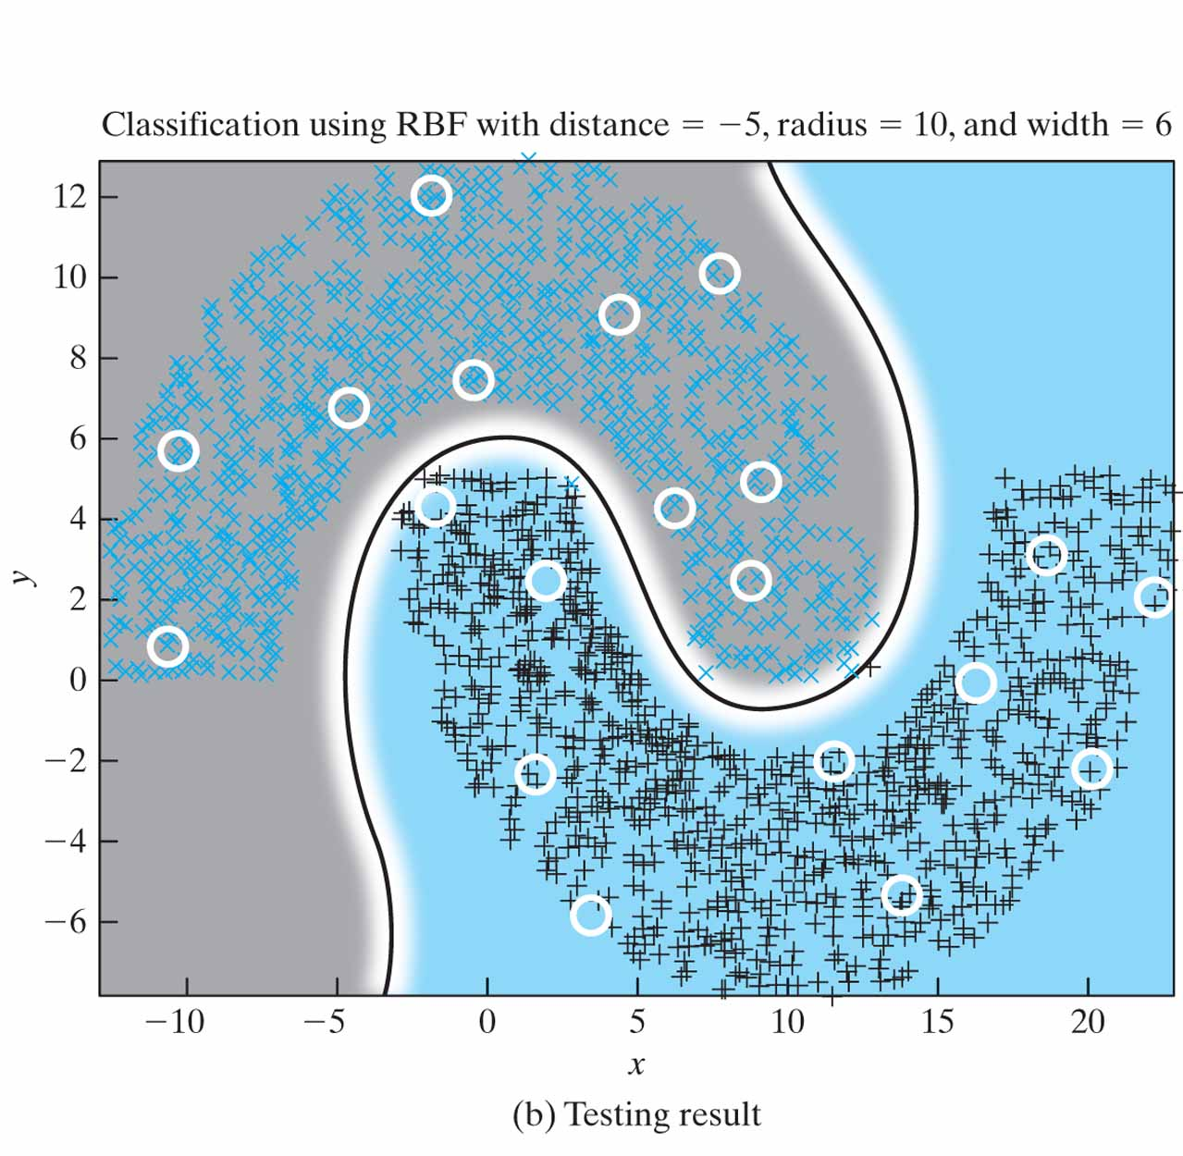
Figure 5.5 RBF network trained with K-means and RLS algorithms for distanced d = –5. The MSE in part (a) of the figure stands for mean-square error.

Slide 8
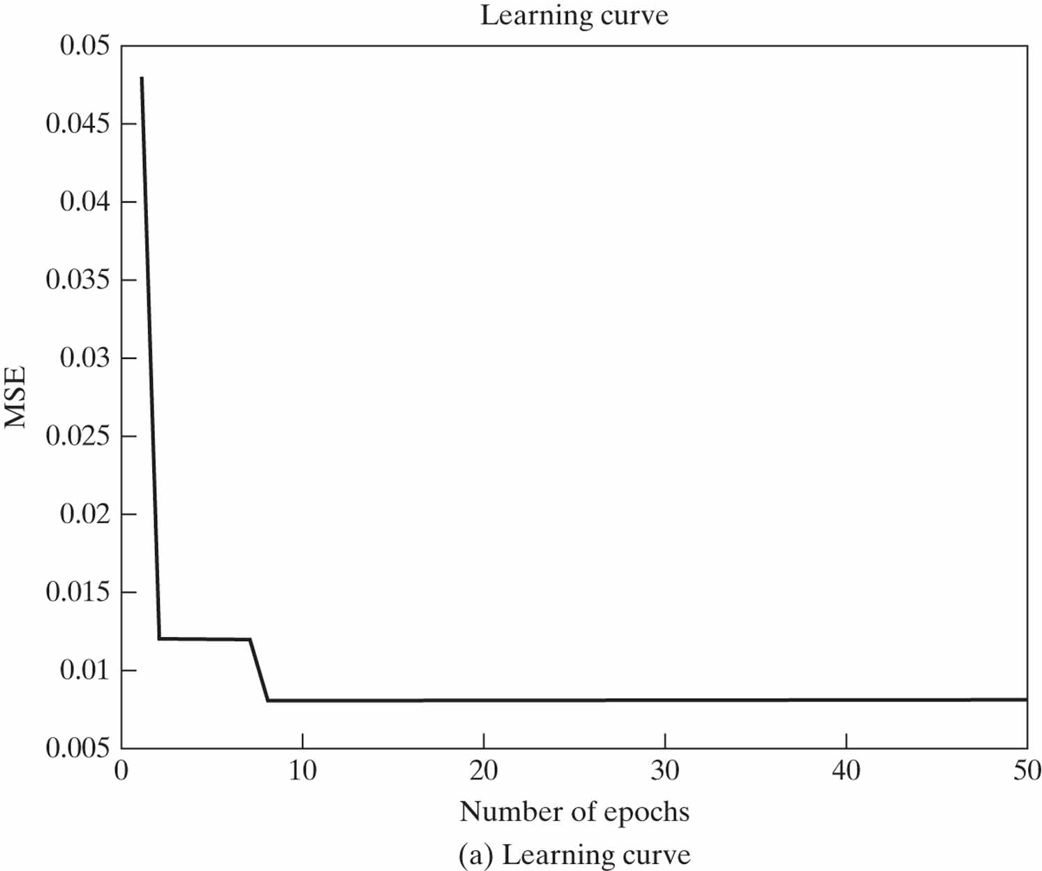
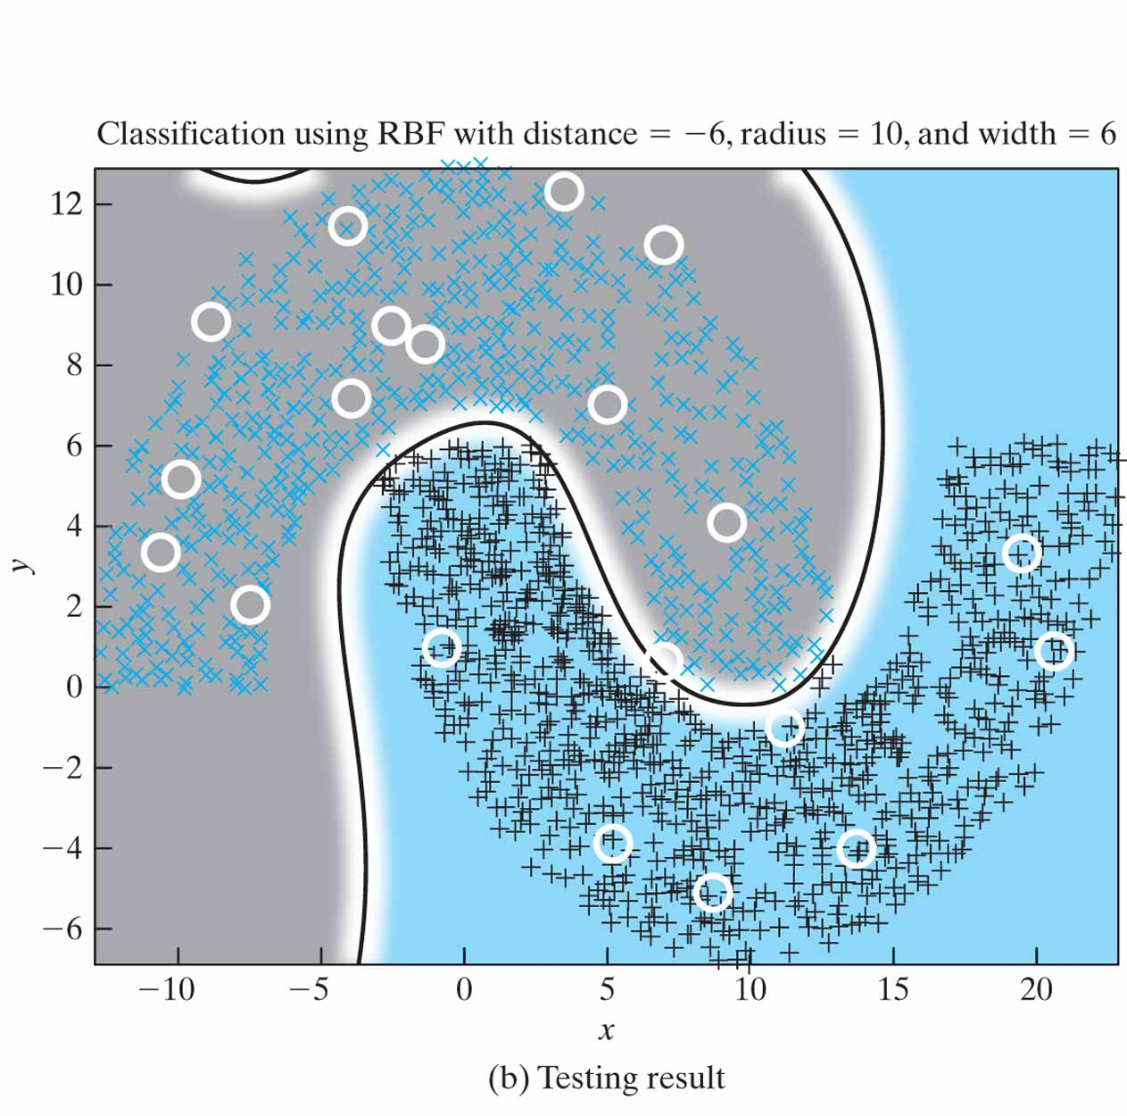
Figure 5.6 RBF network trained with K-means and RLS algorithms for distanced d = –6. The MSE in part (a) stands for mean-square error.

Slide 9
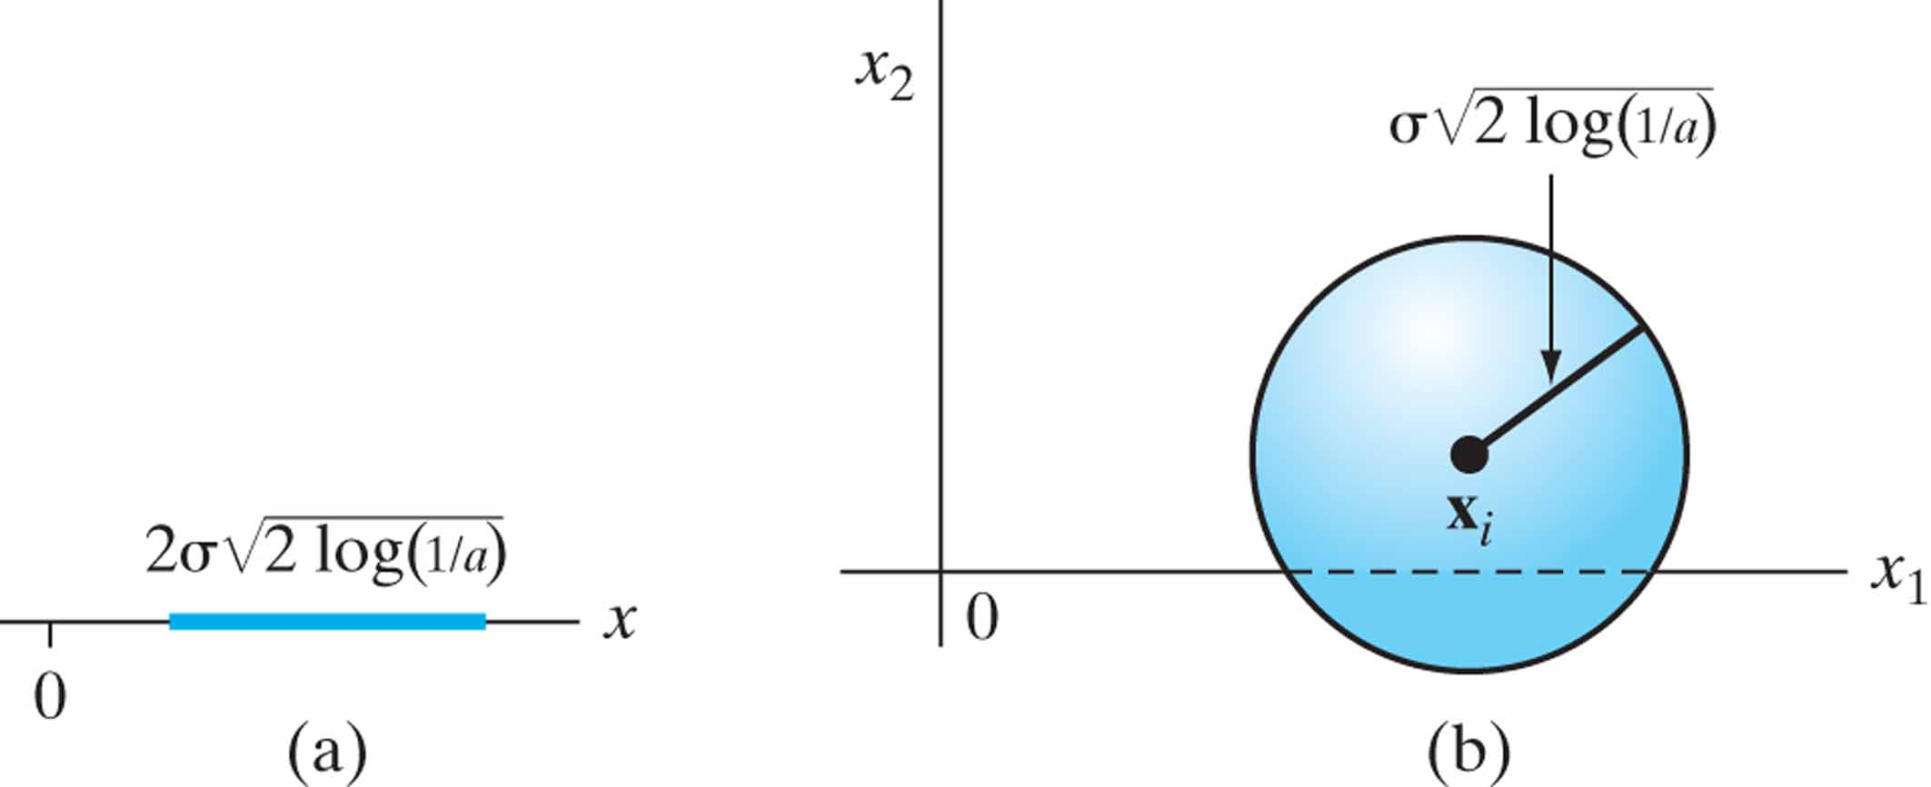
Figure 5.7 Illustrating the notion of receptive field for two special cases: (a) one-dimensional, and (b) two-dimensional.

