Slide 1
Chapter 6
Support Vector Machines

Slide 2
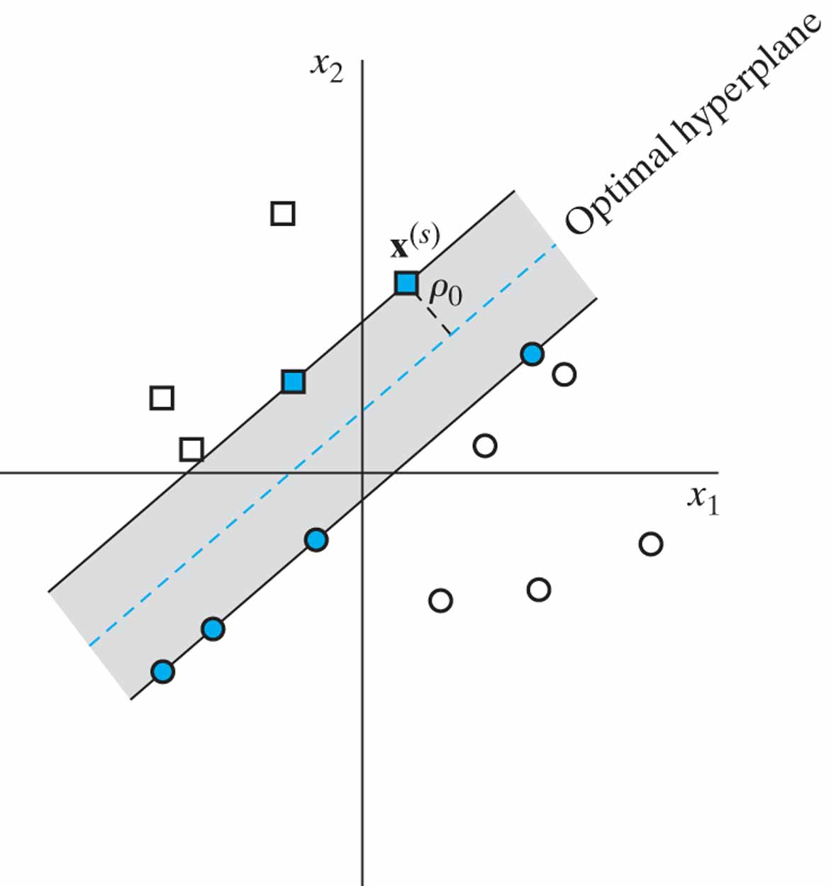
Figure 6.1 Illustration of the idea of an optimal hyperplane for linearly separable patterns: The data points shaded in blue are support vectors.

Slide 3
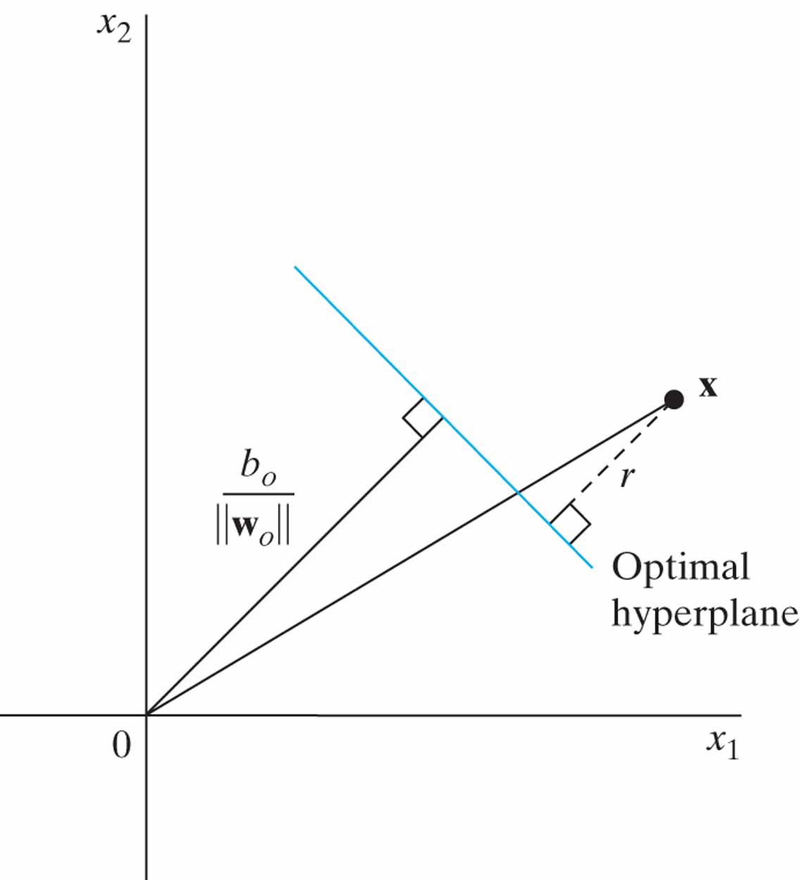
Figure 6.2 Geometric interpretation of algebraic distances of points to the optimal hyperplane for a two-dimensional case.

Slide 4
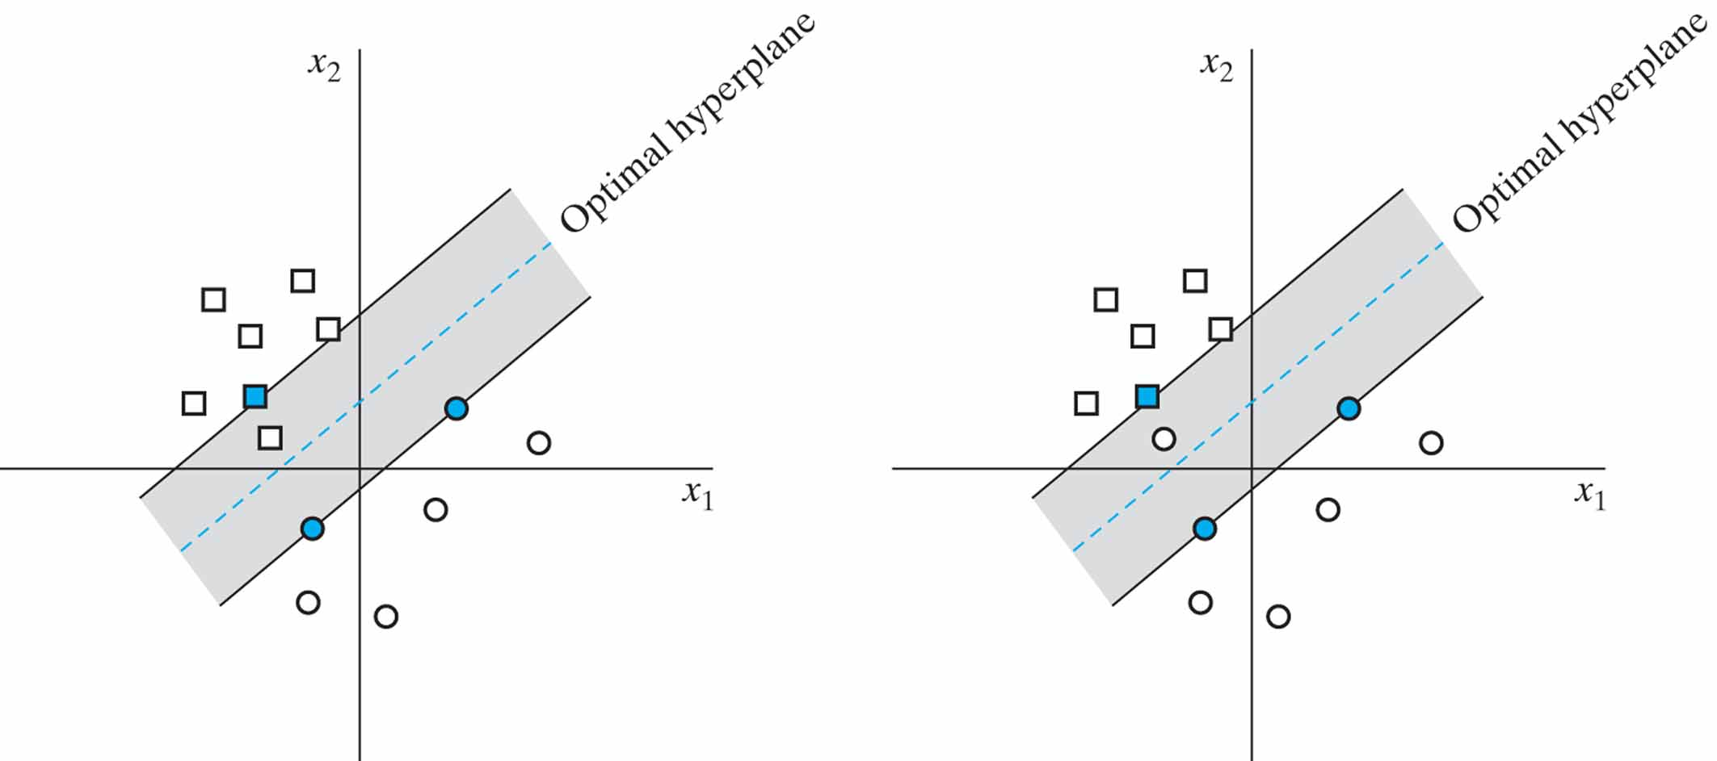
Figure 6.3 Soft margin hyperplane (a) Data point x_{i} (belonging to class C₁, represented by a small square) falls inside the region of separation, but on the correct side of the decision surface. (b) Data point x_{i} (belonging to class C₂, represented by a small circle) falls on the wrong side of the decision surface.

Slide 5
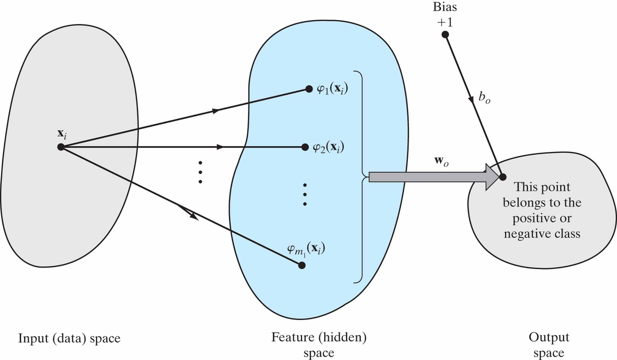
Figure 6.4 Illustrating the two mappings in a support vector machine for pattern classification: (i) nonlinear mapping from the input space to the feature space; (ii) linear mapping from the feature space to the output space.

Slide 6
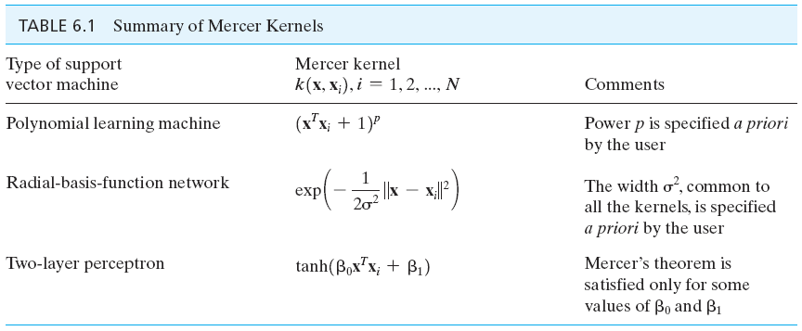
Table 6.1

Slide 7
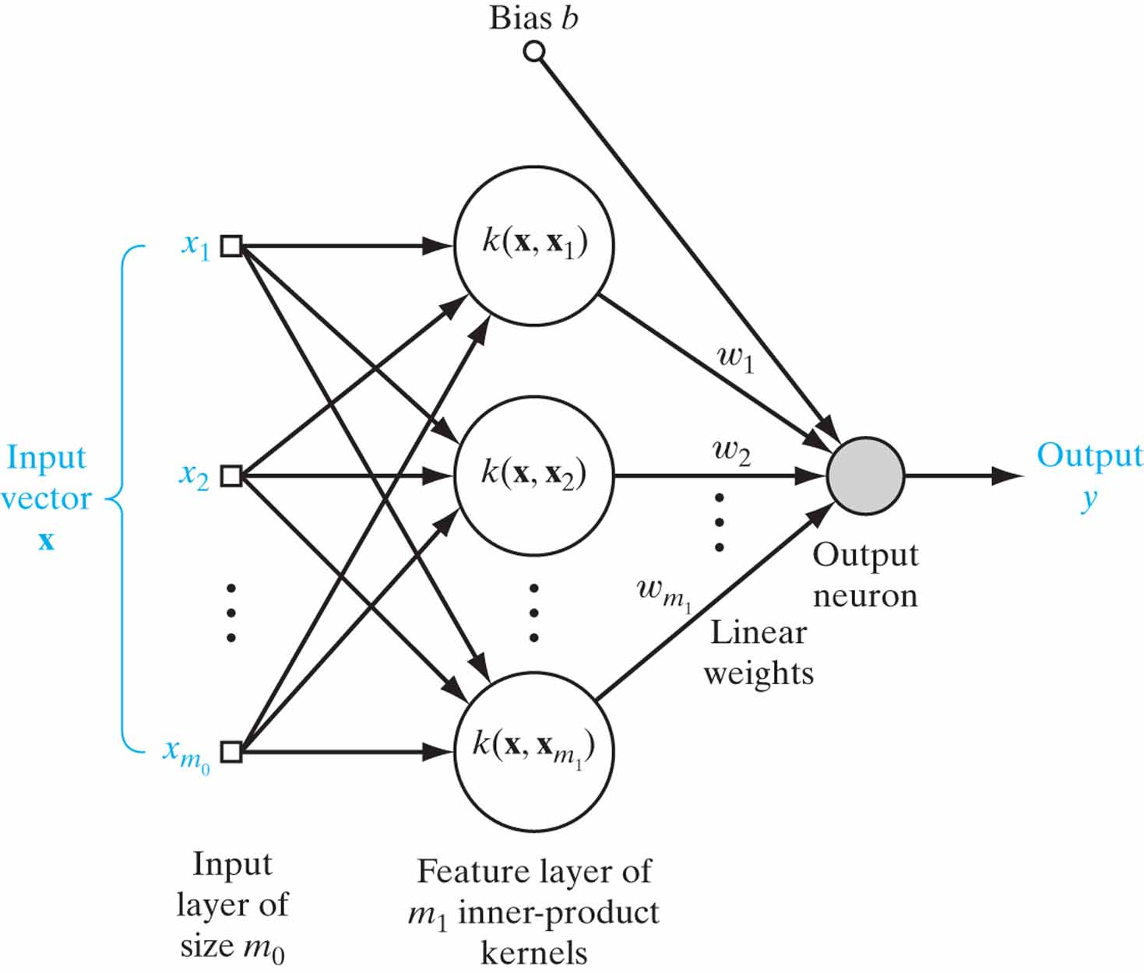
Figure 6.5 Architecture of support vector machine, using a radial-basis function network.

Slide 8
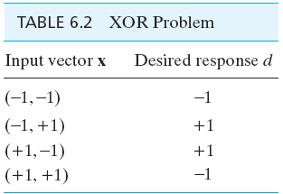
Table 6.2

Slide 9
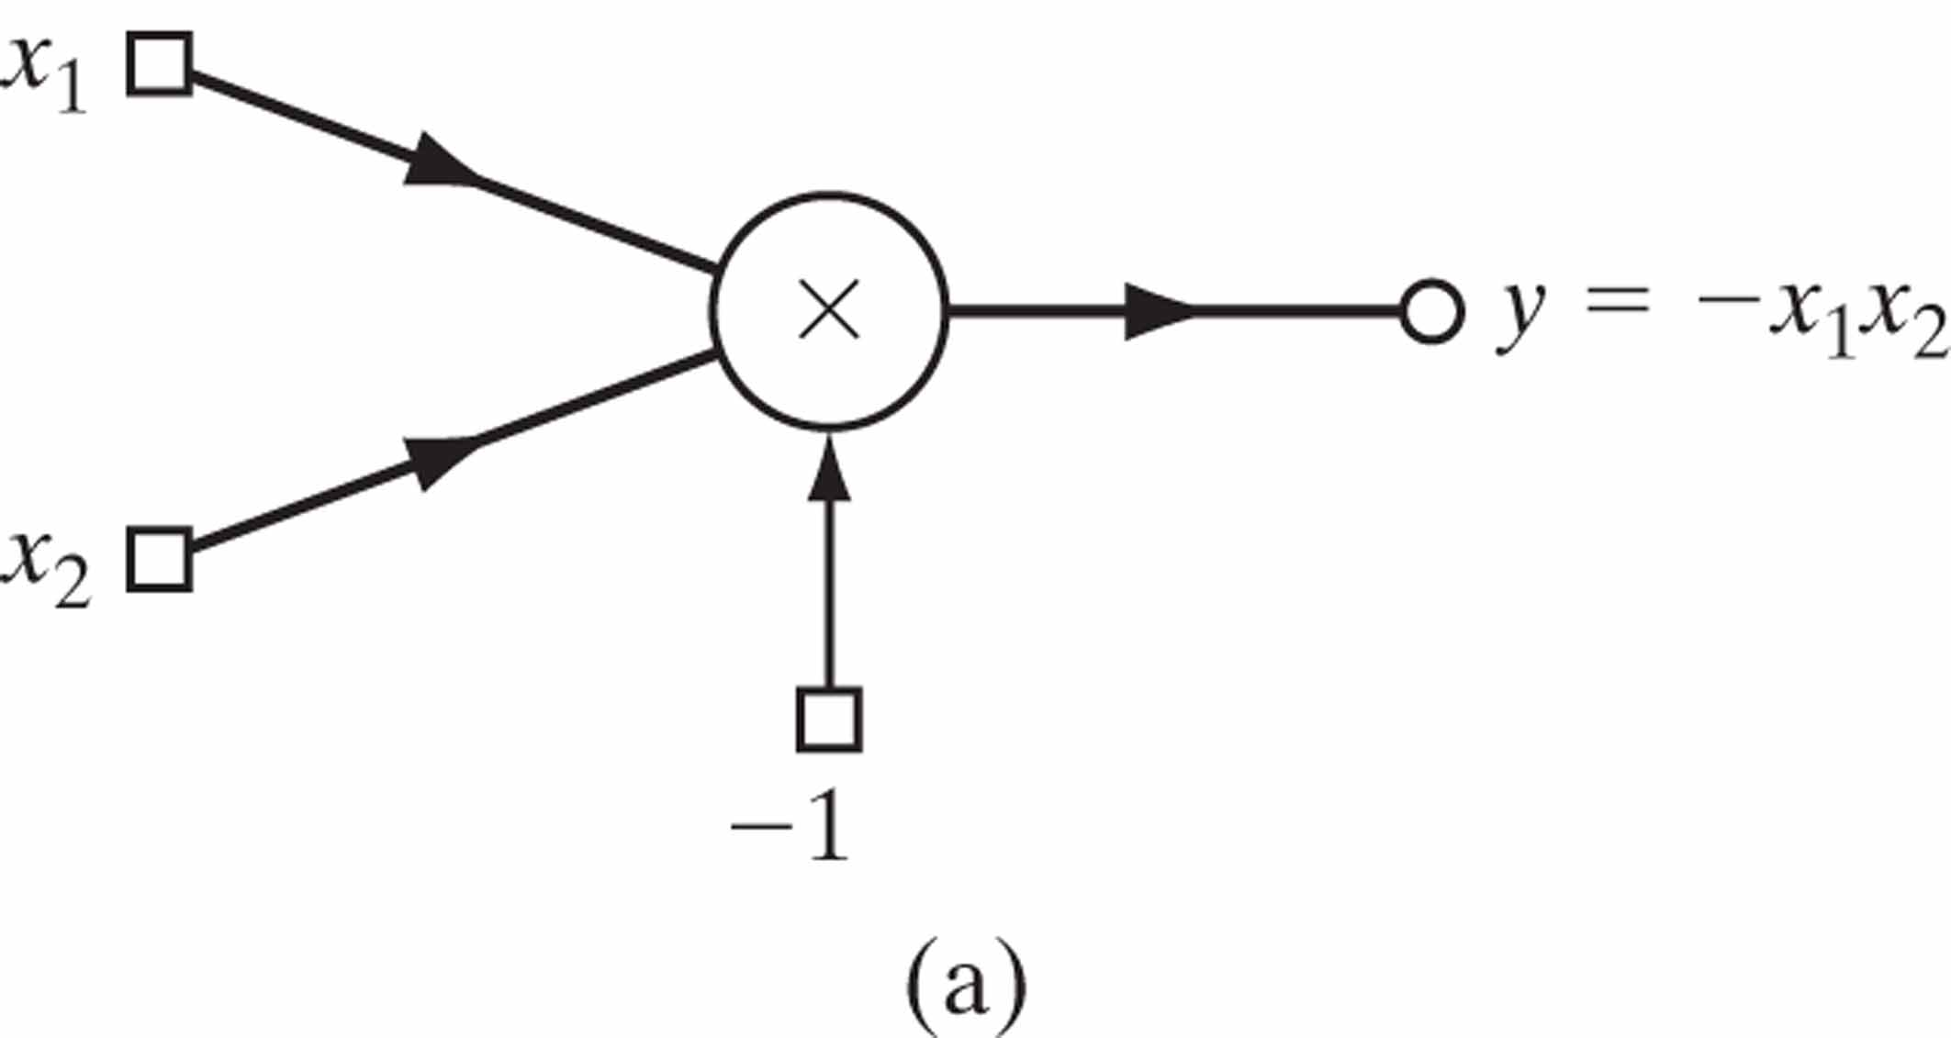
Figure 6.6 (a) Polynomial machine for solving the XOR problem. (b) Induced images in the feature space due to the four data points of the XOR problem.

Slide 10
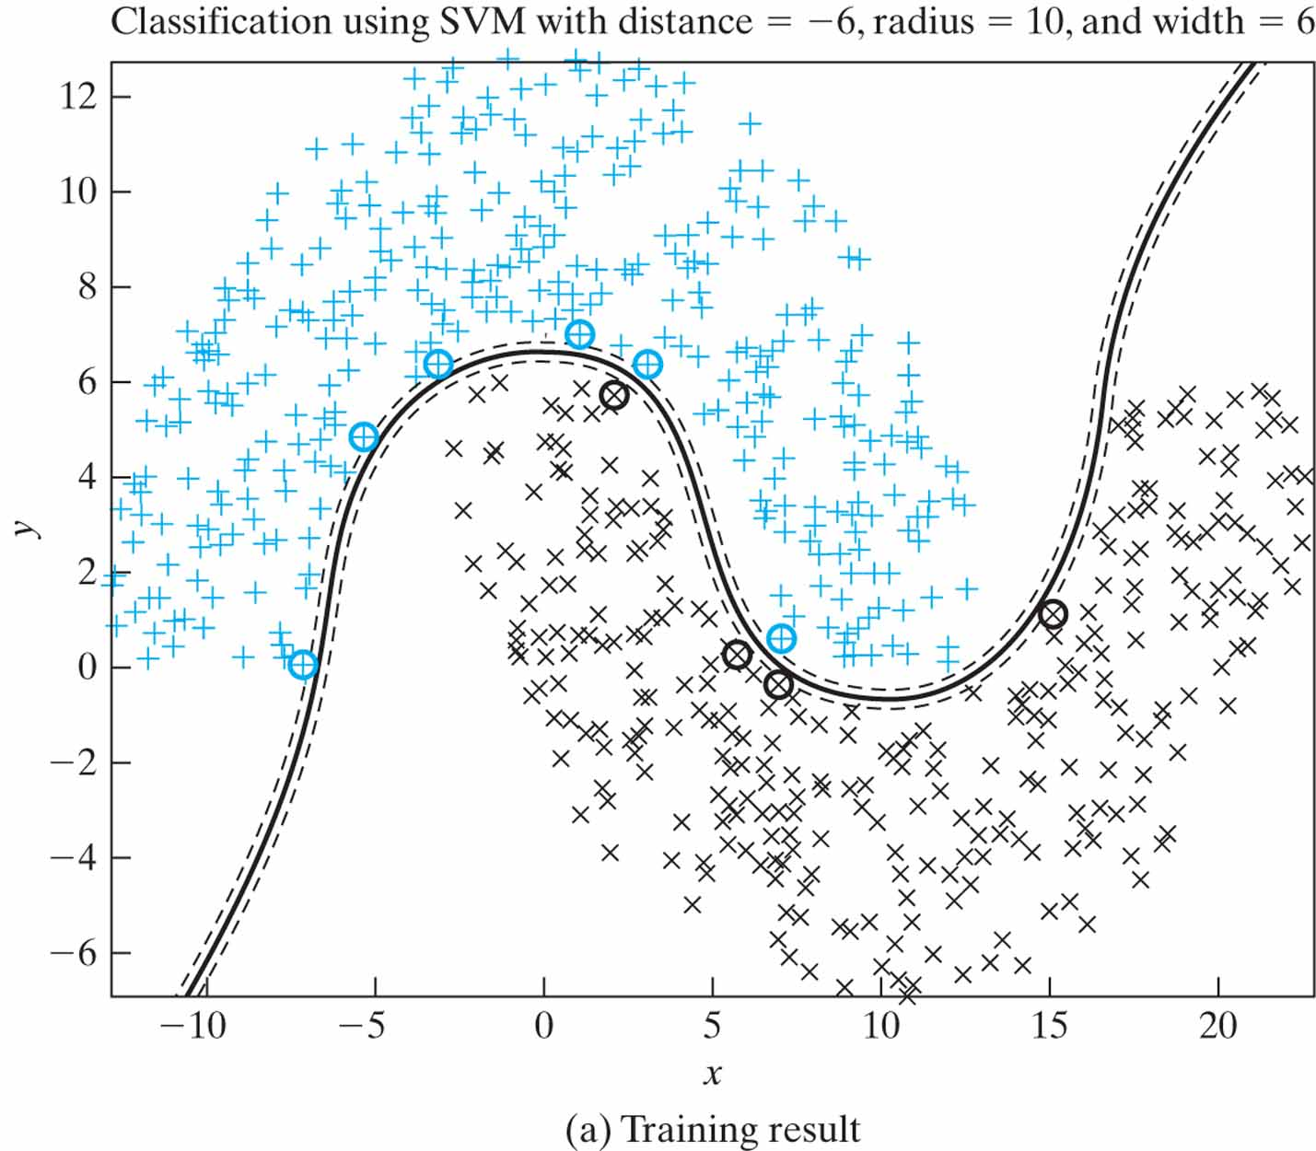
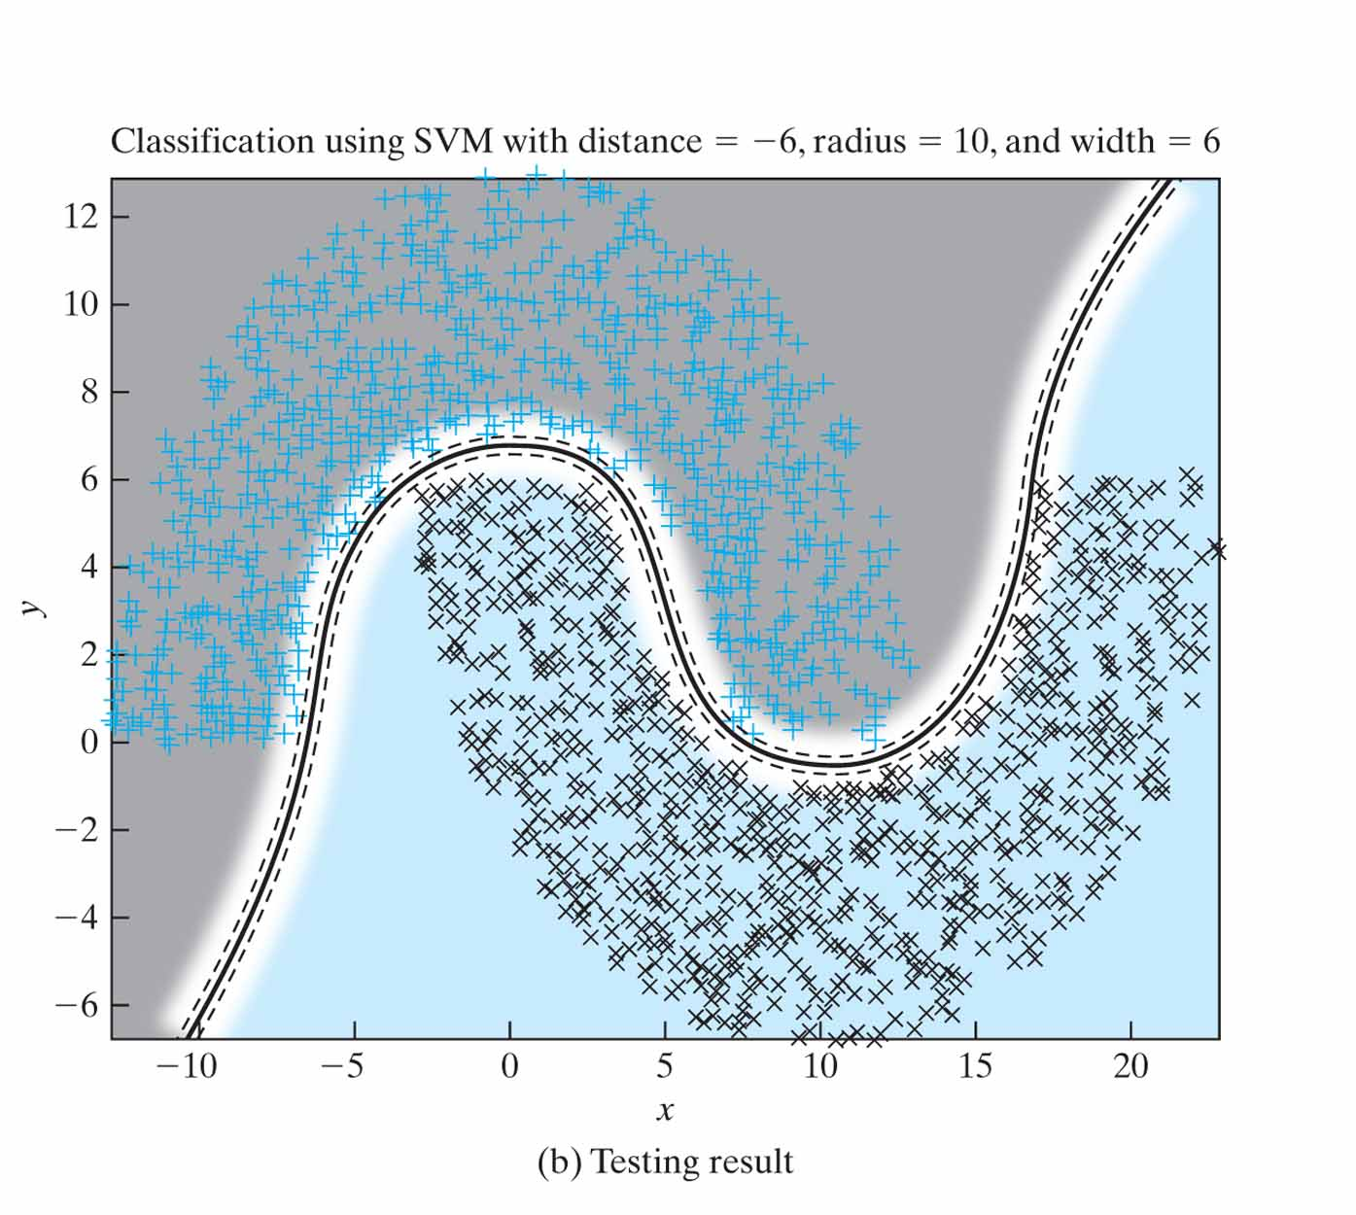
Figure 6.7 Experiment on SVM for the double-moon of Fig. 1.8 with distance d = –6.

Slide 11
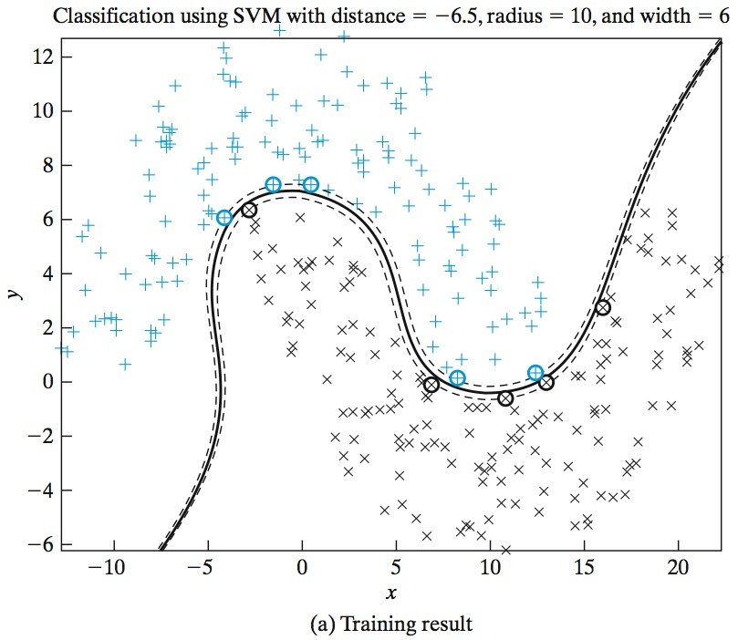
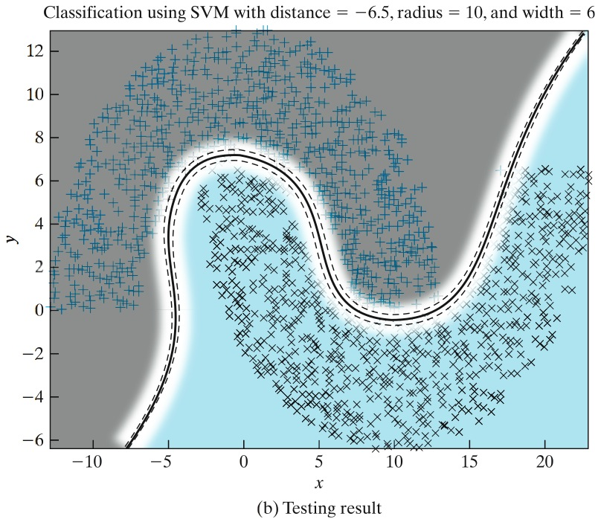
Figure 6.8 Experiment on SVM for the double-moon of Fig. 1.8 with distance d = –6.5.

Slide 12
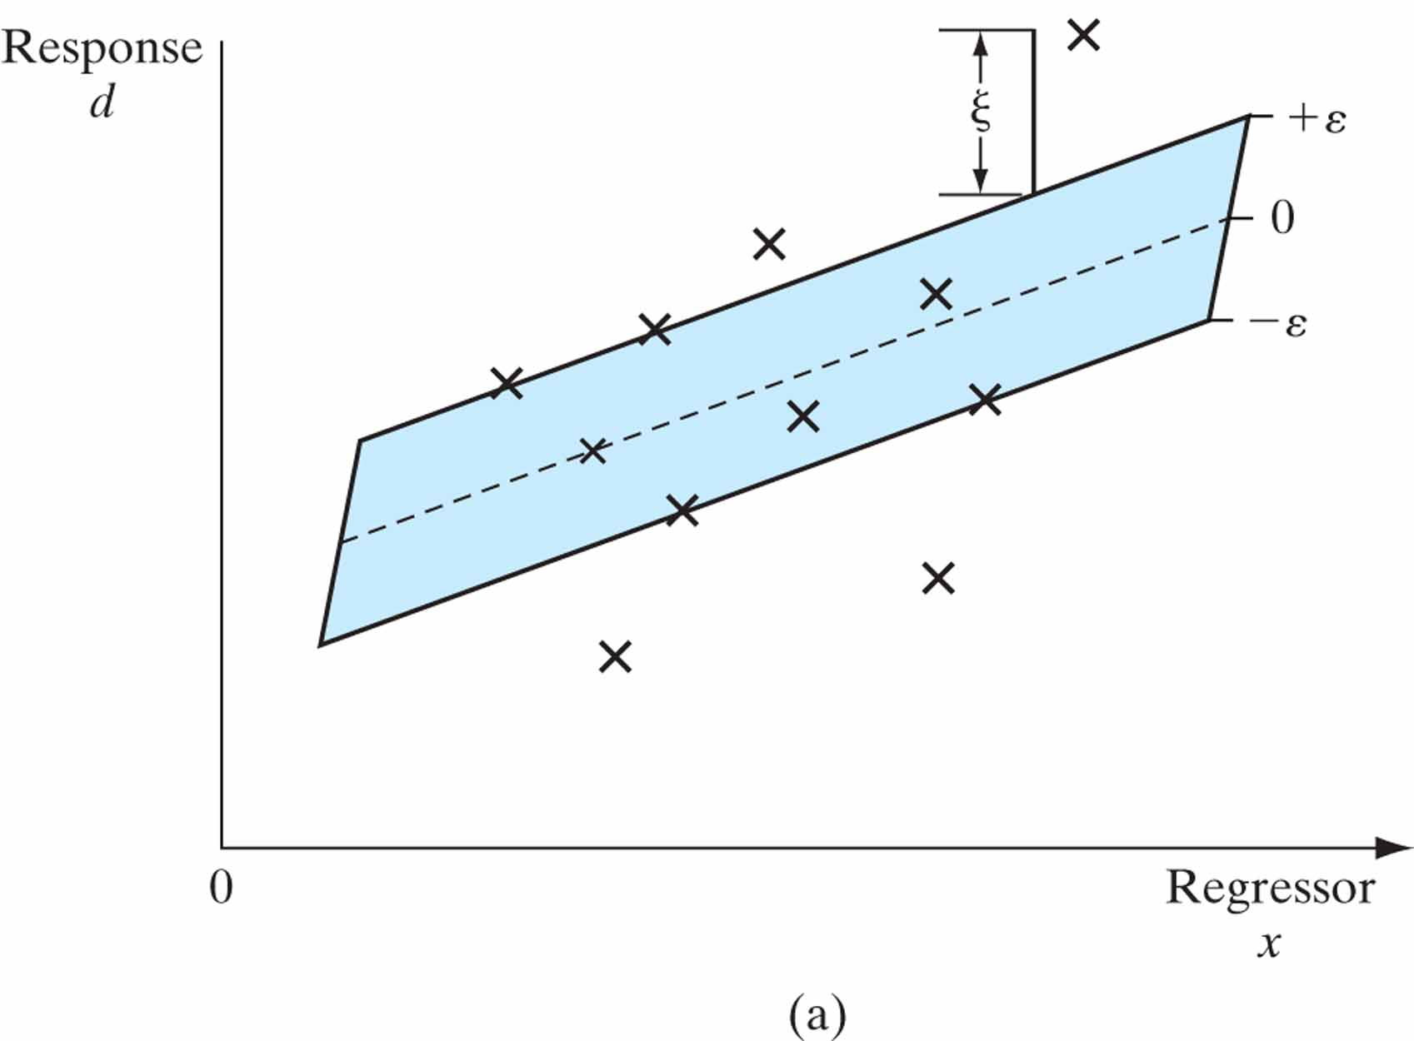
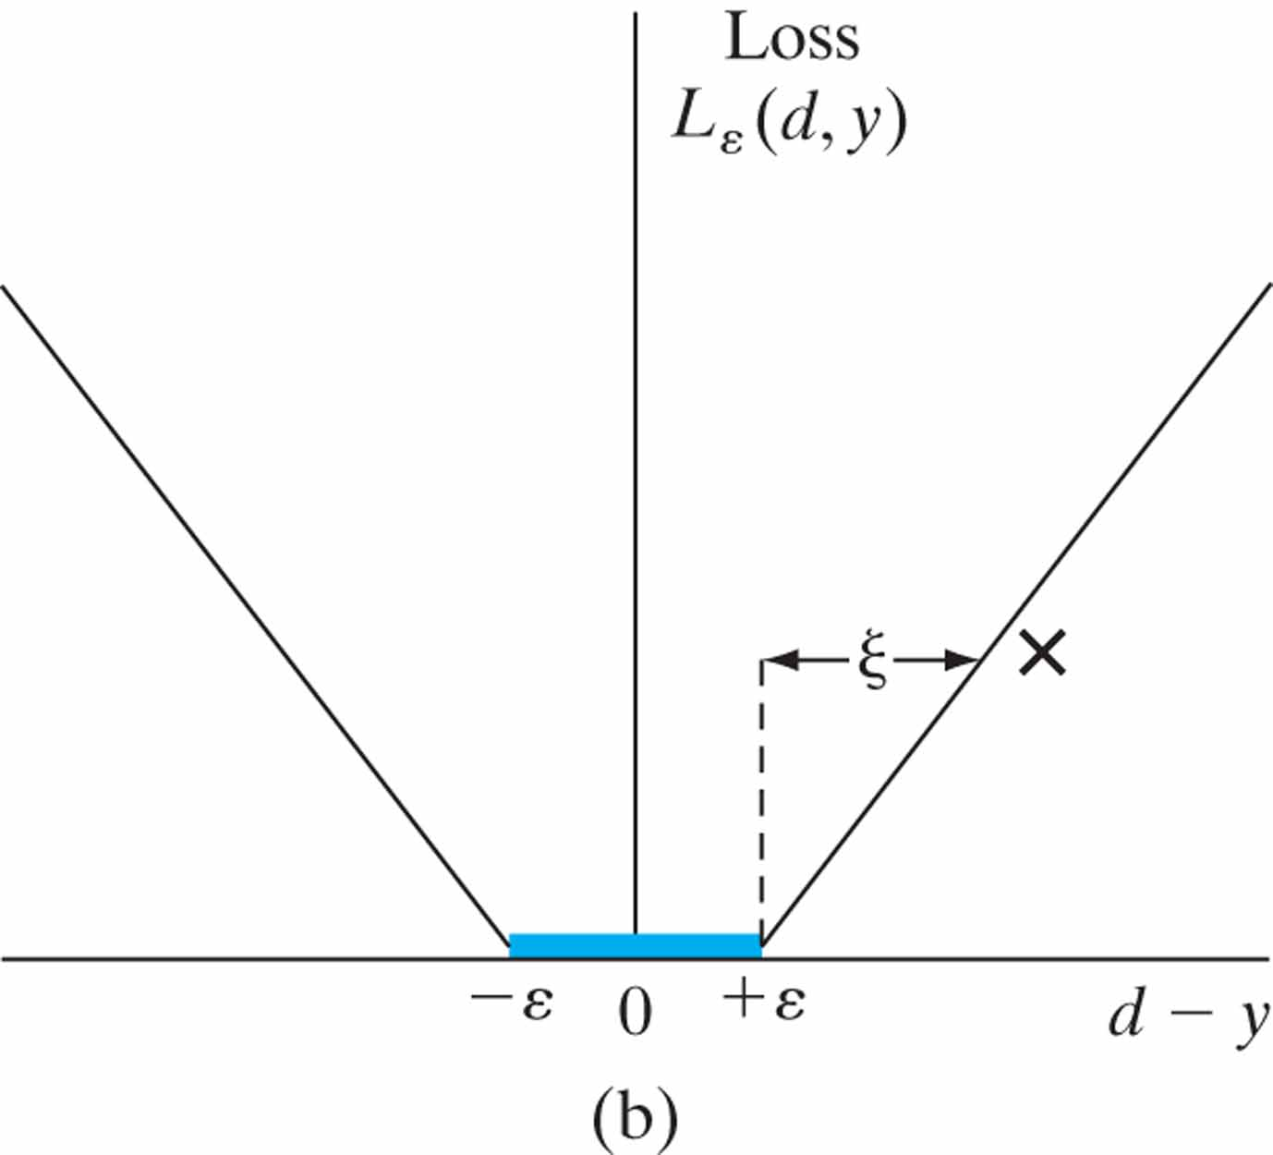
Figure 6.9 Linear regression (a) Illustrating an ε-insensitive tube of radius ε, fitted to the data points shown as X’s. (b) The corresponding plot of the ε -insensitive loss function.

Slide 13
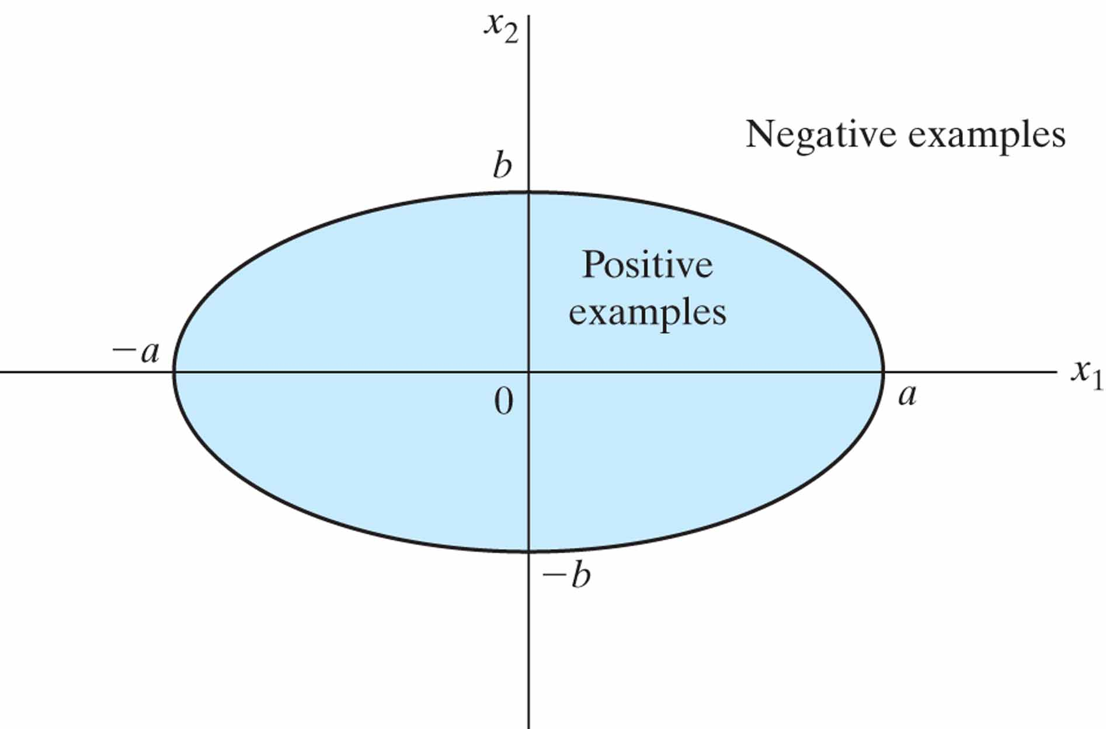
Figure P6.15

Slide 14
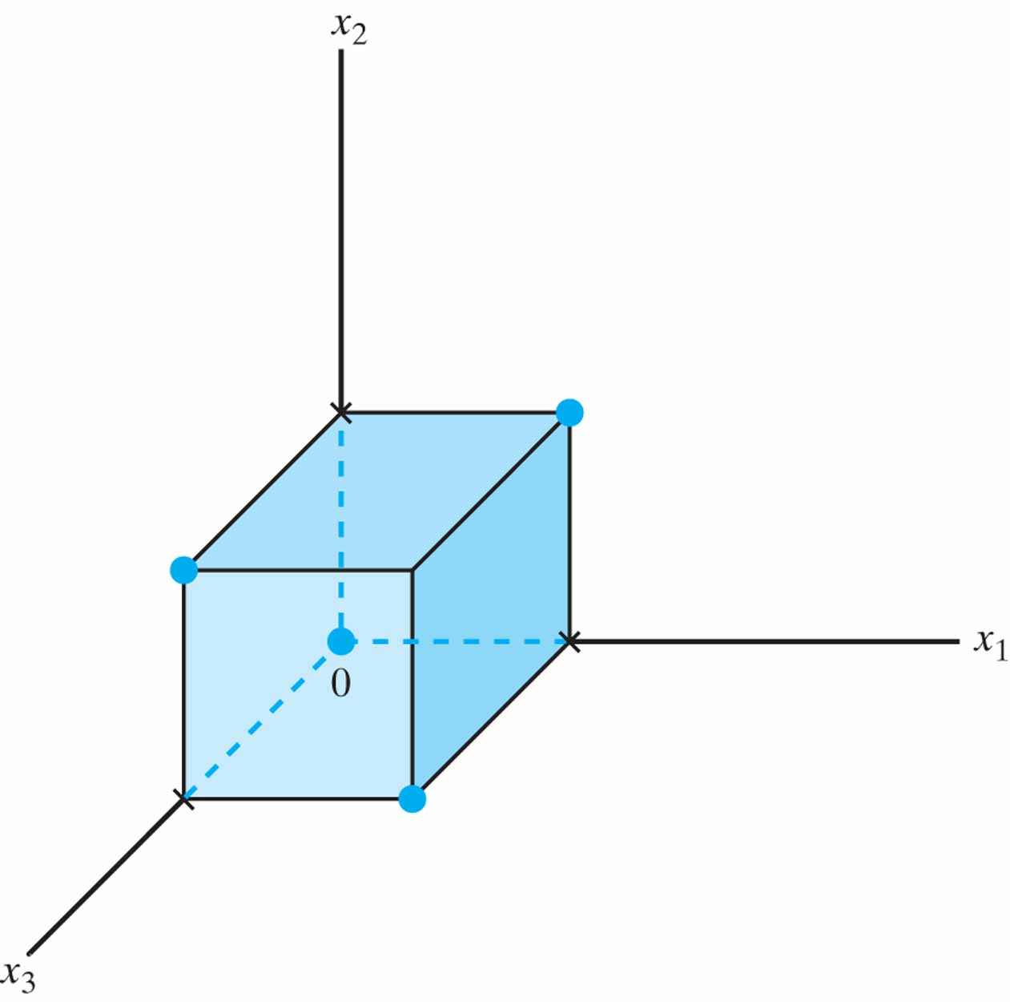
Figure P6.17

Slide 15
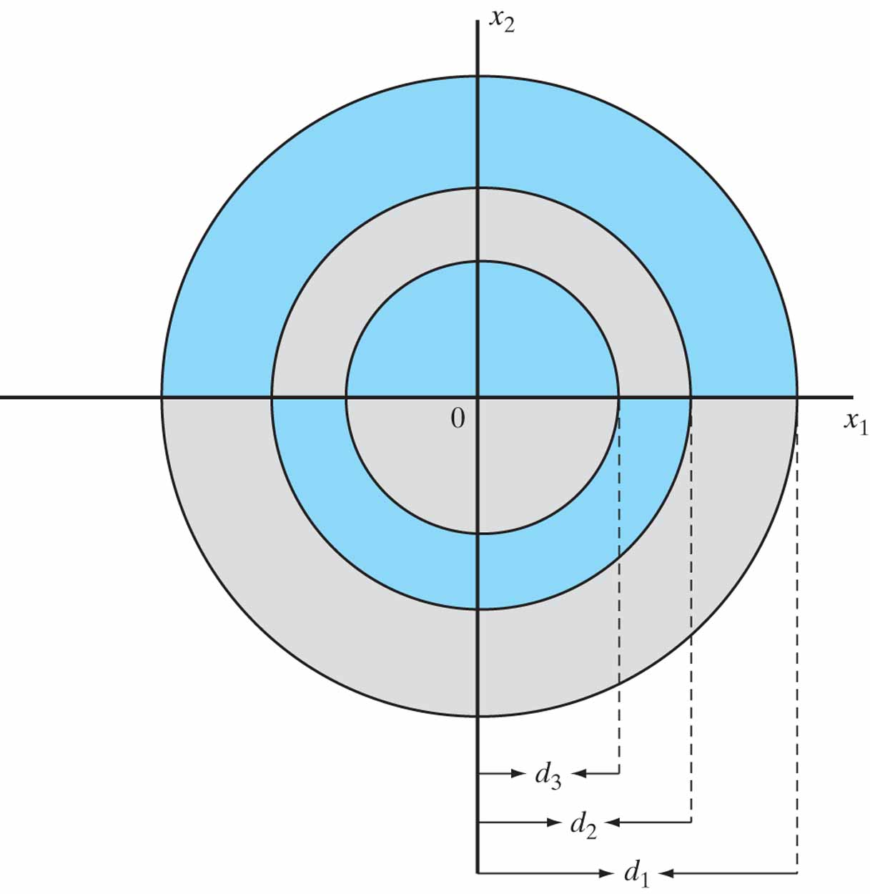
Figure P6.25

