Slide 1
Chapter 7
Regularization Theory

Slide 2
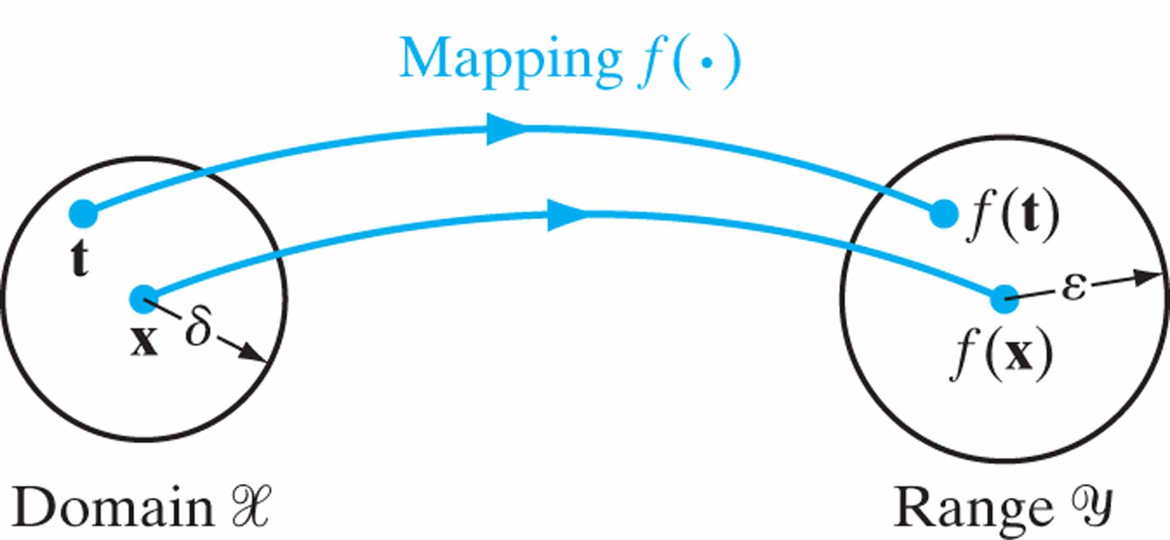
Figure 7.1 Illustration of the mapping of (input) domain X onto (output) range Y.

Slide 3
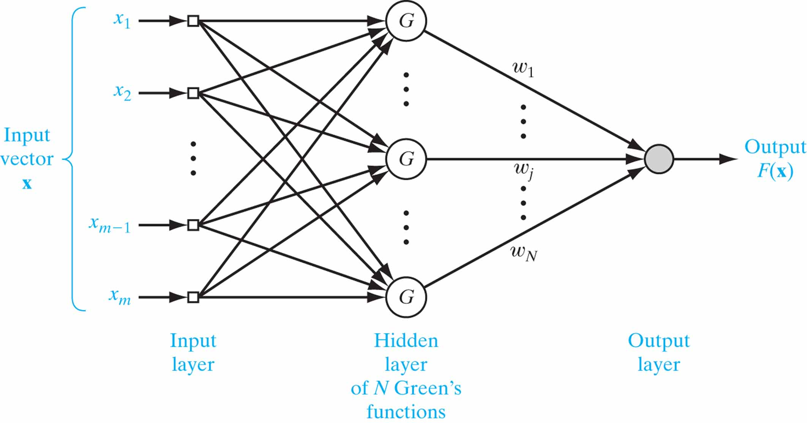
Figure 7.2 Regularization network.

Slide 4
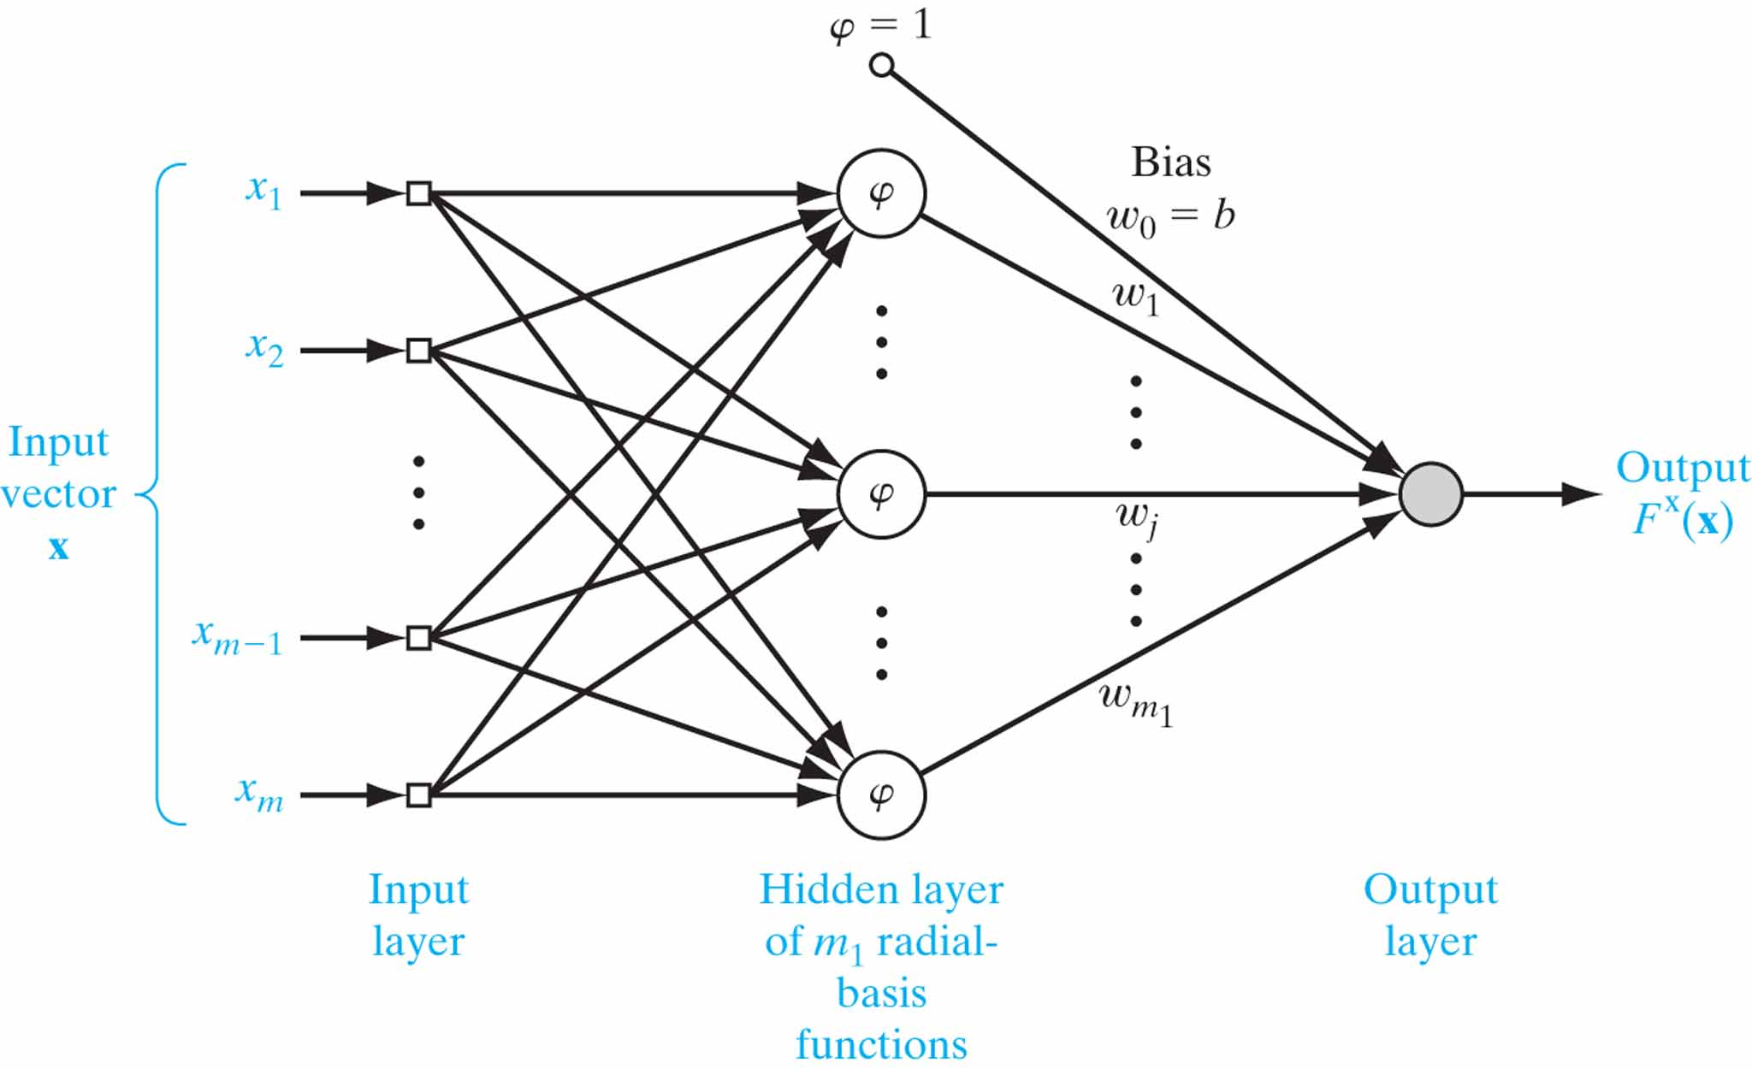
Figure 7.3 Radial-basis-function network of reduced complexity.

Slide 5
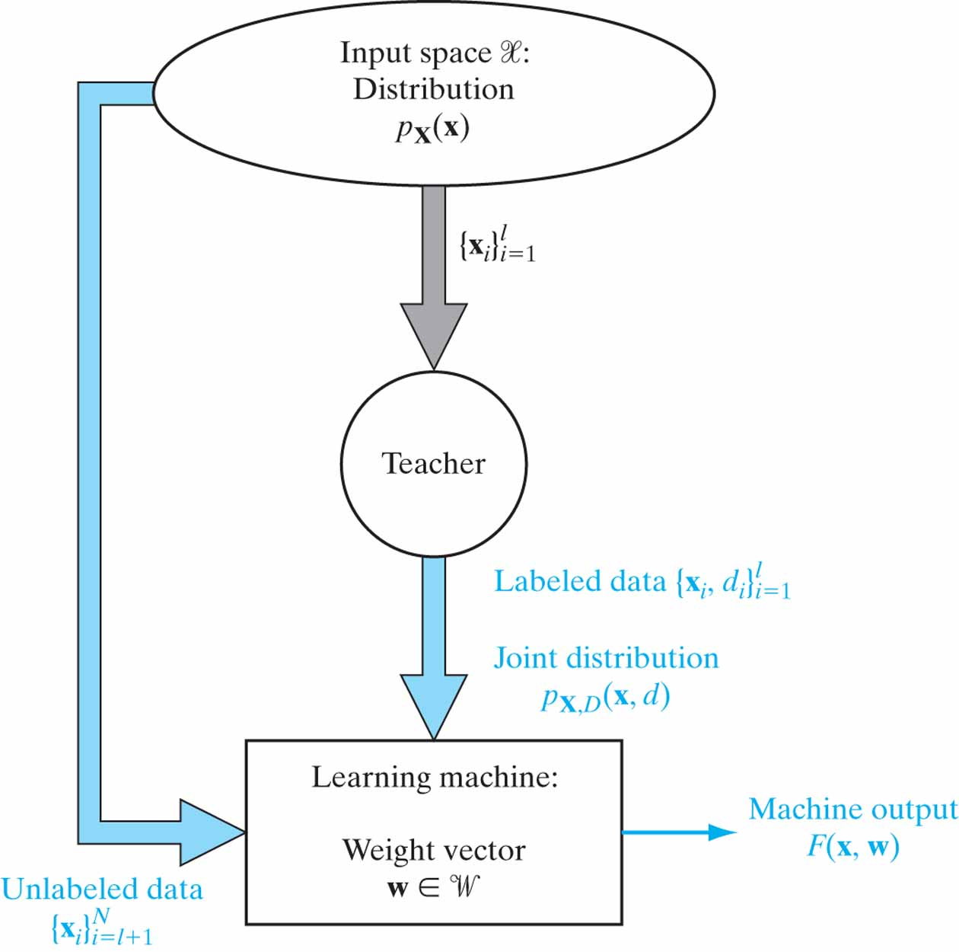
Figure 7.4 Model of the semisupervised learning process.

Slide 6
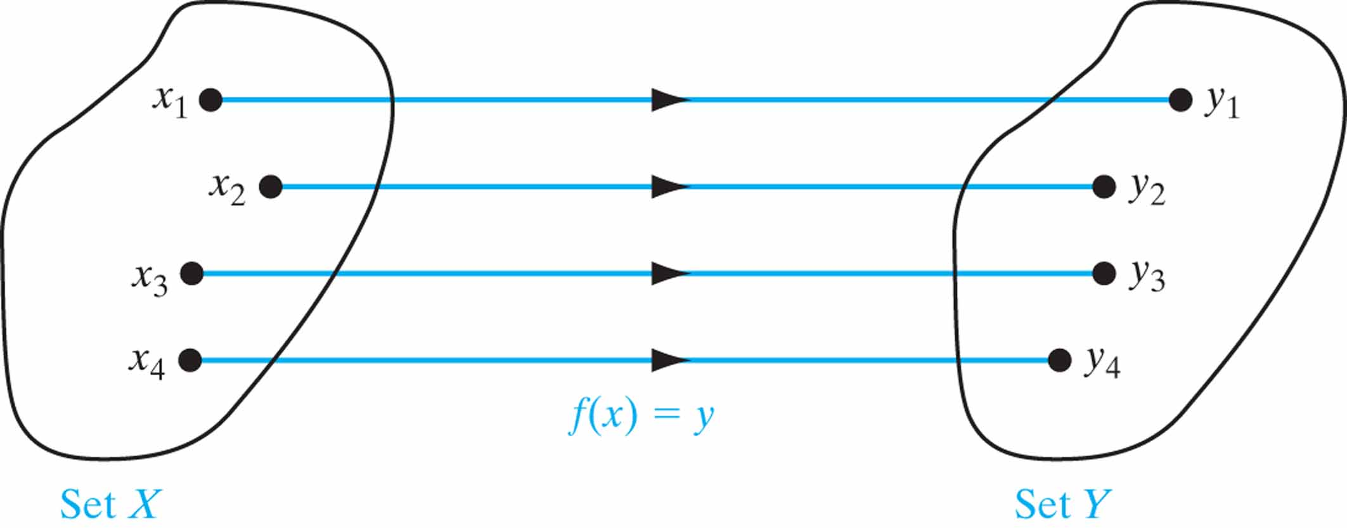
Figure 7.5 A bijection f : X → Y.

Slide 7
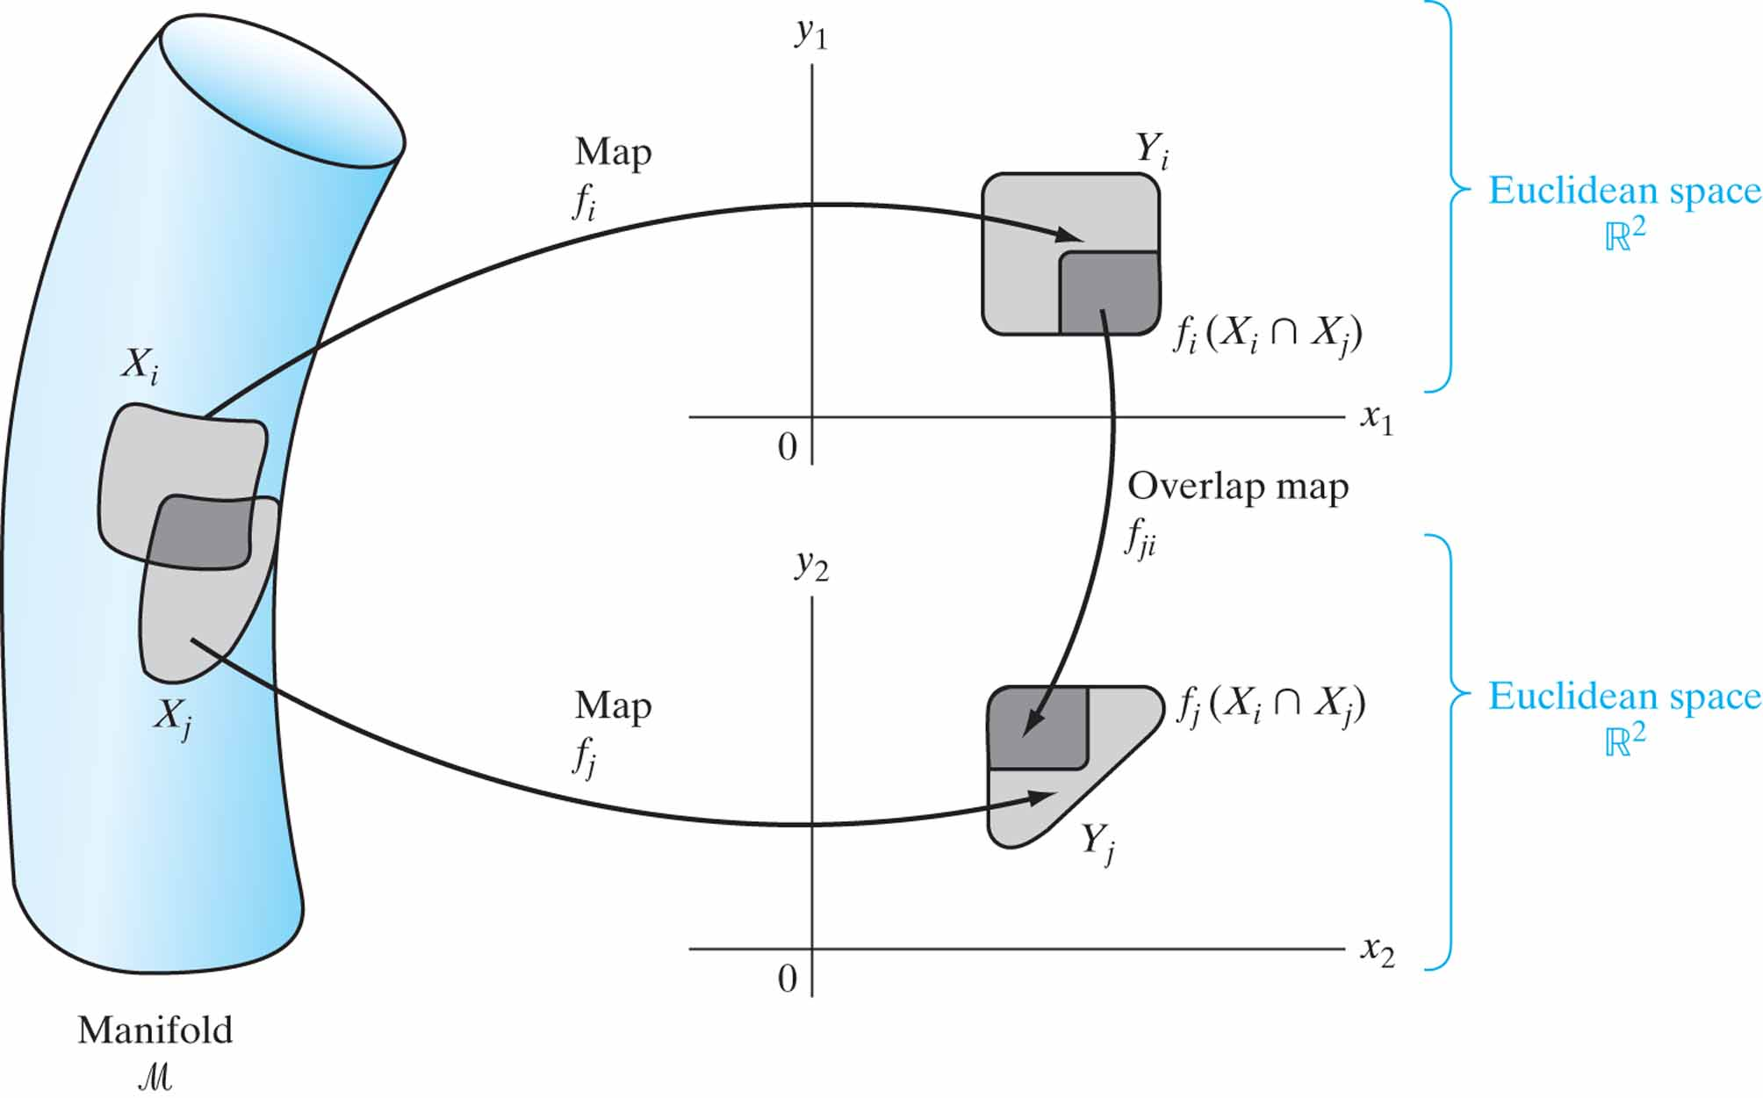
Figure 7.6 Illustrating the relationship between an atlas and its constituent charts. [This figure is adapted from Abraham et al. (1988).]

Slide 8
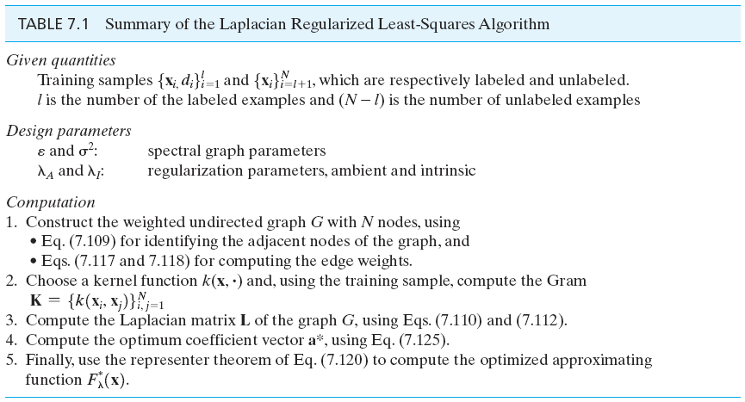
Table 7.1

Slide 9
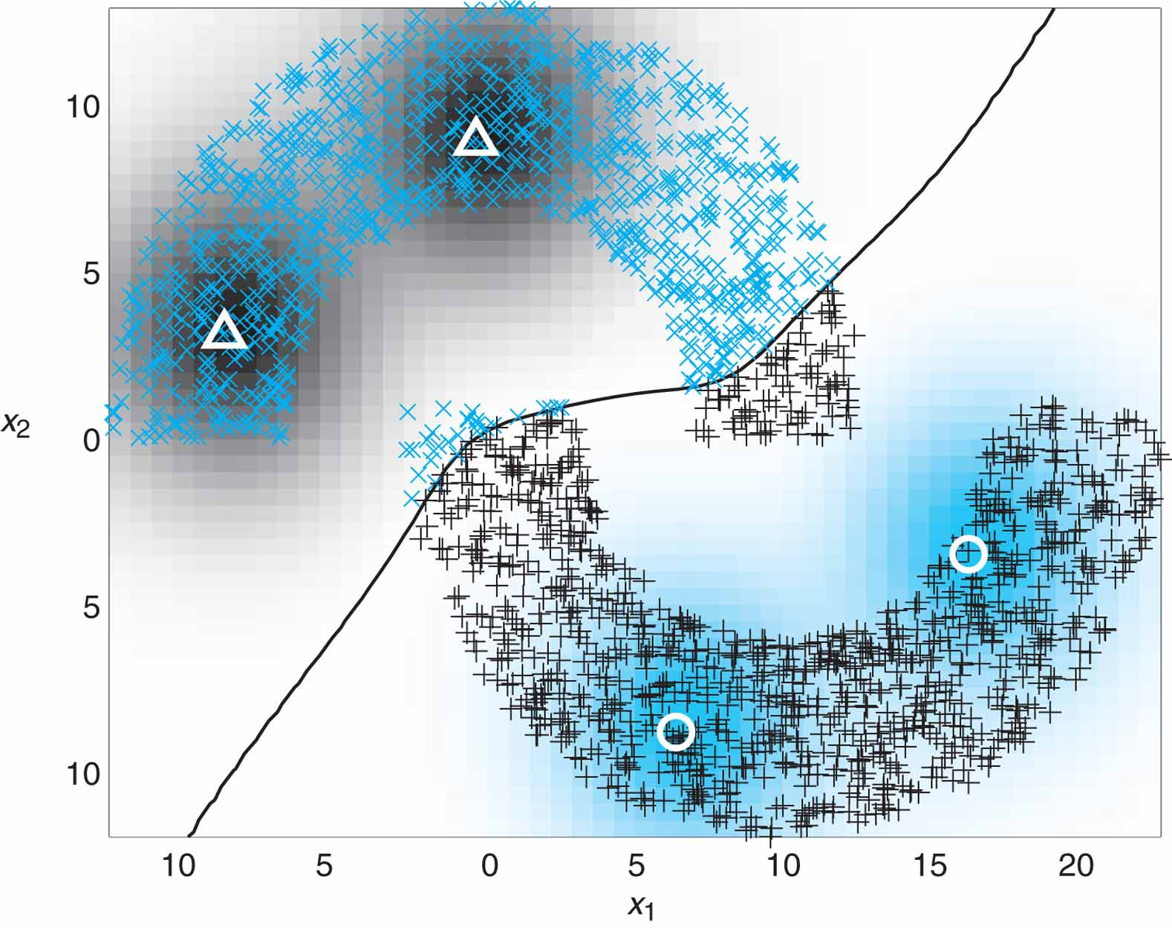
Figure 7.7 Lapacian RLS classification of the double-moon of Fig. 1.8 with distance d = –1 and two labeled data points per class that are denoted by the markers ∆ and . Intrinsic regularization parameter λ_{I} = 0.0001.

Slide 10
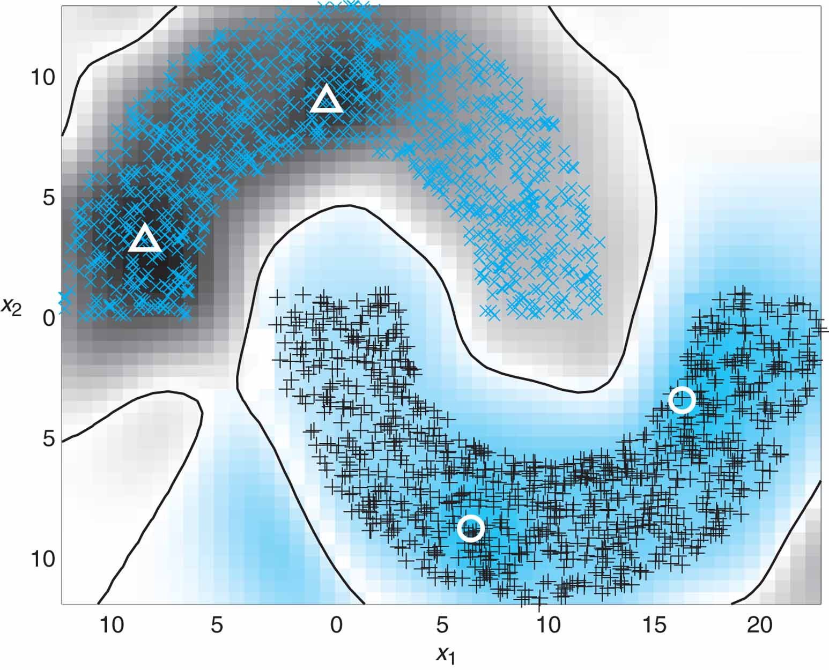
Figure 7.8 Laplacian RLS classification of the double-moon of Fig. 1.8 with distance d = –1 and two labeled data points that are denoted by the markers ∆ and . The intrinsic regularization parameter λ_{I} = 0.1.

Slide 11
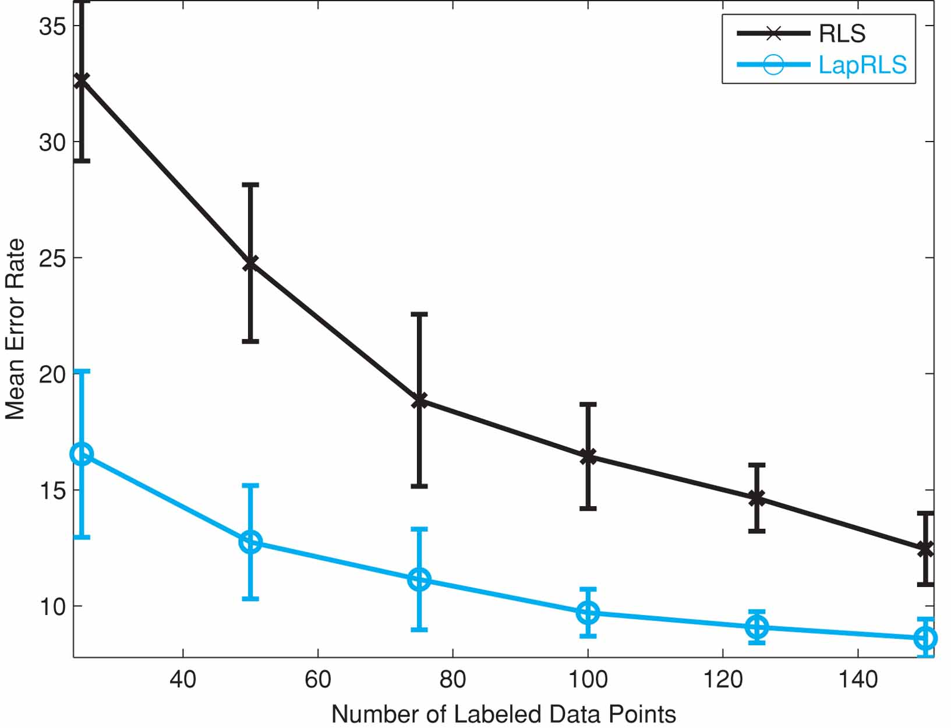
Figure 7.9 USPS data classification using (a) RLS algorithm and (b) Laplician RLS algorithm. (Reproduced with the permission of Dr.Vikas Sindhwani.)

