Slide 1
Chapter 8
Principal-Components Analysis

Slide 2
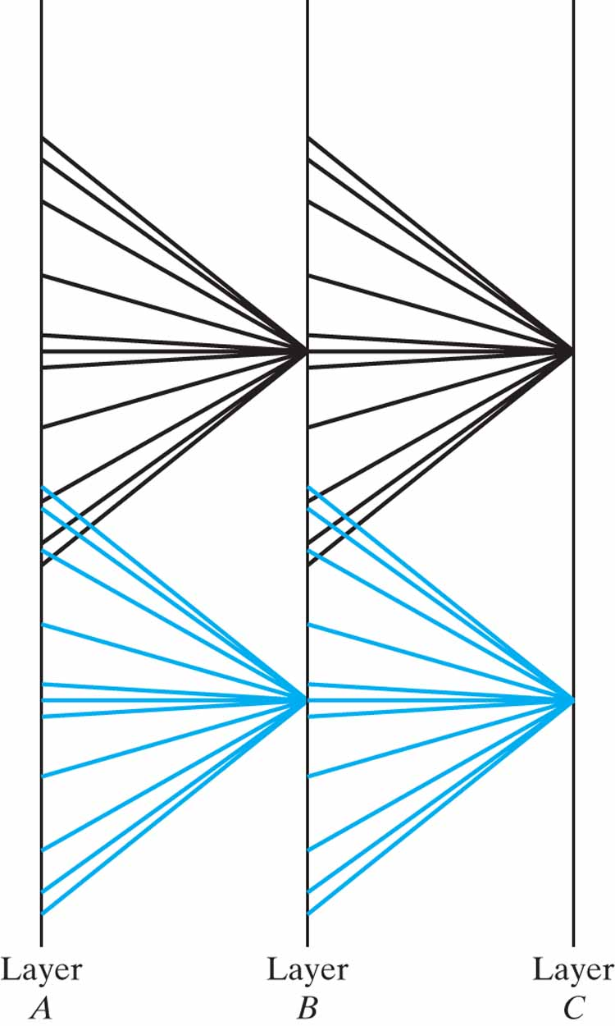
Figure 8.1 Layout of modular self-adaptive Linsker’s model, with overlapping receptive fields.

Slide 3
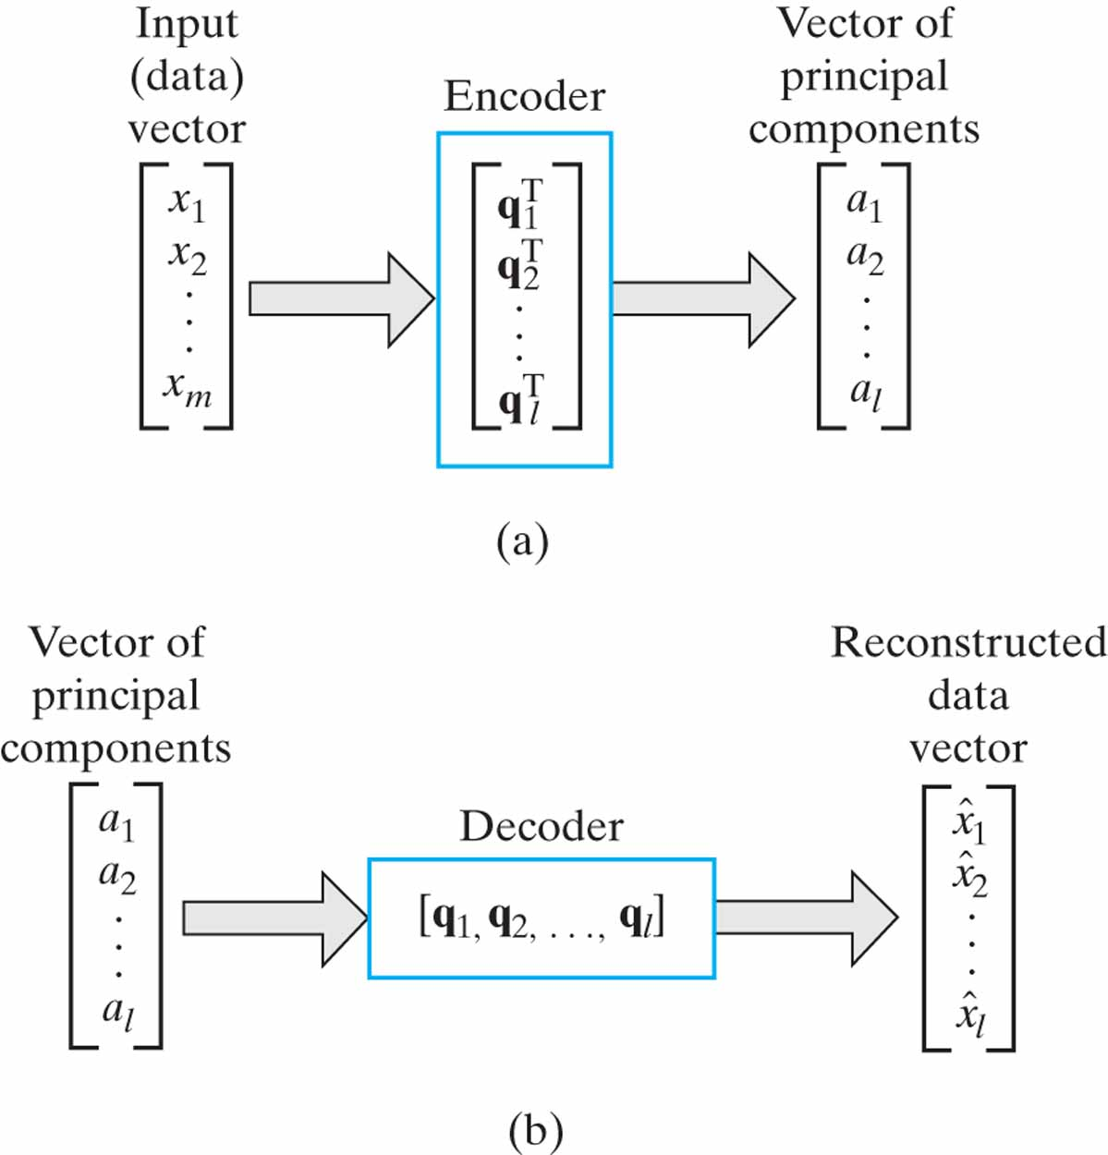
Figure 8.2 Illustration of two phases of principal-components analysis: (a) Encoding. (b) Decoding.

Slide 4
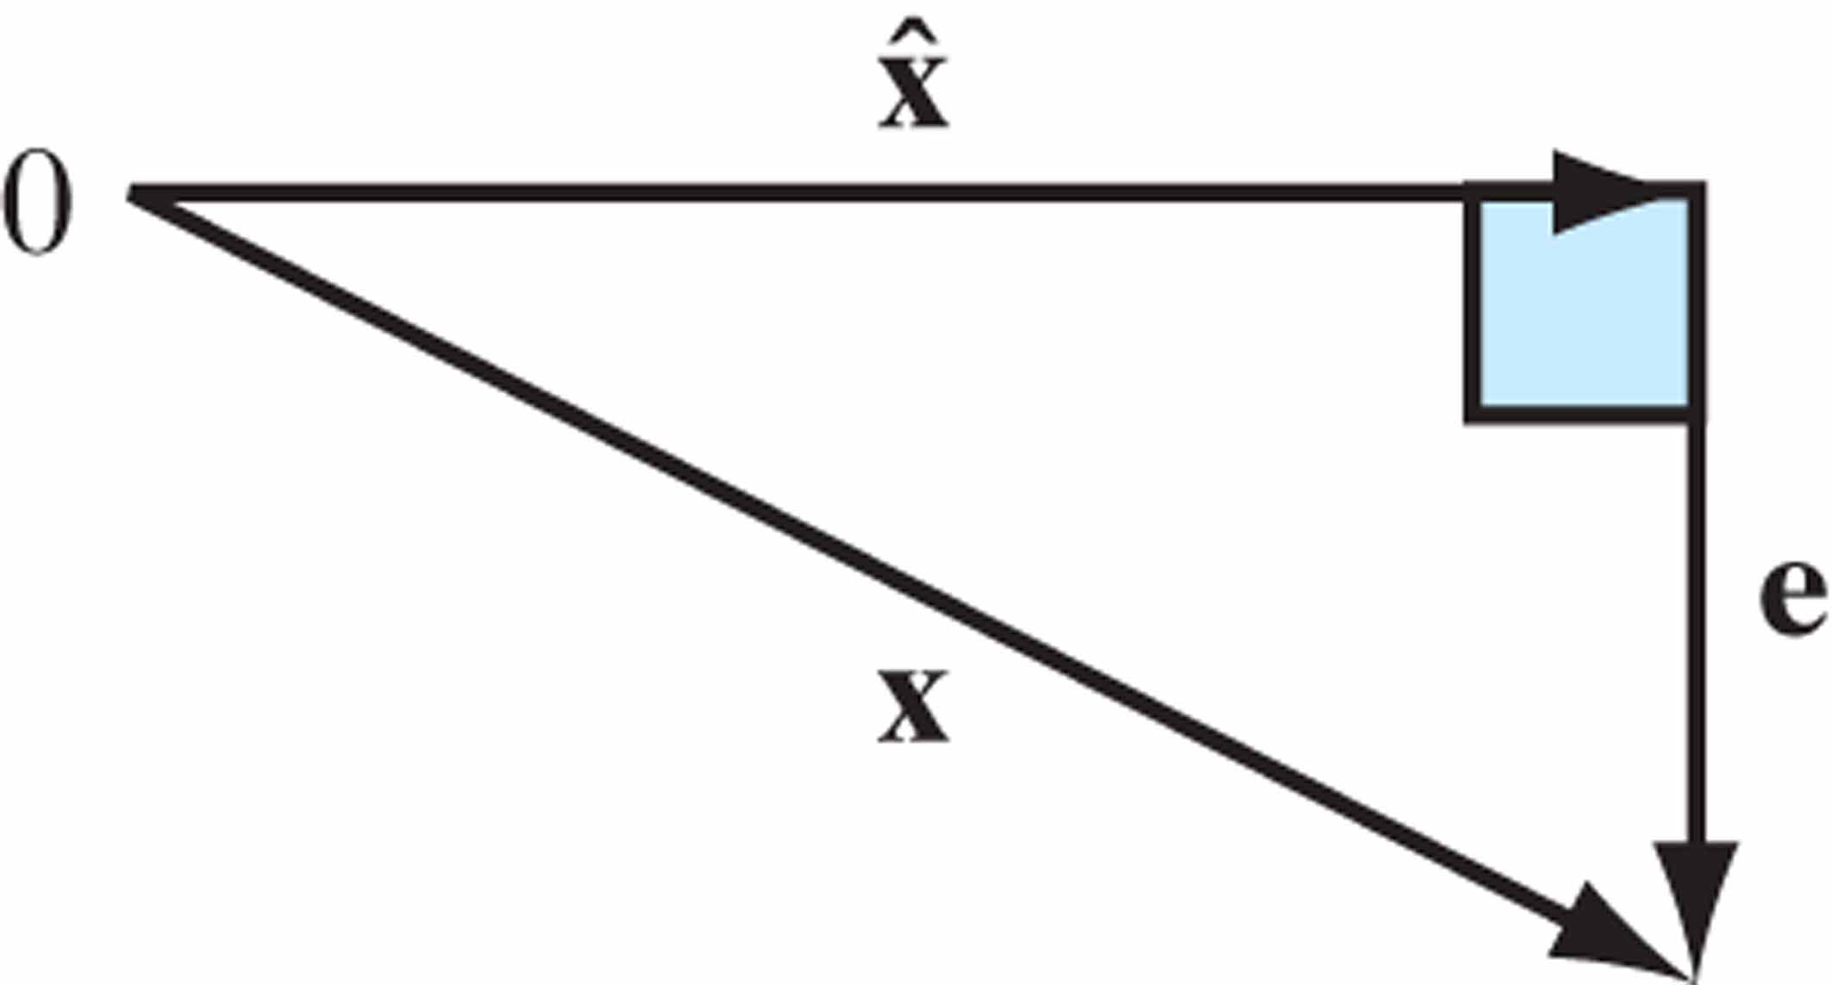
Figure 8.3 Illustration of the relationship between vector x, its reconstructed version x, and error vector e.
ˆ

Slide 5
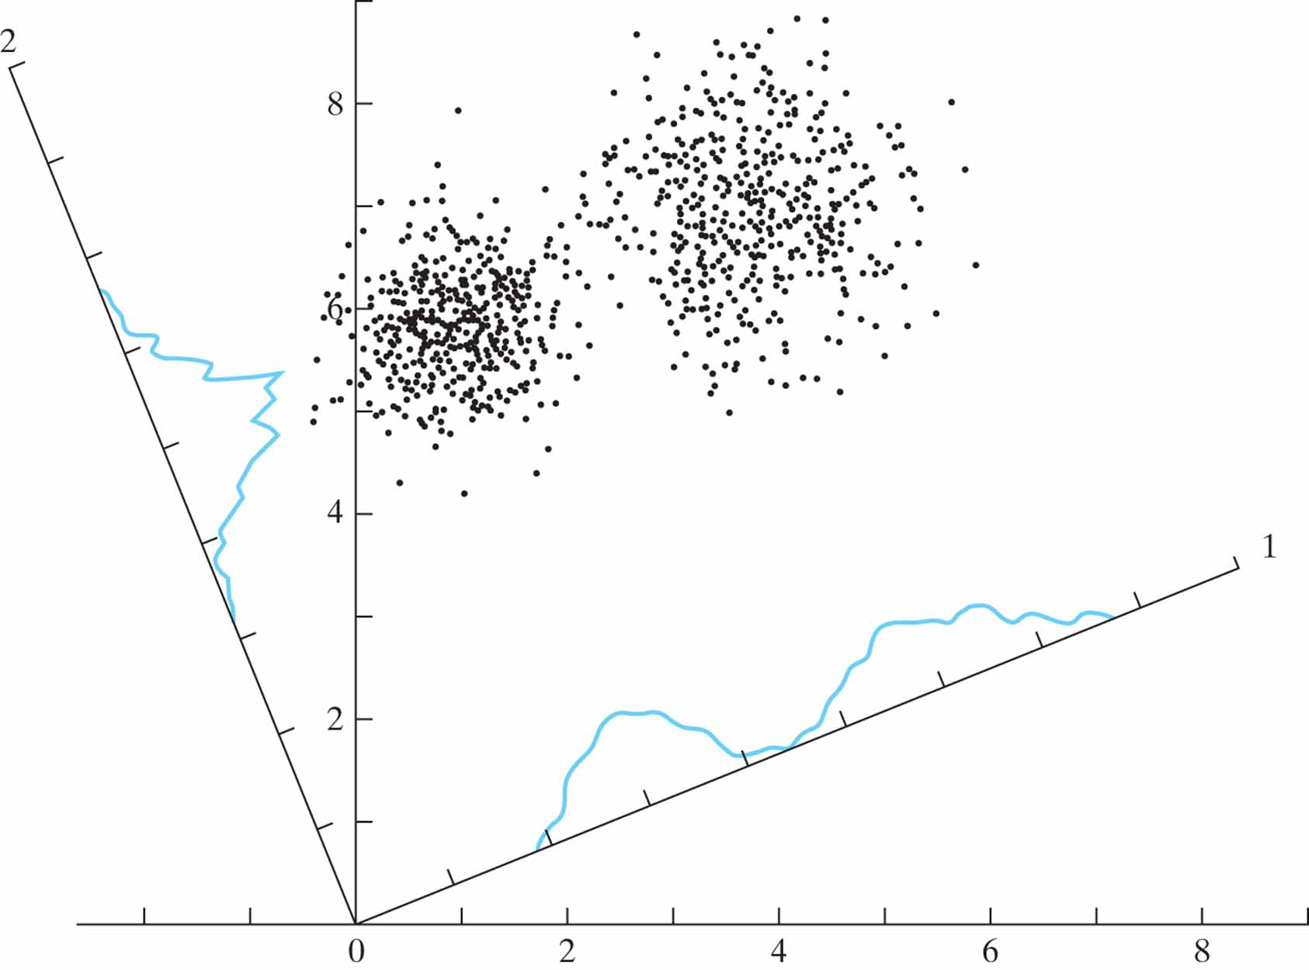
Figure 8.4 A cloud of data points is shown in two dimensions, and the density plots formed by projecting this cloud onto each of two axes, 1 and 2, are indicated. The projection onto axis 1 has maximum variance and clearly shows the bimodal, or clustered, character of the data.

Slide 6
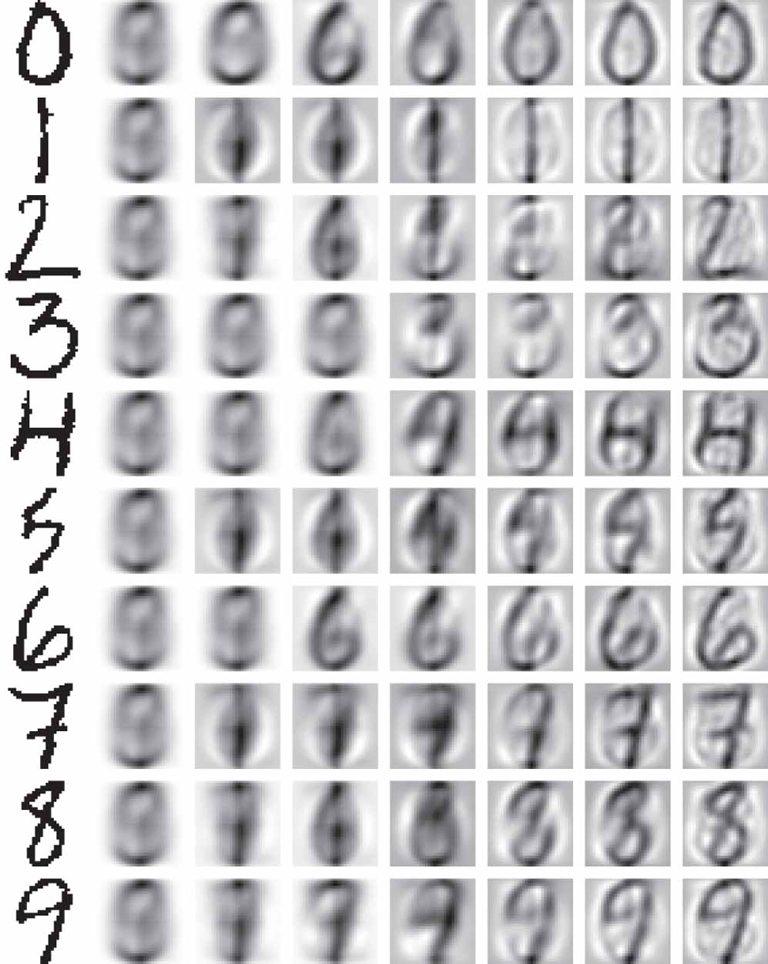
Figure 8.5 Digital compression of handwritten digits using principal-components analysis. (This figure is reproduced with the permission of Dr. Juha Karhunen.)

Slide 7
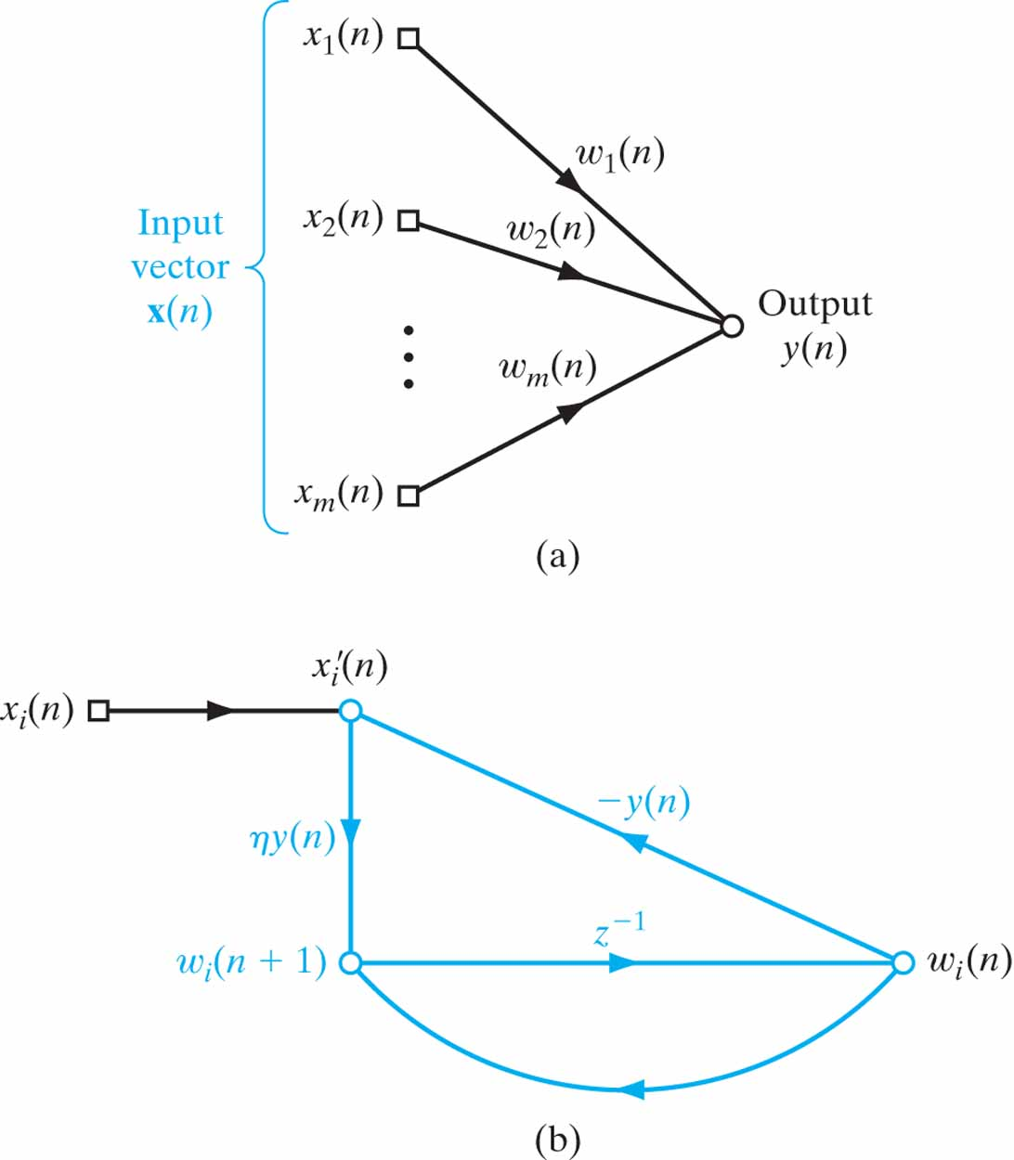
Figure 8.6 Signal-flow graph representation of maximum eigenfilter. (a) Graph of Eq. (8.36). (b) Graph of Eqs. (8.41) and (8.42).

Slide 8
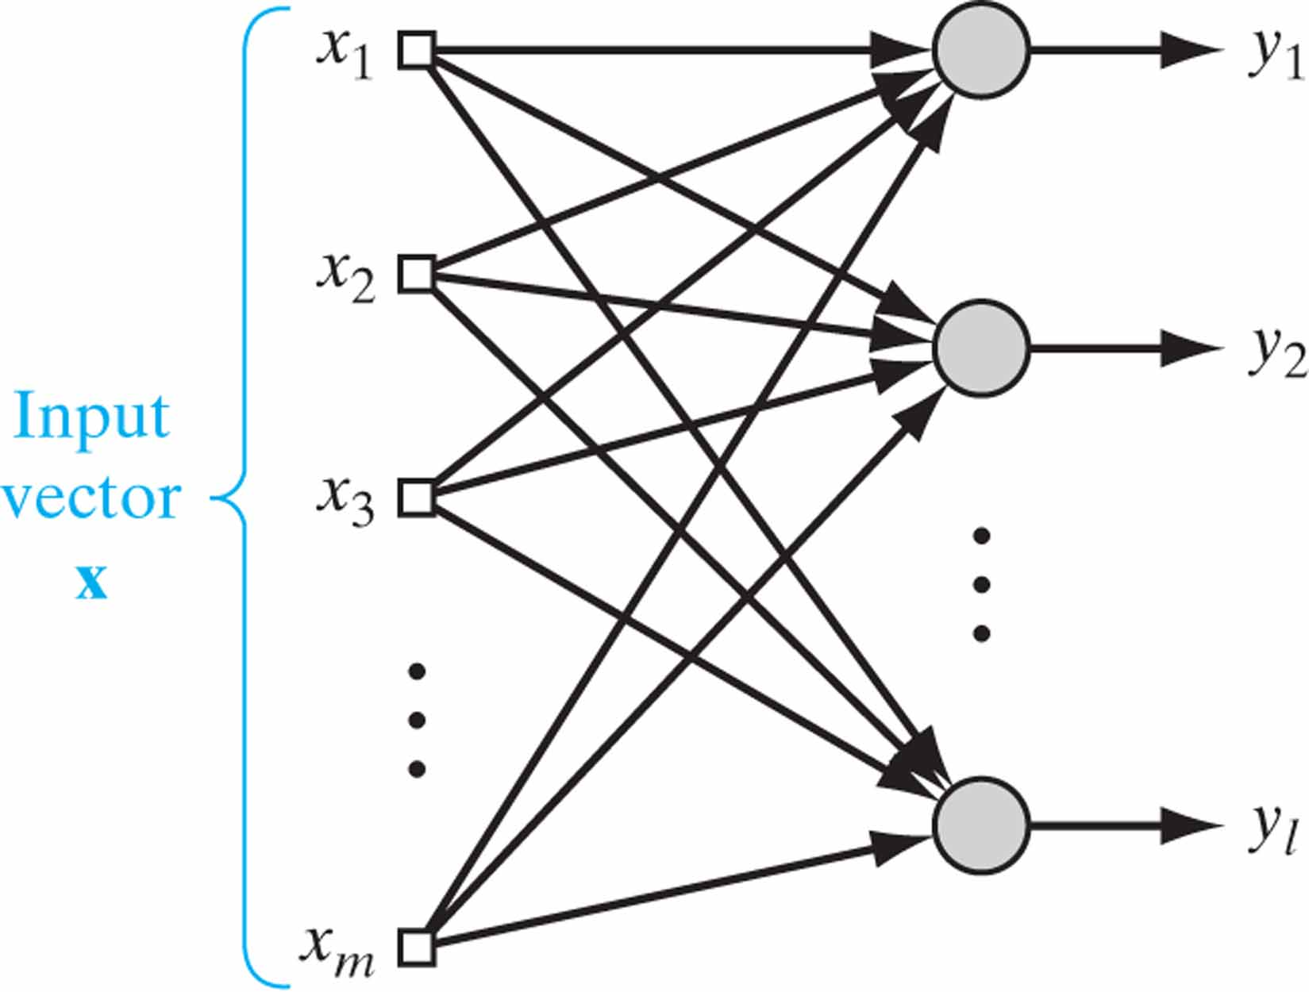
Figure 8.7 Feedforward network with a single layer of computational nodes.

Slide 9
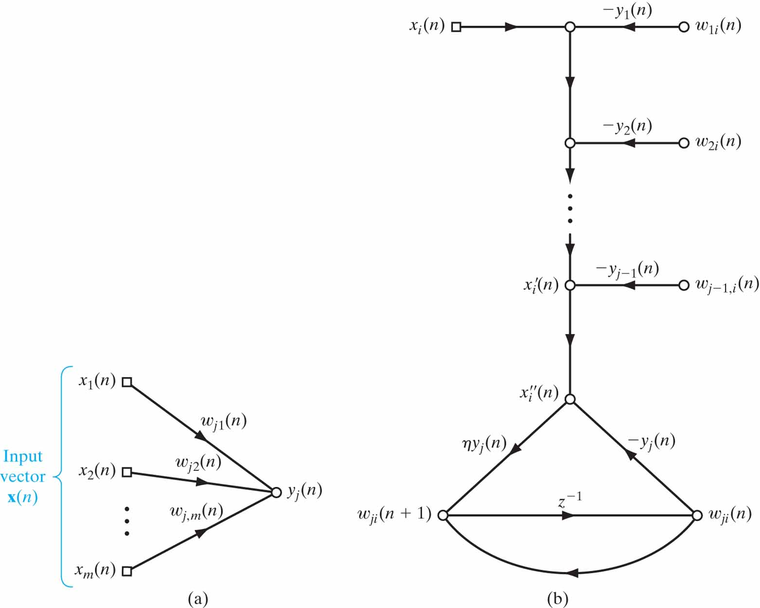
Figure 8.8 The signal-flow graph representation of generalized Hebbian algorithm. (a) Graph of Eq. (8.79). (b) Graph of Eqs. (8.80) through (8.81), where x'_{i}(n) and x"_{i} (n) are defined in Eqs. (8.82) and (8.84).

Slide 10
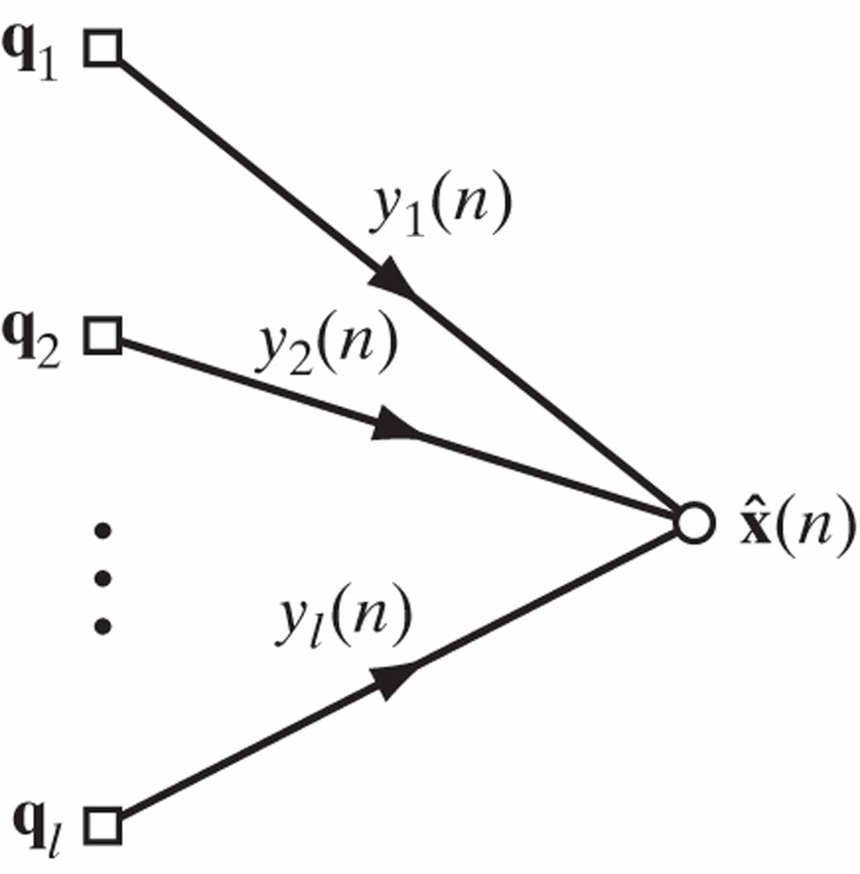
Figure 8.9 Signal-flow graph representation of how the reconstructed vector is x computed in the GHA.
ˆ

Slide 11
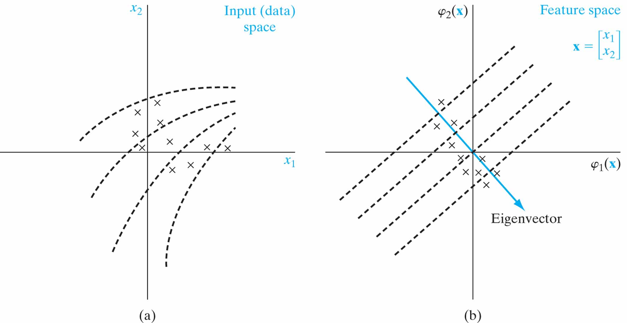
Figure 8.12 Illustration of kernel PCA. (a) Two-dimensional input space, displaying a set of data points. (b) Two-dimensional feature space, displaying the induced images of the data points congregating around a principal eigenvector. The uniformly spaced dashed lines in part (b) represent contours of constant projections onto the eigenvector; the corresponding contours are nonlinear in the input space.

Slide 12
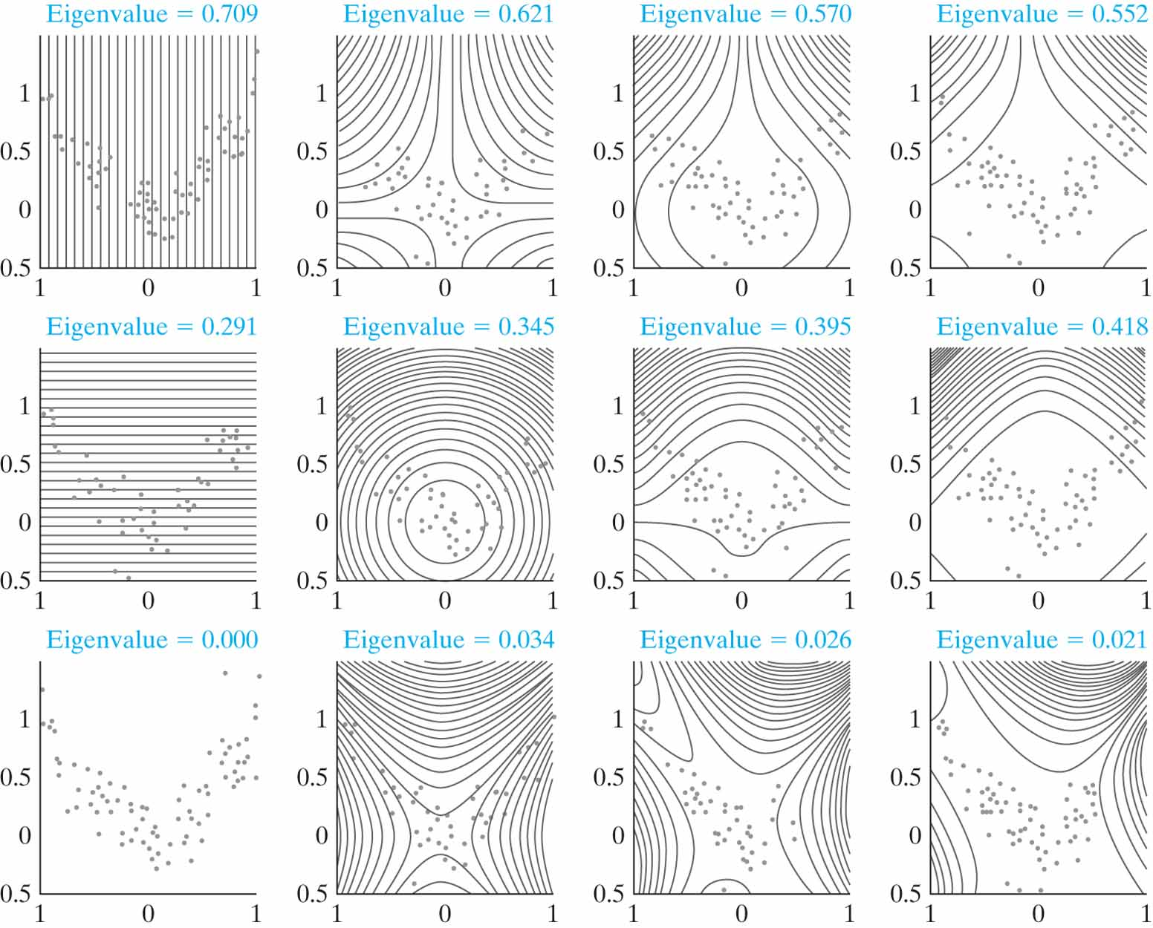
Figure 8.13 Two-dimensional example illustrating kernel PCA. From left to right, the polynomial degree of the kernel is d = 1, 2, 3, and 4, respectively. From top to bottom, the first three eigenvectors in the feature space are shown. The first column corresponds to linear PCA, and the other three columns correspond to kernel PCA with polynomial degree d = 2, 3, and 4, respectively. (Reproduced with permission from Dr. Klaus-Robert Müller.)

Slide 13
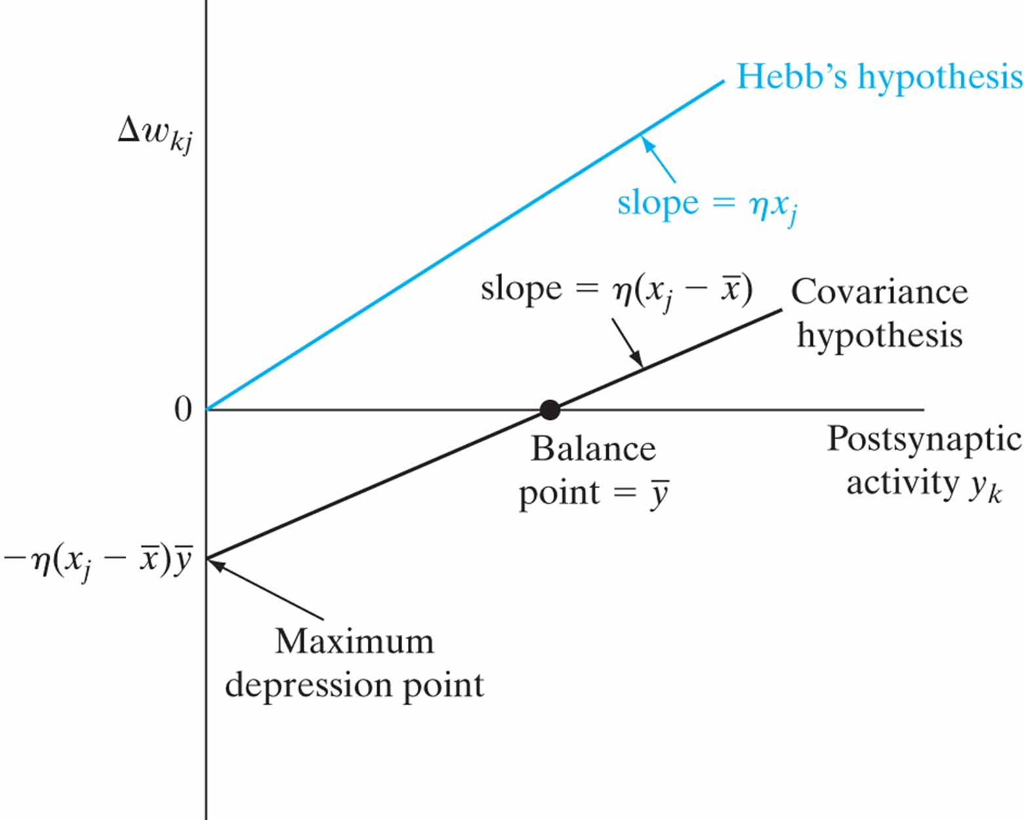
Figure A Illustration of Hebb’s hypothesis and the covariance hypothesis.

Slide 14
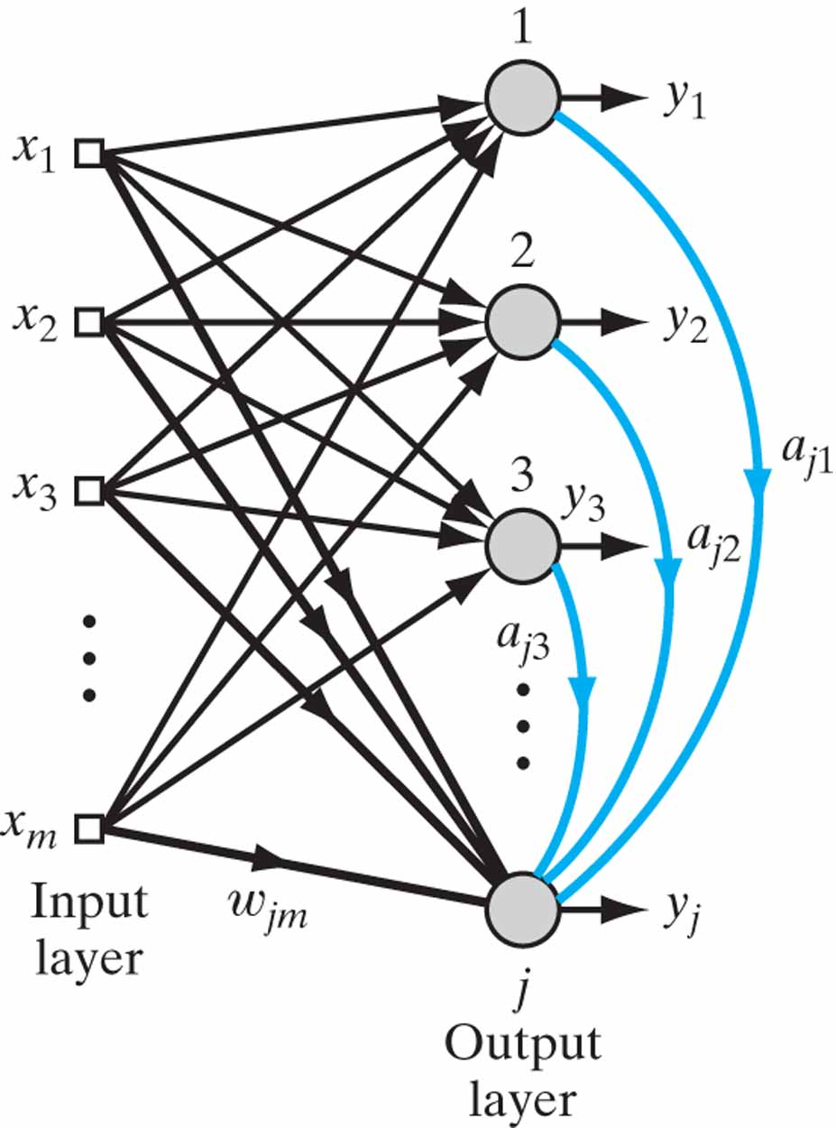
Figure P8.14 Network with feedforward and lateral connections for deriving the APEX algorithm.

