Slide 1
Chapter 9
Self-Organizing Maps

Slide 2
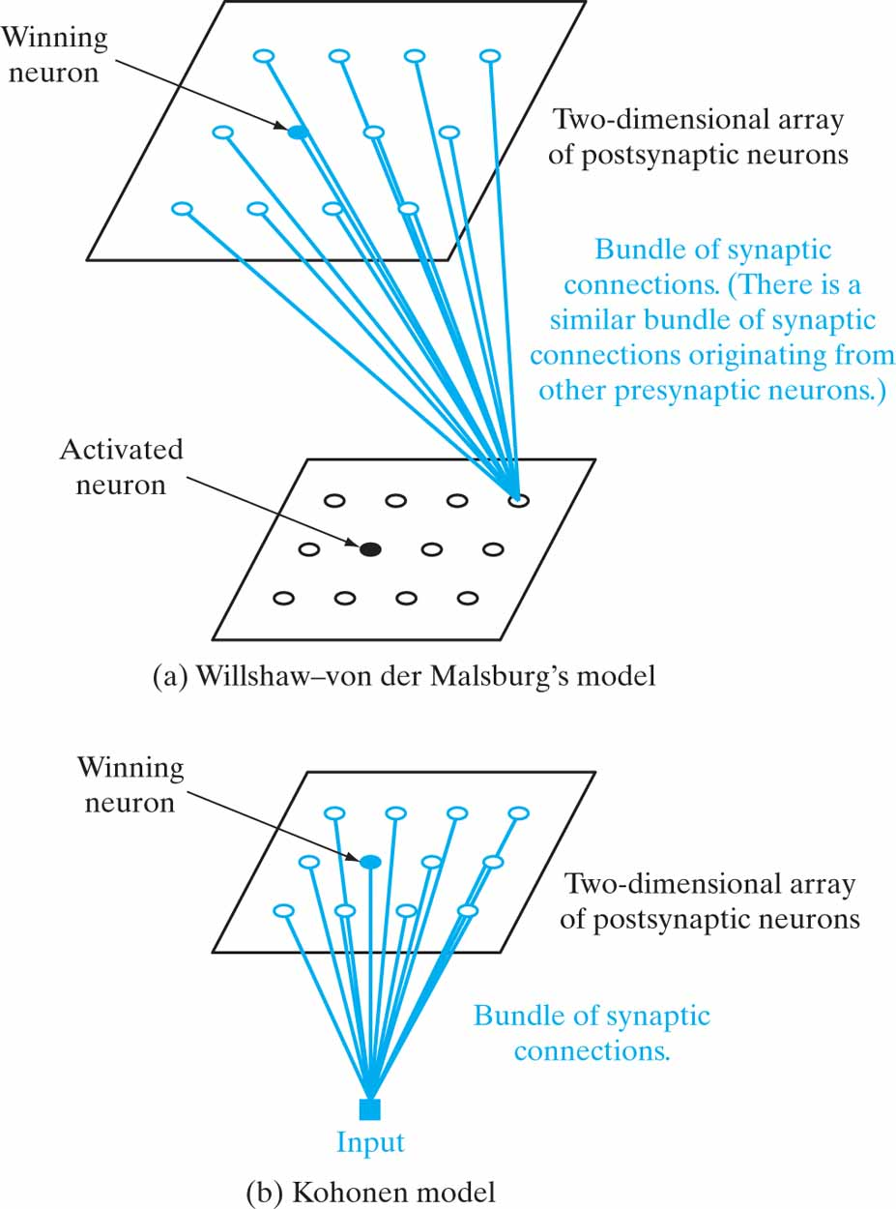
Figure 9.1 Two self-organized feature maps.

Slide 3
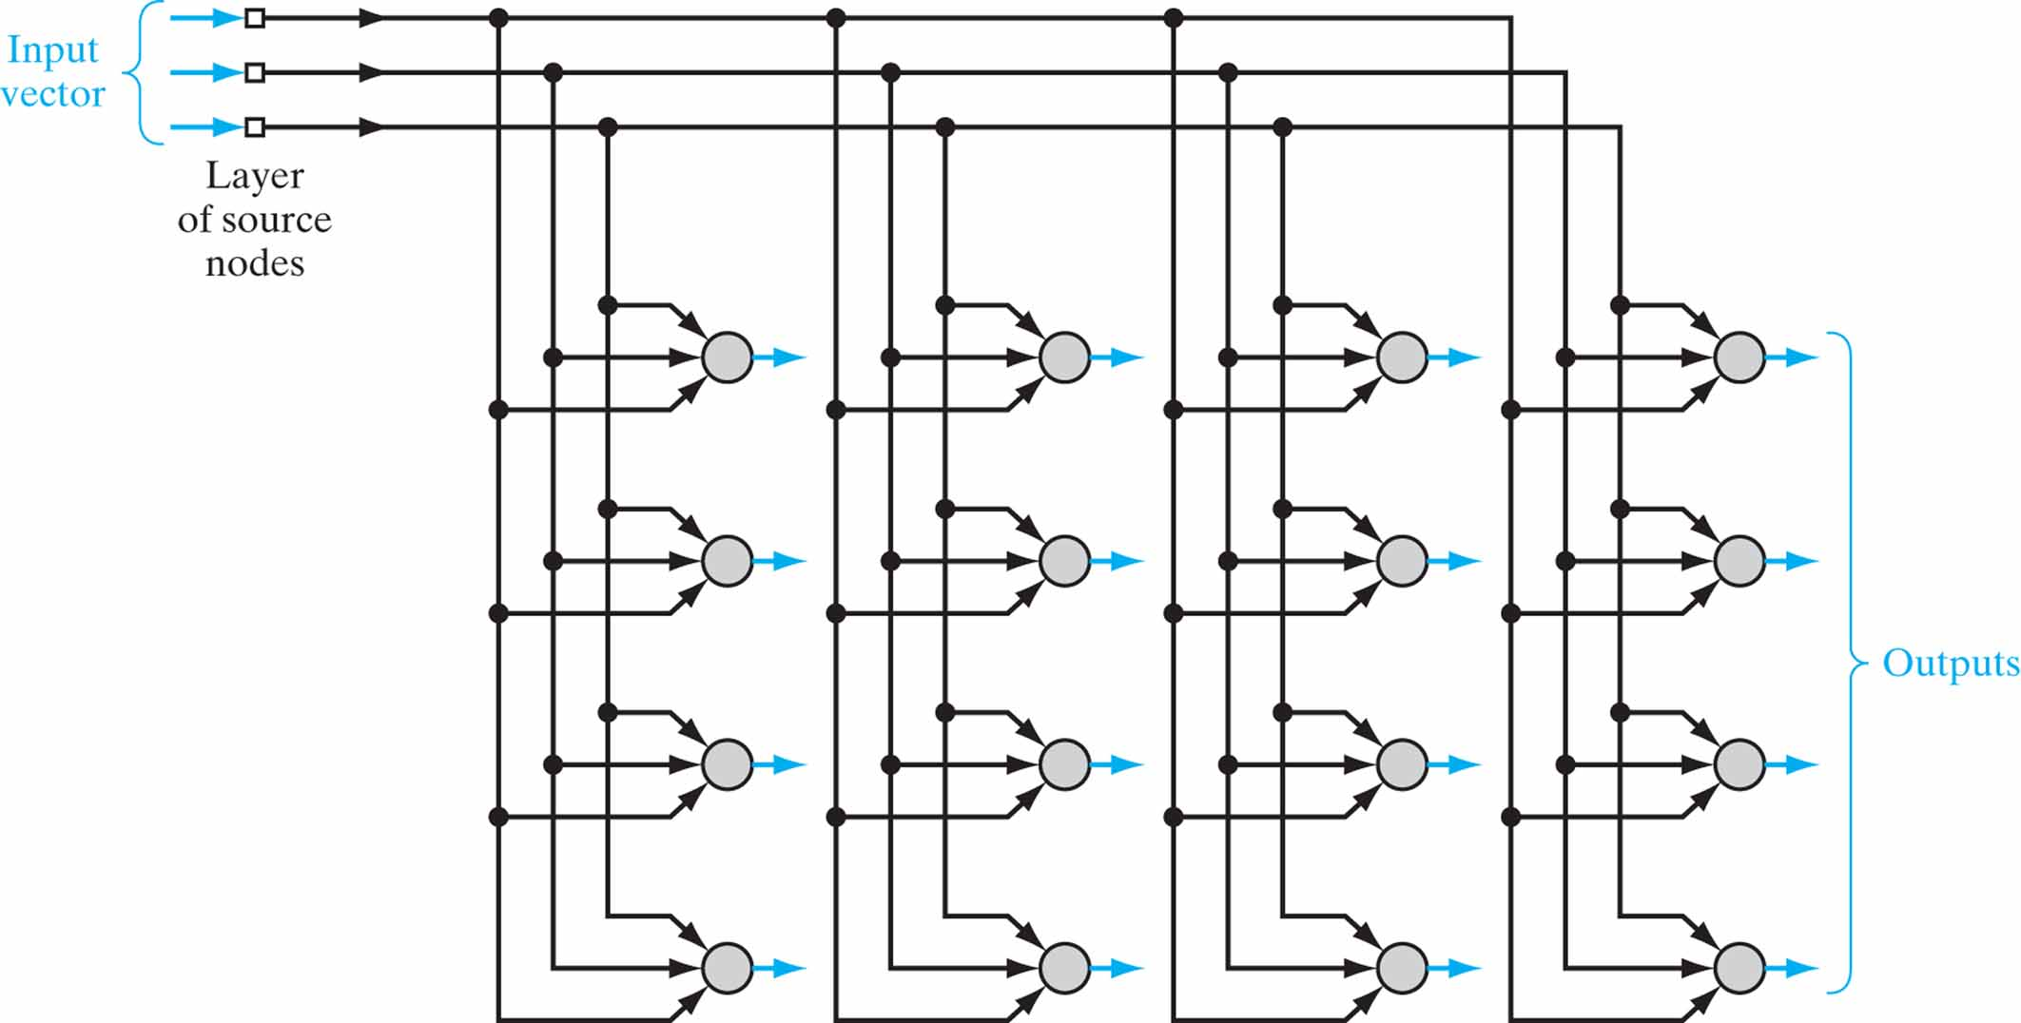
Figure 9.2 Two-dimensional lattice of neurons, illustrated for a three-dimensional input and four-by-four dimensional output (all shown in blue).

Slide 4
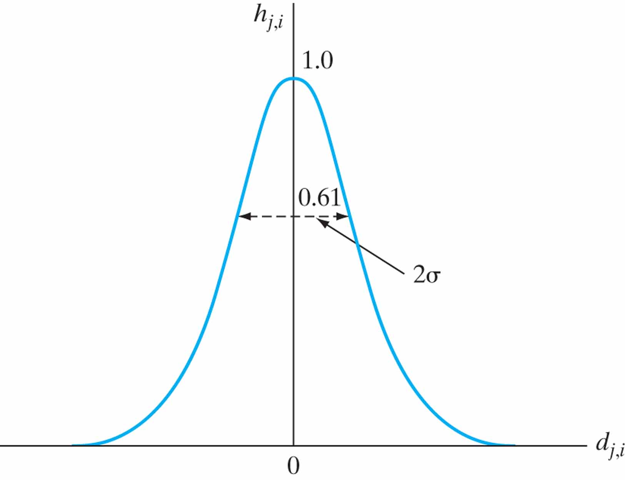
Figure 9.3 Gaussian neighborhood function.

Slide 5
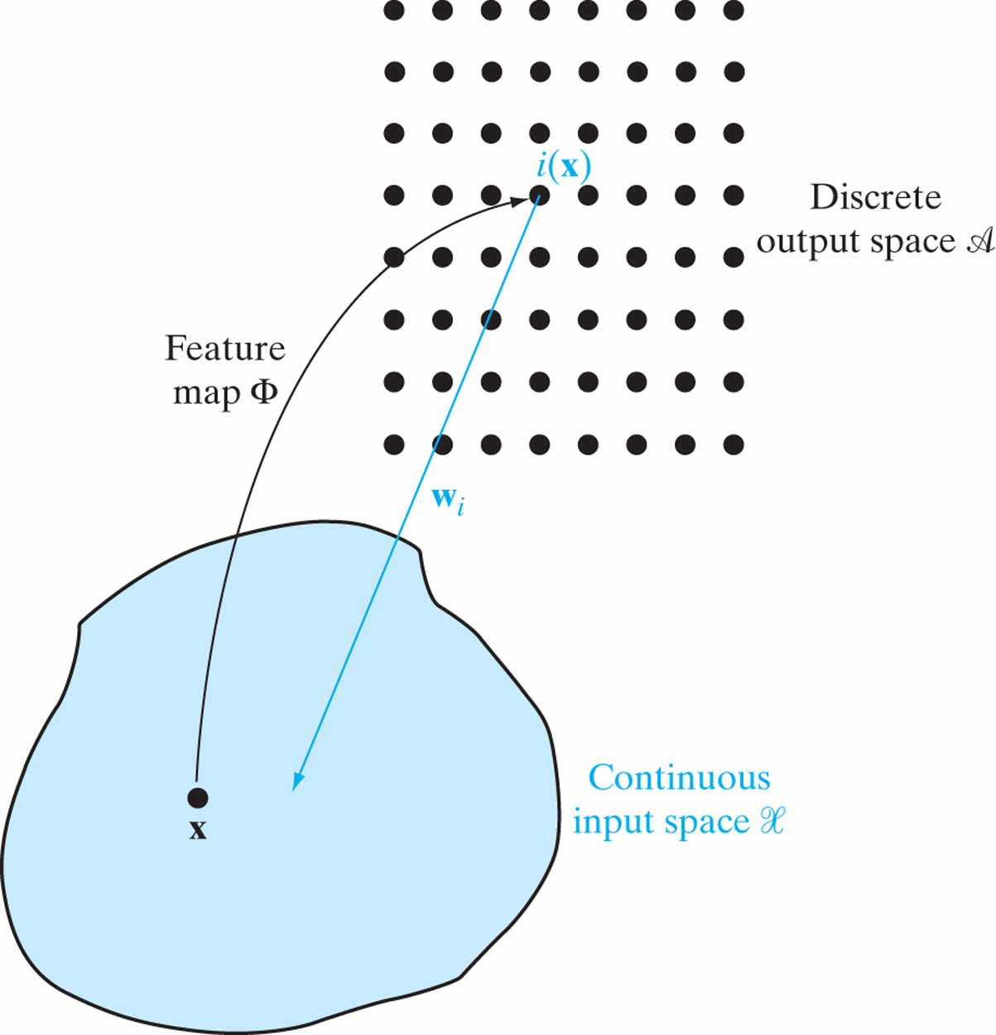
Figure 9.4 Illustration of the relationship between feature map Փ and weight vector w_{i} of winning neuron i.

Slide 6
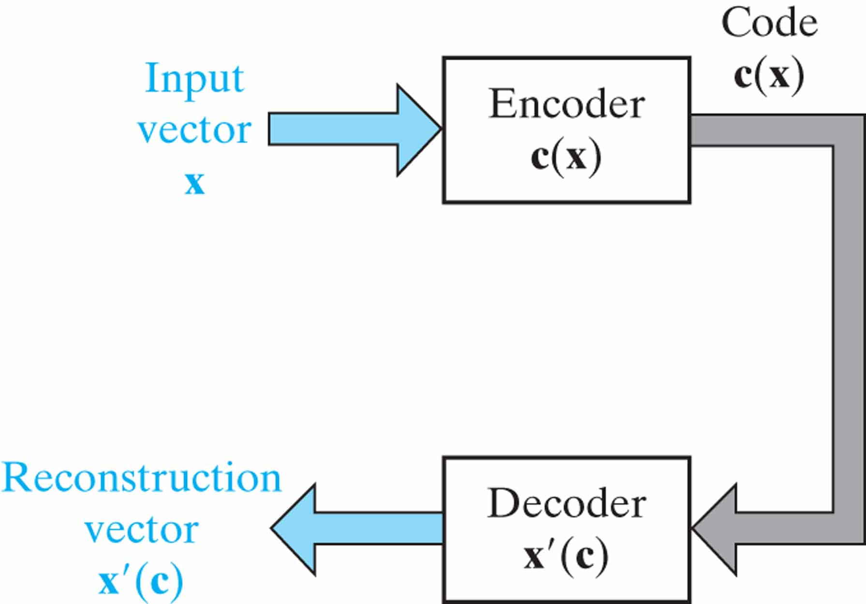
Figure 9.5 Encoder–decoder model for describing Property 1 of the SOM model.

Slide 7
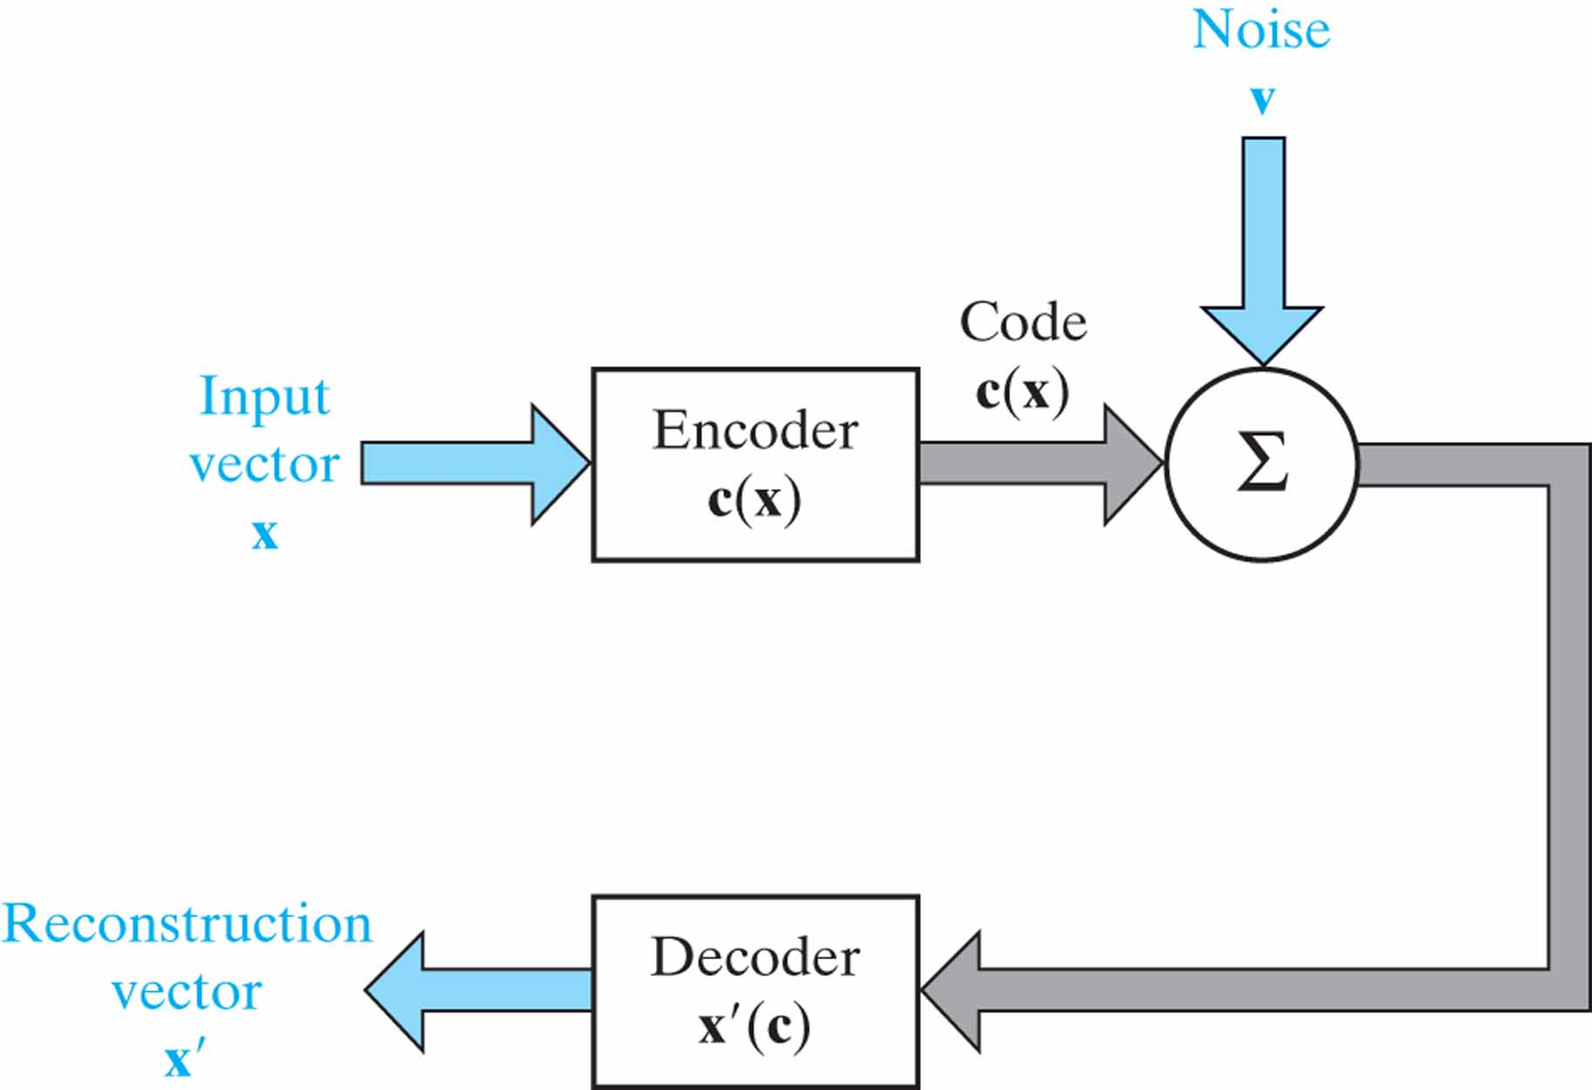
Figure 9.6 Noisy encoder–decoder model.

Slide 8
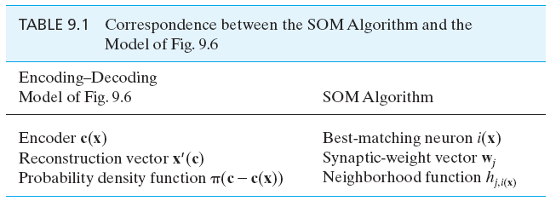
Table 9.1

Slide 9
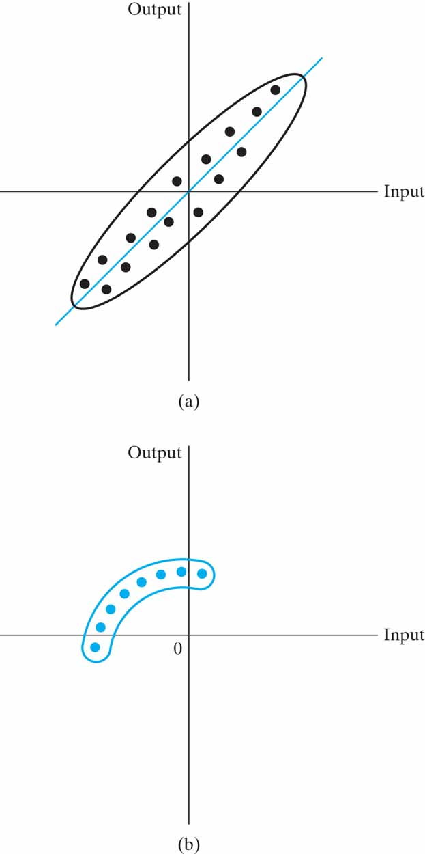
Figure 9.7 (a) Two-dimensional distribution produced by a linear input–output mapping. (b) Two-dimensional distribution produced by a nonlinear input–output mapping.

Slide 10
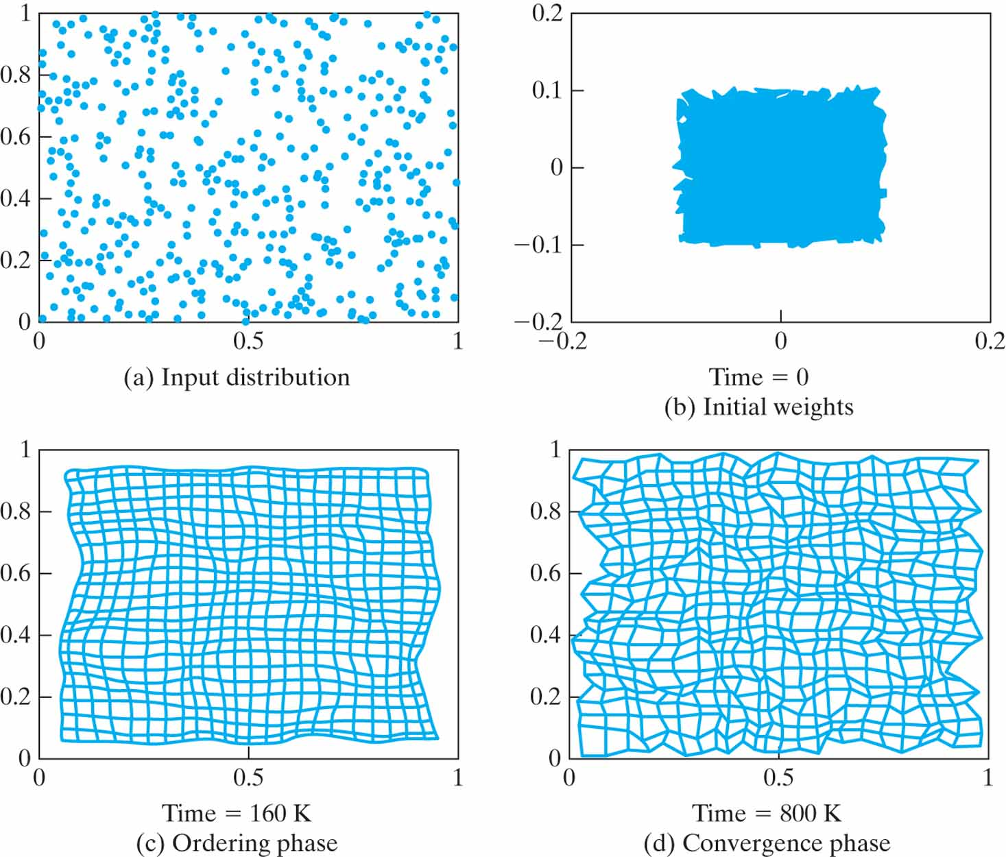
Figure 9.8 (a) Distribution of the input data. (b) Initial condition of the two-dimensional lattice. (c) Condition of the lattice at the end of the ordering phase. (d) Condition of the lattice at the end of the convergence phase. The times indicated under maps (b), (c), and (d) represent the numbers of iterations.

Slide 11
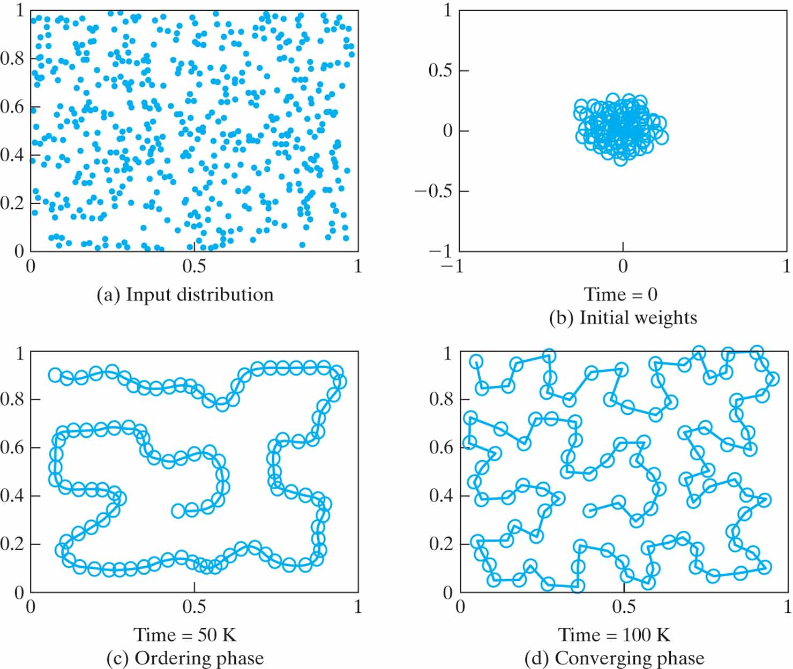
Figure 9.9 (a) Distribution of the two-dimensional input data. (b) Initial condition of the one-dimensional lattice. (c) Condition of the one dimensional lattice at the end of the ordering phase. (d) Condition of the lattice at the end of the convergence phase. The times included under maps (b), (c), and (d) represent the numbers of iterations.

Slide 12
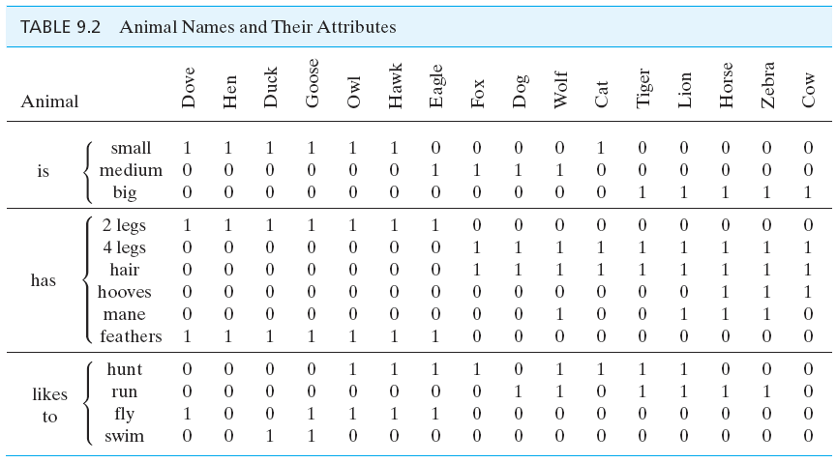
Table 9.2

Slide 13
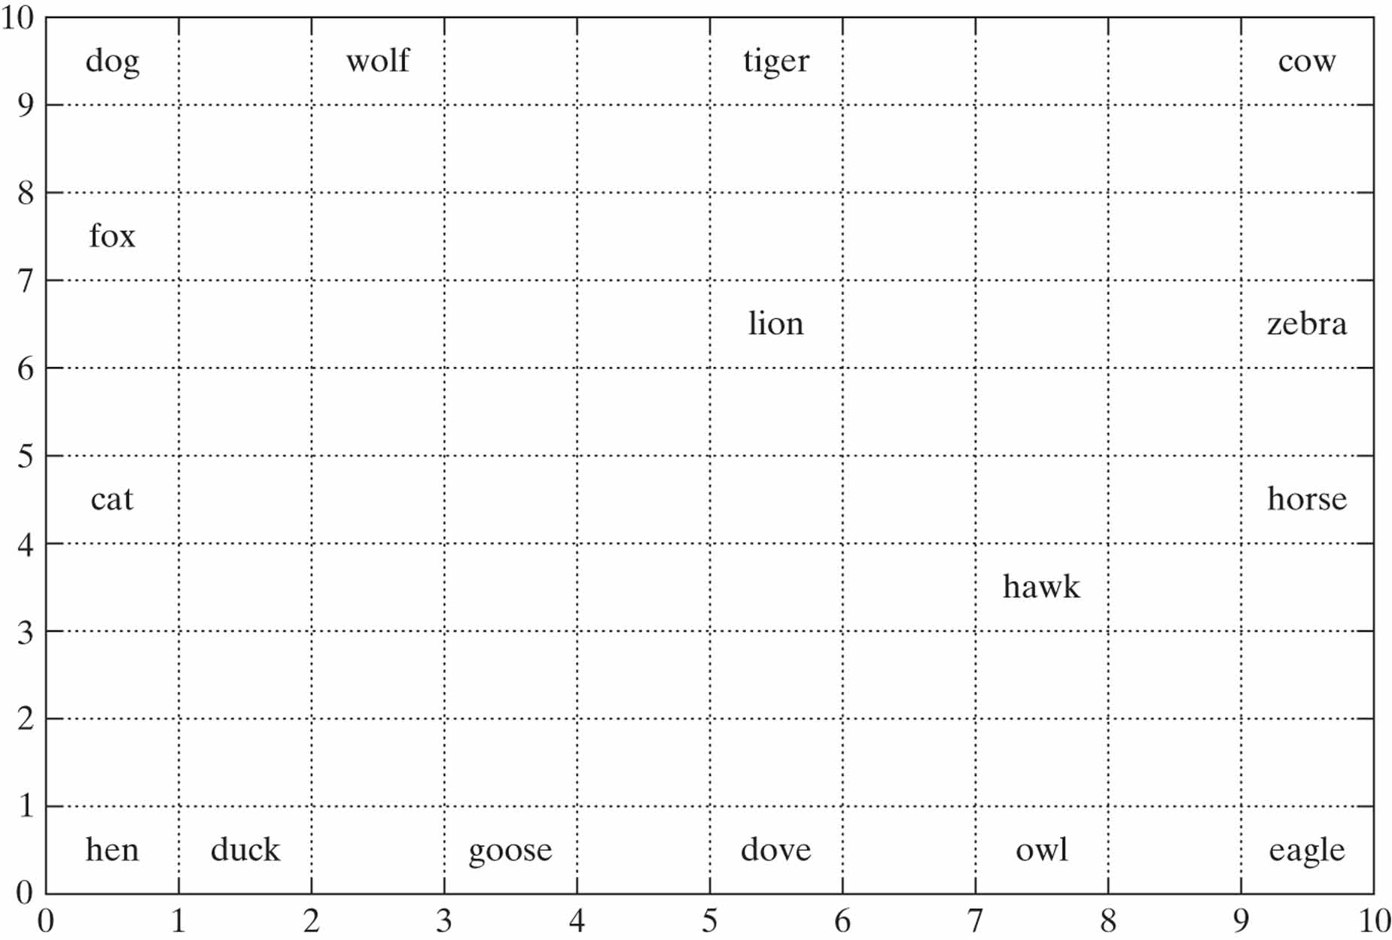
Figure 9.10 Feature map containing labeled neurons with strongest responses to their respective inputs.

Slide 14
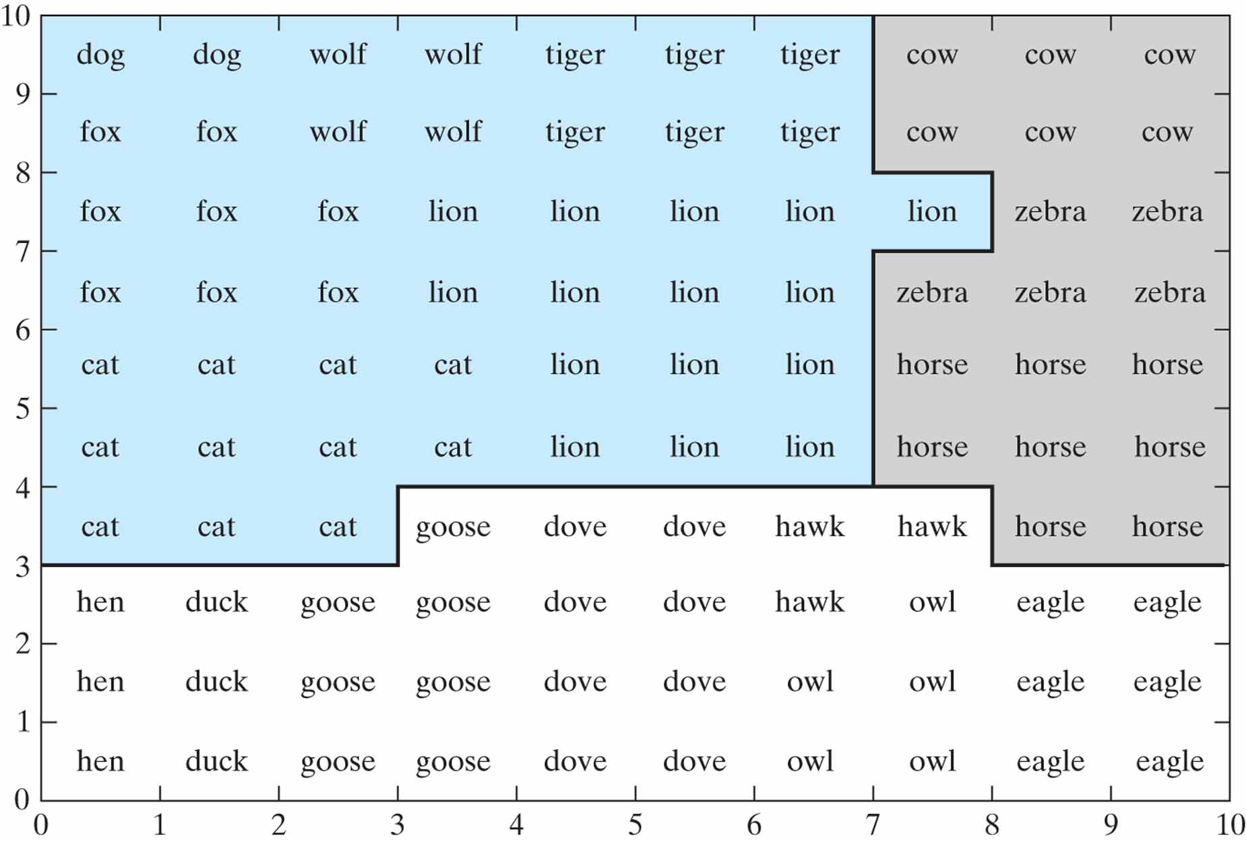
Figure 9.11 Semantic map obtained through the use of simulated electrode penetration mapping. The map is divided into three regions, representing birds (white), peaceful species (grey), and hunters (blue).

Slide 15
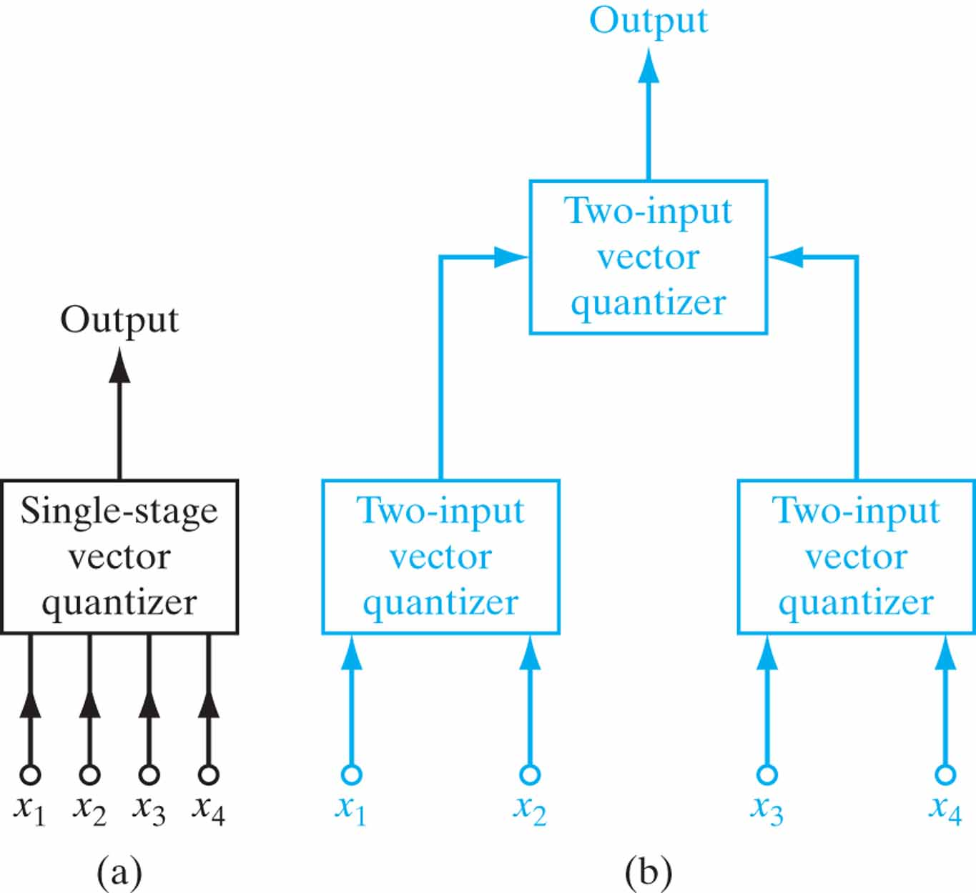
Figure 9.12 (a) Single-stage vector quantizer with four-dimensional input. (b) Two-stage hierarchical vector quantizer using two-input vector quantizers. (From S.P. Luttrell, 1989a, British Crown copyright.)

Slide 16
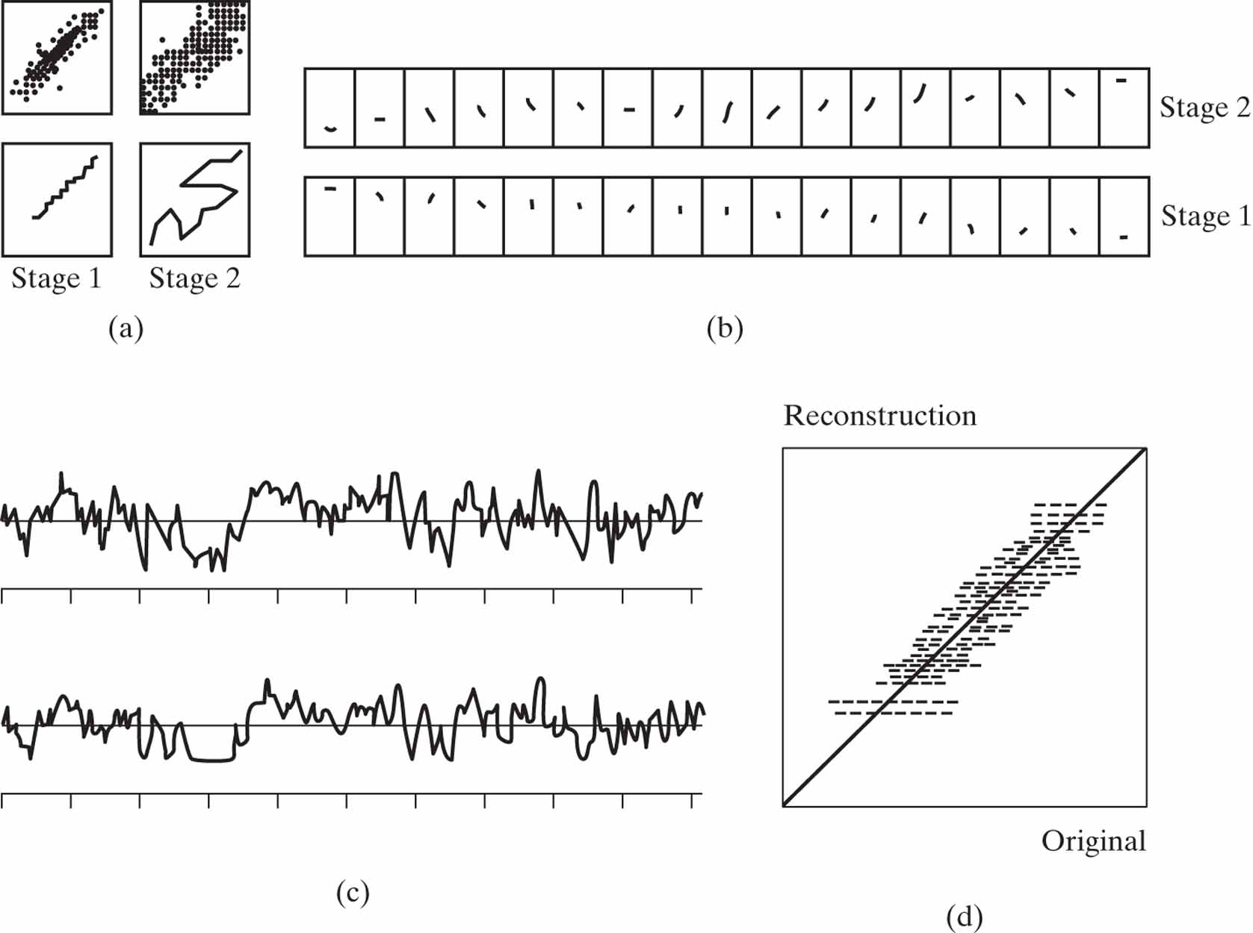
Figure 9.13 Two-stage encoding–decoding results, using the binary tree shown in blue in Fig. 9.12, for the compression of correlated Gaussian noise input. Correlation coefficient ρ = 0.85. (From S.P. Luttrell, 1989a, British Crown copyright.)

Slide 17
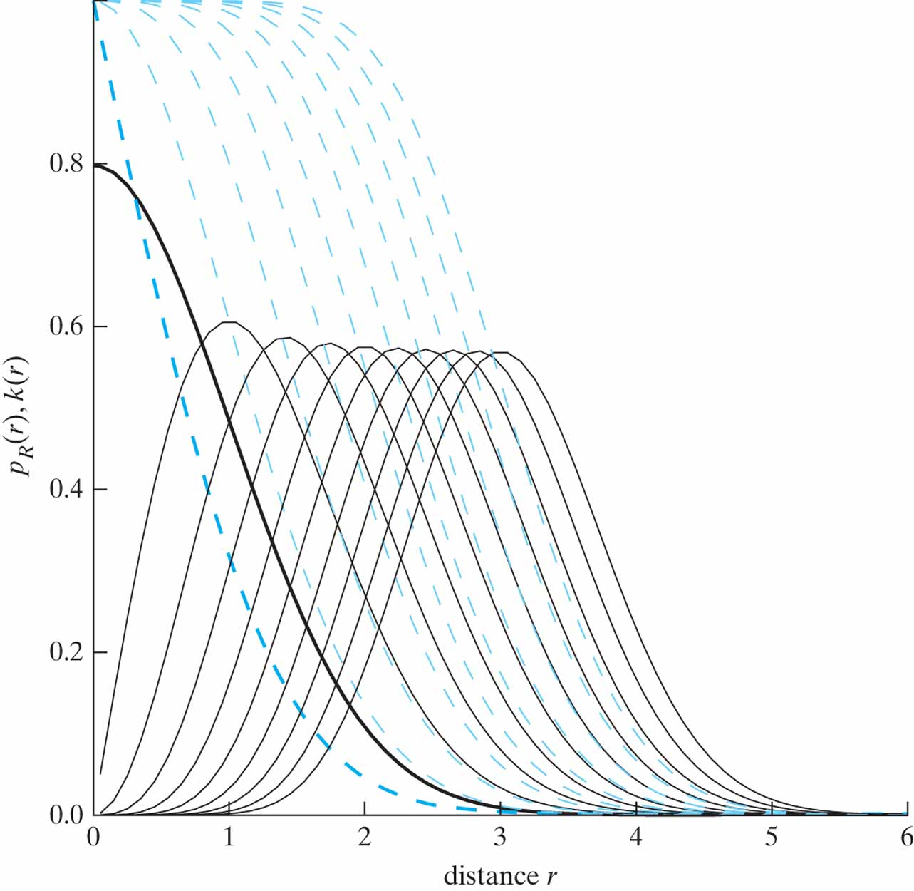
Figure 9.14 Two different sets of plots versus the distance r are shown in the figure for unit variance and increasing dimensionality m = 1, 2, 3, ...:
• The continuous curves (printed in black) are plots of the probability density function of Eq. (9.41).
• The dashed curves (printed in red) are plots of the complement of the incomplete gamma distribution or, equivalently, kernel k(r) of Eq. (9.44) with r = |x - w||.
(This figure is reproduced with the permission of Dr. Marc Van Hulle.)

Slide 18
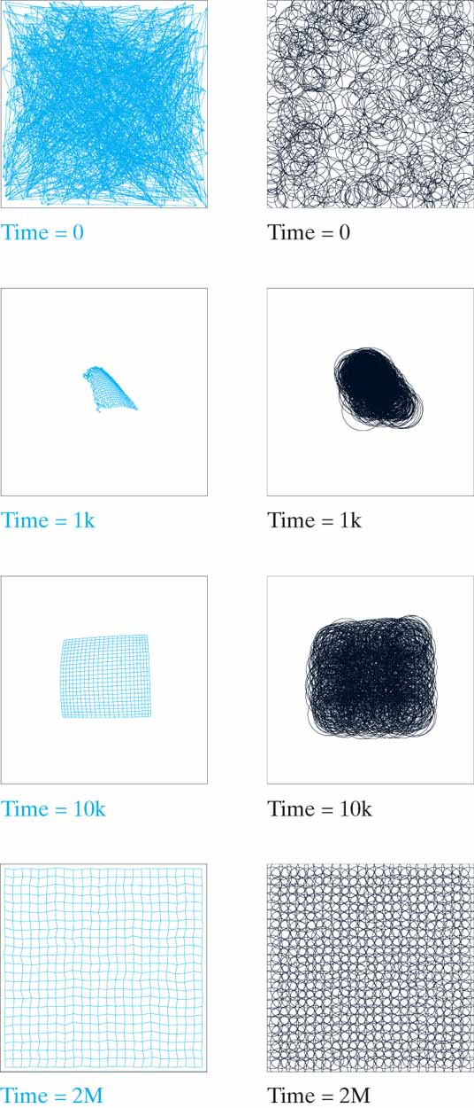
Figure 9.15 The evolution of a 24-by-24 lattice over time, the values of which (in terms of the number of iterations) are given below each picture. Left column: Evolution of the kernel weights. Right column: Evolution of the kernel widths. Each box in the figure outlines the result of a uniform input distribution. The time given below each map represents the number of iterations. (This figure is reproduced with the permission of Dr. Marc Van Hulle.)

Slide 19
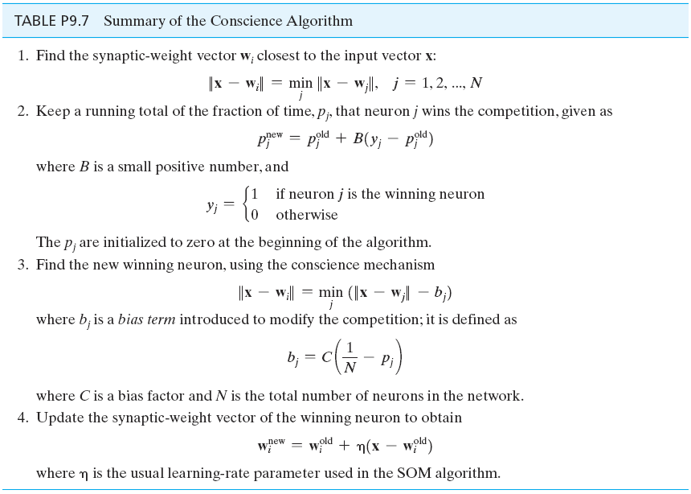
Table P9.7

Slide 20
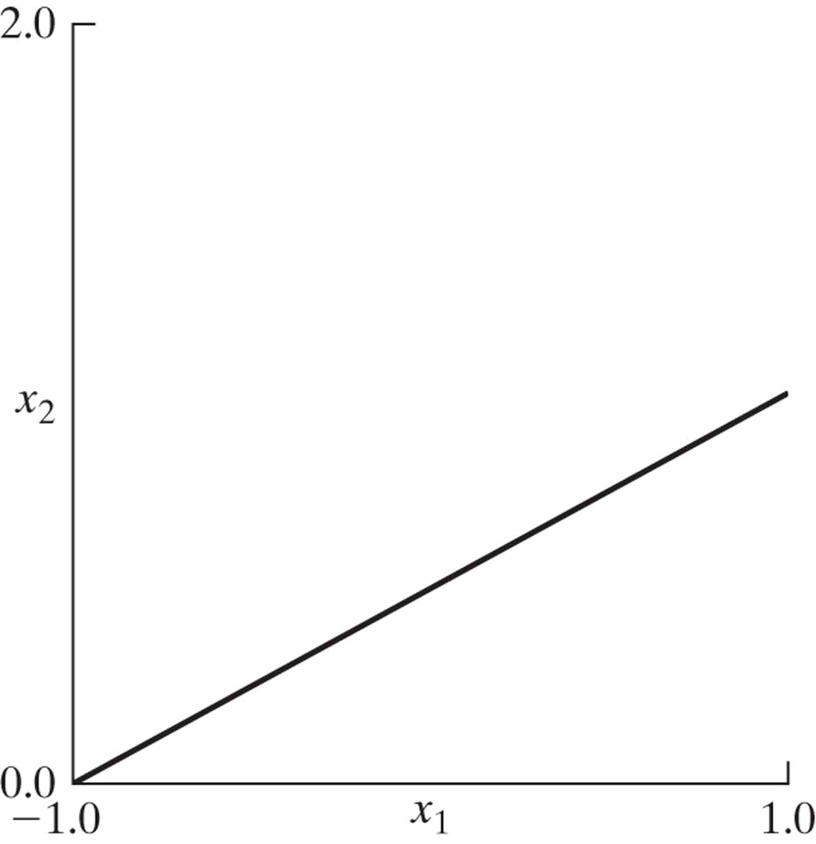
Figure P9.7

Slide 21
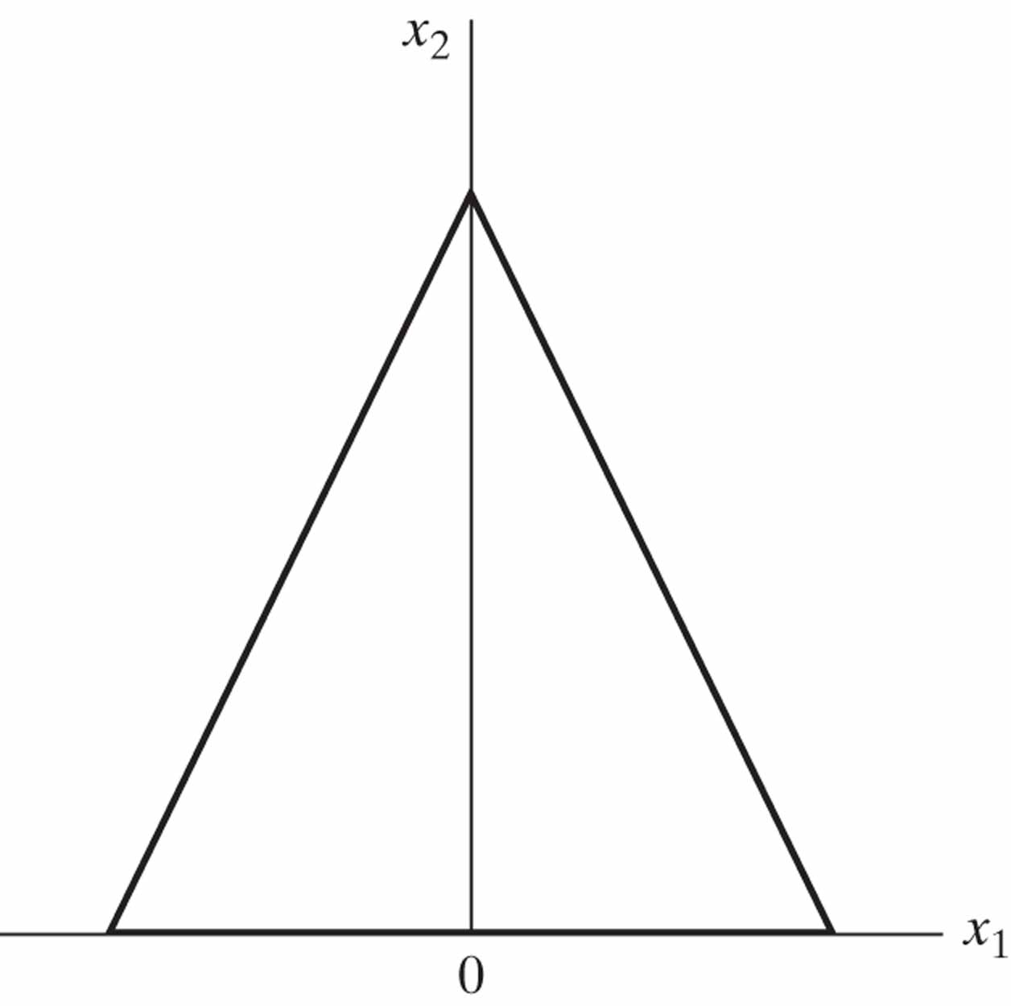
Figure P9.11

Slide 22
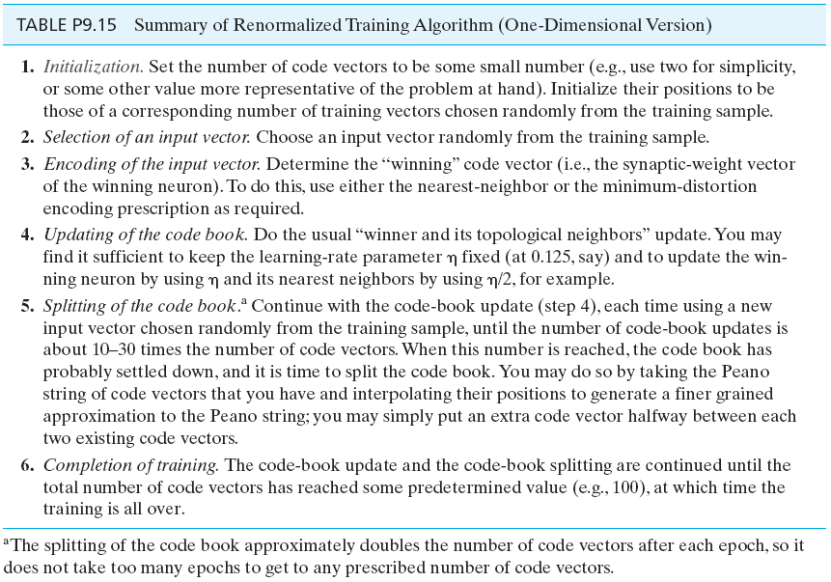
Table P9.15

Slide 23
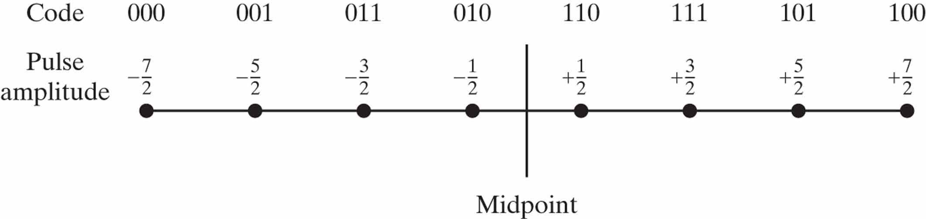
Figure P9.16

