Slide 1
Chapter 11
Stochastic Methods Rooted in the Statistical Mechanics

Slide 2
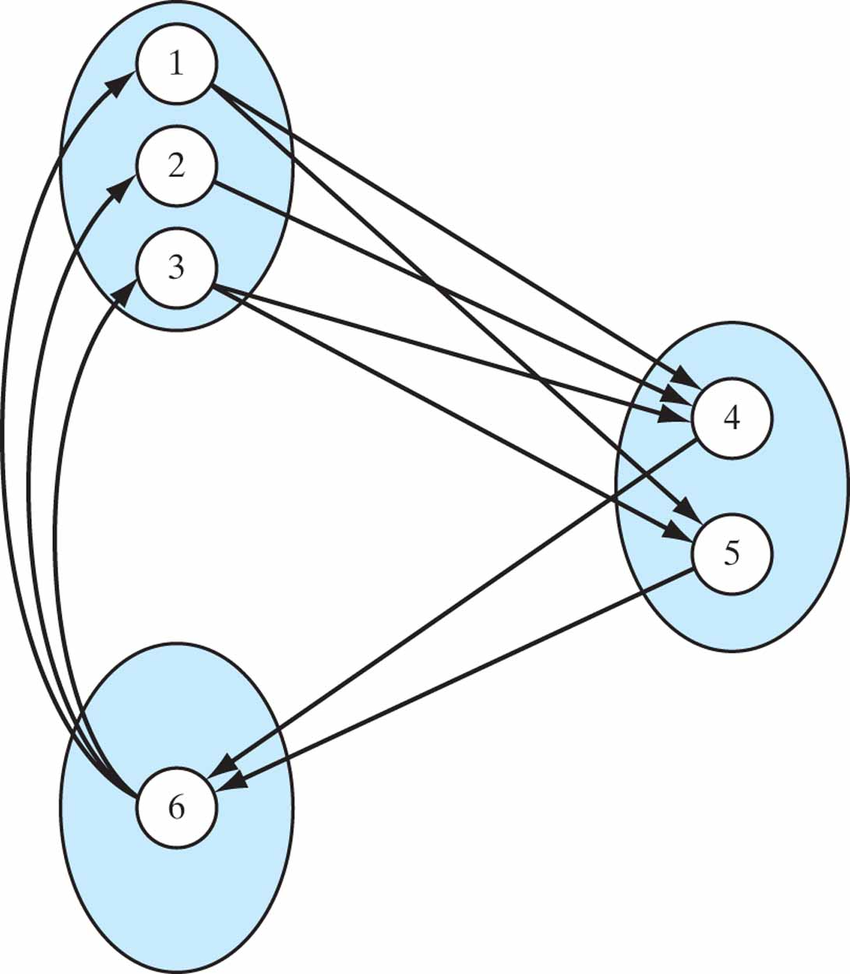
Figure 11.1 A periodic recurrent Markov chain with d = 3.

Slide 3
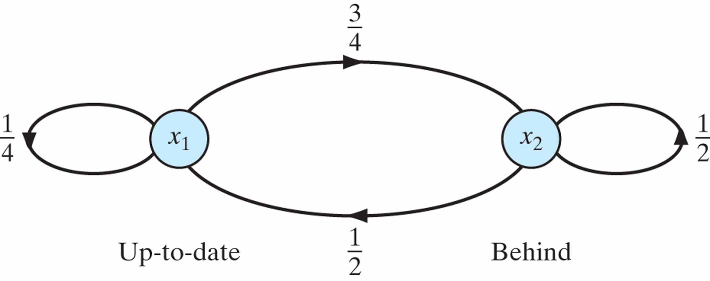
Figure 11.2 State-transition diagram of Markov chain for Example 1: The states x₁ and x₂ and may be identified as up-to-date behind, respectively.

Slide 4
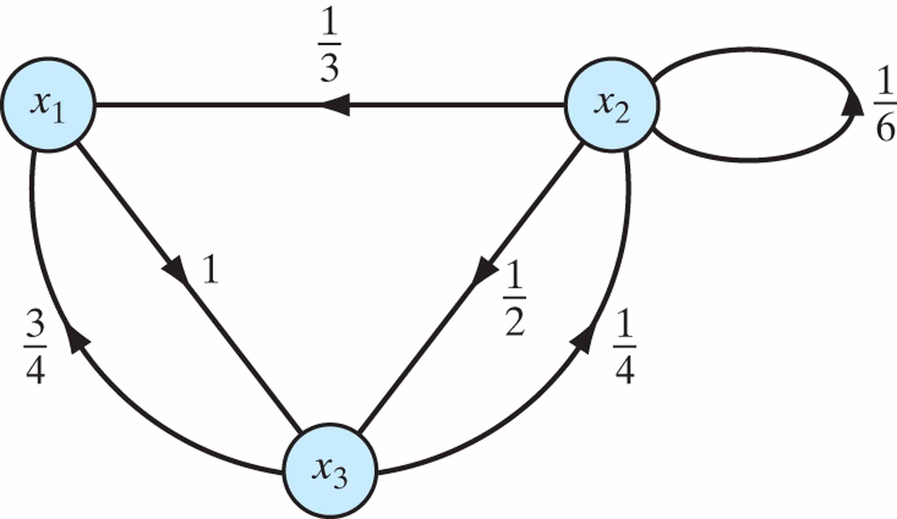
Figure 11.3 State-transition diagram of Markov chain for Example 2.

Slide 5
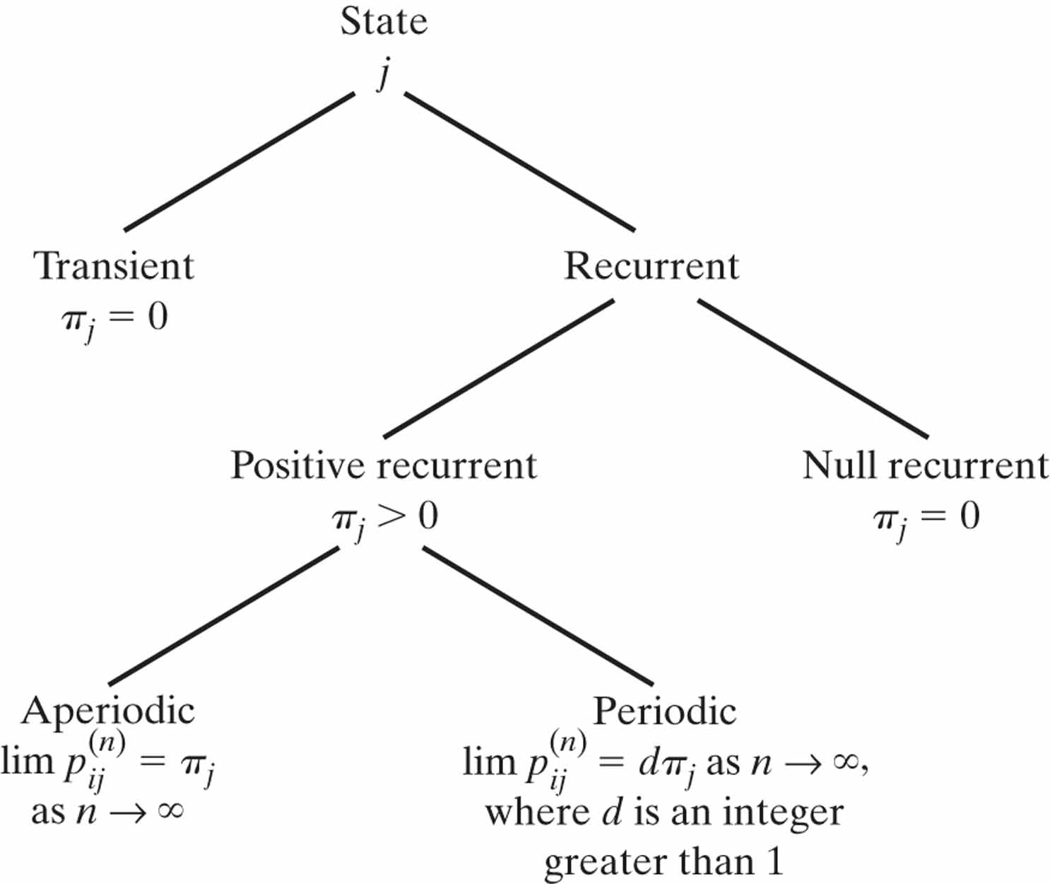
Figure 11.4 Classification of the states of a Markov chain and their associated long-term behavior.

Slide 6
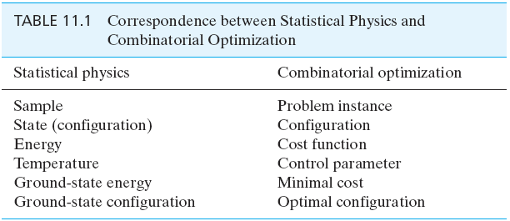
Table 11.1

Slide 7
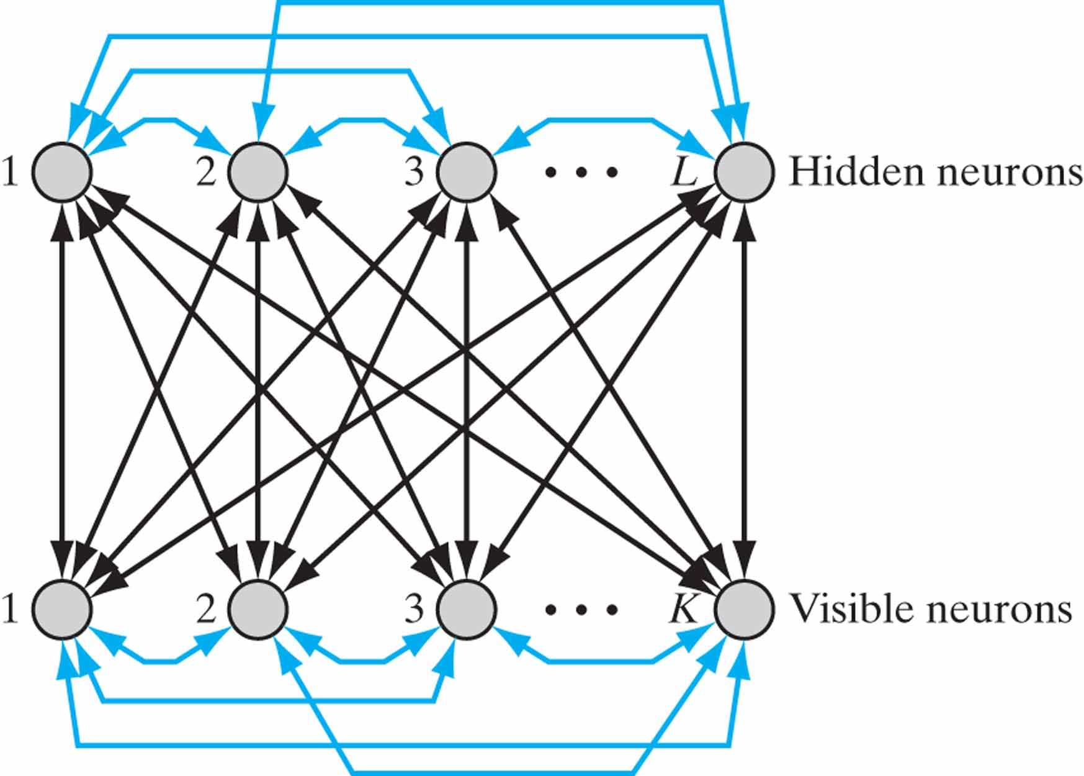
Figure 11.5 Architectural graph of Botzmann machine; K is the number of visible neurons, and L is the number of hidden neurons. The distinguishing features of the machine are:
1. The connections between the visible and hidden neurons are symmetric.
2. The symmetric connections are extended to the visible and hidden neurons.

Slide 8
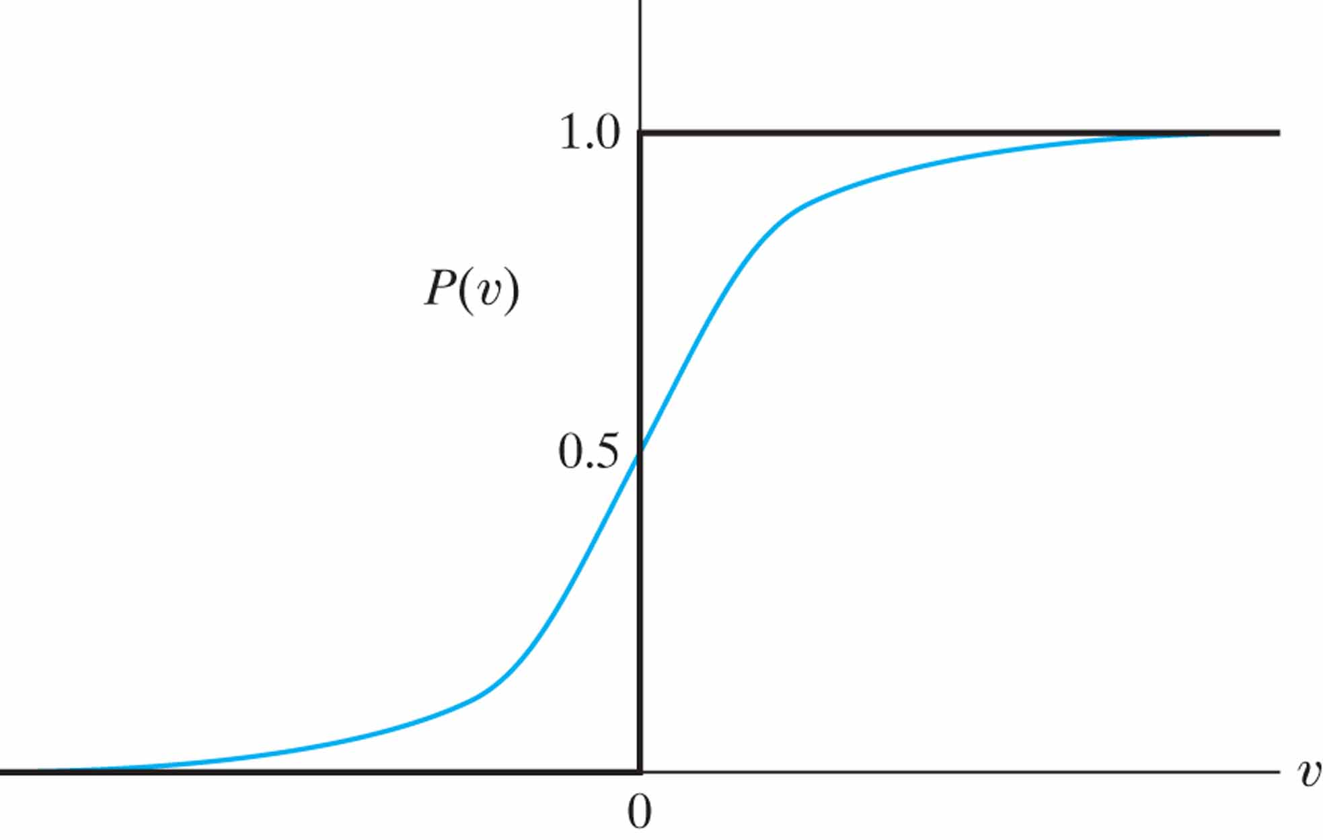
Figure 11.6 Sigmoid-shaped function P(v).

Slide 9
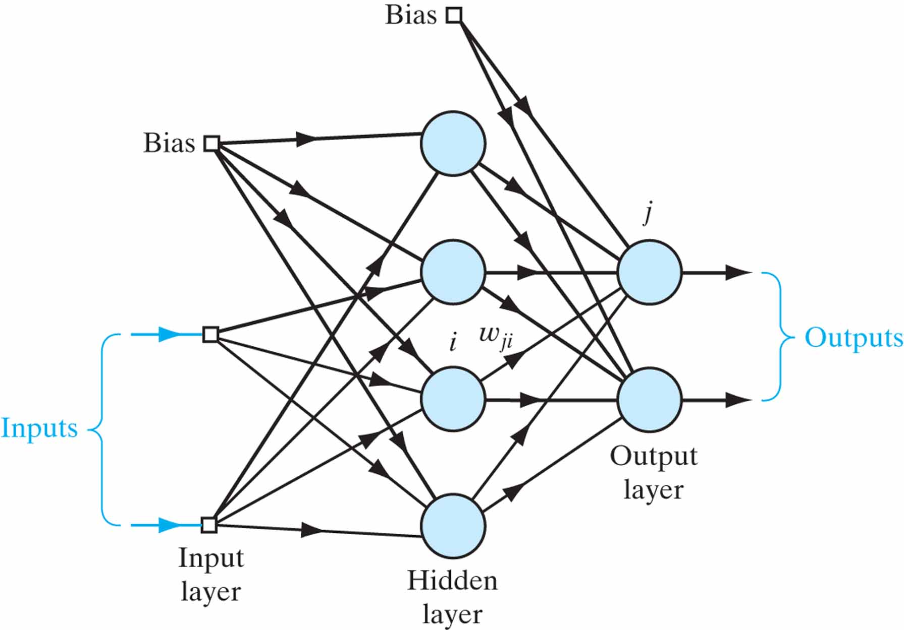
Figure 11.7 Directed (logistic) belief network.

Slide 10
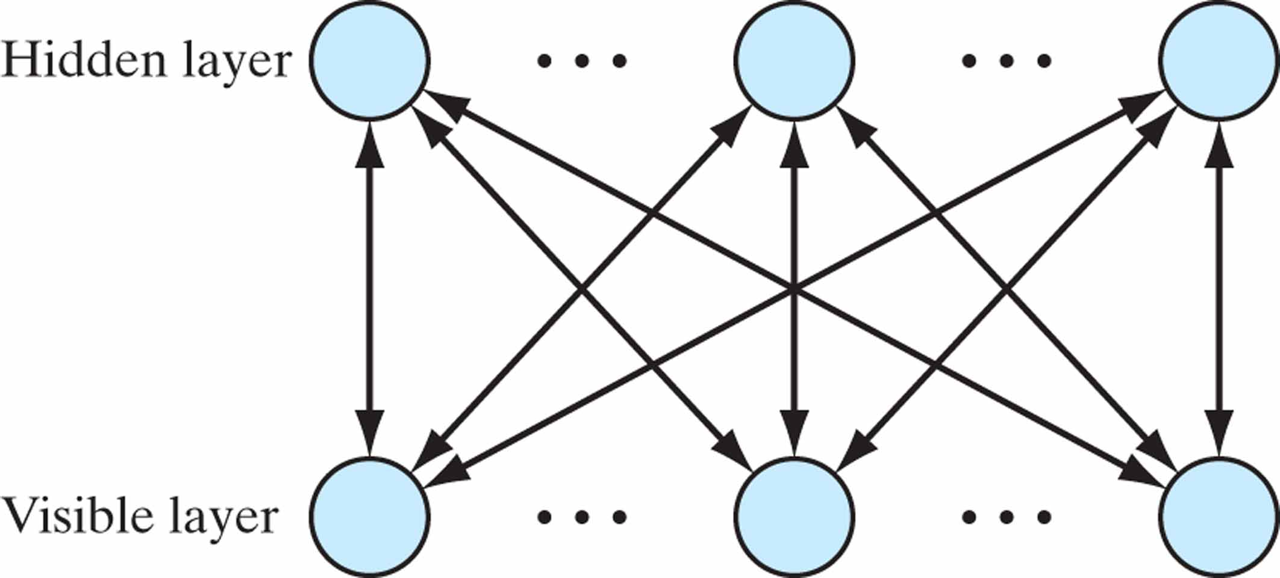
Figure 11.8 Neural structure of restricted Boltzmann machine (RBM). Contrasting this with that of Fig. 11.6, we see that unlike the Boltzmann machine, there are no connections among the visible neurons and the hidden neurons in the RBM.

Slide 11
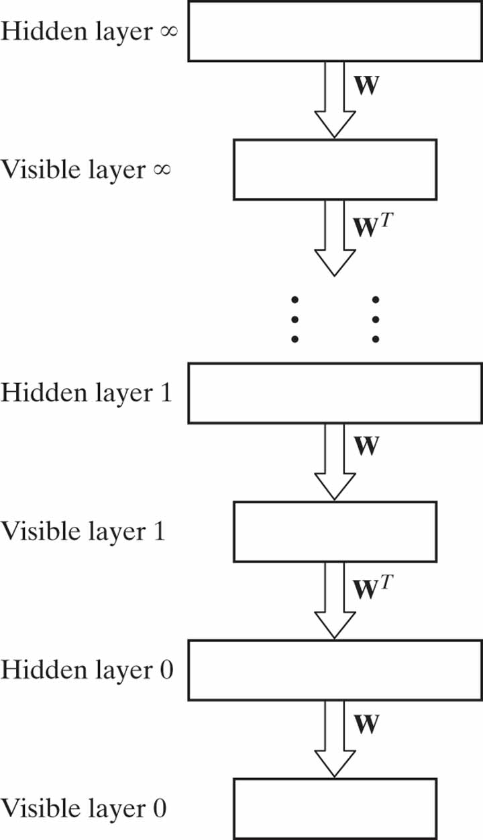
Figure 11.9 Top-down learning, using logistic belief network of infinite depth.

Slide 12
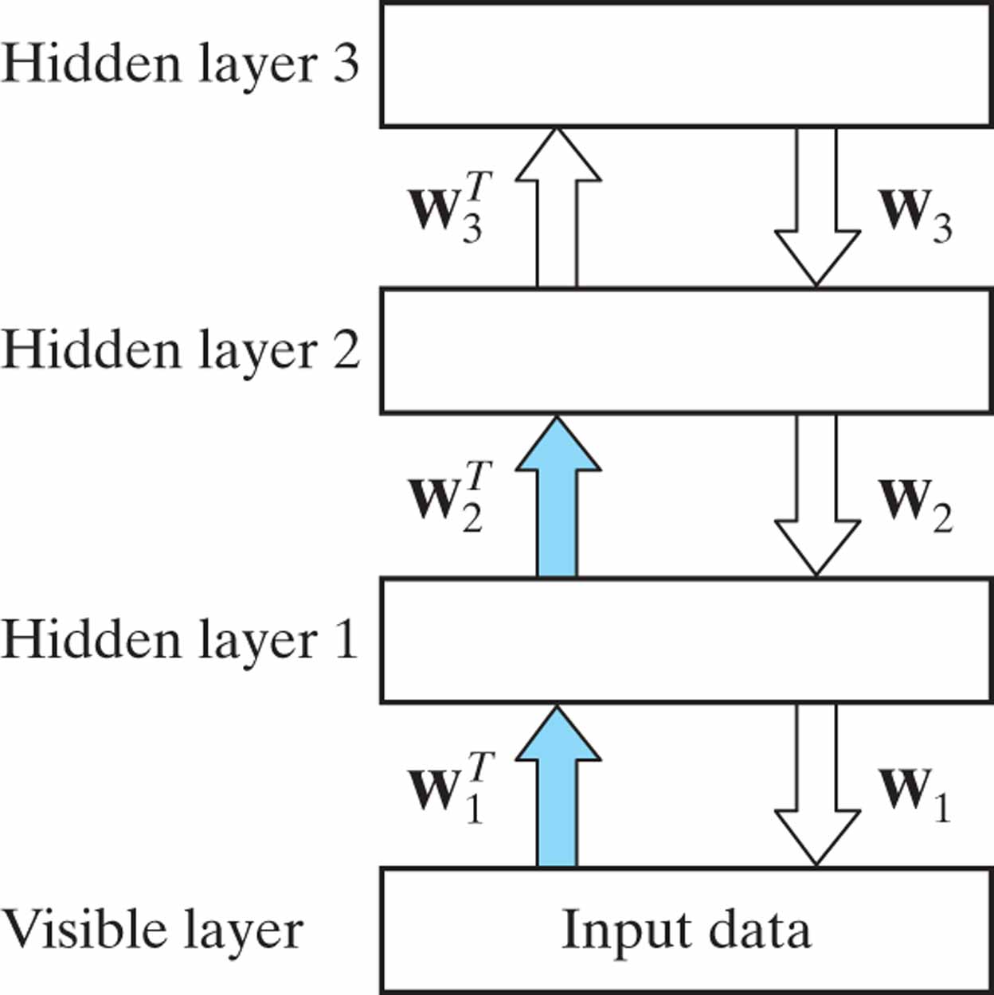
Figure 11.10 A hybrid generative model in which the two top layers form a restricted Boltzmann machine and the lower two layers form a directed model. The weights shown with blue shaded arrows are not part of the generative model; they are used to infer the feature values given to the data, but they are not used for generating data.

Slide 13
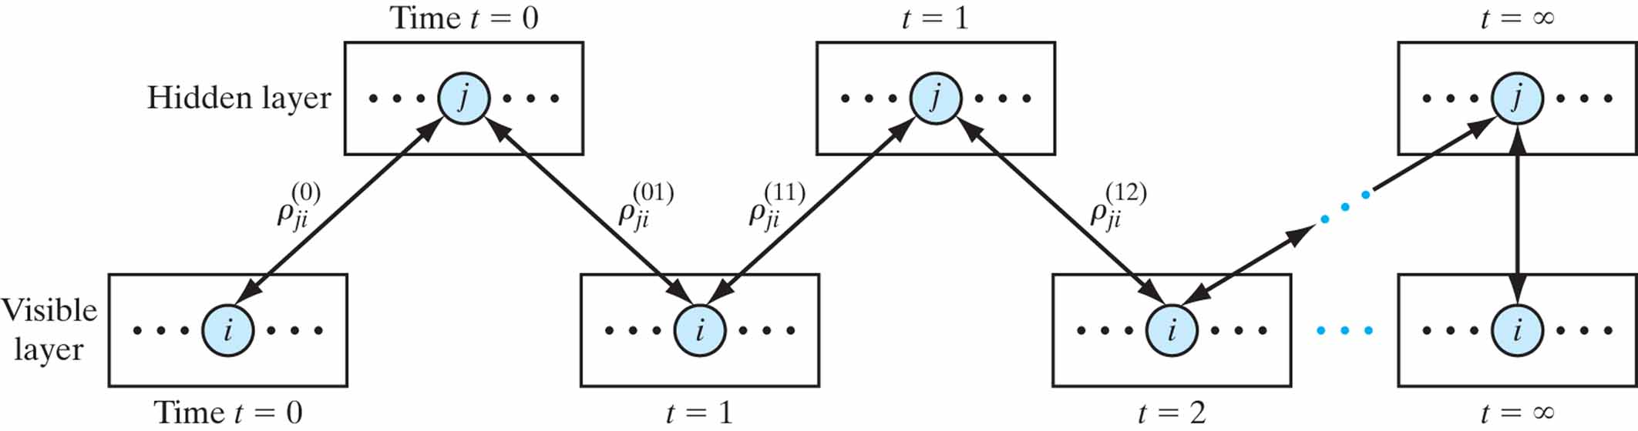
Figure 11.11 Illustrating the progression of alternating Gibbs sampling in an RBM. After sufficiently many steps, the visible and hidden vectors are sampled from the stationary distribution defined by the current parameters of the model.

Slide 14
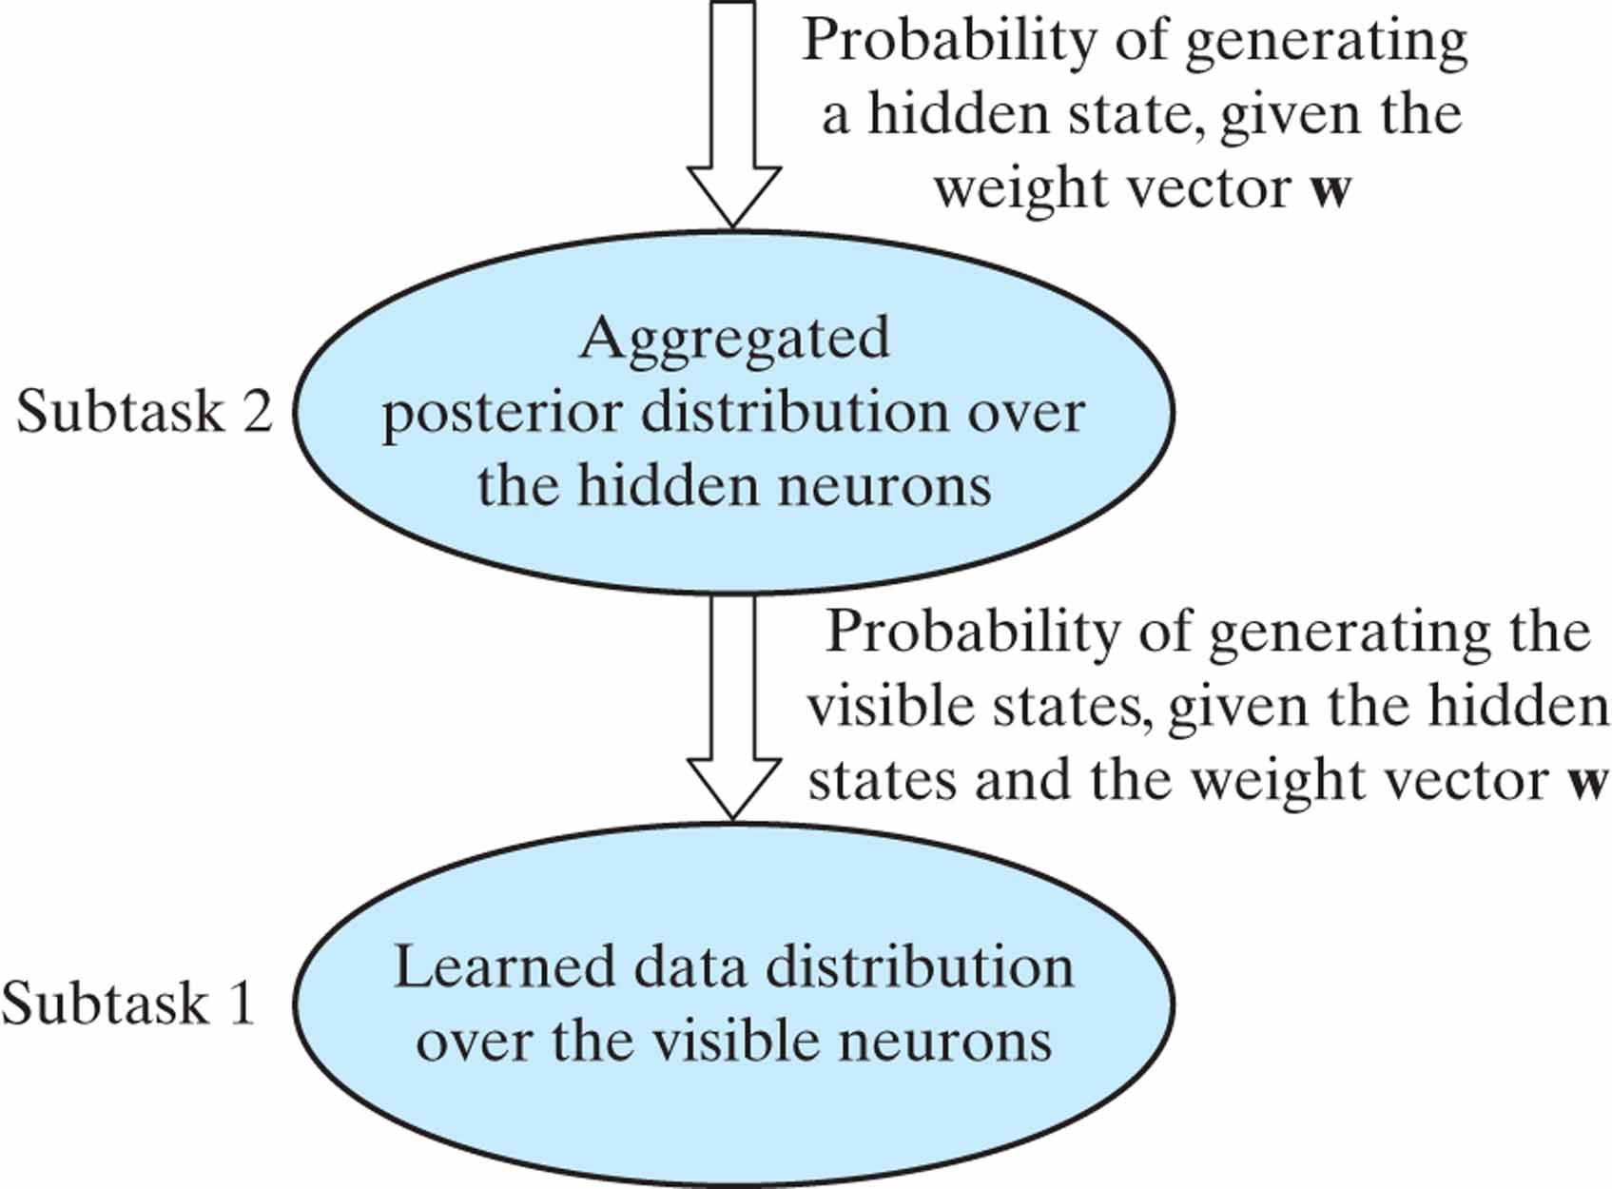
Figure 11.12 The task of modeling the sensory data is divided into two subtasks.

Slide 15
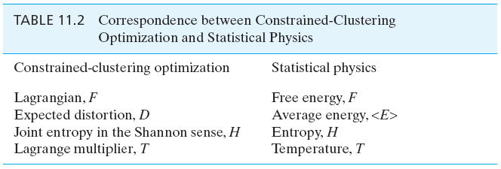
Table 11.2

Slide 16
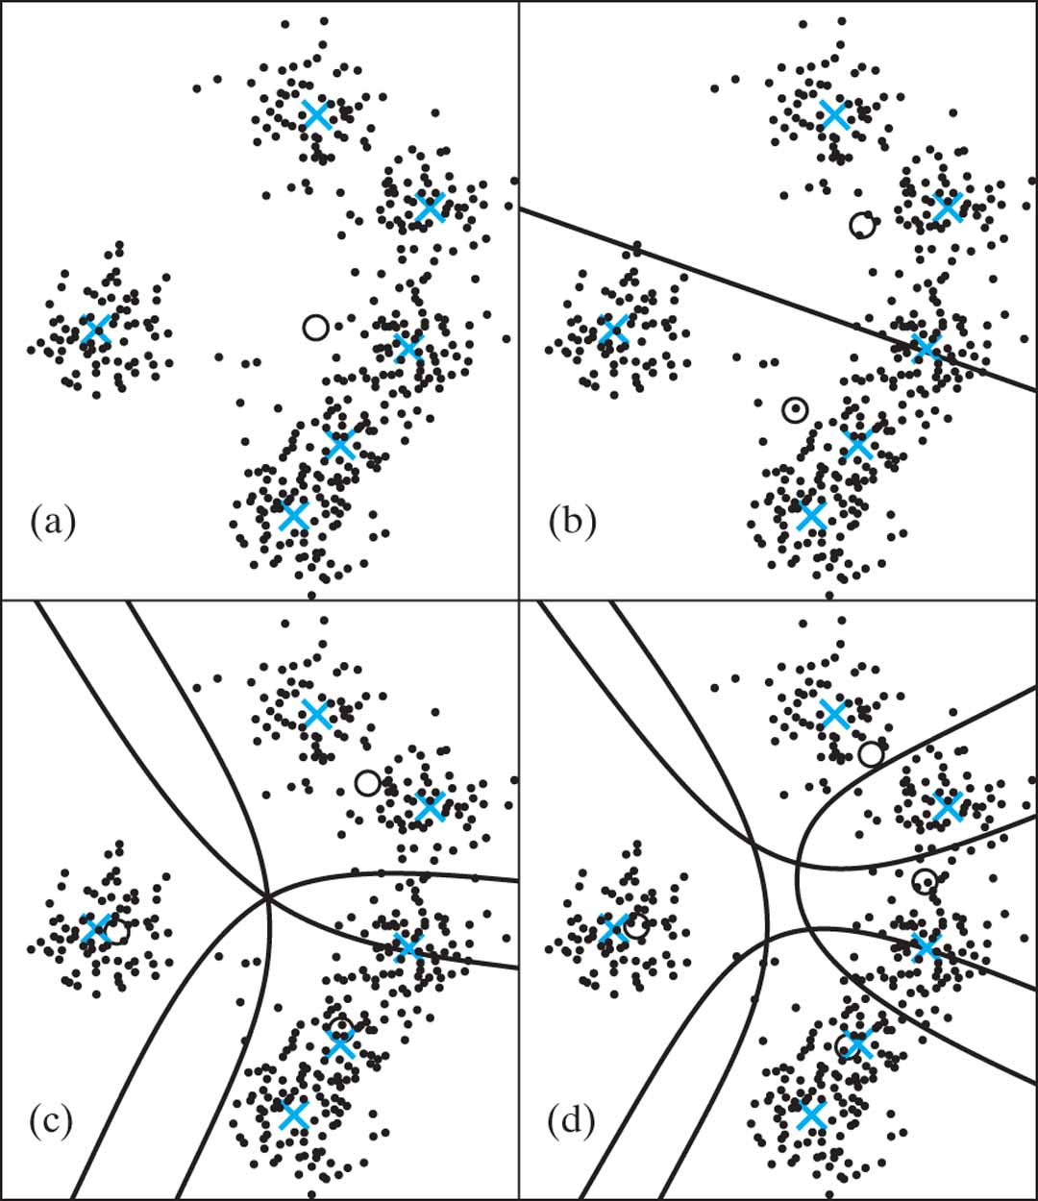
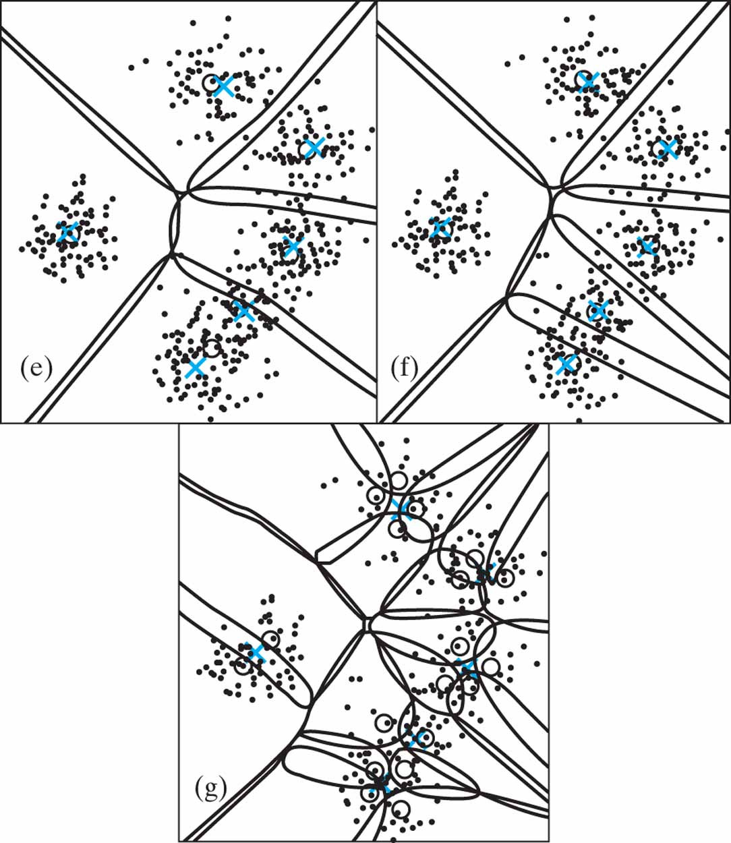
Figure 11.13 Clustering at various phases. The lines are equiprobability contours, p = ½ in (b), and p = ⅓ elsewhere:
(a) 1 cluster (B = 0),
(b) 2 clusters (B = 0.0049),
(c) 3 clusters (B = 0.0056),
(d) 4 clusters (B = 0.0100),
(e) 5 clusters (B = 0.0156),
(f) 6 clusters (B = 0.0347), and
(g) 19 clusters (B = 0.0605).

Slide 17
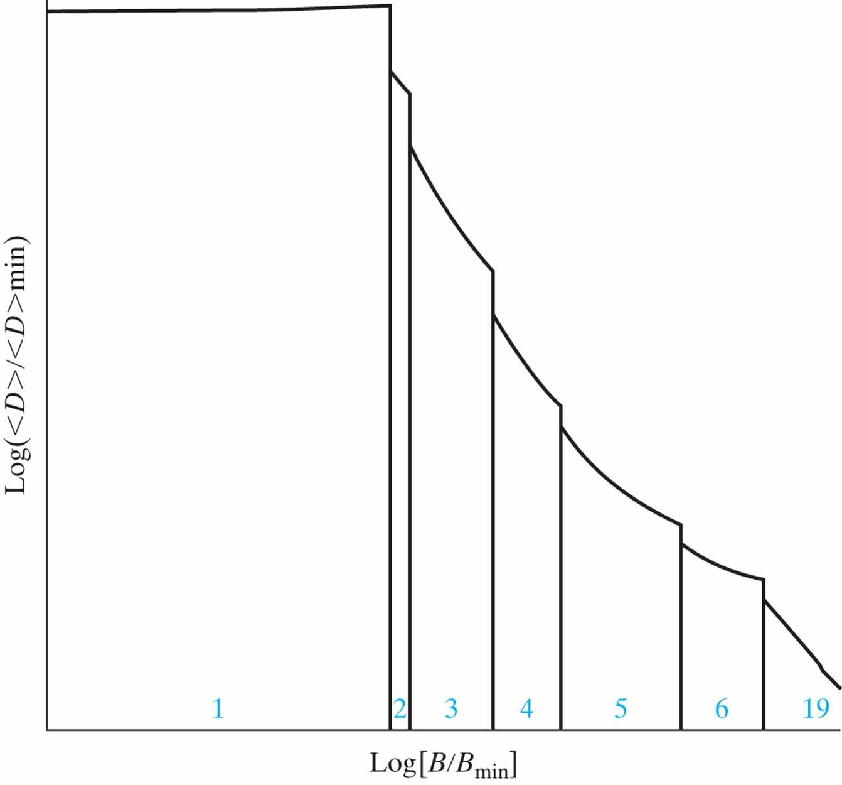
Figure 11.14 Phase diagram for the Case Study in deterministic annealing. The number of effective clusters is shown for each phase.

Slide 18
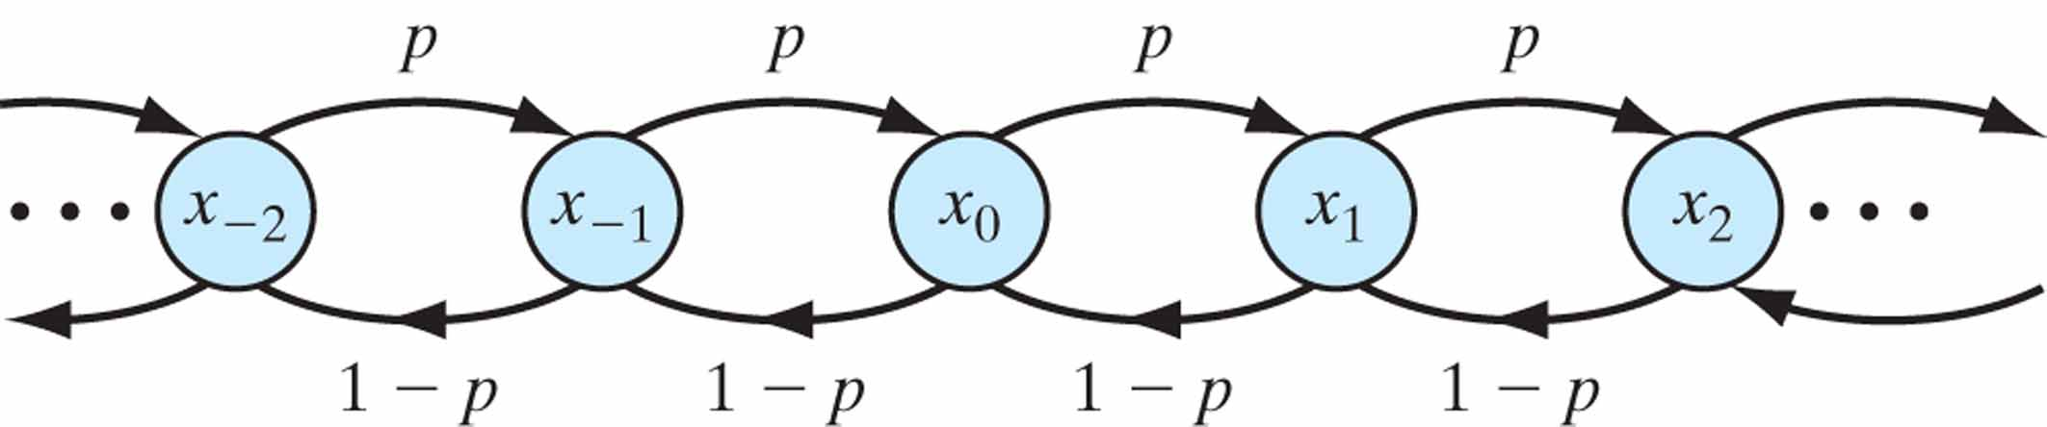
Figure P11.2

Slide 19
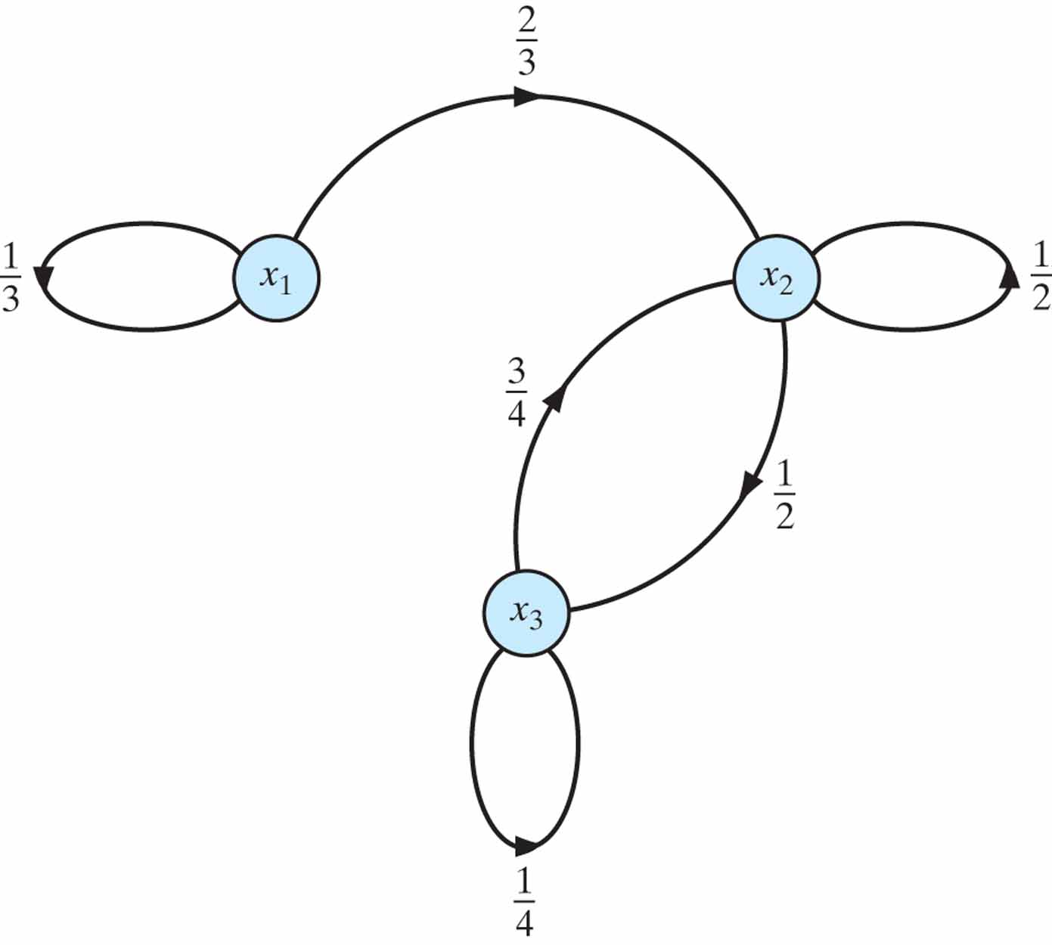
Figure P11.3

Slide 20
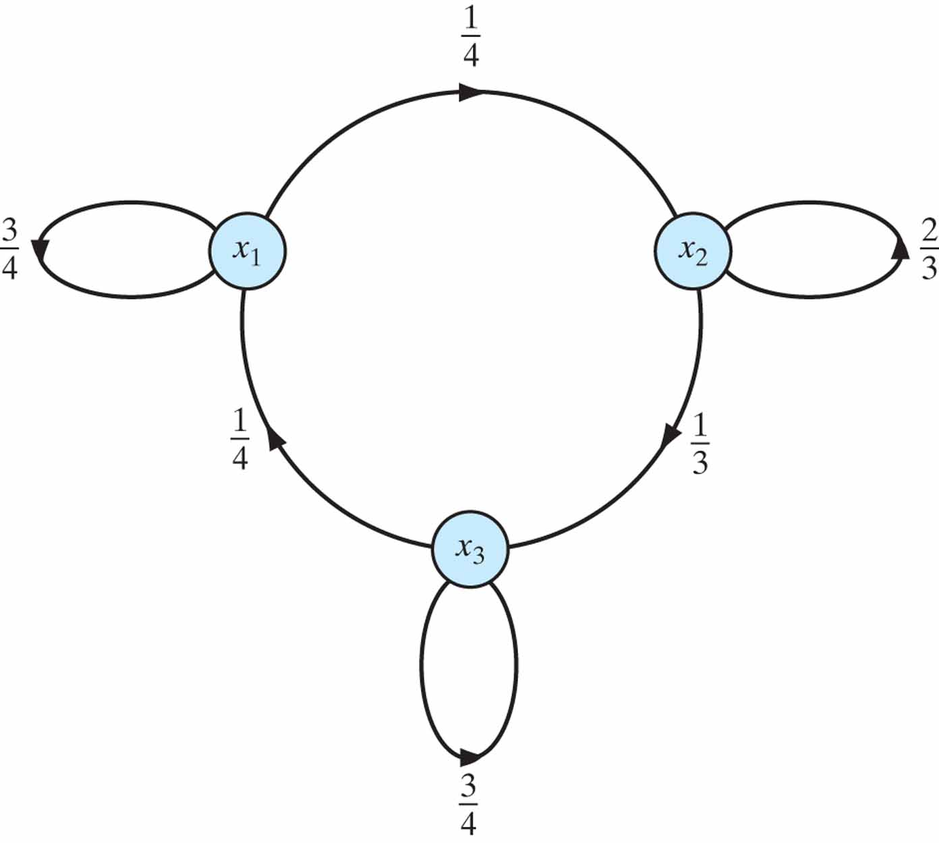
Figure P11.4

Slide 21
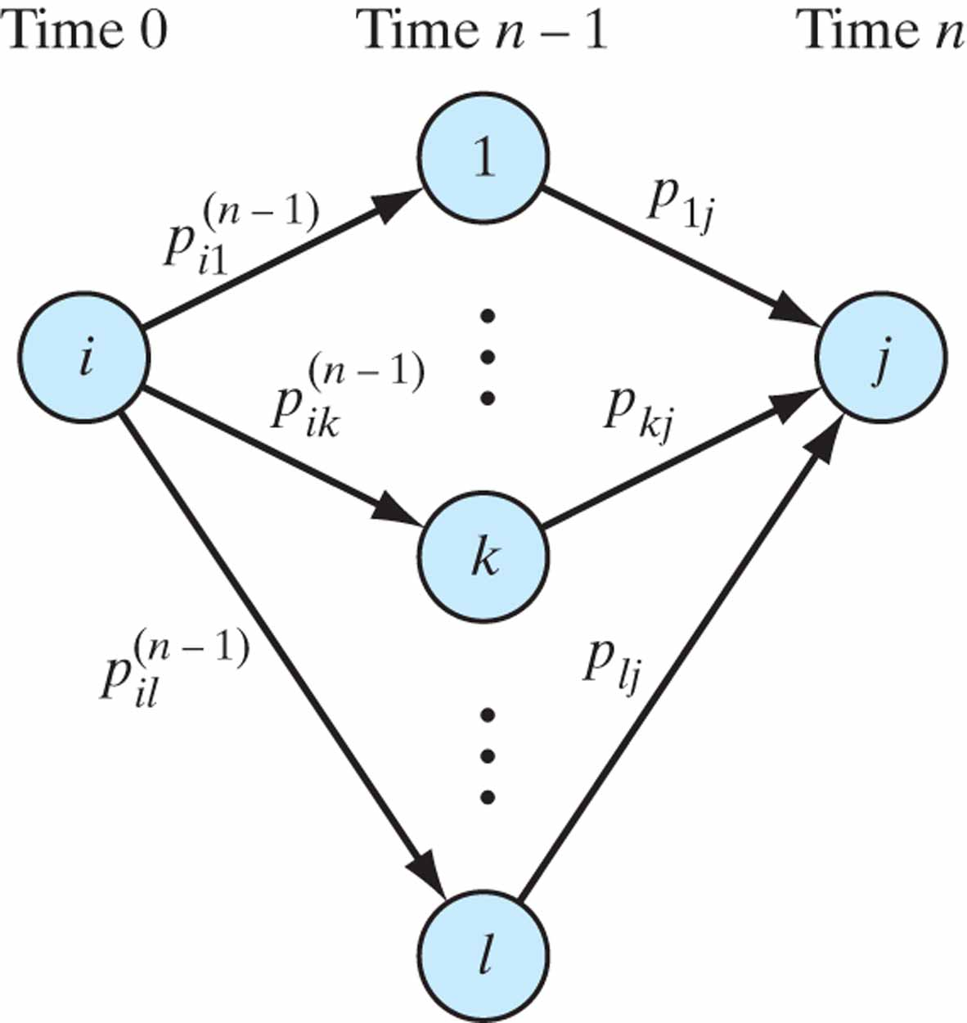
Figure P11.5

