Slide 1
Chapter 12
Dynamic Programming

Slide 2
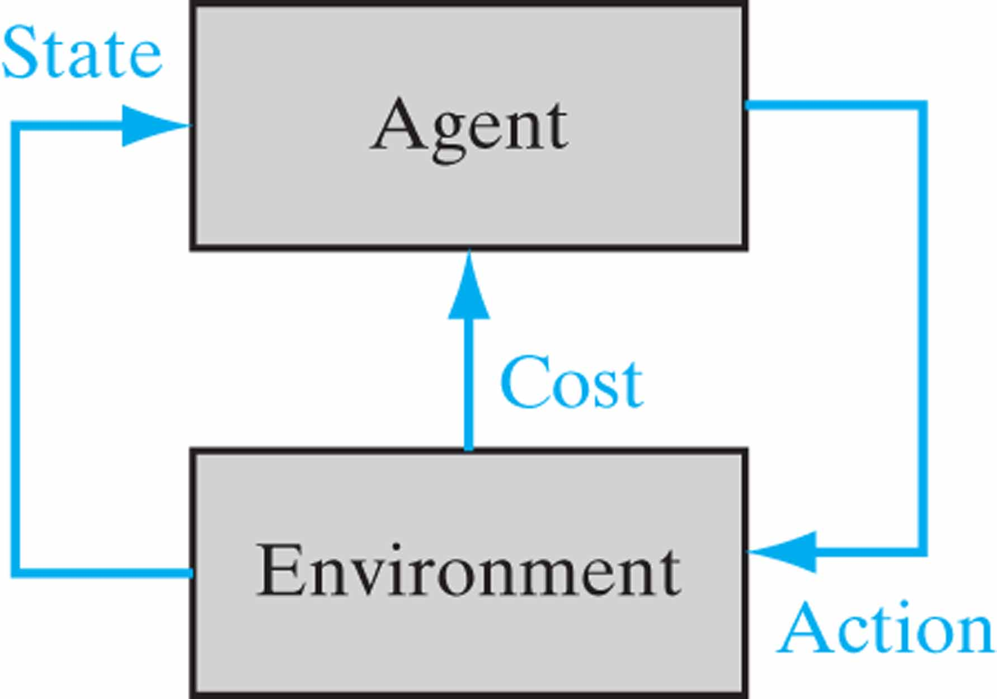
Figure 12.1 Block diagram of an agent interacting with its environment.

Slide 3
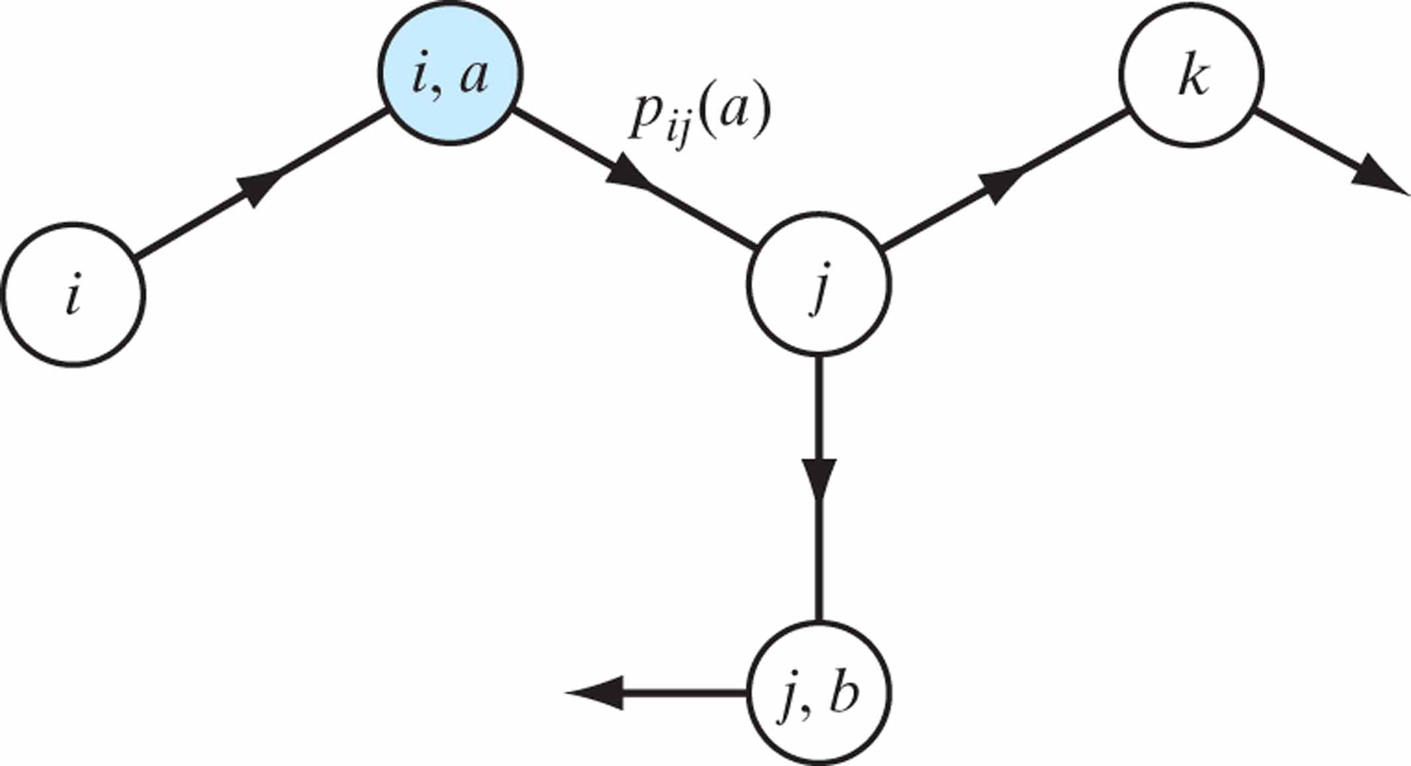
Figure 12.2 Illustration of two possible transitions: The transition from state (i, a) to state j is probabilistic, but the transition from state i to (i, a) is deterministic.

Slide 4
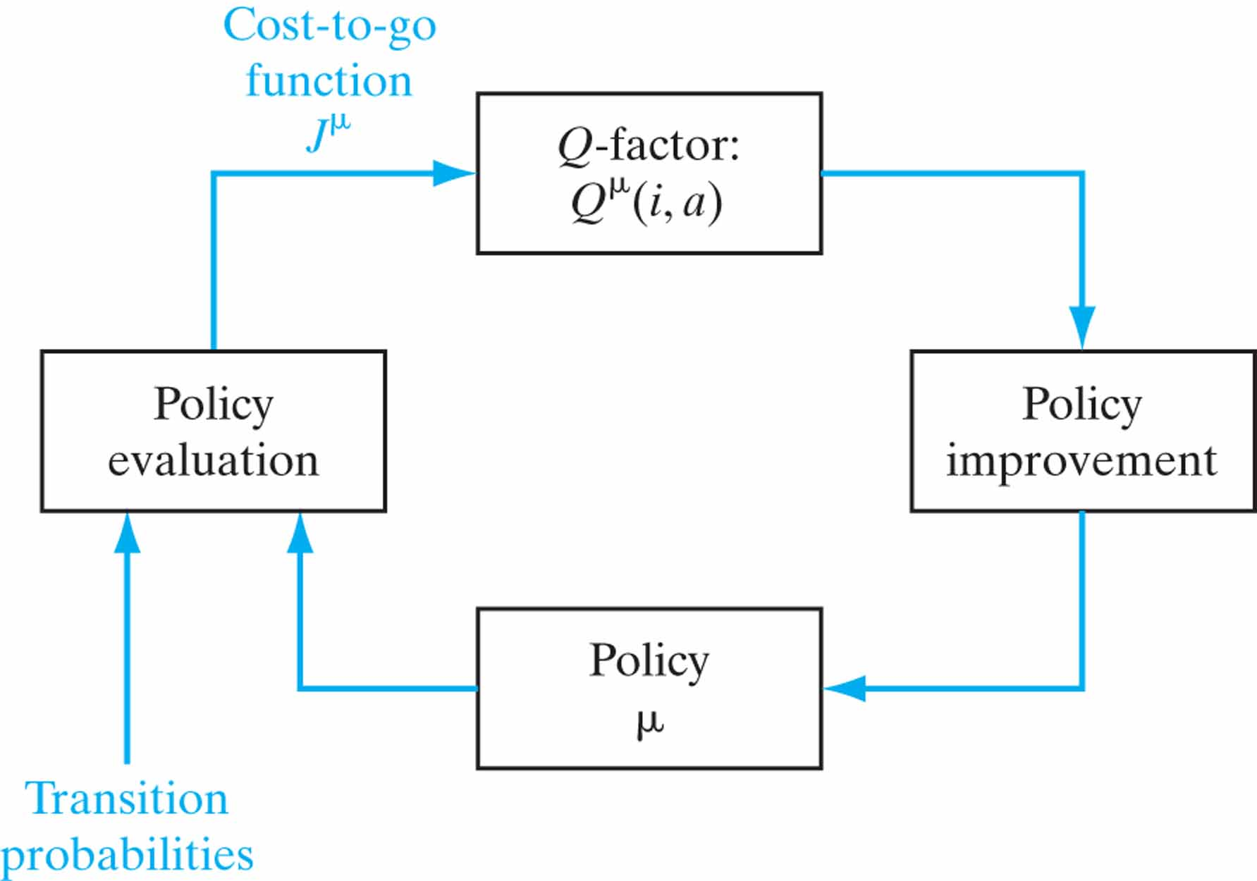
Figure 12.3 Block diagram of the policy iteration algorithm.

Slide 5
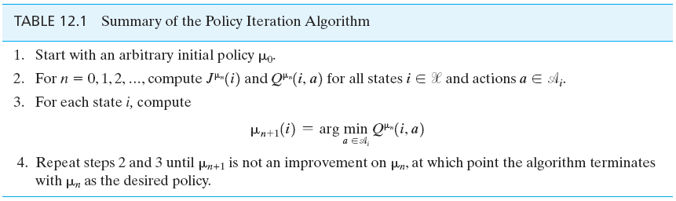
Table 12.1

Slide 6
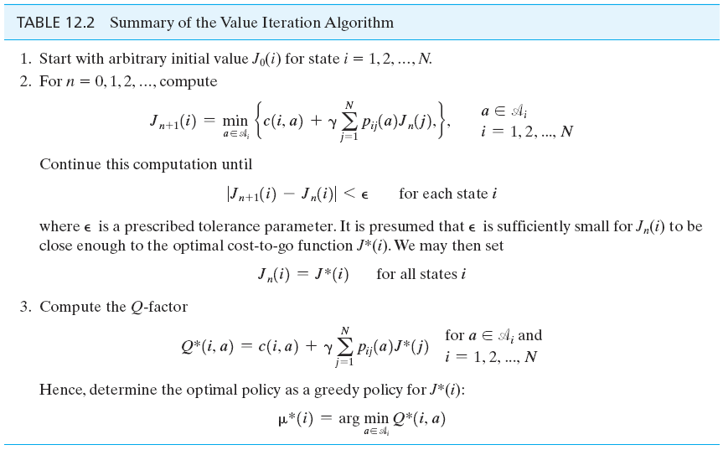
Table 12.2

Slide 7
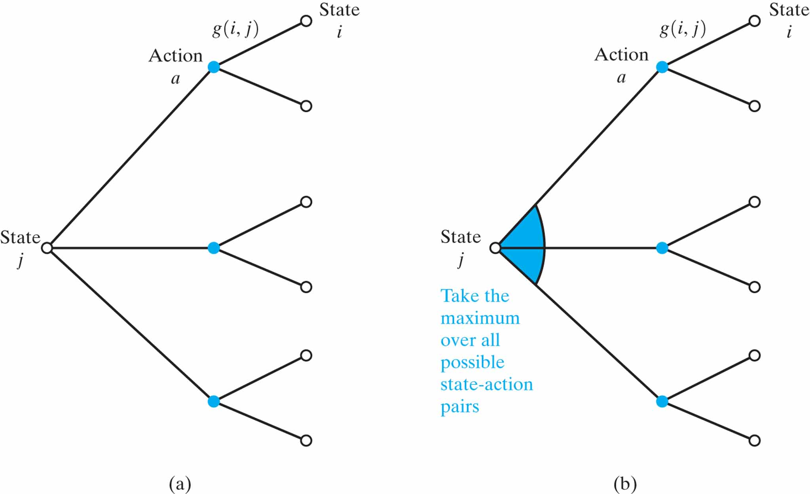
Figure 12.4 Illustrative backup diagrams for (a) policy iteration and (b) value iteration.

Slide 8
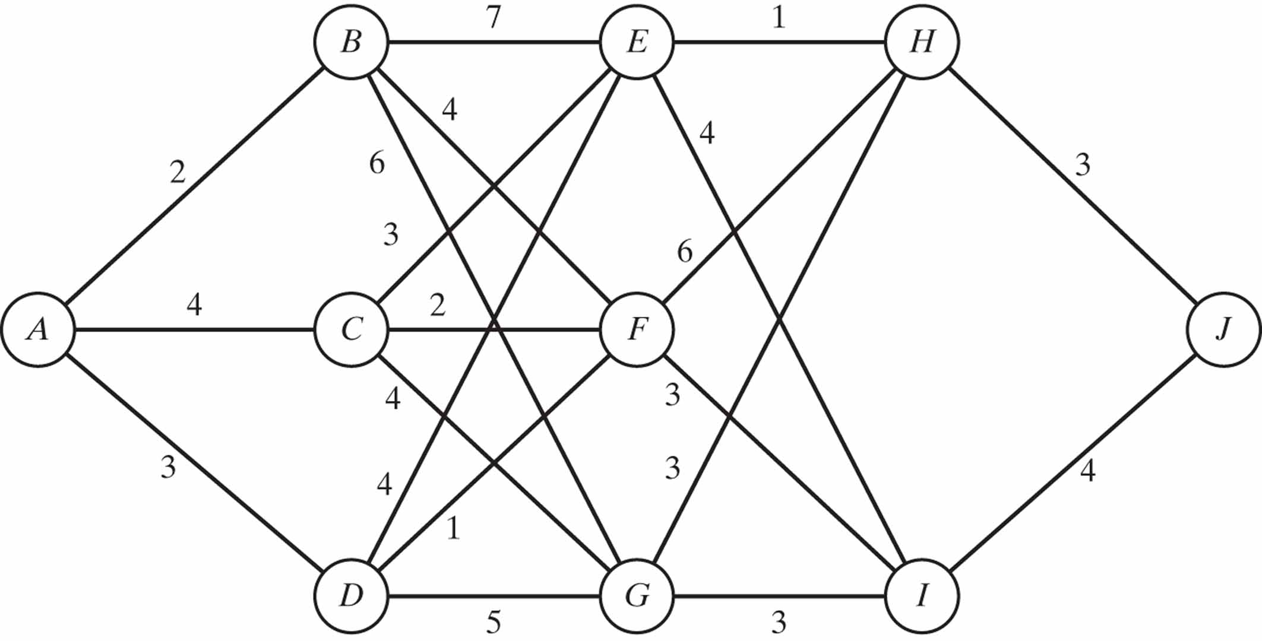
Figure 12.5 Flow graph for stagecoach problem.

Slide 9
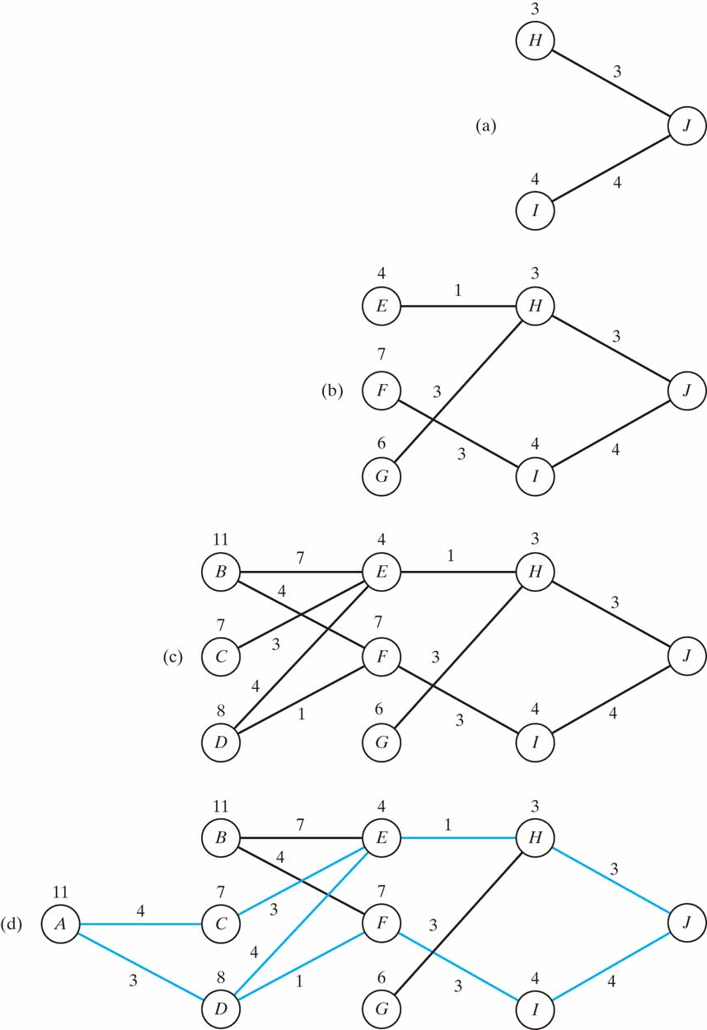
Figure 12.6 Steps involved in calculating the Q-factors for the stagecoach problem. The routes (printed in blue) from A to J are the optimal ones.

Slide 10
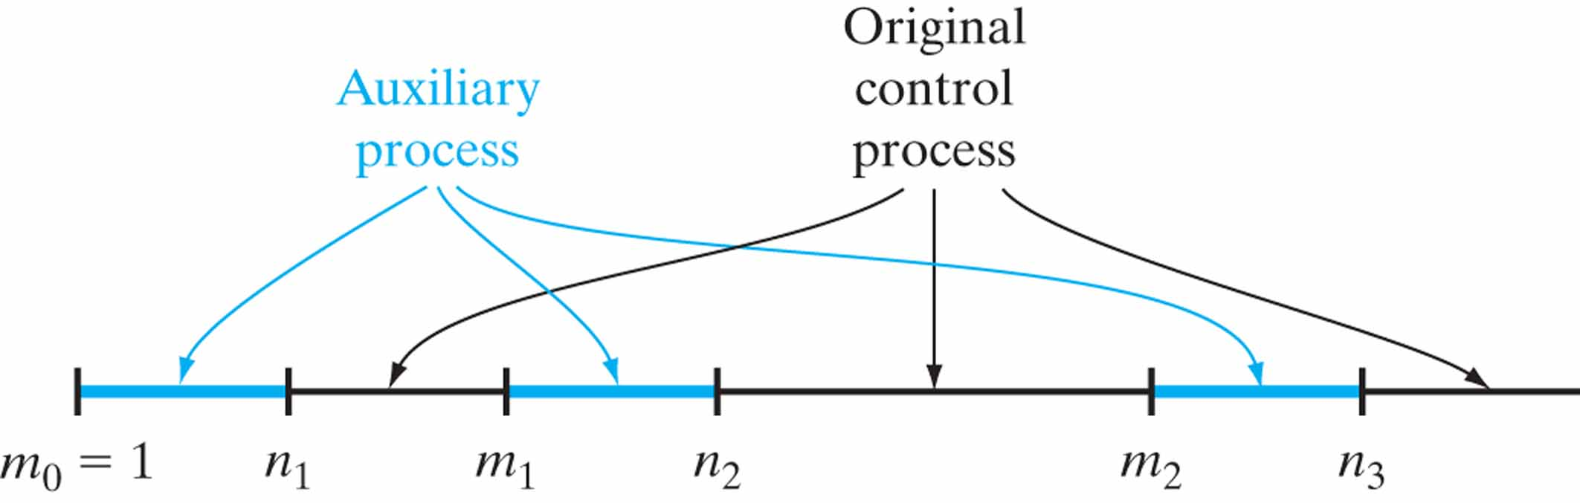
Figure 12.7 The time slots pertaining to the auxiliary and original control processes.

Slide 11
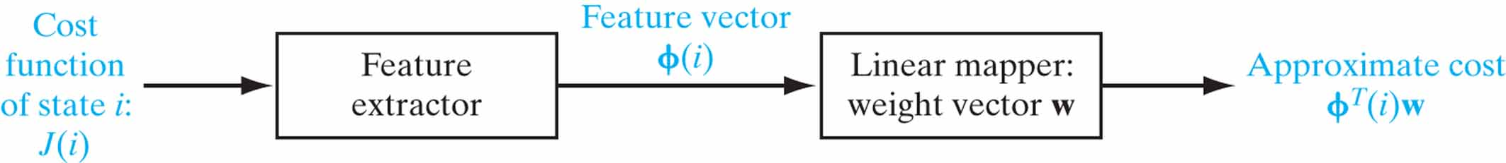
Figure 12.8 Architectural layout of the linear approach to approximate dynamic programming.

Slide 12
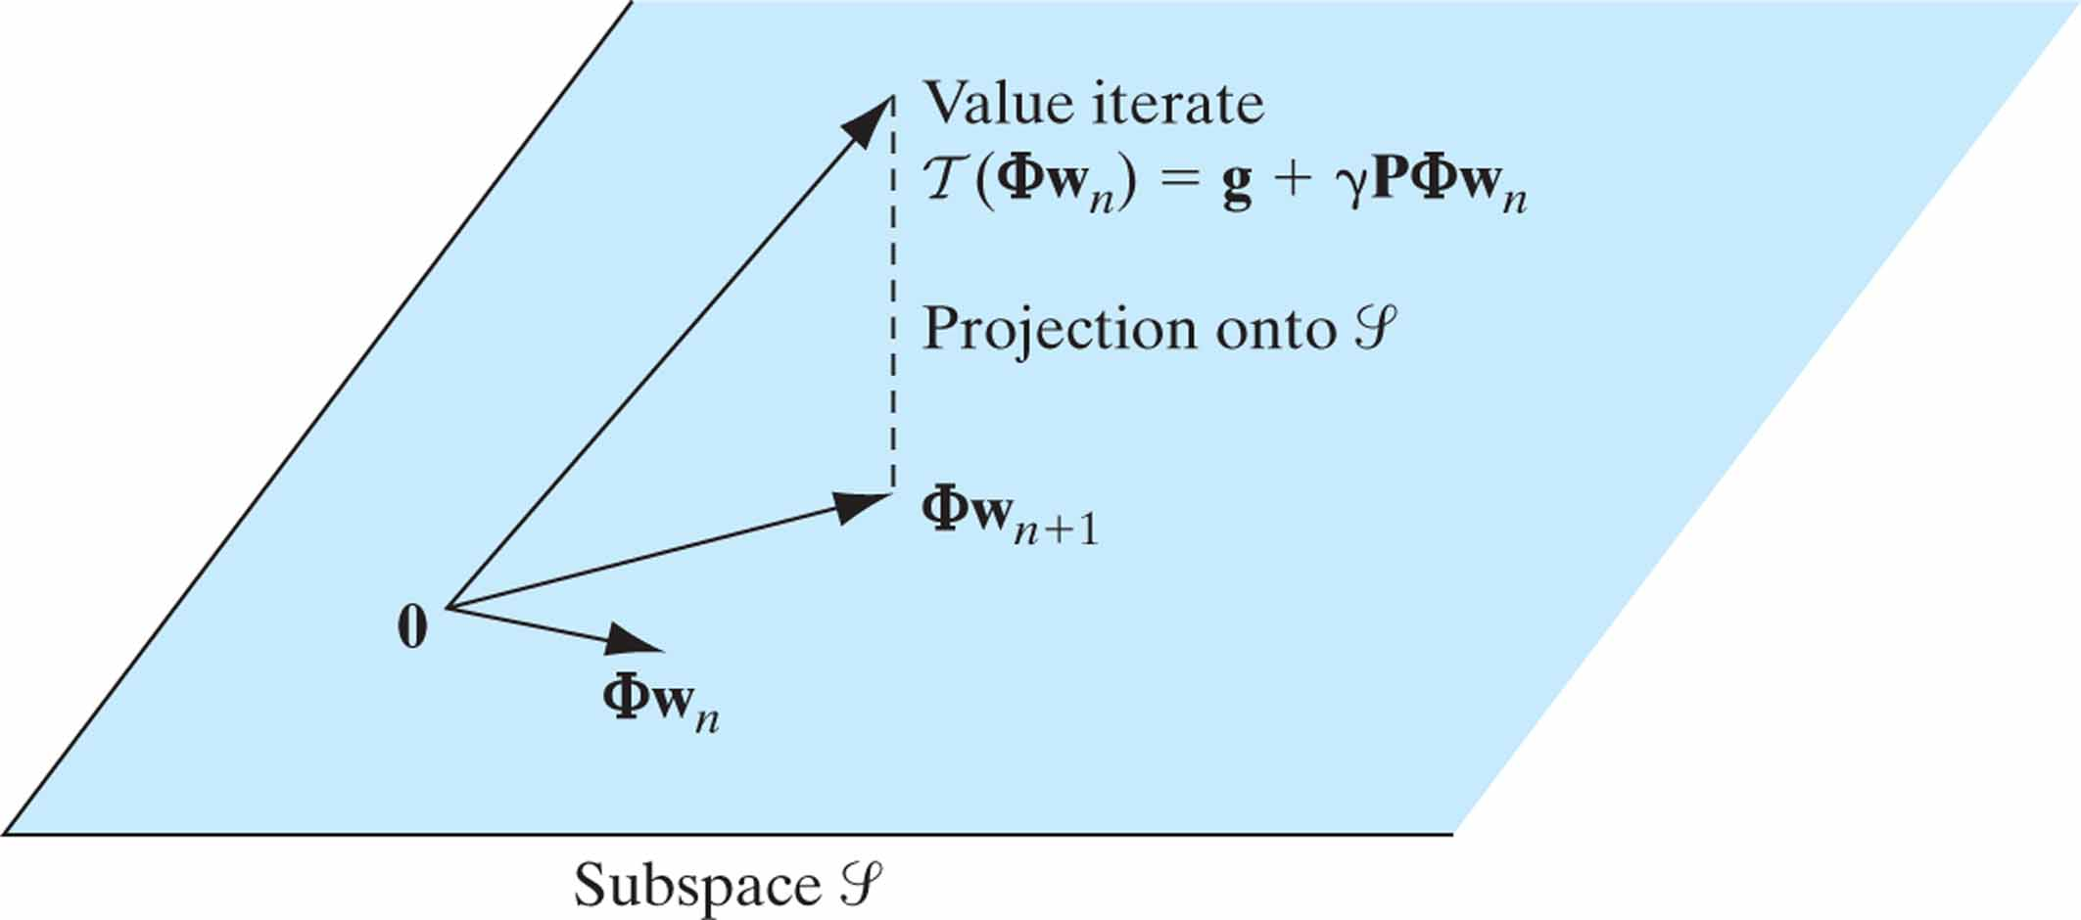
Figure 12.9 Illustration of the projected value iteration (PVI) method.

Slide 13
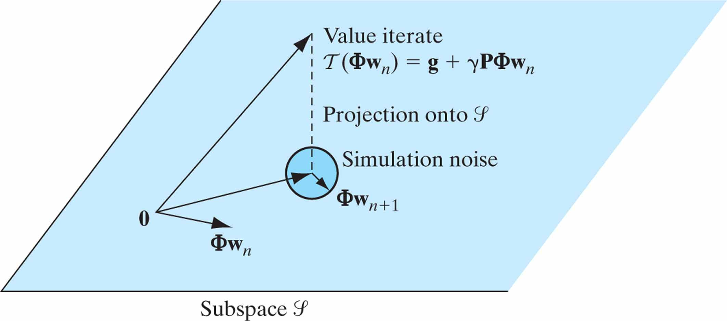
Figure 12.10 Illustration of the least-squares policy evaluation (LSPE) as a stochastic version of the projected value iteration (PVI).

Slide 14
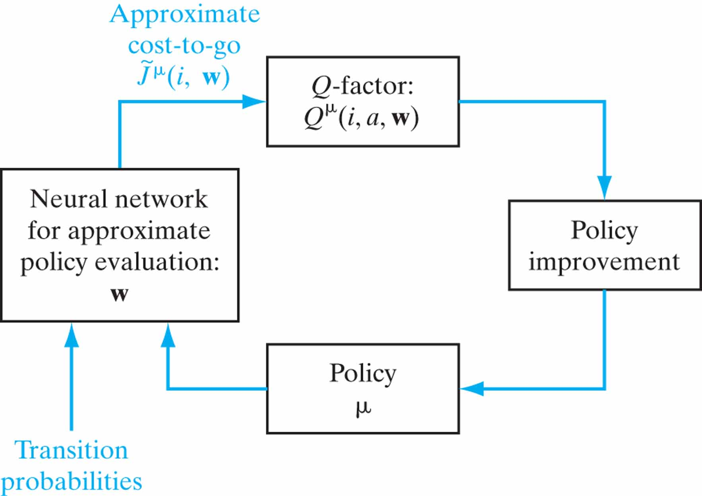
Figure 12.11 Block diagram of the approximate policy iteration algorithm.

Slide 15
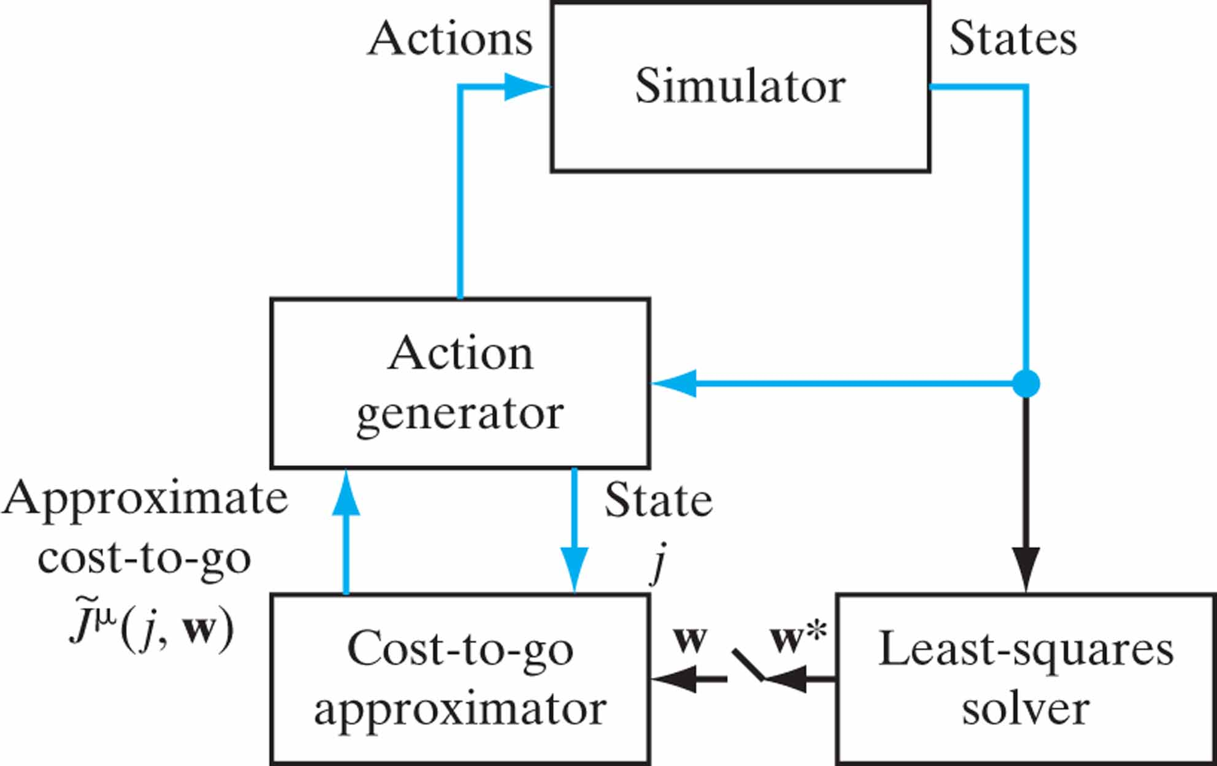
Figure 12.12 Block diagram of the approximate policy-iteration algorithm.

Slide 16
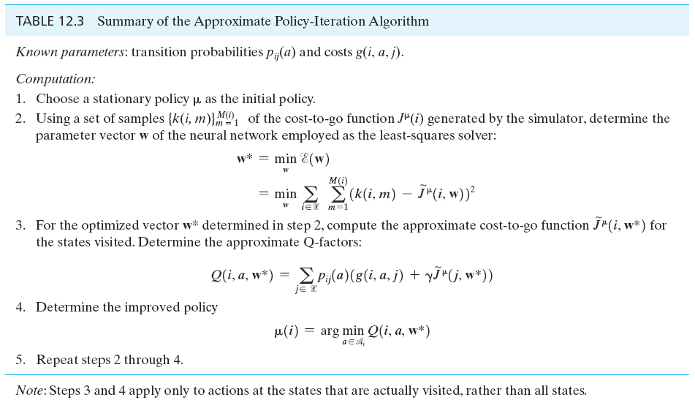
Table 12.3

Slide 17
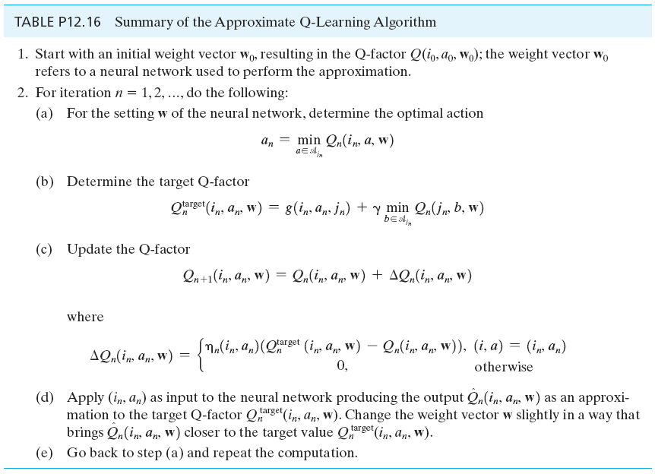
Table P12.16

Slide 18
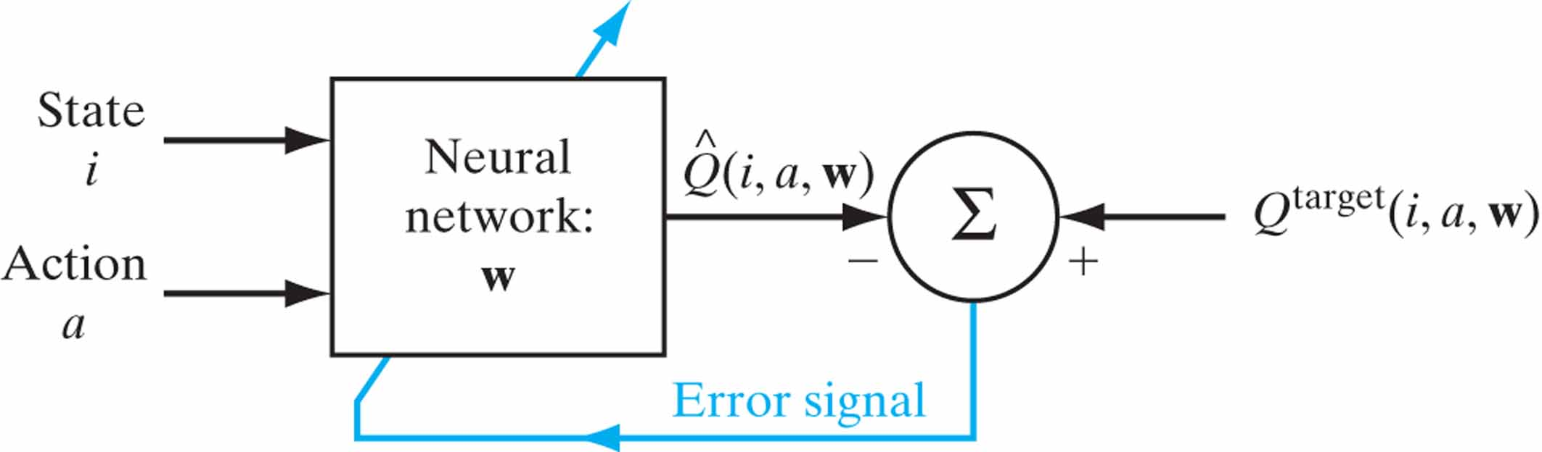
Figure P12.20

