Slide 1
Chapter 13
Neurodynamics

Slide 2
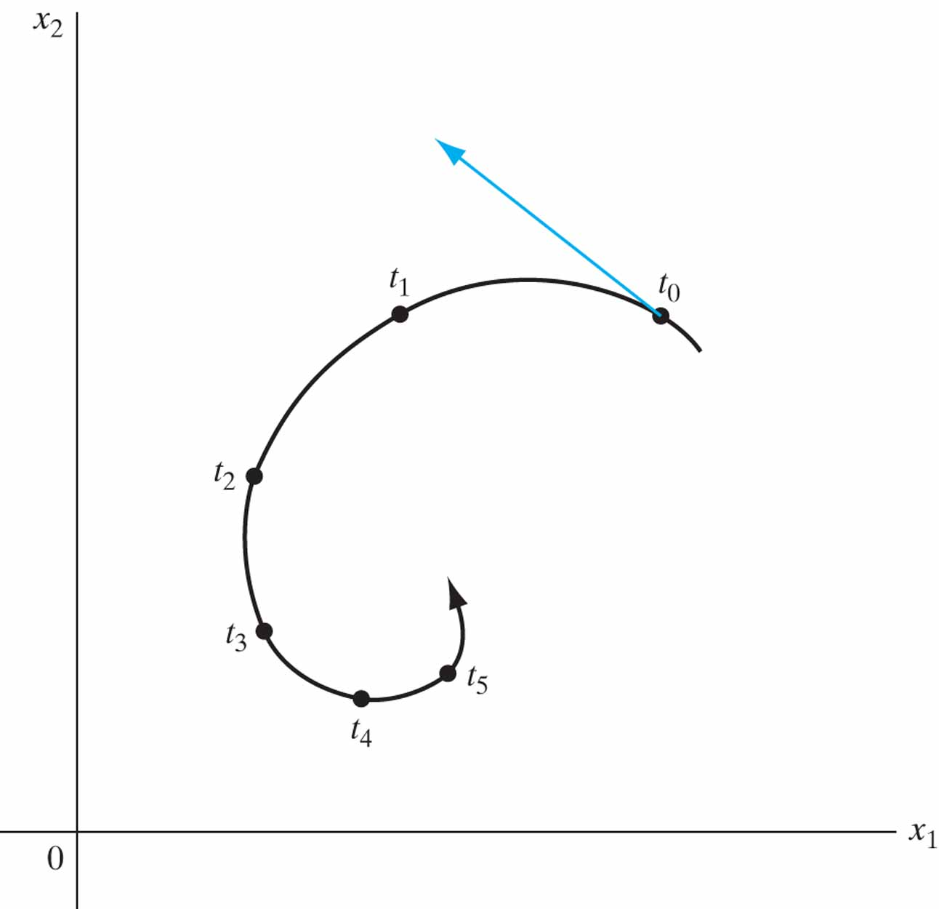
Figure 13.1 A two-dimensional trajectory (orbit) of a dynamic system.

Slide 3
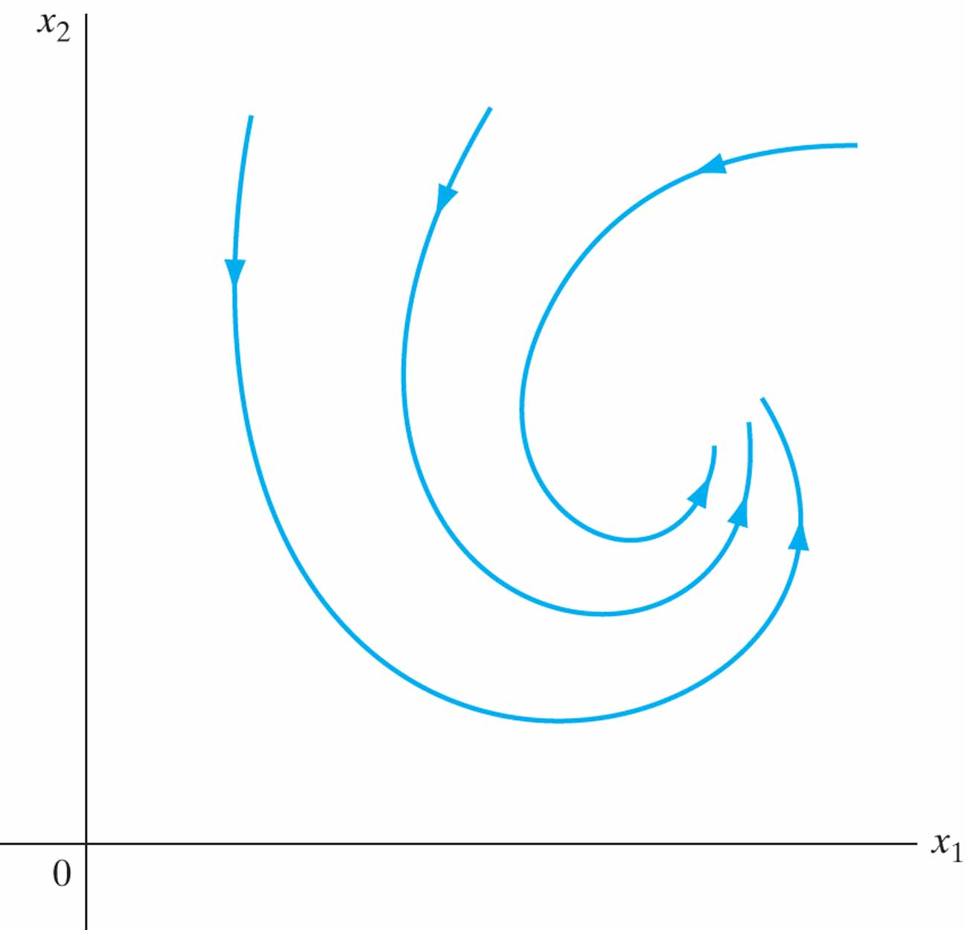
Figure 13.2 A two-dimensional state (phase) portrait of a dynamic system.

Slide 4
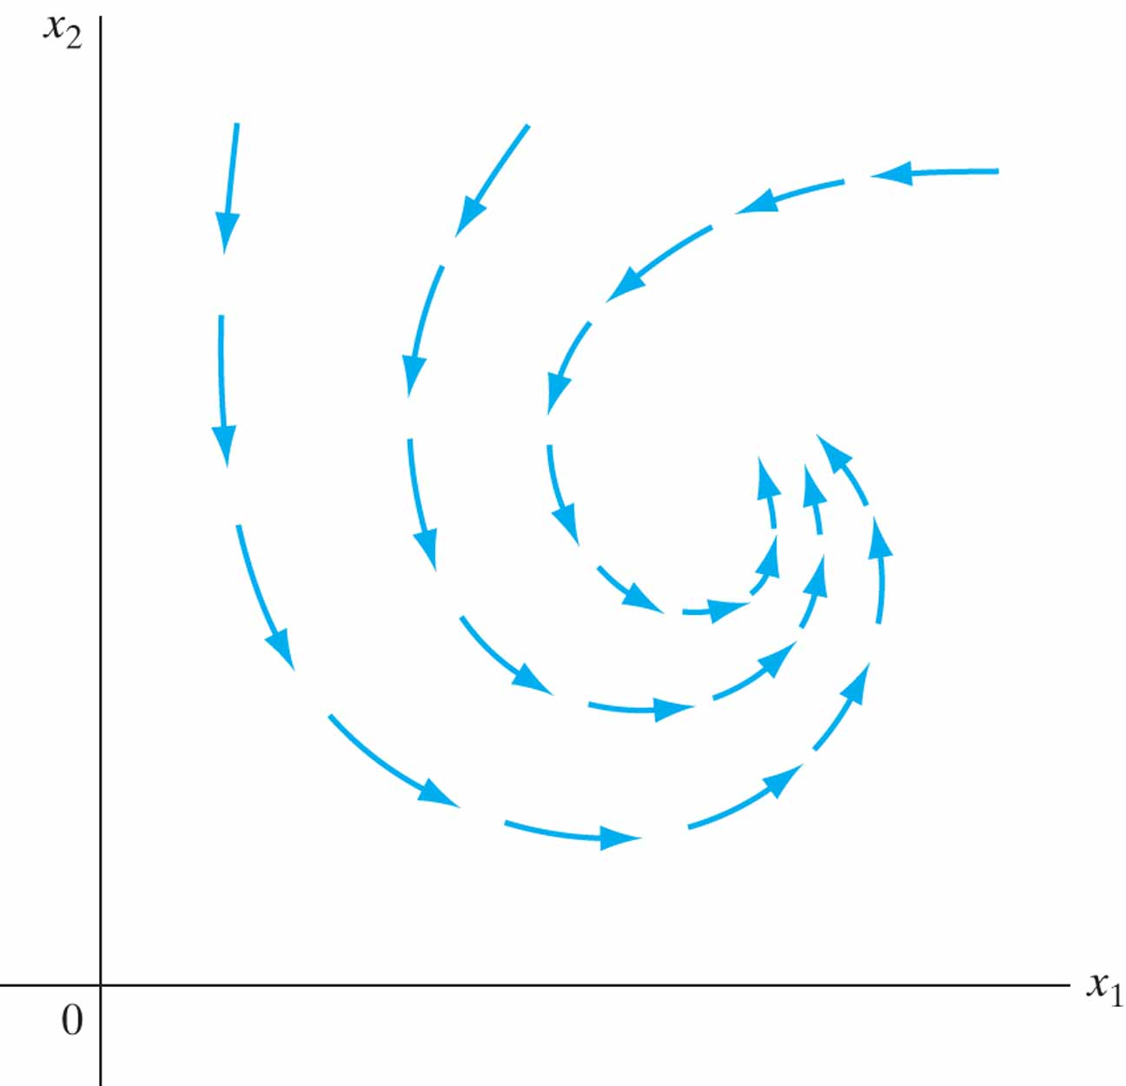
Figure 13.3 A two-dimensional vector field of a dynamic system.

Slide 5
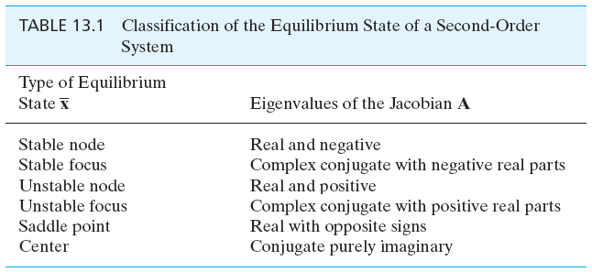
Table 13.1

Slide 6
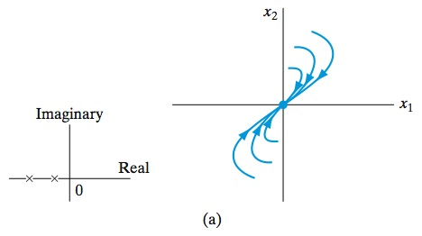
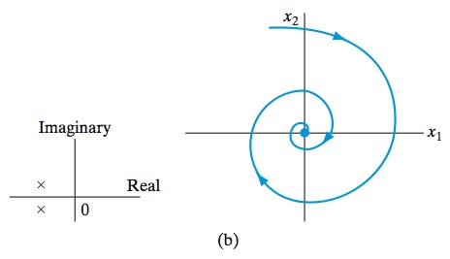
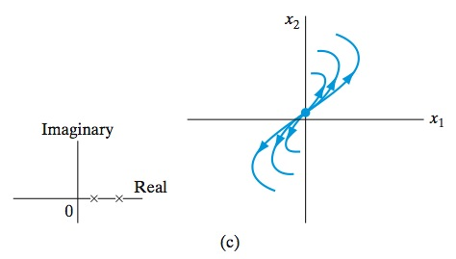
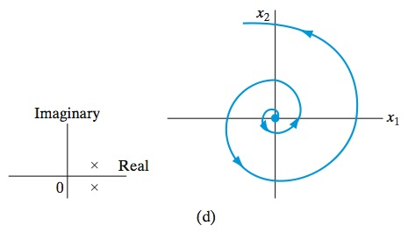
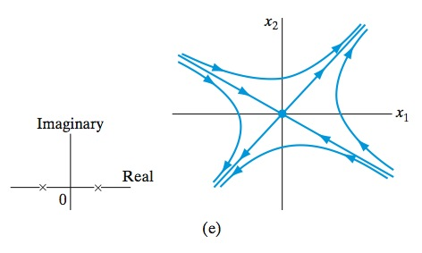
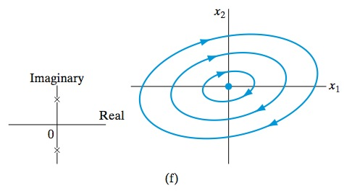
Figure 13.4 (a) Stable node. (b) Stable focus. (c) Unstable node. (d) Unstable focus. (e) Saddle point. (f) Center.

Slide 7
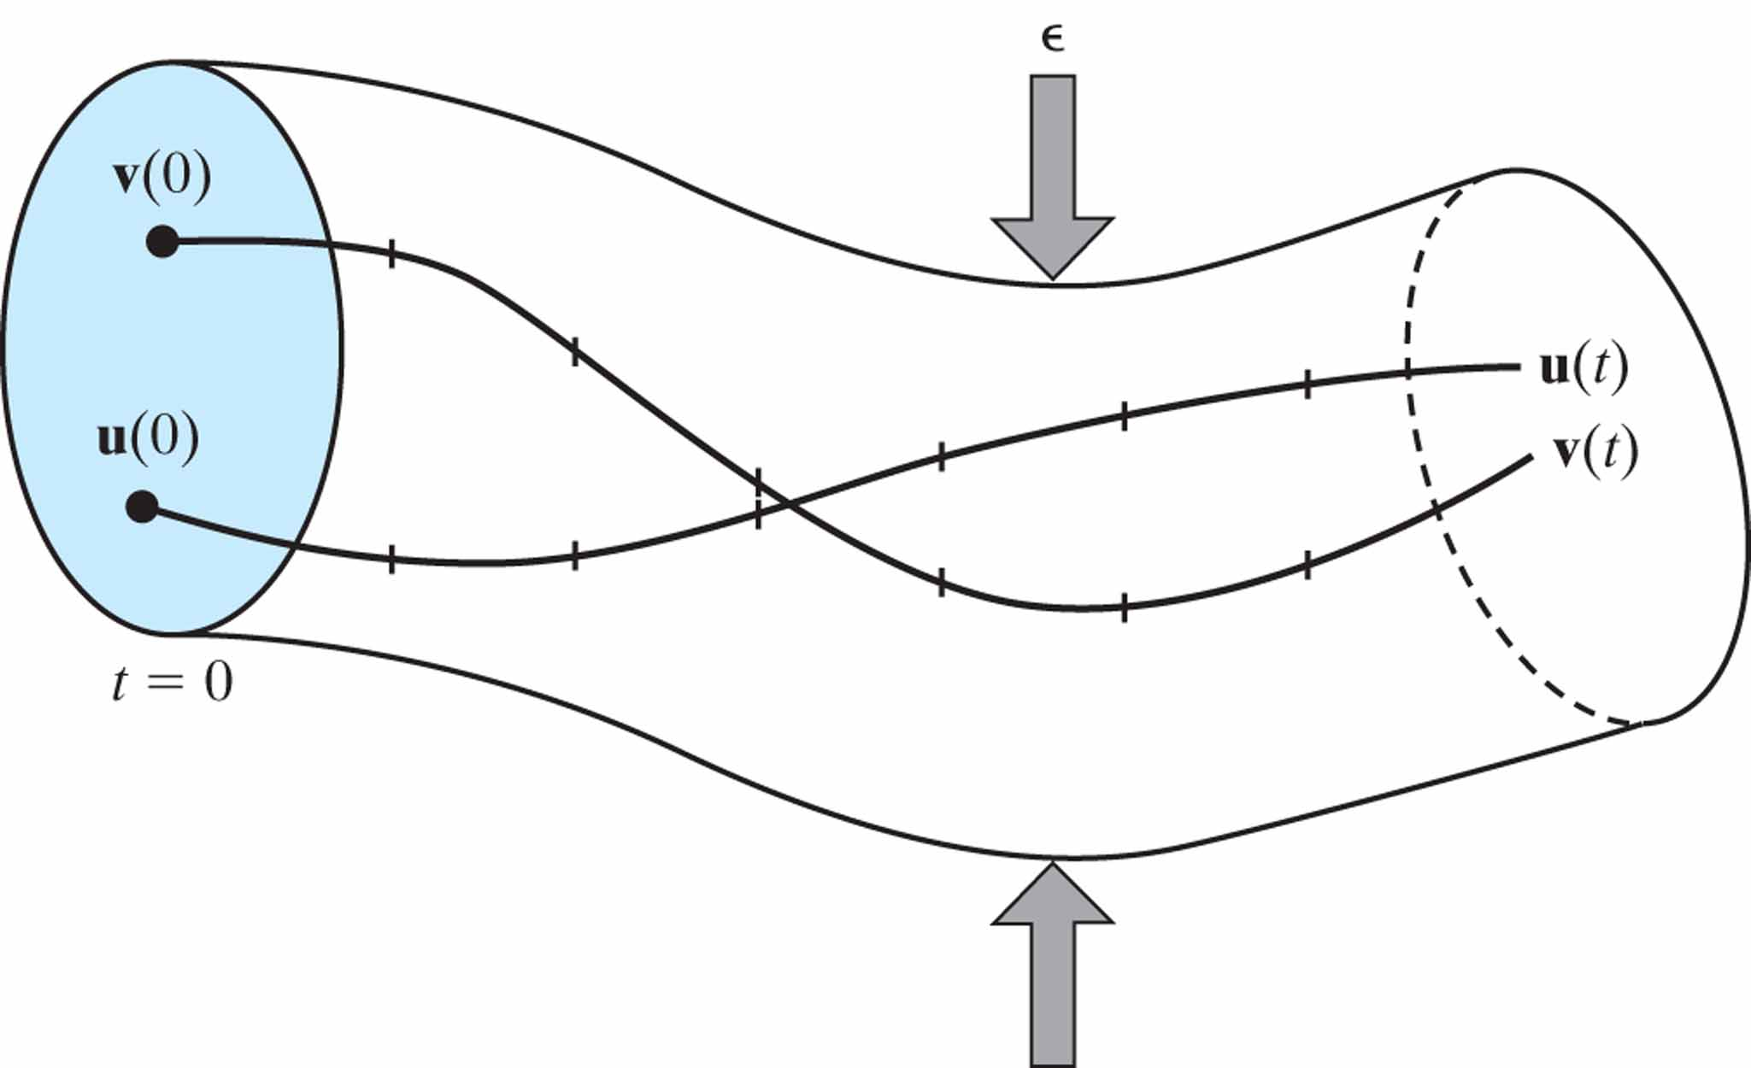
Figure 13.5 Illustration of the notion of uniform stability of a state vector.

Slide 8
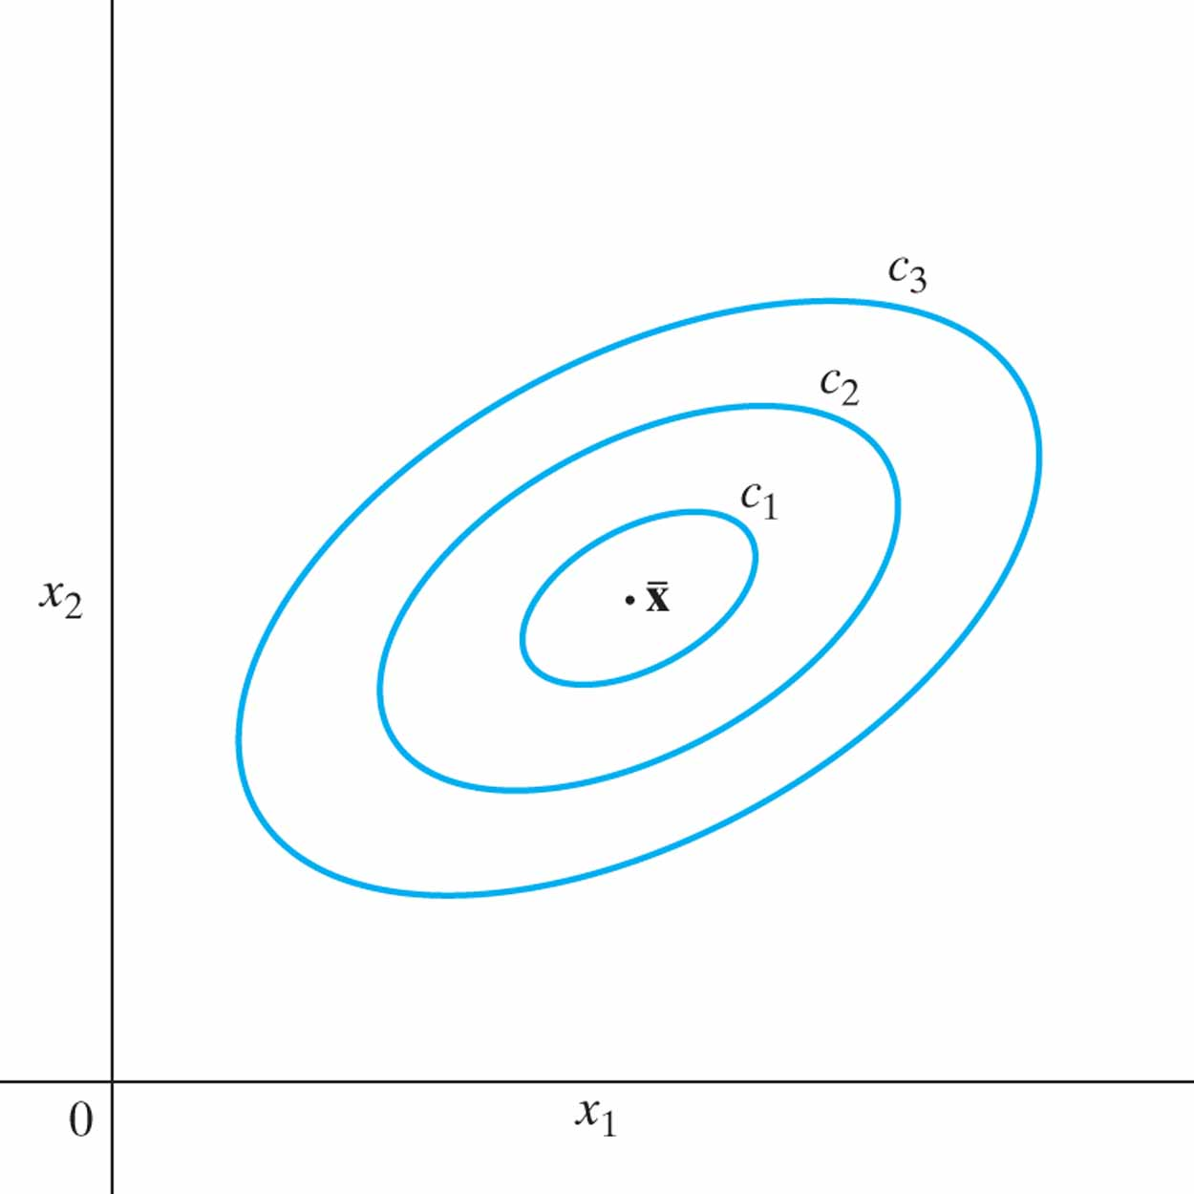
Figure 13.6 Lyapunov surfaces for decreasing value of constant c, with c₁ < c₂ < c₃. The equilibrium state is denoted by the point ¯x.

Slide 9
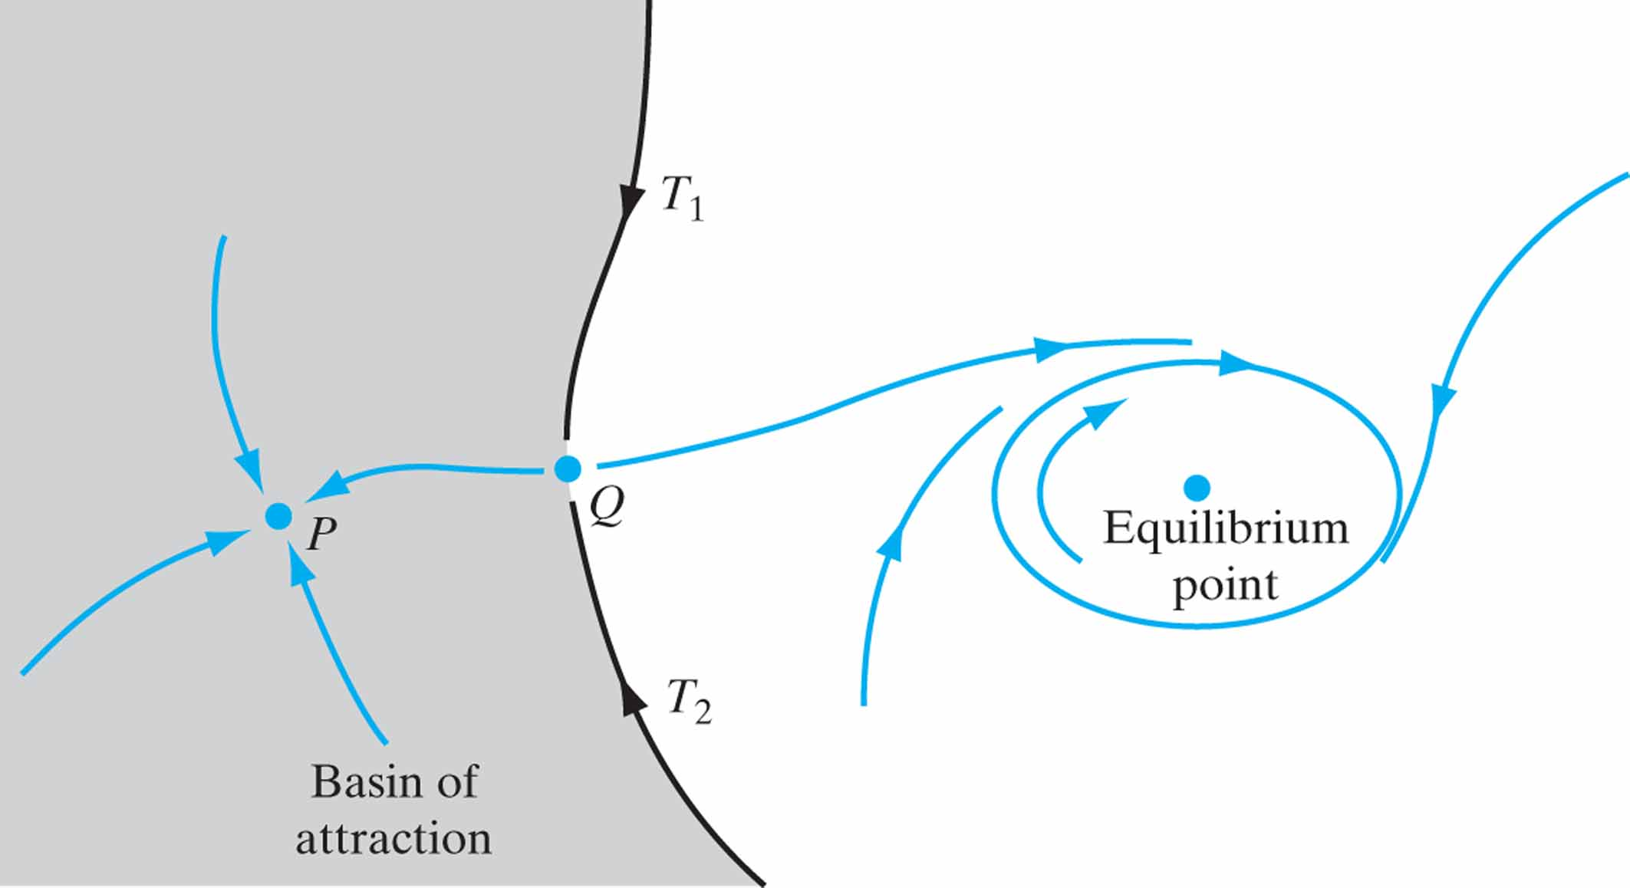
Figure 13.7 Illustration of the notion of a basin of attraction and the idea of a separatrix.

Slide 10
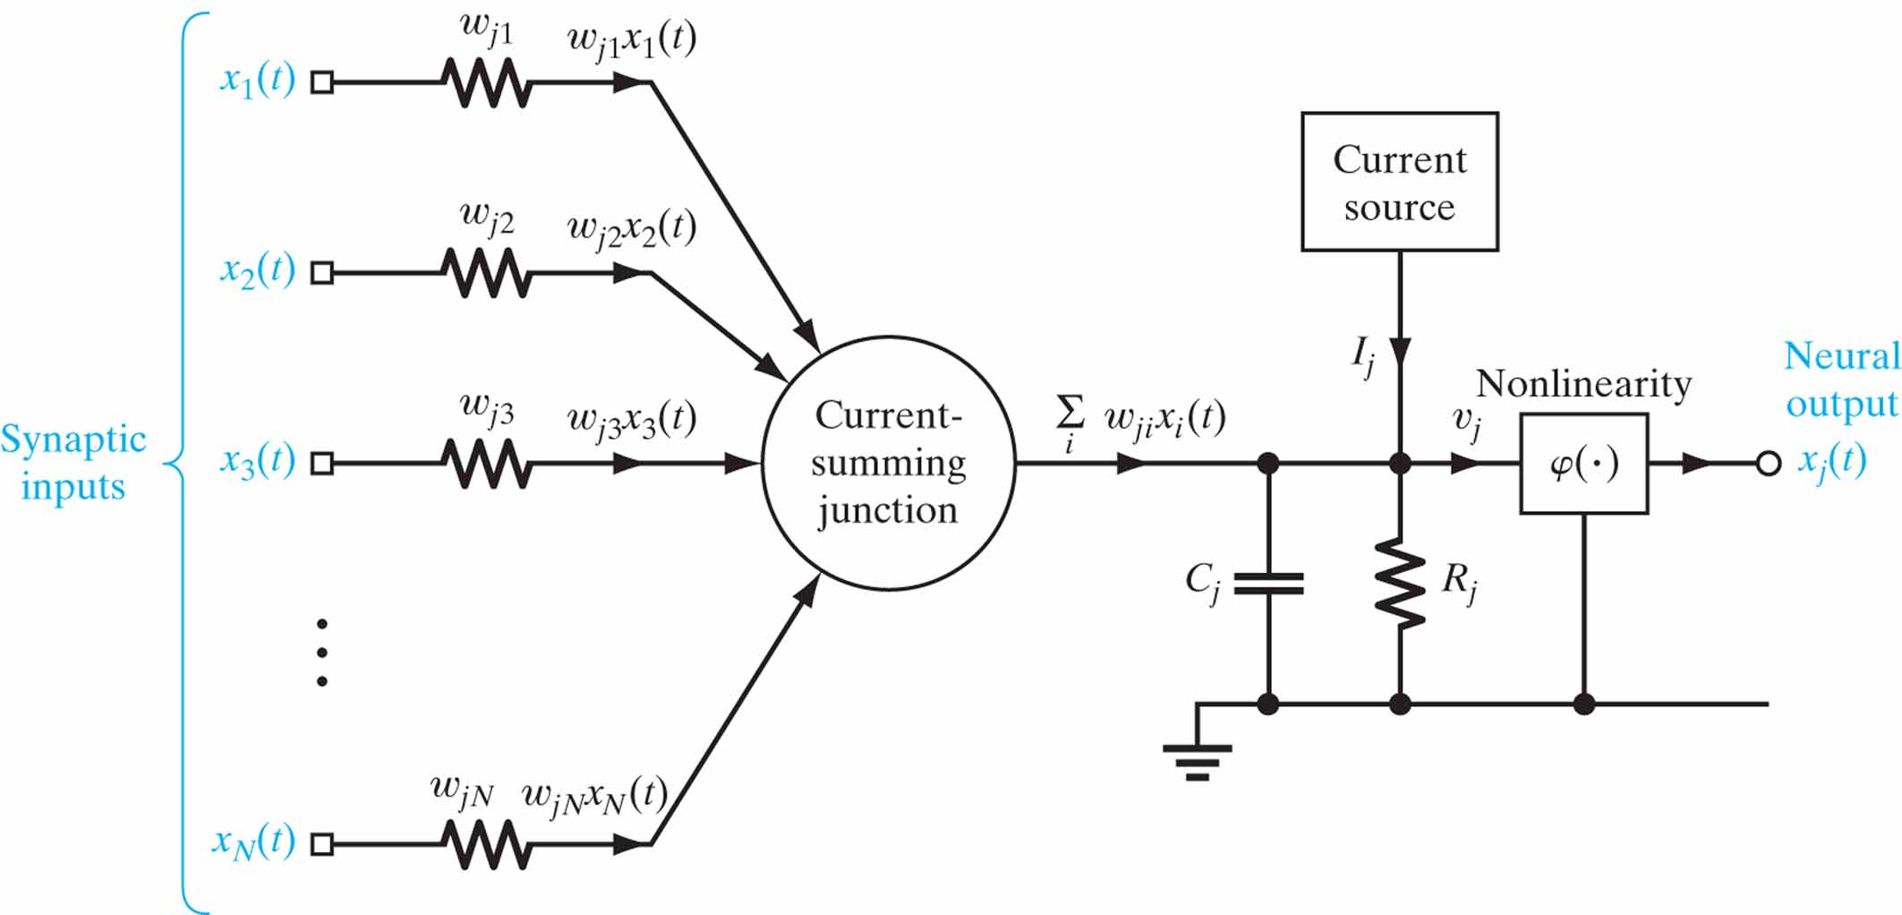
Figure 13.8 Additive model of a neuron, labeled j.

Slide 11
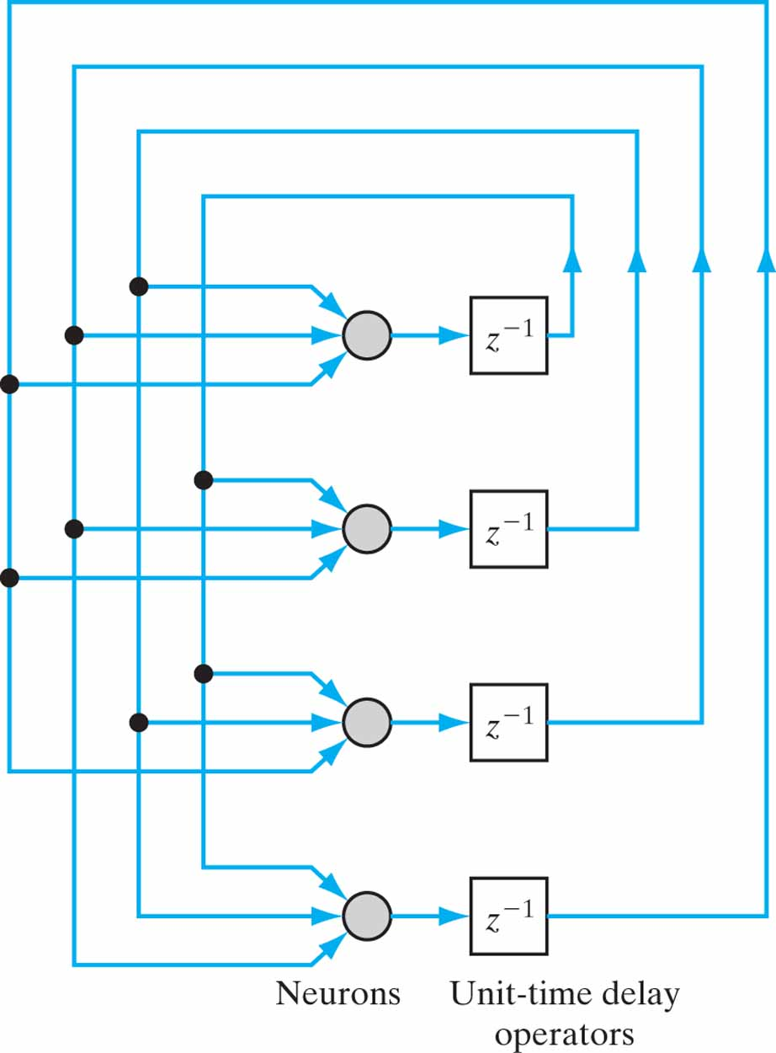
Figure 13.9 Architectural graph of a Hopfield network consisting of N = 4 neurons.

Slide 12
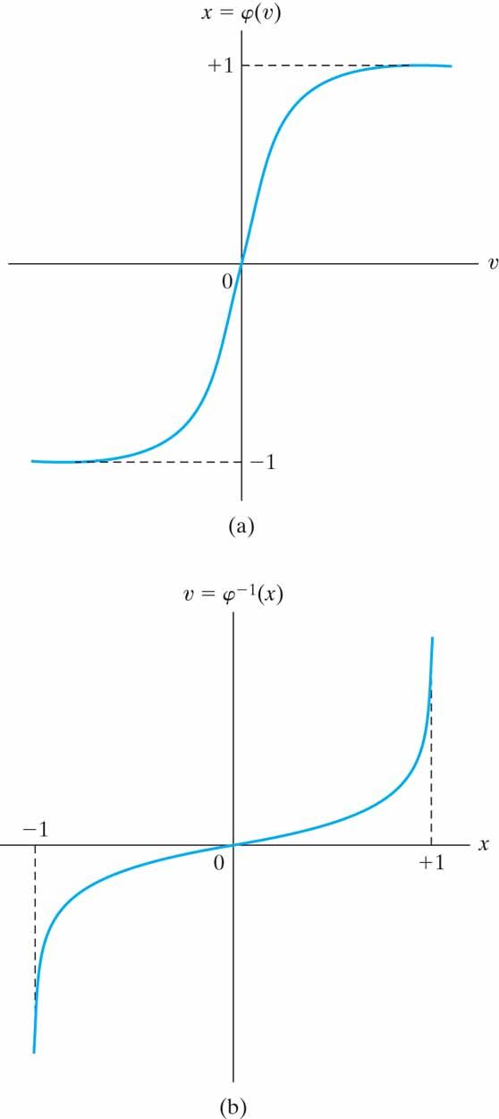
Figure 13.10 Plots of (a) the standard sigmoidal nonlinearity, and (b) its inverse.

Slide 13
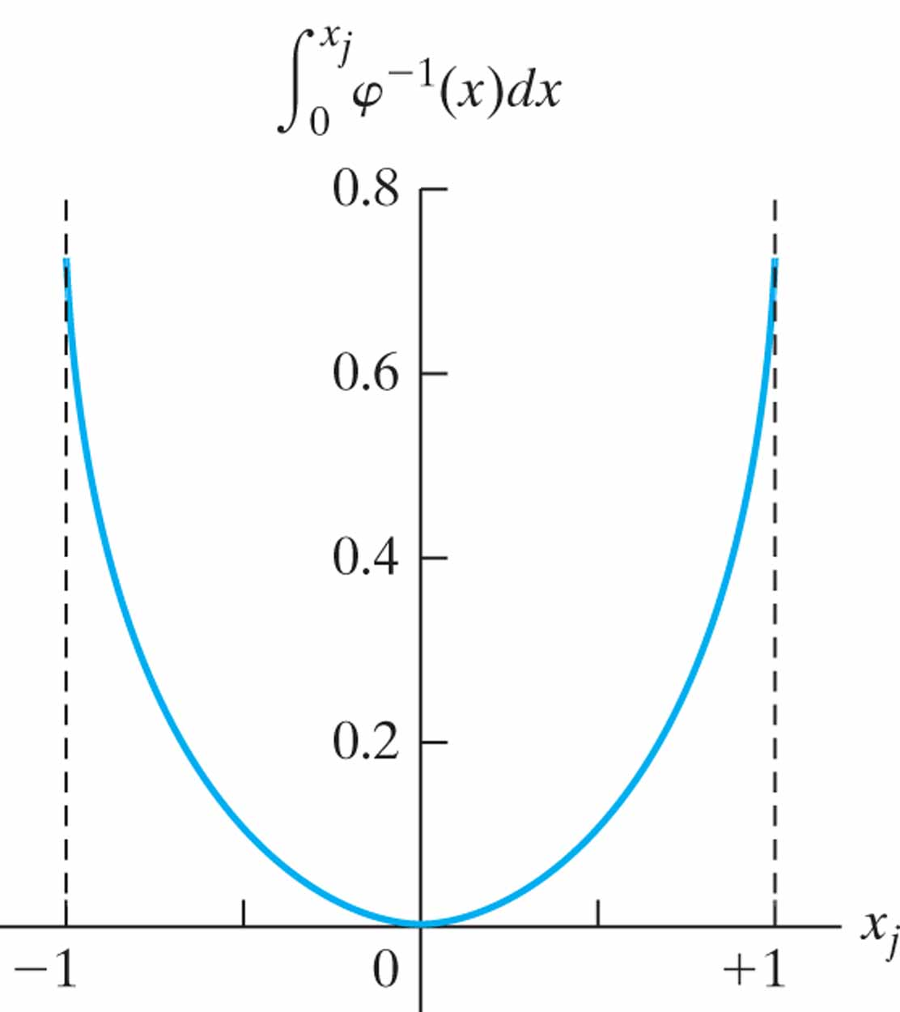
Figure 13.11 Plot of the integral

Slide 14
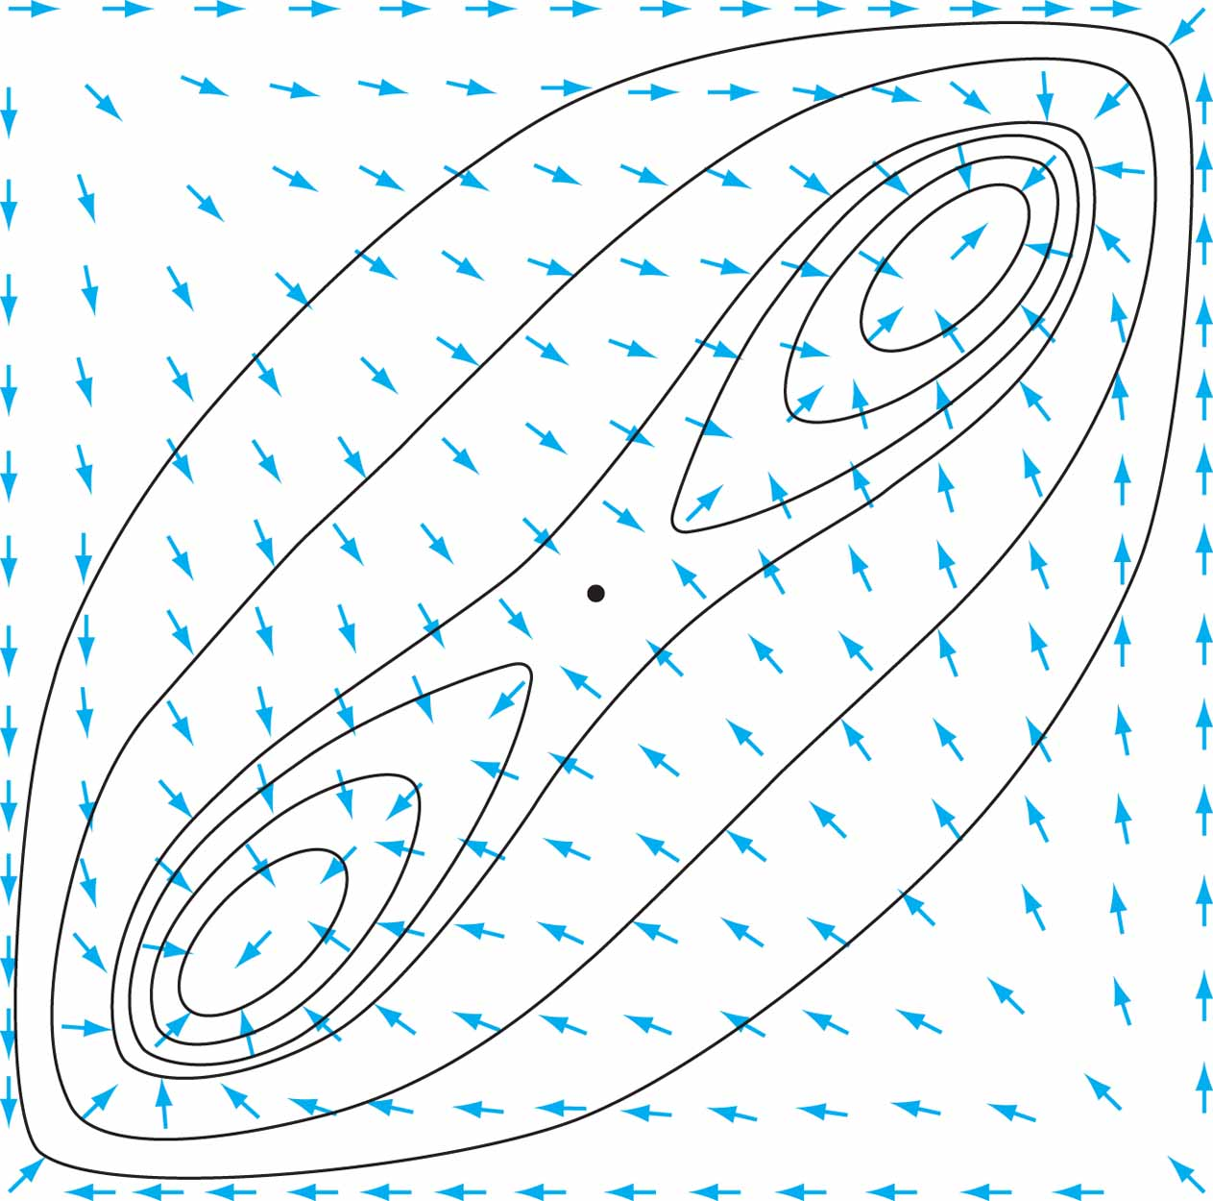
Figure 13.12 An energy contour map for a two-neuron, two-stable-state system. The ordinate and abscissa are the outputs of the two neurons. Stable states are located near the lower left and upper right corners, and unstable extrema are located at the other two corners. The arrows show the motion of the state. This motion is not generally perpendicular to the energy contours. (From J.J. Hopfield, 1984, with permission of the National Academy of Sciences of the U.S.A.)

Slide 15
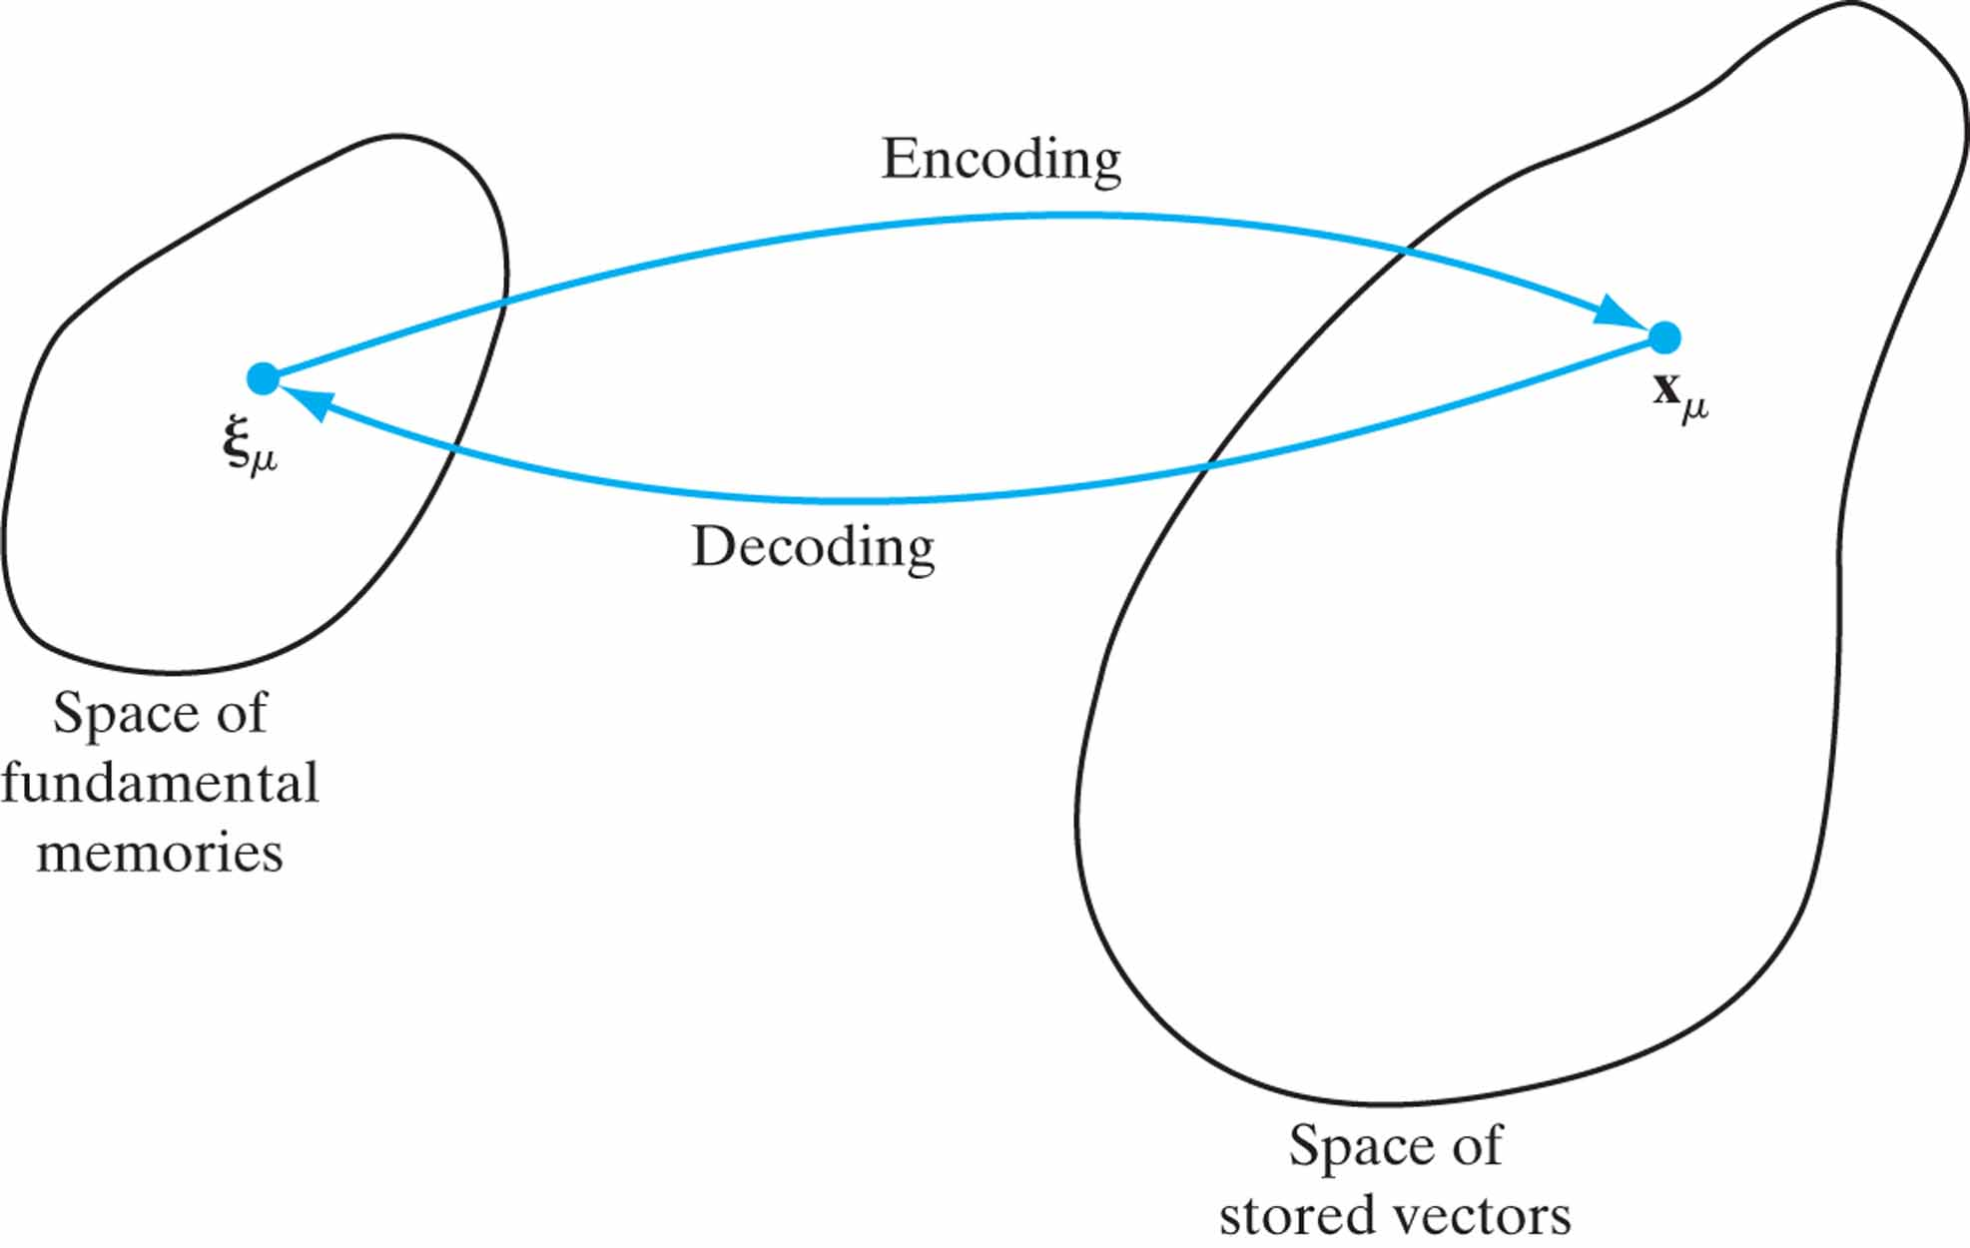
Figure 13.13 Illustration of the encoding–decoding performed by a recurrent network.

Slide 16
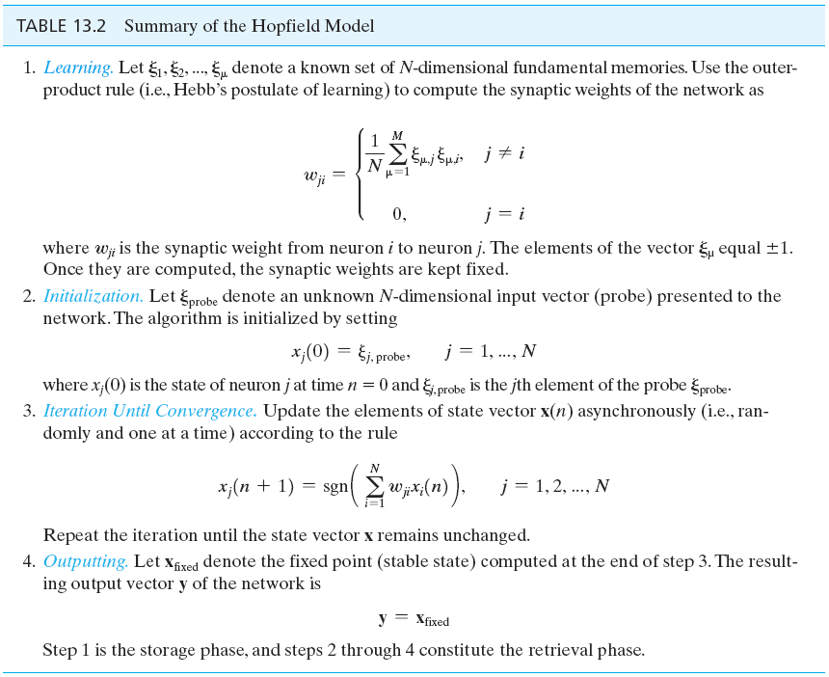
Table 13.2

Slide 17
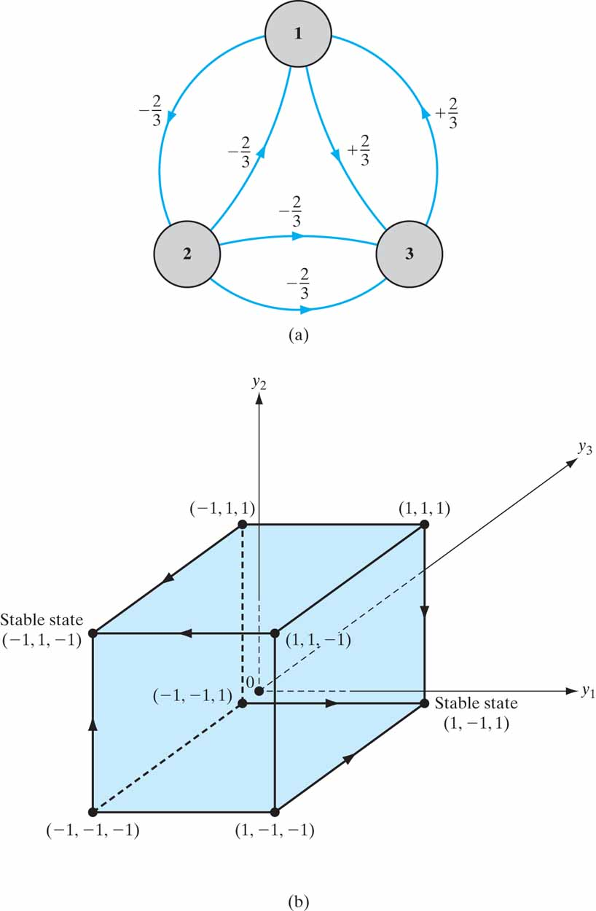
Figure 13.14 (a) Architectural graph of Hopfield network for N = 3 neurons. (b) Diagram depicting the two stable states and flow of the network.

Slide 18
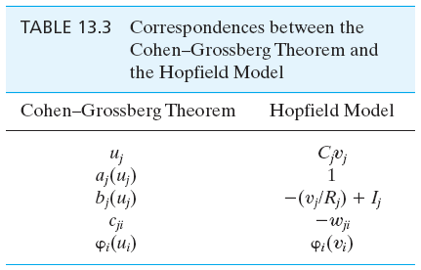
Table 13.3

Slide 19
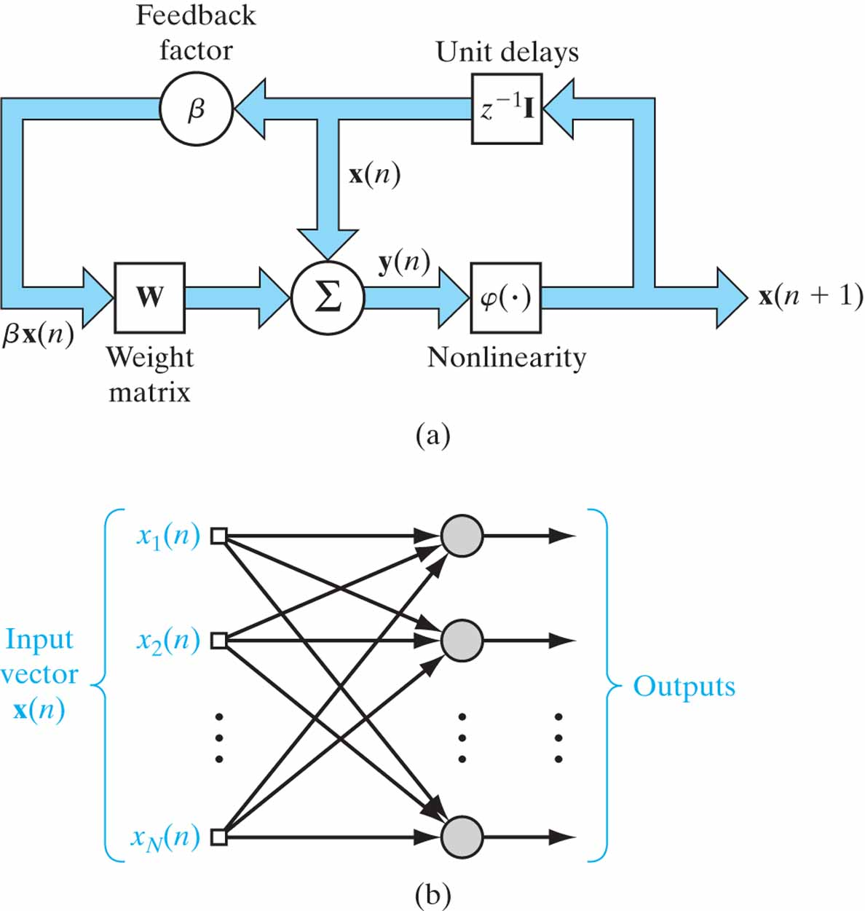
Figure 13.15 (a) Block diagram of the brain-state-in-a-box (BSB) model. (b) Signal-flow graph of the linear associator represented by the weight matrix W.

Slide 20
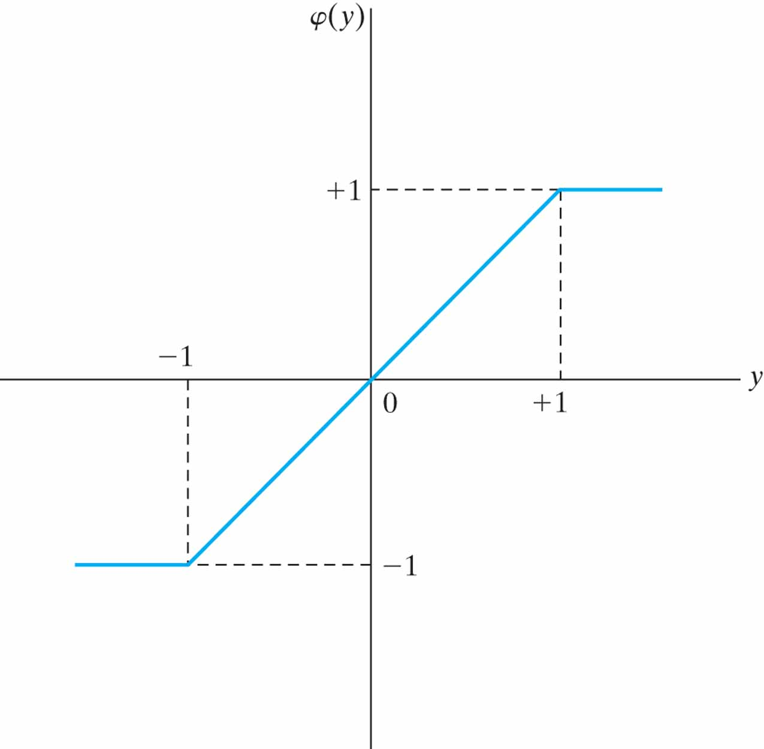
Figure 13.16 Piecewise-linear activation function used in the BSB model.

Slide 21
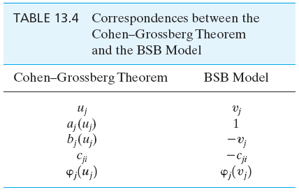
Table 13.4

Slide 22
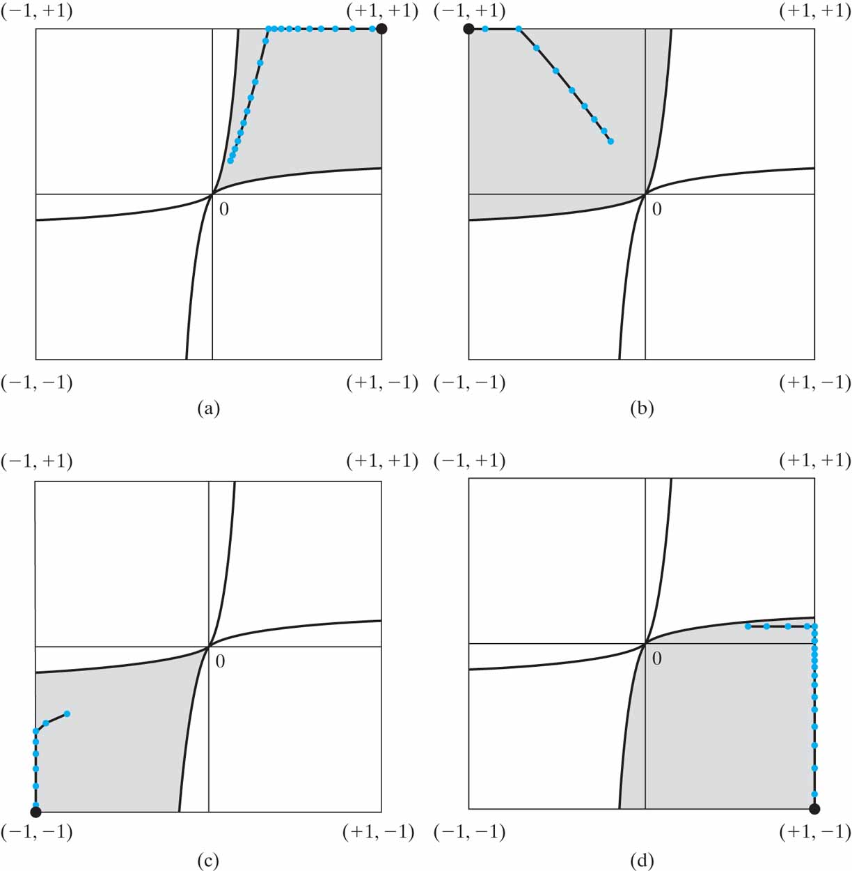
Figure 13.17 Illustrative example of a two-neuron BSB model, operating under four different initial conditions:
• the four shaded areas of the figure represent the model’s basins of attraction;
• the corresponding trajectories of the model are plotted in blue;
• the four corners, where the trajectories terminate, are printed as black dots.

Slide 23
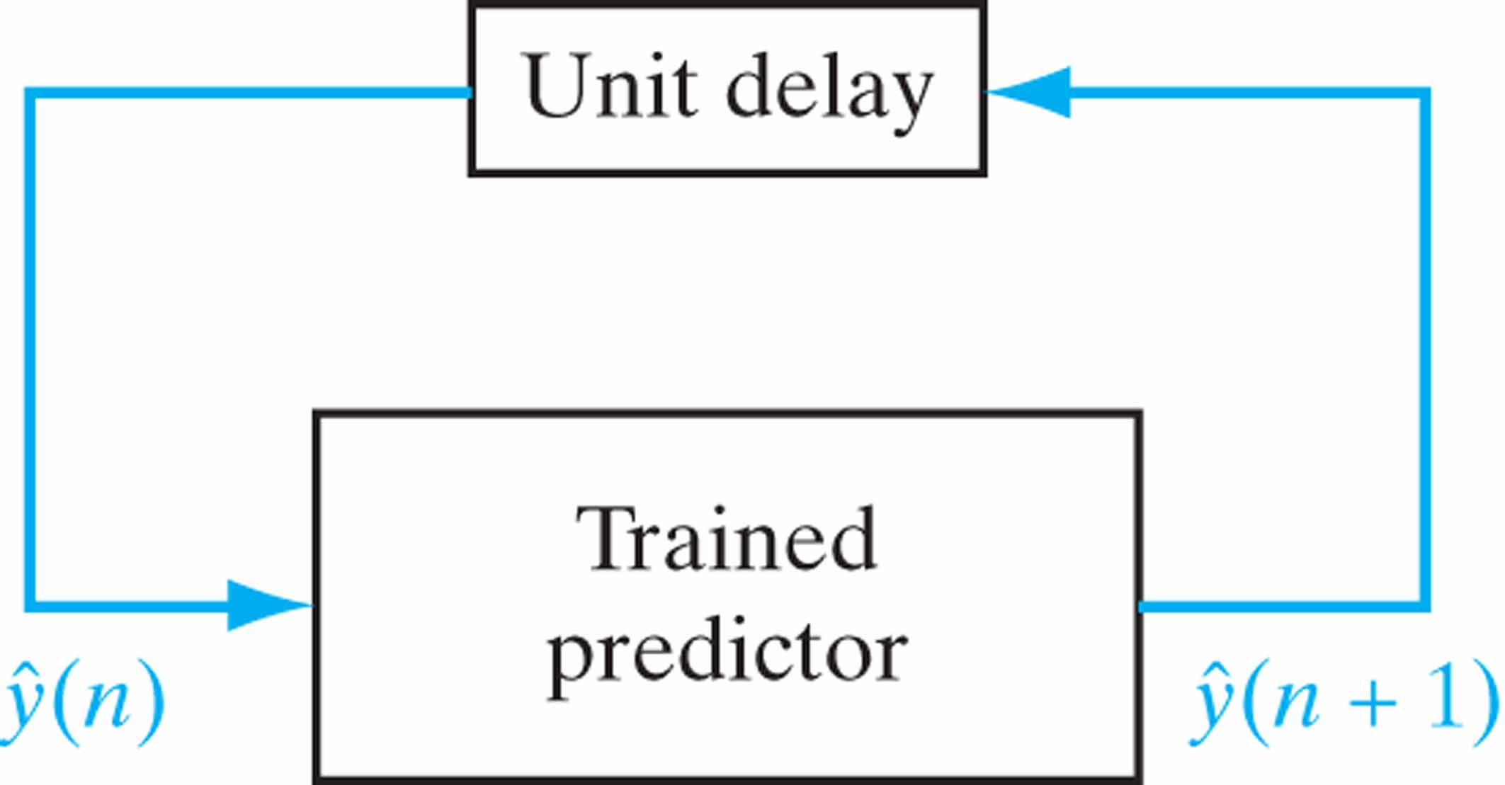
Figure 13.18 Feedback system used as an iterated predictor for the dynamic reconstruction of a chaotic process.

Slide 24
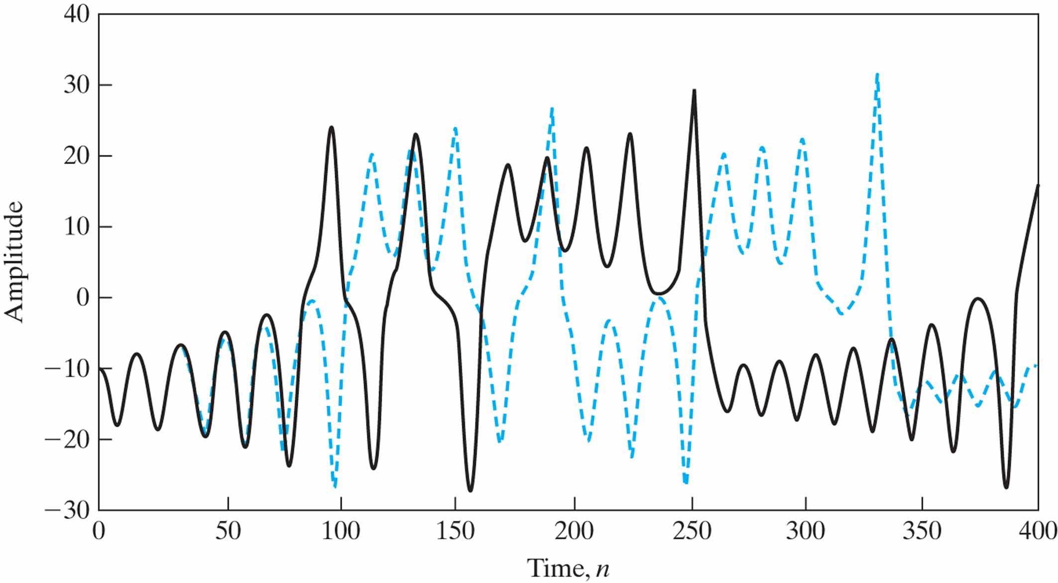
Figure 13.19 Regularized iterated prediction (N = 400, m = 20) on Lorenz data at SNR = +25 dB; the solid curve is the actual chaotic signal, and the red curve is the reconstructed signal.

Slide 25
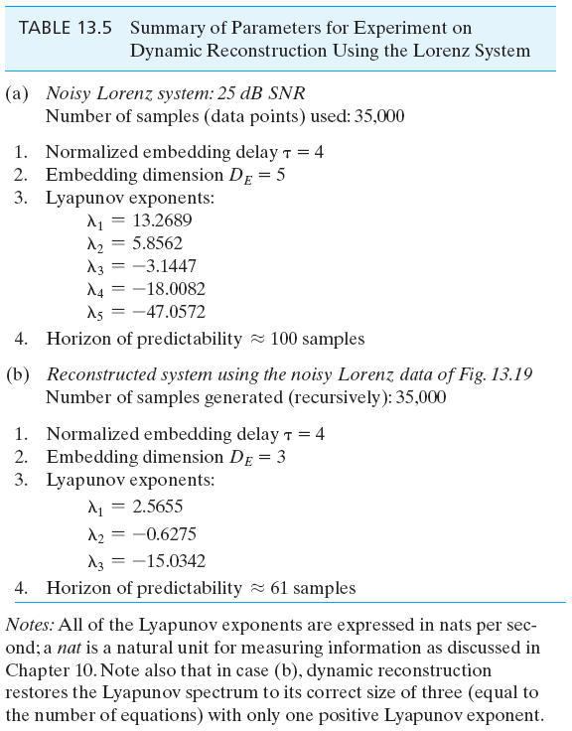
Table 13.5

Slide 26
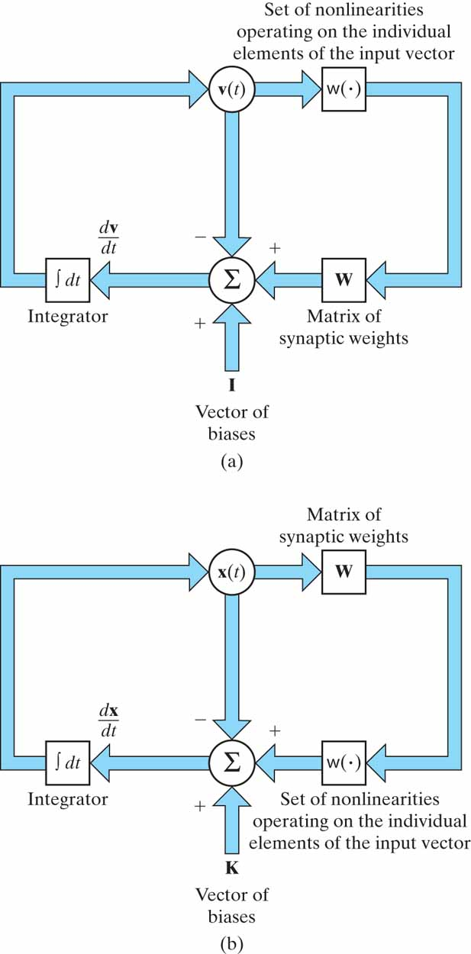
Figure P13.2

Slide 27
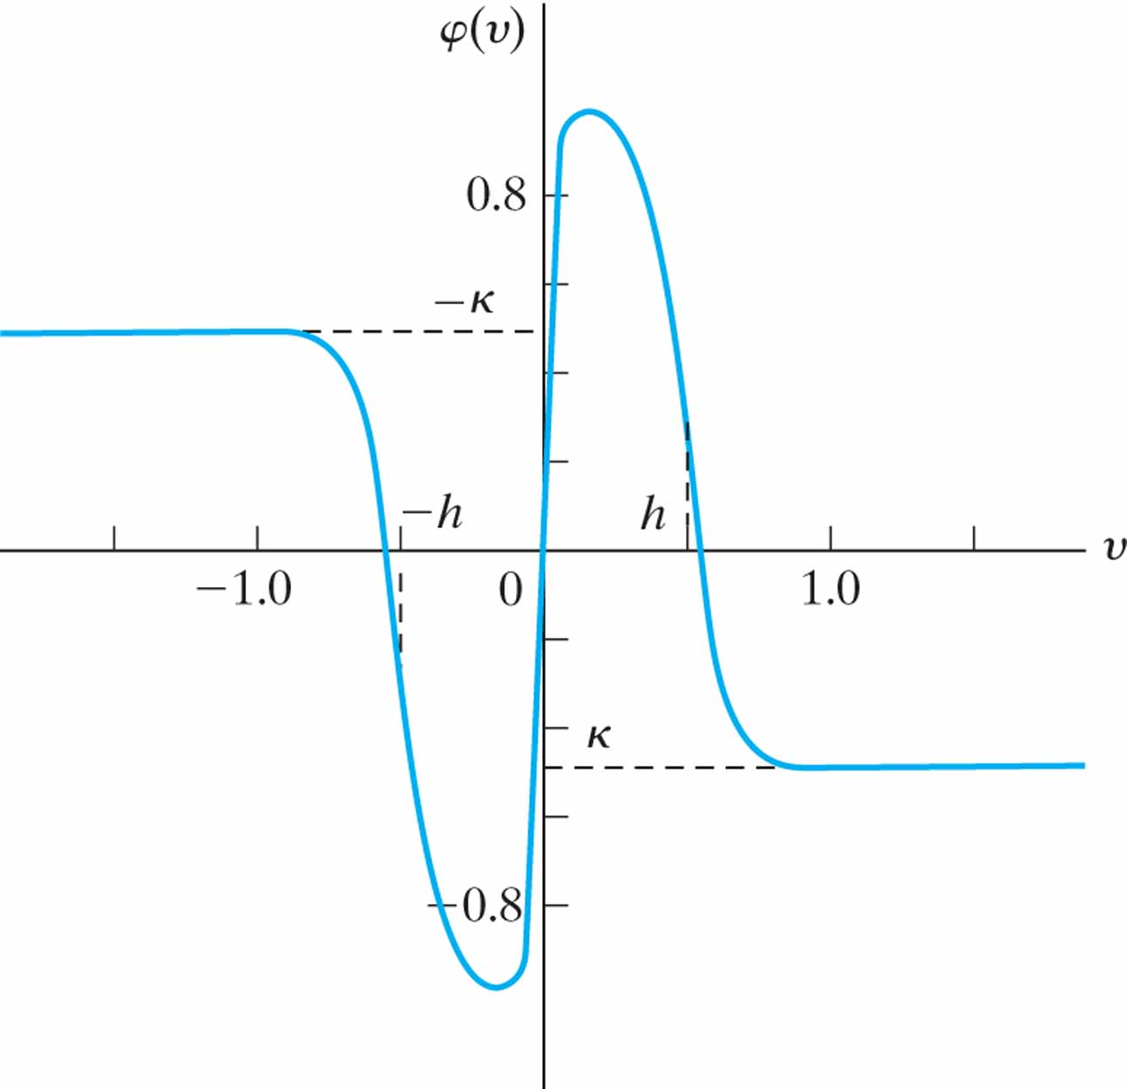
Figure P13.13

