Slide 1
Chapter 14
Bayseian Filtering and State Estimation of Dynamic Systems

Slide 2
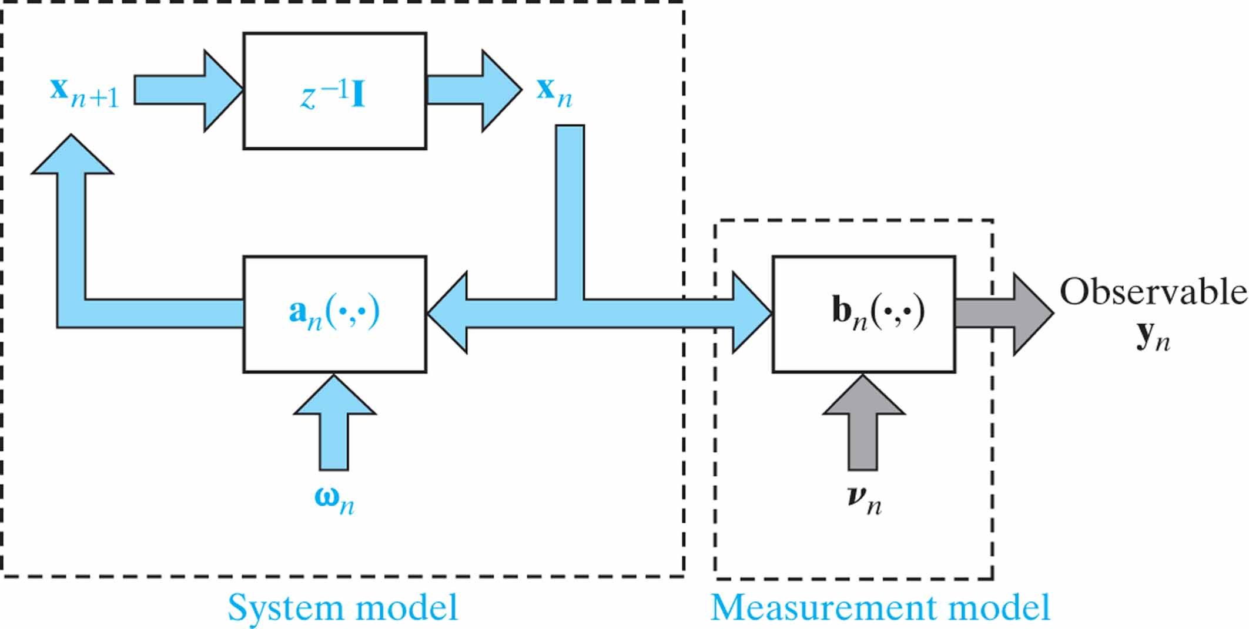
Figure 14.1 Generic state-space model of a time-varying, nonlinear dynamic system, where z^{–1}I denotes a block of unit-time delays.

Slide 3
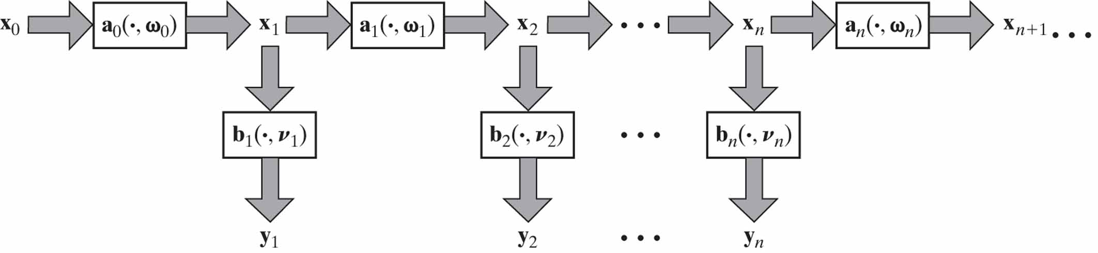
Figure 14.2 Evolution of the state across time, viewed as a first-order Markov chain.

Slide 4
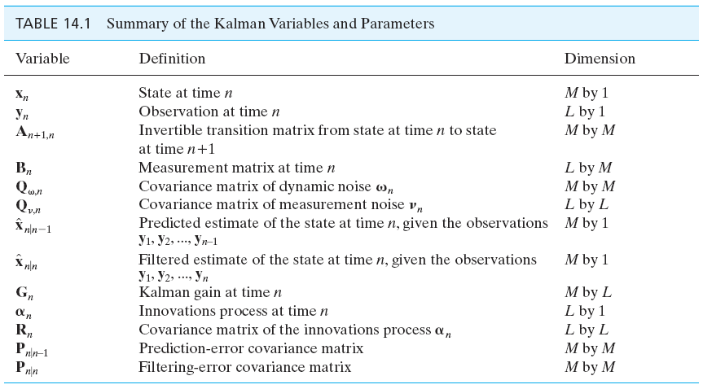
Table 14.1

Slide 5
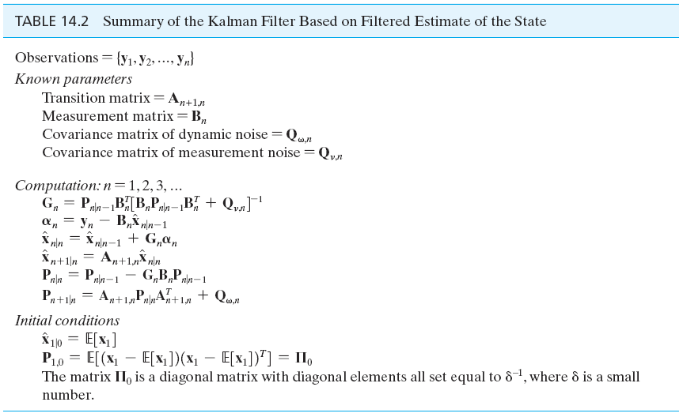
Table 14.2

Slide 6
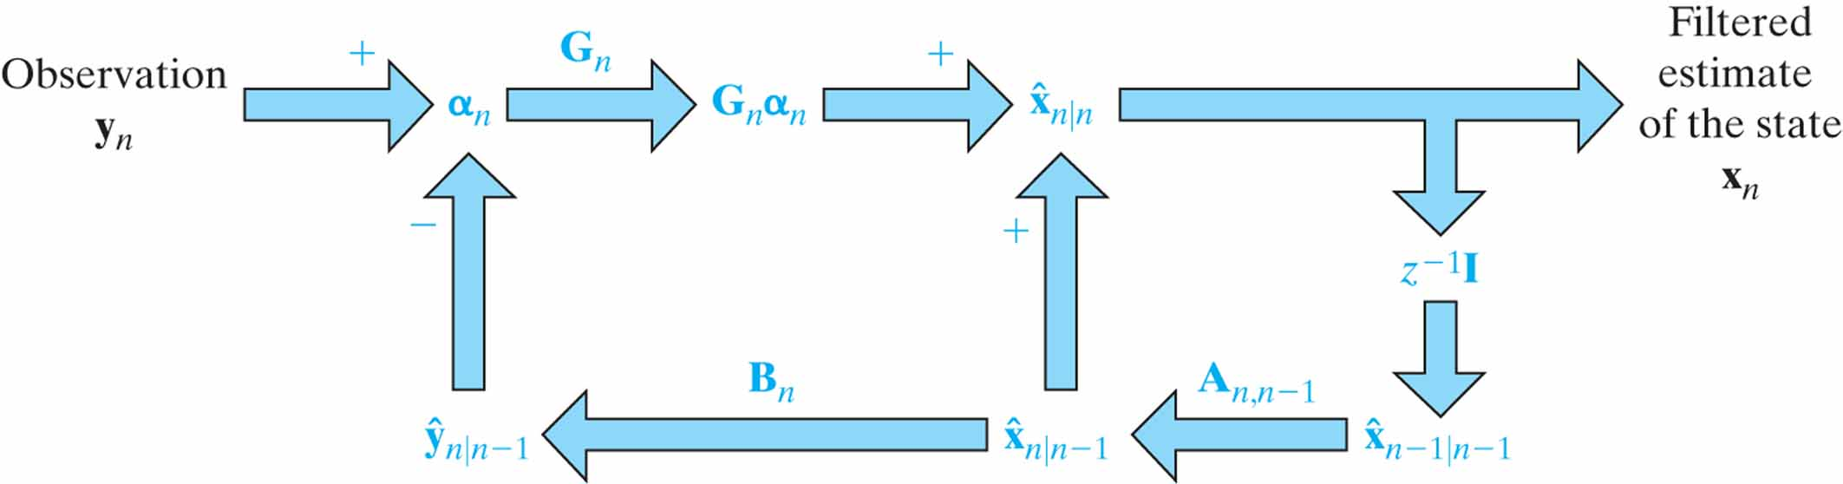
Figure 14.3 Signal-flow graph of the Kalman filter, depicting it as a double-loop feedback system.

Slide 7
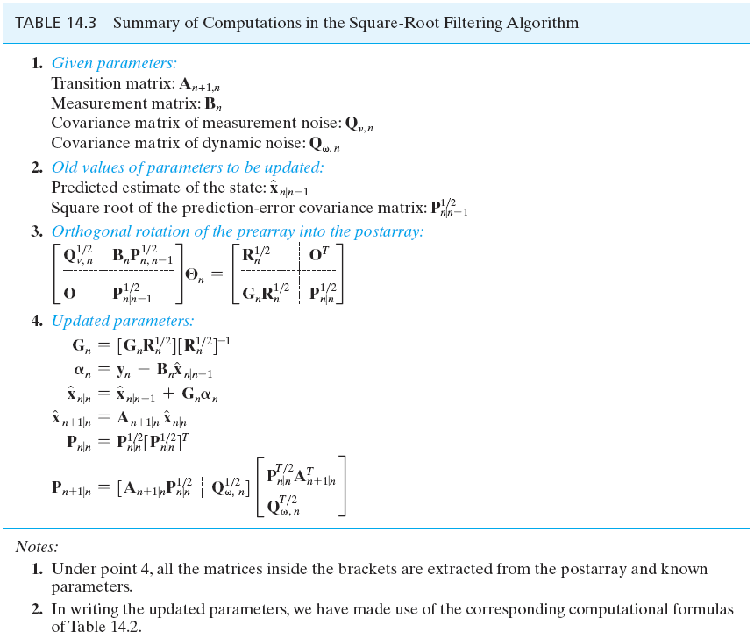
Table 14.3

Slide 8
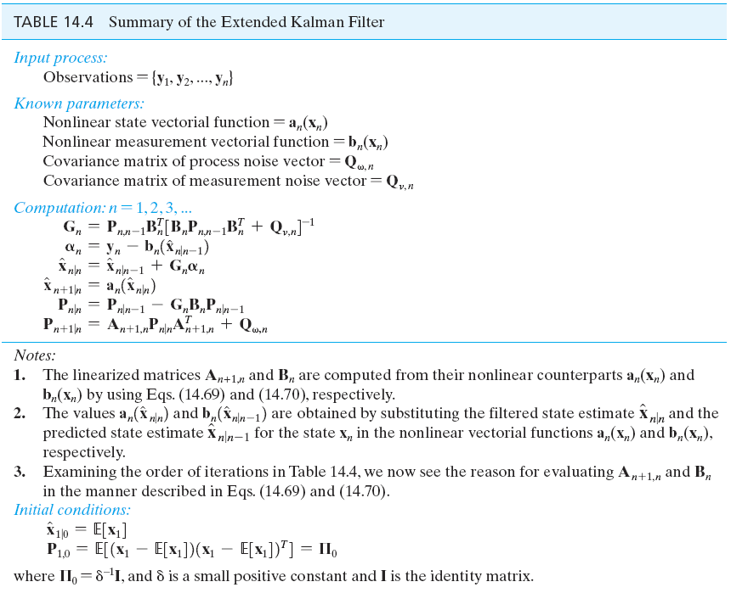
Table 14.4

Slide 9
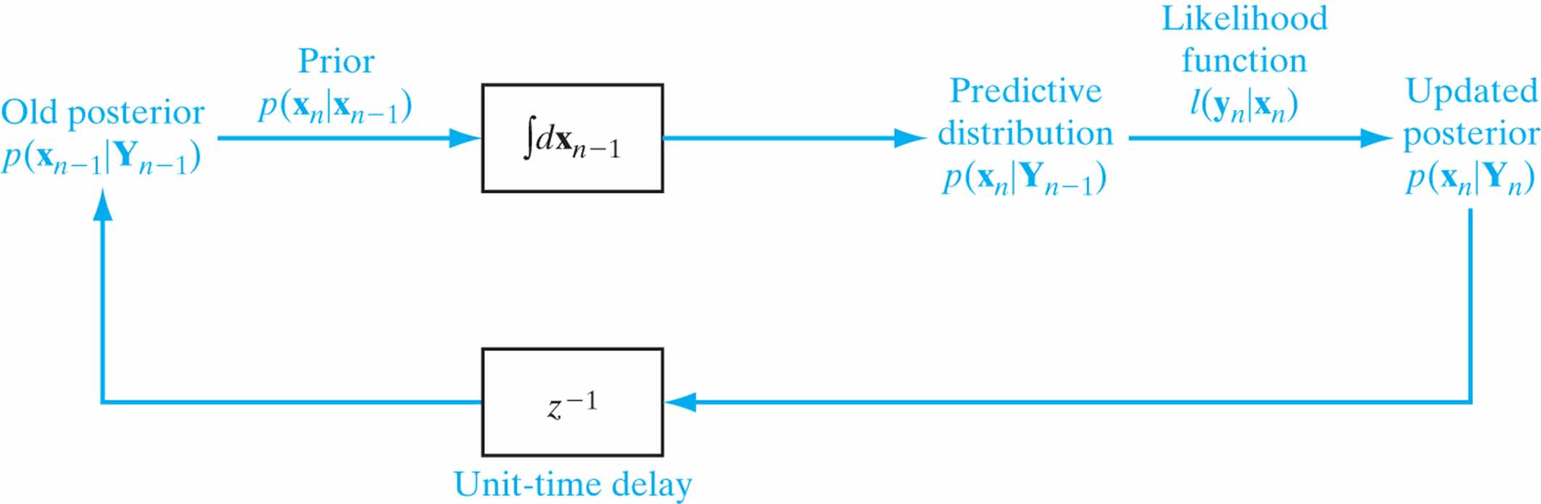
Figure 14.4 Block diagram of the Bayesian filter, with its updated posterior p(x_{n}|Y_{n}) as the output of interest.

Slide 10
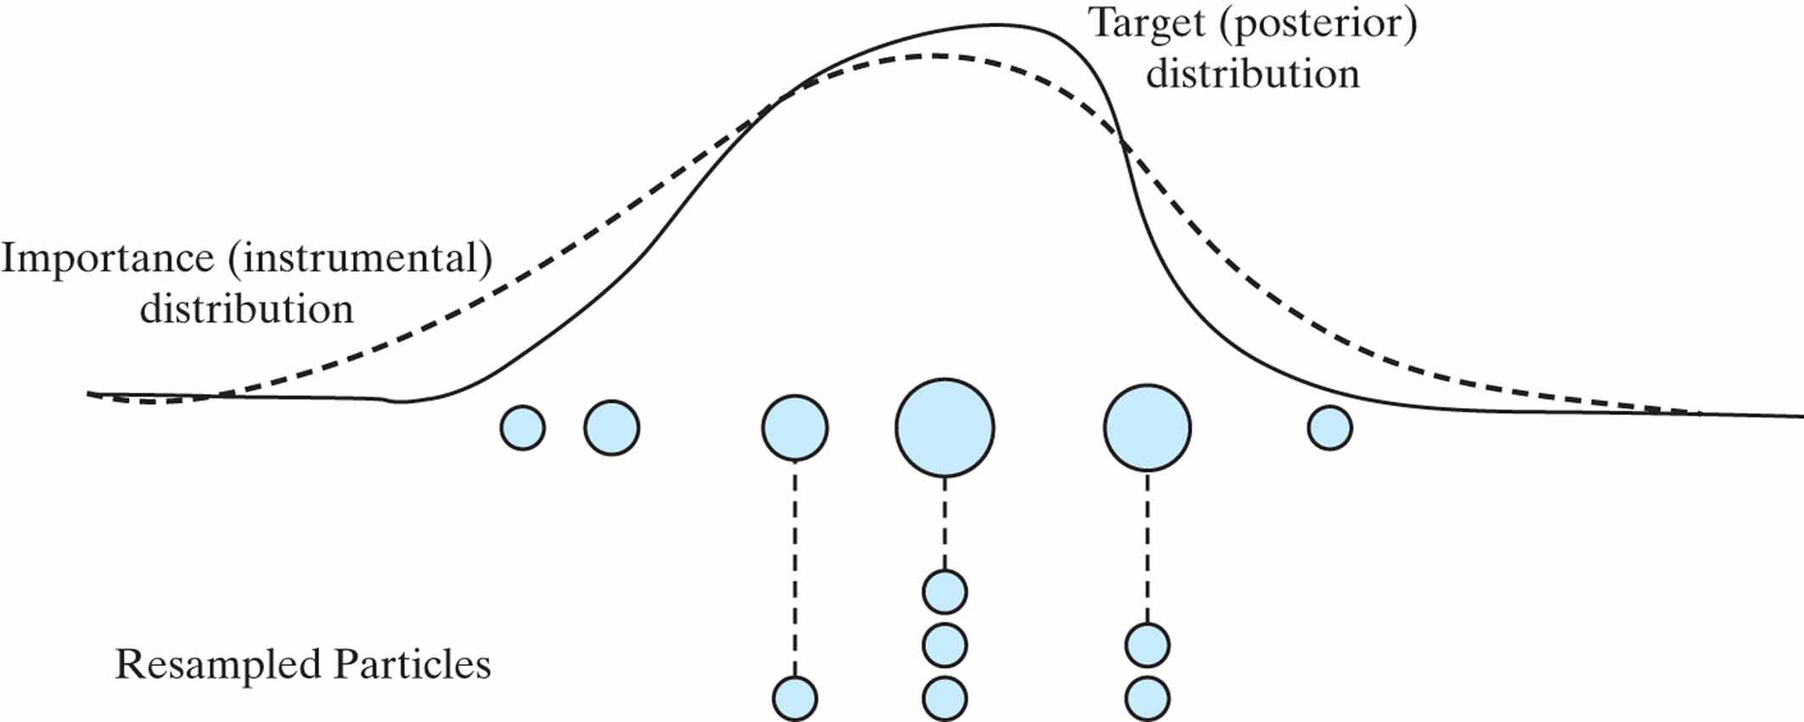
Figure 14.5 Illustration of the resampling process for the example of the number of samples and resamples being equal to six.

Slide 11
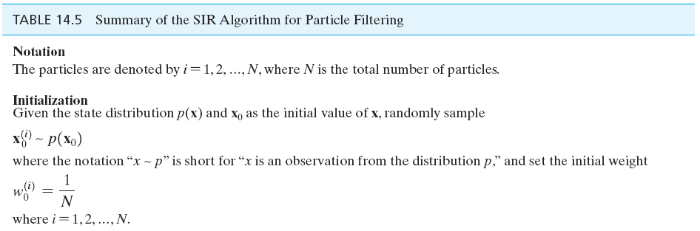
Table 14.5

Slide 12
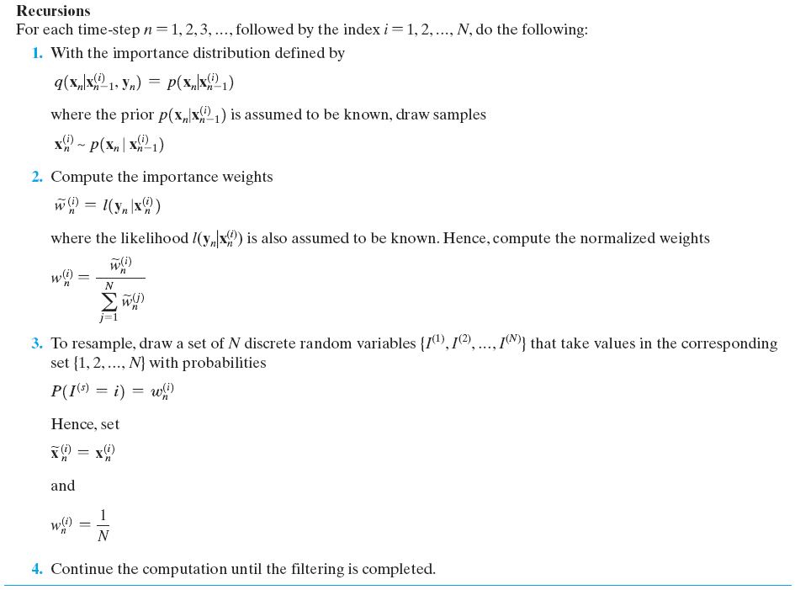
Table 14.5 (continued)

Slide 13
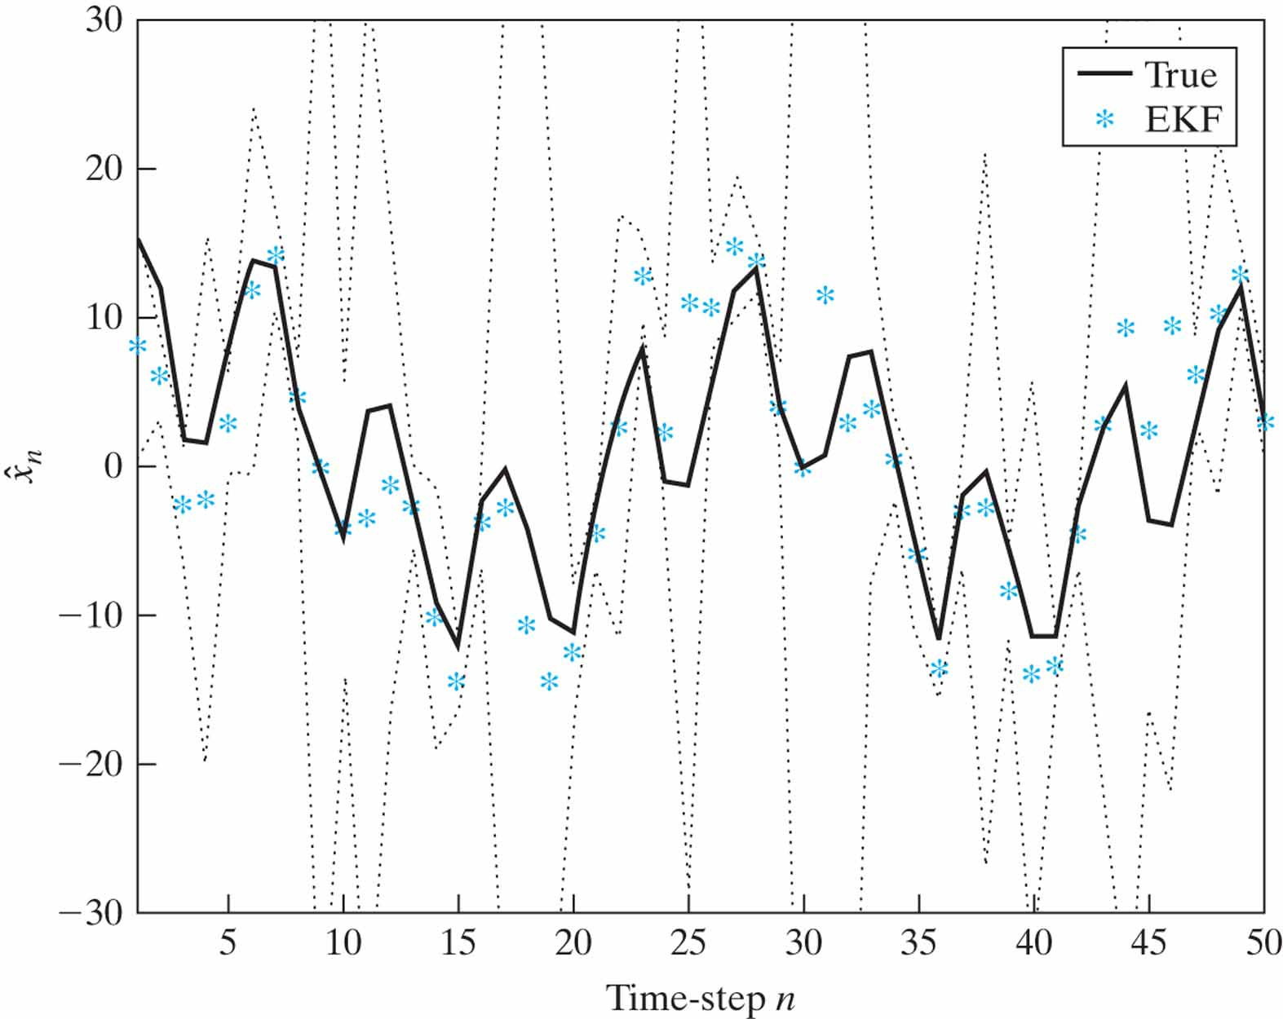
Figure 14.6 Plots of the ensemble-averaged state estimate ˆx_{n} produced by the extended Kalman filter (EKF), shown as a sequence of points *.The upper and lower dotted curves (around the estimates) define the confidence interval of the state estimate produced by the extended Kalman filter. The continuous line is the actual evolution of the state across time n.

Slide 14
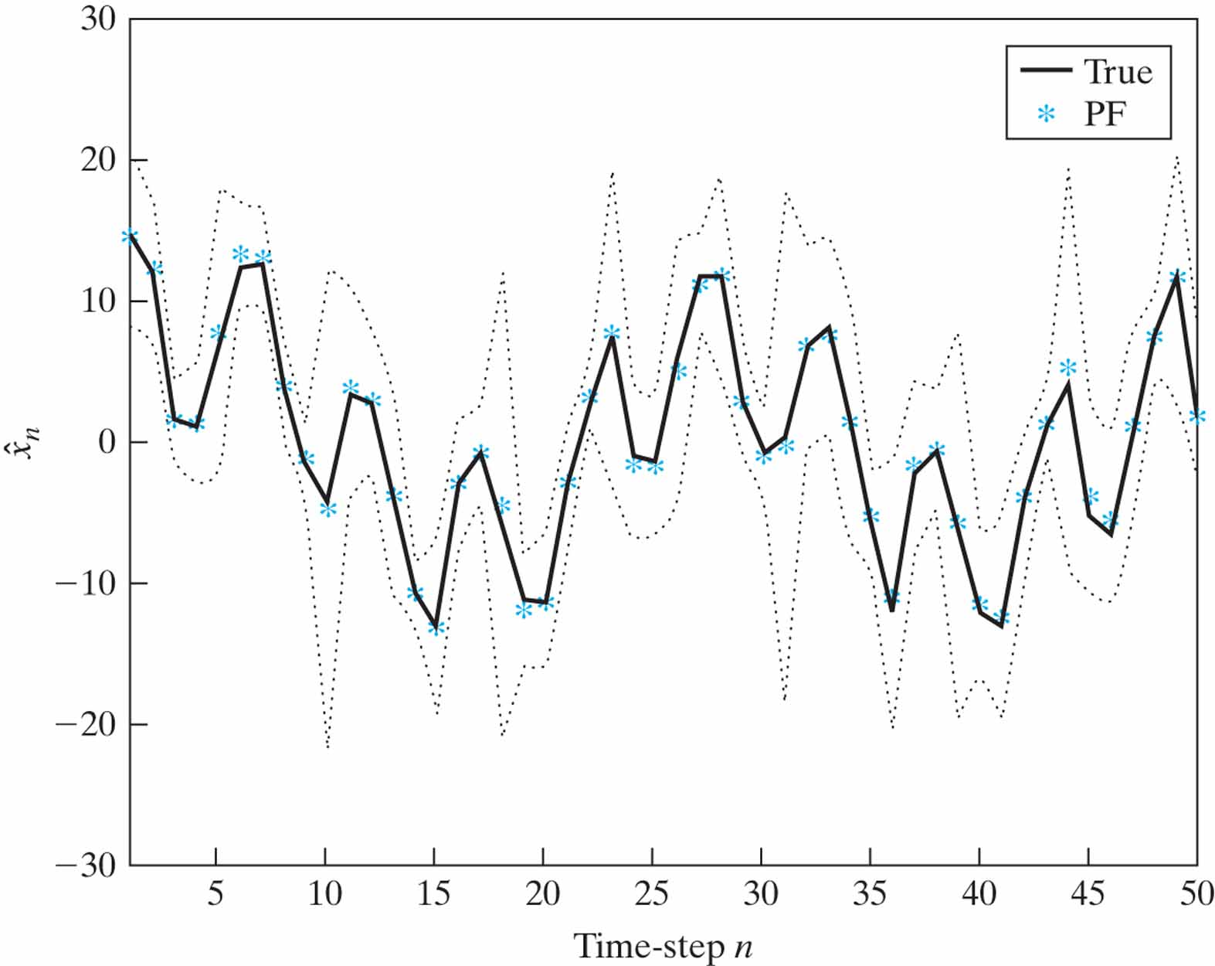
Figure 14.7 Plots of the ensemble-averaged state estimate ˆx_{n} produced by the SIR particle filter, shown as a sequence of points *.The upper and lower dotted curves (around the estimates) define the confidence interval of the state estimate produced by the particle filter (PF). The continuous line is the actual evolution of the state across time n.

Slide 15
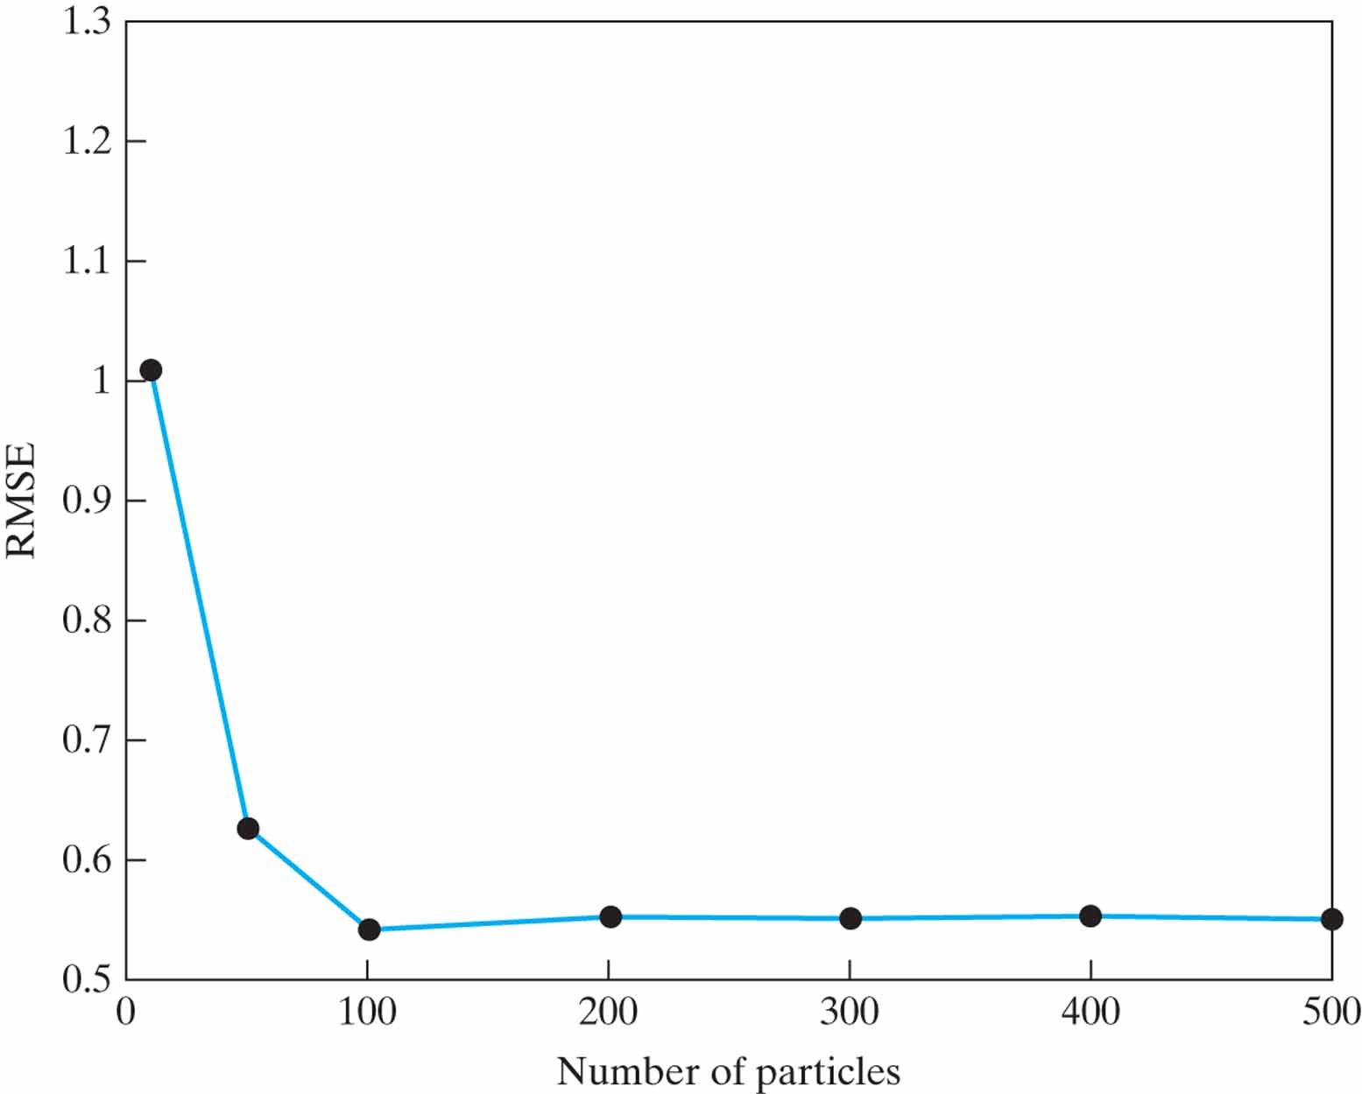
Figure 14.8 Plot of the root mean-square error (RMSE) versus the number of particles produced by the SIR particle filter; the points • are experimentally computed.

Slide 16
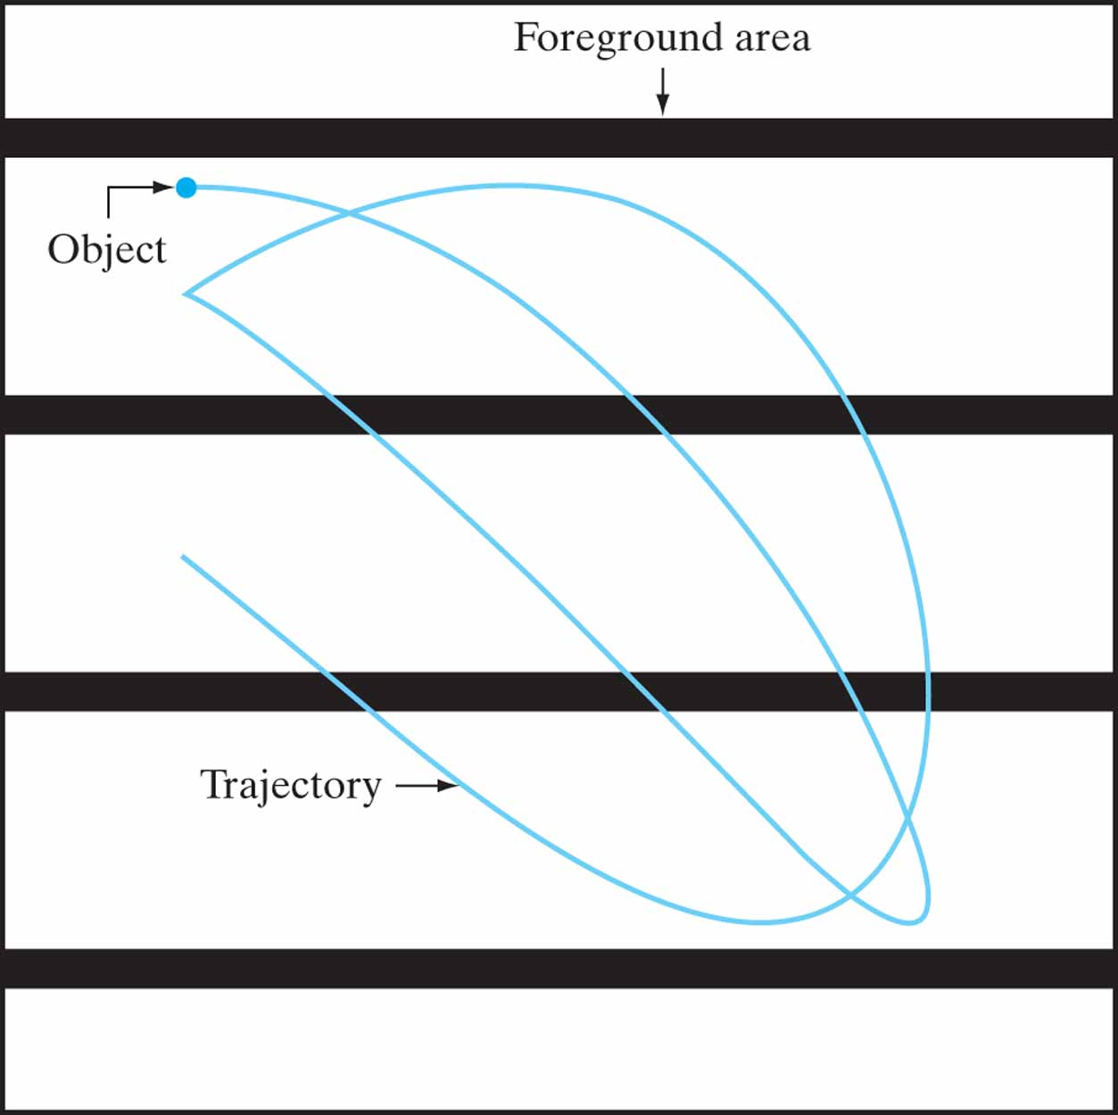
Figure P14.21 Scene and trajectory for Problem 14.21.

