Slide 1
Chapter 15
Dynamically Driven Recurrent Networks

Slide 2
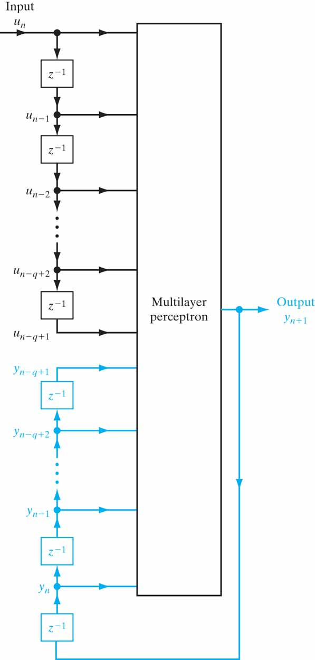
Figure 15.1 Nonlinear autoregressive with exogenous inputs (NARX) model; the feedback part of the network is shown in red.

Slide 3
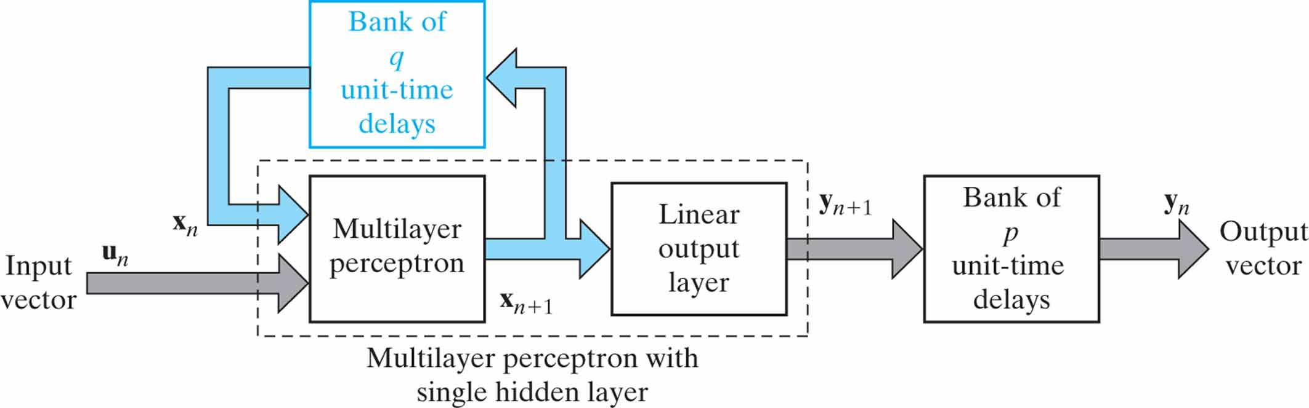
Figure 15.2 State-space model; the feedback part of the model is shown in blue.

Slide 4
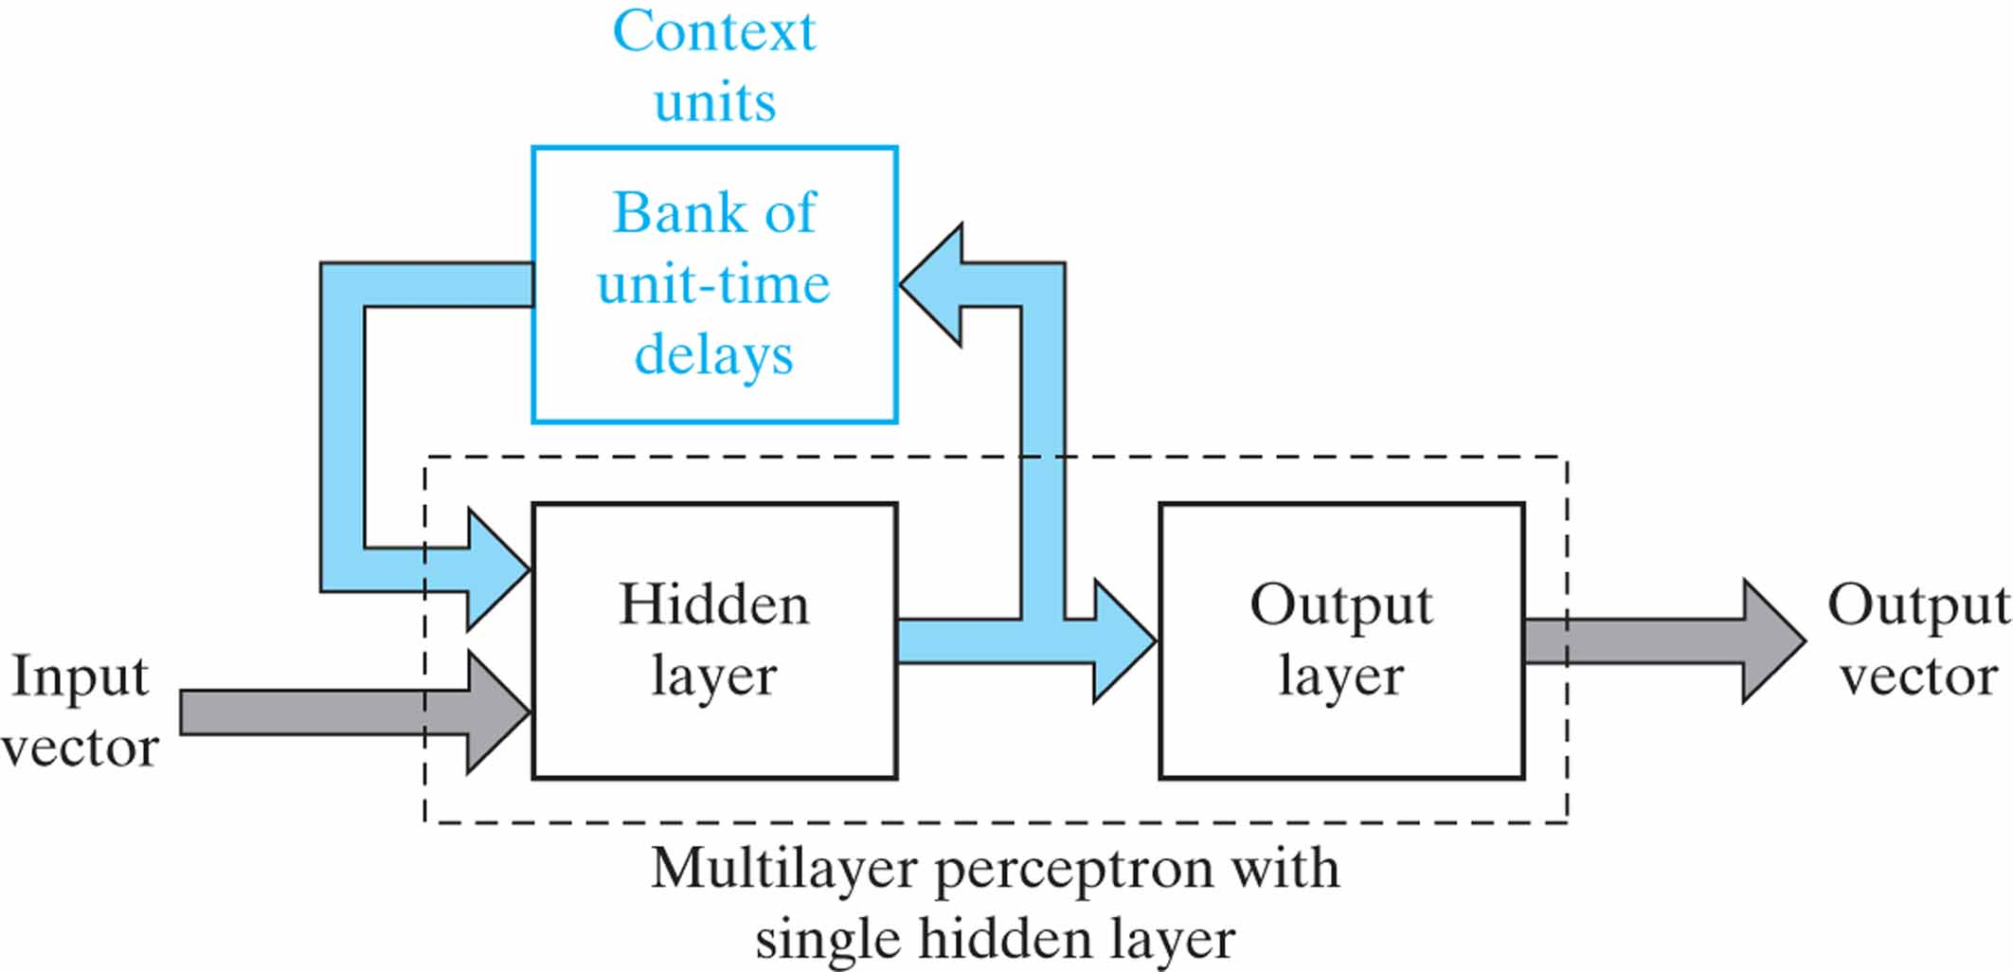
Figure 15.3 Simple recurrent network (SRN); the feedback part of the network is shown in blue.

Slide 5
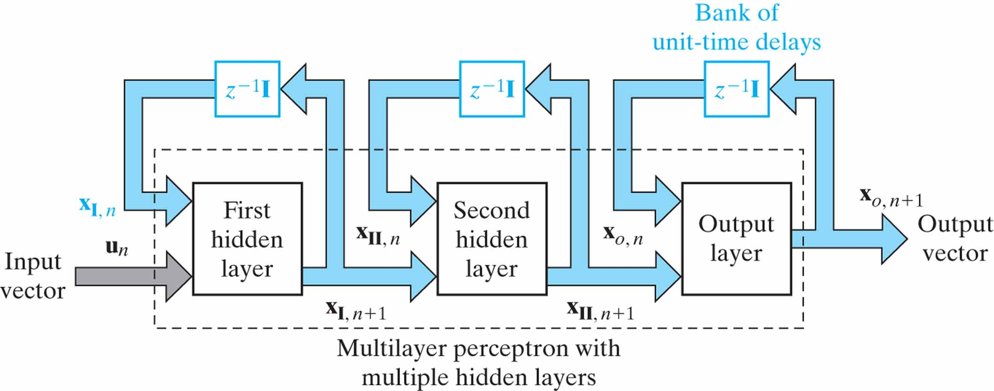
Figure 15.4 Recurrent multilayer perceptron; feedback paths in the network are printed in blue.

Slide 6
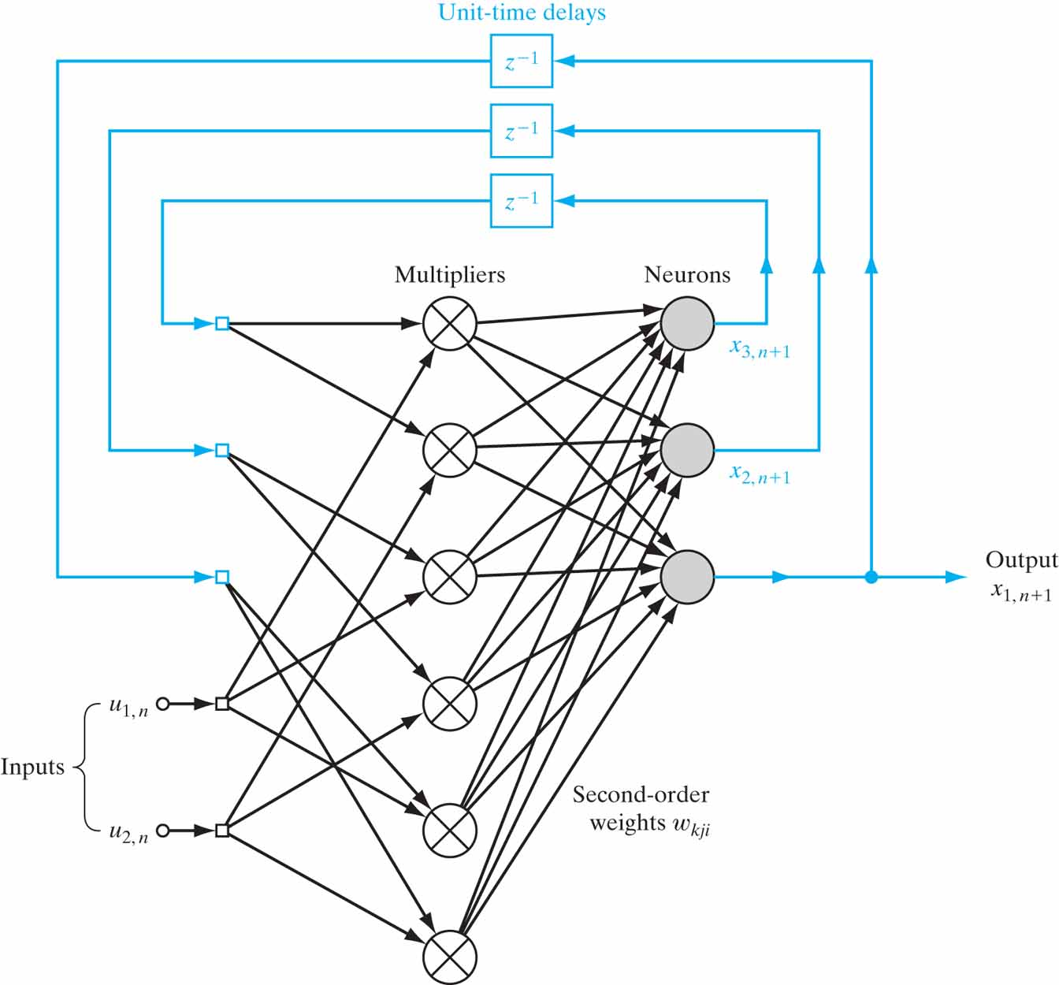
Figure 15.5 Second-order recurrent network; bias connections to the neurons are omitted to simplify the presentation. The network has 2 inputs and 3 state neurons, hence the need for 3 X 2 = 6 multipliers. The feedback links in the figure are printed in blue to emphasize their global role.

Slide 7
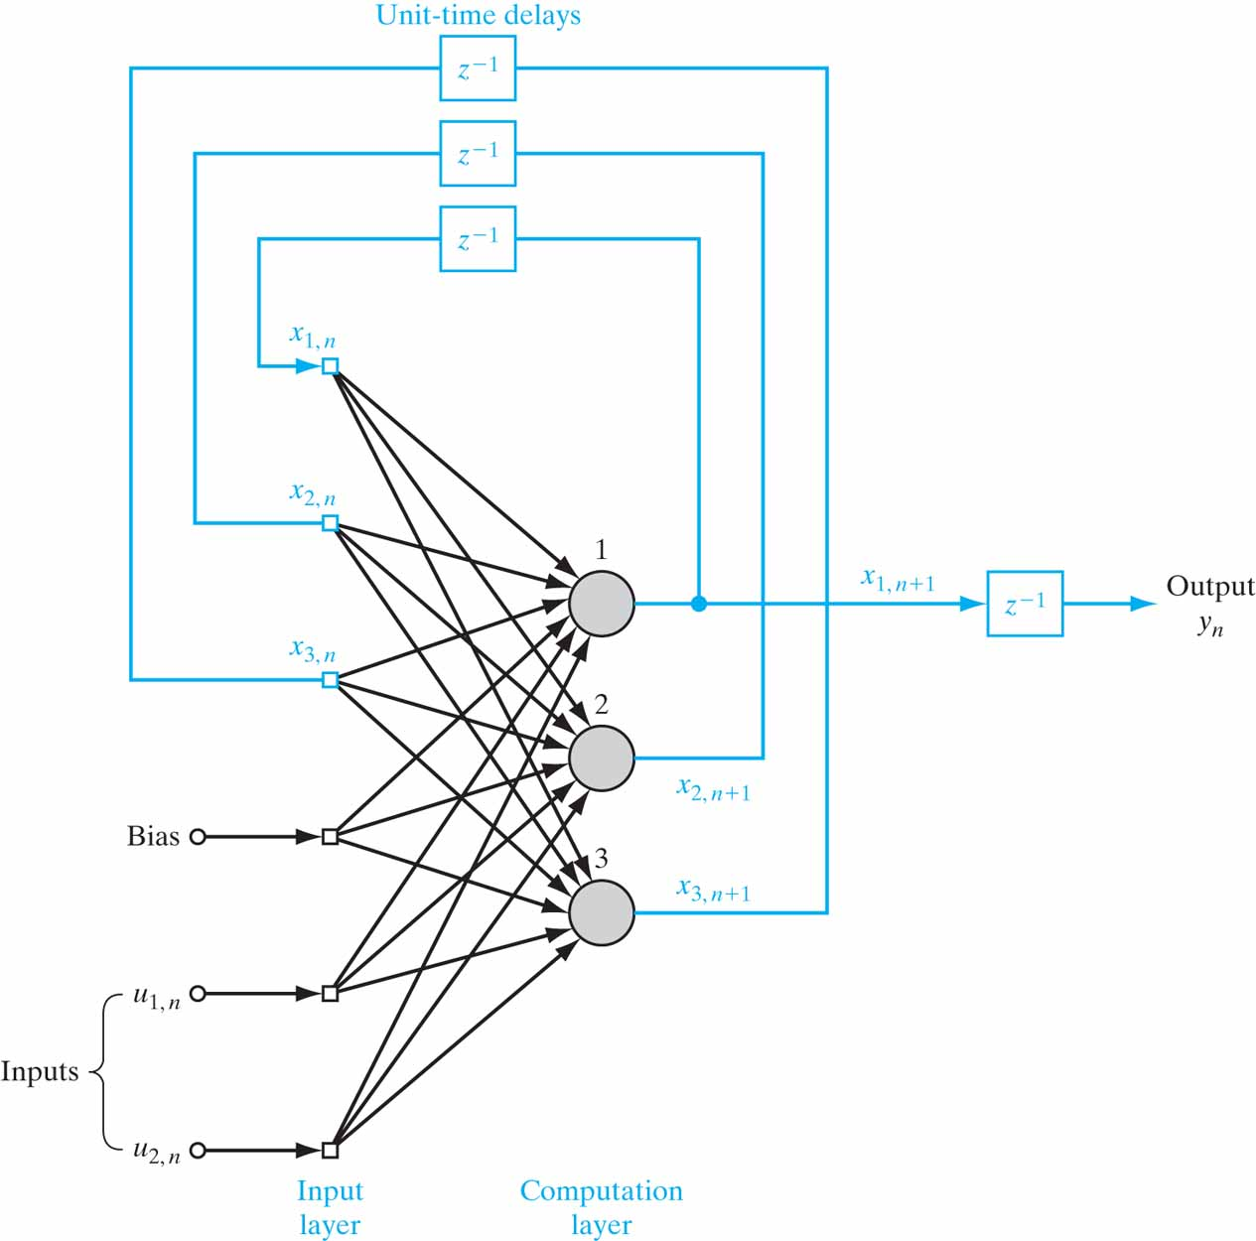
Figure 15.6 Fully connected recurrent network with two inputs, two hidden neurons, and one output neuron. The feedback connections are shown in blue to emphasize their global role.

Slide 8
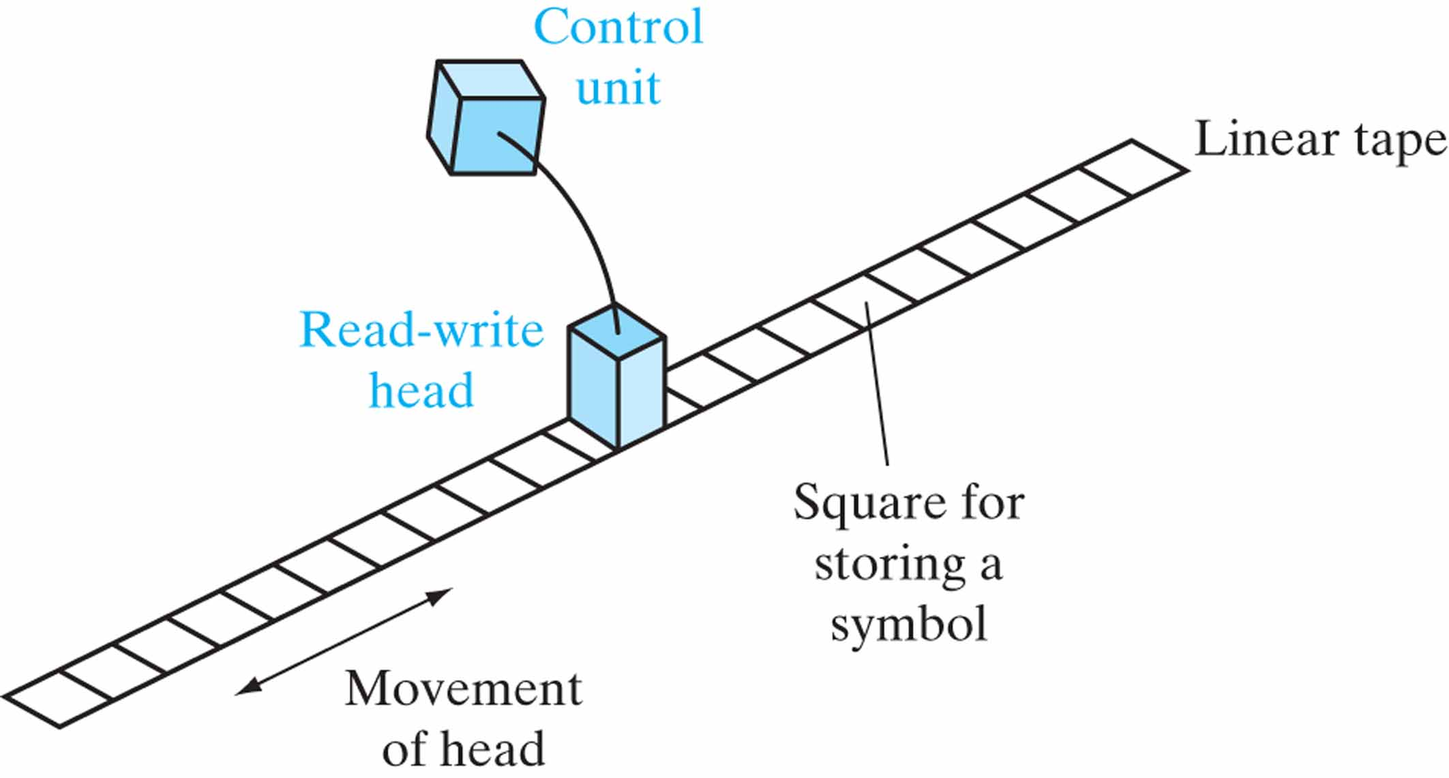
Figure 15.7 Turing machine.

Slide 9
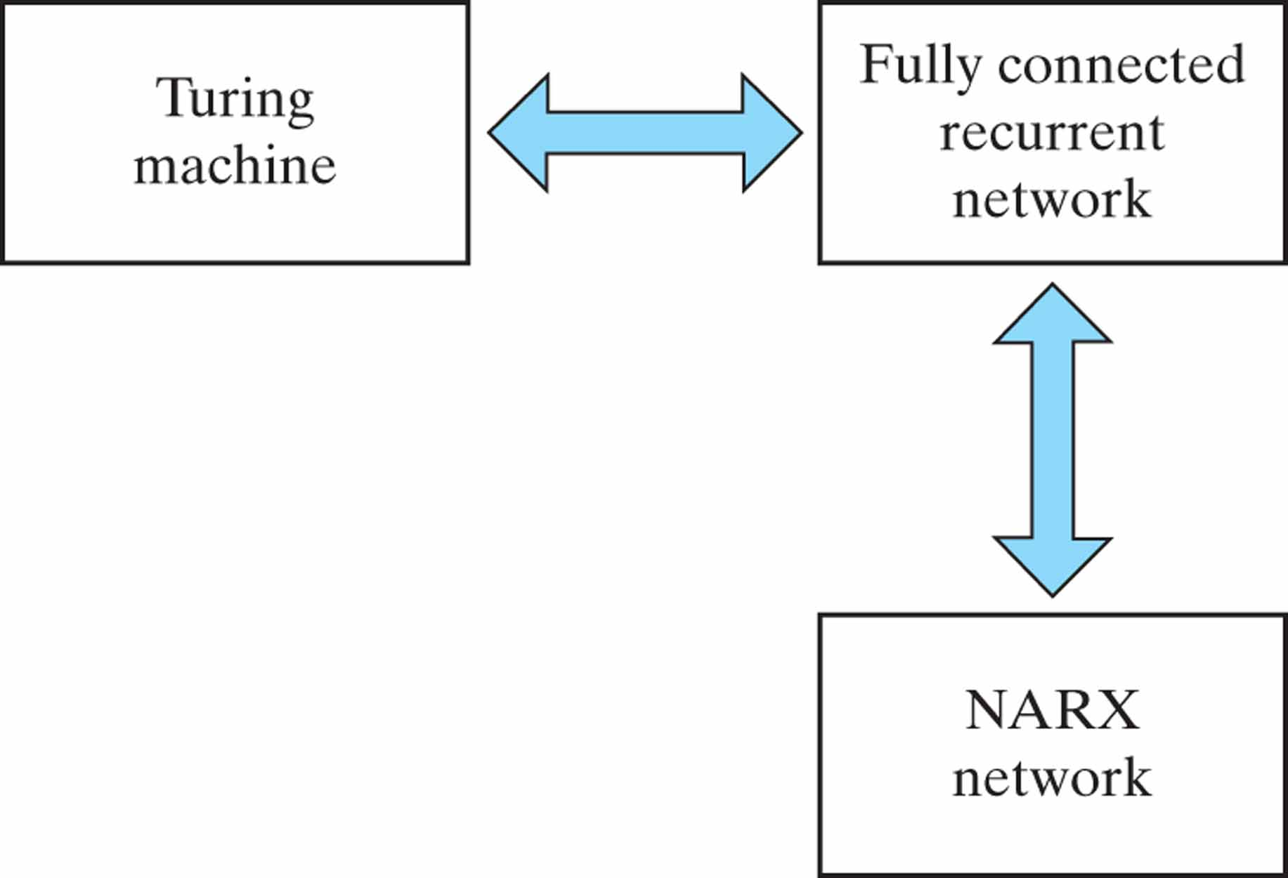
Figure 15.8 Illustration of Theorems I and II, and corollary to them.

Slide 10
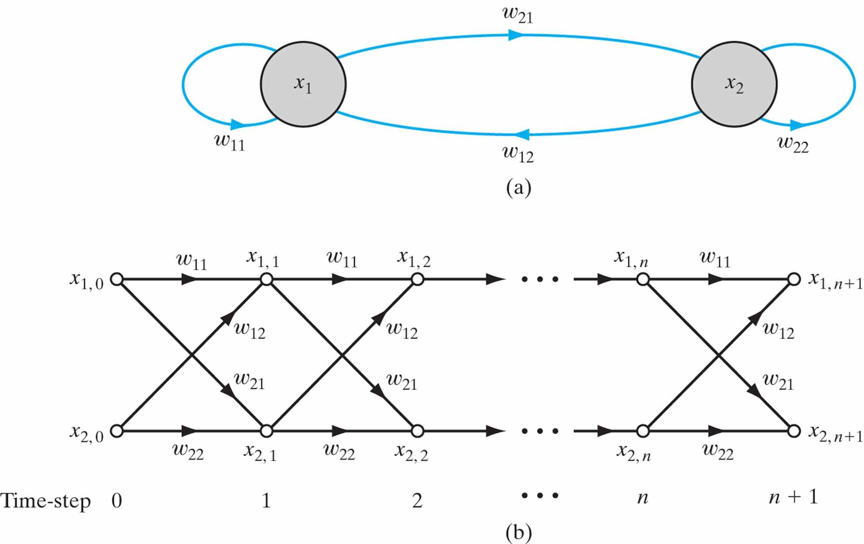
Figure 15.9 (a) Architectural graph of a two-neuron recurrent network N. (b) Signal-flow graph of the network N. unfolded in time.

Slide 11
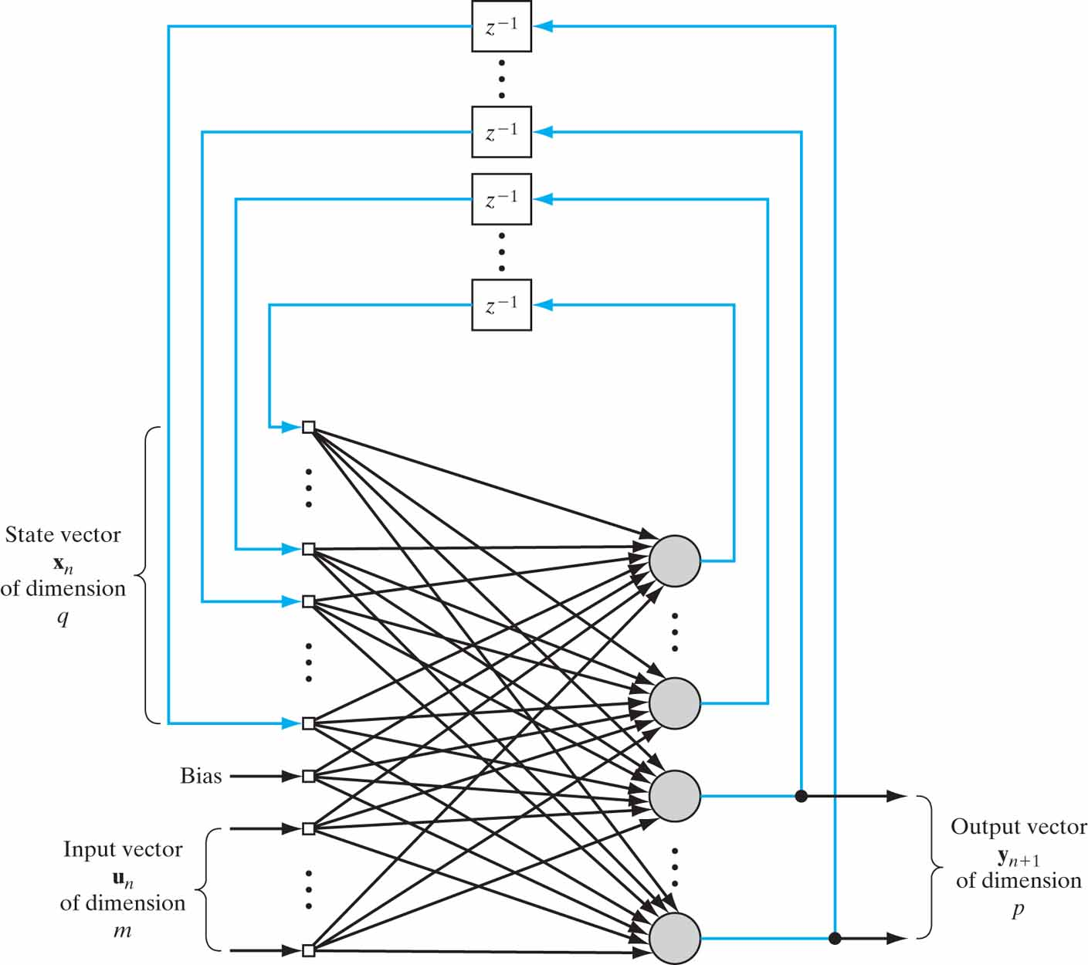
Figure 15.10 Fully connected recurrent network for formulation of the RTRL algorithm; the feedback connections are all shown in blue.

Slide 12
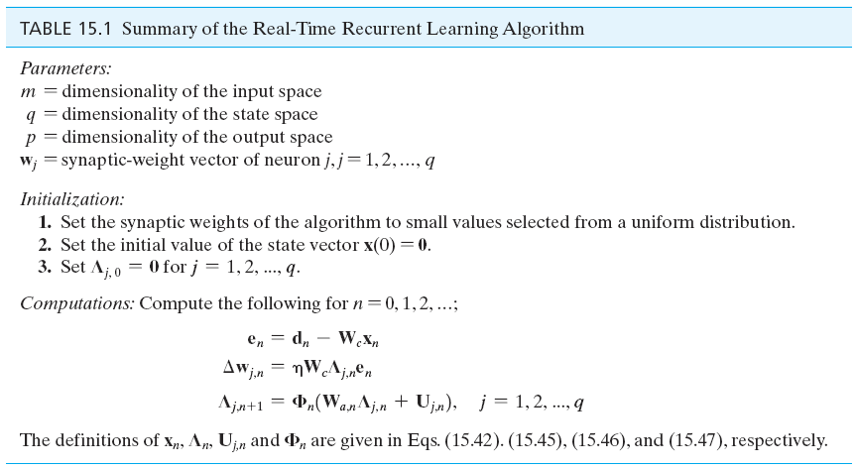
Table 15.1

Slide 13
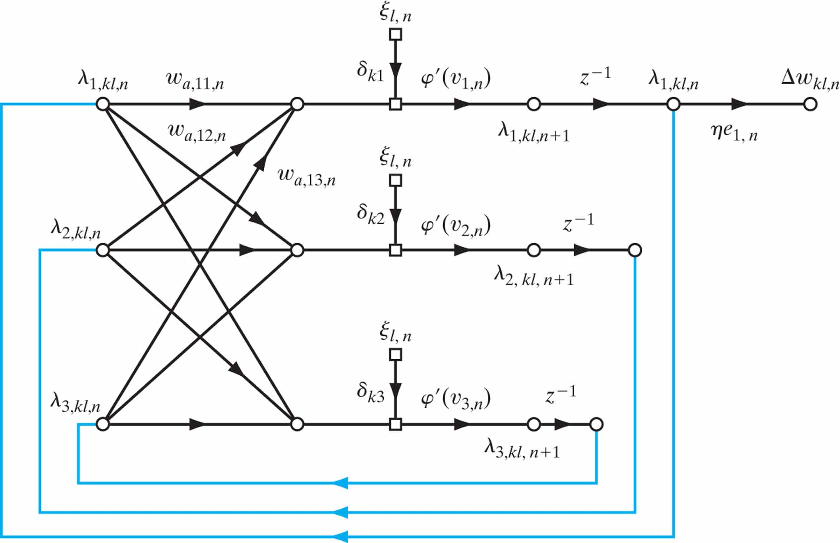
Figure 15.11 Sensitivity graph of the fully recurrent network of Fig. 15.6. Note: The three nodes, labeled ξ_{l,n} are all to be viewed as a single input.

Slide 14
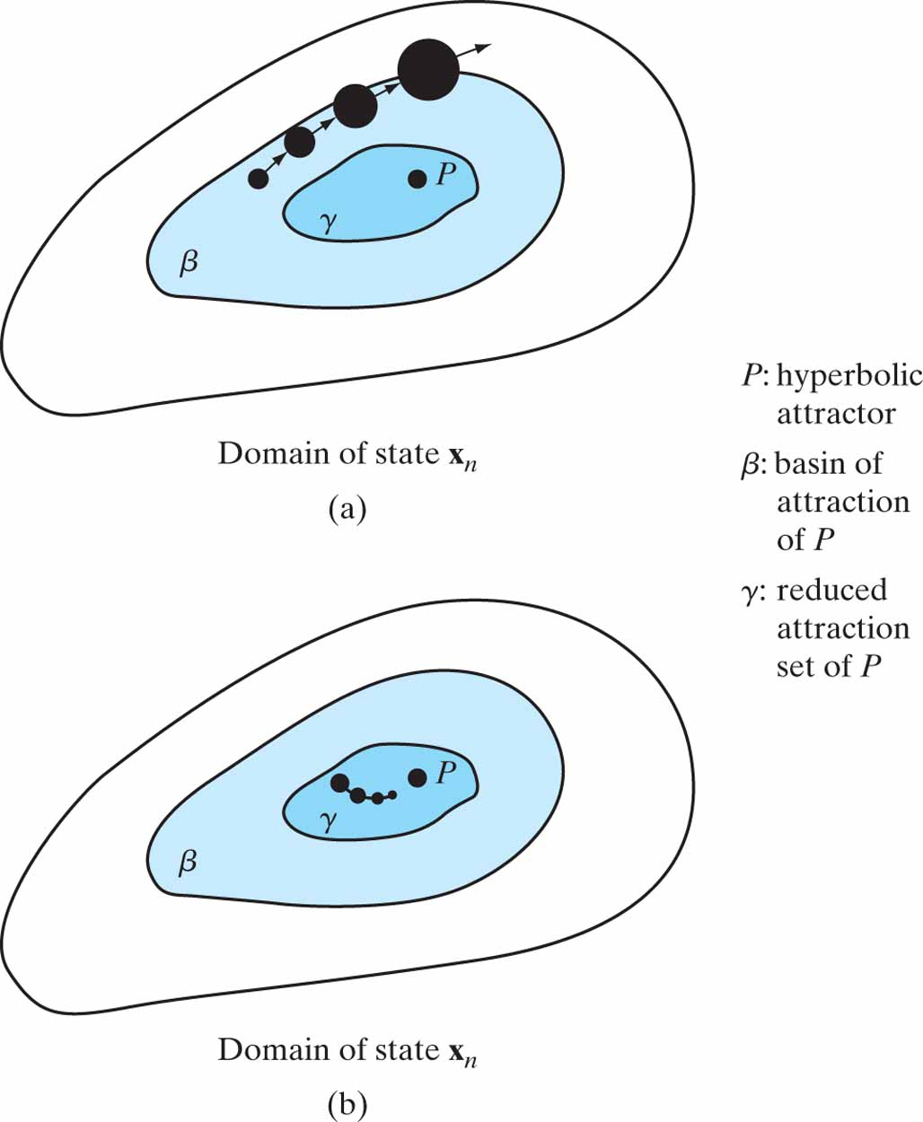
Figure 15.12 Illustration of the vanishing-gradient problem: (a) State x_{n} resides in the basin of attraction, β, but outside the reduced attraction set γ. (b) State x_{n} resides inside the reduced attraction set γ.

Slide 15
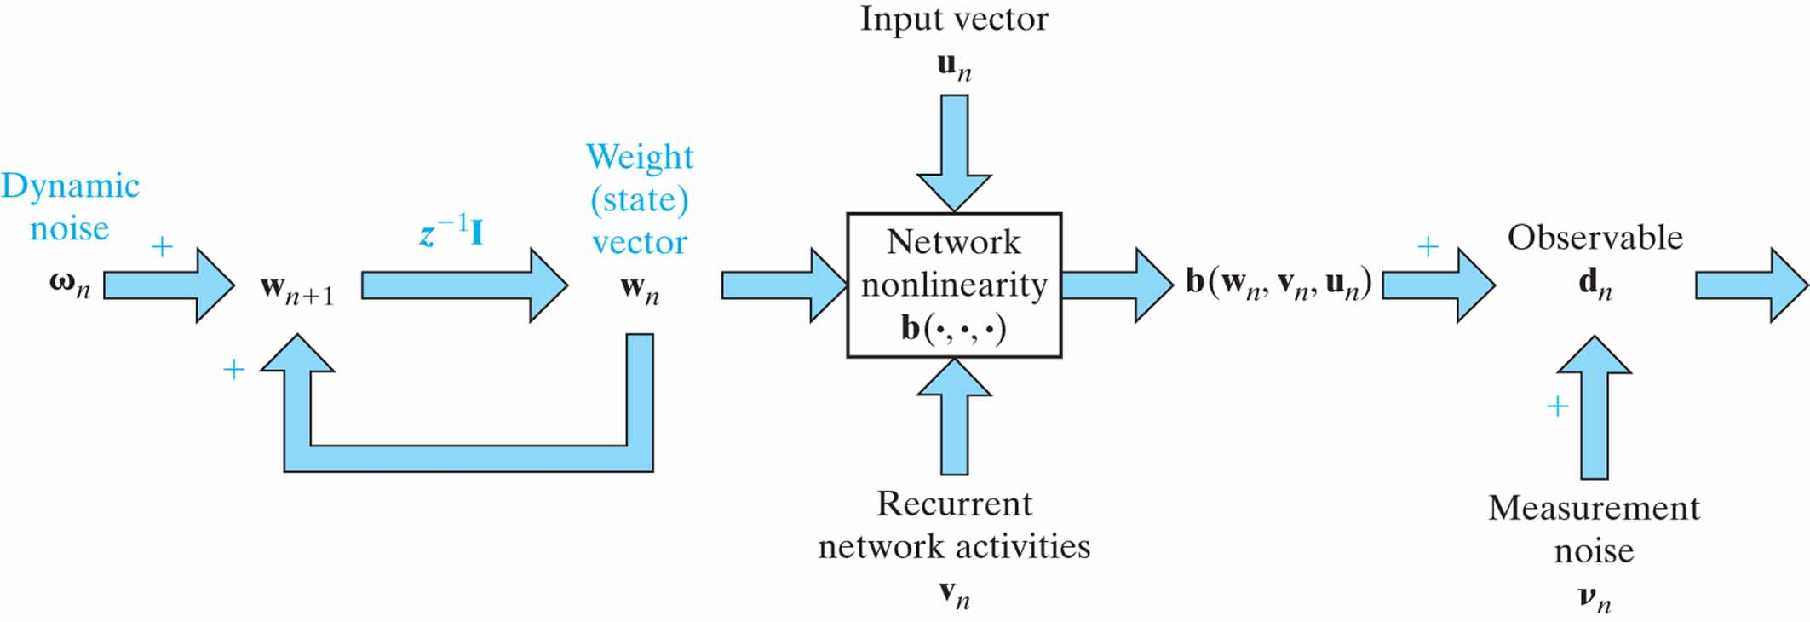
Figure 15.13 Nonlinear state-space model depicting the underlying dynamics of a recurrent network undergoing supervised training.

Slide 16
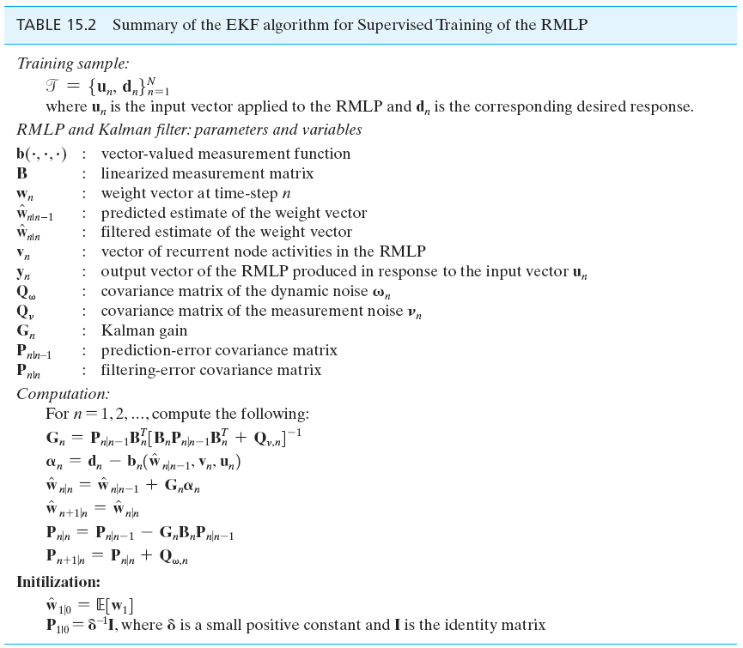
Table 15.2

Slide 17
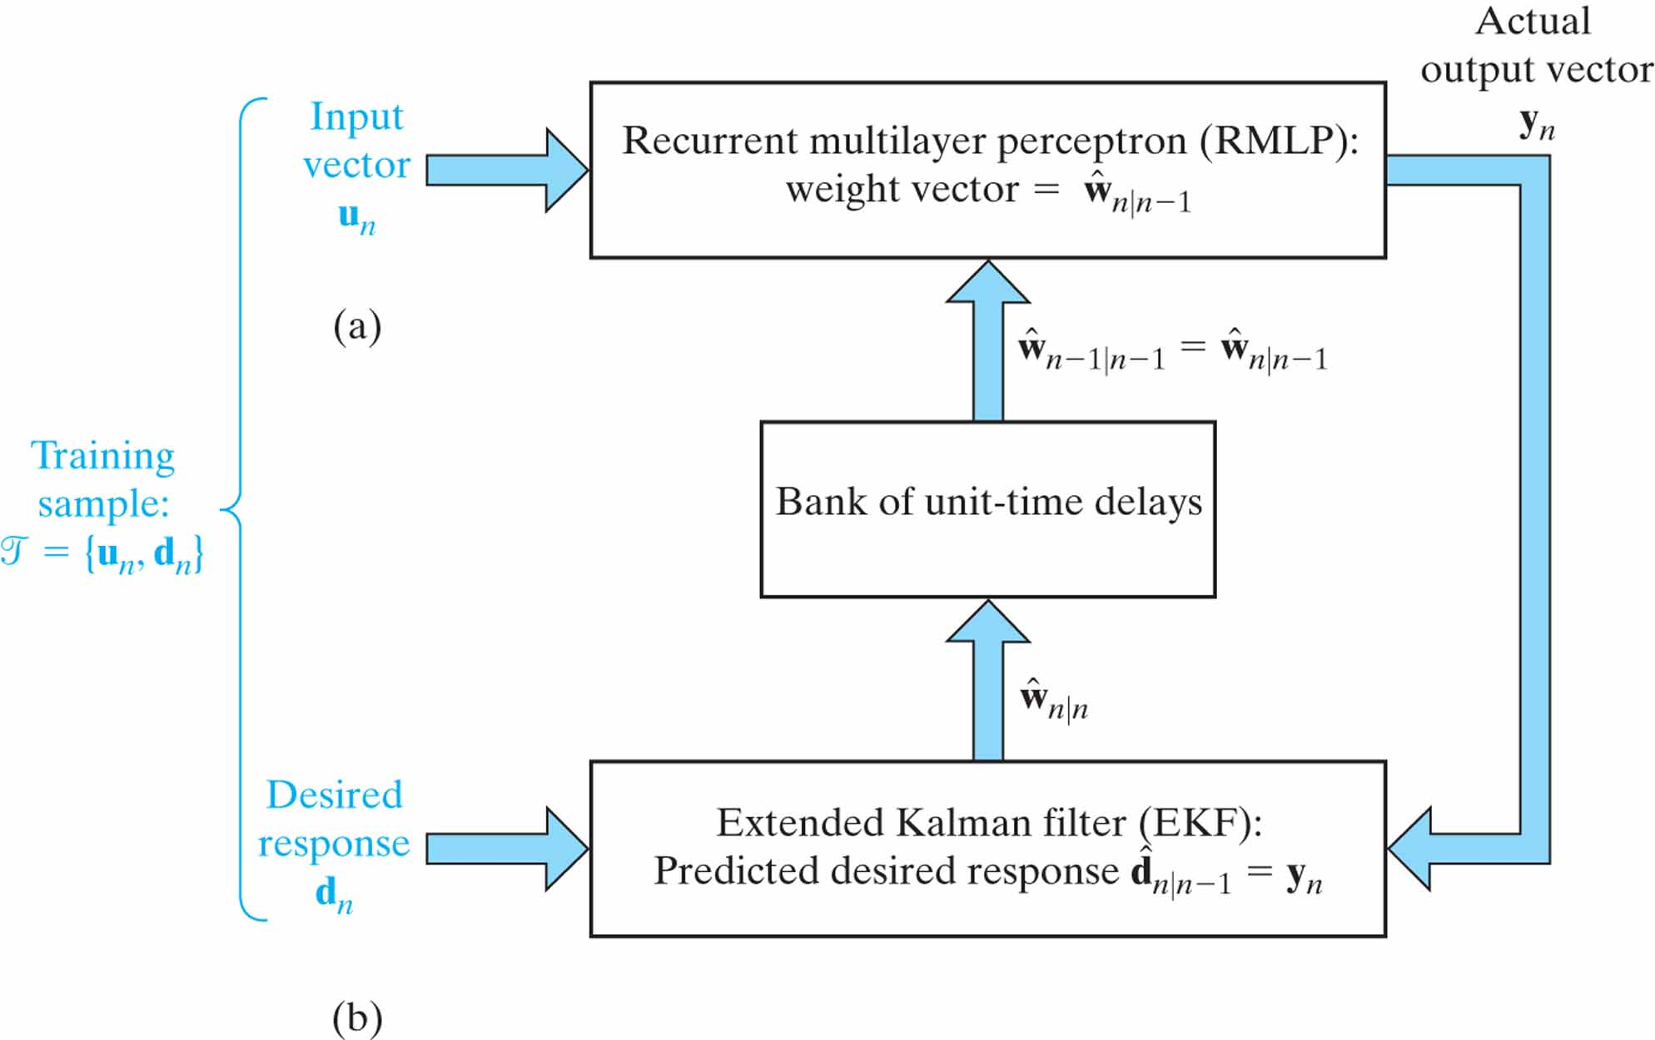
Figure 15.14 Closed-loop feedback system embodying the RMLP and the EKF: (a) The RMLP, with weight vector
ˆw_{n|n - 1}, operates on the input vector u_{n} to produce the output vector y_{n}. (b) The EKF, supplied with the prediction
ˆd_{n|n - 1} = y_{n}, operates on the desired response d_{n} to produce the filtered weight vector ˆw_{n|n} = ˆw_{n+1|n}, thereby preparing the closed-loop feedback system for the next iteration.

Slide 18
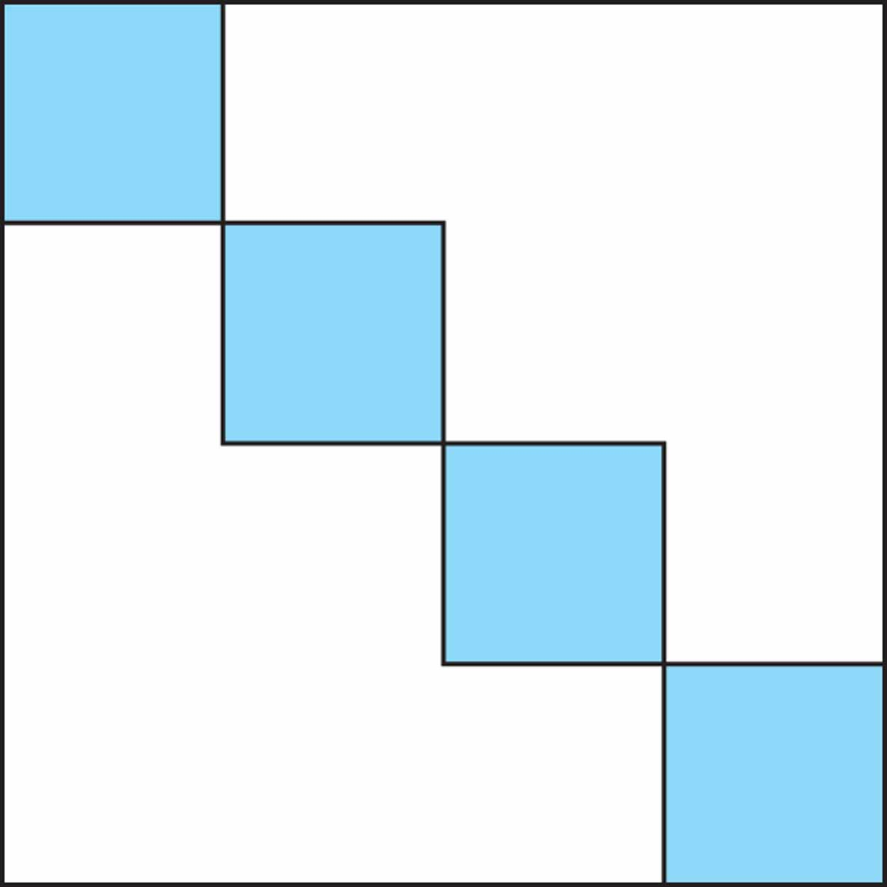
Figure 15.15 Block-diagonal representation of the filtering-error covariance matrix pertaining to the decoupled Kalman filter (DEKF). The shaded parts of the square represent nonzero values of ,where i = 1, 2, 3, 4 for the example illustrated in the figure. As we make the number of disjoint weight groups, g, larger, more zeros are created in the covariance matrix P_{n|n} ; in other words, the matrix P_{n|n} becomes more sparse. The computational burden is therefore reduced, but the numerical accuracy of the state estimation becomes degraded.

Slide 19
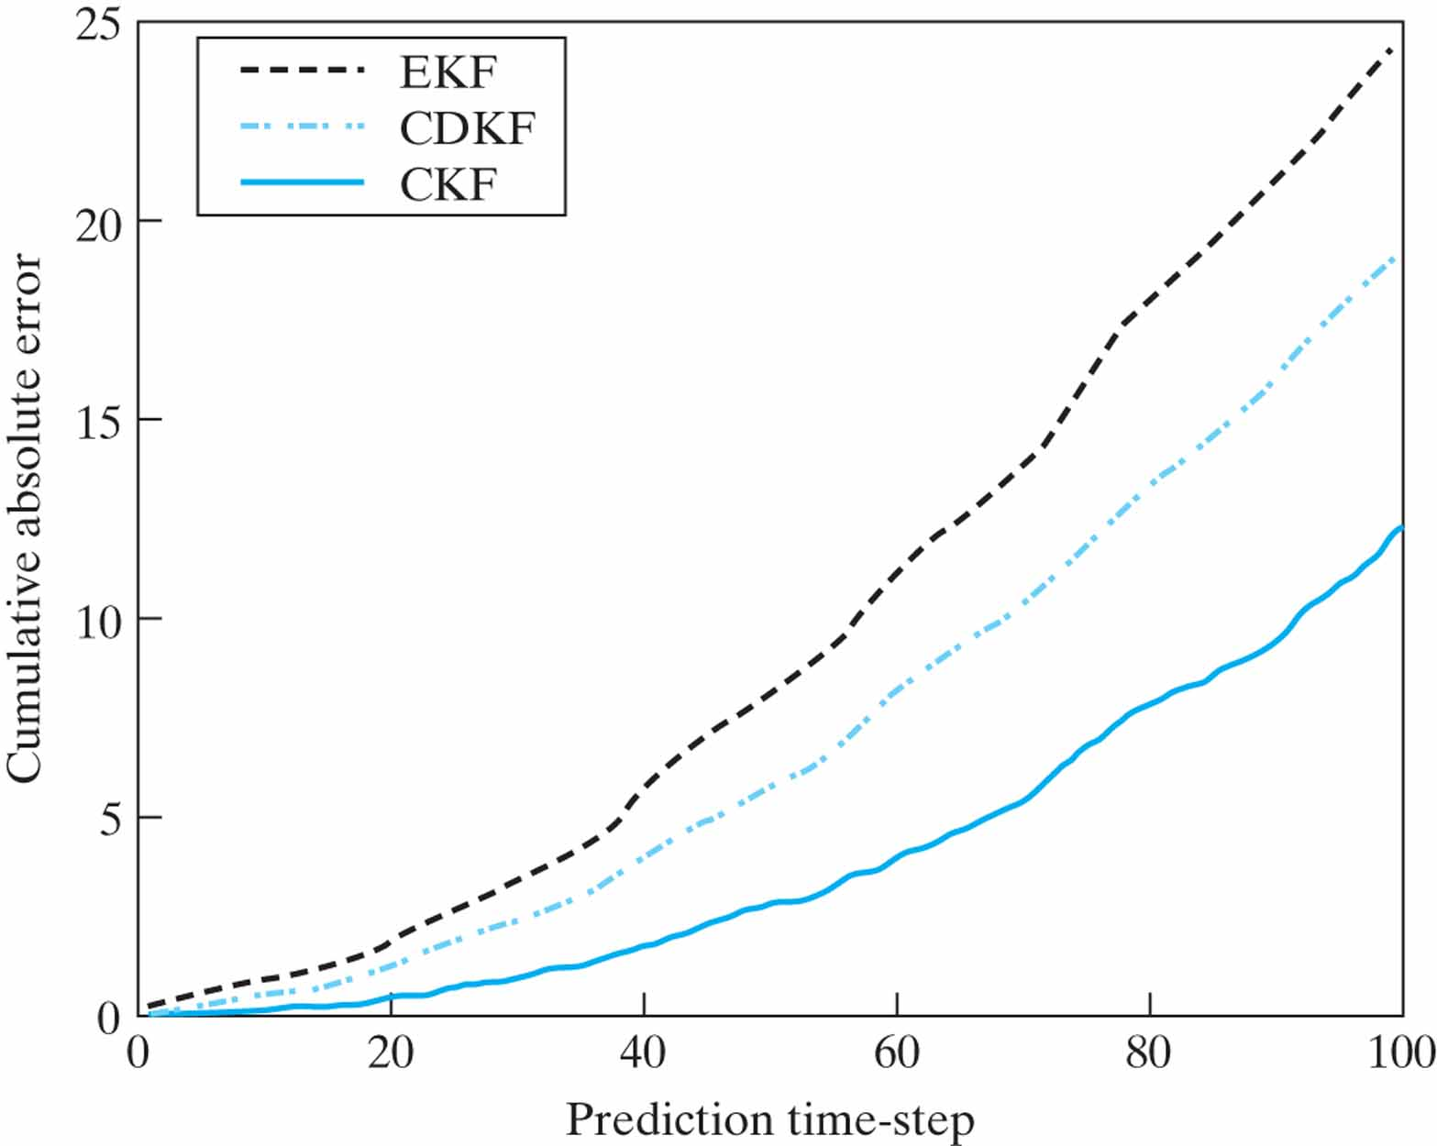
Figure 15.16 Ensemble-averaged cumulative absolute error curves during the autonomous prediction phase of dynamic reconstruction of the Mackey-Glass attractor.

Slide 20
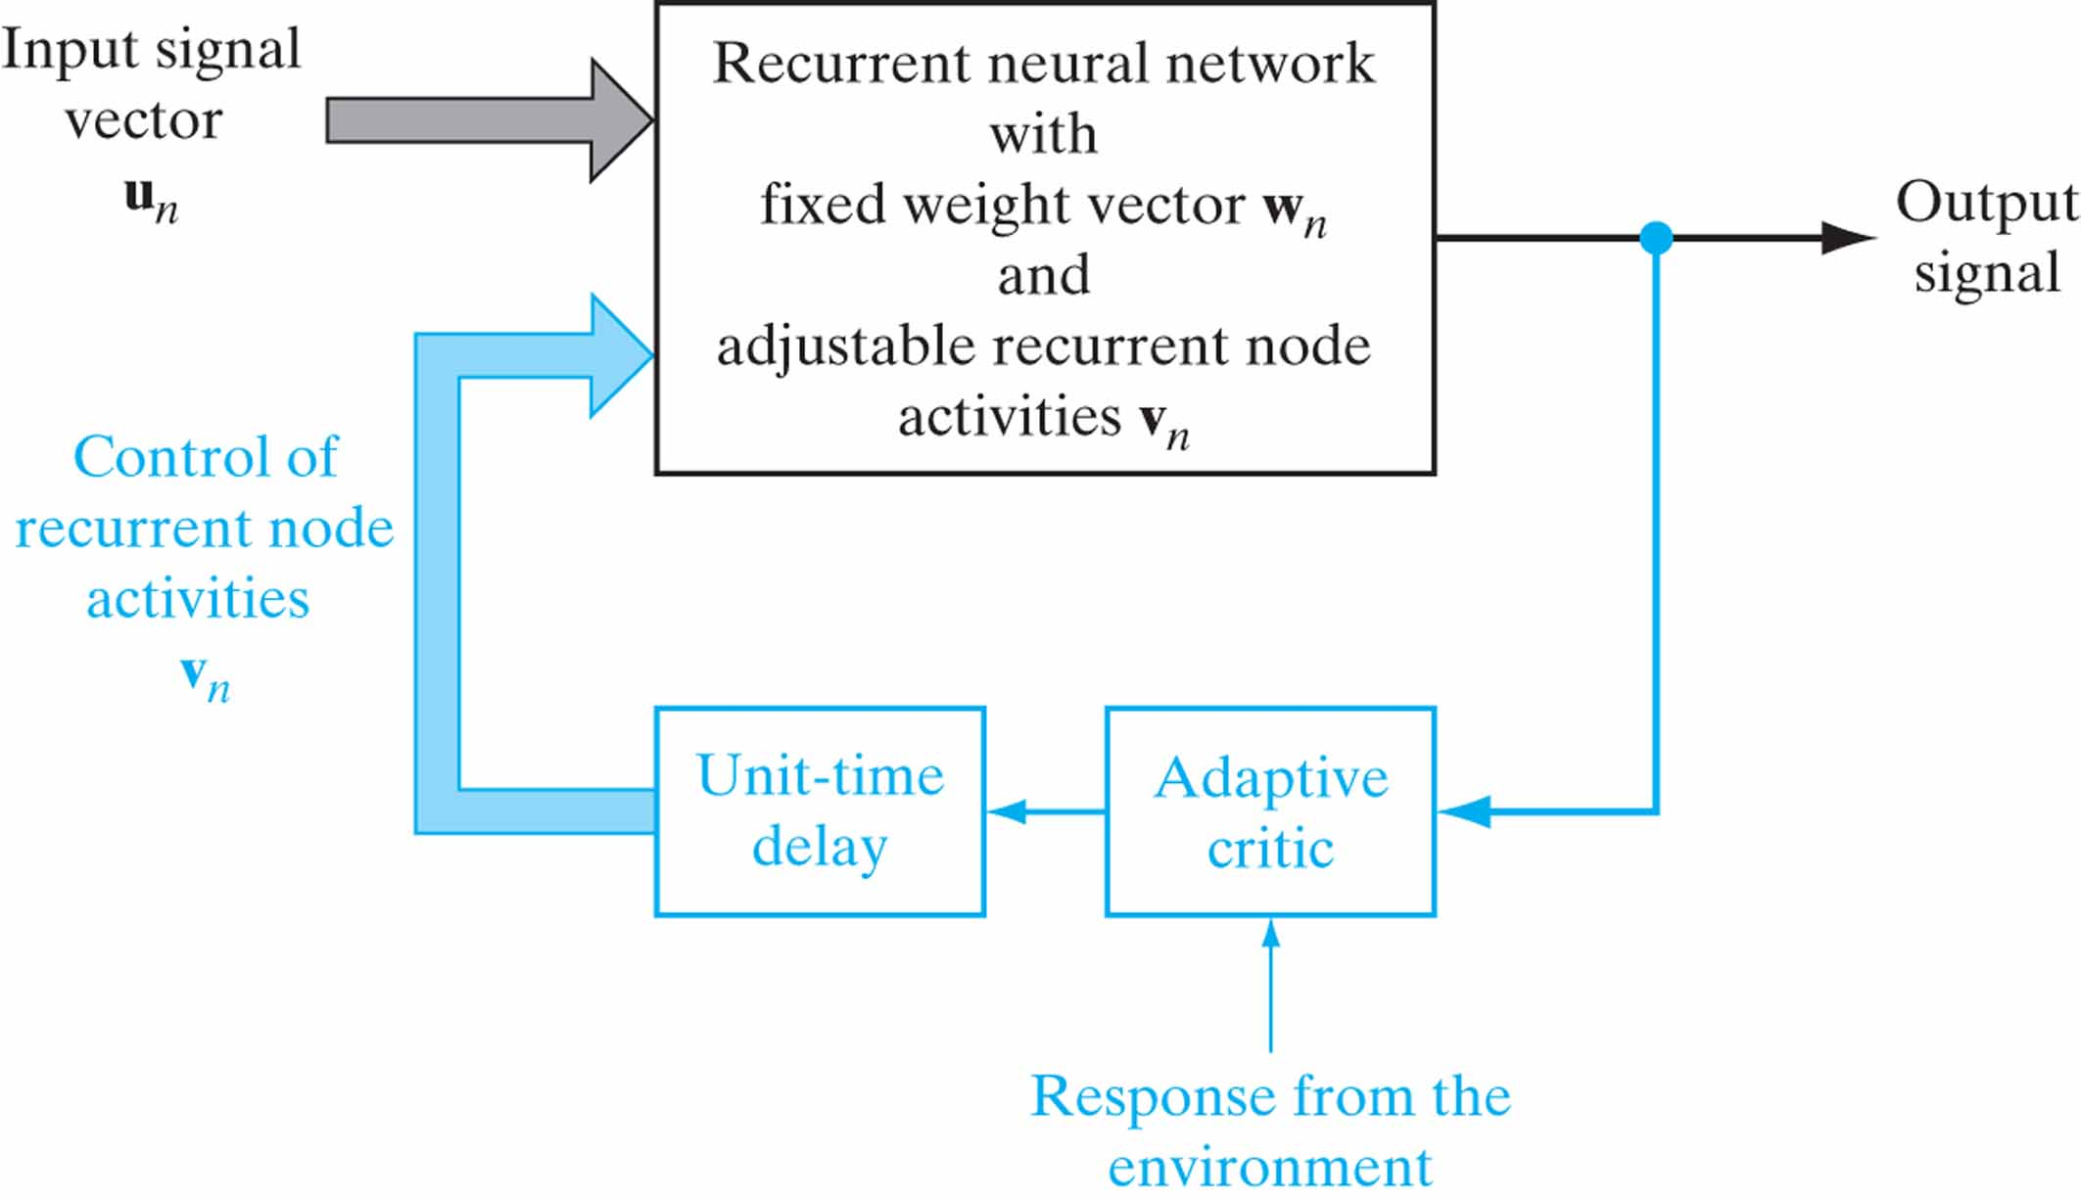
Figure 15.17 Block diagram illustrating the use of an adaptive critic for the control of recurrent node activities v_{n} in a recurrent neural network (assumed to have a single output); the part of the figure involving the critic is shown in blue.

Slide 21
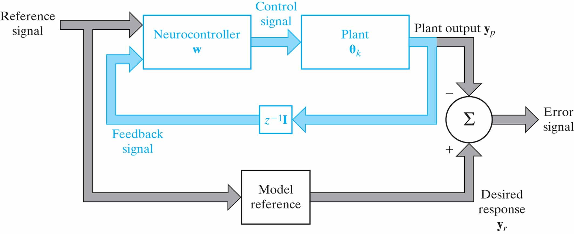
Figure 15.18 Model-reference adaptive control system; the feedback loop of the system is printed in blue.

Slide 22
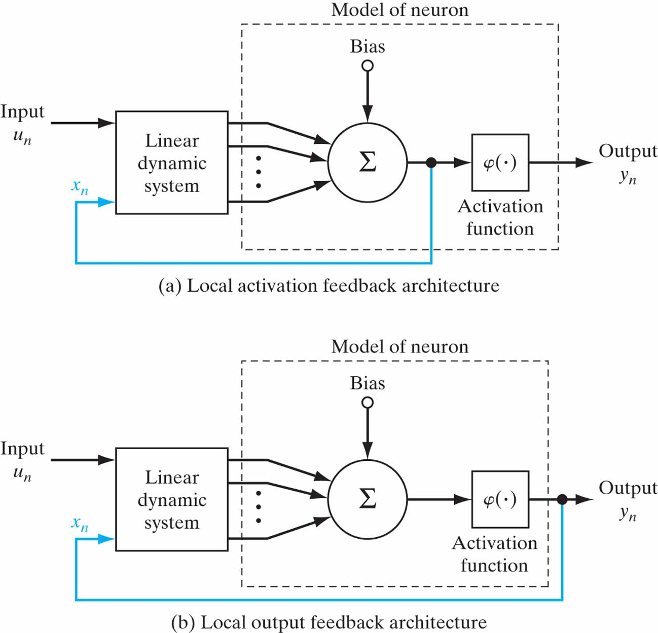
Figure P15.7

Slide 23
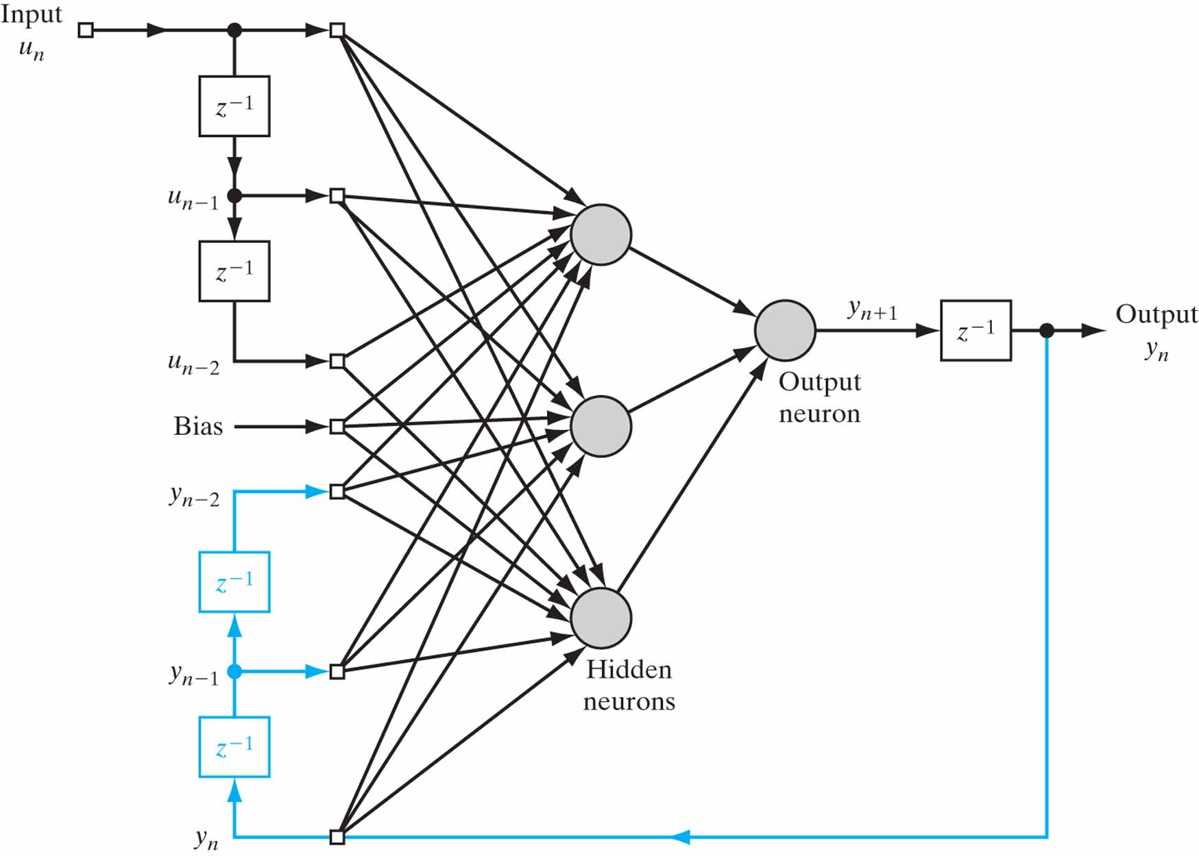
Figure P15.8 NARX network with q = 3 hidden neurons.

Slide 24
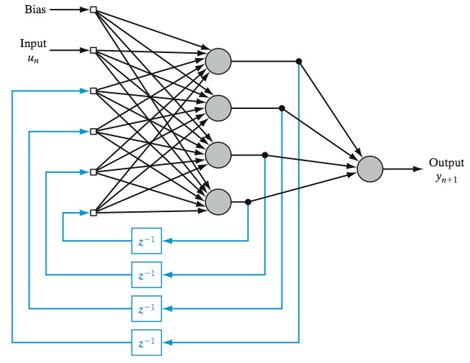
Figure P15.9

Slide 25
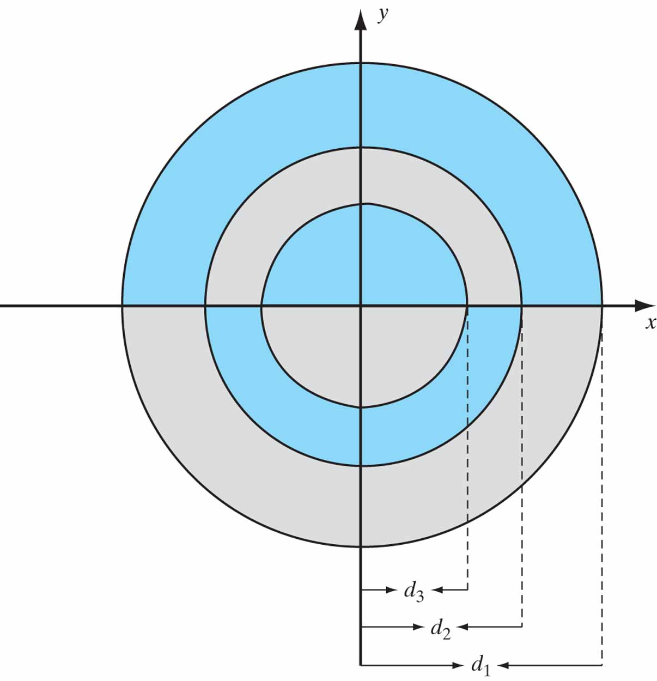
Figure P15.17 Diameters of the three circles: d₁ = 3, d₂ = 6, d₃ = 9.

