Slide 1
Chapter 10
Information-Theoretic Learning Models

Slide 2
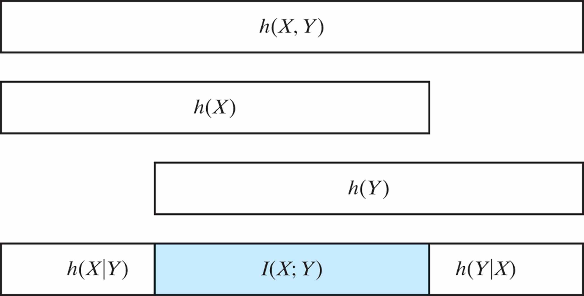
Figure 10.1 Relationships embodied in the three lines of Eq. (10.32), involving the mutual information I(X; Y).

Slide 3
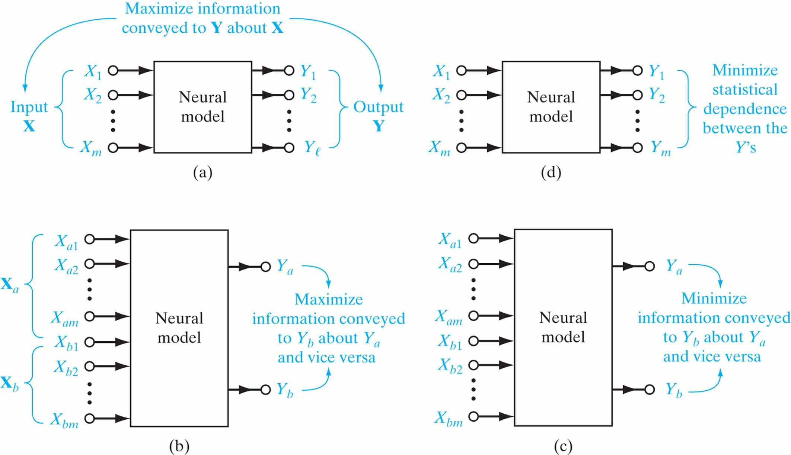
Figure 10.2 Four basic scenarios that lend themselves to the application of information maximization and its three variants.

Slide 4
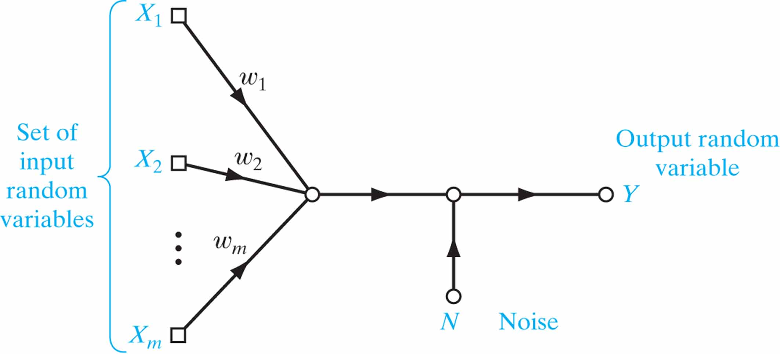
Figure 10.3 Signal-flow graph of a noisy neuron.

Slide 5
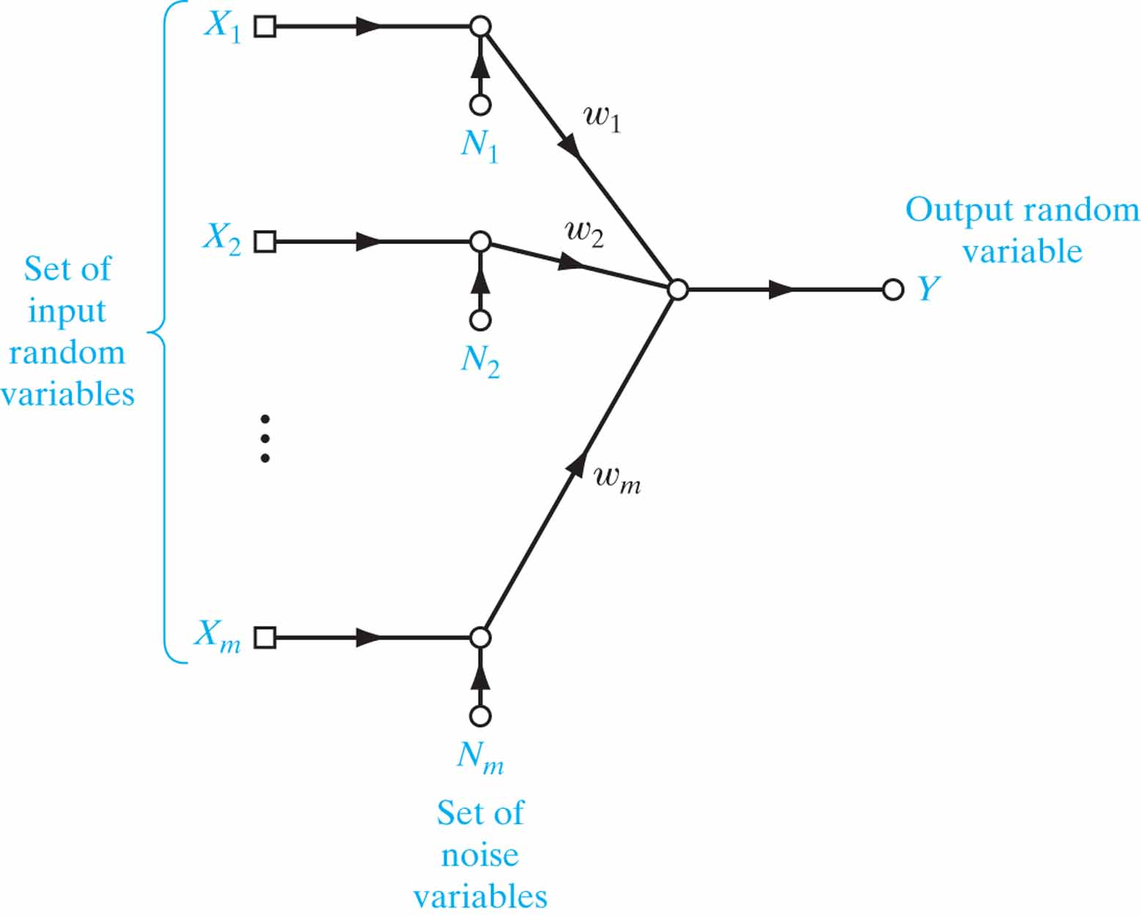
Figure 10.4 Another noisy model of the neuron.

Slide 6
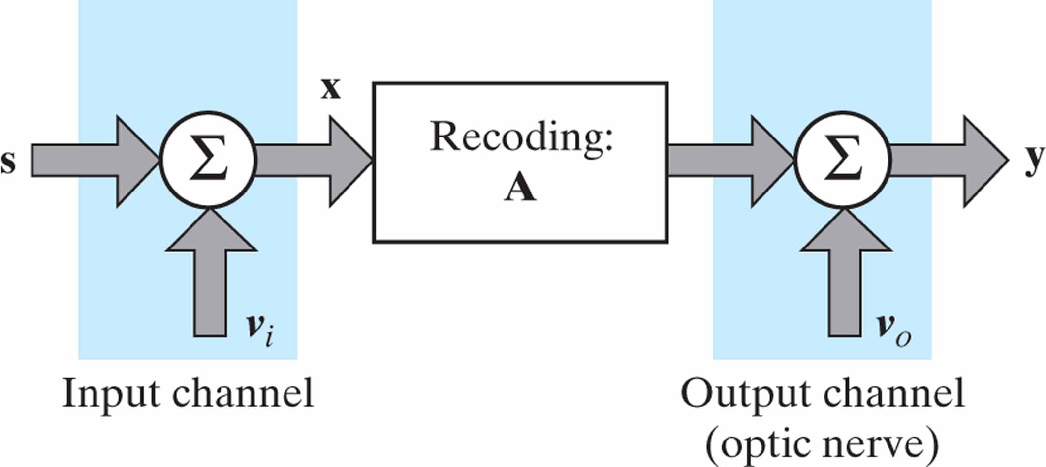
Figure 10.5 Model of a perceptual system. The signal vector s and noise vectors v_{i} and v_{o} are values of the random vectors S, N_{i}, and N_{o}, respectively.

Slide 7
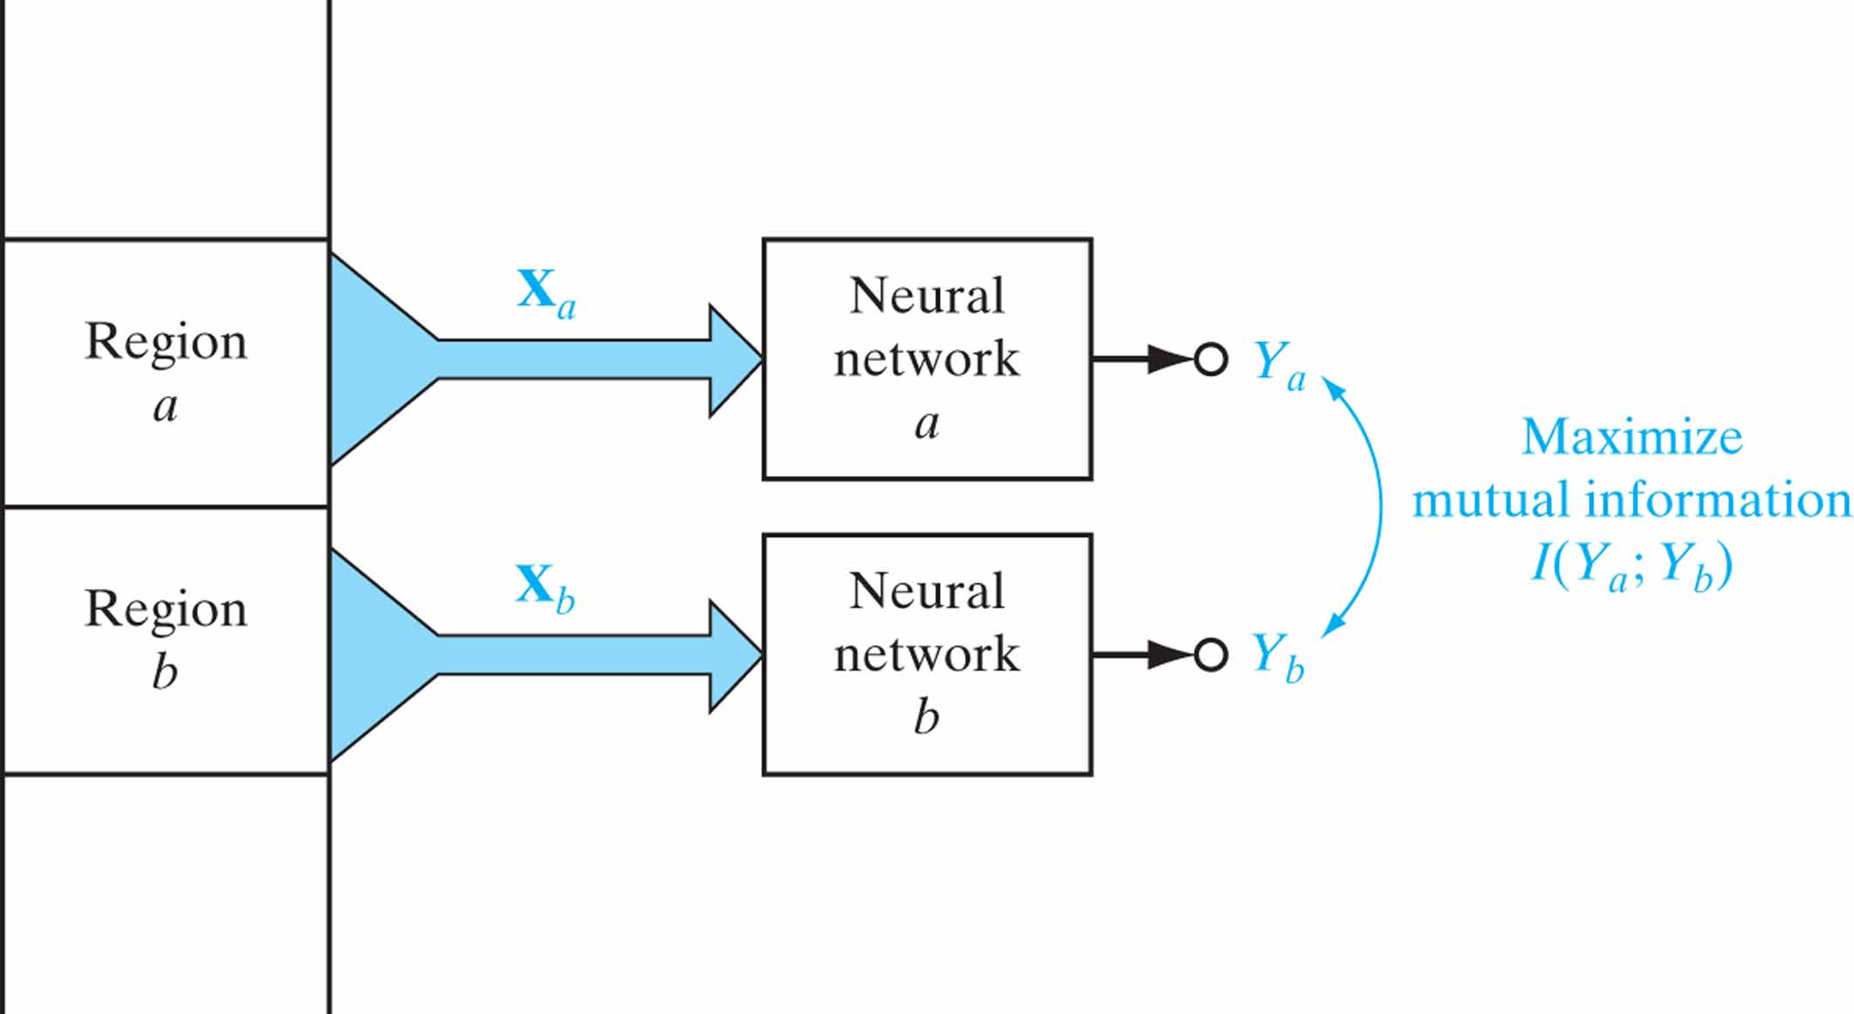
Figure 10.6 Processing of two neighboring regions of an image in accordance with the Imax principle.

Slide 8
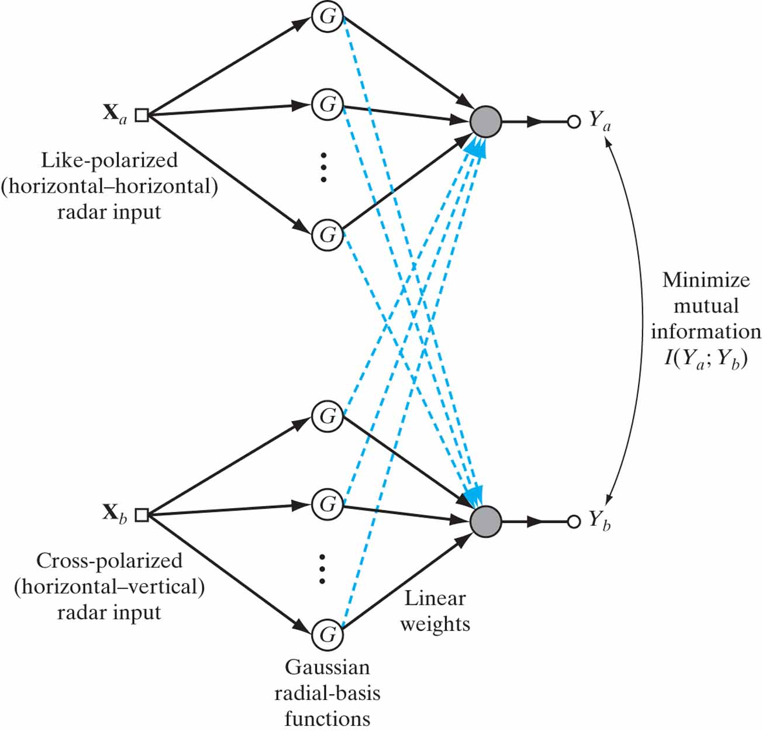
Figure 10.7 Block diagram of a neural processor, the goal of which is to suppress background clutter using a pair of polarimetric, noncoherent radar inputs; clutter suppression is attained by minimizing the mutual information between the outputs of the two modules.

Slide 9
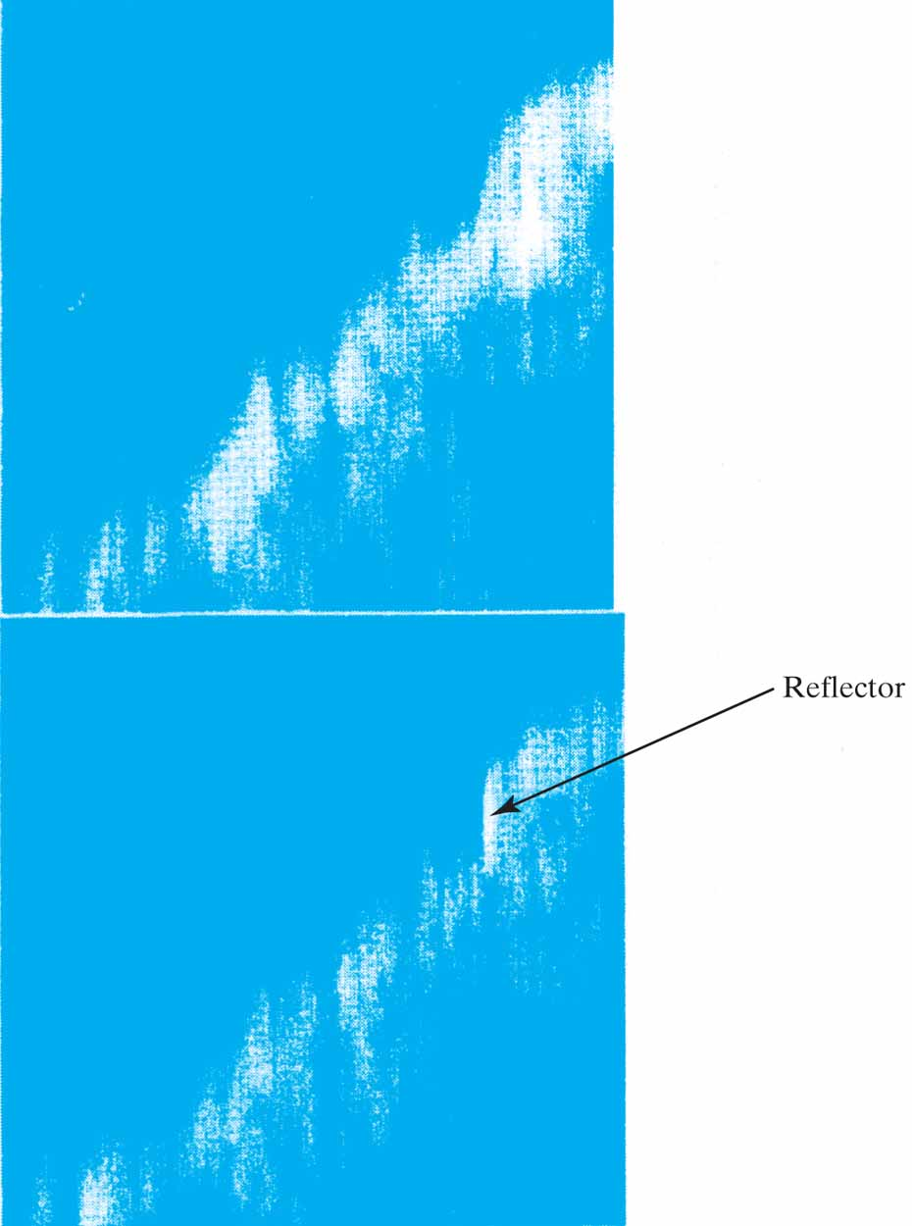
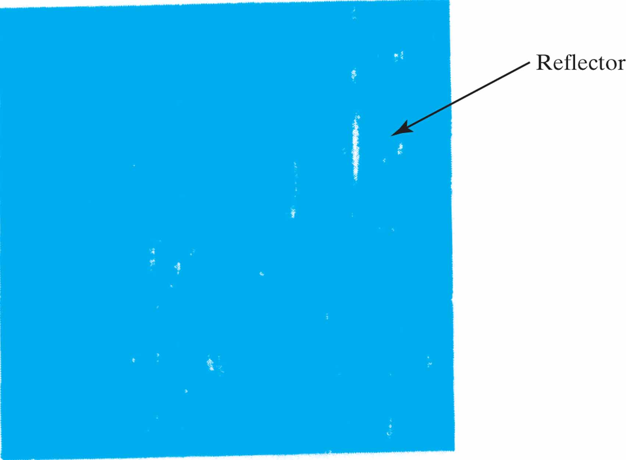
Figure 10.8 Application of the Imin principle to radar polarimetry. (a) Raw B-scan radar images (azimuth plotted versus range) for horizontal– horizontal polarization (top) and horizontal–vertical (bottom) polarization. (b) Composite image computed by minimizing the mutual information between the two polarized radar images of part (a).

Slide 10
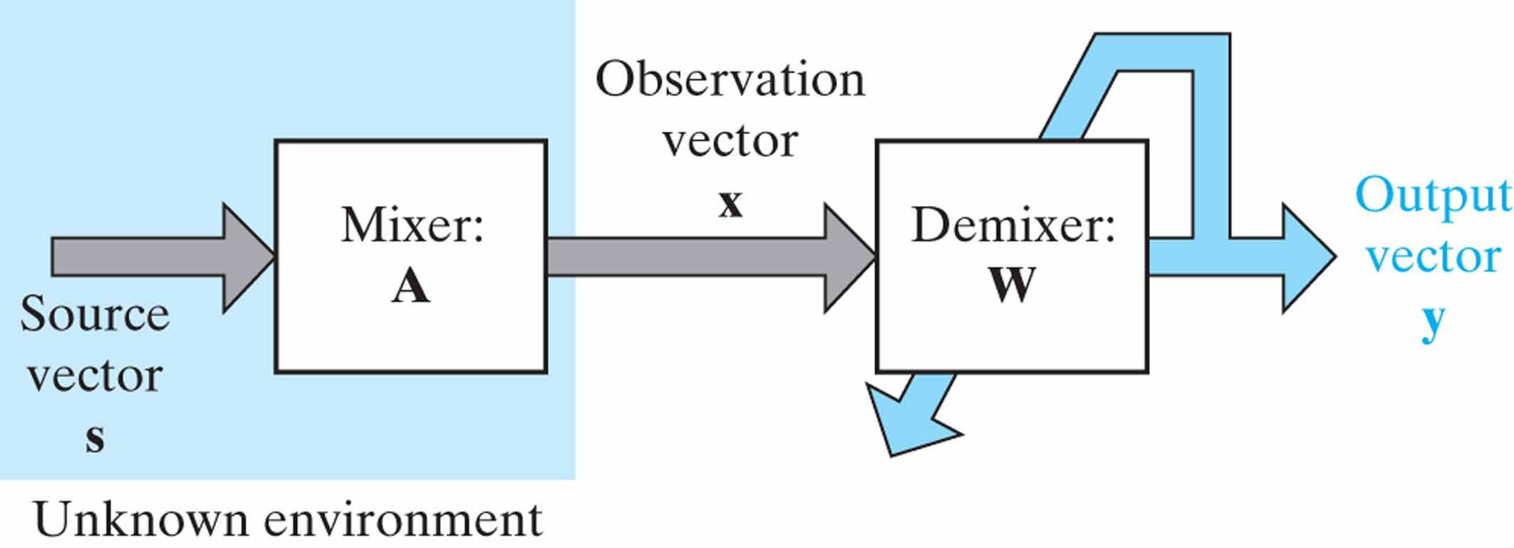
Figure 10.9 Block diagram of the processor for solving the blind source separation problem. The vectors s, x, and y are values of the respective random vectors S, X, and Y.

Slide 11
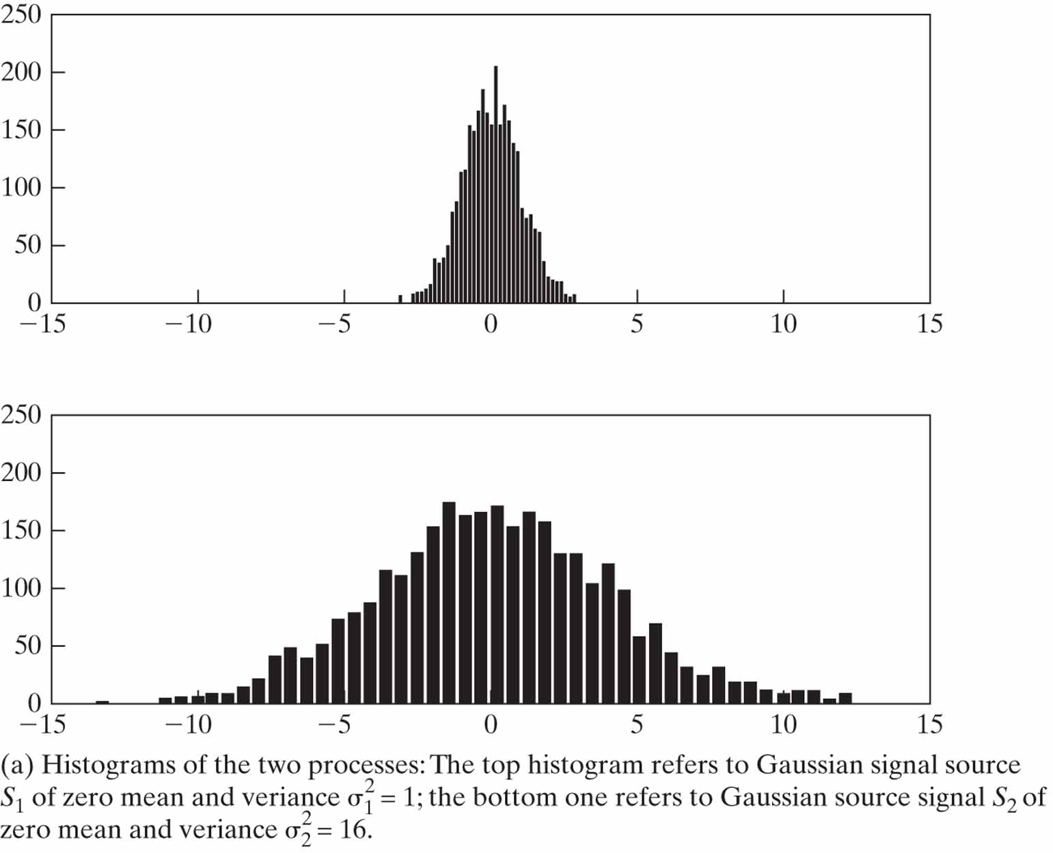
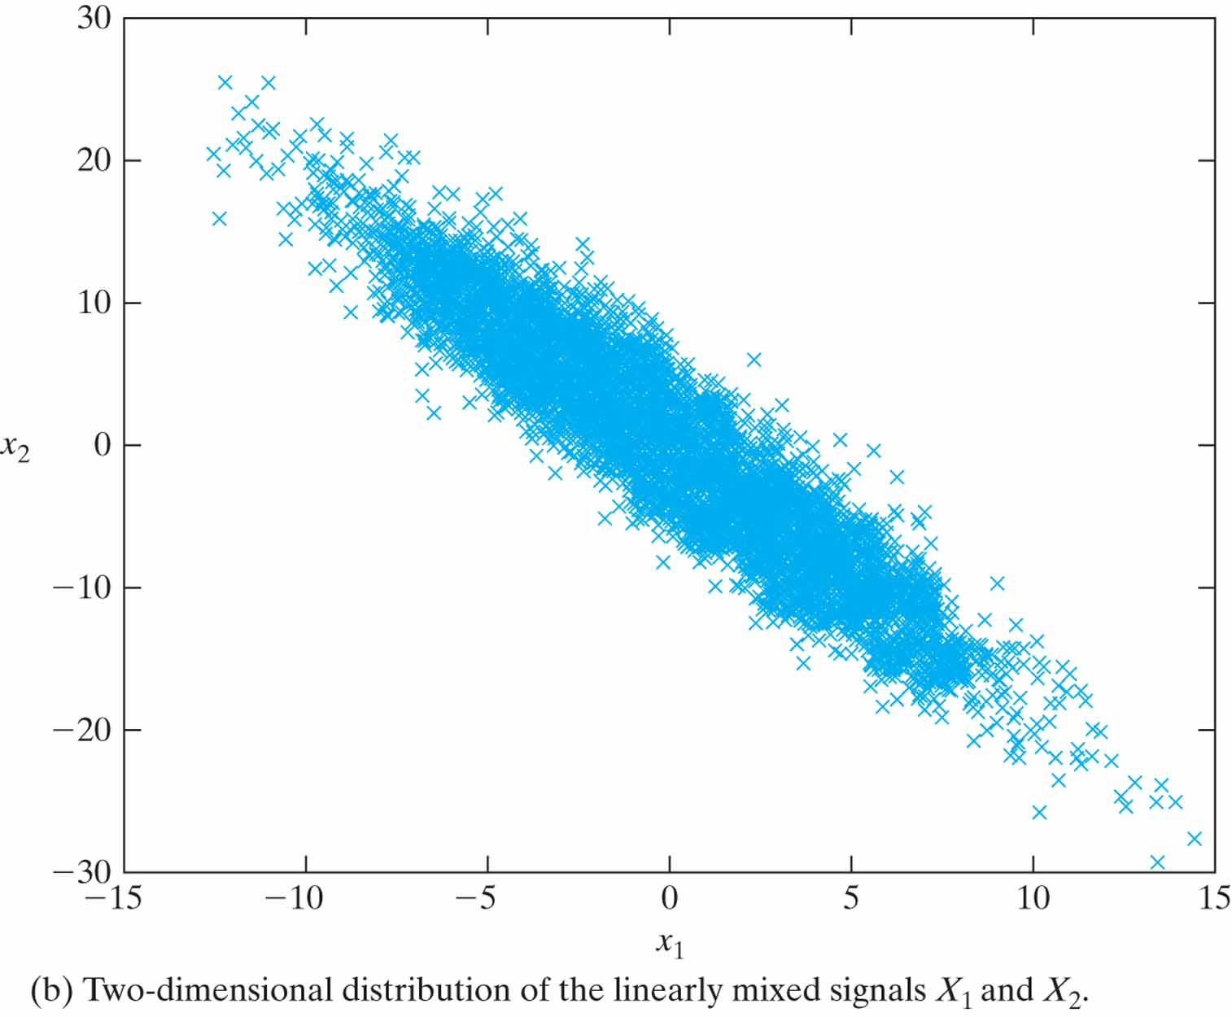
Figure 10.10 Two Gaussian distributed processes.

Slide 12
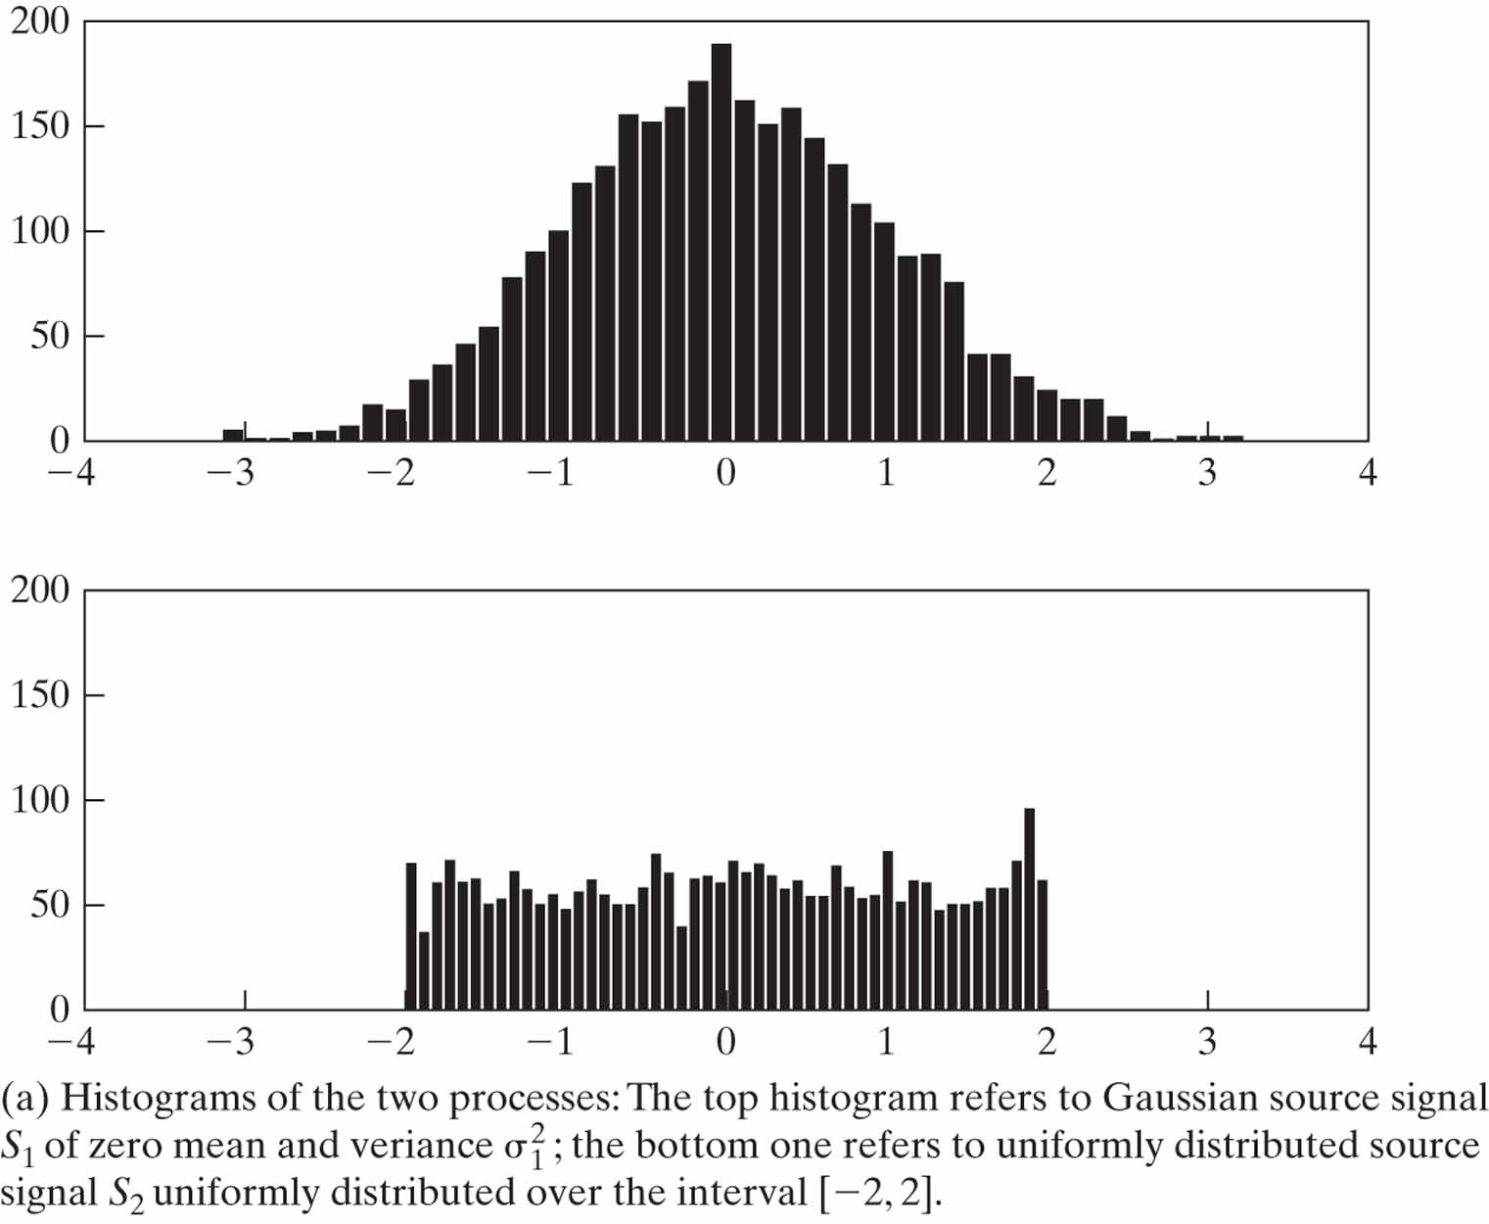
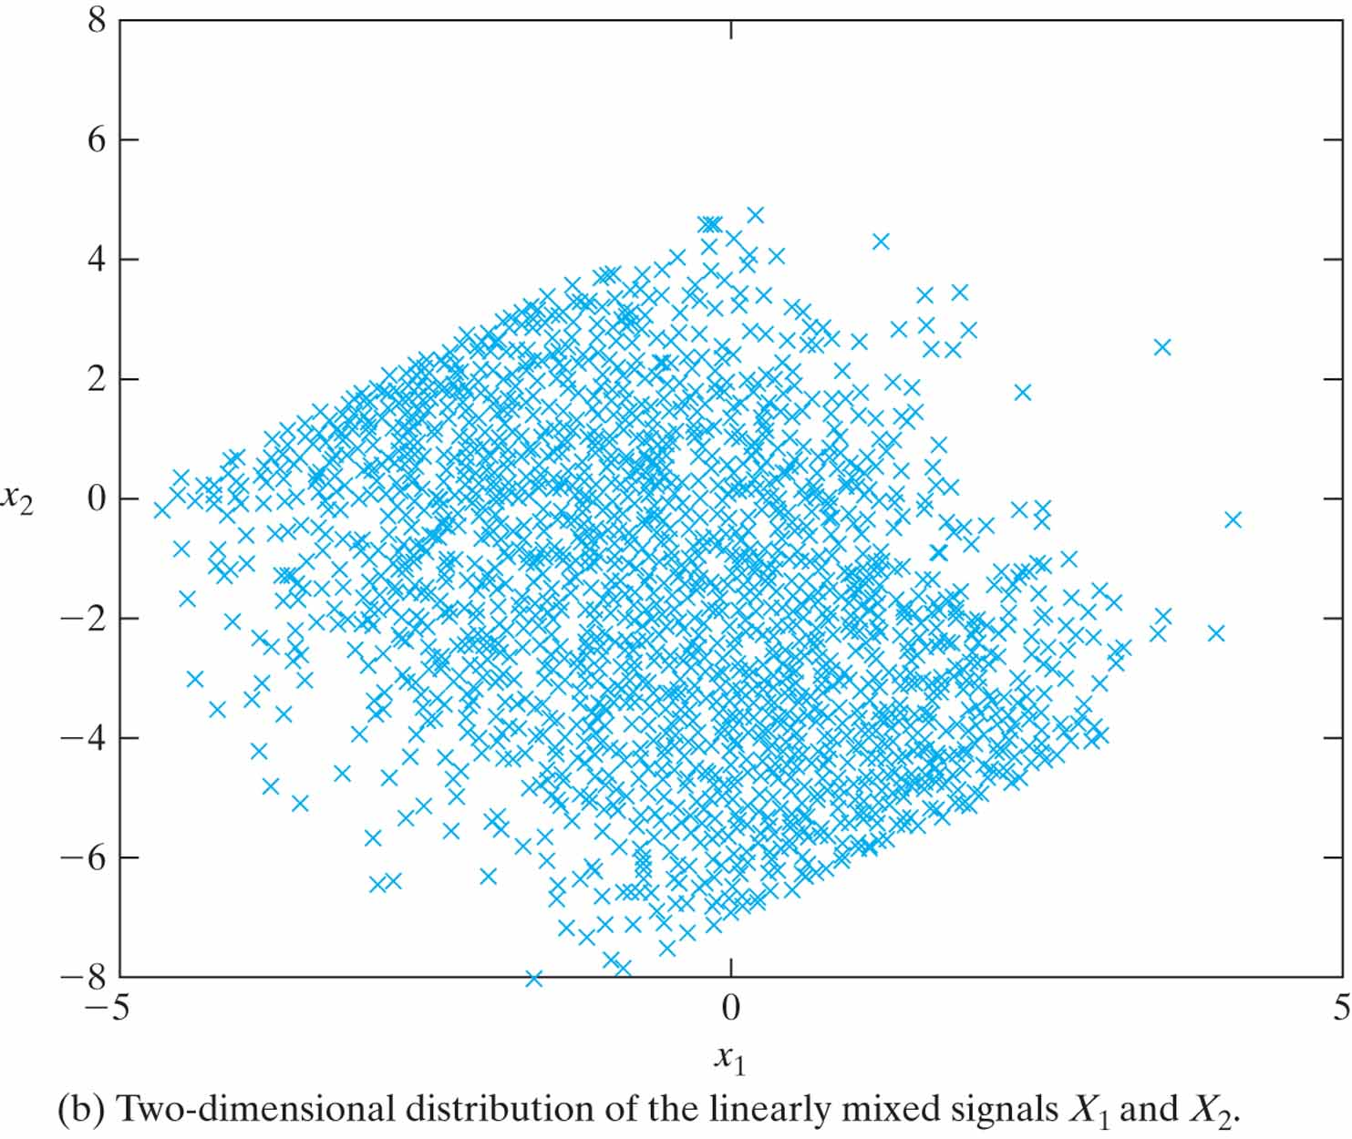
Figure 10.11 Gaussian- and uniformly-distributed processes.

Slide 13
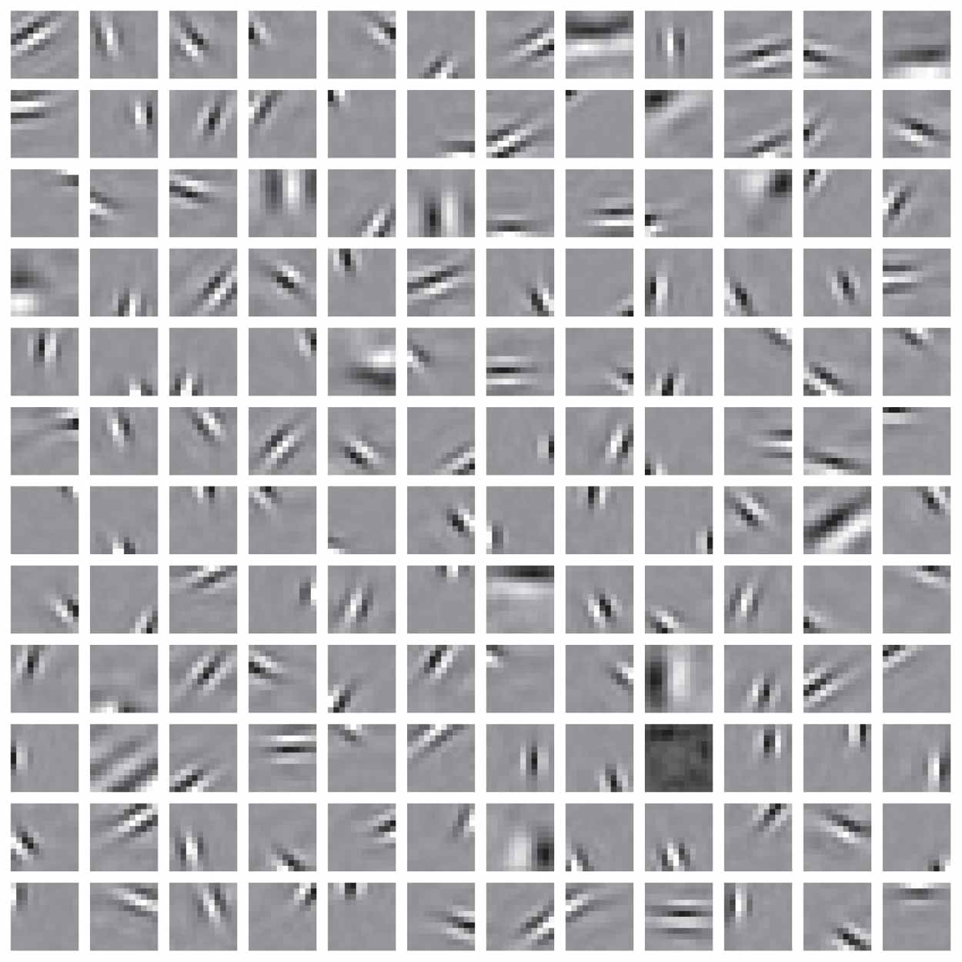
Figure 10.12 The result of applying the sparse-coding algorithm to a natural image. (The figure is reproduced with the permission of Dr. Bruno Olshausen.)

Slide 14
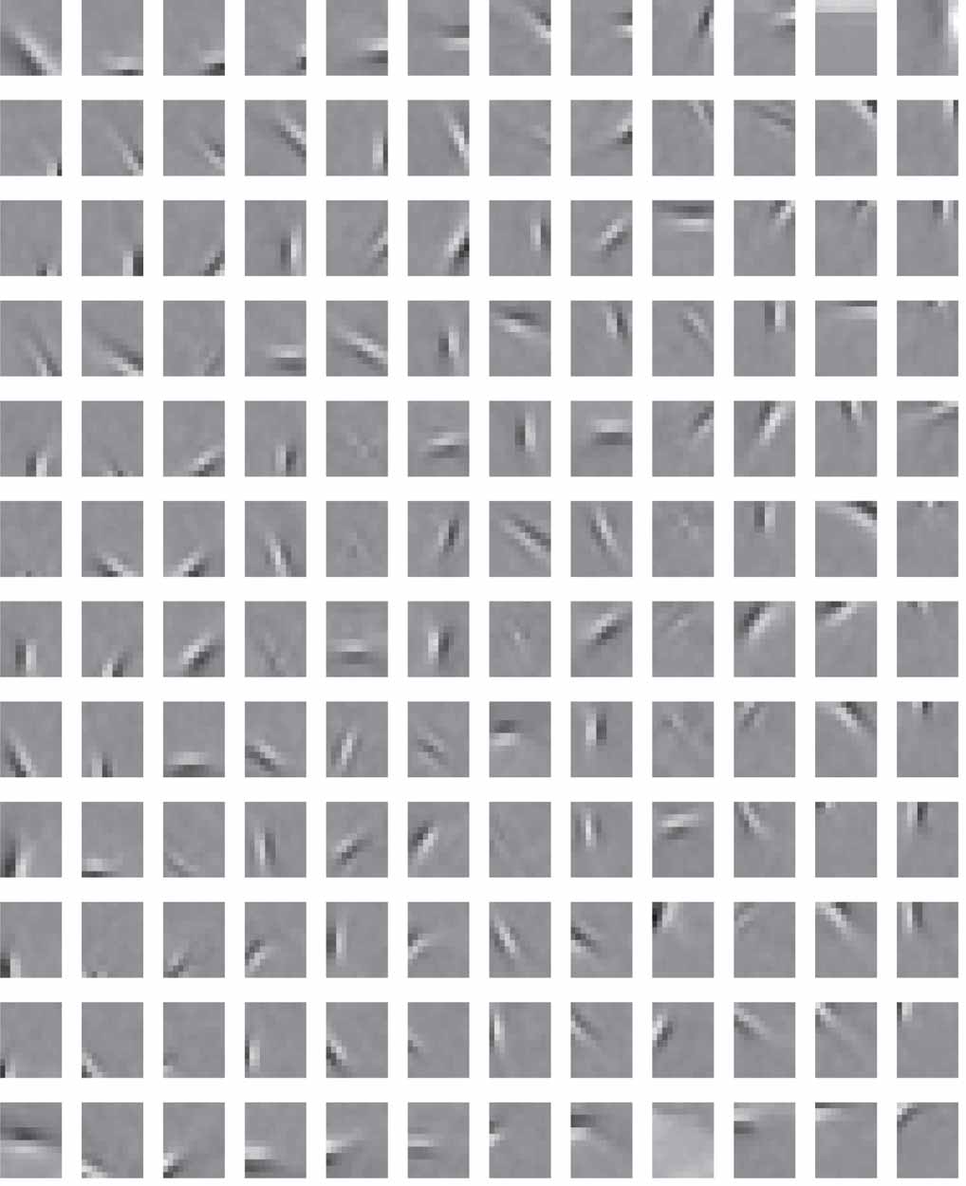
Figure 10.13 The result of applying the Infomax algorithm for ICA to another natural image. (The figure is reproduced with the permission of Dr. Anthony Bell.)

Slide 15
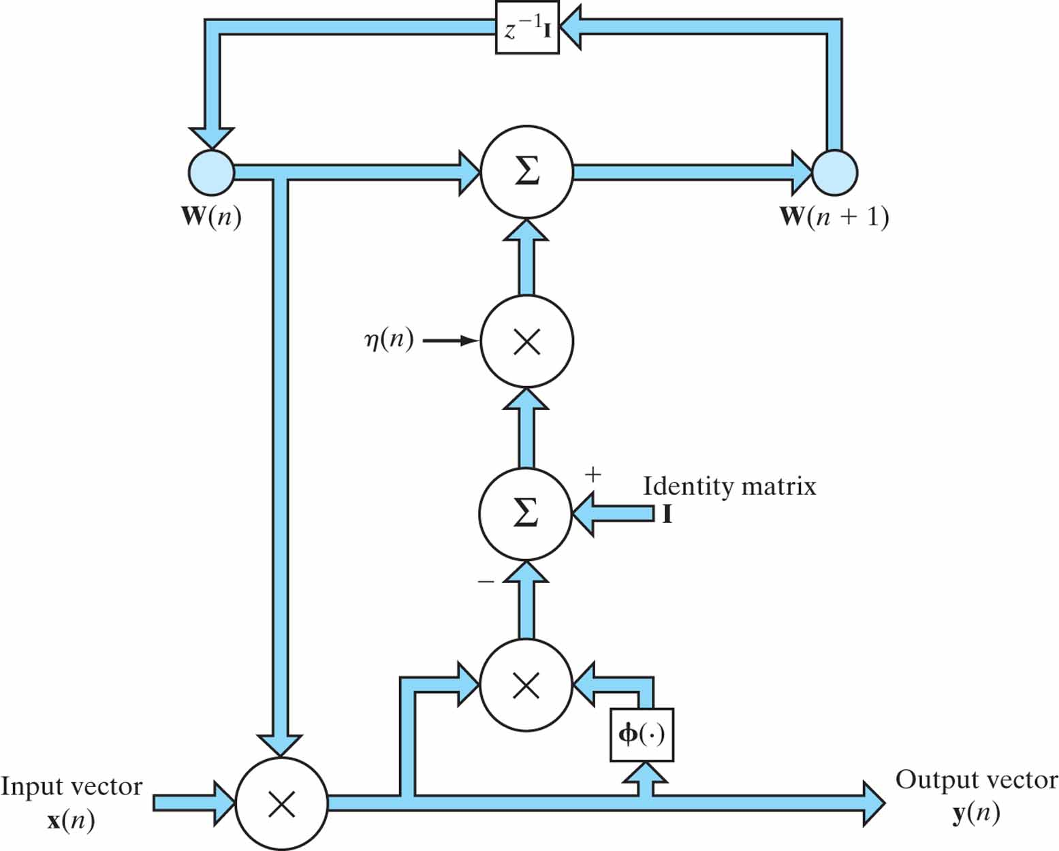
Figure 10.14 Signal-flow graph of the blind source separation learning algorithm described in Eqs. (10.85) and (10.104): The block labeled z^{–1}I represents a bank of uni-time delays. The graph embodies a multiplicity of feedback loops.

Slide 16
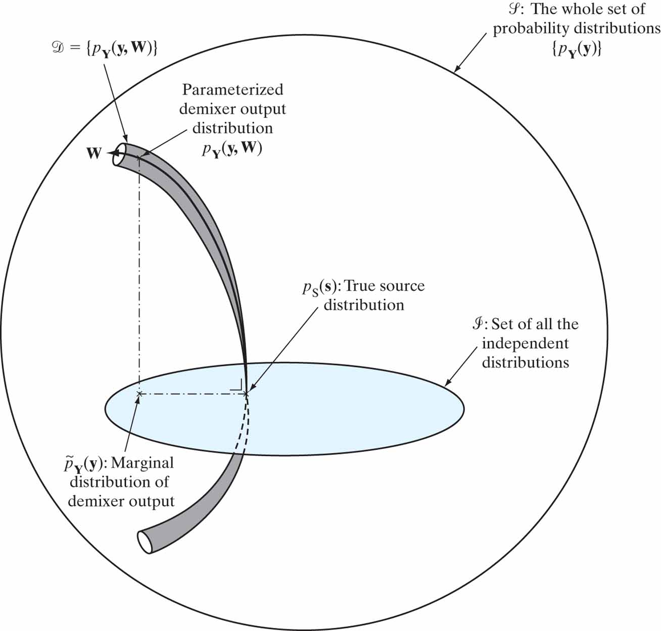
Figure 10.15 Illustration of the relationship between the maximum-likelihood method and independent-components analysis for blind source separation. The maximum-likelihood method minimizes whereas D_{pY||pS} independent-components analysis minimizes D_{pY||pY}.
˜

Slide 17
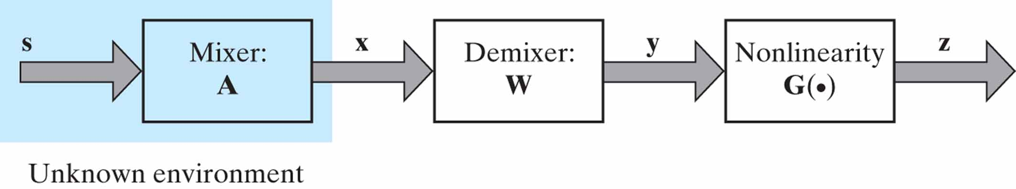
Figure 10.16 Block diagram of the maximum-entropy principle for blind source separation. The vectors s, x, y, and z are sample values of the random vectors S, X, Y, and Z, respectively.

Slide 18

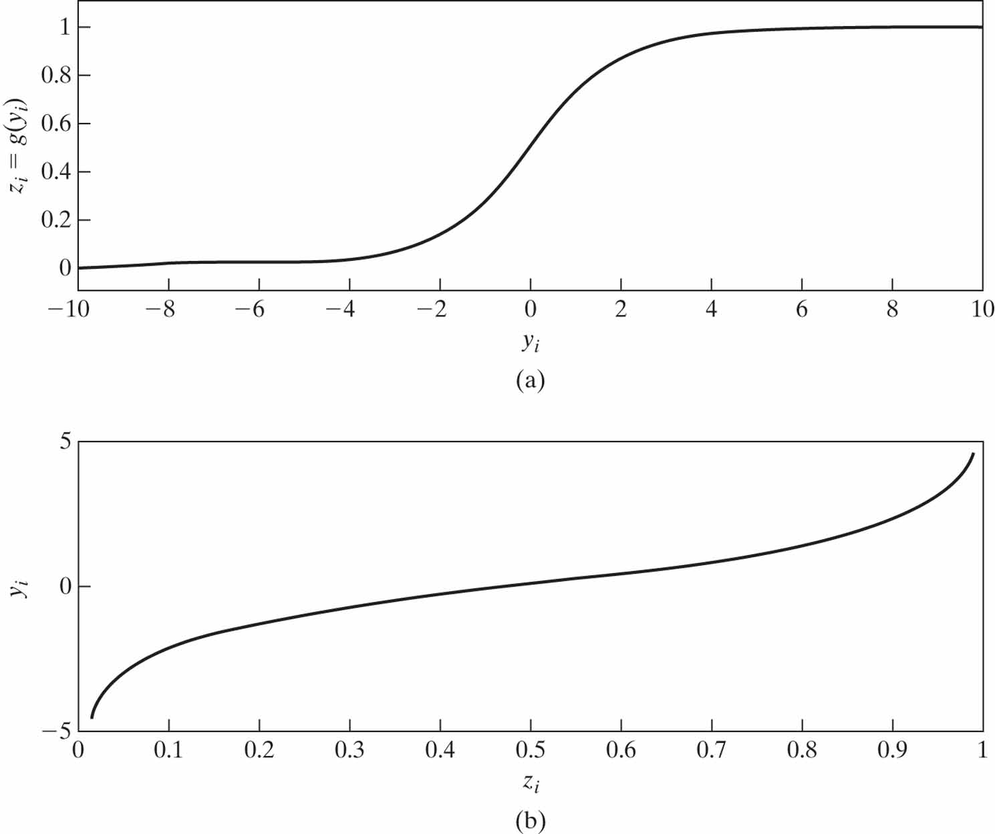
Figure 10.17 (a) Logistic function: z_{i} = g(y_{i}) (b) Inverse of logistic function: y_{i} = g⁻¹(z_{i}).

Slide 19
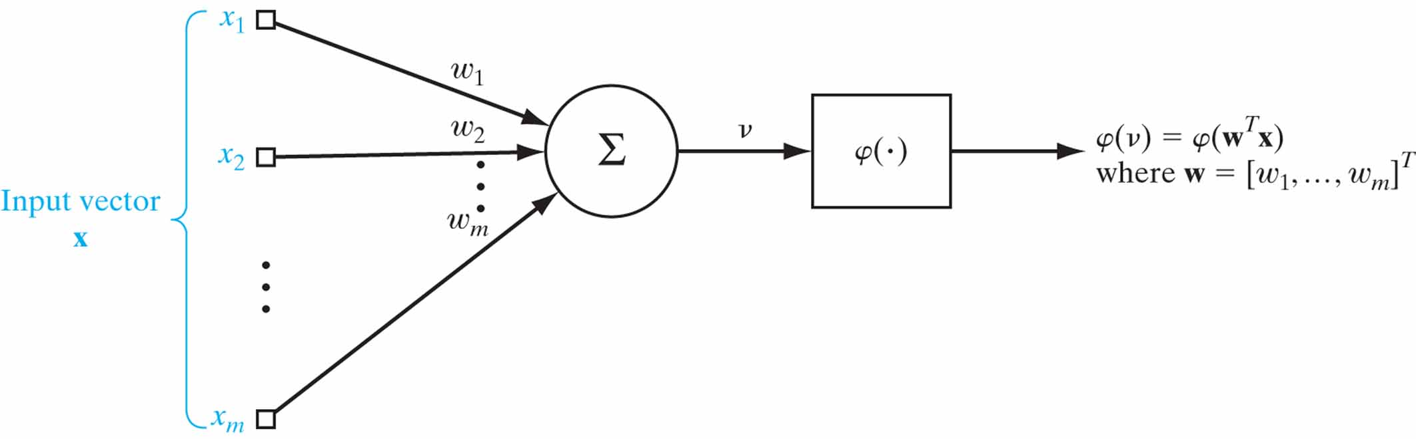
Figure 10.18 Model of the neuron featuring in the basic learning rule of the FastICA algorithm.

Slide 20
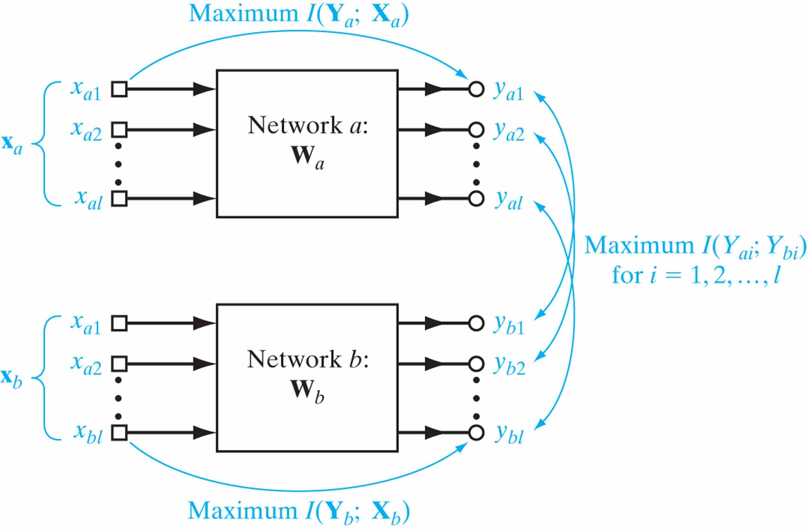
Figure 10.19 The coupled-network layout for coherent ICA.

Slide 21
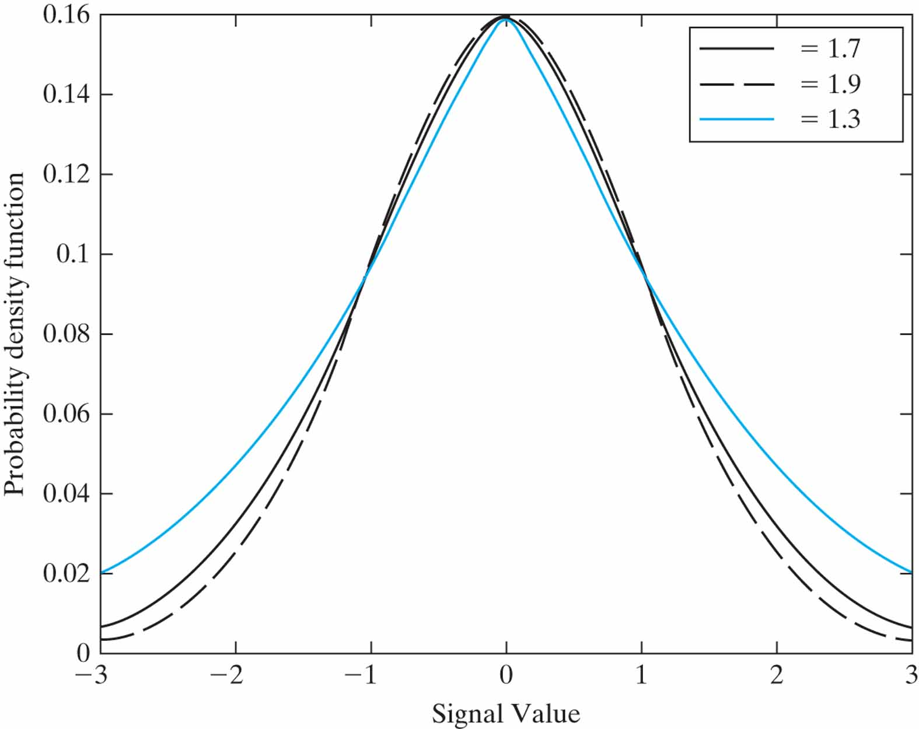
Figure 10.20 Generalized Gaussian distributions for varying values of parameter α.

Slide 22
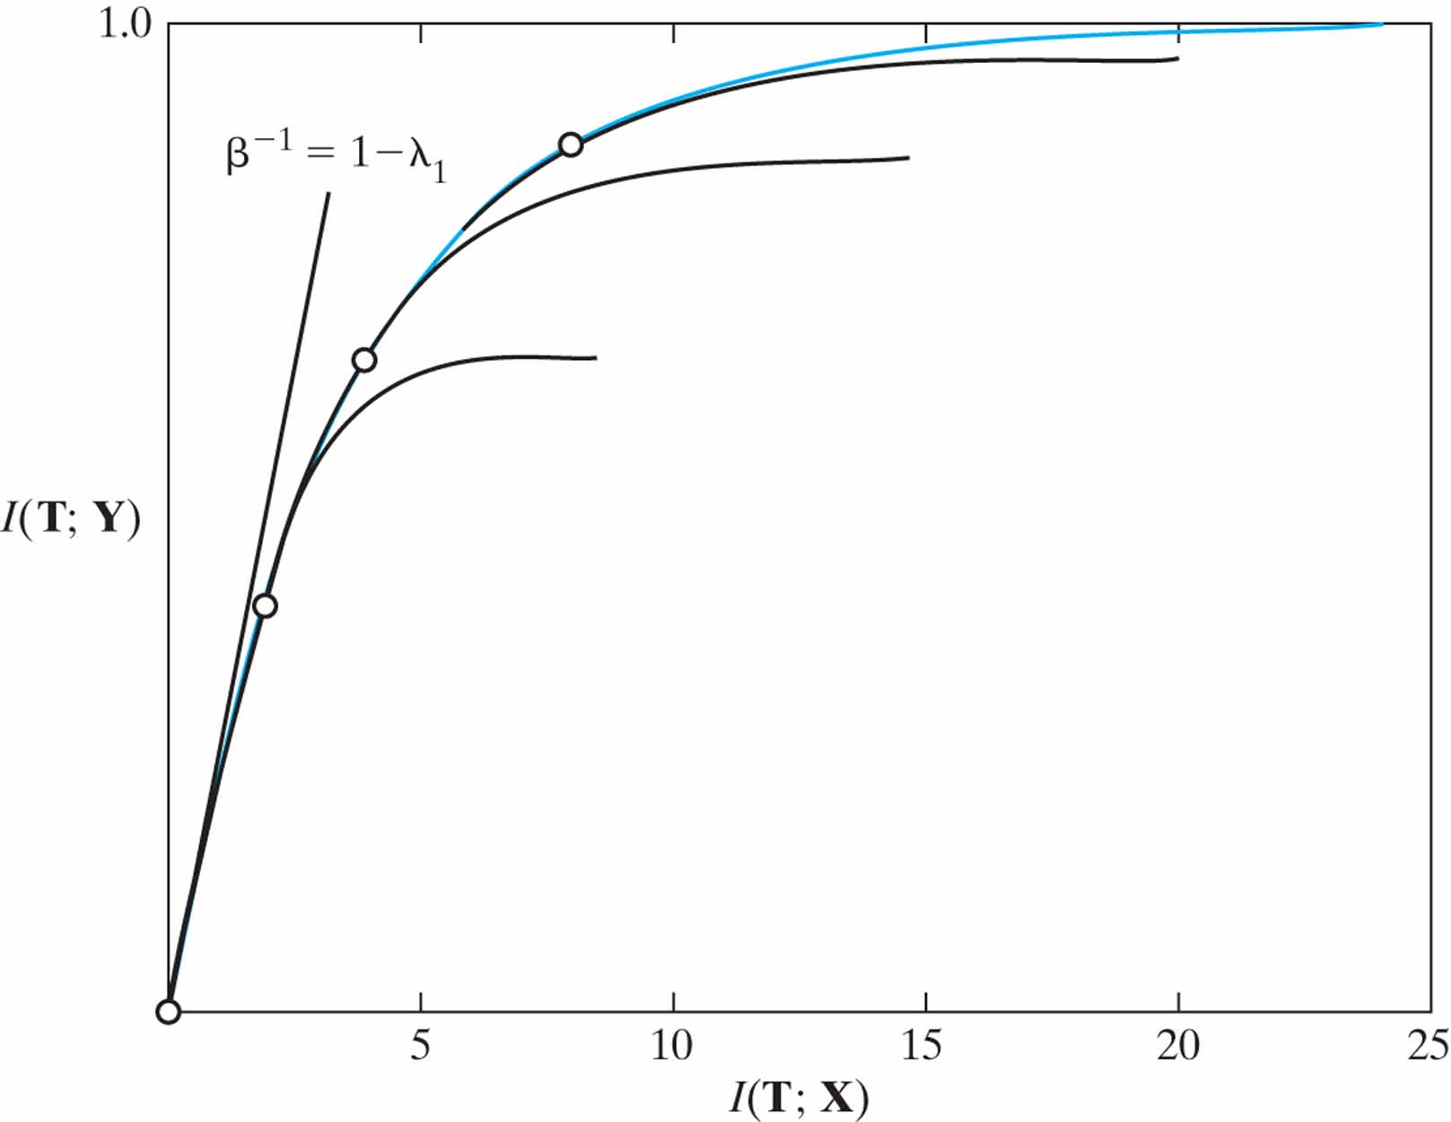
Figure 10.21 The information curve for multivariate Gaussian variables. The envelope (blue curve) is the optimal compression–prediction tradeoff, captured by varying the Lagrange multiplier β from zero to infinity. The slope of the curve at each point is given by 1/β.There is always a critical lower value of β that determines the slope at the origin, below which there are only trivial solutions. The suboptimal (black) curves are obtained when the dimensionality of T is restricted to fixed lower values. (This figure is reproduced with the permission of Dr. Naftali Tishby.)

Slide 23
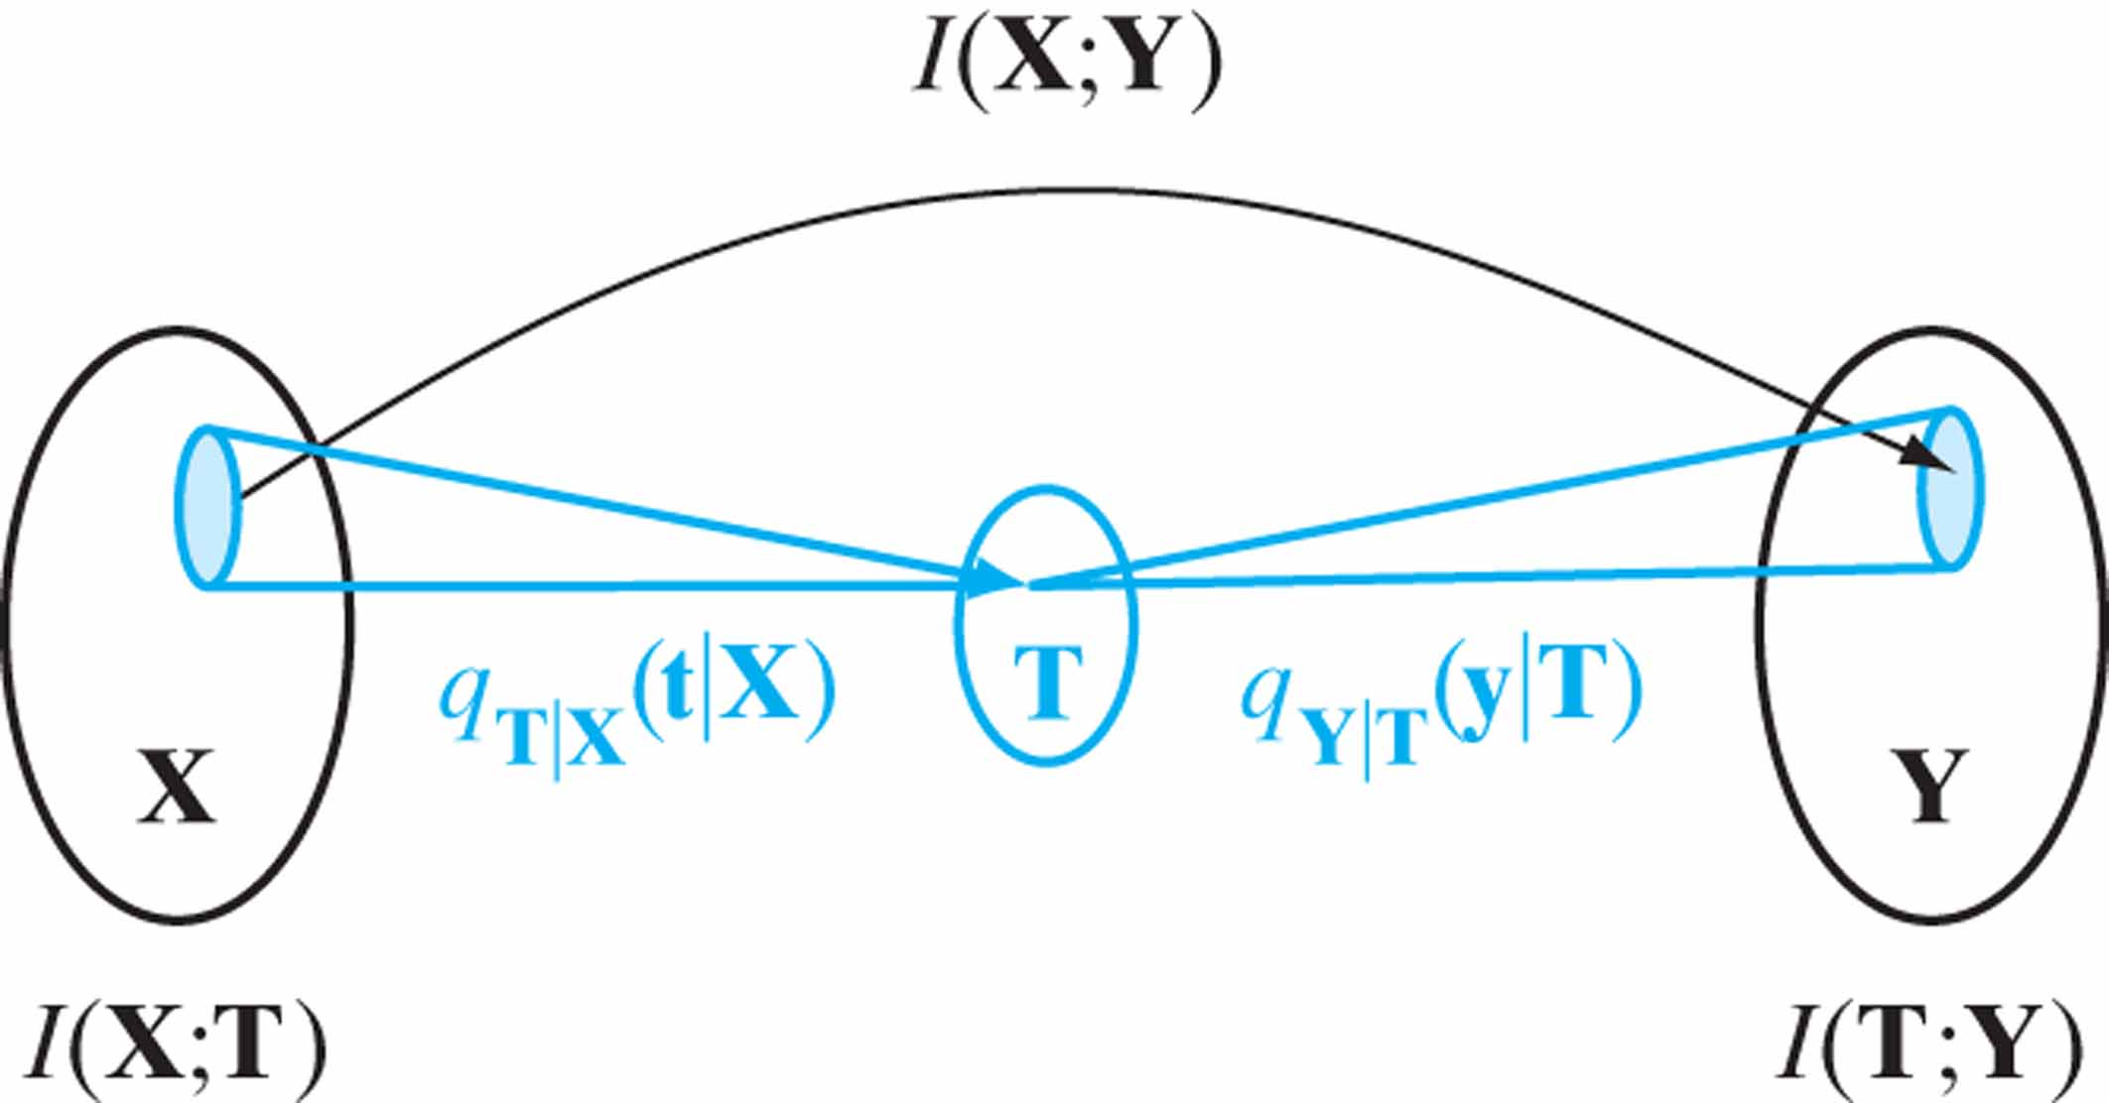
Figure 10.22 An illustration of the information bottleneck method. The bottleneck T captures the relevant portion of the original random vector X with respect to the relevant variable Y by minimizing the information I(X;T) while maintaining I(T;Y) as high as possible. The bottleneck T is determined by the three distributions q_{T|X}(t|X), q_{T}(t), and q_{Y|T}(Y|t), which represent the solution of the bottleneck equations (10.170) to (10.172).

Slide 24
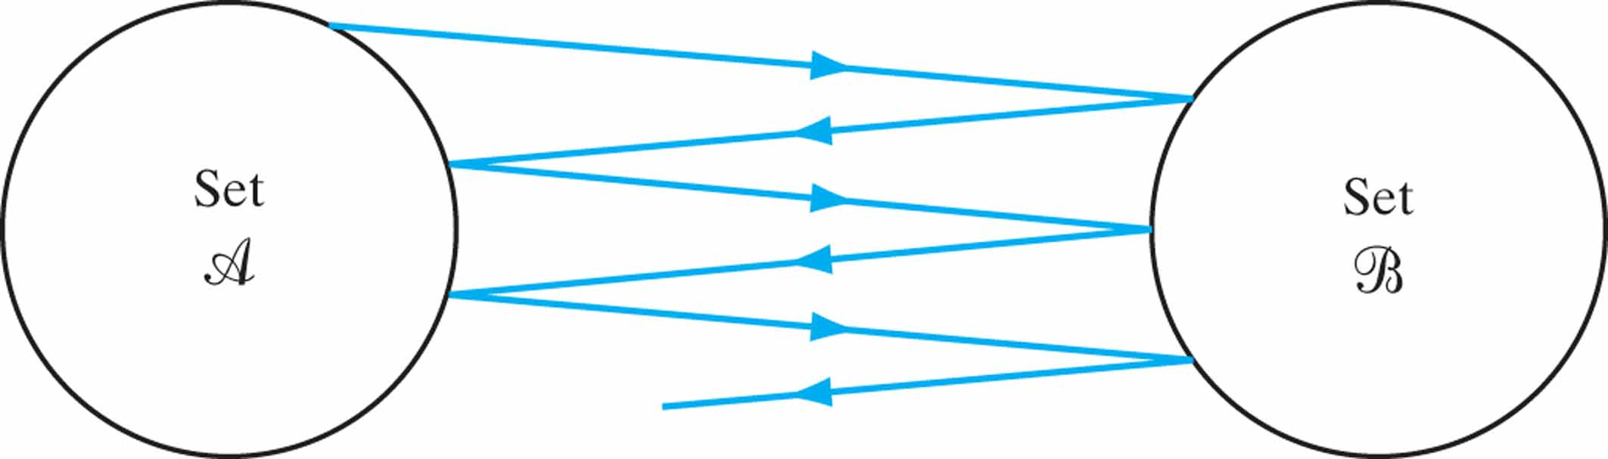
Figure 10.23 Illustrating the alternating process of computing the distance between two convex sets A and B.

Slide 25
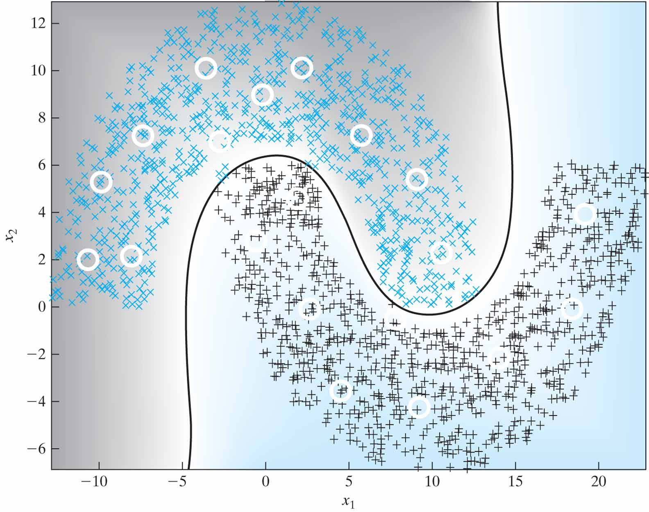
Figure 10.24 Pattern classification of the double-moon configuration of Fig. 1.8, using the optimal manifold + LMS algorithm with distance d = –6 and 20 centers.

Slide 26
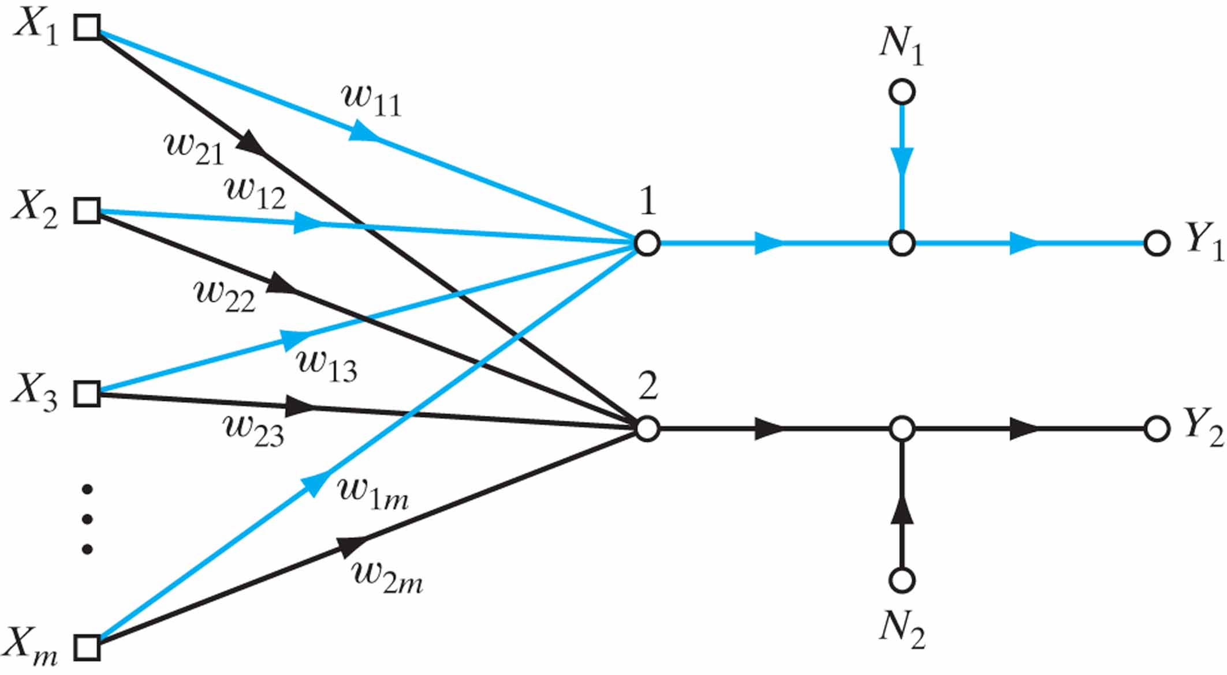
Figure P10.10

