Slide 1
LoyalLink
Your Fun & Friendly Loyalty Rewards App

Slide 2
The Problem
Local businesses lack systems to retain loyal customers,
missing out on repeat visits.

Slide 3
Our Solution
LoyalLink makes it easy to reward repeat customers
using only their phone numbers.

Slide 4
How It Works
- Customer visits a shop
- Phone number is entered
- Points are tracked
- Rewards unlocked!

Slide 5
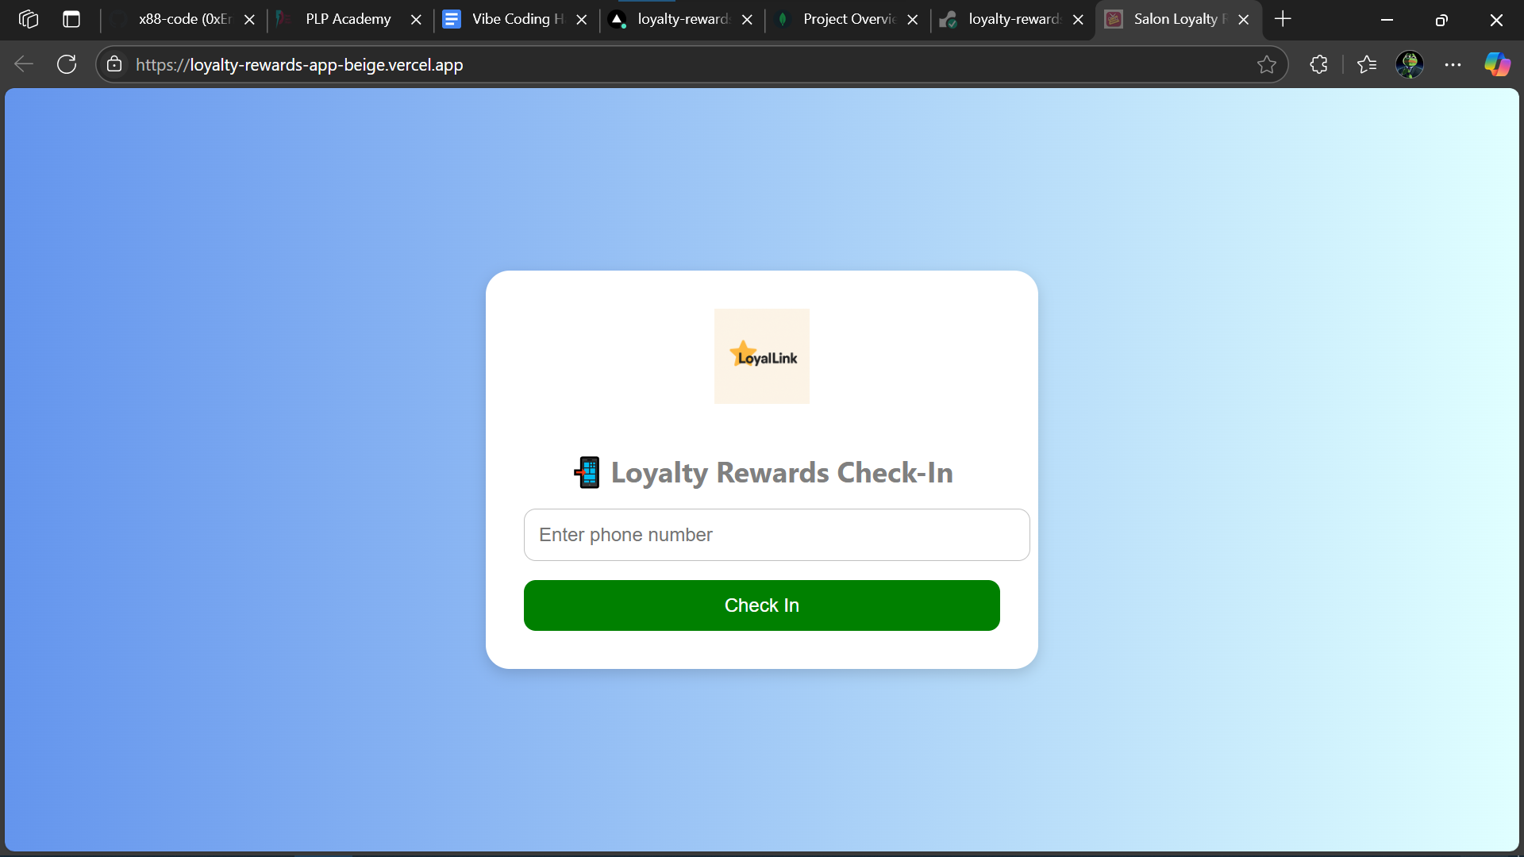
Demo
Live demo of adding a customer
Viewing points
Redeeming rewards
[]

Slide 6
Tech Stack
- Frontend: React
- Backend: Node.js + Express
- Database: MongoDB
- Tools: GitHub, Canva

Slide 7
Next Steps
- Test with local shops
- Add SMS notifications
- Launch MVP
- Collect user feedback

