Slide 1
WEBD 1000
Class 7:
  Images for the web: file types, colour depth, size and compression.
HTML/CSS Techniques
Notes:
Welcome back. Last class we planned a page with a wireframe, and every wireframe was full of X boxes: images. Today we learn how to make those images fast.
Today is mostly hands-on. There are six short labs. Students need a large photo (from their phone is best) and a browser for pixlr.com.

Slide 2
Attendance
Notes:
Take attendance. While you do, ask everyone to get a photo from their phone onto their laptop (OneDrive, email it to yourself, or a USB cable). They'll need it for Lab 1.

Slide 3
HTML/CSS Techniques
Class 7: Class Overview
Title: Images for the Web
Agenda:
  Pixels, dimensions and colour depth
  Compression: lossless vs lossy
  File formats: JPG, PNG, GIF, WebP, AVIF, SVG
  Six labs: test it yourself in Pixlr and File Explorer
  Images in HTML: width, height, lazy loading, srcset
  Choosing the right format: a checklist
Notes:
Roughly: 10 min pixels and colour depth + Lab 1, 15 min compression and formats, then Labs 2–5 in Pixlr (about 45 min, with a short concept slide before each), 15 min putting images on a page (Lab 6), 5 min wrap-up.
Everything students make today gets used next class, when we style images with CSS.

Slide 4
HTML/CSS Techniques
Before We Start: Get Ready
1. Pull this week's examples
git pull
New folder: 04_Images_for_the_Web (examples 01–05, samples/, image_lab.html, my_images/).
2. Get a big photo onto your laptop
A photo from your phone is best (OneDrive, email, or a cable). No photo? Download a free one at full size from unsplash.com. Save it as my_images/original.jpg.
3. Open Pixlr
pixlr.com → Pixlr Editor. Backup if Pixlr won't save: squoosh.app
Notes:
The best test photo is a straight-off-the-phone photo: 3,000–4,000+ pixels wide and 2–5 MB. That's what makes the size differences dramatic.
If a student has no photo: unsplash.com or pexels.com have free photos. Download the largest ('Original') size.
Pixlr: pixlr.com, then Pixlr Editor (the full editor). No account needed to start, but CHECK BEFORE CLASS: Pixlr's free tier has at times limited how many saves you get per day. If students hit a limit, use squoosh.app instead (free, no account, made by Google, shows the file size live).

Slide 5
HTML/CSS Techniques
Why Do Images Matter So Much?
1
Speed
2
Mobile data
Images are usually the heaviest part of a page. Smaller images = faster pages.
A 5 MB photo on a phone plan costs the visitor real money and time.
3
Search ranking
4
Requirements
Google measures how fast the biggest image appears (LCP).
"Pages load in under 2 seconds" [NF]. Images are how you meet it.
Goal: the smallest file that still looks good at the size it's shown.
Notes:
Images are usually the heaviest part of a web page. The HTML for a whole page might be 20–50 KB. One unoptimized phone photo can be 3–5 MB, about 100 times more.
Google measures 'Largest Contentful Paint' (LCP): how long until the biggest thing on screen appears. On most pages the biggest thing is an image. Slow LCP hurts the user and can hurt search ranking.
Connect to non-functional requirements from earlier: 'Pages load in under 2 seconds on a typical connection.' Image choices are how you meet that requirement.

Slide 6
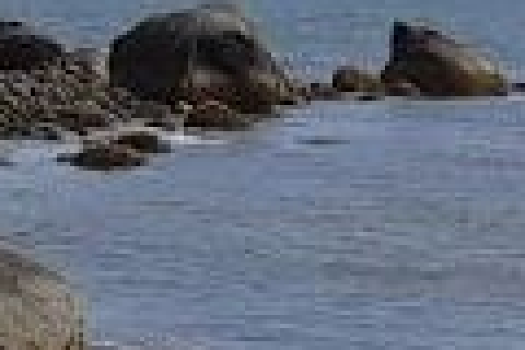
HTML/CSS Techniques
Pixels and Dimensions
​Raster images are a grid of pixels. Each pixel is one colour.
​Dimensions = width × height in pixels, e.g. 4032 × 3024.
​Megapixels = width × height ÷ 1 million. That one is 12 MP.
Zoomed in 5×: every square is one pixel.
!
What about DPI?
​DPI (dots per inch) only matters for printing. Browsers ignore it. A 1200-pixel-wide image is 1200 pixels wide at 72 dpi or 300 dpi. On the web, only pixels count.
Notes:
Zoom into any photo far enough and you see it's a grid of coloured squares: pixels. A 'raster' image (JPG, PNG, GIF, WebP, AVIF) is exactly that grid, stored as numbers.
Dimensions = width × height in pixels. A 12-megapixel phone photo is about 4032 × 3024 = 12.2 million pixels.
DPI / PPI: you'll see '72 dpi' or '300 dpi' in Properties. That number matters for PRINTING. On the web it's ignored: a 1200-pixel-wide image is 1200 pixels wide whether it says 72 or 300 dpi. Only the pixel dimensions matter.

Slide 7
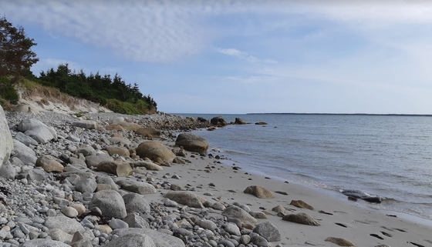
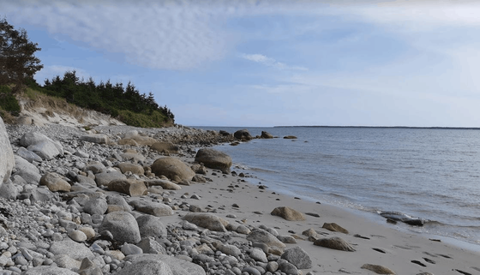
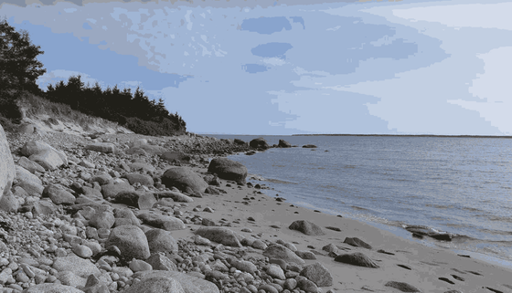
HTML/CSS Techniques
Colour Depth (Bit Depth)
24-bit: 16.7 million colours
8-bit: 256 colours (GIF)
4-bit: 16 colours
Bits per pixel | Colours | Where you see it
1-bit | 2 | Black and white only
8-bit | 256 | GIF, PNG-8
24-bit | 16.7 million | JPG, PNG-24, WebP: photos
32-bit | 16.7 million + transparency | PNG-32, WebP, AVIF with alpha
Alpha channel = the extra 8 bits that store how see-through each pixel is.
Notes:
Colour depth = how many bits are used to store the colour of ONE pixel. More bits = more possible colours = bigger files (before compression).
8 bits per channel × 3 channels (red, green, blue) = 24-bit colour: 256 × 256 × 256 = about 16.7 million colours. That's what JPG uses and what screens show.
32-bit = 24-bit colour + 8 bits of 'alpha' (transparency): each pixel can be anywhere from fully see-through to solid.
The images on the slide are the same photo: 24-bit, then GIF with 256 colours (look at the sky: banding), then only 16 colours. In File Explorer → Properties → Details this is called 'Bit depth'.

Slide 8
HTML/CSS Techniques
Do the Math: Why We Need Compression
Uncompressed = width × height × 3 bytes
(24-bit colour = 3 bytes per pixel: one each for red, green and blue)
Our sample beach photo
→
Uncompressed
2.0 MB
Actual JPG file
134 KB
1118 × 640 × 3
A 12 MP phone photo
→
Uncompressed
36.6 MB
Actual JPG file
about 3 MB
4032 × 3024 × 3
Compression makes files much smaller. But 3 MB is still far too big for one image on a web page.
Notes:
Uncompressed size = width × height × bytes per pixel. 24-bit colour = 3 bytes per pixel.
Our sample: 1118 × 640 × 3 = about 2 MB uncompressed, but the JPG file is only about 134 KB. Compression made it ~15× smaller.
A phone photo: 4032 × 3024 × 3 = 36.6 MB uncompressed. The phone's JPG is usually 2–5 MB. Still WAY too big for a web page, which is why we'll resize too.
1 KB = 1024 bytes, 1 MB = 1024 KB. (Windows shows sizes this way; macOS uses 1000. Close enough for us.)

Slide 9
Lab 1: Get to Know Your Photo (5 min)
1
Save your photo as my_images/original.jpg
Write down
​Inside the 04_Images_for_the_Web folder.
Dimensions (W × H)
Bit depth
File size
Uncompressed size
Expect roughly
Phone: 4000 × 3000, 24-bit, 2–5 MB
Uncompressed: 30–50 MB
2
Right-click it → Properties → Details tab
​Scroll to Image: find Dimensions and Bit depth. File size is on the General tab.
3
Do the math
​width × height × 3 = the uncompressed size in bytes. Divide by 1,048,576 for MB.
4
Fill in Lab 1 in image_lab.html
​How many times smaller is the real file than the uncompressed size?
5
Bonus: set up a better File Explorer view
​View → Details, then right-click a column heading → More… → tick Dimensions and Bit depth. You'll use this all class.
Notes:
Walk around. Common snags:
- iPhone photos may be .HEIC, not .jpg. Fix: on the phone, Settings → Camera → Formats → Most Compatible, or open the HEIC in Pixlr and save as JPG first. Windows may need the free HEIF extension to show HEIC details.
- Photos sent through some chat apps arrive already shrunk (e.g. 1600 px). That's fine, but the differences will be smaller.
The File Explorer Details view with Dimensions and Bit depth columns is the fastest way to compare files for the rest of the class. Show it on the projector.
Ask a couple of students for their compression ratio. Usually 10–20×.

Slide 10

+
Compression
•
○
+
Lossless vs lossy · what you lose and what you save
•
○
Notes:
Next: how files get smaller. Two kinds of compression, and the difference decides which file type to use.

Slide 11
HTML/CSS Techniques
Lossless vs Lossy
Lossless
Lossy
Packs the data more cleverly. Open it and every pixel is exactly the same as before.
Throws away detail your eye probably won't notice. You choose how much.
​Like a ZIP file
​PNG, GIF, lossless WebP
​Great for logos, icons, screenshots, flat colour
​Poor for photos (big files)
​Like summarizing a book
​JPG, WebP, AVIF
​Great for photos (tiny files)
​Too much = blurry, blocky pictures. You can't undo it
Always keep your original. Export copies. Never edit and re-save the same JPG over and over.
Notes:
Lossless: like a ZIP file. The file is packed more cleverly (e.g. 'the next 200 pixels are all this exact blue' instead of listing each one), and when you open it you get back EXACTLY the original pixels. PNG and GIF are lossless. Works great on flat colour; not much help on photos where every pixel is slightly different.
Lossy: throws away detail your eye is unlikely to notice: tiny colour differences, fine texture. You choose how much with the quality slider. You can never get that detail back, which is why you always keep the original and export copies.
Generation loss: open a JPG, save it as JPG, repeat. Each save loses a bit more. Edit from the original.

Slide 12
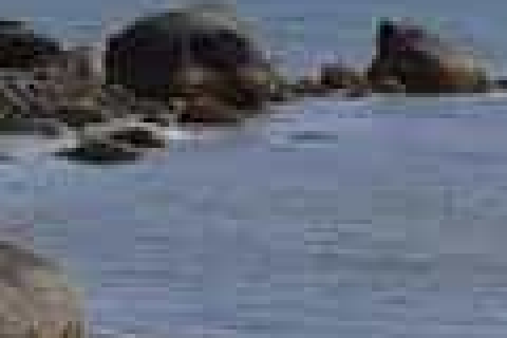
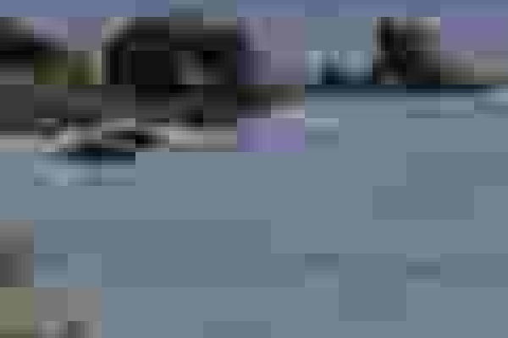
What Lossy Compression Looks Like
The same JPG at three quality settings, zoomed in 5×.
Quality 90
140 KB
Quality 50
51 KB
Quality 10
12 KB
​Blocks: JPG works in 8 × 8 pixel squares. Push the quality too low and you can see them.
​Smudges and noise appear around sharp edges, and smooth areas like sky turn patchy.
​Quality 90 is bigger than the original file (134 KB)! Re-saving at a higher quality can't bring back detail. It only adds bytes.
Notes:
These are real crops from samples/beach_q90.jpg, beach_q50.jpg and beach_q10.jpg (Example 02).
At normal size, quality 50 looks fine to most people. Zoomed in, you start to see smudging. Quality 10 is obviously blocky even at normal size.
The surprising one: the original file is 134 KB, and re-saving it at quality 90 made it 140 KB. Bigger, not better, because the detail was already gone. Lesson: the quality number isn't a promise of quality; it's how much MORE you're willing to throw away.
Most photos look good at quality 60–80. That's where we'll aim in Lab 3.

Slide 13
+
File Formats
•
○
+
JPG · PNG · GIF · WebP · AVIF · SVG
•
○
Notes:
Six formats. Students only really need four day to day: JPG or WebP for photos, PNG for screenshots and graphics with transparency, SVG for logos and icons.

Slide 14
HTML/CSS Techniques
The Six Formats You'll Meet
.jpg
JPEG
.png
PNG
Photos. Lossy, millions of colours, no transparency.
Screenshots, logos, anything needing transparency. Lossless.
.gif
GIF
.webp
WebP
Simple animations. Only 256 colours. Mostly old-fashioned now.
Modern photos AND graphics. Smaller than JPG/PNG. Transparency too.
.avif
AVIF
.svg
SVG
Newest. Usually the smallest photos. Some older apps can't open it.
Logos, icons. Vector: shapes in code, sharp at any size.
Notes:
Quick tour. Dates help explain why things are the way they are:
- GIF (1987): only 256 colours. Still around because of animated memes, but a video file is much smaller for animation.
- JPEG (1992): the classic photo format. Every device and program supports it.
- PNG (1996): created as a free replacement for GIF. Lossless, full colour, real transparency.
- SVG (2001): vector graphics written as XML code. Can even be written by hand or styled with CSS.
- WebP (Google, 2010): lossy or lossless, transparency, animation. Works in all current browsers.
- AVIF (2019): newest, usually the smallest for photos. Works in all current major browsers; some older software (and some image editors) can't open it yet.

Slide 15
HTML/CSS Techniques
Formats Side by Side
Format | Compression | Colours | Transparency | Animation | Our photo
JPG | Lossy | 16.7 M | ✗ | ✗ | 93 KB
PNG | Lossless | 16.7 M | ✓ | ✗ | 978 KB
GIF | Lossless | 256 | On / off only | ✓ | 407 KB
WebP | Both | 16.7 M | ✓ | ✓ | 91 KB
AVIF | Both | 16.7 M+ | ✓ | ✓ | 69 KB
SVG | Vector (code) | Any | ✓ | ✓ | n/a
​Photo? JPG, or WebP / AVIF for smaller files.
​Needs transparency? PNG or WebP. Never JPG.
​Logo or icon? SVG if you have it.
Notes:
Sizes in the last column are our sample photo (1118 × 640) from Example 01. Same pixels, very different files.
The headline: PNG is lossless, so for a photo it's huge (978 KB). GIF is smaller than PNG only because it threw away colours, and the sky shows it. WebP and AVIF beat JPG at similar visual quality.
Transparency column: JPG can't do it. If you save a logo with a transparent background as JPG, the background turns solid (usually white).

Slide 16

EXAMPLE 01
<h1>One Photo, Six Files</h1>
<p>Same photo (1118 &times; 640 pixels), saved as different file types.
Can you see a difference? Check the file sizes in File Explorer.</p>
<!-- JPEG: lossy, millions of colours. The usual choice for photos -->
<figure>
<img src="samples/beach_q75.jpg" width="560" height="320"
alt="Rocky beach with calm water and a tree-lined point">
<figcaption>JPG, quality 75: about 92 KB</figcaption>
</figure>
<!-- PNG: lossless. Keeps every pixel, so photos get BIG -->
<figure>
<img src="samples/beach.png" width="560" height="320"
alt="Rocky beach with calm water and a tree-lined point">
<figcaption>PNG: about 978 KB (10&times; bigger, and it looks the same)</figcaption>
</figure>
<!-- GIF: only 256 colours. Look at the sky for colour bands -->
<figure>
<img src="samples/beach.gif" width="560" height="320"
alt="Rocky beach with calm water and a tree-lined point">
<figcaption>GIF, 256 colours: about 407 KB (look at the sky)</figcaption>
</figure>
<!-- WebP: modern. Works in every current browser -->
<figure>
<img src="samples/beach.webp" width="560" height="320"
alt="Rocky beach with calm water and a tree-lined point">
<figcaption>WebP, quality 75: about 91 KB</figcaption>
</figure>
<!-- AVIF: newest. Usually the smallest file for photos -->
<figure>
<img src="samples/beach.avif" width="560" height="320"
alt="Rocky beach with calm water and a tree-lined point">
<figcaption>AVIF, quality 50: about 69 KB</figcaption>
</figure>
One Photo, Six Files
​The same photo in five raster formats. Open it with Live Server and compare. Most look identical.
​Now open the samples folder in File Explorer (Details view) and compare the sizes: 69 KB → 978 KB.
​Look closely at the GIF's sky. Only 256 colours means smooth gradients turn into bands.
​width and height match the shape of the photo. More on why later.
01_image_formats_example.html
Notes:
Open 01_image_formats_example.html with Live Server.
Ask: 'Which one is the PNG?' Most students can't tell by looking. Then show the samples folder in File Explorer, sorted by size. That's the 'aha'.
The GIF is the only one with a visible difference (banding in the sky). Zoom the browser in to make it obvious.
AVIF note: if a student's browser shows a broken image for AVIF, their browser is out of date. All current Chrome, Edge, Firefox and Safari versions support it.

Slide 17


HTML/CSS Techniques
Raster vs Vector
PNG, zoomed: clean edges
JPG, zoomed: smudges around edges
​Raster (JPG, PNG, GIF, WebP, AVIF): a grid of pixels. Stretch it bigger and it goes soft or blocky. Best for photos.
​Vector (SVG): shapes described in code. Sharp at any size, and tiny. Best for logos, icons and simple drawings.
​Our logo: SVG 0.7 KB · PNG 21 KB · JPG 21 KB (and the JPG lost its transparency).
Notes:
Raster = a grid of pixels (everything we've seen so far). Make it bigger than its pixel size and the browser has to stretch the pixels, so it goes soft or blocky.
Vector = a description of shapes: 'circle at 120,120, radius 112, navy'. The browser redraws it at whatever size you ask for, so it's always sharp. SVG is the web's vector format, and it's actually text (open logo.svg in VS Code!).
Our logo: SVG 0.7 KB vs PNG 21 KB vs JPG 21 KB. The SVG is about 30 times smaller and sharper at every size.
Vector doesn't work for photos. There are no simple shapes to describe, so photos stay raster.

Slide 18
EXAMPLE 03
Logos: SVG vs PNG vs JPG
<h1>Logos: Vector vs Raster</h1>
<h2>Small (100 pixels wide)</h2>
<!-- All three look about the same when they're small -->
<img src="samples/logo.svg" width="100" height="100"
alt="Harbourside Fish and Chips">
<img src="samples/logo.png" width="100" height="100"
alt="Harbourside Fish and Chips">
<img src="samples/logo.jpg" width="100" height="100"
alt="Harbourside Fish and Chips">
<h2>Big (900 pixels wide)</h2>
<!-- SVG: shapes described in code. Sharp at ANY size. 0.7 KB -->
<h3>SVG (0.7 KB)</h3>
<img src="samples/logo.svg" width="900" height="900"
alt="Harbourside Fish and Chips">
<!-- PNG: 600 x 600 pixels, stretched to 900. Soft edges. 21 KB -->
<h3>PNG (21 KB)</h3>
<img src="samples/logo.png" width="900" height="900"
alt="Harbourside Fish and Chips">
<!-- JPG: no transparency (white corners) and smudgy edges. 21 KB -->
<h3>JPG (21 KB)</h3>
<img src="samples/logo.jpg" width="900" height="900"
alt="Harbourside Fish and Chips">
​At 100 pixels wide, all three look about the same.
​At 900 pixels wide: the SVG is still sharp, the PNG (600 px) is stretched and soft, and the JPG has smudgy edges and white corners (no transparency).
​An SVG is just text. Open samples/logo.svg in VS Code: it's a circle, an ellipse and a few paths.
​The <style> line is a sneak peek at next class: CSS.
03_svg_vs_png_example.html
Notes:
Open 03_svg_vs_png_example.html with Live Server. The page background is light blue-grey so the transparency shows: the SVG and PNG have see-through corners, the JPG has white ones.
Then open samples/logo.svg in VS Code. Point out it's readable code with a <title> (for accessibility). Change a fill colour (e.g. #E97132 to #2E7D32), save, and refresh: the logo changes colour. That's something you can't do with a PNG.
Browser zoom (Ctrl +) to 300% makes the difference between SVG and PNG very obvious.

Slide 19
Lab 2: Format Shootout in Pixlr (15 min)
1
Open your photo in Pixlr Editor
Questions
​pixlr.com → Pixlr Editor → Open image → my_images/original.jpg.
Which file is biggest? How many times bigger than the JPG?
Open all three. Can you see a difference?
Which would you put on a website?
Pixlr won't save?
Use squoosh.app: drop in your photo, pick a format on the right, and it shows the new size live.
2
Save as PNG
​File → Save (Ctrl + S). Pick PNG. Name it photo.png in my_images.
3
Save as JPG, quality 80
​Same again: JPG, slide quality to 80. Name it photo_q80.jpg.
4
Save as WebP, quality 80
​Name it photo.webp. Keep the full size for all three.
5
Compare in File Explorer
​Details view, sorted by Size. Fill in the table in image_lab.html.
Notes:
Expect: PNG is enormous, often bigger than the original JPG (e.g. a 3 MB JPG becomes a 15–25 MB PNG). JPG at 80 is usually a bit smaller than the phone original. WebP at 80 is usually smaller again.
Pixlr's save dialog lets you pick the file type and quality, and usually shows an estimated file size. Menus in Pixlr change from time to time; check them before class.
If Pixlr has a daily save limit on the free tier when you teach this, switch the class to squoosh.app for the remaining labs. It does format, quality AND resize in one screen.

Slide 20
EXAMPLE 02
How Low Can You Go?
<h1>How Low Can You Go?</h1>
<p>The same JPG saved at four quality settings.
Zoom in (Ctrl and +) and look at the rocks and the water.</p>
<figure>
<img src="samples/beach_q90.jpg" width="560" height="320"
alt="Beach photo saved at JPG quality 90">
<!-- Bigger than the original! Re-saving can't add back detail -->
<figcaption>Quality 90: about 140 KB</figcaption>
</figure>
<figure>
<img src="samples/beach_q75.jpg" width="560" height="320"
alt="Beach photo saved at JPG quality 75">
<!-- The sweet spot for most photos: 60 to 80 -->
<figcaption>Quality 75: about 92 KB</figcaption>
</figure>
<figure>
<img src="samples/beach_q50.jpg" width="560" height="320"
alt="Beach photo saved at JPG quality 50">
<figcaption>Quality 50: about 51 KB</figcaption>
</figure>
<figure>
<img src="samples/beach_q10.jpg" width="560" height="320"
alt="Beach photo saved at JPG quality 10, very blocky">
<!-- Lossy compression gone too far: 8 x 8 pixel blocks -->
<figcaption>Quality 10: about 12 KB (see the blocks?)</figcaption>
</figure>
​The quality slider (0–100) decides how much detail lossy compression throws away.
​60–80 is the sweet spot for most photos: much smaller, and you can't see the difference at normal size.
​Below about 40, problems start to show: blocks, smudges and patchy sky.
​Quality 90 here is bigger than the original. Always start from the original, never a copy you already compressed.
02_jpeg_quality_example.html
Notes:
Open 02_jpeg_quality_example.html. At normal size ask: which ones look bad? Usually only quality 10. Then Ctrl + to zoom the browser and look again.
Sizes: q90 140 KB, q75 93 KB, q50 51 KB, q10 12 KB. Going from 75 to 50 roughly halves the file with little visible change on this photo.
Different photos react differently: busy, detailed photos (grass, gravel) hide compression well; smooth areas (sky, skin, gradients) show it first. That's why we test with our own photos next.

Slide 21
Lab 3: Find the Sweet Spot (10 min)
1
Start from original.jpg again
Look for
​Never from a file you already compressed.
Blocky squares in smooth areas (sky, walls)
Smudges or halos around edges
Colour bands instead of smooth gradients
Challenge
Find the lowest quality where you honestly can't see a difference at normal size. Share your number in the class chat.
2
Save as JPG at quality 30
​Name it photo_q30.jpg.
3
Save as JPG at quality 10
​Name it photo_q10.jpg.
4
Zoom in on all of them
​Open each one and zoom to 200–400%. Look at sky, skin, edges and text.
5
Record sizes and "Looks OK?"
​In image_lab.html. You already have q80 from Lab 2.
Notes:
Students often find 60–70 is indistinguishable at normal size. Collect a few numbers in the Teams chat: they'll differ by photo, which is the point. Busy photos survive lower quality; photos with lots of sky or a plain background show problems sooner.
If someone has time: try WebP at 30 vs JPG at 30. WebP usually holds up better at low quality.

Slide 22
HTML/CSS Techniques
Size It Right: Dimensions Matter Most
​Export at the size it's shown, × 2 for sharp phone and laptop screens. Shown at 600 px wide → export about 1200 px.
​Halve the width → ¼ of the pixels (the height halves too) → roughly ¼ of the file size.
Image type | Export width | Aim for
Full-width banner (hero) | 1600–2000 px | under 300 KB
Content photo | 1000–1200 px | under 150 KB
Card / thumbnail | 400–600 px | under 50 KB
Logo / icon | SVG (any size) | a few KB
Our sample: 1118 px wide = 134 KB. Resized to 800 px = 45 KB. Resized to 400 px = 13 KB.
Notes:
The biggest win isn't the format or the quality slider. It's not sending pixels nobody will see.
If your page shows an image 800 pixels wide, a 4032-pixel photo sends about 25 times more pixels than needed (4032×3024 vs 800×600). The browser downloads all of it and then shrinks it.
Rule of thumb: export at the largest size it's ever displayed, times 2 for sharp screens (phones, MacBooks and many laptops have 2× 'high-DPI' screens). So an image shown at 600 px wide → export 1200 px.
The width/file size table is a rule of thumb, not a law. Use it as a starting point.
Also halving the width quarters the pixels (width AND height both halve), so file size drops roughly 4×.

Slide 23
Lab 4: Resize and Compare (10 min)
1
Open original.jpg in Pixlr
Questions
​Start from the original again.
How much smaller is photo_1200 than the original?
Halving the width: did the size drop by about ½ or ¼?
Which size would you use for a content photo on a page?
Watch out
Never make a small image bigger. You can't add pixels that aren't there. It just goes blurry.
2
Resize to 2000 px wide
​Find Resize (Pixlr Editor: the Page menu, or set the size in the Save dialog). Keep proportions locked. Save as JPG q80: photo_2000.jpg.
3
Repeat at 1200 px and 600 px
​Start from the original each time: photo_1200.jpg, photo_600.jpg.
4
Compare in File Explorer
​Check the Dimensions and Size columns. Fill in the table.
5
Open original.jpg and photo_1200.jpg
​Fit both to your screen. Can you tell them apart?
Notes:
Typical result from a 4032 px phone photo: 2000 px ≈ 600–900 KB, 1200 px ≈ 200–350 KB, 600 px ≈ 60–100 KB. That's 10–40× smaller than the original, and at normal viewing size it looks the same.
The 'lock proportions' icon (chain link) matters: unlock it and the photo gets squashed.
This is usually the biggest 'aha' of the day: resizing saves far more than switching formats.

Slide 24
Lab 5: Graphics vs Photos (5–10 min)
1
Open samples/logo.png in Pixlr
What you'll find
​A flat-colour logo with a transparent background.
The JPG lost the transparent corners (now white)
Smudges along every edge
The JPG isn't even smaller
SVG: smallest and sharpest
The rule
Photos → JPG / WebP. Flat colour, text, screenshots → PNG. Logos and icons → SVG.
2
Save it as JPG, quality 80
​Name it my_images/logo_test.jpg.
3
Compare logo.png, logo_test.jpg and logo.svg
​Sizes in File Explorer. Then open 03_svg_vs_png_example.html.
4
Zoom in on the edges
​Where the orange fish meets the navy circle. And look at the corners.
5
Take a screenshot (Win + Shift + S)
​Paste it into Pixlr. Save it as PNG and as JPG q80. Which is smaller? Which is sharper?
Notes:
Our results: logo.svg 0.7 KB, logo.png 21 KB, logo.jpg (quality 80) 21 KB. The JPG is no smaller AND it looks worse AND it lost transparency.
Why: JPG is designed for the gradual changes in photos. Hard edges between flat colours are the worst case for it, so it smudges them. PNG's lossless compression is great at long runs of identical pixels.
The screenshot step makes the same point with text: text in a JPG screenshot gets fuzzy halos.

Slide 25
HTML/CSS Techniques
Which Format Should I Use?
Is it a logo, icon or simple drawing?
→
SVG
(PNG if you only have a raster version)
Is it a photo?
→
JPG or WebP
quality 60–80 · AVIF for even smaller
Does it need a see-through background?
→
PNG or WebP
never JPG
Screenshot, text or flat colours?
→
PNG
lossless keeps edges sharp
Is it animated?
→
Video (MP4)
or animated WebP · GIF is the old way
Then: resize to the size it's shown (× 2), and check the file size.
Notes:
Walk through the decision with two or three examples from the class: a menu photo (JPG/WebP), the restaurant's logo (SVG), a screenshot for a how-to page (PNG), a photo of a product with the background removed (PNG or WebP, because it needs transparency).
Animated GIF: mention that a short looping MP4 or WebM video in a <video> tag is usually 5–10× smaller than the same GIF. We'll see video later.
WebP vs JPG: both are fine. WebP is usually 25–35% smaller and works in every current browser. Keep a JPG if the image also needs to open in older software (email, Word, etc.).

Slide 26
+
Images in HTML
•
○
+
width and height · lazy loading · srcset · picture
•
○
Notes:
Now that students know how to make a good image file, a few HTML attributes help the browser load it well.

Slide 27
EXAMPLE 04
width, height and loading="lazy"
<h1>Harbourside Fish &amp; Chips</h1>
<!-- width and height: the browser saves the right amount of
space BEFORE the image downloads, so the page doesn't jump -->
<img src="samples/beach_800.jpg" width="800" height="458"
alt="Rocky beach with calm water and a tree-lined point">
<p>Fresh haddock, hand-cut fries, and a view of the water.</p>
<p>Scroll down to see our location.</p>
<!-- Lots of space so the next image starts off screen -->
<p style="height: 1500px;">&darr; Keep scrolling &darr;</p>
<!-- loading="lazy": don't download this until the user scrolls near it.
Never lazy-load the first big image at the top of the page -->
<img src="samples/beach_400.jpg" width="400" height="229" loading="lazy"
alt="The beach a short walk from the restaurant">
<p>Open DevTools &rarr; Network &rarr; Img, reload, then scroll.
Watch beach_400.jpg download only when you get near it.</p>
​width and height tell the browser the image's shape before it downloads, so it saves the space and the text below doesn't jump around.
​They don't resize the file. A 4000 px photo with width="800" still downloads all 4000 px. Resize the file itself.
​loading="lazy" waits until the user scrolls near the image before downloading it.
​Don't lazy-load the first big image at the top. The user needs that one right away.
04_width_height_lazy_example.html
Notes:
Demo the layout jump: in DevTools → Network, set throttling to 'Slow 4G', then reload a page with and without width/height. Without them, the text appears first and then gets pushed down when the image arrives. Google calls this Cumulative Layout Shift (CLS) and it's one of its page-speed scores.
Lazy loading demo: DevTools → Network → filter 'Img', reload. Only beach_800.jpg loads. Scroll down: beach_400.jpg appears in the list when you get close.
The inline style on the tall paragraph is just to make room for scrolling. We'll do this properly with CSS next class.

Slide 28
EXAMPLE 05
srcset and picture
<h1>Let the Browser Choose</h1>
<h2>srcset: same image, different sizes</h2>
<!-- The browser picks the smallest file that still looks sharp
on this screen. A phone downloads 13 KB instead of 134 KB -->
<img src="samples/beach_800.jpg"
srcset="samples/beach_400.jpg 400w,
samples/beach_800.jpg 800w,
samples/beach_original.jpg 1118w"
width="800" height="458"
alt="Rocky beach with calm water and a tree-lined point">
<h2>picture: same image, different formats</h2>
<!-- The browser uses the FIRST source it understands.
Old browsers skip them all and use the img -->
<picture>
<source srcset="samples/beach.avif" type="image/avif">
<source srcset="samples/beach.webp" type="image/webp">
<img src="samples/beach_q75.jpg" width="800" height="458"
alt="Rocky beach with calm water and a tree-lined point">
</picture>
<p>Which file did your browser pick? Right-click each image &rarr;
Open image in new tab, and look at the address bar.</p>
​srcset: offer the same image at several widths. The browser picks the smallest one that will still look sharp on that screen.
​The 400w / 800w tell the browser how wide each file really is.
​<picture>: offer different formats. The browser uses the first one it supports; older browsers use the <img>.
​Alt goes on the <img>, once. It covers every version.
05_srcset_picture_example.html
Notes:
This is a preview; students don't need to memorize the syntax. The idea is what matters: you can give the browser options and let it choose.
Demo srcset: open DevTools, turn on the device toolbar (Ctrl+Shift+M), pick a phone, and reload with the Network tab open. You'll often see beach_400.jpg or beach_800.jpg load instead of the original. (Browsers also consider screen density and what's cached, so results vary. Use a private window to test.)
The sizes attribute is the advanced part of srcset; we skip it today. Without sizes, the browser assumes the image is the full width of the screen.

Slide 29
Lab 6: Put It on a Page (15 min)
1
Open image_lab.html in VS Code
Look for
​Your name in the <title> and <h1>. Finish the Lab 1 list and the table.
All four look the same size on screen. Are they the same download size?
On Slow 4G, which image appears last?
Which one would you actually use?
Bonus
Add loading="lazy" to the last two images, and width/height to all of them. Reload and watch the Network tab.
2
Fix the alt text
​Replace each TODO with a real description of your photo.
3
Open it with Live Server
​Right-click → Open with Live Server. All four images are shown 600 px wide.
4
DevTools → Network → Img → reload
​Ctrl + Shift + I. Compare the Size column for each image. Try throttling to Slow 4G.
5
Fill in "What I Noticed" and submit
​Screenshot the page (and the Network tab), then upload to Brightspace for participation.
Notes:
This brings it all together: the same picture, shown at the same size, with very different download costs. On Slow 4G the original phone photo can take many seconds to appear while the 600 px version is almost instant.
The table in image_lab.html uses <caption>, <thead> and scope from the Semantic HTML class. Point that out.
Collect: screenshot of the page + Network tab, uploaded to Brightspace (participation). Students keep their my_images folder: next class we'll style these images with CSS.

Slide 30
How did you make out?
​What was the biggest saving: format, quality, or size?
​What was the lowest JPG quality that still looked OK on your photo?
​Why might the same quality number look fine on one photo and bad on another?
​When would you choose PNG over JPG? SVG over PNG?
Smallest file that still looks good
Notes:
Usual answers: size (resizing) is by far the biggest saving, often 10–40×. Format is next (PNG → JPG for a photo is huge; JPG → WebP is a nice extra 25–35%). Quality 80 → 60 is a smaller extra saving.
Same quality, different results: busy photos hide compression; smooth areas (sky, skin, plain walls) show it.
PNG over JPG: transparency, screenshots, text, flat colour. SVG over PNG: logos and icons, anything that needs to be sharp at many sizes.

Slide 31
HTML/CSS Techniques
Web Image Checklist
✓
​Keep the original. Always export copies.
✓
​Right format: photo → JPG / WebP · transparency → PNG / WebP · logo → SVG.
✓
​Right size: the width it's shown at × 2, no bigger.
✓
​Right quality: 60–80 for photos. Zoom in and check.
✓
​Check the file size: content photos under ~150 KB, banners under ~300 KB.
✓
​In HTML: alt text, width and height, and loading="lazy" below the fold.
✓
​Use sensible lower-case file names: harbour-view.jpg, not IMG_4032.JPG.
Notes:
This is the checklist to use on every image from now on, including the assignment. It's also in the README.

Slide 32
HTML/CSS Techniques
Class Recap and Next Steps
Recap:
  Raster images are grids of pixels. Dimensions and colour depth set the raw size.
  Lossless keeps every pixel (PNG, GIF). Lossy throws away detail you won't miss (JPG, WebP, AVIF).
  Photos → JPG/WebP. Transparency → PNG/WebP. Logos → SVG.
  The biggest saving is usually resizing to the size the image is shown at.
Next class: Intro to CSS
  Selectors, colour, text, the box model, and styling images.
  Bring your my_images folder. We'll style your photo.
Notes:
Next class is CSS. Ask students to keep their my_images folder and image_lab.html: we'll use their optimized photo when we style images with CSS.

