Slide 1
WEBD 1000
Week 9, Class 2:
  Media queries, fluid layouts, and images and text that fit any screen.
Week 9: Responsive Web Design
Notes:
Welcome back! Last class we finished our layout tools with float. Today we make layouts work on any screen, from a phone to a big monitor.
This is one of the most useful classes in the course: most people will look at the sites students build on a phone.
Same routine as before: pop quizzes all the way through, then students make a page responsive themselves.

Slide 2
Is Your Environment Set Up?
GIT
VS CODE
✓
Did you run git pull? You should see a 09_Responsive folder.
✓
Is the 09_Responsive folder open in VS Code?
LIVE SERVER
DEVTOOLS
✓
Does 01_fixed_layout_example.html open with Go Live?
✓
In Edge or Chrome: F12, then Ctrl + Shift + M. Can you pick a phone?
Notes:
Take attendance while everyone checks these four things, and help anyone who's stuck now, so they aren't lost during the Try Its.
The device toolbar is the new one, and we'll use it all class. F12 opens DevTools. Ctrl + Shift + M turns on the device toolbar, where you can choose a phone from the list at the top or drag the page to any width. Press Ctrl + Shift + M again to turn it off.
Students last used it in Class 11, to check their Assignment 2 at phone width.

Slide 3
Recall: What Did We Do Last Class?
1
Float
float: left
​float: left or right moves an element to the side, and text flows around it.
2
Width and margin
​Give a float a width, and a margin on the side the text is on.
3
Collapsing parents
​A parent with only floats inside collapses. The fix: display: flow-root.
4
The right tool
​Flexbox and grid for layout. Float for wrapping text around something.
The text flows around the photo, and the box still holds it.
Notes:
Before you read anything out, ask: what did we do last class? Give everyone 30 seconds to tell a neighbour, then take a few answers. Trying to remember it helps more than hearing it again.
Then go through the four points.
The link to today: float, flexbox and grid arrange things on the page. Today's question is what happens to those arrangements when the screen gets small.
The drawing on the left shows both ideas: the text wrapping around a floated photo, and a box that holds its float because of display: flow-root.

Slide 4
Week 9: Responsive Web Design
Week 9, Class 2: Overview
Title: Responsive Web Design
Agenda:
  What responsive design is, and why it matters
  Media queries and breakpoints
  Fluid layouts, with percentages
  Responsive images, video and text
  Make a page responsive, then submit it
Why
→
How
→
Build
Every screen size
Queries, fluid units
Your own page
Notes:
Rough plan for the two hours:
- 10 min: environment check, recall, overview
- 15 min: what and why, Examples 01 and 02, Pop Quiz 1
- 25 min: the video, media queries, breakpoints, Examples 03 and 04, Pop Quizzes 2 and 3
- 15 min: fluid layouts, Example 05, Pop Quiz 4
- 20 min: images, video and text, Examples 06 and 07, Pop Quiz 5
- 5 min: the full page, Example 08
- 25 min: Try Its 1 to 3, then submit
- 5 min: recap and the one-sentence summary
That's about two hours. If time is short, skip the old padding trick for video and leave clamp() as a demo.
Pop quizzes: give everyone 30 seconds to think, then count down and have them hold up 1 to 4 fingers (A to D) all at once, so nobody just copies a neighbour. Or use the Teams chat. Nobody is marked on these.

Slide 5

+
Responsive Web Design
•
○
+
What it is · why it matters · what goes wrong without it
•
○
Notes:
Today's sites get viewed on everything from a small phone to a huge monitor. In the early days of phones, companies often built a second, separate site (m.example.com). Responsive design replaced that with one site that adapts.

Slide 6
Two Words to Define (1 min)
?
?
What does RESPONSIVE mean?
What does MEDIA QUERY mean?
On a web page, what is it responding to?
A query is a question. What is the CSS asking?
Notes:
Ask before defining anything. One minute with a neighbour, then take a few answers.
Responsive: in everyday English, something that reacts. Here, the page reacts to the space it's given.
Media query: a query is a question. 'Media' means the kind of device or screen. So a media query is CSS asking a question about the screen: are you 768 pixels wide or narrower?
The definitions are on the next slides, so don't spend long on it.

Slide 7
Week 9: Responsive Web Design
What is Responsive Web Design?
An approach to web design that makes a site look good and work well on devices of all sizes, from desktops to phones.
1
2
3
Fluid layouts
Flexible media
Media queries
Adapt to the screen size
Images and video that fit
Different CSS for different screens
​The goal: the best experience on each device, not the same look on all of them.
Notes:
Read the definition, then the three ingredients. Each one gets its own section today.
1. Fluid layouts: sizes in percentages and other flexible units instead of fixed pixels. Flexbox and grid from last week already help here.
2. Flexible media: images and videos that shrink to fit.
3. Media queries: different CSS for different screen sizes.
The goal isn't to make a site look identical on every device. It's to make it work well on each one.

Slide 8
Week 9: Responsive Web Design
Why Responsive Design Matters
User experience
Search
No zooming in, no scrolling sideways, on any device.
Google looks at the mobile version of your site first.
Cost
Accessibility
One site to update, not a desktop site and a mobile site.
Text stays readable when people zoom in, because the page reflows.
Notes:
User experience: nobody wants to zoom in and scroll sideways to read a menu. Ask who has given up on a site like that on their phone.
Search: Google uses the mobile version of a site for indexing and ranking, so what's on the phone version is what counts.
Cost: one site means one set of files to update, instead of a separate desktop site and mobile site.
Accessibility: someone who zooms in to 400% on a laptop is effectively looking at a phone-width page. If the layout reflows, they can read it without scrolling sideways. That's a WCAG requirement (Reflow, 1.4.10).

Slide 9

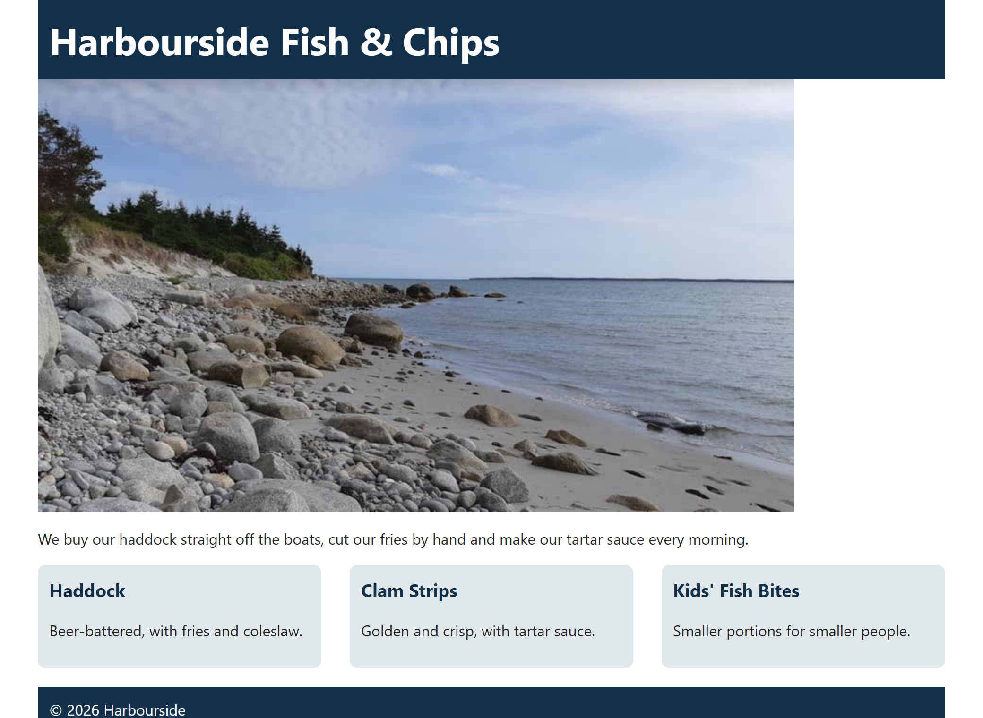
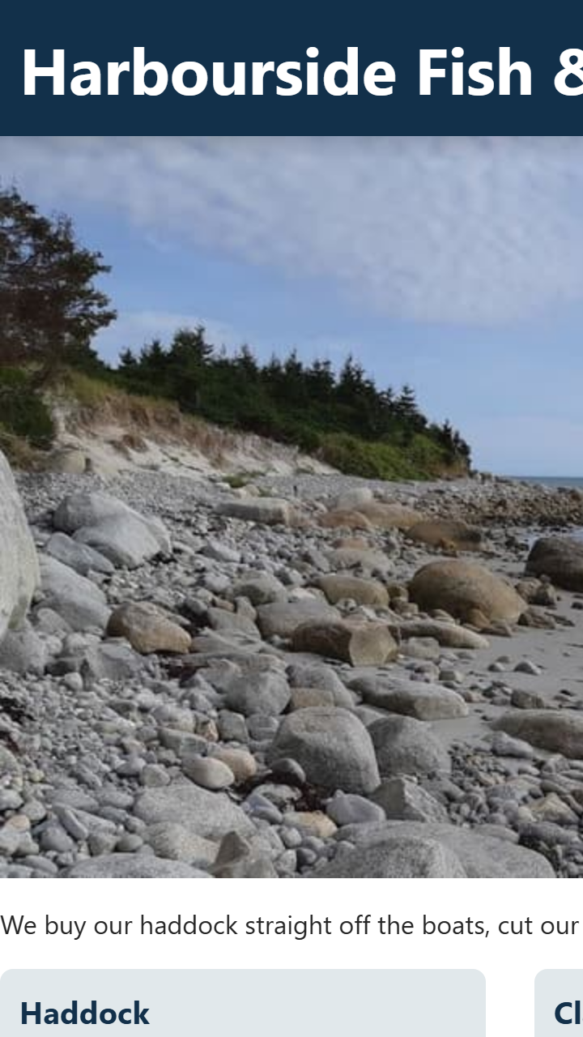
THE PROBLEM · EXAMPLE 01
A Page That Doesn't Fit
/* 1. A fixed width: always 960px */
.container {
width: 960px;
margin: 0 auto;
}
/* 2. A fixed-size photo */
.photo {
display: block;
width: 800px;
}
/* 3. Three fixed columns */
.cards {
display: grid;
grid-template-columns: 300px 300px 300px;
gap: 30px;
}
​Every size here is in pixels, so nothing can shrink.
​On a phone you only see part of the page, and you have to scroll sideways.
WIDE
PHONE, 360PX
09_Responsive/01_fixed_layout_example.css
Notes:
Open 01_fixed_layout_example.html with Live Server. It looks fine on the classroom screen.
Now drag the window narrower, or use the device toolbar (Ctrl + Shift + M) and pick a phone. The right side of the page disappears and a sideways scrollbar shows up.
Three fixed things cause this: the 960px container, the 800px photo, and the three 300px columns. We'll fix each of them today. Students fix this very file in the Try Its at the end of class, so leave it broken.

Slide 10
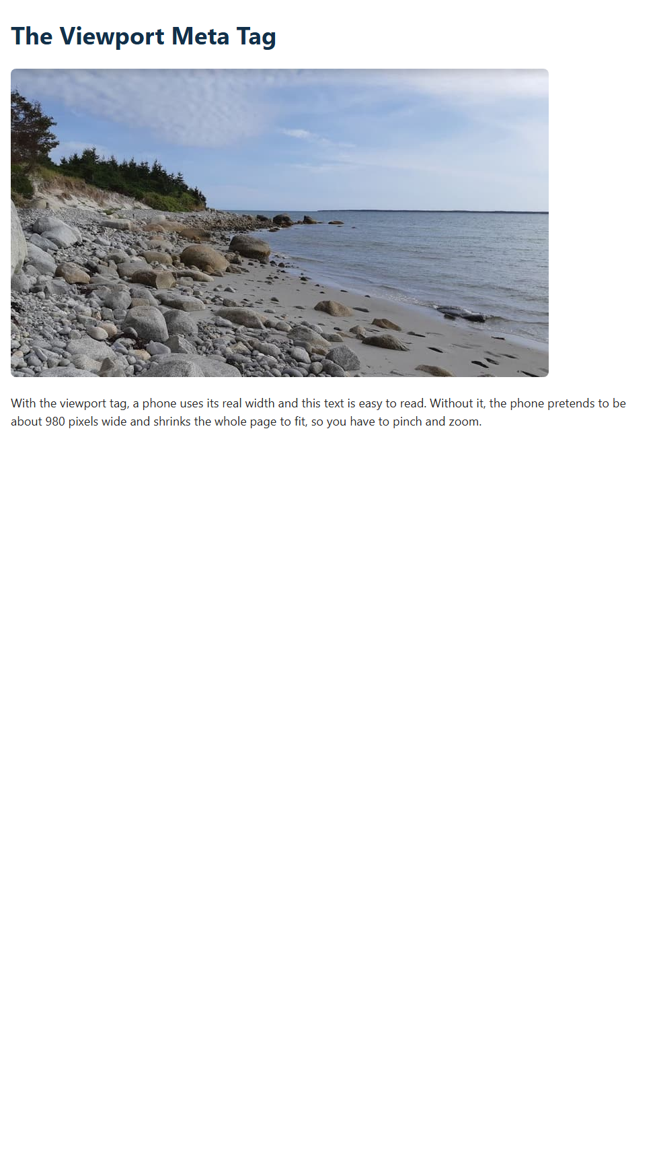
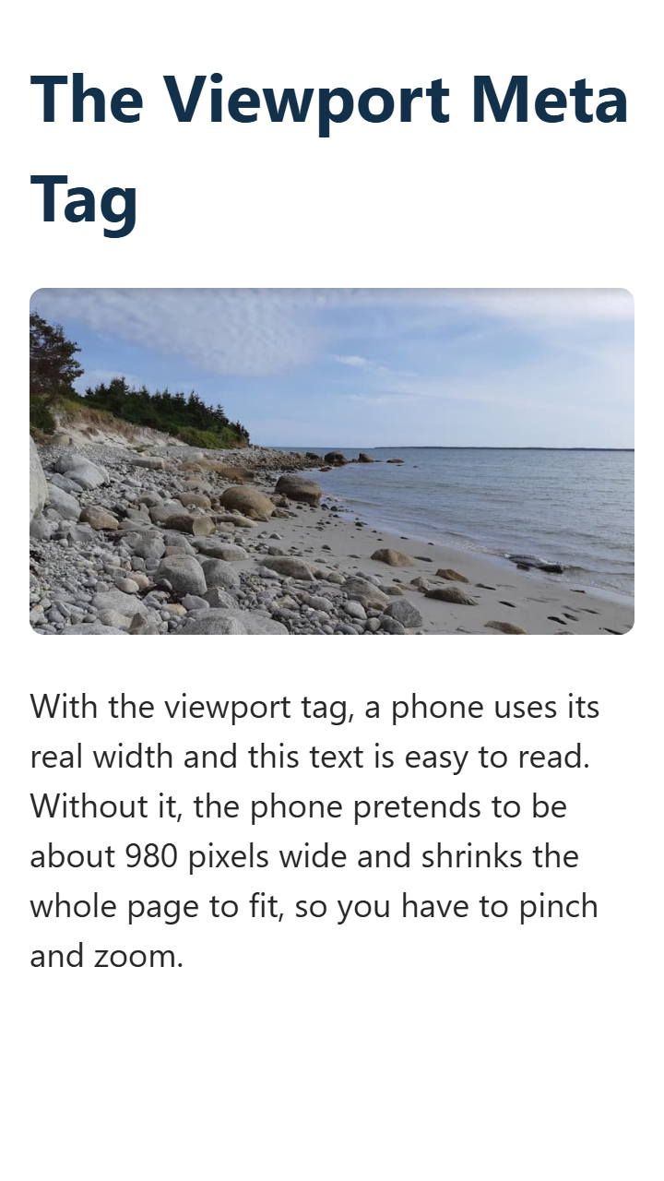
Week 9: Responsive Web Design
First: the Viewport Meta Tag
<meta name="viewport"
content="width=device-width, initial-scale=1.0">
WITHOUT IT
WITH IT
​Without it: the phone lays the page out about 980px wide, then shrinks it.
​With it: the page uses the phone's real width.
​In every page you make. Example 02.
Notes:
This one line has been in the head of our example pages for a while. Today we find out what it does.
Open 02_viewport_example.html, turn on the device toolbar and pick a phone. Then comment out the meta tag, save and reload. Everything shrinks to tiny text.
Why: the first smartphones had to show sites built for desktops, so a phone pretends to be about 980 pixels wide and shrinks the page to fit. This tag says: this page is ready for phones, so use the device's real width.
width=device-width: make the layout as wide as the screen. initial-scale=1.0: don't zoom in or out when the page loads.
Without it, media queries don't work as you'd expect either: a phone that thinks it's 980 pixels wide never matches max-width: 768px.
The left picture is a true 980-pixel layout, shown at phone size, to match what a phone does.
Never add maximum-scale=1 or user-scalable=no: they stop people zooming in.

Slide 11
?
POP QUIZ 1
​You forgot the viewport meta tag. What happens when someone opens your page on a phone?
​The browser shows an error
​The page lays out about 980px wide and shrinks to fit, so the text is tiny
A
B
​The page looks the same, because the tag only affects search engines
​All of your CSS is ignored
C
D
Vote: hold up 1, 2, 3 or 4 fingers (A to D), or type your letter in the Teams chat. 30 seconds!
Notes:
A quick check straight after the demo. Option C is the common guess, because it's in the head with the other 'meta' tags.

Slide 12
?
POP QUIZ 1: ANSWER
​You forgot the viewport meta tag. What happens when someone opens your page on a phone?
​The browser shows an error
​The page lays out about 980px wide and shrinks to fit, so the text is tiny
A
✓
​The page looks the same, because the tag only affects search engines
​All of your CSS is ignored
C
D
Why?
​Phones do this so older desktop sites can still be seen in full.
​width=device-width tells the phone that the page is ready for its real width.
Notes:
Answer: B.
No error, and the CSS still works. Which is why it's easy to miss: the page looks fine on a laptop, and it's only on a real phone or in the device toolbar that you notice.

Slide 13
+
Media Queries
•
○
+
Asking the screen a question · breakpoints · the order of your CSS
•
○
Notes:
A media query is CSS that only applies when a condition is true. This is the part of responsive design people usually think of first.

Slide 14
Week 9: Responsive Web Design
Media Queries in 7 Minutes
Learn CSS Media Query In 7 Minutes
Web Dev Simplified on YouTube
https://www.youtube.com/watch?v=yU7jJ3NbPdA
Listen for:
@media
max-width
min-width
Notes:
Click the dark box (or the link) to open the video. It's the same one as in last year's slides.
Tell students not to take notes yet: the next few slides go through the same ideas, slowly, and they'll write their own in the Try Its.

Slide 15
Week 9: Responsive Web Design
Reading a Media Query
@media (max-width: 768px) {
body {
font-size: 14px;
}
}
@media
​Starts a media query.
(max-width: 768px)
​The question: is the window 768px or narrower?
{ ... }
​Normal CSS rules, used only when the answer is yes.
It can also ask about height, orientation, or printing. Width is the one you'll use most.
Notes:
Read it out as a sentence: 'If the window is 768 pixels wide or narrower, make the body text 14 pixels.'
Inside the curly braces it's just normal CSS rules, as many as you like. That's why there are two levels of braces, and why people forget to close the outer one.
A media query can also ask about height and orientation (portrait or landscape), or whether the page is being printed (@media print). Width is the one students will use nearly every time.
The width it checks is the browser window's, not the size of the device. That's why dragging the window on a laptop works for testing.

Slide 16
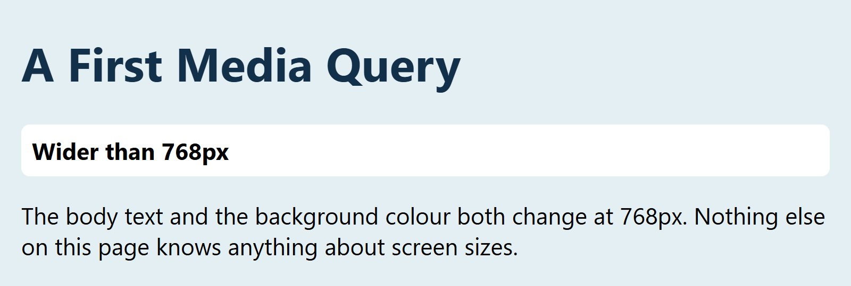
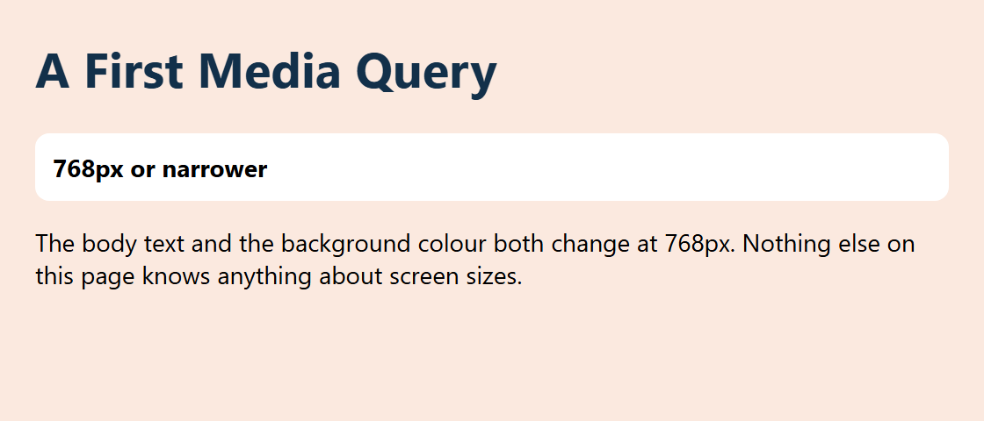
MEDIA QUERIES 1 · EXAMPLE 03
/* 1. The normal styles: used at every width */
body {
font-family: "Segoe UI", Arial, sans-serif;
margin: 20px;
font-size: 22px;
background-color: #E4EFF3;
}
.status::before {
content: "Wider than 768px";
}
/* 2. Only when the window is 768px or narrower */
@media (max-width: 768px) {
body {
font-size: 14px;
background-color: #FBE9DF;
}
.status::before {
content: "768px or narrower";
}
}
A First Media Query
​The normal rules apply at every width. The query's rules win when it's true.
800PX WIDE
560PX WIDE
09_Responsive/03_media_query_example.css
Notes:
Open 03_media_query_example.html and slowly drag the window narrower. At 768px the background and the text size change, all at once.
The label on the page changes too: that's the ::before pseudo-element from Class 9, with different content in each state.
Try it live: change 768px to 500px and save. Now the change happens later. Then change the colour inside the media query, so students can see it's just normal CSS.
The device toolbar shows the exact width at the top of the page, which helps when you're hunting for a breakpoint.

Slide 17
?
POP QUIZ 2
​At which window widths does this background turn pink?
​Only at exactly 768px
A
​At 768px and narrower
B
@media (max-width: 768px) {
body {
background: pink;
}
}
​At 768px and wider
C
​At every width
D
Vote: hold up 1, 2, 3 or 4 fingers (A to D), or type your letter in the Teams chat. 30 seconds!
Notes:
'Max' trips people up, because it sounds like big screens. Say it this way: the biggest window this applies to is 768px.

Slide 18
?
POP QUIZ 2: ANSWER
​At which window widths does this background turn pink?
A
​Only at exactly 768px
✓
​At 768px and narrower
C
​At 768px and wider
@media (max-width: 768px) {
body {
background: pink;
}
}
D
​At every width
Why?
​max-width: 768px means the window can be, at most, 768px.
​So the rule applies at 768px, and at everything narrower.
Notes:
Answer: B.
And the opposite: min-width: 768px means at least 768px, so 768px and wider. Next, breakpoints use both.

Slide 19
Week 9: Responsive Web Design
Breakpoints
A breakpoint is a screen width where your layout changes.
Phone
Tablet
Desktop
Big screen
up to 480px
481px to 768px
769px and up
1200px and up
max-width
min-width
Desktop first
Phones first
Start with the big layout. Change things as the window gets smaller.
Start with the phone layout. Add to it as the window gets bigger.
​Tip: these are starting points. Add a breakpoint where your layout starts to look wrong.
Notes:
A breakpoint is a width where the layout changes.
These are the common values from last year's slides. Treat them as starting points: there are hundreds of screen sizes, and they keep changing. A better habit: drag the window, and add a breakpoint where your own layout starts to look wrong.
Two ways to write them:
- max-width (desktop first): write the big-screen layout, then change things as the window gets smaller.
- min-width (mobile first): write the phone layout, then add to it as the window gets bigger.
Both work. Phone CSS tends to be simpler, so mobile first usually means less code, and that's how Example 04 and Week 8's Example 17 are written. The page students fix today uses max-width, because they're starting from a page that's already a desktop layout.

Slide 20
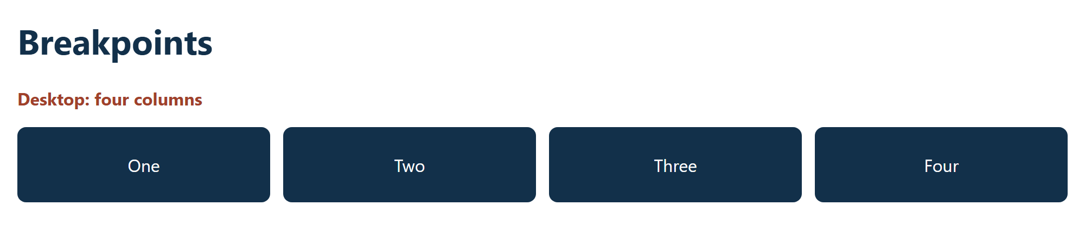
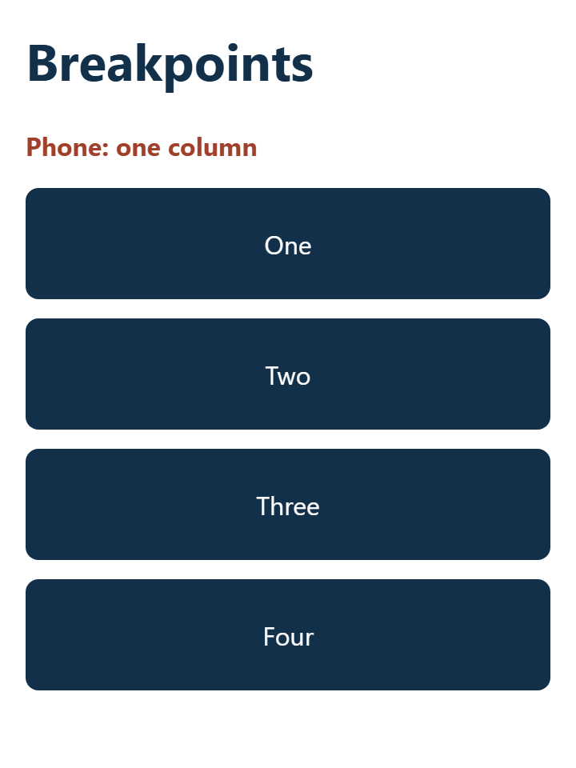
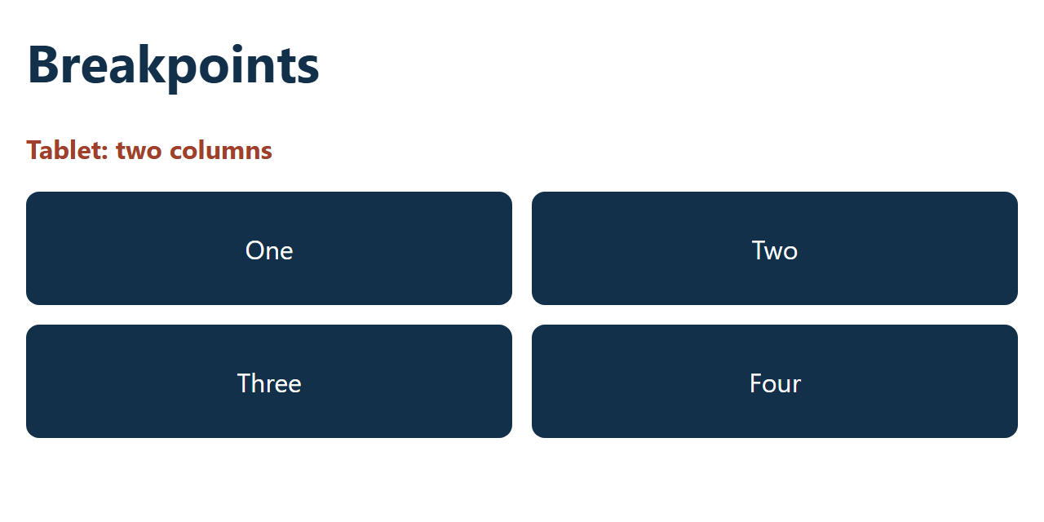
MEDIA QUERIES 2 · EXAMPLE 04
/* 1. Phones first: no media query, one column */
.cards {
display: grid;
gap: 12px;
grid-template-columns: 1fr;
}
.status::before {
content: "Phone: one column";
}
/* 2. Tablets: 481px and wider, two columns */
@media (min-width: 481px) {
.cards {
grid-template-columns: repeat(2, 1fr);
}
.status::before {
content: "Tablet: two columns";
}
}
/* 3. Desktops: 769px and wider, four columns */
@media (min-width: 769px) {
.cards {
grid-template-columns: repeat(4, 1fr);
}
.status::before {
content: "Desktop: four columns";
}
}
Phones First
​The phone layout needs no media query. It's the starting point.
​Each min-width query adds to the one before it.
​The 1200px rule is in the file too: it stops the page growing.
1000PX
360PX
640PX
09_Responsive/04_breakpoints_example.css
Notes:
Open 04_breakpoints_example.html and drag the window from narrow to wide: one column, two columns, four columns. The line under the heading says which rule is on.
Read the CSS from the top down. No media query means it applies everywhere, so that's the phone layout. At 481px and up, the second block also applies and overrides the columns. At 769px and up, the third block also applies, and it overrides the second one because it comes later.
Part 4 of the file (not on the slide) sets width: 1170px from 1200px up, with margin: 0 auto. That's the 'big screen' case: long lines of text and huge cards get hard to read.
These blocks only work in this order, smallest first. That's the next quiz.

Slide 21
?
POP QUIZ 3
​You check this page on a phone. How big is the h1?
​20px, because the media query matches
A
@media (max-width: 768px) {
h1 {
font-size: 20px;
}
}
h1 {
font-size: 40px;
}
​40px, because the last rule wins
B
​30px, halfway between the two
C
​It depends on the phone
D
Vote: hold up 1, 2, 3 or 4 fingers (A to D), or type your letter in the Teams chat. 30 seconds!
Notes:
This is the most common media query bug. The query is correct, and DevTools shows it matching, but the rule is crossed out.
It's the cascade at work.

Slide 22
?
POP QUIZ 3: ANSWER
​You check this page on a phone. How big is the h1?
A
​20px, because the media query matches
✓
​40px, because the last rule wins
@media (max-width: 768px) {
h1 {
font-size: 20px;
}
}
h1 {
font-size: 40px;
}
C
​30px, halfway between the two
D
​It depends on the phone
Why?
​A media query adds no specificity, so both rules tie.
​When rules tie, the later one wins. Keep media queries after the rules they change.
Notes:
Answer: B.
Demo it: in any example, move a media query above the rule it changes, and watch it stop working. In DevTools, the Styles panel shows the 20px rule crossed out.
The habit: put media queries at the bottom of the stylesheet.

Slide 23
+
Fluid Layouts
•
○
+
Percentages, not pixels · the padding trap
•
○
Notes:
Media queries change the layout at a few set widths. Fluid layouts take care of all the widths in between, so the page keeps fitting as the window changes.

Slide 24
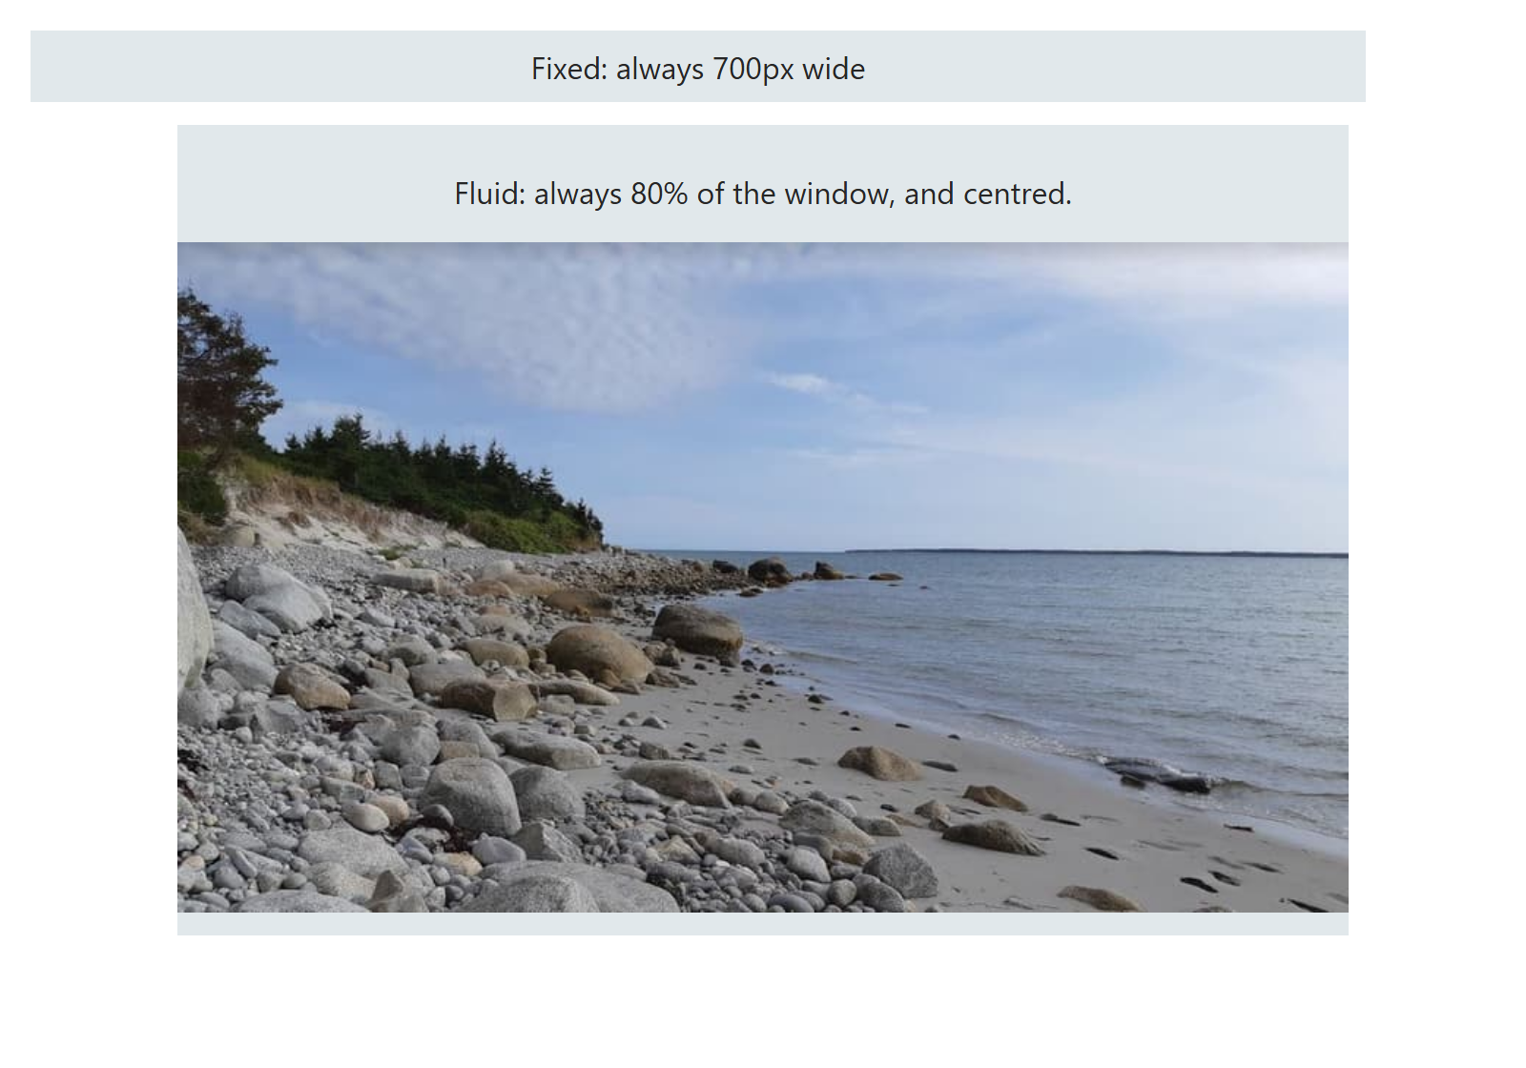
FLUID 1 · EXAMPLE 05
Percentages, Not Pixels
/* 1. Fixed: a pixel width ignores the window */
.fixed {
width: 700px;
}
/* 2. Fluid: a percentage follows the window */
.container {
width: 80%;
margin-left: auto;
margin-right: auto;
}
/* 3. The photo fits, and keeps its shape */
.container img {
max-width: 100%;
height: auto;
}
​A percentage width resizes with the window, so there's no sideways scrolling.
​margin: auto on the sides centres it.
RESULT
09_Responsive/05_fluid_layout_example.css
Notes:
Open 05_fluid_layout_example.html and drag the window narrower (the picture leaves out the padding trap at the bottom of the page, which is coming up next). The grey fixed box stays at 700px and starts sticking out. The fluid box keeps shrinking.
A percentage is a percentage of the parent. Here the parent is the body, so 80% of the body's width.
Practical tips from this one:
- Use percentages for containers.
- Keep images inside them with max-width: 100% (more on that soon).
- Grid's fr units and flexbox from last week are fluid too.
max-width is a useful partner: width: 80% plus max-width: 1170px means 'fluid, but stop growing at some point'. Example 08 does that.

Slide 25
?
POP QUIZ 4
​On a 360px phone, how wide is this .container box?
​330px
A
​345px
B
.container {
width: 100%;
padding: 0 15px;
}
​360px
C
​390px
D
Vote: hold up 1, 2, 3 or 4 fingers (A to D), or type your letter in the Teams chat. 30 seconds!
Notes:
The box model, coming back at exactly the moment it matters. Most students will say 360px. Let them vote before you say anything.
This is the code from last year's slides, and it's in a lot of real sites. It's only a problem without box-sizing.

Slide 26
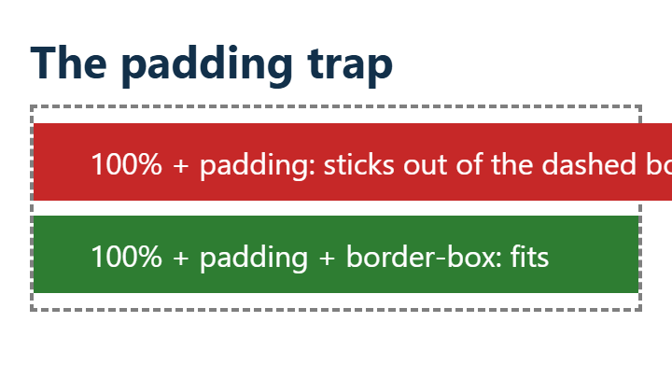
?
POP QUIZ 4: ANSWER
​On a 360px phone, how wide is this .container box?
WHAT THE BROWSER DOES
A
​330px
B
​345px
C
​360px
✓
​390px
Why?
​By default, width doesn't include padding. So it's 360 + 15 + 15 = 390px.
​That's 30px too wide, and now the page scrolls sideways.
Notes:
Answer: D.
The screenshot is the bottom of Example 05 at 360px. The red box has width: 100% and padding, and it sticks out of the dashed box. The green one has box-sizing: border-box as well, and fits.
The fix is on the next slide.

Slide 27
FLUID 2 · EXAMPLE 05
The Padding Trap
​box-sizing: border-box keeps padding and borders inside the width.
/* 4. The trap: padding goes ON TOP of 100% */
.wrong {
width: 100%;
padding: 10px 30px;
}
/* 5. The fix: padding stays inside the width */
.right {
width: 100%;
padding: 10px 30px;
box-sizing: border-box;
}
A PHONE (360PX)
09_Responsive/05_fluid_layout_example.css
Notes:
This is the bottom of 05_fluid_layout_example.html at phone width. Same width, same padding. The only difference is one line.
With border-box, width: 100% means the whole box, padding included, is 100%. The browser takes the padding out of the content area.
Many developers put this at the top of every stylesheet:
* { box-sizing: border-box; }
That's fine for students to do too.

Slide 28
+
Images, Video and Text
•
○
+
max-width: 100% · aspect-ratio · vw and clamp()
•
○
Notes:
The layout fits now. What's left is what goes inside it: images, video and text.

Slide 29
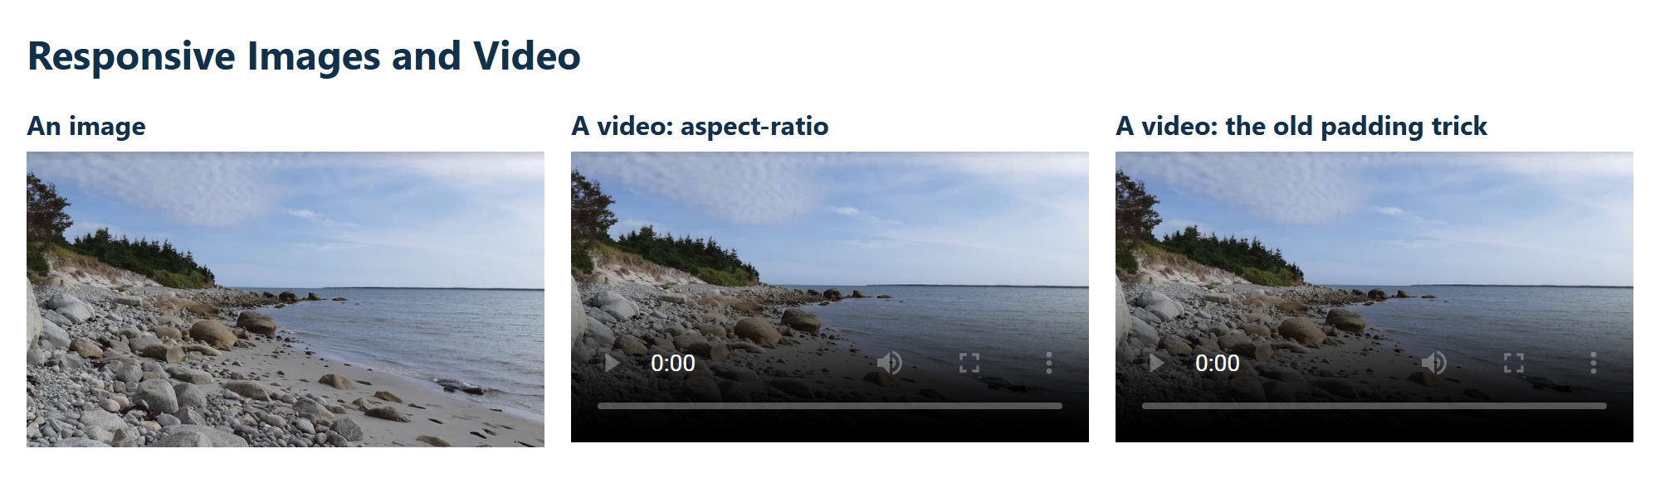
MEDIA 1 · EXAMPLE 06
Responsive Images
​max-width: 100%: never wider than the container.
​height: auto: keep the shape, so it isn't squashed.
​Keep the HTML's width and height, so the page doesn't jump as it loads.
/* 1. An image: never wider than its container */
.photo {
max-width: 100%;
height: auto;
}
RESULT
09_Responsive/06_responsive_media_example.css
Notes:
Open 06_responsive_media_example.html and drag the window narrower. The photo shrinks with its column.
Why max-width and not width? width: 100% would stretch a small image to fill the container, and it would look blurry. max-width: 100% lets it shrink but never grow past its real size.
Without height: auto, the height from the HTML attribute (458) would stay put while the width shrinks, and the photo would look squashed. Try it live: delete height: auto.
The width and height attributes on the img tag tell the browser the shape before the file arrives, so it can save the right amount of space.

Slide 30
MEDIA 2 · EXAMPLE 06
Responsive Video
/* 2. A video, today's way: keeps its 16:9 shape */
.video {
width: 100%;
aspect-ratio: 16 / 9;
}
/* 3. A video, the old way, from older code */
.video-container {
position: relative;
padding-bottom: 56.25%; /* 9 / 16 = 56.25% */
height: 0;
overflow: hidden;
}
.video-container video {
position: absolute;
top: 0;
left: 0;
width: 100%;
height: 100%;
}
​aspect-ratio does the job in one line. Use this one.
​You'll still see the old padding-bottom trick in older code, and in code copied from the web.
RESULT
09_Responsive/06_responsive_media_example.css
Notes:
Videos and iframes don't keep their shape the way images do, so they need help.
Today's way: width: 100% and aspect-ratio: 16 / 9. The browser works out the height from the width. Every current browser supports it. It works on a YouTube iframe too.
The old way, from last year's slides, is worth recognizing:
- padding-bottom: 56.25%: percentage padding is based on the parent's WIDTH, and 9 divided by 16 is 56.25%. So the padding makes a box that's always 16:9.
- height: 0, so the padding is the only height there is.
- The video is positioned absolutely, to fill that padding.
It's clever, and it isn't needed any more. For another shape, like 4:3, you'd use 3 / 4 = 75%.
The videos in this example have a poster image and no video file, so the repo stays small and nothing needs the internet. The comment in the HTML shows how to add a real one.

Slide 31
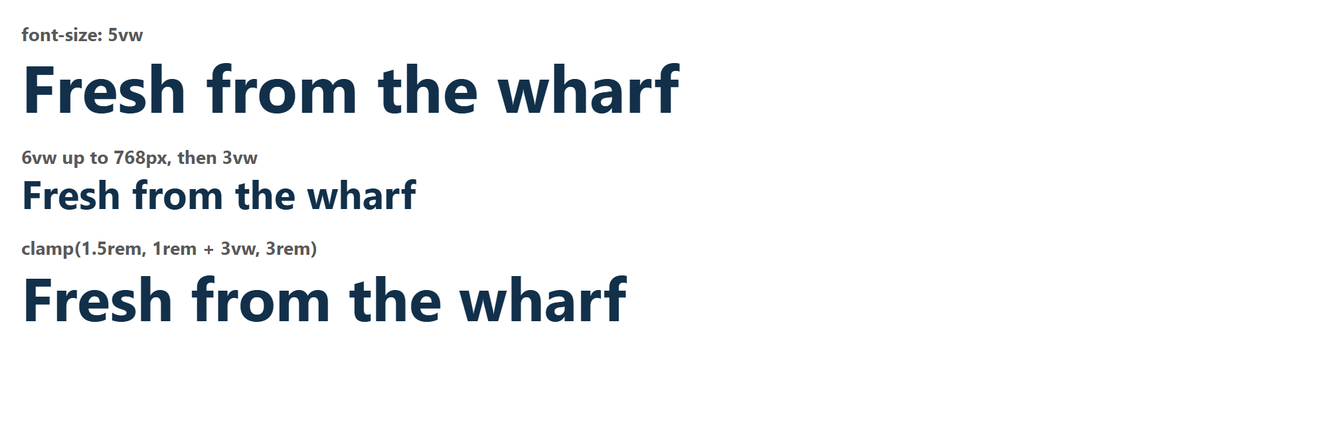
TEXT 1 · EXAMPLE 07
Fluid Typography
​1vw is 1% of the window's width: at 1000px, 5vw is 50px.
​Text scales with the window, with no media query.
​But it has no limits: tiny on a phone, huge on a big screen.
/* 1. vw: 1vw is 1% of the window's width */
.vw-only {
font-size: 5vw;
}
1000PX WIDE
09_Responsive/07_fluid_type_example.css
Notes:
Open 07_fluid_type_example.html and look at the top line while you drag the window. It scales smoothly.
The arithmetic: 5vw on a 1000px window is 50px. On a 360px phone it's 18px. On a 2000px monitor it's 100px.
A more serious problem: text sized only in vw doesn't get bigger when you zoom the browser (try Ctrl and +), because the window's width in CSS pixels shrinks as you zoom. People who need to zoom in can't. That's an accessibility failure, WCAG 1.4.4 (Resize Text).
So plain vw isn't enough. Next, two ways to control it.

Slide 32
?
POP QUIZ 5
​You drag the window from 768px to 769px, just 1px wider. What happens to the h1?
​It stays about the same
A
@media (max-width: 768px) {
h1 {
font-size: 6vw;
}
}
@media (min-width: 769px) {
h1 {
font-size: 3vw;
}
}
​It gets a tiny bit bigger
B
​It suddenly gets about half as big
C
​It suddenly gets about twice as big
D
Vote: hold up 1, 2, 3 or 4 fingers (A to D), or type your letter in the Teams chat. 30 seconds!
Notes:
Last year's slides use this exact code to combine vw with media queries, and it does work to set a different size for phones and desktops. But work out the arithmetic at the breakpoint with the class.
They can use a calculator. 768 x 6% and 769 x 3%.

Slide 33
?
POP QUIZ 5: ANSWER
​You drag the window from 768px to 769px, just 1px wider. What happens to the h1?
A
​It stays about the same
B
​It gets a tiny bit bigger
@media (max-width: 768px) {
h1 {
font-size: 6vw;
}
}
@media (min-width: 769px) {
h1 {
font-size: 3vw;
}
}
✓
​It suddenly gets about half as big
D
​It suddenly gets about twice as big
Why?
​At 768px: 6vw is about 46px. At 769px: 3vw is about 23px.
​The window got bigger, and the heading got smaller! The next slide has a fix.
Notes:
Answer: C.
Demo it in Example 07: watch the middle line while you drag slowly across 768px. It's a real jump. It also means the heading is smaller on a 1000px laptop (30px) than on a 768px tablet (46px).
You can fix that by picking better numbers, or use clamp().

Slide 34
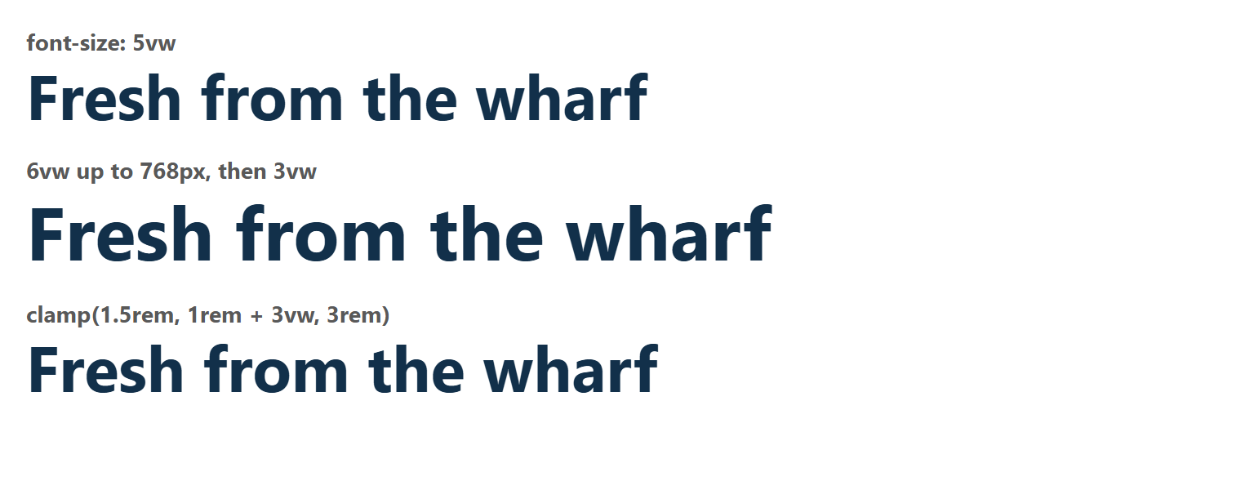
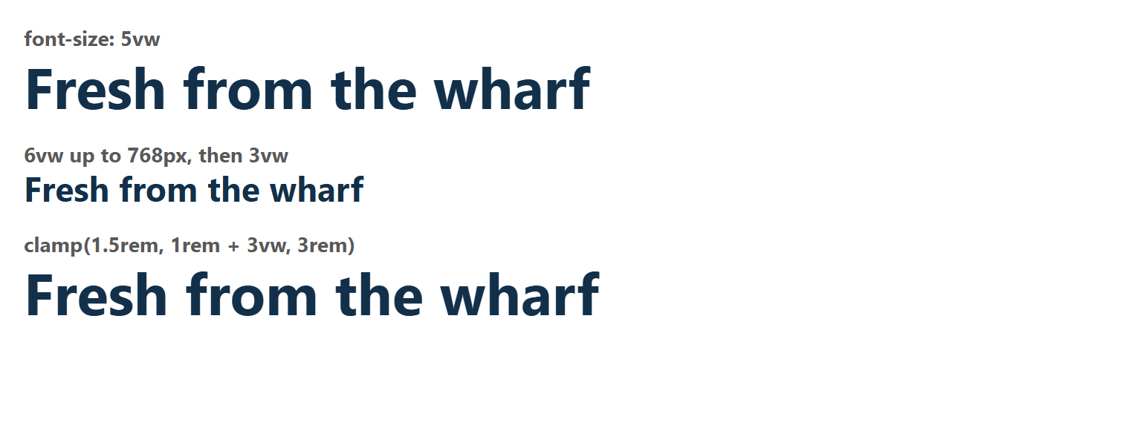
TEXT 2 · EXAMPLE 07
clamp(): Fluid, With Limits
​clamp(smallest, fluid, biggest) sets a floor and a ceiling.
​Mix in rem so the text still grows when people zoom.
​Look at the pictures: only the middle line jumps.
/* 3. clamp(smallest, fluid, biggest) */
.fluid {
font-size: clamp(1.5rem, 1rem + 3vw, 3rem);
}
768PX
769PX
09_Responsive/07_fluid_type_example.css
Notes:
clamp takes three values: a minimum, the size you'd like, and a maximum.
clamp(1.5rem, 1rem + 3vw, 3rem):
- never smaller than 1.5rem (24px by default)
- never bigger than 3rem (48px)
- in between, 1rem + 3vw. You can do arithmetic inside clamp, without calc().
At 768px: 16 + 23 = 39px. At 360px: 16 + 11 = 27px. At 2000px: it would be 76px, but it stops at 48px.
The 1rem in the middle is what helps zooming, because rem grows with the browser's zoom and text size settings.
The pictures are Example 07 at 768px and 769px, one pixel apart. The top and bottom lines barely change, and the middle one halves.
Students don't need to memorize the numbers: 1rem + 3vw is a fine default to copy for headings. Body text can stay in rem with no vw at all.

Slide 35
+
Putting It Together
•
○
+
Example 01, made responsive · then your turn
•
○
Notes:
Everything from today, on one page. It's the same page as Example 01, with the same HTML, and it's what students are about to build.

Slide 36
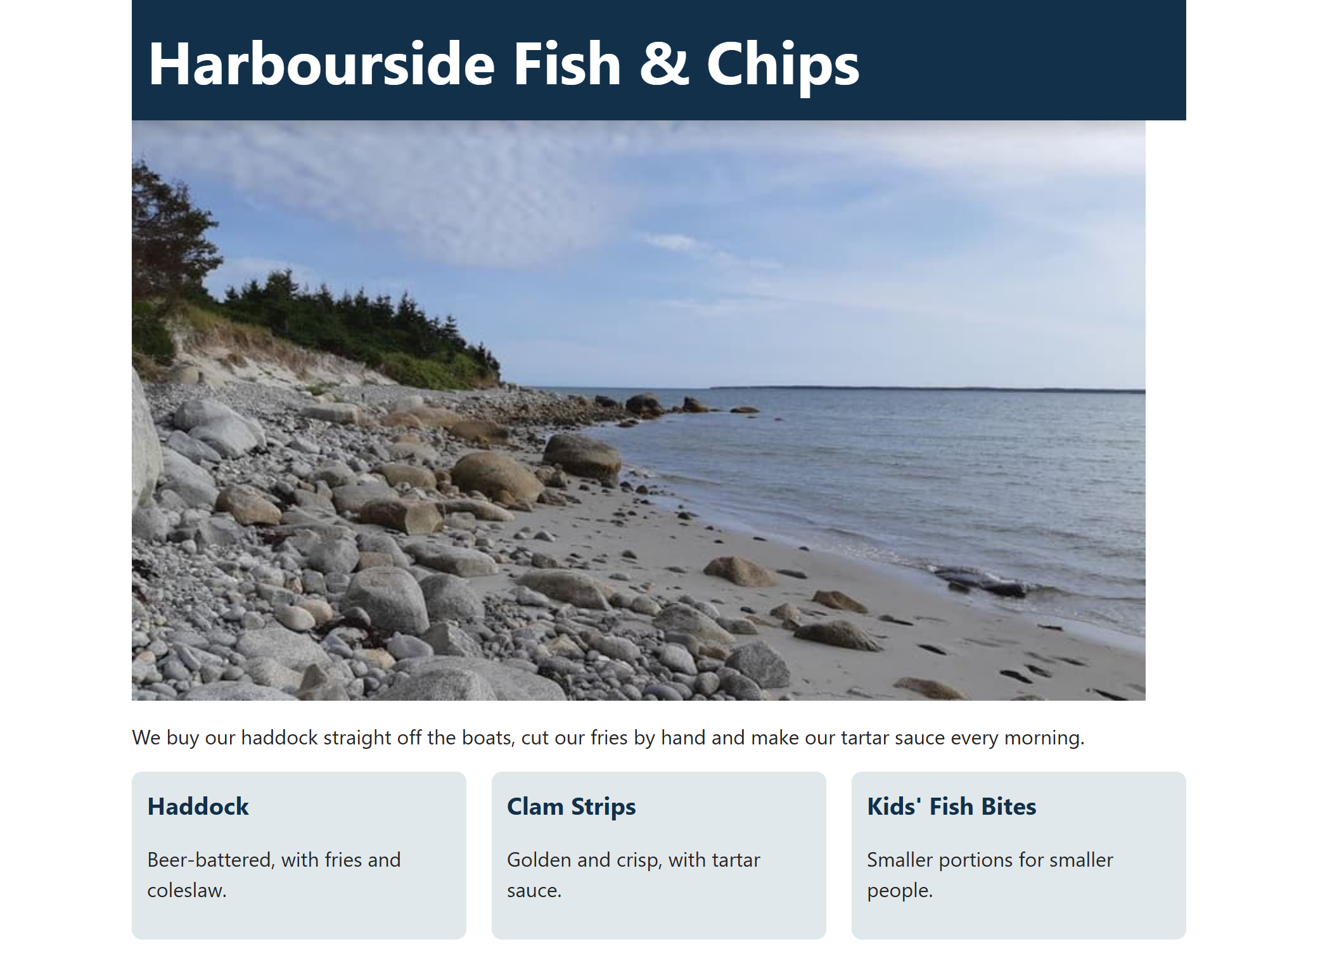
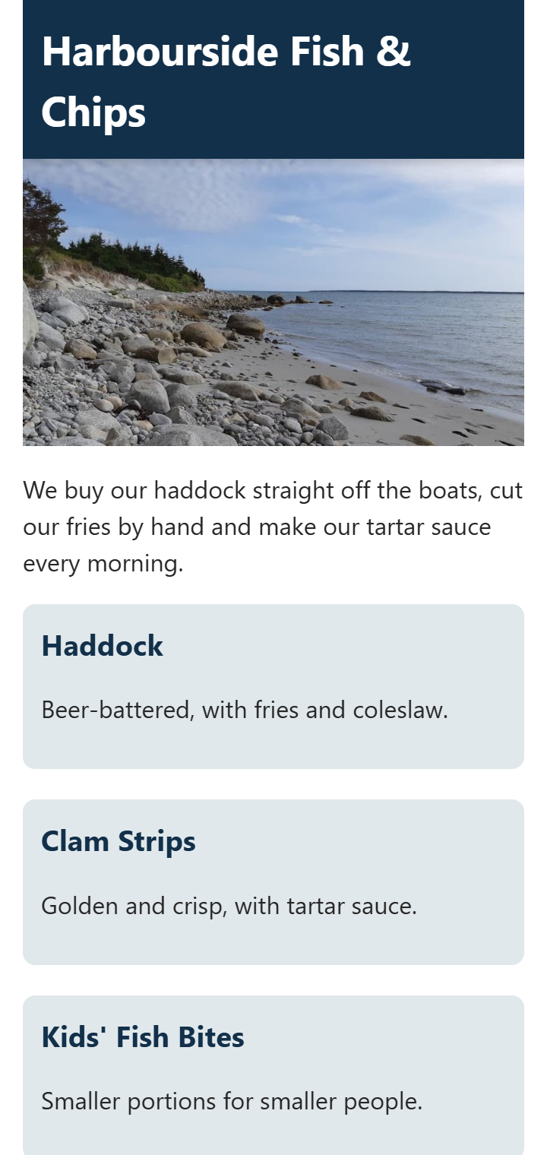
PRACTICAL EXAMPLE · EXAMPLE 08
Same HTML as Example 01
​A simple page in a container. Only the CSS changed.
​Good HTML doesn't need to change for a phone.
<div class="container">
<header>
<h1>Harbourside Fish &amp; Chips</h1>
</header>
<section>
<img class="photo" src="images/harbour.jpg"
width="800" height="458"
alt="Rocky beach with calm water and a tree-lined point">
<p>We buy our haddock straight off the boats,
cut our fries by hand and make our tartar
sauce every morning.</p>
</section>
...
</div>
WIDE
PHONE, 360PX
09_Responsive/08_responsive_page_example.html
Notes:
Open 08_responsive_page_example.html next to 01_fixed_layout_example.html, and drag both narrower.
The point of this slide: the HTML files are the same, apart from the title, the stylesheet link and one comment. Responsive design is nearly all CSS, as long as the HTML is clean and in a sensible order. That's a good reminder of why semantic HTML, in reading order, was worth doing.

Slide 37
PRACTICAL EXAMPLE · EXAMPLE 08
/* 1. Fluid: 80% wide, up to a limit */
.container {
width: 80%;
max-width: 1170px;
margin: 0 auto;
box-sizing: border-box;
}
/* 2. A photo that fits its container */
.photo {
display: block;
max-width: 100%;
height: auto;
}
/* 3. Three columns that share the space */
.cards {
display: grid;
grid-template-columns: repeat(3, 1fr);
gap: 20px;
}
/* 4. A heading that grows, within limits */
h1 {
font-size: clamp(1.5rem, 1rem + 3vw, 3rem);
}
/* 5. Tablets and phones. Keep this last! */
@media (max-width: 768px) {
.container {
width: 100%;
padding: 0 15px;
}
.cards {
grid-template-columns: 1fr;
}
}
All the CSS It Took
​Everything from today: fluid width, a fitted photo, clamp(), and one media query, last.
A PHONE (360PX)
09_Responsive/08_responsive_page_example.css
Notes:
Walk through the numbered comments, and link each one back to its section:
1. Fluid container, with a max-width and box-sizing. 80% on a big screen, 100% on a small one.
2. The photo.
3. Three columns with fr instead of pixels.
4. clamp() for the heading.
5. One media query at the very end.
The media query includes width: 100% with padding, which is the padding trap, and box-sizing: border-box in part 1 is what makes it safe.
That's about 30 lines to fix the whole page. Don't dwell here: students are about to type it.

Slide 38
Try It 1: A Fluid Page (8 min)
1
Open Example 01
REPLACE PARTS 1 TO 3 IN THE CSS FILE
​Open the html with Go Live, and the css beside it. Using your own page is fine too.
/* 1. Fluid: 80% wide, up to a limit */
.container {
width: 80%;
max-width: 1170px;
margin: 0 auto;
box-sizing: border-box;
}
/* 2. A photo that fits its container */
.photo {
display: block;
max-width: 100%;
height: auto;
}
/* 3. Three columns that share the space */
.cards {
display: grid;
grid-template-columns: repeat(3, 1fr);
gap: 20px;
}
2
Be a phone
​F12, then Ctrl + Shift + M. Scroll sideways: that's the problem.
3
Change the CSS
​Replace parts 1, 2 and 3 with the code on the right. Save.
4
Check it
​The photo and the container now fit, but the three columns get squished. That's next.
Notes:
Students work directly in 01_fixed_layout_example.css. The finished version is Example 08, so anyone who's stuck can look there.
The old activity was 'create a simple web page', so anyone who'd rather use their own page can do that. They'll need a fluid layout, a responsive image and a media query.
Expect this: after Try It 1, at phone width, there are still three squished columns. That's right, and the media query in Try It 3 fixes it.

Slide 39
Try It 2: A Fluid Heading (3 min)
1
Change the CSS
​Replace part 4 with the code on the right. Save.
2
Drag the window
​The heading grows and shrinks smoothly.
REPLACE PART 4 IN THE CSS FILE
3
Play with it
​Change 3vw to 5vw. Or change the limits. When does it stop growing?
/* 4. A heading that grows, within limits */
h1 {
font-size: clamp(1.5rem, 1rem + 3vw, 3rem);
}
Notes:
A quick one. It's fine to copy the formula.
To see the limits: drag the window to full width (it stops at 3rem) and then to a phone's width (it stops at 1.5rem).

Slide 40
Try It 3: A Media Query (8 min)
1
Type the CSS on the right
​At the very end of the file. Save.
ADD TO THE VERY END OF THE CSS FILE
/* 5. Tablets and phones. Keep this last! */
@media (max-width: 768px) {
.container {
width: 100%;
padding: 0 15px;
}
.cards {
grid-template-columns: 1fr;
}
}
2
Drag past 768px
​One column at 768px and narrower. Three columns above it.
3
Check for sideways scrolling
​At 360px there should be none. The page should still have side padding.
4
Make it yours
​Add one more change to the query: a colour, a font size, or a smaller gap.
​Not working? Check the two levels of }, and that the query comes after the rules it changes.
Notes:
The two usual problems:
- A missing closing brace. Everything after it stops working. The CSS validator will catch it.
- The query isn't last. That's Pop Quiz 3.
If the page scrolls sideways at 360px, check that box-sizing: border-box from Try It 1 is on .container.
Fast finishers: add a second breakpoint, with two columns between 481px and 768px. Or go back to Harbourside and do Try It 8 ('On a phone') from Grid_and_Float.pptx, in 08_Flex_Grid_CSS/activity.

Slide 41
Class Activity: Submit Your Page
WIDE
PHONE
Your page should have:
✓
A fluid layout
✓
Responsive images
✓
Media queries for different screen sizes
Then:
1
​Take two screenshots: wide, and at phone width (Ctrl + Shift + M).
2
​Drop them in the box on Week 9 Brightspace.
​Stuck? 08_responsive_page_example is the finished page.
Notes:
This is the activity from last year's slides: a simple page with a fluid layout, responsive images and media queries.
Students take the screenshots with the device toolbar, so the phone width shows. Its menu (the three dots on the toolbar) also has 'Capture screenshot'.
Check that the Brightspace box is set up before class.

Slide 42
Week 9: Responsive Web Design
Class Recap
What we covered:
  Responsive design: one site that works well on any screen.
  The viewport meta tag goes on every page.
  Media queries change the CSS at breakpoints. Keep them last.
  Fluid layouts use percentages, with box-sizing: border-box.
  img { max-width: 100%; height: auto; } and aspect-ratio for video.
  clamp() gives fluid text, with limits.
Notes:
Go through these quickly. If students remember three things: the viewport tag goes on every page, media queries go last, and use max-width: 100% on images.
Then the last slide: the one-sentence summary.

Slide 43
+
Write a one-sentence summary of what we did in today's class.
•
○
+
One sentence, in your own words.
•
○
Notes:
Give everyone a minute. They can write it on paper or post it in the Teams chat. Ask two or three people to read theirs out.
If the sentences mention media queries but nothing else, that's normal. Bring up fluid layouts next time.

