Slide 1
WEBD 1000
Class 10:
  Navigation menus, and tables for data like prices and opening hours.
HTML/CSS Techniques
Notes:
Welcome back! Last class: advanced selectors and CSS animation.
This week has two classes. Today is about the furniture every real site has: a navigation menu to get around, and tables for data like prices and opening hours. Next class (Class 11) we check our HTML and CSS with the W3C validators, then review Assignment 2.
We're back on the Harbourside page from Class 8. By the end of today it will have a real navigation bar with a dropdown and a styled opening-hours table.

Slide 2
Attendance
Notes:
Take attendance. While you do, have students git pull and open the 07_Navigation_Tables_Validation folder in VS Code.

Slide 3
HTML/CSS Techniques
Class 10: Class Overview
Title: Navigation Menus and Tables
Agenda:
  Navigation menus: horizontal, vertical and dropdown
  Tables for data: structure, styling, zebra stripes, small screens
  Harbourside, Part 2: Try Its 1 to 6
  Next class: validation (Try Its 7 and 8), then an Assignment 2 review
Navigate
→
Tabulate
→
Make it yours
A menu to get around
Data in rows and columns
Then save it for Class 11
Notes:
Rough plan for the two hours:
- 8 min: intro and getting the code
- 40 min: navigation menus (four examples, then Try Its 1 to 4)
- 30 min: tables (four examples, then Try Its 5 and 6)
- 15 min: make it yours, cheat sheet and recap
That's about 95 minutes, so there's room to go slowly on the dropdown (Try It 3 is the one people get stuck on) and to help anyone who's behind.
Every Try It adds to the same Harbourside page, so it builds up across the class, like Class 8. Students need to keep their page: Class 11 starts by validating it (Try Its 7 and 8), and the three screenshots are submitted after that.

Slide 4
HTML/CSS Techniques
Before We Start: Get the Code
1. Pull this week's examples
git pull
New folder: 07_Navigation_Tables_Validation (examples 01–12, and the activity folder).
2. Open each example with Live Server as we go
Hover the menus, press Tab, shrink the window. Change a value, save, and see what happens.
3. The activity: Harbourside, Part 2
activity/index.html and activity/style.css. Our Class 8 page, ready for a nav and a table.
Notes:
Examples 01–04 are navigation, 05–08 are tables, 09–10 are HTML validation and 11–12 are CSS validation. Every example is a single file with its CSS in a <style> block.
The activity folder is the Harbourside page from Class 8, with our finished Class 8 CSS already in style.css (tidied up). There's no nav yet, and the hours are still a bulleted list.
The starter index.html has 5 deliberate mistakes in it, and the Class 8 part of style.css has 3. Don't mention them yet! They're the surprises in Try Its 7 and 8.
Ask students not to open activity/answer until they're stuck.

Slide 5

+
Navigation Menus
•
○
+
Every menu is a list · horizontal · vertical · dropdown
•
○
Notes:
Every site you use has a navigation menu: the set of links that gets you around. It's often the first thing people look for, so it has to be easy to find, easy to read and easy to click (or tap, or Tab to).
The good news: every menu, however fancy, starts as the same plain HTML. The difference is all CSS.

Slide 6
HTML/CSS Techniques
Three Kinds of Menu
Starters
Home
Menu ▾
Contact
Home
Menu
Contact
Fish & Chips
Fish & Chips
Lobster
Lobster
Drinks
Kids' Menu
Horizontal
Vertical
Dropdown
Side by side across the top
Stacked down the side
A list inside a list
Use for: A few main links
Use for: Longer lists, sections
Use for: Grouping related pages
Same HTML every time:
<nav>
→
<ul>
→
<li>
→
<a>
Notes:
Horizontal: the classic bar across the top. Best for a handful of main links (about 3 to 7).
Vertical: a stack of links down the side. Good for longer lists: sections of a menu, account settings, documentation.
Dropdown: a horizontal bar where some items open a smaller list. Good for grouping related pages without making the bar too long.
On phones, a horizontal menu usually collapses into a 'hamburger' button (☰). That needs a little JavaScript, which we'll meet later in the program.
The key point is the bottom of the slide: all three are the same HTML structure. nav, then ul, then li, then a.

Slide 7

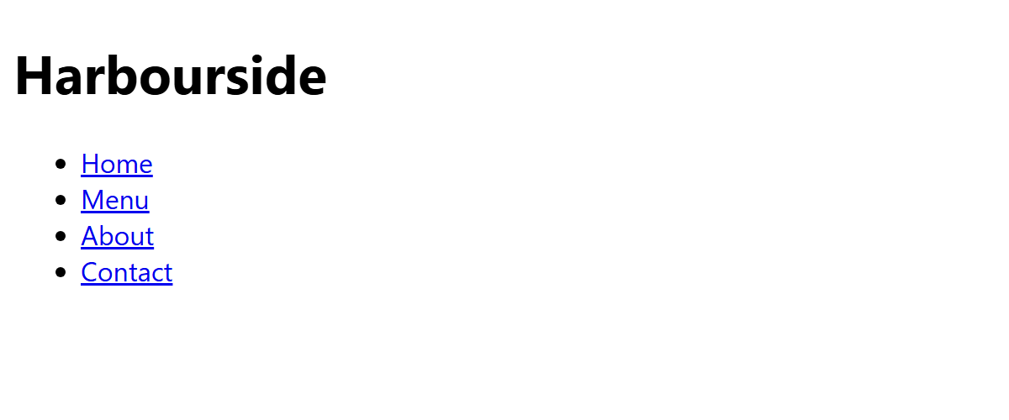
NAVIGATION 1 · EXAMPLE 01
Every Menu Is a List
​<nav> says "this is the main way around the site". Screen readers can jump straight to it.
​A <ul> of links, because a menu is a list. Screen readers say "list, 4 items".
​aria-label names it, if a page has more than one nav.
<header>
<h1>Harbourside</h1>
<!-- nav = "this is the main way around the site" -->
<nav aria-label="Main">
<ul>
<li><a href="#home">Home</a></li>
<li><a href="#menu">Menu</a></li>
<li><a href="#about">About</a></li>
<li><a href="#contact">Contact</a></li>
</ul>
</nav>
</header>
RESULT
01_nav_structure_example.html
Notes:
Open 01_nav_structure_example.html. With no CSS it's just a bulleted list of links. That's fine! It works, it's accessible, and it's the starting point for every menu we'll build.
Why a list? Because it is one: a group of related links. A screen reader announces 'navigation, list, 4 items', so the user knows how big the menu is before they start. A row of bare links or a pile of divs doesn't tell them that.
We met <nav> as a landmark in Class 4. Only use it for major navigation blocks (the main menu, maybe a table of contents), not for every group of links on the page. A link list in the footer doesn't need one.
On a real site the href values would be page names like menu.html or contact.html. Here they're # links so nothing breaks when you click.

Slide 8


NAVIGATION 2 · EXAMPLE 02
/* 1. Remove the bullets and the indent */
nav ul {
list-style: none;
margin: 0;
padding: 0;
/* 2. Put the items side by side (a sneak peek at Flexbox) */
display: flex;
gap: 4px;
}
/* 3. Make the whole link a big box that's easy to click */
nav a {
display: block;
padding: 14px 18px;
color: white;
text-decoration: none;
font-weight: bold;
}
nav a:hover,
nav a:focus-visible {
background-color: #1B5E82;
}
/* 4. Show which page you're on */
nav a[aria-current="page"] {
border-bottom: 4px solid #E97132;
}
A Horizontal Menu
​list-style: none and padding: 0 remove the bullets and the indent.
​display: flex puts the items side by side; gap spaces them. (A sneak peek: more on Flexbox next class.)
​display: block + padding on the a makes the whole box clickable, not just the word.
NORMAL
HOVER ON "ABOUT"
02_nav_horizontal_example.html
Notes:
Open 02_nav_horizontal_example.html. Walk through the four numbered comments; each one is one step from Example 01 to a real menu bar.
1. The bullets and indent go. (Last year's version of this slide used display: inline-block on each li, which also works. Flexbox is the modern way, and it lines things up more reliably.)
2. display: flex on the ul lays its children, the li's, out in a row. gap adds space between them, but not at the ends. We'll do Flexbox properly next class; today we just need these two lines.
3. Put the padding on the a, not the li, and make the a display: block. Then the whole coloured box is the link: a much bigger target for a mouse, and especially for a finger on a phone. WCAG 2.5.8 asks for targets of at least 24 by 24 pixels.
4. aria-current="page" tells screen readers 'you are here', and the attribute selector from Class 9 lets us style it too. One attribute does both jobs.
Try in class: comment out display: flex and save. The menu goes back to a stacked list.

Slide 9
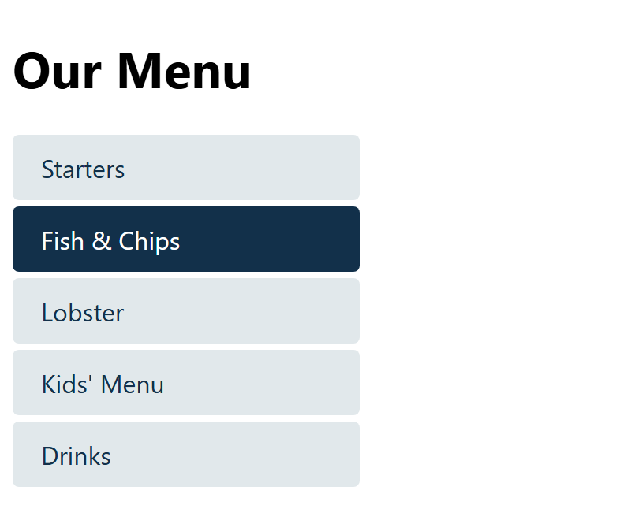
NAVIGATION 3 · EXAMPLE 03
nav ul {
list-style: none;
margin: 0;
padding: 0;
}
nav li {
margin-bottom: 4px;
}
/* display: block = the whole row is clickable, not just the words */
nav a {
display: block;
padding: 10px 14px;
background-color: #E1E8EB;
color: #12304A;
text-decoration: none;
border-left: 4px solid transparent;
border-radius: 4px;
}
nav a:hover,
nav a:focus-visible {
background-color: #FBE9DF;
border-left-color: #E97132;
}
nav a[aria-current="page"] {
background-color: #12304A;
color: white;
}
A Vertical Menu
​A list is already vertical. No flex needed: just remove the bullets and style the links.
​border-left that's transparent until you hover: the text doesn't jump sideways.
RESULT
03_nav_vertical_example.html
Notes:
Open 03_nav_vertical_example.html. This is the kind of menu you see down the side of a page: menu sections, account settings, a course's list of weeks in Brightspace.
Same starting point (remove the bullets), but no display: flex this time, because a list stacks vertically on its own.
The transparent border trick: the left border is always there, just invisible. On hover it changes colour. If the border only appeared on hover, the box would get 4px wider and the text would shift. Little details like this make a menu feel solid.
The 'current page' style is the strongest one (navy with white text), so you can see where you are at a glance.
The width: 220px on the nav keeps it narrow, like a sidebar. Placing it beside the page content is a layout job (Flexbox), coming next class.

Slide 10
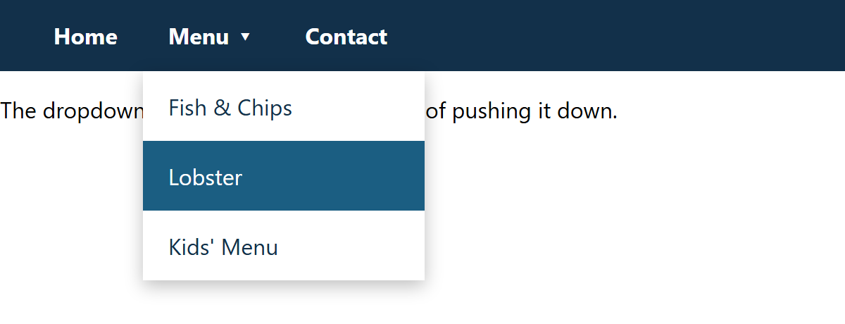
NAVIGATION 4 · EXAMPLE 04
A Dropdown Menu
/* 1. The dropdown is placed against its own li */
nav li {
position: relative;
}
/* 2. Hide the inner list, and float it above the page */
nav ul ul {
display: none;
position: absolute;
top: 100%;
left: 0;
min-width: 200px;
background-color: white;
box-shadow: 0 4px 12px rgba(0, 0, 0, 0.25);
}
/* 3. Show it on hover, or on keyboard focus inside */
nav li:hover > ul,
nav li:focus-within > ul {
display: block;
}
​The dropdown is a list inside a list item: a <ul> inside the Menu <li>.
​position: absolute floats it over the page; position: relative on the li keeps it under its own item.
​:focus-within opens it for keyboard users too, not just the mouse.
MOUSE OVER "MENU"
04_nav_dropdown_example.html
Notes:
Open 04_nav_dropdown_example.html. Hover Menu: the list drops down. Now click in the page and press Tab: when you reach Menu, the dropdown opens too, and you can Tab through its links. That's :focus-within. It matches an element when it, or anything inside it, has focus.
Last year's version of this slide only used :hover, which means keyboard users could never open the dropdown. That's a WCAG failure (2.1.1 Keyboard). One extra selector fixes it.
The HTML: look at the body of the file. The Menu li contains a link AND a whole second <ul>.
The CSS, step by step:
1. position: relative on each li. On its own it does nothing visible. It just says 'measure absolute things inside me from here'.
2. The inner list is hidden (display: none) and positioned absolutely: top: 100% means 'just below the bottom of my li', left: 0 lines it up with the li's left edge. Absolute elements don't take up space, so the dropdown floats over the paragraph instead of pushing it down.
3. When the li is hovered or has focus inside it, show the list.
The > in 'li:hover > ul' is the child combinator from Class 9: only the li's own list, not lists deeper down.
Try: remove position: relative from nav li. The dropdown jumps to the left edge of the page, because it's now measured from the page itself.
Real-world note: big sites usually open dropdowns with a button and a few lines of JavaScript, so they work on touch screens too. The CSS version is the foundation.

Slide 11
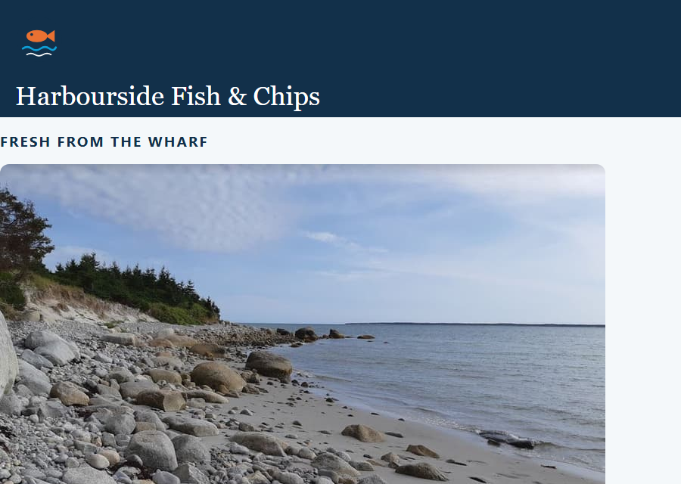
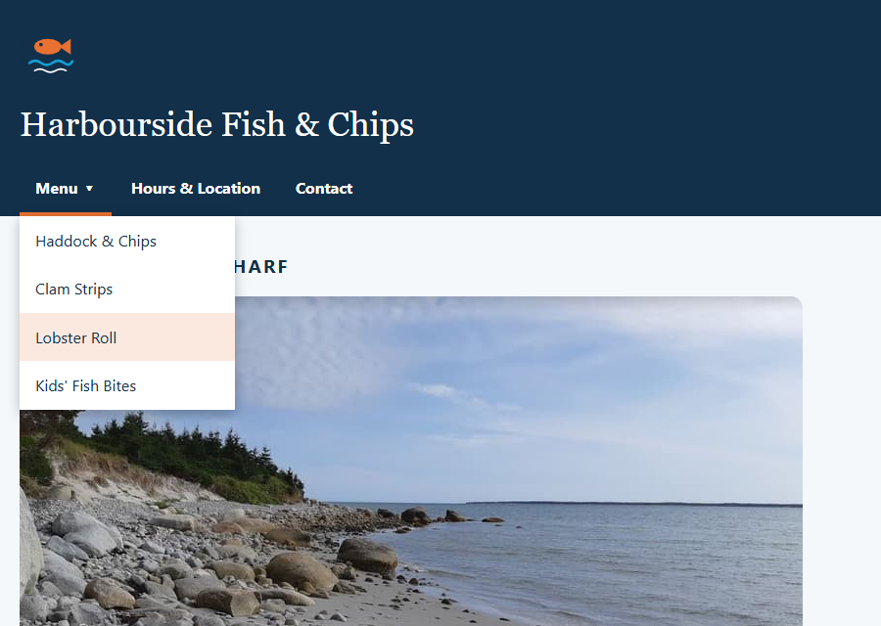
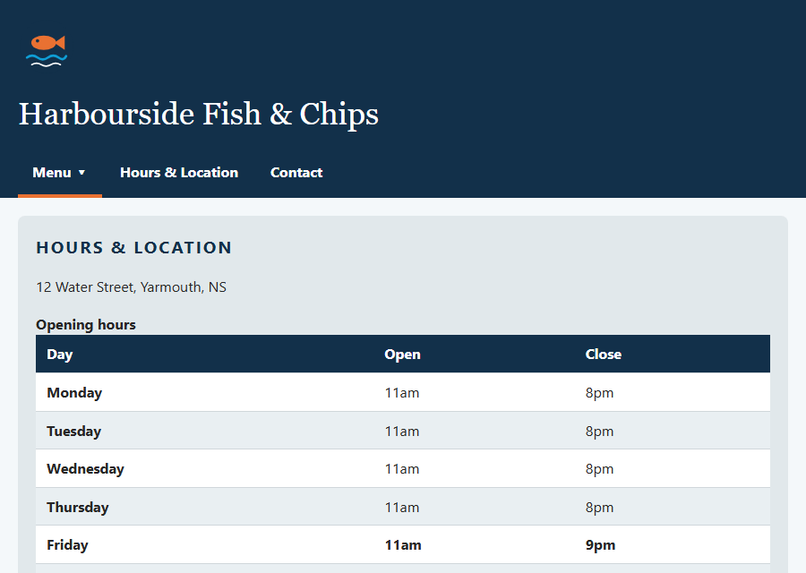
Harbourside, Part 2: Today's Activity
START
END: THE NAV
END: THE TABLE
1
Nav HTML + horizontal
5
Hours table HTML
Submit after Class 11
2
Style the links
6
Style the table
Three screenshots:
1. Your page, with the dropdown open
2. The HTML validator: "No errors"
3. The CSS validator: "No Error Found"
Win + Shift + S takes a screenshot.
3
A dropdown
7
Validate the HTML
4
Make it readable
8
Validate the CSS
Notes:
This is the plan for the hands-on part. Same Harbourside page as Class 8, with eight Try Its: four for the nav and two for the table today, then two for validation (HTML, then CSS) at the start of Class 11.
The left picture is the starter: our Class 8 page, no nav, hours as a bullet list. (Look closely: the prices are plain black. That's one of the hidden CSS mistakes Try It 8 finds.) The right pictures are where we'll be by the end.
The starter style.css has the Class 8 CSS at the top, then an empty heading for each Try It. Everything we type goes under those headings.
Submission (participation, after Try It 8 in Class 11): three screenshots on Brightspace: the page with the dropdown open, the HTML validator saying 'No errors', and the CSS validator saying 'No Error Found'. Students can take screenshot 1 today, after Try It 4.

Slide 12
Try It 1: Add the Nav (8 min)
1
Open activity/index.html with Live Server
INDEX.HTML, THEN STYLE.CSS
​Our Class 8 page, with no menu yet.
<nav aria-label="Main">
<ul>
<li><a href="#menu" aria-current="page">Menu</a></li>
<li><a href="#hours">Hours &amp; Location</a></li>
<li><a href="#contact">Contact</a></li>
</ul>
</nav>
/* style.css, Try It 1 */
nav ul {
list-style: none;
margin: 0;
padding: 0;
display: flex;
gap: 4px;
}
2
Type the nav HTML
​In index.html, inside <header>, under the h1. Save: a bulleted list appears.
3
Type the CSS
​In style.css, under Try It 1. Save: the links line up in a row.
4
Play with it
​Change gap: 4px to 40px. Then take out display: flex and put it back.
​The links go to the ids already on the page: #menu, #hours and #contact. Click them!
Notes:
Type it together. Two files this time: the HTML in index.html (inside the header, under the h1, where the 'Try It 1' comment is), then the CSS in style.css.
Save after the HTML first, so they see the plain bulleted list (Example 01). Then save after the CSS and watch it become a row (Example 02). Seeing both steps makes the point that CSS is doing all the work.
&amp; is the entity for & from Class 1. A bare & usually works, but the entity is the safe habit.
The links jump down the page to the sections with those ids. That's an in-page link: href="#hours" goes to id="hours".
Until Try It 2, the links are the browser's default blue and purple on navy: hard to read. That's fixed next.

Slide 13
Try It 2: Style the Links (6 min)
1
Type the CSS on the right
IN STYLE.CSS
​Under Try It 2. Save.
nav a {
display: block;
padding: 12px 16px;
color: white;
text-decoration: none;
font-weight: bold;
}
nav a:hover,
nav a:focus-visible {
background-color: #1B5E82;
}
nav a[aria-current="page"] {
border-bottom: 4px solid #E97132;
}
2
Hover each link
​The whole box lights up, not just the word.
3
Press Tab
​Click in the page, then Tab: the :focus-visible style follows the keyboard.
4
Play with it
​Change the hover colour. Try border-bottom: 4px dotted on the current page.
​aria-current="page" tells screen readers "you are here". The attribute selector (Class 9) styles it.
Notes:
Now it looks like a real menu bar.
White on navy is 13.6 : 1 contrast (from Class 8). White on the hover teal #1B5E82 is about 7 : 1, still well over 4.5 : 1.
The orange underline is decoration, not text, so the 3 : 1 rule for non-text elements applies, and #E97132 on navy passes that.
Why hover AND focus-visible in one rule: anything that reacts to the mouse should also react to the keyboard. Grouping them means you can't forget one.

Slide 14
Try It 3: A Dropdown (10 min)
1
Replace the Menu li
INDEX.HTML, THEN STYLE.CSS
​In index.html. The new <ul> goes inside the <li>, after the link.
<li>
<a href="#menu" aria-current="page">Menu &#9662;</a>
<ul>
<li><a href="#haddock">Haddock &amp; Chips</a></li>
<li><a href="#clams">Clam Strips</a></li>
<li><a href="#lobster">Lobster Roll</a></li>
<li><a href="#kids">Kids' Fish Bites</a></li>
</ul>
</li>
/* style.css, Try It 3 */
nav li { position: relative; }
nav ul ul {
display: none;
position: absolute;
top: 100%;
left: 0;
}
nav li:hover > ul,
nav li:focus-within > ul {
display: block;
}
2
Type the CSS
​Under Try It 3. Save and hover Menu.
3
Can't read it? Good!
​The links are white on a pale page. Try It 4 fixes it.
4
Press Tab
​When you reach Menu, it opens. That's :focus-within.
Notes:
The trickiest Try It, so go slowly and check the HTML first. The most common mistake: putting the new <ul> after the </li> instead of inside it. Then it's a sibling, not a child, and the CSS never finds it.
&#9662; is a numbered entity for the small down-triangle ▾ (Class 1 entities again). It tells sighted users 'this one opens'.
nav li { position: relative; } is written on one line to save space. It's exactly the same as three lines.
The planned 'bug': when the dropdown opens, the links are white (from Try It 2) on a transparent background, so they almost disappear against the pale page. Let students discover this, then fix it in Try It 4. A good moment to point out that a white-on-white menu passes no contrast test.
Why does the dropdown stack vertically when the main menu is a row? 'nav ul ul' is more specific than 'nav ul', so its display wins: none, then block. The cascade again!
One more thing to notice: the Kids' Fish Bites link won't jump anywhere when clicked. There's a reason, and the validator finds it in Try It 7. Don't give it away.

Slide 15
Try It 4: Make the Dropdown Readable (4 min)
1
Type the CSS on the right
IN STYLE.CSS
​Under Try It 4. Save and hover Menu.
nav ul ul {
min-width: 220px;
background-color: white;
box-shadow: 0 4px 12px rgba(0, 0, 0, 0.25);
}
nav ul ul a {
color: #12304A;
font-weight: normal;
}
nav ul ul a:hover,
nav ul ul a:focus-visible {
background-color: #FBE9DF;
}
2
Two nav ul ul rules?
​That's fine: the browser combines them.
3
Play with it
​Make the shadow bigger: 0 8px 24px. Or change min-width.
​box-shadow: across, down, blur, colour. rgba = a colour you can see through (0.25 = 25%).
Notes:
Short and satisfying: the dropdown becomes a proper white panel with a shadow, and navy links.
box-shadow: 0 4px 12px rgba(0, 0, 0, 0.25) means: 0 across, 4px down, 12px of blur, in black at 25% opacity. A soft shadow just below makes it look like it's floating above the page.
nav ul ul a is more specific than nav a, so the dropdown links are navy, not white. The hover rule overrides the teal from Try It 2 with peach.
Checkpoint: everyone should now have a working menu bar with a dropdown. That's half of today's activity. Have them take screenshot 1 now (the dropdown open), while they're here.

Slide 16
+
Tables
•
○
+
For data, not layout · structure · styling · zebra stripes · small screens
•
○
Notes:
Tables are for data that has rows AND columns: prices, schedules, results, timetables. If you'd put it in a spreadsheet, it's probably a table.
In the 1990s, whole websites were laid out with tables. Don't do that! It's a nightmare for screen readers and phones. Today, CSS does layout, and tables are only for tabular data.

Slide 17
HTML/CSS Techniques
The Parts of a Table
Fresh Fish Prices
Fish
Caught in
Price / lb
<thead>
Haddock
Yarmouth
$11.99
<tbody>
Halibut
Digby
$24.50
Scallops
Digby
$29.99
<caption>
The table's name: read out first
<thead> <tbody>
The header rows, and the data rows
<tr>
A table row
<th scope="col">
A heading for the column below
<th scope="row">
A heading for the row beside it
<td>
A table data cell: the actual data
Notes:
We met accessible tables in Class 4 (caption, th, scope). Here they are all together, because these are exactly the tags we'll style.
The nesting: a table contains rows (tr), and rows contain cells (th or td). There's no 'column' tag: columns are made by lining cells up, row after row. So every row needs the same number of cells.
thead and tbody split the header rows from the data. They matter for CSS: 'tbody tr:nth-child(even)' stripes the data rows only.
scope="col" says 'this heading labels the column below it'. scope="row" says 'this heading labels the row to its right'. With these, a screen reader can say 'Halibut, Price per lb, $24.50' instead of just '$24.50'.
caption is the table's name, and it's the first thing a screen reader announces.

Slide 18
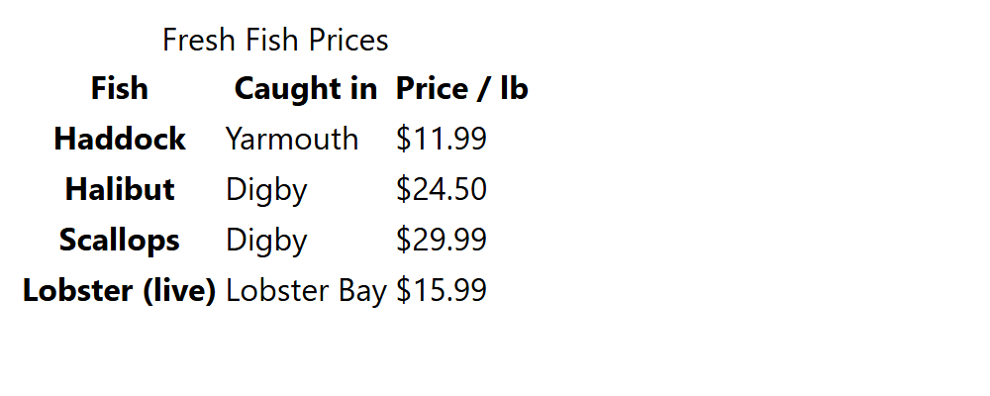
TABLES 1 · EXAMPLE 05
<table>
<caption>Fresh Fish Prices</caption>
<thead>
<tr>
<th scope="col">Fish</th>
<th scope="col">Caught in</th>
<th scope="col">Price / lb</th>
</tr>
</thead>
<tbody>
<tr>
<th scope="row">Haddock</th>
<td>Yarmouth</td>
<td>$11.99</td>
</tr>
<tr>
<th scope="row">Halibut</th>
<td>Digby</td>
<td>$24.50</td>
</tr>
<!-- …two more rows… -->
</tbody>
</table>
A Table, No CSS
​The browser bolds and centres every th. There are no borders yet.
​Write the structure first: caption, thead, tbody, th with scope. Then style it.
RESULT
05_table_structure_example.html
Notes:
Open 05_table_structure_example.html. It works, and it's accessible, but it's hard to read: no lines, the columns are squashed together, and the headings are centred.
Notice the browser already treats the th cells differently: bold, and centred in the header row. The first cell of each data row is a th too (scope="row"), so the fish names are bold.
All of the next three examples use exactly this HTML. Only the CSS changes. That's the point of separating structure (HTML) from presentation (CSS).

Slide 19
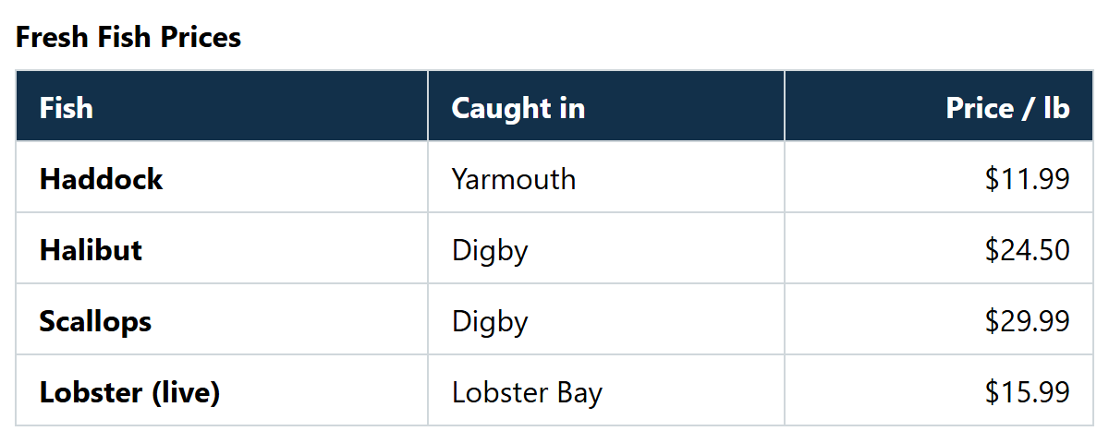
TABLES 2 · EXAMPLE 06
/* collapse = one line between cells, not two */
table {
width: 100%;
border-collapse: collapse;
}
caption {
font-weight: bold;
text-align: left;
padding-bottom: 8px;
}
th, td {
border: 1px solid #D0D7DB;
padding: 8px 12px;
text-align: left;
}
thead th {
background-color: #12304A;
color: white;
}
/* Line up the prices on the right */
th:last-child,
td:last-child {
text-align: right;
}
Styling a Table
​border-collapse: collapse: one line between cells, not two.
​Borders and padding go on the cells (th, td), not the table.
​Line numbers up on the right: td:last-child (a Class 9 selector).
RESULT
06_table_styled_example.html
Notes:
Open 06_table_styled_example.html, then comment out border-collapse: collapse and save. Every cell gets its own border with a gap in between: double lines everywhere. That's the browser default, and almost nobody wants it.
Padding goes on th and td. Padding on the table itself only adds space around the outside.
text-align: left on th undoes the browser's centred headings, so headings line up with their data.
Right-aligning prices is a typography habit: the decimal points line up, so it's easy to compare numbers down a column. th:last-child, td:last-child picks the last cell in every row, no classes needed.
width: 100% makes the table fill its container. Without it, a table is only as wide as its content.

Slide 20
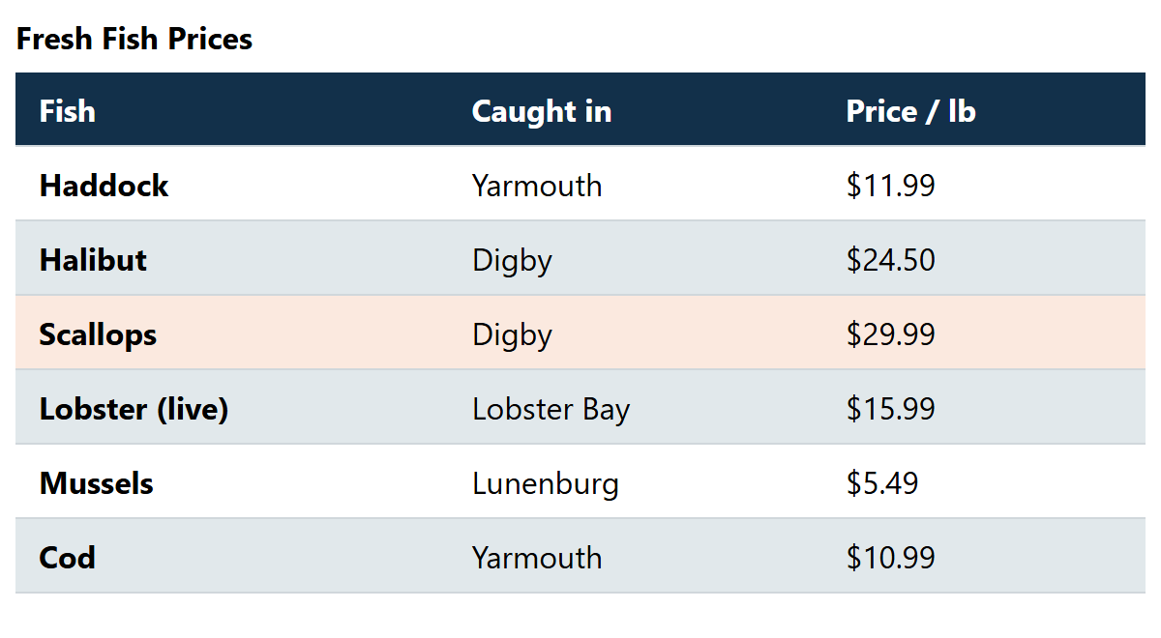
TABLES 3 · EXAMPLE 07
Zebra Stripes
/* Lines between rows only: cleaner than a full grid */
th, td {
border-bottom: 1px solid #D0D7DB;
padding: 8px 12px;
text-align: left;
}
thead th {
background-color: #12304A;
color: white;
}
/* tbody: so the header row isn't counted */
tbody tr:nth-child(even) {
background-color: #E1E8EB;
}
/* Helps your eye follow a row across */
tbody tr:hover {
background-color: #FBE9DF;
}
​tbody tr:nth-child(even): every second data row. Add a row and the stripes still work.
​tbody so the header row isn't counted. tr:hover helps the eye follow a row.
RESULT (MOUSE OVER SCALLOPS)
07_table_zebra_example.html
Notes:
Open 07_table_zebra_example.html and hover the rows.
Zebra stripes (alternating row colours) help your eye stay on the same row as it moves across a wide table. nth-child from Class 9 does it automatically: no classes on rows, and if you add or delete a row, the stripes fix themselves.
Why tbody tr and not just tr? Plain tr:nth-child(even) would also work here, because each tr is counted inside its own parent (thead or tbody). But writing tbody makes your intent clear, and keeps your header style safe if the stripe rule ever changes to odd.
Also new: borders on the bottom only. A full grid can look busy; lines between rows are cleaner and very common on real sites.
Keep the stripe colour gentle. The text still needs 4.5 : 1 contrast on both colours.

Slide 21
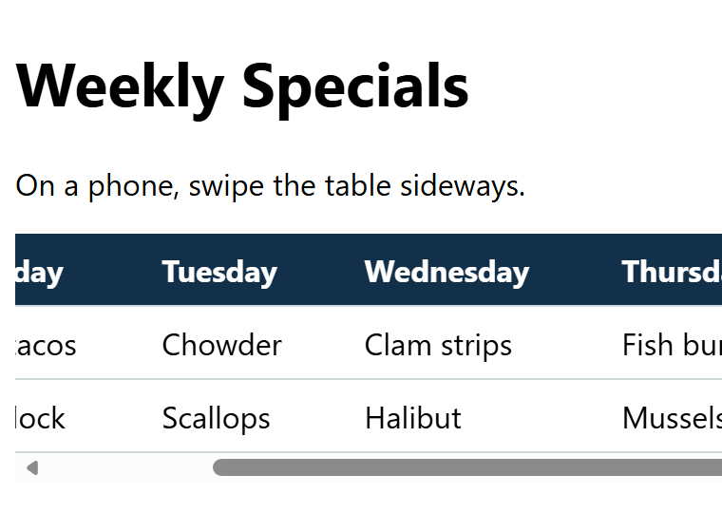
TABLES 4 · EXAMPLE 08
Tables on Small Screens
​Wrap the table in a div with overflow-x: auto. The box scrolls, not the whole page.
​tabindex="0" + a label: keyboard users can scroll it with the arrow keys.
​Or show it another way on phones, like cards (later, with media queries).
/* The wrapper scrolls sideways, not the whole page */
.table-wrap {
overflow-x: auto;
}
table {
min-width: 700px;
border-collapse: collapse;
}
<div class="table-wrap" role="region"
aria-label="Weekly specials" tabindex="0">
<table>
…
</table>
</div>
ON A PHONE: IT SCROLLS SIDEWAYS
08_table_responsive_example.html
Notes:
Open 08_table_responsive_example.html and make the browser narrow (or use the DevTools device toolbar: Ctrl + Shift + M). The table keeps its width and the wrapper scrolls sideways. The rest of the page stays put.
Without the wrapper, a wide table pokes out of the page, and the WHOLE page scrolls sideways on a phone. That's WCAG 1.4.10 Reflow: content shouldn't need two-way scrolling at 320px wide (data tables are an allowed exception, but they should only scroll themselves).
Last year's slide put overflow-x: auto and display: block on the table itself. That works visually, but changing a table's display can make some screen readers stop treating it as a table. The wrapper div is the safer way.
role="region" + aria-label + tabindex="0": the scrolling box can get keyboard focus (so the arrow keys scroll it), and a screen reader announces its name. Nice to have, not required today.
min-width: 700px stops the browser from squashing the columns down to nothing before it scrolls.
The other approach, turning each row into a 'card' on small screens, needs media queries, which come with responsive design.

Slide 22
Try It 5: An Hours Table (10 min)
1
Find the hours list
IN INDEX.HTML
​In index.html, in <aside id="hours">. Delete the <ul>.
<div class="table-wrap">
<table>
<caption>Opening hours</caption>
<thead>
<tr>
<th scope="col">Day</th>
<th scope="col">Open</th>
<th scope="col">Close</th>
</tr>
</thead>
<tbody>
<tr>
<th scope="row">Monday</th>
<td>11am</td>
<td>8pm</td>
</tr>
<!-- Tuesday to Sunday -->
</tbody>
</table>
</div>
2
Type the table on the right
​In its place. Save: an unstyled table appears.
3
Copy the row, six times
​Select the Monday <tr> (5 lines), then Shift + Alt + ↓ copies it.
4
Fill in the days
​Mon–Thu: 11am to 8pm. Fri–Sat: 11am to 9pm. Sun: Noon to 7pm.
Notes:
The div with class table-wrap is the wrapper from Example 08. Our table is narrow, so it may never actually scroll, but wrapping every table is a good habit.
VS Code shortcut: select the five lines of the Monday row, then Shift + Alt + Down Arrow copies them below. Press it six times, then change the days and times. Much faster than typing, and no typos in the tags.
Common mistakes:
- A row with only two cells: the columns go out of line.
- <th> for the day but forgetting scope="row".
- Rows typed outside the </tbody>.
Don't remove the 'Try It 5' comment if you don't want to. Comments are fine.

Slide 23
Try It 6: Style the Table (8 min)
1
Type the CSS on the right
IN STYLE.CSS
​In style.css, under Try It 6. Save.
.table-wrap { overflow-x: auto; }
table {
width: 100%;
border-collapse: collapse;
background-color: white;
}
caption { font-weight: bold; text-align: left; }
th, td {
padding: 8px 12px;
border-bottom: 1px solid #D0D7DB;
text-align: left;
}
thead th {
background-color: #12304A;
color: white;
}
tbody tr:nth-child(even) {
background-color: #E9EFF2;
}
2
Find the stripes
​Tuesday, Thursday and Saturday: even rows.
3
Play with it
​Change even to odd. Then take out border-collapse and look closely.
Notes:
Same recipe as Examples 06 and 07: collapse the borders, padding and lines on the cells, a navy header row, zebra stripes on the data rows.
thead th, not just th: the day names are th too (scope="row"). Plain th would make every day name white on navy as well.
The stripes land on Tuesday, Thursday and Saturday, rows 2, 4 and 6 of the tbody.
Checkpoint: everyone should have a styled nav with a dropdown and a styled hours table. That's all of today's typing. Next class we find out whether our HTML and CSS are actually correct.

Slide 24
Make It Yours
Make it yours
Before next class
1
​Highlight the row under the mouse: tbody tr:hover
Keep your Harbourside page!
Class 11 starts by validating it (Try Its 7 and 8).
Screenshot 1 now? Hover Menu, then Win + Shift + S. All three go on Brightspace after Class 11.
Stuck? Peek at activity/answer/.
2
​Bold Friday to Sunday: tbody tr:nth-child(n+5)
3
​Give the dropdown rounded corners: border-radius (try 0 0 8px 8px)
4
​A new colour for the current page underline
5
​Line up the Open and Close times on the right: td + text-align
Notes:
Anyone with a working dropdown and a styled hours table has done today's job. The ideas are for fast finishers, or homework.
Remind everyone to keep their Harbourside folder as it is: Class 11 starts by validating it (Try Its 7 and 8), and the three screenshots go on Brightspace after that.
Screenshot 1 (the page with the Menu dropdown open) can be taken now: hover Menu, then Win + Shift + S. The Snipping Tool waits for you to pick an area, so the dropdown stays open.

Slide 25
HTML/CSS Techniques
Cheat Sheet: Menus and Tables
Code | What it does
nav ul { list-style: none; padding: 0; } | Remove the bullets and the indent
nav ul { display: flex; gap: 4px; } | Links side by side, with space between
nav a { display: block; padding: … } | The whole box is clickable
a[aria-current="page"] | Style the "you are here" link
li { position: relative; } | Dropdowns are placed against their li
ul ul { display: none; position: absolute; } | Hide the dropdown; float it over the page
li:hover > ul, li:focus-within > ul | Show it for the mouse and the keyboard
border-collapse: collapse | One line between table cells, not two
tbody tr:nth-child(even) | Zebra stripes on the data rows
.table-wrap { overflow-x: auto; } | A wide table scrolls in its own box
Notes:
Everything from today's CSS in one place. It's in the README too.

Slide 26
HTML/CSS Techniques
Class 10 Recap and Next Steps
Recap:
  Every menu is nav → ul → li → a. CSS makes it horizontal, vertical or a dropdown.
  Make the whole link clickable (display: block + padding), and open dropdowns with :focus-within too.
  Tables are for data: caption, thead, tbody, th with scope, td.
  border-collapse, padding on cells, zebra stripes with nth-child, and a scrolling wrapper for small screens.
Before next class:
  Keep your Harbourside page as it is. Bring your Assignment 2 folder too.
Next class (Class 11):
  Validation: the W3C HTML and CSS validators (Try Its 7 and 8).
  Assignment 2 review: one stylesheet for many pages.
Notes:
Next class (Class 11): the W3C HTML and CSS validators, which find the hidden mistakes in today's Harbourside page, then a review of Assignment 2, with a worked solution: two pages that share one stylesheet.
Ask students to bring their Assignment 2 folder to Class 11. We'll check it with the validators too.

