Slide 1
WEBD 1000
Class 11:
  Checking your HTML and CSS with the W3C validators, and an Assignment 2 review.
HTML/CSS Techniques
Notes:
Welcome back! Last class: navigation menus and tables, on the Harbourside page.
Today has two halves. First, validation: the browser has been quietly hiding mistakes in our Harbourside page, and two free W3C tools will find them. Then we review Assignment 2, with a worked solution, and look closely at the one idea every multi-page site depends on: one stylesheet shared by many pages.

Slide 2
Attendance
Notes:
Take attendance. While you do, have students git pull (there's a new assignment2_solution folder), open their Harbourside page from last class (07_Navigation_Tables_Validation/activity) with Live Server, and open their own Assignment 2 folder too.

Slide 3
HTML/CSS Techniques
Class 11: Class Overview
Title: Validation and Assignment 2 Review
Agenda:
  HTML validation with validator.w3.org (Try It 7)
  CSS validation with jigsaw.w3.org (Try It 8), then submit
  Assignment 2 review: one stylesheet, many pages
  A worked solution, file by file, then check your own (Try It 9)
Validate
→
Share
→
Review
Find the hidden mistakes
One stylesheet, many pages
Assignment 2, solved
Notes:
Rough plan for the two hours:
- 5 min: attendance, a quick recap of Class 10
- 22 min: HTML validation (what, why, how, Example 09, then Try It 7)
- 10 min: CSS validation (Example 11, then Try It 8)
- 5 min: submit Harbourside, Part 2
- 7 min: Assignment 2 at a glance, wireframe to page
- 12 min: one stylesheet, many pages (the diagram, the flowchart, a live demo)
- 15 min: the solution, file by file
- 12 min: paths, photos, common mistakes
- 12 min: Try It 9, check your own Assignment 2
- 5 min: recap and questions
That's about 105 minutes, so there's a little slack for questions about Assignment 2.
Assignment 2 was due Sunday, October 11, so it's safe to show a full solution today.

Slide 4
HTML/CSS Techniques
Before We Start: Get the Code
1. Pull the new folder
git pull
New in 07_Navigation_Tables_Validation: assignment2_solution (two pages, one stylesheet, three photos).
2. Open your Harbourside page from last class
activity/index.html with Live Server. Your own copy, nav and table included: that's what we validate.
3. Have your Assignment 2 folder handy
We'll check it with the same tools at the end of class (Try It 9).
Notes:
git pull brings in one new folder: assignment2_solution, a complete Assignment 2 (two HTML pages, one CSS file, three photos). Every file is under 30 lines on purpose: it's the smallest thing that meets every requirement.
Students should NOT start a fresh copy of the Harbourside activity. Try Its 7 and 8 validate the page they built last class, so their own nav and table code gets checked too.
If someone missed Class 10, they can validate the untouched starter files in activity/: they still have all 8 hidden mistakes (5 HTML, 3 CSS).

Slide 5

+
Validation
•
○
+
Browsers forgive · validators don't · HTML and CSS
•
○
Notes:
Here's a secret: browsers are very forgiving. If your HTML has a mistake, the browser quietly guesses what you meant and shows the page anyway. Most of the time it guesses right, so you never notice.
That's great for people browsing the web, but terrible for finding your own mistakes. A validator is a tool that doesn't forgive: it reads your HTML and lists every place it breaks the rules.

Slide 6
HTML/CSS Techniques
What Is Validation, and Why Bother?
The browser forgives
The validator doesn't
<h2>Lobster Roll</h3>
ERROR
End tag “h3” seen, but there were open elements.
Shows up fine. You never notice.
Why bother, if it looks fine?
  Browsers and screen readers can guess differently. Valid = the same page for everyone.
  It finds bugs you can't see: a duplicate id quietly breaks a link.
  Accessibility: missing alt text, tags in the wrong order.
  It's a professional habit, and part of how your projects are marked.
Notes:
What: checking your HTML against the official rules (the HTML standard, maintained by WHATWG and W3C). The W3C validator is a free website that does this.
Why, honestly:
- The browser's guess isn't always the same guess. Different browsers, and especially screen readers, can repair broken HTML differently. Valid HTML means everyone gets the same page.
- It finds bugs you can't see. A duplicate id breaks in-page links and form labels. A wrongly closed tag can swallow half your page.
- Accessibility: missing alt text and broken nesting confuse assistive technology.
- It's a professional habit. Clients and employers notice, and it's part of how your projects are marked in this program.
A myth from last year's slide: validation doesn't directly change your Google ranking. Search engines read broken HTML fine. But a clean, well-structured page helps everything that reads it, search engines included.

Slide 7
HTML/CSS Techniques
How to Use the W3C Validator
validator.w3.org
1
By URI
2
By File Upload
3
By Direct Input
A page that's already online
Pick your .html file
Paste your code
Later in the program
Works today
Quickest today!
​Error = breaks the rules. Fix it.
​Warning / Info = advice. Read it; fix it if you agree.
​CSS has its own: jigsaw.w3.org/css-validator (after Try It 7).
Notes:
validator.w3.org has three tabs across the top.
Validate by URI (address): for pages that are already online. Ours aren't yet, so this one's for later in the program.
Validate by File Upload: pick the .html file from your computer.
Validate by Direct Input: paste the code into a box. This is the quickest today: in VS Code, Ctrl + A then Ctrl + C, and paste.
The results are a numbered list. Red 'Error' messages are rule-breakers: fix them. 'Warning' and 'Info' messages are advice: read them, and fix them if you agree. For example, a slash at the end of <img ... /> gets an info message. It's harmless.
There's a separate CSS validator at jigsaw.w3.org/css-validator, with the same three tabs. We'll use it after Try It 7.

Slide 8


VALIDATION · EXAMPLE 09
Looks Fine. Isn't.
​This page has 4 mistakes. Can you spot them before the validator does?
​The browser shows it perfectly. That's the problem!
<!-- This page has 4 errors. The browser hides them all! -->
<img src="images/logo.svg" width="64" height="64">
<h1>Today's Specials</h1>
<h2>Lobster Roll</h3>
<p color="red">Fresh lobster on a toasted bun.</p>
<p><strong><em>Today only!</strong></em></p>
RESULT
09_validation_broken_example.html
Notes:
Open 09_validation_broken_example.html in the browser: it looks completely normal.
Give the class a minute to spot the four mistakes in the code (don't reveal yet):
1. The img has no alt attribute.
2. <h2> is closed with </h3>.
3. color="red" isn't an HTML attribute (and the text isn't even red: the browser ignored it).
4. <strong><em> … </strong></em>: closed in the wrong order.
Then demo it live: validator.w3.org → Validate by Direct Input → paste the whole file → Check. The next slide shows what comes back.

Slide 9
HTML/CSS Techniques
Reading the Results
ERROR
An “img” element must have an “alt” attribute…
Add alt="" (decoration) or alt="description"
line 16
ERROR
End tag “h3” seen, but there were open elements.
Close it with the same tag: </h2>
line 19
ERROR
Attribute “color” not allowed on element “p” at this point.
Not an HTML attribute: do it in CSS
line 20
ERROR
End tag “strong” violates nesting rules.
Last opened, first closed:
line 21
ERROR
No “em” element in scope but a “em” end tag seen.
<strong><em>…</em></strong>
line 21
↑ one mistake on line 21, two messages
​Fix the first error, save, check again. Repeat until: “No errors or warnings to show.”
Notes:
This is the real output for Example 09 (copied from validator.w3.org). Four mistakes, but FIVE error messages: the wrong nesting on line 21 creates two. One mistake often causes a little chain of messages.
So the method is:
1. Read the FIRST error.
2. Go to that line in VS Code (Ctrl + G, then the line number).
3. Fix it, save, and validate again.
4. Repeat until it says 'Document checking completed. No errors or warnings to show.'
Often fixing one error makes others disappear too.
The messages use the official names, so they can sound scary. 'End tag h3 seen, but there were open elements' just means 'you closed an h3, but the h2 you opened is still open'.
Example 10 is the fixed version, with a comment on each fix.

Slide 10
Try It 7: Validate the HTML (12 min)
1
Open validator.w3.org
The starter page had 5 hidden mistakes!
​Choose Validate by Direct Input.
Clues:
1
An image that says nothing about itself
2
Copy all of index.html
​In VS Code: Ctrl + A, Ctrl + C. Paste it in, then Check.
2
Two tags closed in the wrong order
3
A closing tag that doesn't match its opening tag
3
Fix the first error
​Ctrl + G jumps to the line. Fix it and save.
4
Two of something there should only be one of
4
Copy, paste, check again
5
An attribute HTML has never heard of
​Repeat until there are no errors left.
5
Screenshot the result
​Clue 4 explains why the Kids' Fish Bites link in your dropdown doesn't go anywhere!
​Errors in the code you typed? Fix those too.
​“Document checking completed. No errors or warnings to show.”
Notes:
The surprise: the starter index.html had five mistakes in it from the start. Not in anything students typed last class (hopefully!), but in the page they were given.
The five, for you (all fixed and commented in activity/answer/index.html):
1. Line ~15: the header logo <img> has no alt. It's decoration (the h1 says the name), so alt="".
2. Line ~30: <strong>…<em>boats</strong></em>, closed in the wrong order (two messages).
3. Line ~44: <h3>Clam Strips</h2>.
4. Line ~55: Duplicate ID “clams”. The Kids' Fish Bites article is id="clams" (copy-and-paste!). It should be id="kids", and that's why the dropdown's Kids link didn't work in Try It 3.
5. Line ~77: <p font="small">. Not an attribute: use class="small" and CSS.
Line numbers move a little, depending on what each student typed.
If students get errors in their own nav or table code, even better: they fix those too. Common ones: a missing </li>, a <ul> outside its <li>, or a missing </tr>.
The HTML validator doesn't open style.css, so it can't see the CSS mistakes. That's next, in Try It 8.

Slide 11

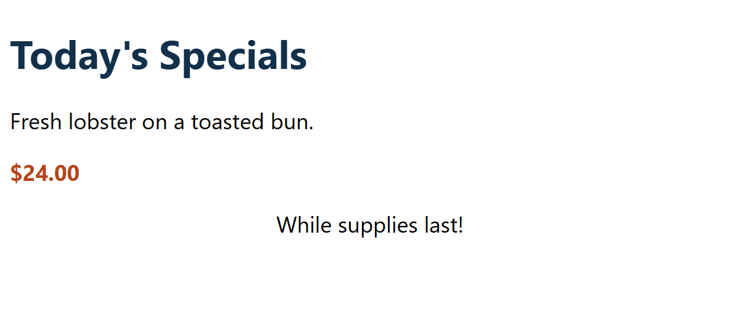
CSS VALIDATION · EXAMPLE 11
CSS Fails Quietly
h1 {
colour: #12304A;
}
p {
font-size: 18;
}
.price {
font-weight: bold
color: #B5451B;
}
.note {
text-align: middle;
}
​The browser skips any CSS it doesn't understand. No error, no warning: it just doesn't happen.
​4 mistakes: the heading isn't navy, the text isn't bigger, the price isn't orange, the note isn't centred.
​The HTML validator checks a <style> block, but never opens your linked style.css.
WHAT YOU GET
WHAT YOU MEANT (EXAMPLE 12)
11_css_validation_broken_example.html
Notes:
Open 11_css_validation_broken_example.html. It looks like a plain, unstyled page, and nothing tells you why. Open DevTools (F12) and look at the Styles panel: the broken declarations are crossed out, with a little warning triangle. That's the browser's only hint.
Give the class a minute to spot the four mistakes:
1. colour (British spelling). CSS only knows color.
2. font-size: 18 with no unit. Only 0 can go without a unit.
3. A missing semicolon after font-weight: bold. The browser reads 'bold color: #B5451B' as one broken value, so BOTH lines are lost: the price is neither bold nor orange.
4. text-align: middle. The word is center.
Then demo it live: jigsaw.w3.org/css-validator → By direct input → paste the whole file → Check. The CSS validator accepts a whole HTML file and checks its <style> block. The next slide shows what comes back.
Why we need a second validator: validator.w3.org does check CSS inside a <style> block (paste Example 11 into it and you get the same four errors). But it never downloads linked stylesheets. Our Harbourside CSS lives in style.css, so only the CSS validator can check it.
Right-hand picture: Example 12, the fixed version (each fix has a comment).

Slide 12
HTML/CSS Techniques
The W3C CSS Validator
jigsaw.w3.org/css-validator
→ By direct input
ERROR
h1 Property “colour” doesn't exist. The closest matching property name is “color”
Spell it color
line 14
ERROR
p only “0” can be a “unit”. You must put a unit after your number
18px (or 1.1rem)
line 18
ERROR
.price Missing a semicolon before the property name “color”
bold; ← it broke both lines
line 23
ERROR
.note “middle” is not a “text-align” value
text-align: center
line 27
​When it's clean: “Congratulations! No Error Found.”
Notes:
This is the real output for Example 11 (from jigsaw.w3.org/css-validator, October 2026). One message per mistake this time, and they're friendlier than the HTML ones: the first even suggests the right spelling.
The page has the same three tabs as the HTML validator: By URI, By file upload, By direct input. Direct input is quickest: Ctrl + A, Ctrl + C in style.css, paste, Check.
Each message gives the line number and the selector it's in (h1, p, .price, .note), which makes it easy to find.
When it's clean, the result says 'Congratulations! No Error Found.' (with a green banner). That's screenshot 3.
Warnings: the CSS validator sometimes warns about things that are fine, like vendor prefixes (-webkit-…). Errors matter; warnings are advice, same as with HTML.

Slide 13
Try It 8: Validate the CSS (6 min)
1
Open jigsaw.w3.org/css-validator
Our Class 8 CSS had 3 hidden mistakes!
​Choose By direct input.
Clues:
1
A number with no unit
2
Copy all of style.css
​In VS Code: Ctrl + A, Ctrl + C. Paste it in, then Check.
2
A word CSS spells differently
3
Fix each error
3
A missing semicolon (it breaks two lines!)
​The message names the line and the selector.
4
Copy, paste, check again
​Until there are no errors left.
​Watch the page as you fix them. Something changes every time.
​Did you notice the prices were plain black last class?
​The HTML validator can't find these: it never opens style.css.
5
Screenshot the result
​“Congratulations! No Error Found.”
Notes:
The second surprise: the Class 8 part of the starter style.css has three mistakes in it. They've been there since Class 8, and nobody noticed, because the browser just skipped them.
The three, for you (fixed and commented as CSS Fix 1–3 in activity/answer/style.css):
1. Line ~50: main { padding: 20; }, no unit, so main has no padding at all.
2. Line ~70: figcaption { colour: #595959; }, so the caption is black instead of grey.
3. Line ~74: .price { font-weight: bold (no semicolon) color: #B5451B; }, so the prices are neither bold nor orange.
Line numbers move depending on what each student typed below.
After fixing, the page visibly changes: orange bold prices, a grey caption, and the main column gets its padding back. Ask: 'Did anyone notice the prices were black all last class?'
Also possible: errors in the CSS students typed today, e.g. a missing } or a typo in a property. They fix those too.
If time is short, this one is fine as homework.

Slide 14
Submit Harbourside, Part 2
Before you submit
Submit to Brightspace
1
​Changed anything since Try It 7? Validate index.html again.
Three screenshots:
1. Your page in the browser, with the Menu dropdown open
2. The HTML validator: “No errors or warnings to show.”
3. The CSS validator: “No Error Found.”
Win + Shift + S: hover the menu first, then pick the area.
Stuck? Peek at activity/answer/. Every fix has a comment.
2
​Changed anything since Try It 8? Validate style.css again.
3
​Click every link in the menu, including Kids' Fish Bites.
4
​Press Tab through the page: the dropdown should open for the keyboard too.
Notes:
Anyone who has a working dropdown, a styled table and two clean validator results has done the job.
Re-validate after making changes! It's easy to break something while adding to it.
What to collect on Brightspace (participation): three screenshots. 1: the page in the browser with the Menu dropdown open (hover it, then Win + Shift + S. The Snipping Tool waits for you to pick an area, so the dropdown stays open). Some students took this one in Class 10. 2: the HTML validator showing no errors. 3: the CSS validator showing 'No Error Found'.
Next: Assignment 2.

Slide 15
HTML/CSS Techniques
Cheat Sheet: Validator Messages
The HTML validator says… | It means… / the fix
An “img” element must have an “alt” attribute | Add alt="description", or alt="" for decoration
End tag “h3” seen, but there were open elements | The closing tag doesn't match the opening tag
Unclosed element “section” | A closing tag is missing
End tag “strong” violates nesting rules | Last opened, first closed: <b><i>…</i></b>
Duplicate ID “clams” | Every id must be unique on the page
Attribute “color” not allowed on element “p” | Not an HTML attribute: do it in CSS
The CSS validator says… | It means… / the fix
Property “colour” doesn't exist | Spelling: CSS uses color (and center)
only “0” can be a “unit”… | Add a unit: 20px, 1.2rem
Missing a semicolon before the property name… | End every declaration with ;
“middle” is not a “text-align” value | Not an allowed value: check MDN
Notes:
The messages students will see most often this term, and what they really mean. Top: validator.w3.org (HTML). Bottom: jigsaw.w3.org/css-validator (CSS).
Two more HTML ones worth knowing: 'Element li not allowed as child of element nav' (an li must be inside a ul or ol) and 'Stray end tag div' (a closing tag with no opening tag).

Slide 16
+
Assignment 2 Review
•
○
+
Two pages · one stylesheet · three photos
•
○
Notes:
Assignment 2 (Website Planning and Wireframing, 10% of the final grade) was due Sunday, October 11. Now that it's in, we walk through a complete solution.
The solution is in assignment2_solution. It's deliberately tiny: every file is under 30 lines. It isn't the prettiest site in the class, and it doesn't need to be. It shows the smallest thing that meets every requirement, so the important ideas are easy to see.
The big idea for today: one stylesheet shared by many pages. Every site you build from now on works this way.

Slide 17
HTML/CSS Techniques
Assignment 2 at a Glance
The task
  Wireframe two pages (e.g. About Me and Portfolio).
  Build them by hand in VS Code. Both share one style sheet and link to each other.
  Page 2: at least 3 of your own photos, optimized and responsive.
Hand in (Brightspace)
  One PDF with the two wireframes, and one ZIP: 2 HTML pages, 1 CSS file, 3 images.
Component | Full marks (A) | Points
Wireframes (2) | Detailed, clear, meet the requirements | /10
HTML pages (2) | Clean, organized, valid; fully working | /10
CSS style sheet | Clean, valid, consistent; one shared file | /5
Photos (3) | Optimized, responsive, add to the content | /15
Total |  | /40
Notes:
A quick reminder of what was asked, and how it was marked.
Point out the weights: the photos are worth 15 of the 40 marks, more than the HTML (10) or the CSS (5). 'Optimized and responsive' is the whole point of that row. That's why there's a slide on photos coming up.
'Both pages should share the same style sheet' and 'the pages should contain links to each other' are the two requirements that make this a website rather than two separate pages. They're the focus of the next few slides.
Learning outcomes 2 and 3: plan and design a site from requirements (the wireframes), and author standards-based HTML/CSS by hand (the pages). 'Standards-based' is exactly what the validators check, which is why we did validation first today.

Slide 18
HTML/CSS Techniques
From Wireframe to Page
index.html About Me
portfolio.html Portfolio
header: Sam Rivers (h1)
header: Sam Rivers (h1)
nav: About Me | Portfolio
nav: About Me | Portfolio
main: h2 + 3 paragraphs
main: h2 + 3 photos
max-width: 100%
footer: © 2026 Sam Rivers
footer: © 2026 Sam Rivers
​Same on both pages → written the same way → styled once, in style.css. Only main changes.
Notes:
The wireframes aren't just a separate deliverable: they tell you how to write the code.
Look at what's the same on both wireframes: the header with the name, the nav, the footer. Those parts are written the same way on both pages, so one set of CSS rules styles both. Only the middle (main) changes from page to page.
Good wireframes for full marks: both pages, labelled boxes (header, nav, main, footer), placeholder boxes with an X for images, and notes where something isn't obvious (e.g. 'links to portfolio.html', '3 photos, full width'). A box called 'stuff' isn't detailed enough.
If students drew their wireframes in draw.io (Class 6), the same tool works for any future project.

Slide 19
One Stylesheet, Many Pages
index.html
portfolio.html
contact.html
About Me
Portfolio
Any page you add later
<link rel="stylesheet" href="style.css">
<link rel="stylesheet" href="style.css">
<link rel="stylesheet" href="style.css">
each page links to it
​Change a colour here once → every page changes.
​A new page gets the whole look for free: just keep the <link>.
style.css
ONE file, for every page
Every page: the same fonts, colours, header and nav
Notes:
This is the most important idea in Assignment 2, and in every site from now on.
Each page has ONE line in its <head>: <link rel="stylesheet" href="style.css">. That line points at the shared file. The CSS isn't copied into the pages; every page reads the same file.
Why it matters:
- Consistency: every page gets the same fonts, colours and nav automatically.
- Less work: change a colour once, and every page changes. With a <style> block in each page, you'd have to make the same change in every file, and sooner or later one gets missed.
- Faster: the browser downloads style.css once and reuses it on the next page (next slide).
- Adding a page is easy: copy an existing page, change the main, keep the <link>. The dashed box is a page you might add later; it gets the whole look for free.
LIVE DEMO: open assignment2_solution/index.html and portfolio.html in two tabs. In style.css, change h1, h2 { color: #12304A; } to a bright colour and save. Both pages change. Change it back.

Slide 20
What the Browser Does with the <link>
3
1
​You open portfolio.html
2
​In the <head> it finds <link href="style.css">
Already got style.css?
4
​Use the saved copy (from index.html)
Yes
No
6
Why it matters
5
​Download style.css
Found it?
7
​Apply the rules. The page appears, styled.
Yes
​One file = downloaded once, reused on every page. The second page opens faster.
​Wrong path = a plain page and no warning. Style.css isn't style.css on most web servers.
​Check it: F12 → Network → reload. style.css should say 200, not 404.
No
8
​No styles at all, and no error message!
Notes:
Walk through the flowchart from the top left. This is what happens every time a page opens.
1-2. The browser reads the HTML from the top. In the <head> it finds the <link>, and asks for style.css.
3. The fork: has it already got style.css? If you opened index.html first, yes: it keeps a saved copy (the cache) and uses that. Nothing to download, so the second page shows up faster. That's a real advantage of one shared file over a <style> block in every page.
5-6. If not, it downloads style.css. If the file is found, the rules are applied and the page appears, styled.
8. The trap: if the href is wrong (a typo, a capital letter, the wrong folder), the browser can't find the file. It does NOT show an error. It just shows the page with no styles at all: Times New Roman, blue links, photos at full size.
How to check: F12 → Network tab → reload. style.css should be there with status 200. A red 404 means the path is wrong.
Capital letters: Windows doesn't care (Style.css and style.css are the same file on your laptop), but most web servers do. So it can work at home and break once it's online.

Slide 21
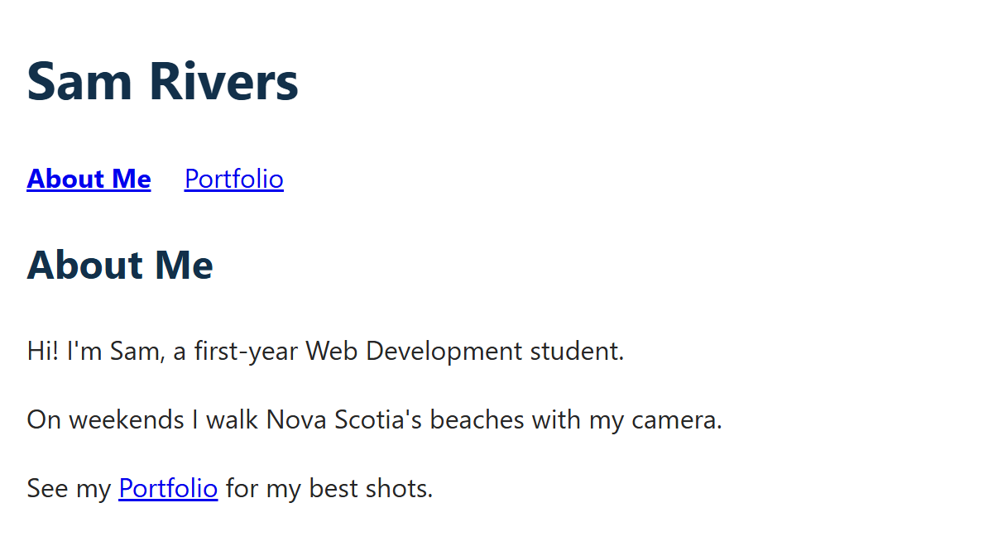
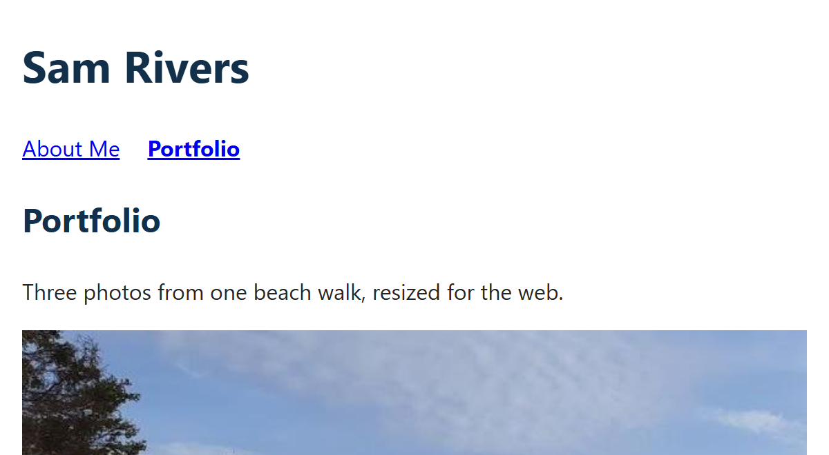
ASSIGNMENT 2 · THE SOLUTION
/* One stylesheet, linked from index.html and portfolio.html */
body {
max-width: 800px;
margin: 0 auto;
padding: 0 16px;
font-family: "Segoe UI", Arial, sans-serif;
line-height: 1.6;
color: #262626;
}
h1, h2 { color: #12304A; }
nav ul {
list-style: none;
padding: 0;
display: flex;
gap: 20px;
}
nav a[aria-current="page"] { font-weight: bold; }
/* Responsive photos: fit any screen, never stretched */
img {
display: block;
max-width: 100%;
height: auto;
margin-bottom: 16px;
}
style.css: The One Stylesheet
​Nothing in it belongs to one page, so both pages can use it.
​max-width: 800px + margin: 0 auto: readable lines, centred page.
​The nav ul rule is Class 10's horizontal menu.
​max-width: 100% + height: auto: the photos fit any screen, and keep their shape.
INDEX.HTML
PORTFOLIO.HTML
assignment2_solution/style.css
Notes:
Open assignment2_solution/style.css. 29 lines, and it styles the whole site.
body: max-width: 800px stops lines getting too long to read on a wide screen; margin: 0 auto centres the column; the padding keeps text off the edges on a phone.
h1, h2 on one line: short rules are fine on one line (we did the same in Try It 3).
nav ul: list-style: none, padding: 0 and display: flex with a gap: exactly the horizontal menu from Class 10. aria-current="page" marks 'you are here', and the attribute selector makes it bold.
The img rule (orange bars) is the 'responsive' part of the Photos row in the rubric:
- max-width: 100%: never wider than its container. On a phone it shrinks.
- height: auto: the height shrinks in proportion, so the photo isn't squashed. Without it, the width and height attributes in the HTML would keep the photo 427 px tall on a narrow screen.
- display: block puts each photo on its own line, and margin-bottom spaces them.
Both screenshots on the right use this one file.

Slide 22
ASSIGNMENT 2 · THE SOLUTION
index.html: About Me
<!DOCTYPE html>
<html lang="en">
<head>
<meta charset="UTF-8">
<meta name="viewport" content="width=device-width, initial-scale=1.0">
<title>About Me | Sam Rivers</title>
<link rel="stylesheet" href="style.css">
</head>
<body>
<header>
<h1>Sam Rivers</h1>
<nav>
<ul>
<li><a href="index.html" aria-current="page">About Me</a></li>
<li><a href="portfolio.html">Portfolio</a></li>
</ul>
</nav>
</header>
<main>
<h2>About Me</h2>
<p>Hi! I'm Sam, a first-year Web Development student.</p>
<p>On weekends I walk Nova Scotia's beaches with my camera.</p>
<p>See my <a href="portfolio.html">Portfolio</a> for my best shots.</p>
</main>
<footer>
<p>&copy; 2026 Sam Rivers</p>
</footer>
</body>
</html>
​The <link> in the <head> joins the page to style.css. It's the same line on every page.
​Links between pages are just the file name: href="portfolio.html".
​aria-current moves to whichever page you're on.
RESULT
assignment2_solution/index.html
Notes:
Open assignment2_solution/index.html. 29 lines.
The two orange bars:
1. The <link> in the <head>. Without it, this page would ignore style.css completely.
2. aria-current="page" on the About Me link, because this IS the About Me page. On portfolio.html it moves to the Portfolio link.
The nav is a list (nav → ul → li → a), like Class 10. The rubric asks for HTML that's 'fully compliant with web standards': this page passes validator.w3.org with no errors or warnings.
The title says which page you're on and whose site it is: 'About Me | Sam Rivers'. It's what shows in the browser tab and in search results.
The link in the last paragraph is a second way to reach the Portfolio, in the text. The requirement is that the pages link to each other: the nav does that on both pages.

Slide 23
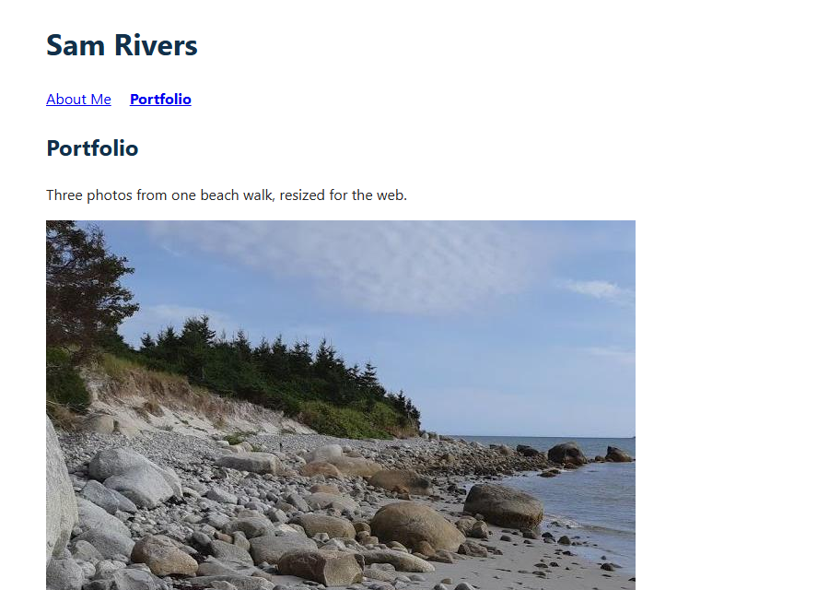
ASSIGNMENT 2 · THE SOLUTION
portfolio.html: Three Photos
​Same <head>, header and footer as index.html. Only the title, aria-current and main change.
​alt says what's in each photo. width and height (the real size) save its space while it loads.
THE <MAIN> (THE HEAD, HEADER AND FOOTER MATCH INDEX.HTML)
<main>
<h2>Portfolio</h2>
<p>Three photos from one beach walk, resized for the web.</p>
<img src="images/beach_trees.jpg"
alt="Spruce trees on a sandy bank above a rocky beach"
width="640" height="427">
<img src="images/beach_rocks.jpg"
alt="Round grey boulders on wet sand at the water's edge"
width="640" height="427">
<img src="images/beach_water.jpg"
alt="Calm sea under a pale blue sky, a low shore on the horizon"
width="640" height="427">
</main>
RESULT
assignment2_solution/portfolio.html
Notes:
Open assignment2_solution/portfolio.html. 30 lines; only the main is on the slide, because everything else matches index.html line for line, apart from the <title> and which link has aria-current.
That's the quick way to make page 2: copy index.html, rename it, change the title, move aria-current, and replace the main. The <link> comes along for free.
Each img (split over three lines here so it fits on the slide; in the file each img is one line):
- src="images/...": the photos are in an images folder next to the page.
- alt describes what's in the photo, for screen readers and for when the image doesn't load (Class 5).
- width="640" height="427" are the photo's real pixel size. The browser saves the right amount of space before the photo arrives, so the text doesn't jump around (Class 7, Images for the Web). The CSS height: auto still lets it shrink.
The photos are three crops of one beach photo, resized and saved as JPG at quality 75. Students had to use their own photos.

Slide 24
HTML/CSS Techniques
Paths: How Pages Find Their Files
ONE FOLDER, ZIPPED
​Everything in one folder. Zip the folder.
​Lowercase names, no spaces: beach_trees.jpg
​Test the ZIP: unzip it somewhere else, open index.html, click every link.
assignment2_solution/
├── index.html
├── portfolio.html
├── style.css
└── images/
├── beach_trees.jpg
├── beach_rocks.jpg
└── beach_water.jpg
From index.html, you write… | It means…
href="portfolio.html" | A file in the same folder
href="style.css" | The same folder too
src="images/beach_trees.jpg" | Go into the images folder, then the file
src="C:\Users\sam\…\beach.jpg" | ✗ Only works on your own computer
src="images/Beach_Trees.JPG" | ✗ Capitals matter on a web server
Notes:
Every href and src in the solution is a relative path: it's measured from the page that contains it. That's what makes the ZIP work on the marker's computer, and later on a web server.
- portfolio.html and style.css are in the same folder as index.html, so the path is just the file name.
- The photos are one folder down, so the path is images/ then the file name.
The two that break:
- A path starting with C:\ or file:/// only exists on your laptop. VS Code's autocomplete sometimes suggests one, and the image disappears as soon as the folder moves. Hard to spot, because it works for you!
- Capitals: Windows treats Beach_Trees.JPG and beach_trees.jpg as the same file. Most web servers don't. Lowercase everything and you never have to think about it.
No spaces in file names: 'my photo.jpg' becomes my%20photo.jpg in a URL. Use - or _ instead.
Before handing in a ZIP: unzip it somewhere else (the Desktop), open index.html, and click everything.

Slide 25
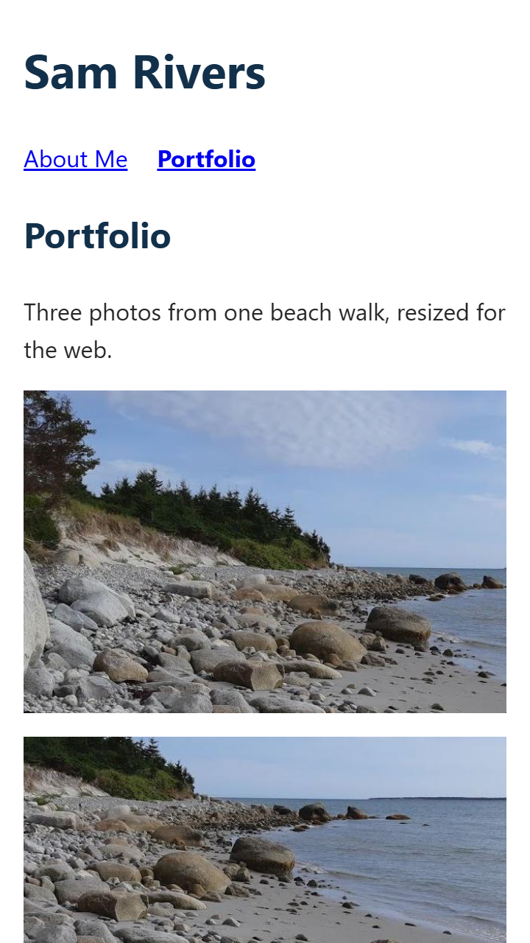
HTML/CSS Techniques
Photos: Optimized and Responsive
Optimized: a small file
ON A PHONE (360 PX)
Photo | Size | File
Straight off a phone | 4000 × 3000 | 2–5 MB
beach_trees.jpg | 640 × 427 | 50 KB
beach_rocks.jpg | 640 × 427 | 58 KB
beach_water.jpg | 640 × 427 | 32 KB
Resize to the size it's shown at, then JPG quality 70–80 (Pixlr or squoosh.app). Aim for under 200 KB.
Responsive: fits any screen
img {
max-width: 100%; /* never wider than the page */
height: auto; /* keep its shape */
}
Notes:
The Photos row is worth 15 of the 40 marks, so it's worth getting right. It asks for two separate things.
Optimized = a small file. A photo straight from a phone is 4000 px wide and 2-5 MB (Class 7). Our page is never wider than 800 px, so most of those pixels are thrown away, after making the visitor download them. The solution's photos are 640 px wide JPGs at quality 75: the sizes in the table are the real files.
How: Pixlr (File → Save, choose JPG, quality and size) or squoosh.app. Resize to the size it's shown at, then compress. Aim for under 200 KB a photo.
Responsive = fits any screen. The img rule in style.css: max-width: 100% (never wider than the page) and height: auto (keep the shape). The screenshot is portfolio.html at 360 px wide, a typical phone: the photos shrink to fit, and nothing sticks out sideways.
Check it: F12, then Ctrl + Shift + M for the device toolbar, then pick a phone or drag the width.
A common half-mark: photos that fit on a laptop because they happen to be small, but have no max-width, so they poke out on a phone. Or the opposite: a huge 5 MB photo that's made small with width="300". It looks optimized, but it isn't.

Slide 26
HTML/CSS Techniques
Common Mistakes (and the Fix)
1
A <style> block on each page
2
The page shows with no styles
Fix: One style.css, linked from every page
Fix: Check the <link> href: spelling, folder, capitals
3
Photos straight off the phone
4
A photo sticks out on a phone
Fix: Resize and compress: under 200 KB each
Fix: img { max-width: 100%; height: auto; }
5
Works on your laptop only
6
Broken images after unzipping
Fix: No C:\ paths. Just href="portfolio.html"
Fix: Zip the whole folder, images/ too. Test it.
Notes:
These are the mistakes that cost marks most often on an assignment like this one. Ask students to check their own submission against the list while you go through it.
1. A <style> block in each page, or two different CSS files. It might look the same, but the requirement was one shared stylesheet. Inline style="…" attributes have the same problem.
2. The page shows with no styles. Almost always the href in the <link>: a typo, a capital letter, or the CSS in a different folder from where the href says.
3. Photos straight off the phone. They look fine on screen, but each one is a multi-megabyte download.
4. A photo that's too wide on a phone: missing max-width: 100%. Or a fixed height in the CSS, which squashes the photo when it shrinks.
5. Links or images that only work on your own computer: a C:\ path.
6. Broken images after unzipping: the ZIP had the HTML but not the images folder, or the images were somewhere else on the laptop.
And one more: the validators. Most HTML marks lost are things the validator would have found in 30 seconds.

Slide 27
Try It 9: Check Your Assignment 2 (12 min)
1
Open your Assignment 2 folder
THE TWO MUST-HAVES
​In VS Code, with Live Server.
<!-- in the <head> of EVERY page -->
<link rel="stylesheet" href="style.css">
/* in style.css */
img {
max-width: 100%;
height: auto;
}
2
Validate both HTML pages
​validator.w3.org, By Direct Input. One page at a time.
3
Validate style.css
​jigsaw.w3.org/css-validator. Aim for No Error Found.
4
Be a phone
​F12, then Ctrl + Shift + M. At 360 px wide, do the photos fit?
5
Change one colour in style.css
​Save, then open the other page. Did it change too?
​Every multi-page site you build this term needs these checks: valid, shared, small, responsive.
Notes:
Students check the Assignment 2 they handed in, with today's tools. Fixing it now won't change the mark, but the same checks apply to every project from here on.
Step 5 is the real test of 'both pages share the same style sheet'. If only one page changes, the pages aren't sharing the file: look for a <style> block, or a second CSS file.
Walk around and look at file sizes too: in File Explorer, the images folder in Details view. Anything over 1 MB is a phone photo that was never resized.
Common validator finds on Assignment 2: a missing alt, an unclosed </li> or </p>, a stray </div>, a duplicate id, and CSS like 'colour' or a missing unit (the same as Try It 8).

Slide 28
HTML/CSS Techniques
Class 11 Recap and Next Steps
Recap:
  Browsers forgive broken HTML. The W3C validator doesn't: fix the first error, then check again.
  Browsers silently skip broken CSS. The W3C CSS validator checks style.css (the HTML one can't).
  One stylesheet, many pages: one <link> in each <head>. Change it once, every page changes.
  A wrong href gives a plain page and no error. Check the Network tab.
  Photos: resize and compress (optimized), max-width: 100% + height: auto (responsive).
This week:
  Submit your three Harbourside screenshots to Brightspace.
Next class:
  Page layout: display, position, and Flexbox.
Notes:
Next class: page layout. Class 10's display: flex was a sneak peek; next time we look at display, position and Flexbox properly, and use them to put the Harbourside menu cards side by side.
Make sure the three Harbourside screenshots are on Brightspace.

