Slide 1
WEBD 1000
Class:
  Intro to CSS: making our HTML look good.
HTML/CSS Techniques
Notes:
Welcome back. So far: user stories, semantic HTML, a wireframe for Harbourside Fish & Chips, and last class, optimized images. Today we finally make it look like a real website, with CSS.
Format for today: a short concept slide, then you try it straight away on the Harbourside page. Seven rounds of that. By the end of class everyone has a styled page.

Slide 2
Attendance
Notes:
Take attendance. While you do, have students git pull and open the 05_Intro_to_CSS folder in VS Code.

Slide 3
HTML/CSS Techniques
Class 8: Class Overview
Title: Intro to CSS
Agenda:
  What CSS is, and how a rule is written
  Seven rounds of concept → try it:
    linking CSS · selectors · colour · text · the box model · images · the cascade and DevTools
  Make it yours, and submit
Concept
→
Try it
→
Repeat
One idea, one example
Add it to the Harbourside page
Seven times
Notes:
Each round is about 5 minutes of concept and 8–12 minutes of hands-on time. Rough plan: 15 min intro, then seven rounds (~85 min), and 'Make It Yours' if there's time (otherwise it's homework).
Everything students write goes into one file, activity/style.css, under a heading for each activity. If anyone falls behind, they can copy that section from activity/answer/style.css and keep going.

Slide 4
HTML/CSS Techniques
Before We Start: Get the Code
1. Pull this week's examples
git pull
New folder: 05_Intro_to_CSS (examples 01–07, and the activity folder).
2. Open the activity with Live Server
Right-click activity/index.html → Open with Live Server. Put VS Code and the browser side by side (Win + ← and Win + →).
3. Have last class's photo handy
04_Images_for_the_Web/my_images/photo_1200.jpg. We'll put it on the page in Try It 6.
Notes:
The activity folder is the Harbourside Fish & Chips page from the wireframe class, written in semantic HTML, with no CSS yet.
Ask students not to open activity/answer until they're stuck. It has the finished style.css with a section for each activity.
They'll also want their my_images folder from last class for Try It 6.

Slide 5
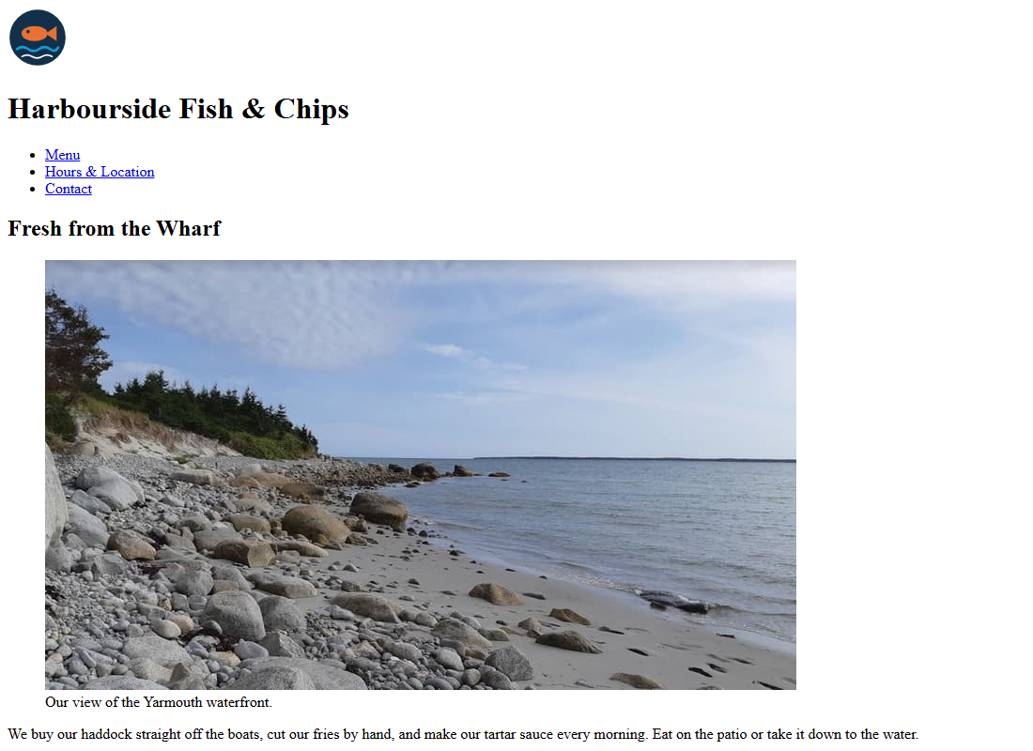
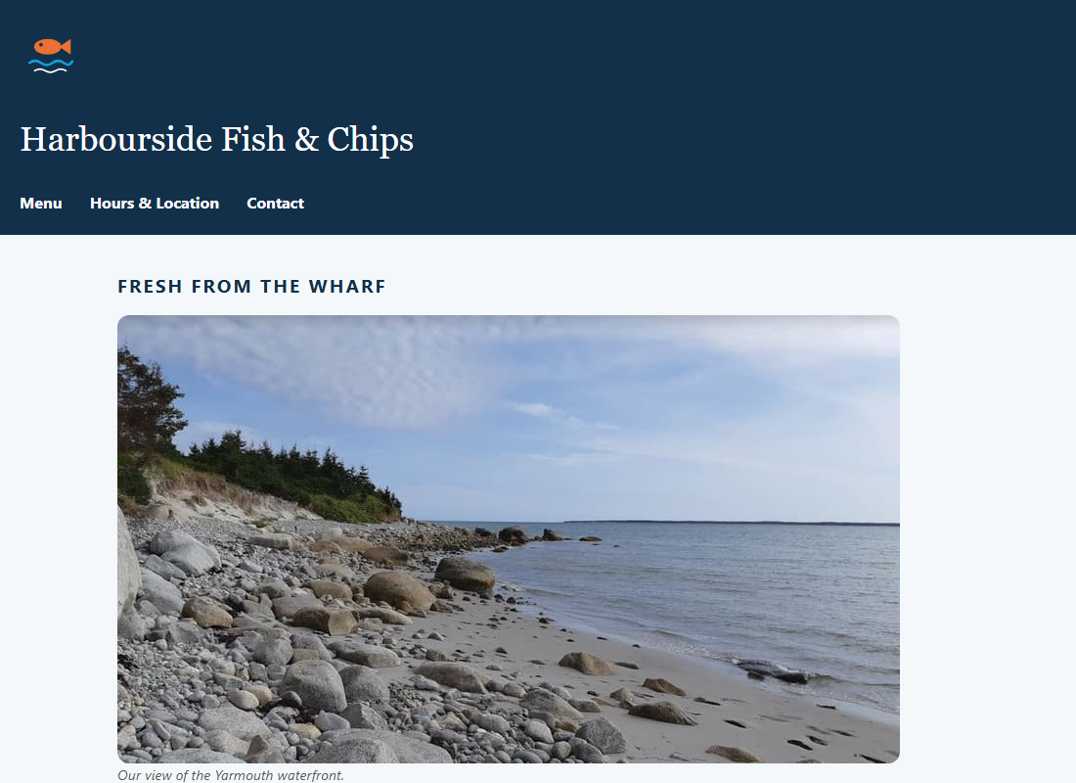
HTML/CSS Techniques
What Is CSS?
HTML ONLY
HTML + CSS
​CSS = Cascading Style Sheets. HTML says what things are. CSS says how they look.
​Same index.html in both pictures. The only difference is one linked .css file.
​One stylesheet can style a whole site. Change it once, every page updates.
Notes:
CSS = Cascading Style Sheets. HTML says what each thing IS (a heading, a list, a navigation area). CSS says how it LOOKS: colours, fonts, spacing, layout.
These two screenshots are the SAME index.html file. The only difference is one linked stylesheet. That's where we're going today.
Famous demo: csszengarden.com. Hundreds of designs, all using exactly the same HTML file. Click through a few designs if there's time.
Why keep them separate? Change one .css file and every page on the site updates. And the HTML stays clean and accessible, which is what screen readers and search engines read.

Slide 6
HTML/CSS Techniques
Anatomy of a CSS Rule
h1
Selector
Which elements to style
h1 {
color: navy;
font-size: 2rem;
}
color
Property
What to change
navy
Value
What to change it to
Read it out loud
color: navy;
Declaration
One instruction, ending in ;
"For every h1: make the colour navy, and the font size 2rem."
{ }
Braces
Wrap all the declarations
Notes:
Every CSS rule has the same shape. Read it out loud: 'For every h1: make the colour navy, and the font size 2rem.'
Selector = WHO. Declarations = WHAT. Each declaration is property: value; and you can have as many as you like inside the braces.
The colours on the right match the colours VS Code uses, so students can spot each part in their own editor.

Slide 7
HTML/CSS Techniques
Writing CSS: Watch Out For…
/* Broken: nothing happens */
h1 {
colour: navy
font-size: 2 rem;
text-align = centre;
}
/* Fixed */
h1 {
color: navy;
font-size: 2rem;
text-align: center;
}
​American spelling: color and center, not colour and centre.
​Every declaration ends in ;. Missing one breaks the next line too.
​Colon, not equals: color: navy. (HTML attributes use =.)
​No space before the unit: 2rem, not 2 rem.
​Comments are /* … */ in CSS, not <!-- -->.
Notes:
These are the mistakes beginners make most. The big problem: CSS fails SILENTLY. A typo doesn't give an error message. The browser skips that line and carries on, so the page just doesn't change.
The Canadian one: it's color, not colour. CSS only understands American spelling. Same with 'center', not 'centre'.
DevTools helps: an invalid declaration shows with a yellow warning triangle and a line through it.

Slide 8

+
Concept → Try It
•
○
+
Seven rounds · one restaurant website · all in activity/style.css
•
○
Notes:
From here on it's a rhythm: a concept slide, then a Try It slide. Students add each piece to activity/style.css under the matching heading.
Keep the browser and VS Code side by side. Live Server reloads every time they save.

Slide 9
HTML/CSS Techniques
Concept 1: Three Ways to Add CSS
1
Inline
style="…" on one element
One element only. Hard to maintain. Avoid.
<p style="color: red;">
2
Internal
<style> in the <head>
One page only. Fine for demos.
<style> p { … } </style>
3
External
<link> to a .css file
Every page shares one file. Use this.
<link rel="stylesheet" href="style.css">
Notes:
Inline styles are handy for a quick test but a nightmare to maintain: to change the colour of every price, you'd have to edit every element. They also beat almost every other rule, which makes debugging hard.
Internal (<style> in the head) is fine for a single page or a demo. That's what our numbered examples use, so everything is in one file.
External is what real sites use: one style.css linked from every page. The browser also downloads it once and caches it for the other pages.

Slide 10

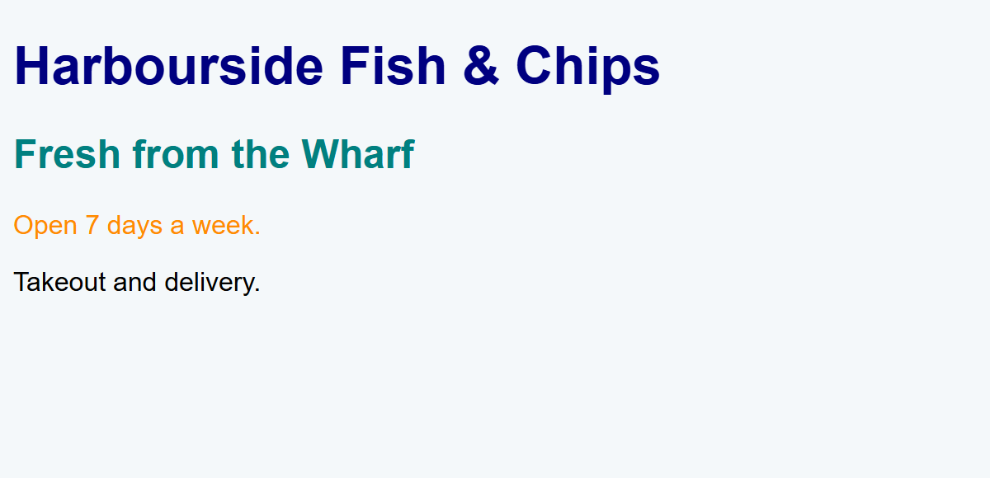
EXAMPLE 01
All Three on One Page
<!-- 3. External: a separate .css file. Best! -->
<link rel="stylesheet" href="01_external.css">
<!-- 2. Internal: a style block (this page only) -->
<style>
h2 {
color: teal;
}
</style>
<!-- Styled by 01_external.css -->
<h1>Harbourside Fish &amp; Chips</h1>
<!-- Styled by the style block above -->
<h2>Fresh from the Wharf</h2>
<!-- 1. Inline: a style attribute on ONE element (avoid this) -->
<p style="color: darkorange;">Open 7 days a week.</p>
<p>Takeout and delivery.</p>
​<link> goes in the <head>. href is the path to the .css file, just like an <a href>.
​Open 01_external.css: no <style> tags, just rules.
​The inline style only affects that one paragraph.
RESULT
01_three_ways_example.html + 01_external.css
Notes:
Open 01_three_ways_example.html with Live Server, then open 01_external.css next to it.
Demo: change navy to darkred in 01_external.css and save. The h1 changes. If ten pages linked this file, all ten would change. That's the reason external stylesheets win.
Common bug for Try It 1: the href path is wrong (e.g. href="css/style.css" when the file isn't in a css folder). The browser fails silently. DevTools → Console shows a 404 for the missing file.

Slide 11
Try It 1: Link Your Stylesheet (5 min)
1
Open activity/index.html with Live Server
TYPE THIS
​Black text on white: the browser's default styles.
<!-- in index.html, inside <head> -->
<link rel="stylesheet" href="style.css">
/* in style.css */
body {
background-color: #F4F8FA;
}
2
Open activity/style.css
​Only comments so far. It isn't linked, so the browser ignores it.
3
Add the <link> in index.html
​Inside the <head>, where the comment says Activity 1.
4
Add the body rule under Activity 1
​Save both files. The background should turn a very light blue.
5
Nothing happened?
​Check: both files saved? href spelled exactly style.css? Both files in the activity folder?
​The colour is subtle on purpose. If you can't tell it worked, try hotpink first, then change it back.
Notes:
Walk around and make sure EVERYONE has a working link before moving on. Everything else today depends on it.
The most common problems: forgot to save index.html; typed href="styles.css" (with an s); put the <link> inside <body>; or opened index.html directly from File Explorer instead of with Live Server (it still works, it just doesn't auto-reload).

Slide 12
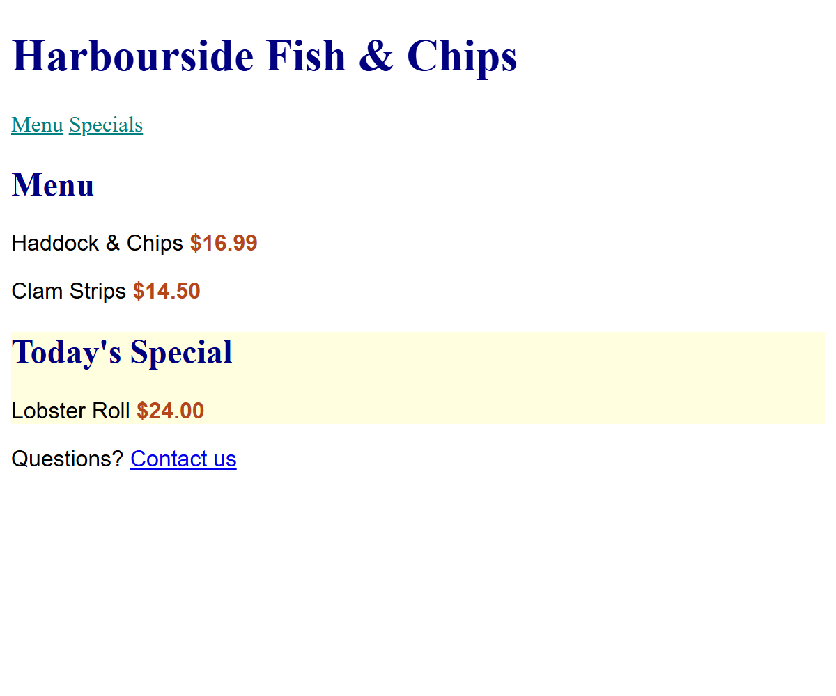
CONCEPT 2
/* Element: every <p> on the page */
p {
font-family: Arial, sans-serif;
}
/* Class (.): every element with class="price" */
.price {
font-weight: bold;
color: #B5451B;
}
/* ID (#): the ONE element with id="specials" */
#specials {
background-color: lightyellow;
}
/* Group (,): the same style for h1 AND h2 */
h1, h2 {
color: navy;
}
/* Descendant (space): only links INSIDE a nav */
nav a {
color: teal;
}
Selectors: Choosing What to Style
​p element: every one. .price class: every element with class="price". #specials id: one element only.
​h1, h2 comma = both. nav a space = an a somewhere inside a nav.
RESULT
02_selectors_example.html
Notes:
Walk through each selector and find what it styles in the result.
Class vs id: a class can be used on as many elements as you like, and one element can have several classes (class="menu-item special"). An id must be unique on the page. We've already used ids for links (href="#menu") and aria-labelledby.
Naming: lower case, words joined with hyphens: menu-item, not MenuItem or menu item (a space would make it TWO classes).
In the HTML it's class="price" (no dot); in the CSS it's .price (with a dot). That's the most common mistake in Try It 2.
Note the 'Contact us' link at the bottom stays blue. It isn't inside a nav, so 'nav a' doesn't match it.

Slide 13
Try It 2: Selectors (8 min)
1
Group: make h1 and h2 navy
IN STYLE.CSS
​One rule with a comma: h1, h2.
h1, h2 {
color: #12304A;
}
.price {
font-weight: bold;
}
.special {
background-color: #FBE9DF;
}
nav a {
color: #12304A;
}
2
Add class="price" to all four prices
​In index.html: <p class="price">$16.99</p> and so on.
3
Add class="special" to the Lobster Roll
​On its <article> tag.
4
Write the .price, .special and nav a rules
​Copy the code on the right into style.css under Activity 2.
5
Check
​All four prices bold? Only the Lobster Roll highlighted?
​Typed .price in the HTML? The dot only goes in the CSS.
Notes:
Two kinds of change in this one: HTML (adding class attributes) and CSS. That's the normal workflow: the HTML says what something is (this is a price), the CSS says how prices look.
If the Lobster Roll isn't highlighted: check class="special" is on the <article>, not the <h3>.
The nav links turning navy matters in Try It 3: on a navy header they'll disappear, and we'll fix that.

Slide 14
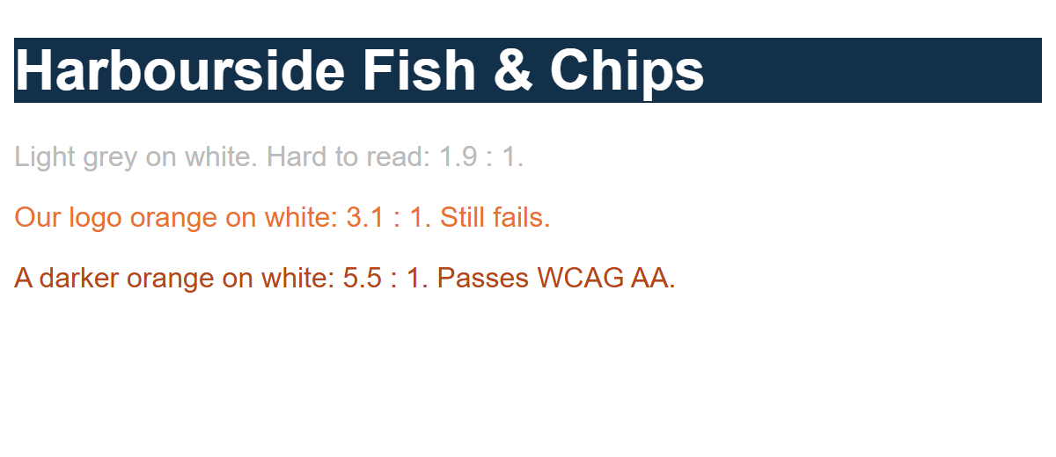
CONCEPT 3
Colour and Contrast
body {
font-family: Arial, sans-serif;
background-color: white; /* a colour name */
}
header {
background-color: #12304A; /* hex: #RRGGBB */
color: rgb(255, 255, 255); /* rgb: red, green, blue (0-255) */
}
/* Contrast: text vs. its background. WCAG AA needs 4.5 : 1 */
.fail {
color: #BBBBBB; /* 1.9 : 1 fails */
}
.brand-orange {
color: #E97132; /* 3.1 : 1 fails for normal text */
}
.pass {
color: #B5451B; /* 5.5 : 1 passes */
}
​color = text. background-color = behind it. Write colours as a name, hex (#12304A) or rgb.
​Contrast: WCAG AA needs 4.5 : 1 for normal text (3 : 1 for large headings).
​DevTools shows the ratio: inspect the text → click the colour square in Styles.
RESULT
03_colour_example.html
Notes:
Hex: #RRGGBB, two digits each for red, green and blue, from 00 (none) to FF (full). #000000 is black, #FFFFFF is white, #FF0000 is red. rgb(255, 0, 0) is the same red written in decimal.
Colour names: there are about 140 (navy, teal, darkorange, hotpink…). Handy for testing; real designs use hex.
Contrast ties back to Class 4 and 5 (Perceivable). Lighthouse flags low contrast. The interesting one here: the brand orange from our logo fails for body text (3.1 : 1). It's fine for big bold headings or decoration, but prices need the darker orange.
DevTools: right-click text → Inspect → in Styles, click the small colour square next to color. The picker shows 'Contrast ratio' with a ✓ or ✗ for AA and AAA.

Slide 15
Try It 3: Colour (8 min)
1
Header: navy background, white text
IN STYLE.CSS
​Add the header rule.
header {
background-color: #12304A;
color: white;
}
header h1 {
color: white;
}
nav a {
color: white;
}
.price {
color: #B5451B;
}
footer {
background-color: #262626;
color: #F2F2F2;
}
2
Uh-oh: the h1 is still navy on navy!
​Why? The h1, h2 rule targets the h1 directly. Fix it with header h1.
3
White nav links, dark orange prices, dark footer
​Add the rest of the rules on the right.
4
Check the contrast in DevTools
​Inspect a price → click its colour square → contrast ratio. Is it at least 4.5?
5
Try your own colours
​Change any colour you like, as long as it still passes 4.5 : 1.
Notes:
Step 2 is a planned 'bug'. Text colour is inherited from the header, BUT the h1 has its own rule (h1, h2 { color: navy }) and a rule aimed at the element itself always beats an inherited value. 'header h1' targets the h1 more specifically, so it wins. Full explanation in Concept 7.
Colour picking: coolors.co and Adobe Color are good palette generators. WebAIM's contrast checker (webaim.org/resources/contrastchecker) is another way to check a pair of colours.

Slide 16
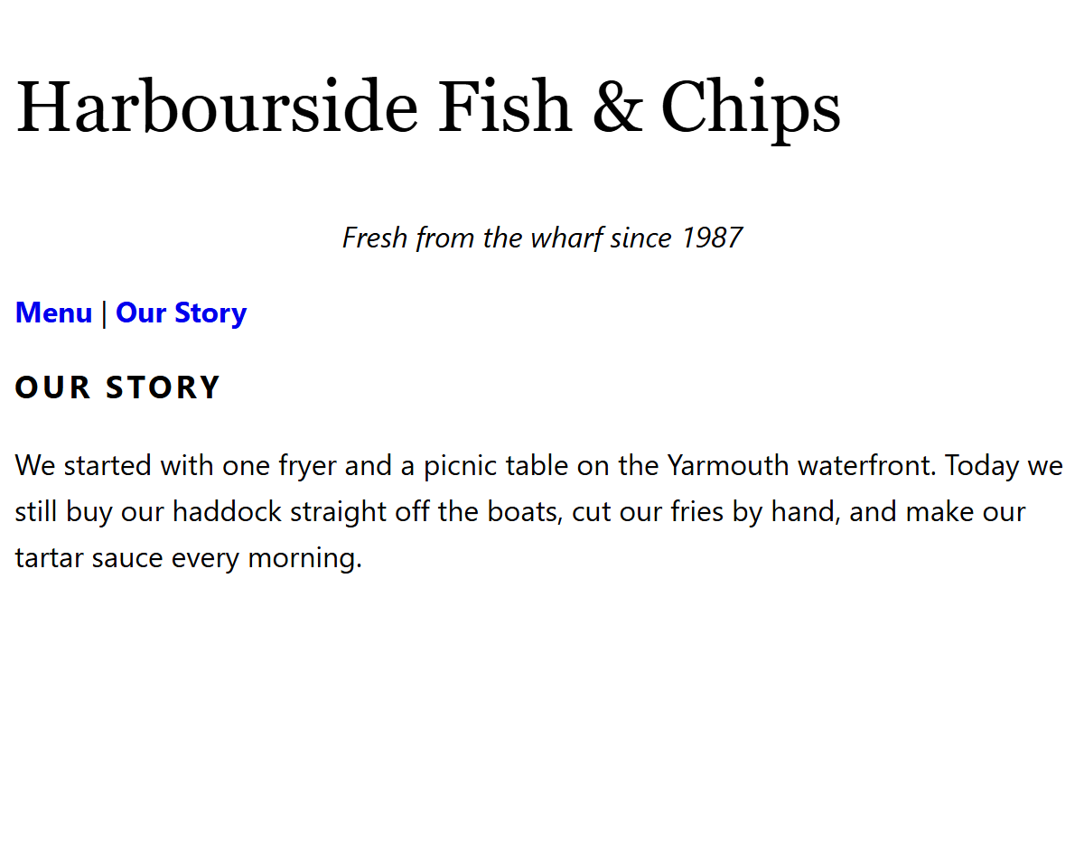
CONCEPT 4
Text and Fonts
body {
/* A font stack: use the first one this computer has */
font-family: "Segoe UI", Arial, sans-serif;
font-size: 1rem; /* the user's default size, usually 16px */
line-height: 1.6; /* space between lines: 1.6 x font size */
}
h1 {
font-family: Georgia, "Times New Roman", serif;
font-size: 2.5rem;
font-weight: normal;
}
h2 {
font-size: 1.1rem;
text-transform: uppercase;
letter-spacing: 2px;
}
.tagline {
font-style: italic;
text-align: center;
}
nav a {
text-decoration: none; /* no underline */
font-weight: bold;
}
​Font stack: a list of fonts. The browser uses the first one it has. End with serif or sans-serif.
​Size text in rem, not px: rem respects the user's own font-size setting.
​line-height: 1.5–1.7 makes paragraphs much easier to read.
RESULT
04_text_fonts_example.html
Notes:
Font stacks: we can only use fonts the visitor's computer has (or ones we download, like Google Fonts). 'Segoe UI' is on Windows; Mac users fall back to Arial; and if all else fails, any sans-serif. Font names with spaces need quotes.
rem: 1rem = the browser's default font size, usually 16px. People with low vision often turn that up in their browser settings. Text sized in rem grows with it; text sized in px doesn't. That's a WCAG point (Resize Text, 1.4.4).
text-transform: uppercase vs typing in capitals: with CSS, the HTML still says 'Our Story', so screen readers read it normally (some read typed ALL CAPS letter by letter).
Google Fonts (fonts.google.com): pick a font, copy the <link> into your <head>, then use the font name in font-family. That's the bonus in Try It 4.

Slide 17
Try It 4: Text and Fonts (8 min)
1
Body: a font stack, line height and text colour
IN STYLE.CSS
​Everything inherits it, so one rule changes the whole page.
body {
font-family: "Segoe UI", Arial, sans-serif;
line-height: 1.6;
color: #262626;
}
h1 {
font-family: Georgia, serif;
font-size: 2.2rem;
font-weight: normal;
}
h2 {
font-size: 1.2rem;
text-transform: uppercase;
letter-spacing: 2px;
}
nav a {
text-decoration: none;
font-weight: bold;
}
2
h1: a serif font
​Georgia looks good for a restaurant name.
3
h2: small capitals with spacing
​text-transform and letter-spacing.
4
Nav links: no underline, bold
​Add to your existing nav a rule, or write a new one below it.
5
Bonus: a Google Font
​fonts.google.com → pick one → copy the <link> into your head → use its name in font-family.
Notes:
Point out that body now has two rules (Activity 1's background, and this one). That's fine: the browser combines them. The answer key keeps them separate so you can see what each activity added.
For the Google Font bonus, 'Pacifico' or 'Lobster' are fun for the h1 of a fish-and-chip shop; 'Open Sans' or 'Lato' for body text. Remind them to keep a fallback: font-family: "Lobster", Georgia, serif;

Slide 18
HTML/CSS Techniques
Concept 5: The Box Model
margin
margin
border
Space OUTSIDE the border. Always see-through. Pushes other boxes away.
padding
border
content
A line around the padding: width, style, colour.
Haddock & Chips
padding
Space INSIDE the border. Gets the background colour.
content
The text or image itself: width and height.
​padding: 10px 20px; = top/bottom 10px, left/right 20px. Four values go clockwise: top, right, bottom, left.
​margin: 0 auto; + a max-width = a centred column.
Notes:
Every element on the page is a rectangular box, even text and images. The box has four layers, from the inside out: content, padding, border, margin.
Padding is INSIDE the border, so it gets the background colour. Margin is OUTSIDE the border; it's always transparent, it just pushes other boxes away.
Shorthand: 'padding: 10px 20px' = top & bottom 10, left & right 20. Four values go clockwise from the top: top, right, bottom, left (remember 'TRouBLe').
Turn on DevTools → Elements → Computed to see this exact diagram for any element.

Slide 19
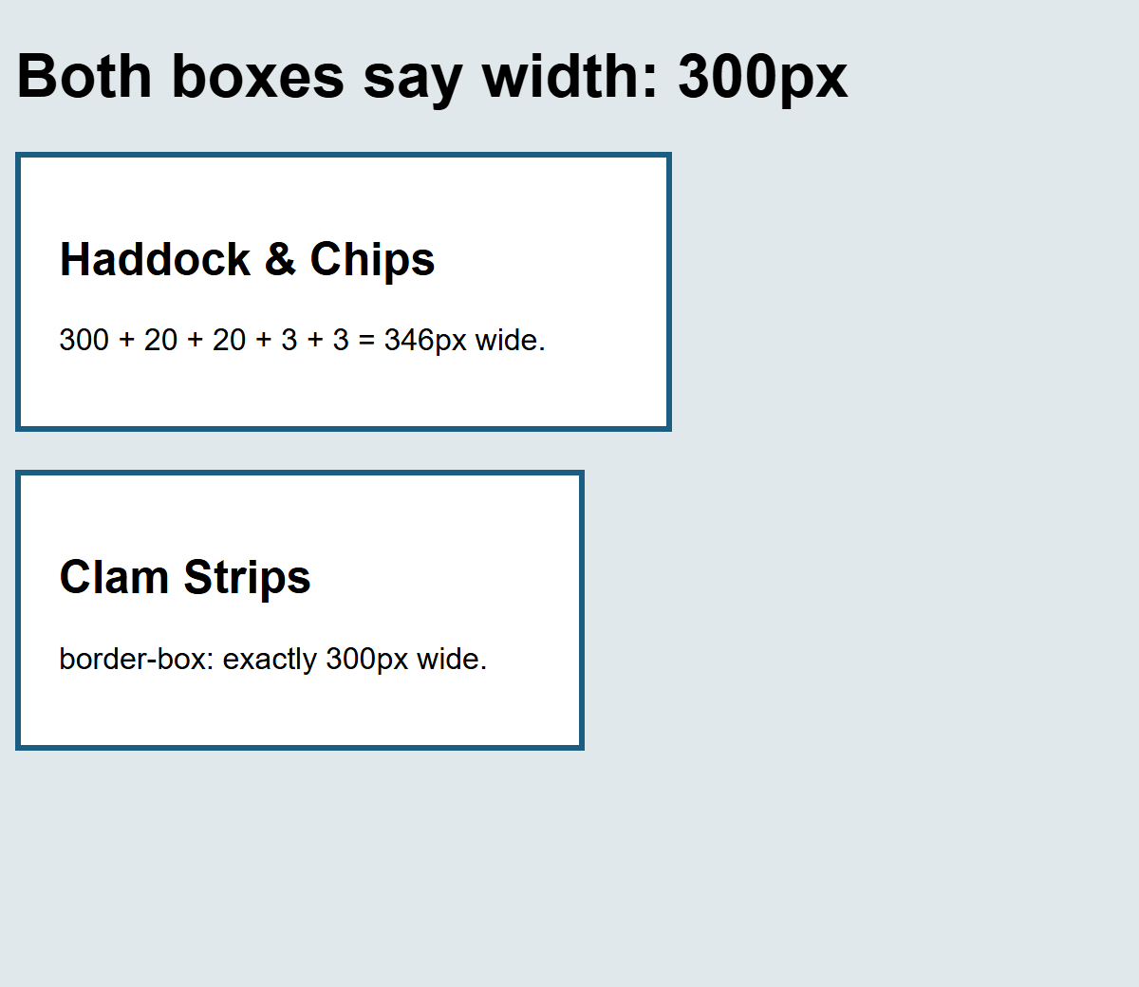
EXAMPLE 05
Padding, Border, Margin
body {
font-family: Arial, sans-serif;
background-color: #E1E8EB;
}
main {
max-width: 700px;
margin: 0 auto; /* auto left and right = centred */
}
.menu-item {
width: 300px;
padding: 20px; /* space INSIDE the border */
border: 3px solid #1B5E82; /* width, style, colour */
margin: 20px 0; /* OUTSIDE: top/bottom, left/right */
background-color: white;
}
.border-box {
box-sizing: border-box; /* width INCLUDES padding + border */
}
​Both boxes say width: 300px, but by default width is only the content. Padding and border are added on top: 346px.
​box-sizing: border-box makes width include padding and border. Much easier to plan.
RESULT
05_box_model_example.html
Notes:
Open 05_box_model_example.html. The two boxes have identical width, padding and border, but the first is visibly wider.
Most developers put this at the top of every stylesheet:
* { box-sizing: border-box; }
The * is the universal selector: every element. We'll do that in Try It 5.
Demo in DevTools: inspect the first box, open Computed, and hover over the box diagram. The page highlights margin (orange), border (yellow), padding (green) and content (blue). Those are the colours on the previous slide.

Slide 20
Try It 5: The Box Model (12 min)
1
border-box for everything, and no gap around the page
IN STYLE.CSS
​* { box-sizing: border-box; } and body { margin: 0; }.
* {
box-sizing: border-box;
}
body {
margin: 0;
}
main {
max-width: 900px;
margin: 0 auto;
padding: 20px;
}
#menu article {
background-color: white;
border: 1px solid #D0D7DB;
border-radius: 8px;
padding: 4px 20px;
margin-bottom: 16px;
}
nav ul {
list-style: none;
padding: 0;
}
nav li {
display: inline;
margin-right: 24px;
}
2
Centre the main content
​main: a max-width and margin: 0 auto.
3
Turn each menu item into a card
​#menu article: white background, border, rounded corners, padding, margin.
4
Padding for the header, footer and aside
​header, footer { padding: 20px; } Then try a background on the aside.
5
Nav links side by side (sneak peek)
​Remove the bullets, then display: inline on each li.
6
Hmm… did something disappear?
​Look at the Lobster Roll. Hold that thought until Try It 7!
Notes:
The biggest visual change of the day. Resize the browser: the main column stays centred and never gets wider than 900px.
display is a big topic (block vs inline, then flexbox and grid). Here it's a sneak peek so the nav looks right. We'll cover it properly when we do layout.
Step 6 is deliberate: the Lobster Roll's .special highlight from Try It 2 is gone, because '#menu article' (white background) beats '.special'. Don't explain it yet. Students solve it with DevTools in Try It 7.

Slide 21
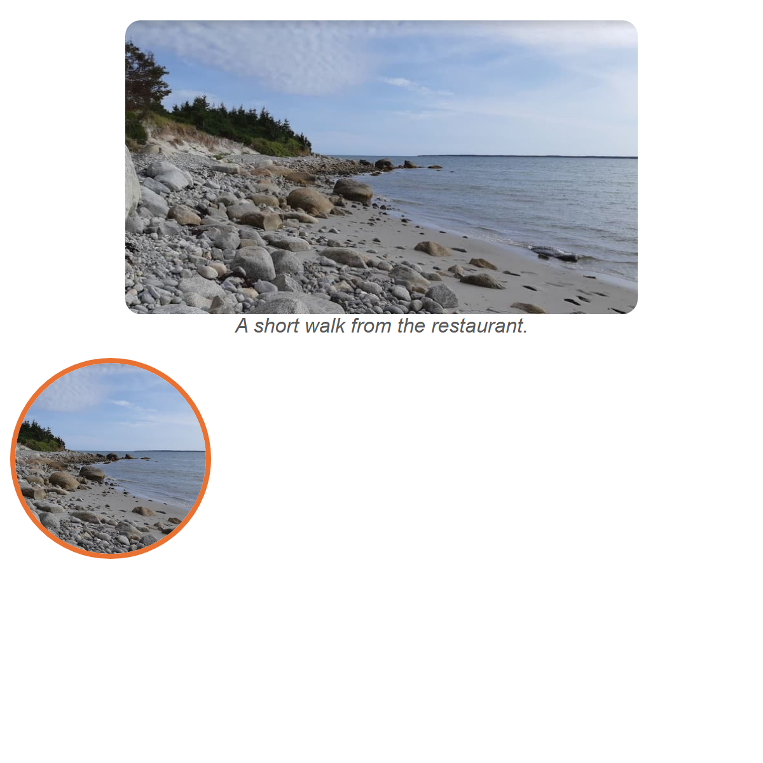
CONCEPT 6
body {
font-family: Arial, sans-serif;
}
/* Never wider than its container, and keep the proportions */
img {
max-width: 100%;
height: auto;
}
.hero {
display: block; /* so margin: auto can centre it */
width: 80%;
margin: 0 auto;
border-radius: 12px; /* rounded corners */
}
figcaption {
text-align: center;
font-style: italic;
color: #595959;
}
/* A square crop, then a circle */
.round {
width: 150px;
height: 150px;
object-fit: cover; /* fill the box, crop the extra */
border-radius: 50%;
border: 4px solid #E97132;
}
Styling Images
​max-width: 100% + height: auto: the image shrinks on small screens and keeps its shape. Use it on every site.
​border-radius rounds corners. 50% on a square = a circle. object-fit: cover crops to fill the box.
RESULT
06_styling_images_example.html
Notes:
max-width: 100% is the single most useful image rule. Without it, an 800px image on a 375px phone makes the whole page scroll sideways. With it, the image is never wider than its container. height: auto keeps the proportions (the HTML height attribute would otherwise stretch it).
This connects to last class: keep the width and height attributes in the HTML (so the browser reserves space), and let CSS decide the displayed size.
Centring an image: images are inline by default (they sit in a line of text like a big letter), so margin: auto doesn't centre them. display: block makes it a box of its own, then margin: 0 auto centres it.
object-fit: cover is how 'profile picture' circles are made from rectangular photos.

Slide 22
Try It 6: Images (8 min)
1
Make every image flexible
IN STYLE.CSS
​Then make the browser narrow. Does the photo shrink?
img {
max-width: 100%;
height: auto;
}
figure {
margin: 0 0 16px;
}
figure img {
display: block;
border-radius: 12px;
}
2
Round the corners of the main photo
​figure img: display: block and a border-radius.
3
Use YOUR photo from last class
​Copy photo_1200.jpg into activity/images. Update the src, width, height and alt.
4
Check the download size
​DevTools → Network → Img → reload. Is it under 150 KB?
5
Bonus: a round thumbnail
​object-fit: cover and border-radius: 50%, like Example 06.
​Your photo's width and height are in File Explorer → Properties → Details (Lab 1).
Notes:
This ties the two classes together: the optimized image from Class 7 goes onto the page from Class 6's wireframe, styled with today's CSS.
Testing flexible images: drag the browser narrower, or use DevTools device mode (Ctrl + Shift + M) and pick a phone.
If a student's photo is portrait (taller than wide), it will be very tall. That's a good conversation: choose a landscape crop for a banner photo, or limit it with max-height and object-fit: cover.

Slide 23
HTML/CSS Techniques
Concept 7: The Cascade — Who Wins?
Inline style
style="…"
1
More specific wins
Inline beats id beats class beats element.
ID
#special
2
A tie? The later rule wins
Same specificity: whichever comes last in the file.
Class
.notice
3
Inheritance
Element
p
Text styles like color and font-family pass down to children that don't have their own rule.
​Try It 3 mystery solved: header passed white down to the h1, but the h1, h2 rule targets the h1 directly. A rule aimed at the element always beats an inherited value.
Notes:
When two rules set the same property on the same element, the browser has to choose. That decision is 'the cascade': the C in CSS.
1. Specificity: the more specific selector wins. Inline style beats an id, an id beats a class, a class beats an element. (A combination like '#menu article' counts the id AND the element, so it beats '.special'.)
2. If they're equally specific, the rule that comes LATER in the file wins.
3. Inheritance: some properties (color, font-family, line-height) pass down from parent to child, unless the child has its own rule. Others (background, border, padding, margin) don't.
Before showing the next slide, play 'Who wins?': show the CSS from Example 07 and have students predict the colour of each line.

Slide 24
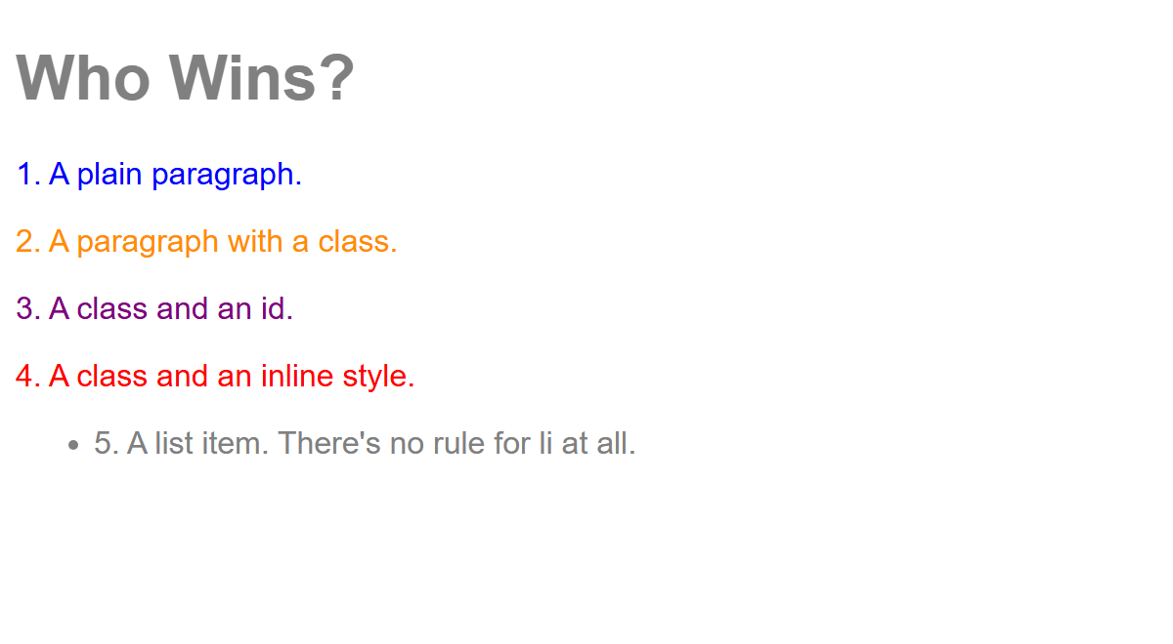
EXAMPLE 07
Who Wins? Check Your Predictions
/* Predict each line's colour, THEN check in DevTools */
body {
font-family: Arial, sans-serif;
color: gray; /* inherited by everything inside body */
}
p {
color: green;
}
p {
color: blue; /* same selector: the later rule wins */
}
.notice {
color: darkorange; /* a class beats an element */
}
#special {
color: purple; /* an id beats a class */
}
<h1>Who Wins?</h1>
<p>1. A plain paragraph.</p>
<p class="notice">2. A paragraph with a class.</p>
<p class="notice" id="special">3. A class and an id.</p>
<p class="notice" style="color: red;">4. A class and an inline style.</p>
<ul>
<li>5. A list item. There's no rule for li at all.</li>
</ul>
​1 blue: the later p rule wins the tie. 2 orange: class beats element. 3 purple: id beats class. 4 red: inline beats everything.
​5 and the h1: no rule of their own, so they inherit gray from body.
RESULT
07_cascade_example.html
Notes:
Show the CSS first (cover the result, or show the previous slide), and get predictions for each line. Then reveal.
Then open it in DevTools: inspect line 3. In Styles, #special is at the top; .notice and both p rules are listed below it with color crossed out. Inherited styles appear under 'Inherited from body'.
There's one level stronger than inline: !important. Mention that it exists and that students should avoid it: it's usually a sign the selectors need fixing.

Slide 25
HTML/CSS Techniques
Your Best Friend: DevTools Styles
Styles Computed Layout
Crossed out
#menu .special {
style.css:150
Lost to a stronger rule above it.
background-color: ■ #FBE9DF;
border-color: ■ #E97132;
⚠ Warning
}
The browser didn't understand it (here: colour).
#menu article {
style.css:124
Click to edit
background-color: ■ white;
Change any value live. Untick to switch it off.
border: 1px solid ■ #D0D7DB;
padding: 4px 20px;
}
style.css:124
Which file and line the rule came from.
.special {
style.css:23
background-color: ■ #FBE9DF;
⚠
DevTools changes vanish on reload. Copy the good ones to style.css!
colour: red;
}
Notes:
Right-click anything → Inspect. The Styles pane (Edge/Chrome; Firefox calls it Rules) shows every rule that applies to the selected element, most specific first.
- Crossed-out declarations lost the cascade to a rule higher up.
- A yellow warning triangle means the browser didn't understand the line (typo, colour vs color, missing unit).
- Checkboxes appear on hover: untick to switch a declaration off.
- Click any value to edit it live. Click a colour square for the colour picker and contrast ratio.
- The link on the right (style.css:42) jumps to the line in the Sources panel.
IMPORTANT: DevTools changes vanish on reload. When you find something you like, copy it into style.css.

Slide 26
Try It 7: DevTools Detective (10 min)
1
The mystery: where did the Lobster Roll's highlight go?
IN STYLE.CSS
​It was peach after Try It 2. Now it's white.
/* An id + a class beats an id + an element */
#menu .special {
background-color: #FBE9DF;
border-color: #E97132;
}
2
Right-click the Lobster Roll card → Inspect
​Click the <article class="special"> line in Elements.
3
Find .special in Styles
​Its background is crossed out. Which rule beat it, and why?
4
Fix it in style.css
​#menu article has an id, so it beats .special. Add the id to your rule too (on the right).
5
Play with it
​Click values in Styles and change them live. Untick some. Then reload: what happens?
​Open the Computed tab too: it shows the box model diagram for the card, with its real padding, border and margin.
Notes:
Answer: '#menu article' (one id + one element) beats '.special' (one class). It doesn't matter that .special came first or last; specificity is checked before order.
The fix: '#menu .special' (one id + one class) beats '#menu article' (one id + one element). Something like 'article.special' isn't enough, because it has no id. This is why many developers avoid id selectors in CSS: they're so strong they're hard to override. Classes for styling, ids for links and labels is a good habit.
Step 5: changes made in DevTools disappear on reload. It's a sandbox for trying things, and then you copy what works into the file.

Slide 27
Make It Yours, Then Submit (10 min, or homework)
Change at least three things. Ideas:
Submit to Brightspace
1
​Your own colour palette (coolors.co). Check every pair passes 4.5 : 1.
1. A screenshot of your page in the browser (Win + Shift + S)
2. Your style.css file
Stuck? Compare with activity/answer/style.css, one section at a time. Then use DevTools to find what's different.
2
​A Google Font for the h1 (fonts.google.com).
3
​A hover style for links: nav a:hover { text-decoration: underline; }
4
​Style the aside (hours): background, border, rounded corners.
5
​Make the footer centred, with smaller text.
6
​Make the prices bigger, or put a border-bottom under each h2.
Notes:
If time is short, students submit what they have and finish 'make it yours' as homework.
What to collect on Brightspace: a screenshot of their page in the browser, and their style.css file. Checking style.css tells you whether they actually wrote the rules (look for their own colours and at least two changes beyond the answer key).

Slide 28
How did you make out?
​Which change made the biggest difference to how the page looks?
​What was your most annoying bug? How did you find it?
​Why use a class for the prices instead of styling each one inline?
​Did any of your colour choices fail the contrast check?
HTML = what it is
CSS = how it looks
Notes:
Usual answers: the box model round (centring main, cards) makes the biggest visual jump. Common bugs: a missing semicolon or brace, 'colour', a class typed with a dot in the HTML, and the specificity mystery.
Why classes: change one rule and every price updates; the HTML stays clean; and inline styles are so specific they're hard to override later.

Slide 29
HTML/CSS Techniques
Today's CSS Cheat Sheet
Property | Example | What it does
color | color: #12304A; | Text colour
background-color | background-color: white; | Colour behind the element
font-family | font-family: Georgia, serif; | The font (with fallbacks)
font-size | font-size: 1.2rem; | Text size (prefer rem)
font-weight / font-style | font-weight: bold; | Bold / italic
line-height | line-height: 1.6; | Space between lines
text-align / text-transform | text-align: center; | Alignment / capitals
text-decoration | text-decoration: none; | Remove or add underlines
padding / border / margin | padding: 10px 20px; | The box model layers
max-width + margin: auto | margin: 0 auto; | A centred column
border-radius | border-radius: 8px; | Rounded corners (50% = circle)
box-sizing | box-sizing: border-box; | Width includes padding and border
Notes:
Everything we used today, in one place. It's also in the README. Students can keep this slide open while they finish 'make it yours'.

Slide 30
HTML/CSS Techniques
Class Recap and Next Steps
Recap:
  CSS rules: selector { property: value; }. Link one external style.css to every page.
  Select by element, .class, #id, groups (a, b) and descendants (nav a).
  Colour with contrast of 4.5 : 1 or better. Fonts in stacks, sizes in rem.
  Every element is a box: content, padding, border, margin.
  img { max-width: 100%; height: auto; } on every site.
  When rules clash: more specific wins, then the later one. DevTools shows you which.
Next class:
  More selectors (:hover, :focus), navigation menus, tables, and validating our code.
Notes:
Next: more selectors (pseudo-classes like :hover and :focus), styling navigation menus and tables, and checking our code with the W3C validator. Then layout with flexbox.

