Slide 1
WEBD 1000
Week 10, Class 1:
  CSS frameworks, and Bootstrap's 12-column grid.
Week 10: CSS Frameworks
Notes:
Welcome back! For the last few weeks we've written every line of CSS ourselves: flexbox, grid, float, media queries. This week we look at CSS frameworks: CSS that someone else has already written, that we link to and use with class names.
Bootstrap is the main one. Next class we also look at Tailwind CSS, then rebuild Harbourside with Bootstrap.
Same routine as before: pop quizzes all the way through, and Try Its.

Slide 2
Attendance and a Quick Check-in
OUTLOOK
TEAMS
✓
Are you checking your school Outlook email?
✓
Are you signed into Teams?
TEAMS
BRIGHTSPACE
✓
Are you following our Teams channel and General chat?
✓
Are you following the Content on Brightspace?
Notes:
Take attendance while everyone checks these four things.
Remind students that announcements go to their school email and the Teams channel. If anyone hasn't been checking, now is the time.

Slide 3
Is Your Environment Set Up?
GIT
VS CODE
✓
Did you run git pull? You should see a 10_CSS_Frameworks folder.
✓
Is the 10_CSS_Frameworks folder open in VS Code?
LIVE SERVER
INTERNET
✓
Does Example 01 (the starter) open with Go Live?
✓
Bootstrap loads from the web today. Does Example 01 have a blue button?
Notes:
Help anyone who's stuck now, so they aren't lost during the Try Its.
New this week: the examples link to Bootstrap on a CDN (a server on the internet). If Example 01 shows plain black text and a grey button, the Bootstrap file didn't load. Check the Wi-Fi, then check the link for typos.
git pull: if it complains about local changes, they can commit their changes first, or copy their work somewhere safe and run git stash.

Slide 4
Recall: What Did We Do Last Class?
1
The viewport meta tag
​Goes in every page, or phones lay it out 980px wide.
2
Media queries
​@media (min-width: 768px): phones first, then add to it.
3
Fluid layouts
​Percentages, max-width, and box-sizing: border-box.
4
Images and text
​img { max-width: 100%; } and clamp().
One page, three screens: 1, 2 and 3 columns.
Notes:
Before you read anything out, ask: what did we do last class? Give everyone 30 seconds to tell a neighbour, then take a few answers.
Then go through the four points.
The link to today: Bootstrap is built on exactly these things. Its grid is flexbox plus min-width media queries, and it needs the viewport tag. Students who understood last week will find Bootstrap much less magical.

Slide 5
Week 10: CSS Frameworks
Week 10, Class 1: Overview
Title: CSS Frameworks and the Bootstrap Grid
Agenda:
  What a CSS framework is, and what it costs
  The popular frameworks, and the two kinds
  Adding Bootstrap to a page
  Containers, rows and the 12-column grid
  Breakpoints, and colour and spacing classes
Why
→
Link
→
Grid
Frameworks
Bootstrap
12 columns
Notes:
Rough plan for the class:
- 10 min: check-in, environment, recall, overview, warm-up
- 15 min: frameworks, the two kinds, Pop Quiz 1
- 15 min: Bootstrap, Example 01, Pop Quiz 2
- 25 min: the grid, breakpoints, Examples 02 and 03, Pop Quizzes 3 to 5
- 10 min: utilities, Example 04, Pop Quiz 6
- 15 min: Try It 1, together
- 5 min: recap
Pop quizzes: give everyone 30 seconds to think, then count down and have them hold up 1 to 4 fingers (A to D) all at once. Or use the Teams chat. Nobody is marked on these, but the Week 10 quiz on Brightspace uses the same questions.

Slide 6
Warm-up: What Does "Bootstrap" Mean? (1 min)
?
?
"To bootstrap"
"Booting" a computer
What does it mean when a person or a business does it?
Where do you think that word comes from?
Notes:
Ask before saying anything about the framework. One minute with a neighbour, then take a few answers.
The phrase: to 'pull yourself up by your bootstraps' means to get going with no outside help. (Bootstraps are the loops at the back of a boot. Taken literally it's impossible, which was the original joke.)
Computers: 'booting' a computer is short for bootstrapping: a tiny program that loads a bigger one, which loads the operating system.
Business: a 'bootstrapped' startup grows on its own money, with no investors.
The framework: Bootstrap gets a site up and running quickly, from almost nothing. It started at Twitter in 2011 as a way to make their internal tools look consistent.

Slide 7

+
CSS Frameworks
•
○
+
What they are · what they cost · the popular ones
•
○
Notes:
So far we've written all of our CSS by hand. A framework is CSS someone else has already written and tested, which you use by putting class names on your HTML.

Slide 8
Week 10: CSS Frameworks
What Is a CSS Framework?
A library of CSS (and sometimes JavaScript) that's already written. You use it by adding class names to your HTML.
1
2
3
4
Consistency
Speed
Responsive
Cross-browser
Every page looks the same
Ready-made parts
Phones first, built in
Already tested
​It's still just CSS. Selectors, the cascade, flexbox and media queries: everything you've learned is underneath.
Notes:
Read the definition. The important words: already written, and class names.
The four benefits from last year's slides:
- Consistency: every button, form and table on every page looks the same, without you having to remember the exact padding.
- Speed: a navbar that folds into a menu button on phones takes a few minutes, not an afternoon.
- Responsive: the grid and components are built phones first, with media queries like last week's.
- Cross-browser: the framework's authors have already tested it in every current browser.
The dark box is the point to come back to all week: a framework is not a different language. When something looks wrong, it's still the cascade, specificity, the box model and flexbox underneath. DevTools still works.

Slide 9
Week 10: CSS Frameworks
What a Framework Costs
Sites look alike
A big file
The "Bootstrap look" is easy to spot. You'll want your own CSS on top.
About 230 KB of CSS (31 KB compressed), and most pages use a small part.
Lots of classes
You still need CSS
Busy HTML, and hundreds of class names to look up.
To make it yours, and to fix it when it goes wrong.
Notes:
Last year's slides only listed the benefits. Students should hear the other side too, so they can choose.
- Every site looks the same: the default Bootstrap look (that blue button, that navbar) is very recognizable. You need your own CSS on top to look like yourself. That's Try It 7 next class.
- Size: bootstrap.min.css is about 230 KB, and the JavaScript bundle about 80 KB. Compressed over the network they're about 31 KB and 24 KB. Most pages use a small part of it. Show this in the DevTools Network tab on Example 01 (F12, Network, reload).
- Lots of classes: the HTML gets busy, and there are hundreds of class names to learn. The docs are open on every developer's second monitor.
- You still need CSS: to change the look, and to fix things when they go wrong. Which is why we learned CSS first.
On balance, frameworks are very widely used, especially for prototypes, admin pages and internal tools, where speed matters more than a unique look.

Slide 10
Week 10: CSS Frameworks
Two Kinds of Framework
COMPONENT · BOOTSTRAP
Ready-made parts with names.
<button class="btn btn-primary">
Order
</button>
UTILITY-FIRST · TAILWIND
Small classes you put together.
<button class="bg-blue-600 text-white
px-4 py-2 rounded">
Order
</button>
Notes:
This is the main idea for comparing frameworks, and it's why we look at Tailwind next class.
Component frameworks (Bootstrap, Foundation, Bulma) give you finished parts with names: a button, a card, a navbar. You write class="btn btn-primary" and get a complete, styled button.
Utility-first frameworks (Tailwind) give you small classes that each do about one CSS property: bg-blue-600 is a background colour, px-4 is left and right padding, rounded is a border radius. You build the button yourself, out of those.
Both buttons here look about the same in a browser. Ask: which HTML would be easier to read? Which would be easier to make look different from every other site?
Bootstrap has utility classes too (we'll see them today), so the line isn't perfectly sharp. It's about what each one leads with.

Slide 11
Week 10: CSS Frameworks
Popular CSS Frameworks
Framework | Kind | Known for
Bootstrap | Component | The most used on existing sites. Grid, components, JavaScript.
Tailwind CSS | Utility-first | The most popular for new projects. Small classes for everything.
Foundation | Component | Very customizable. Few updates now.
Bulma | Component | Flexbox based, CSS only, readable class names.
​This week: Bootstrap (both classes), and a look at Tailwind next class: one of each kind.
Notes:
From last year's slides, updated.
- Bootstrap: on more existing websites than any other CSS framework. Version 5.3 is current, and version 6 is in alpha (a test version, not for real sites yet).
- Tailwind CSS: the most popular choice for new projects in developer surveys over the last few years. Version 4 is current.
- Foundation, by ZURB: very customizable, and was big for a while, but it gets few updates now.
- Bulma: CSS only (no JavaScript), built on flexbox, with readable class names like 'button is-primary'.
Why we demo Bootstrap and Tailwind: they're the two students are most likely to meet in a job, and they're one of each kind. If you learn those two, the others will look familiar.

Slide 12
?
POP QUIZ 1
​Which of these frameworks is utility-first?
​Bootstrap
​Bulma
A
B
​Foundation
​Tailwind CSS
C
D
Vote: hold up 1, 2, 3 or 4 fingers (A to D), or type your letter in the Teams chat. 30 seconds!
Notes:
A quick check on the last two slides.

Slide 13
?
POP QUIZ 1: ANSWER
​Which of these frameworks is utility-first?
​Bootstrap
​Bulma
A
B
​Foundation
​Tailwind CSS
C
✓
Why?
​Utility-first means lots of small classes, each doing about one thing: px-4, bg-blue-600, rounded.
​Bootstrap, Bulma and Foundation lead with ready-made components, like btn and card.
Notes:
Answer: D.
If anyone said Bootstrap: it does have utility classes (we'll use them today), but it's known for its components.

Slide 14
+
Bootstrap
•
○
+
What it is · adding it to a page · the grid
•
○
Notes:
Bootstrap is the framework for the rest of the week.

Slide 15
Week 10: CSS Frameworks
What Is Bootstrap?
A free, open-source framework of CSS and JavaScript, built phones first. Made at Twitter in 2011. We use version 5.3.
Grid
TODAY
Utilities
TODAY
Rows and 12 columns
Colour, spacing, display
Components
NEXT CLASS
JavaScript
NEXT CLASS
Buttons, cards, navbars
Menus, dropdowns, modals
​Searching for help? Add "Bootstrap 5". Code for 3 and 4 doesn't always work.
Notes:
Bootstrap is free and open source (MIT licence), so you can use it on any site, including for a client.
History: Mark Otto and Jacob Thornton made it at Twitter in 2011, to make Twitter's internal tools consistent. It was released to everyone later that year and became the most used CSS framework on the web.
Versions matter: a lot of tutorials online are for Bootstrap 3 or 4, and their code doesn't always work in 5. When you search for help, put 'Bootstrap 5' in the search. Last year's slides used Bootstrap 4 code in places, and we'll see what goes wrong with that next class.
The four parts, from last year's slides: today is the grid and the utilities. Next class is components and JavaScript.

Slide 16

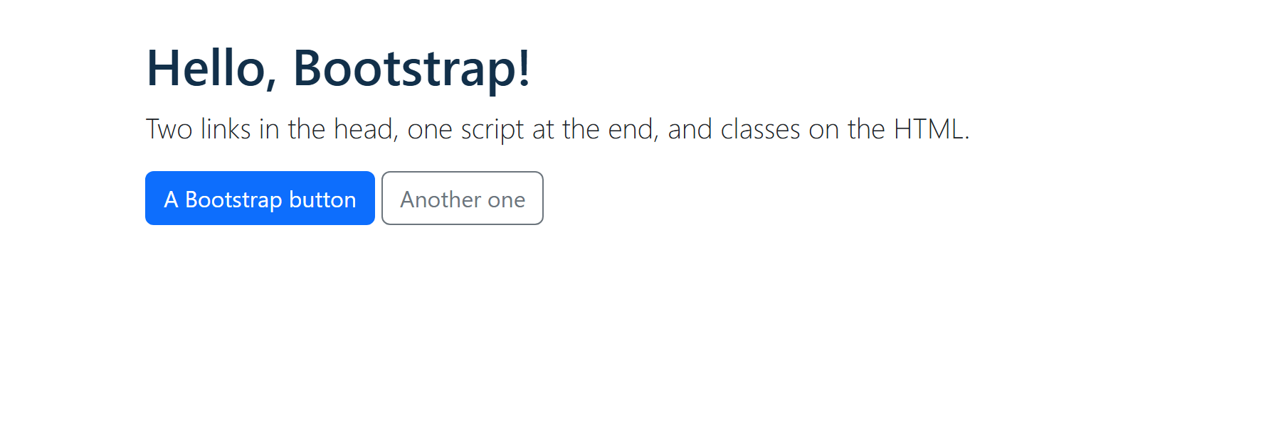
LINKING BOOTSTRAP · EXAMPLE 01
Adding Bootstrap to a Page
​1. Bootstrap's CSS in the head.
​2. Your own CSS after it.
​3. Bootstrap's JavaScript just before </body>.
<!-- 1. Bootstrap's CSS, from a CDN -->
<link rel="stylesheet" href="https://cdn.jsdelivr.net/npm/bootstrap@5.3.8/dist/css/bootstrap.min.css">
<!-- 2. Your own CSS, AFTER Bootstrap's, so your rules win ties -->
<link rel="stylesheet" href="01_bootstrap_starter_example.css">
</head>
<body>
...
<script src="https://cdn.jsdelivr.net/npm/bootstrap@5.3.8/dist/js/bootstrap.bundle.min.js"></script>
</body>
RESULT
10_CSS_Frameworks/01_bootstrap_starter_example.html
Notes:
Open 01_bootstrap_starter_example.html with Live Server.
Three lines do everything (the orange marks):
1. The CSS link. Without it, nothing on the page is styled by Bootstrap. Try it: comment it out and save. The button goes grey and the font changes back.
2. Our own stylesheet, after Bootstrap's. Our h1 rule turns the heading navy. That's the next quiz.
3. The JavaScript bundle. Only the interactive parts need it (navbars on phones, dropdowns, modals, carousels). 'Bundle' means it includes Popper, which positions dropdowns and tooltips.
The viewport meta tag from last week is here too. Bootstrap is built phones first and won't work properly on a phone without it.
The classes: container centres the page, py-4 adds padding on the top and bottom, lead makes a bigger paragraph, and btn btn-primary is a button. More on all of these soon.
Bootstrap's docs also show integrity="sha384-..." and crossorigin attributes on these tags. They're a safety check that the CDN's file hasn't been changed. Fine to copy them from the docs exactly; leave them out if you type the link by hand.

Slide 17
Week 10: CSS Frameworks
A CDN, or Download It?
1. A CDN
One link to a copy on the web. Fast, and nothing to download. Needs the internet.
<link rel="stylesheet"
href="https://cdn.jsdelivr.net/npm/bootstrap@5.3.8/dist/css/bootstrap.min.css">
2. Download it
Put the files in your site's folder, and link to them like your own CSS. Works offline.
<link rel="stylesheet" href="css/bootstrap.min.css">
​3. npm (npm install bootstrap): what big projects use. Not in this course.
Notes:
Option 1, the CDN, is what we use in class. A CDN (content delivery network) is a group of servers around the world that hand out popular files. jsDelivr is the one Bootstrap's own docs use.
The version is in the URL: bootstrap@5.3.8. Keep it, so the site doesn't change when Bootstrap releases a new version.
Last year's slides used a stackpath.bootstrapcdn.com link for Bootstrap 4.5.2. Don't use it: it's an old version, from an old CDN.
Option 2, downloading: put bootstrap.min.css and bootstrap.bundle.min.js in a folder in your site and link to them with a relative path, like any other stylesheet. It works offline, and nothing outside your site can break it.
Option 3, npm, is what professional projects do (npm install bootstrap). It also lets you customize Bootstrap with Sass before it's built. That's beyond this course.

Slide 18
?
POP QUIZ 2
​You want your own CSS to change some of Bootstrap's styles. Where does the <link> to your stylesheet go?
​Before Bootstrap's <link>
​At the very end of the <body>
A
B
​After Bootstrap's <link>
​Anywhere: the order doesn't matter
C
D
Vote: hold up 1, 2, 3 or 4 fingers (A to D), or type your letter in the Teams chat. 30 seconds!
Notes:
The cascade, from Week 5, coming back.

Slide 19
?
POP QUIZ 2: ANSWER
​You want your own CSS to change some of Bootstrap's styles. Where does the <link> to your stylesheet go?
​Before Bootstrap's <link>
​At the very end of the <body>
A
B
​After Bootstrap's <link>
​Anywhere: the order doesn't matter
✓
D
Why?
​Bootstrap's rules and yours often have the same specificity, like h1 and h1.
​When rules tie, the one that comes later wins. So link yours second.
Notes:
Answer: C.
Demo it in Example 01: swap the two link lines and save. The heading goes from navy back to Bootstrap's near-black.
It's the same reason media queries go last in a stylesheet.

Slide 20
Week 10: CSS Frameworks
Container, Row, Columns
.container
.row
1
1
1
1
1
1
1
1
1
1
1
1
.row
col-6
col-6
.row
col-4
col-4
col-4
.row
col-3
col-9
​Why 12? It splits evenly into halves, thirds, quarters and sixths.
Notes:
Last year's slides put it like this: in the minds of Bootstrap users, a page has one container, the container has rows, and each row has 12 columns. It's a lot like thinking in tables, but with divs and classes.
- container: centres the page and adds padding at the sides. It has a max-width that steps up at each breakpoint (up to 1320px). container-fluid is always the full width of the window.
- row: a flex container (display: flex; flex-wrap: wrap). Everything in it is a column.
- col-4: this column is 4 of the 12 columns wide, so a third.
Why 12? It divides evenly into halves (6), thirds (4), quarters (3) and sixths (2).
The numbers in a row should add up to 12. If they add up to more, the extra wraps to a new line: that's a pop quiz soon.

Slide 21
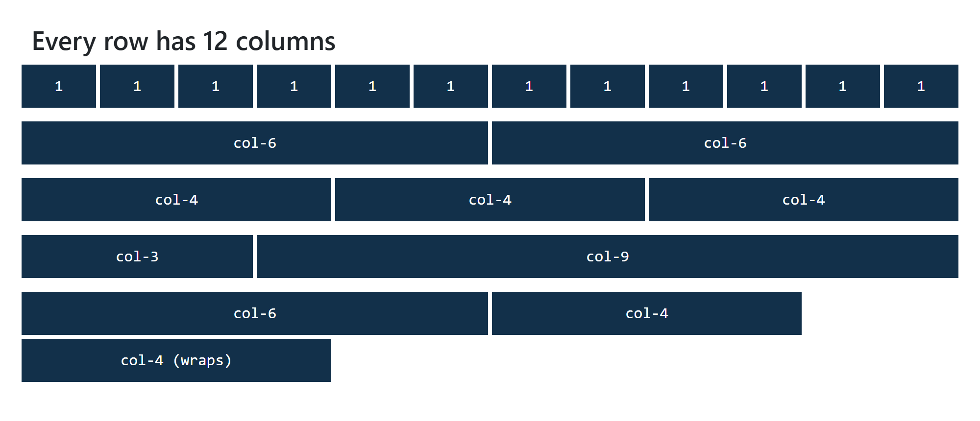
THE GRID · EXAMPLE 02
<!-- Halves: 6 + 6 = 12 -->
<div class="row">
<div class="col-6">col-6</div>
<div class="col-6">col-6</div>
</div>
<!-- Thirds: 4 + 4 + 4 = 12 -->
<div class="row">
<div class="col-4">col-4</div>
<div class="col-4">col-4</div>
<div class="col-4">col-4</div>
</div>
<!-- A sidebar: 3 + 9 = 12 -->
<div class="row">
<div class="col-3">col-3</div>
<div class="col-9">col-9</div>
</div>
<!-- Too many: 6 + 4 + 4 = 14, so the last one wraps -->
<div class="row">
<div class="col-6">col-6</div>
<div class="col-4">col-4</div>
<div class="col-4">col-4 (wraps)</div>
</div>
Columns Add Up to 12
​A row holds columns. col-4 is 4 of the 12 columns wide.
​Make each row add up to 12.
RESULT
10_CSS_Frameworks/02_grid_example.html
Notes:
Open 02_grid_example.html and walk down the rows: 12 ones, halves, thirds, then a 3 + 9 sidebar layout.
The last row on the page adds up to 14. Don't explain it yet: it's the next quiz.
Try it live: change col-3 and col-9 to col-2 and col-10, save, and look.
The CSS file only colours the columns so you can see them. Every width comes from Bootstrap.
The white gaps between columns are Bootstrap's 'gutters'. The g-3 class (Example 03) changes their size.

Slide 22
?
POP QUIZ 3
​What does this row look like?
​All three squeeze onto one line
A
​C wraps onto a new line
B
<div class="row">
<div class="col-6">A</div>
<div class="col-4">B</div>
<div class="col-4">C</div>
</div>
​Bootstrap ignores C
C
​The browser shows an error
D
Vote: hold up 1, 2, 3 or 4 fingers (A to D), or type your letter in the Teams chat. 30 seconds!
Notes:
Let them add it up first.

Slide 23
?
POP QUIZ 3: ANSWER
​What does this row look like?
WHAT THE BROWSER DOES
A
​All three squeeze onto one line
✓
​C wraps onto a new line
C
​Bootstrap ignores C
D
​The browser shows an error
Why?
​6 + 4 + 4 = 14, and a row only has 12.
​A row is a flexbox with flex-wrap: wrap, so C moves down to the next line, still 4 columns wide.
Notes:
Answer: B.
The picture is Example 02. The bottom row is this exact code.
Sometimes wrapping is what you want: a row of 8 cards that are col-3 each makes two lines of 4. That's how Bootstrap card grids usually work.

Slide 24
Week 10: CSS Frameworks
Bootstrap's Breakpoints
xs
sm
md
lg
xl
xxl
under 576
576px +
768px +
992px +
1200px +
1400px +
(none)
col-sm-
col-md-
col-lg-
col-xl-
col-xxl-
Reading a column class:
col
​A grid column.
md
​From the md breakpoint (768px) and up.
4
​4 of the 12 columns wide.
​Each one is a min-width media query: phones first, like last week.
Notes:
These are Bootstrap's breakpoints. They're close to the ones we used last week, with a few more.
Every one of them is a min-width media query, so Bootstrap is phones first, like Example 04 last week. col-md-4 means: from 768px and up, be 4 columns wide. Below 768px, the class does nothing, and a column with no other class is the full width of the row.
Read the class in three parts: col, the breakpoint, the number. No breakpoint (col-4) means every size, from the smallest phone up.
Last year's slide listed col-sm-, col-md- and col-lg-. There are also col-xl- and col-xxl-, and the classes add up: col-12 col-md-6 col-lg-3 on one div. That's the next example.

Slide 25
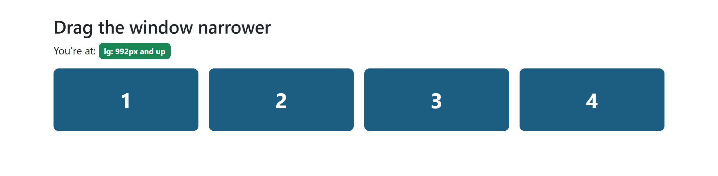
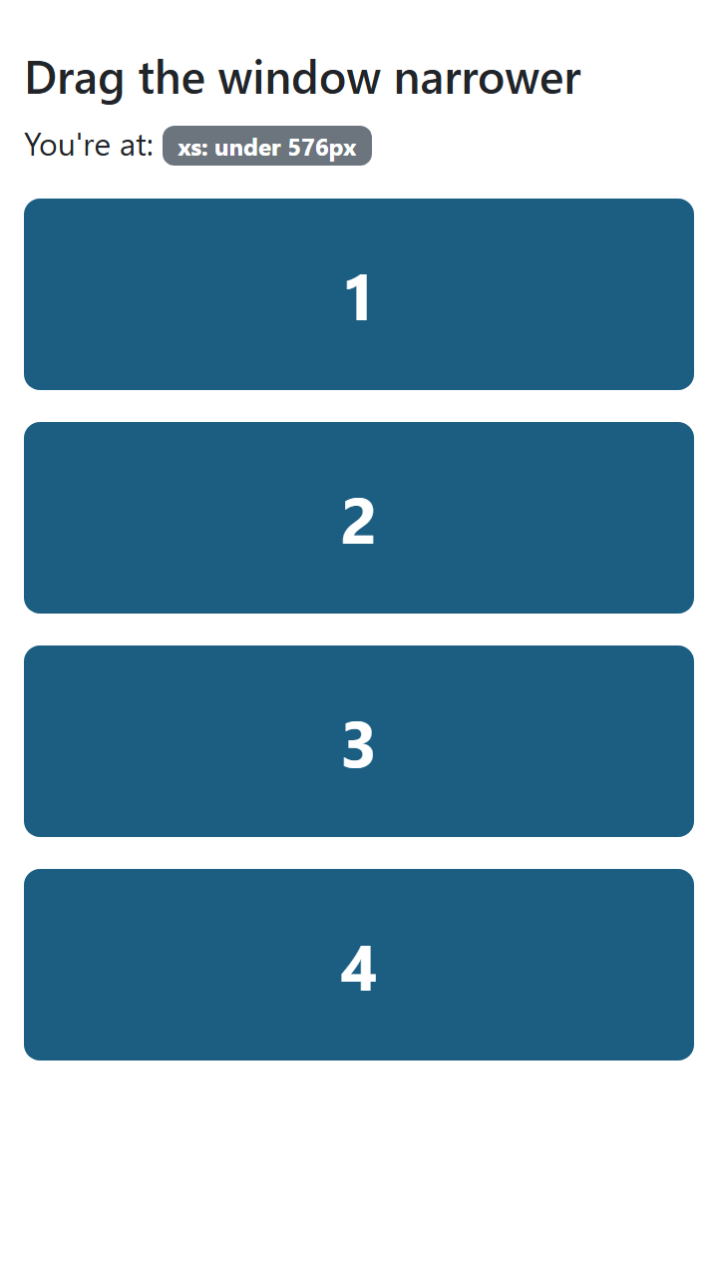
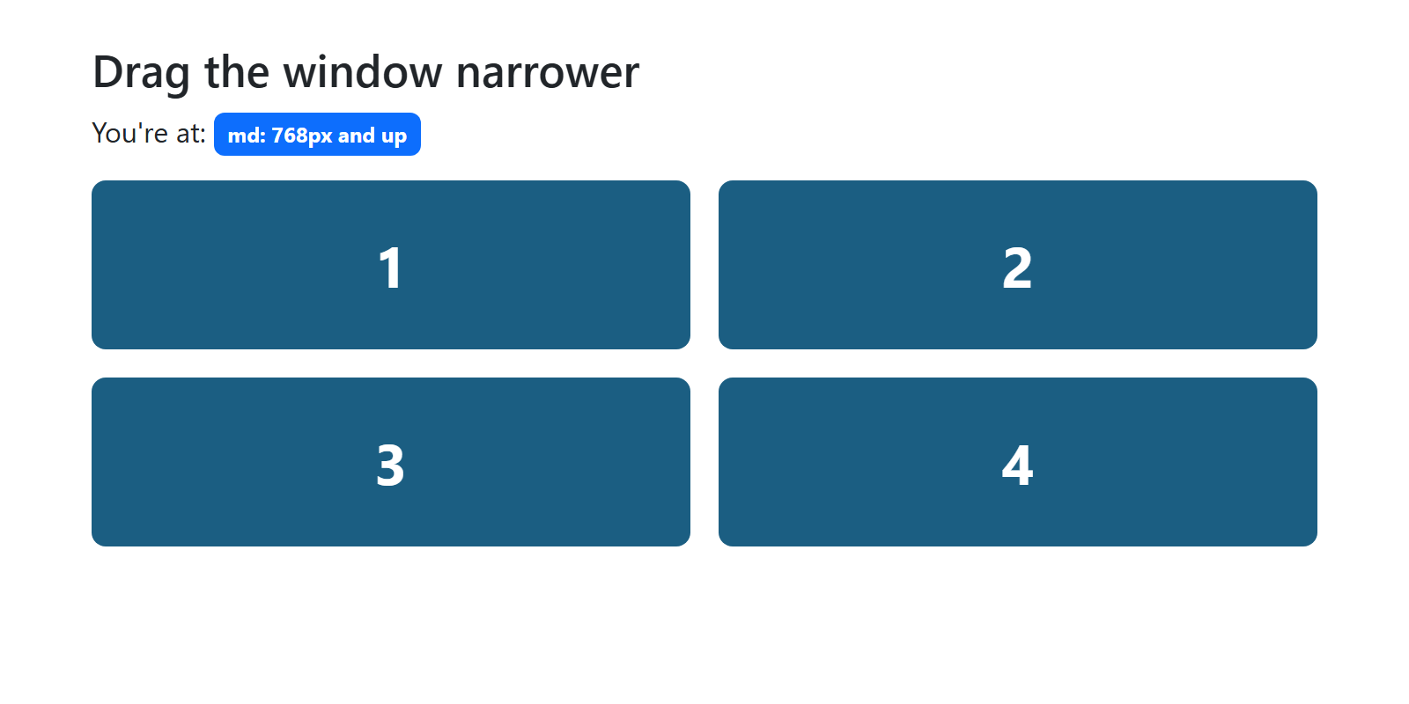
THE GRID · EXAMPLE 03
A Responsive Grid
​Classes add up: 1 across on a phone, 2 from md, 4 from lg.
<!-- 1 across, then 2 from md, then 4 from lg -->
<div class="row g-3">
<div class="col-12 col-md-6 col-lg-3">
<div class="box">1</div>
</div>
<div class="col-12 col-md-6 col-lg-3">
<div class="box">2</div>
</div>
<div class="col-12 col-md-6 col-lg-3">
<div class="box">3</div>
</div>
<div class="col-12 col-md-6 col-lg-3">
<div class="box">4</div>
</div>
</div>
1100PX: 4 ACROSS
360PX
800PX: 2 ACROSS
10_CSS_Frameworks/03_responsive_grid_example.html
Notes:
Open 03_responsive_grid_example.html and drag the window from wide to narrow. The badge at the top says which breakpoint you're at.
Read the class from left to right, smallest screen first:
- col-12: on the smallest screens, 12 of 12 columns, so full width. (You could leave this one out: a column with no class for that size is full width anyway. It's there to make it obvious.)
- col-md-6: from 768px, half width, so 2 across.
- col-lg-3: from 992px, a quarter, so 4 across.
g-3 on the row sets the gap ('gutter') between the boxes, across and down.
The badges use display classes: d-none hides one, d-md-inline shows it again from md up. More on those next class.

Slide 26
?
POP QUIZ 4
​On a 600px-wide phone, how do these three columns look?
​Stacked, each one the full width
A
​Side by side, a third each
B
<div class="row">
<div class="col-md-4">A</div>
<div class="col-md-4">B</div>
<div class="col-md-4">C</div>
</div>
​Two on the first line, one on the next
C
​Hidden until the window is 768px
D
Vote: hold up 1, 2, 3 or 4 fingers (A to D), or type your letter in the Teams chat. 30 seconds!
Notes:
This is how the activity from last year's slides is written: 'three columns that take up equal space on medium and larger screens'.

Slide 27
?
POP QUIZ 4: ANSWER
​On a 600px-wide phone, how do these three columns look?
✓
​Stacked, each one the full width
B
​Side by side, a third each
C
​Two on the first line, one on the next
<div class="row">
<div class="col-md-4">A</div>
<div class="col-md-4">B</div>
<div class="col-md-4">C</div>
</div>
D
​Hidden until the window is 768px
Why?
​md means 768px and up, and 600px is smaller, so col-md-4 does nothing yet.
​Below that, each column is the full width of the row. That's what you want on a phone.
Notes:
Answer: A.
If they said B: that would be col-4, with no breakpoint, which is a third at every size, even 360px. Usually too narrow on a phone.
Demo: Example 03 with the device toolbar.

Slide 28
Week 10: CSS Frameworks
Look Inside a Bootstrap Class
FROM BOOTSTRAP.CSS
Try it in DevTools:
.row {
display: flex;
flex-wrap: wrap;
}
@media (min-width: 768px) {
.col-md-4 {
flex: 0 0 auto;
width: 33.33333333%;
}
}
1
Right-click a column
Inspect
2
Styles panel
Find the @media rule
3
Drag the window
Watch it switch off
​No magic: flexbox (Week 8) and a min-width media query (Week 9).
Notes:
This links Bootstrap back to Weeks 8 and 9, and gets students using DevTools on it.
Demo in Example 03: right-click a box, Inspect, then click its parent div (the col-12 col-md-6 col-lg-3 one). In the Styles panel you'll see the .col-md-6 and .col-lg-3 rules, each inside an @media (min-width: ...) block. Drag the window narrower and watch them get crossed out or disappear.
Then click the row and find display: flex and flex-wrap: wrap. Chrome and Edge show a little 'flex' badge on the element in the Elements panel; click it to see the flex overlay.
This is the actual CSS from bootstrap.css 5.3.8, trimmed. 33.33333333% is a third.
The point: there's nothing magic in a framework. It's flexbox and media queries, which they already know.

Slide 29
?
POP QUIZ 5
​What does Bootstrap's grid use to put columns side by side?
​Float
​HTML tables
A
B
​Flexbox
​JavaScript
C
D
Vote: hold up 1, 2, 3 or 4 fingers (A to D), or type your letter in the Teams chat. 30 seconds!
Notes:
Straight after the DevTools slide, so most people should get it.

Slide 30
?
POP QUIZ 5: ANSWER
​What does Bootstrap's grid use to put columns side by side?
​Float
​HTML tables
A
B
​Flexbox
​JavaScript
✓
D
Why?
​.row is display: flex with flex-wrap: wrap. Each column sets its own width.
​Bootstrap 3 used float. Since Bootstrap 4, it's flexbox. No JavaScript needed: the grid is pure CSS.
Notes:
Answer: C.
A bit of history: Bootstrap 3 (2013) used floats and clearfixes, like our float examples from Week 9. Bootstrap 4 (2018) switched to flexbox. Bootstrap 5 also has an optional CSS Grid version, but flexbox is still the default.

Slide 31
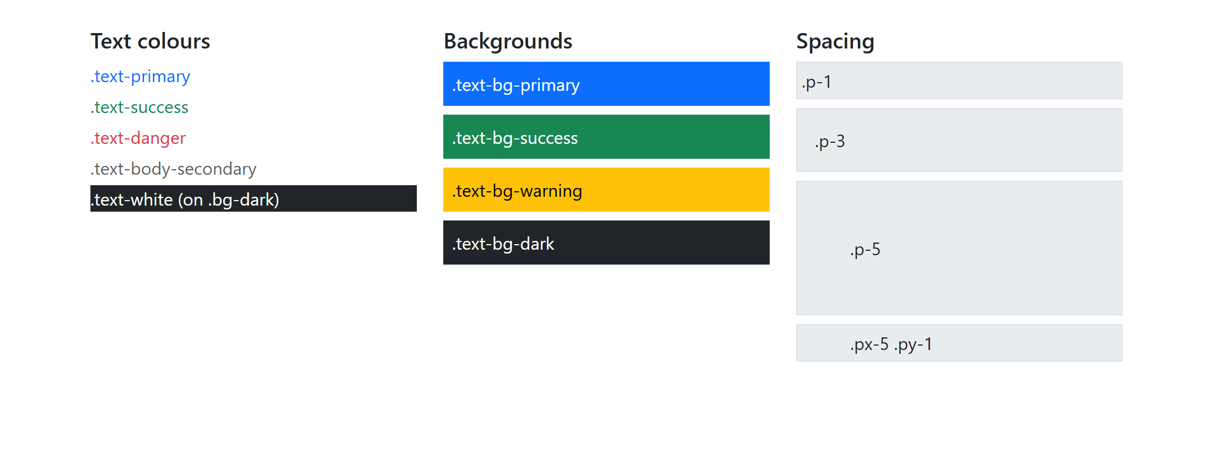
UTILITIES · EXAMPLE 04
Colour and Spacing Classes
​text-bg-primary: a background and a text colour you can read on it.
​p-3 is padding, mb-2 is margin on the bottom.
<h2 class="h5">Backgrounds</h2>
<!-- text-bg-*: a background, and a text colour to match -->
<div class="text-bg-primary p-2 mb-2">.text-bg-primary</div>
<div class="text-bg-success p-2 mb-2">.text-bg-success</div>
<div class="text-bg-warning p-2 mb-2">.text-bg-warning</div>
<div class="text-bg-dark p-2 mb-2">.text-bg-dark</div>
</section>
<section class="col-md-4">
<h2 class="h5">Spacing</h2>
<!-- p = padding, m = margin. Sizes 0 to 5. -->
<div class="bg-body-secondary border p-1 mb-2">.p-1</div>
<div class="bg-body-secondary border p-3 mb-2">.p-3</div>
<div class="bg-body-secondary border p-5 mb-2">.p-5</div>
<div class="bg-body-secondary border px-5 py-1">.px-5 .py-1</div>
RESULT
10_CSS_Frameworks/04_utilities_example.html
Notes:
Open 04_utilities_example.html. There's no CSS file of our own: every colour and space is a Bootstrap class.
Colours (from last year's colour slides, updated for Bootstrap 5.3):
- text-primary, text-success, text-danger: text colour.
- bg-primary and friends: background colour only.
- text-bg-primary: background plus a matching readable text colour. Use this one for coloured boxes. On yellow (warning) it picks black text, which bg-warning with text-white would get wrong.
- text-muted and text-black-50 from last year's slides still work, but are deprecated in 5.3. Use text-body-secondary.
The names (primary, success, danger, warning, info, light, dark) describe a purpose, not a colour. 'danger' is red, but if you change the theme, it changes everywhere.
Spacing is on the next slide.

Slide 32
Week 10: CSS Frameworks
Reading a Spacing Class
<div class="mt-3 px-5 mb-0">
m or p
​Margin or padding.
t b s e x y
​top, bottom, start (left), end (right), x = left and right, y = top and bottom. None = all four.
0 to 5
​0 none, 1 4px, 2 8px, 3 16px, 4 24px, 5 48px, or auto.
​Bootstrap 4 used ml- and mr-. Version 5 uses ms- and me-. Old tutorials won't work.
Notes:
Every spacing class is built from three parts. Once students can read one, they can read them all.
- m for margin, p for padding.
- The side: t (top), b (bottom), s (start, the left in English), e (end, the right), x (left and right), y (top and bottom). Leave it out for all four sides.
- The size: 0 to 5. With Bootstrap's defaults: 0 = 0, 1 = 0.25rem (4px), 2 = 0.5rem (8px), 3 = 1rem (16px), 4 = 1.5rem (24px), 5 = 3rem (48px). Plus auto for margins.
mx-auto is the old margin: 0 auto centring trick.
Bootstrap 4 used l and r (ml-3, pr-2). Bootstrap 5 changed them to s and e (ms-3, pe-2), so that pages in right-to-left languages flip properly. Old tutorials will have ml- and mr-, which do nothing in Bootstrap 5.
They can also take a breakpoint: p-2 p-md-5 is small padding on phones, big from md up.

Slide 33
?
POP QUIZ 6
​What does class="px-3 mb-0" do?
​3px of padding on the left and right, no bottom margin
​1rem of padding on the top and bottom, no bottom margin
A
B
​1rem of margin on the left and right, no bottom padding
​1rem of padding on the left and right, no bottom margin
C
D
Vote: hold up 1, 2, 3 or 4 fingers (A to D), or type your letter in the Teams chat. 30 seconds!
Notes:
Two traps: 3 is a size step, not pixels, and x is left and right (y is top and bottom).

Slide 34
?
POP QUIZ 6: ANSWER
​What does class="px-3 mb-0" do?
​3px of padding on the left and right, no bottom margin
​1rem of padding on the top and bottom, no bottom margin
A
B
​1rem of margin on the left and right, no bottom padding
​1rem of padding on the left and right, no bottom margin
C
✓
Why?
​p is padding, x is left and right, and size 3 is 1rem (16px), not 3px.
​m is margin, b is bottom, and 0 is none. Handy for taking the space off the last paragraph in a box.
Notes:
Answer: D.
Check in DevTools: inspect a box with px-3 and the Computed tab shows padding-left: 16px and padding-right: 16px.

Slide 35
Try It 1: A Colour Grid, Together (15 min)
1
Make a new file
​Save Example 01 as my_grid.html. Keep the head. Empty the body.
INSIDE <BODY>, IN A NEW FILE
2
A container and a row
​A container, then a row inside it.
<div class="row g-3">
<div class="col-md-4">
<div class="text-bg-primary p-4 h-100">
<h2 class="h4">Primary</h2>
<p>...</p>
<button type="button" class="btn btn-light">A light button</button>
</div>
</div>
<!-- ...two more columns, the same way -->
</div>
3
Three columns
​Equal widths from md up: col-md-4. Stacked on a phone.
4
Colour each one
​text-bg-primary, -success, -warning, plus p-4.
5
Add a heading and a button
​Then drag the window narrower. Do they stack?
​Why text-bg- and not bg-? It picks a text colour you can read, even on yellow.
Notes:
This is the 'Activity - together' from last year's slides. Do it together: you type, they type along, one step at a time.
One change from the original: it asked for bg-primary, bg-success and bg-warning. Use text-bg-* instead, so the text is readable (white on blue and green, black on yellow).
Why the colour goes on an inner div, not on the column: the column has padding for the gutter, and a coloured column would make the boxes touch. g-3 on the row adds space between them.
The finished page is activity/try_it_1_answer.html.
Fast finishers: make the middle column wider (col-md-6, with col-md-3 on each side), or add a fourth column that goes 2 across on md and 4 across on lg.

Slide 36
Week 10: CSS Frameworks
Class 1 Recap
What we covered:
  A framework is CSS someone else wrote. You use it with class names.
  Two kinds: components (Bootstrap) and utility-first (Tailwind).
  Bootstrap's CSS in the head, yours after it, the JavaScript at the end.
  A container holds rows. Each row has 12 columns.
  col-md-4: a third of the row, from 768px and up.
  text-bg-*, p-3, mb-2: colour and spacing utilities.
Next class:
  Components, customizing, Tailwind, and Harbourside in Bootstrap.
Notes:
If students remember three things: link your CSS after Bootstrap's, rows have 12 columns, and col-md-4 means 'from 768px up'.
Next class: Bootstrap's components, customizing Bootstrap, a look at Tailwind CSS, and rebuilding Harbourside with Bootstrap.
If there's time, have students start reading through getbootstrap.com/docs/5.3/layout/grid/.

Slide 37
+
Week 10, Class 2
•
○
+
Components · customizing · Tailwind CSS · Harbourside in Bootstrap
•
○
Notes:
Welcome back. Last class was the grid and the utilities. Today: Bootstrap's ready-made components, how to make Bootstrap look like your site and not everyone else's, a look at Tailwind, and then the big activity: Harbourside, rebuilt with Bootstrap.

Slide 38
Is Your Environment Set Up?
GIT
VS CODE
✓
Did you run git pull since last class?
✓
Is the 10_CSS_Frameworks folder open in VS Code?
LIVE SERVER
OUTLOOK AND TEAMS
✓
Does activity/index.html open with Go Live? (It has no CSS yet.)
✓
Have you checked your school email and the Teams channel?
Notes:
Take attendance while everyone checks these.
activity/index.html is the Harbourside page with no CSS at all, so it should look plain: big logo, bullet-point menu, Times New Roman. That's correct.
The Harbourside activity needs the internet again, for Bootstrap's CDN.

Slide 39
Recall: What Did We Do Last Class?
1
Linking Bootstrap
1
2
3
4
5
6
7
8
9
10
11
12
​Its CSS in the head, yours after it, its JavaScript at the end.
col-md-4
col-md-8
2
Container, row, columns
​A row is a flexbox with 12 columns.
col-md-6
col-md-6
col-md-12
3
Breakpoints
​col-md-4: a third of the row from 768px up. Stacked under that.
Every row has 12 columns. The numbers add up to 12.
4
Utilities
​text-bg-primary, p-3, mb-2: colour and spacing with classes.
Notes:
Same as always: 30 seconds with a neighbour, then take answers, then go through the four points.
Quick check while you're here: on a phone, what does col-md-4 do? (Nothing: the column is full width.)

Slide 40
Week 10: CSS Frameworks
Week 10, Class 2: Overview
Title: Components, Tailwind and Harbourside
Agenda:
  Bootstrap's components: buttons, alerts, cards, the navbar
  Customizing Bootstrap so it looks like your site
  Tailwind CSS: the same cards, the other way
  Rebuild Harbourside with Bootstrap, then submit
Use
→
Compare
→
Build
Components
Tailwind
Harbourside
Notes:
Rough plan:
- 10 min: environment, recall, overview
- 20 min: components, Examples 05 and 06, Pop Quiz 7
- 10 min: customizing, Example 07, Pop Quiz 8
- 15 min: Tailwind, Examples 08 and 09, Pop Quizzes 9 and 10
- 45 min: Harbourside, Try Its 2 to 7, then submit
- 5 min: recap and the one-sentence summary
The activity is the priority. If time is short, demo Tailwind quickly and skip the 'Which one?' slide.

Slide 41
+
Components
•
○
+
Buttons · alerts · cards · the navbar
•
○
Notes:
Components are Bootstrap's ready-made parts. You copy the HTML from the docs, then change the words.

Slide 42
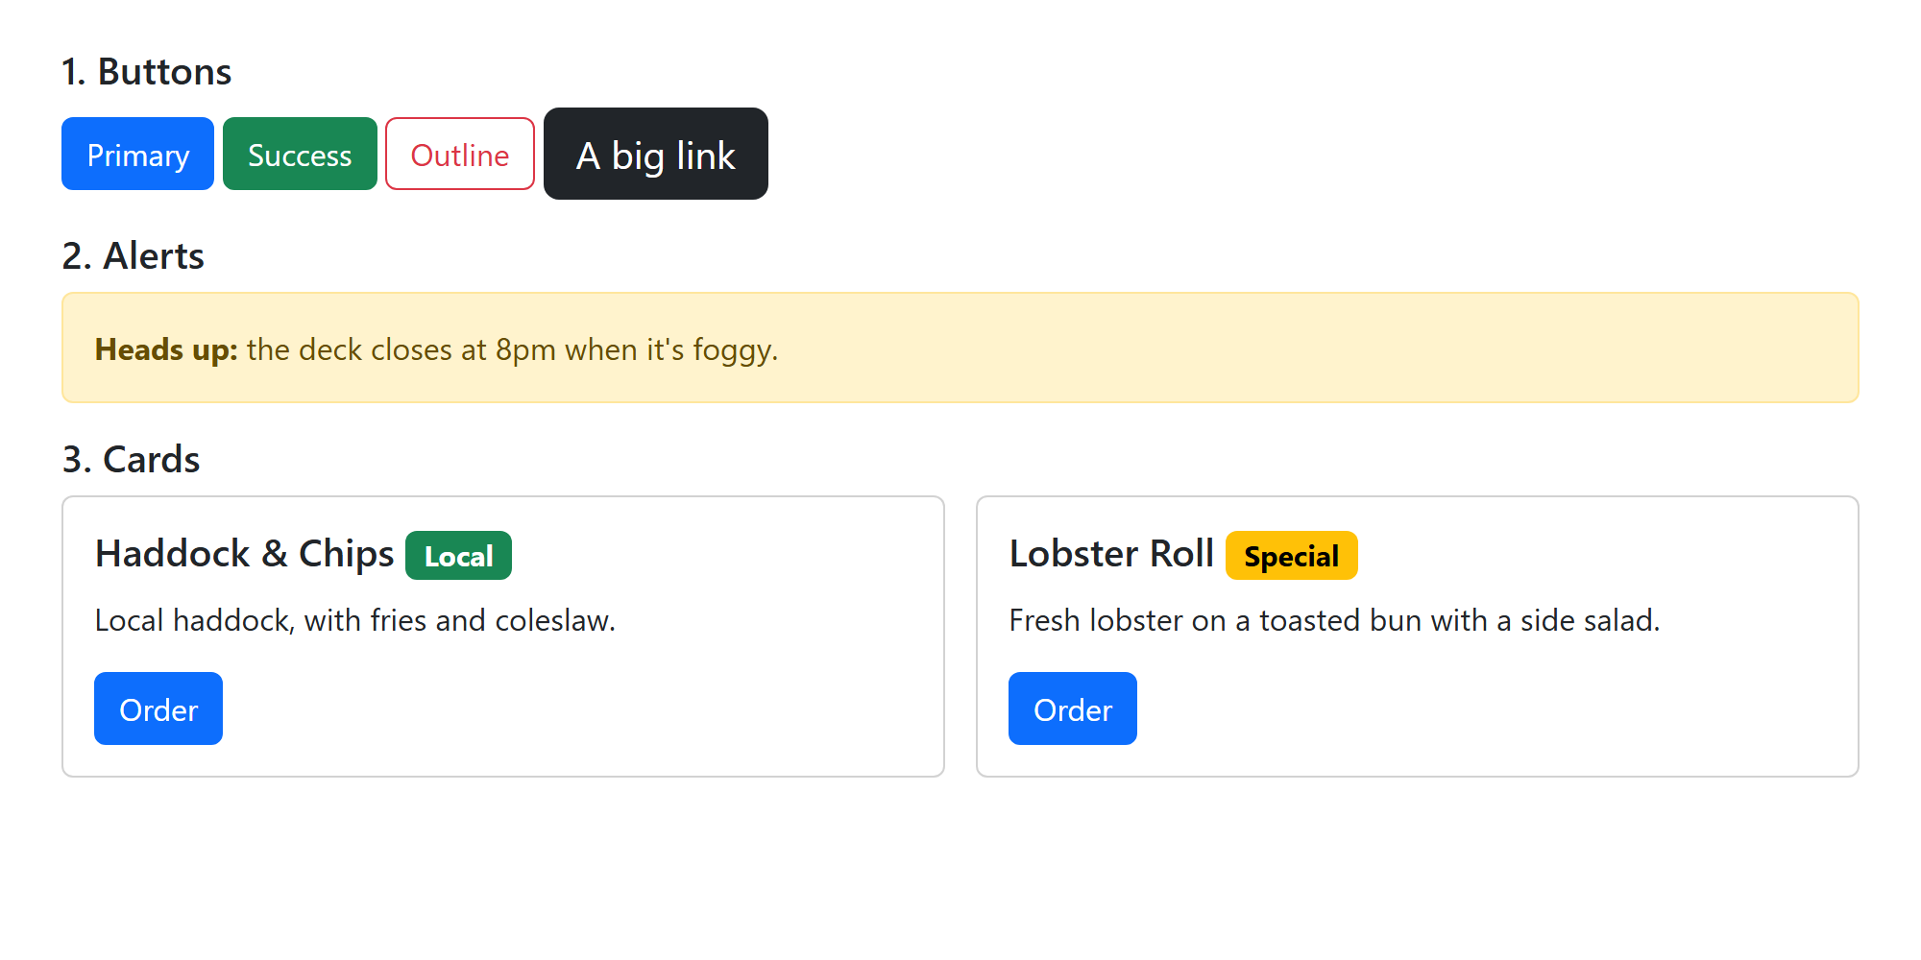
COMPONENTS · EXAMPLE 05
Buttons and Alerts
​btn plus a colour: btn-primary, btn-outline-danger, btn-lg.
​Works on a <button> or a link.
<!-- 1. Buttons: btn, then a colour -->
<h2 class="h5">1. Buttons</h2>
<p>
<button type="button" class="btn btn-primary">Primary</button>
<button type="button" class="btn btn-success">Success</button>
<button type="button" class="btn btn-outline-danger">Outline</button>
<a class="btn btn-dark btn-lg" href="#">A big link</a>
</p>
<!-- 2. Alerts: role="alert" is read out -->
<h2 class="h5">2. Alerts</h2>
<div class="alert alert-warning" role="alert">
<strong>Heads up:</strong> the deck closes at 8pm when it's foggy.
</div>
RESULT
10_CSS_Frameworks/05_components_example.html
Notes:
Open 05_components_example.html.
Buttons: always two classes, btn and a style. btn alone gives you the shape and padding with no colour. Add btn-lg or btn-sm for size.
Use a <button> for actions on the page and an <a> for going somewhere. The classes look the same on both, so pick the right element for the job (Week 2: semantic HTML).
Alerts: alert plus a colour. role="alert" makes screen readers announce it straight away, so only use it for messages that matter right now.
The colour names are the same ones as last class's text-bg-* classes.

Slide 43
COMPONENTS · EXAMPLE 05
Cards
​card is the box. card-body adds the padding inside.
​Put cards in grid columns to line them up.
​badge is the small label.
<div class="row g-3">
<div class="col-md-6">
<div class="card">
<div class="card-body">
<h3 class="card-title h5">
Haddock &amp; Chips
<span class="badge text-bg-success">Local</span>
</h3>
<p class="card-text">Local haddock, with fries and coleslaw.</p>
<a href="#" class="btn btn-primary">Order</a>
</div>
</div>
</div>
<!-- ...and the Lobster Roll card -->
</div>
RESULT
10_CSS_Frameworks/05_components_example.html
Notes:
A card is a box with a border and rounded corners. Inside: card-body for padding, card-title and card-text for spacing. It can also have card-header, card-footer and card-img-top for a picture at the top.
Cards don't set their own width. They fill whatever column they're in. So the pattern is always: row, then col-md-6 (or whatever), then the card inside it. That's how Harbourside's menu will work.
Last year's slides listed 'wells'. Wells were Bootstrap 3, and cards replaced them in Bootstrap 4.
The headings use class="h5": it makes an h3 look like an h5, so you can keep the right heading order for screen readers and still pick the size.

Slide 44
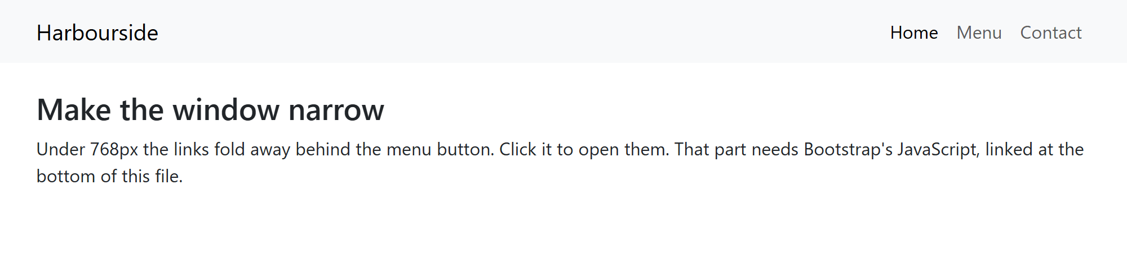
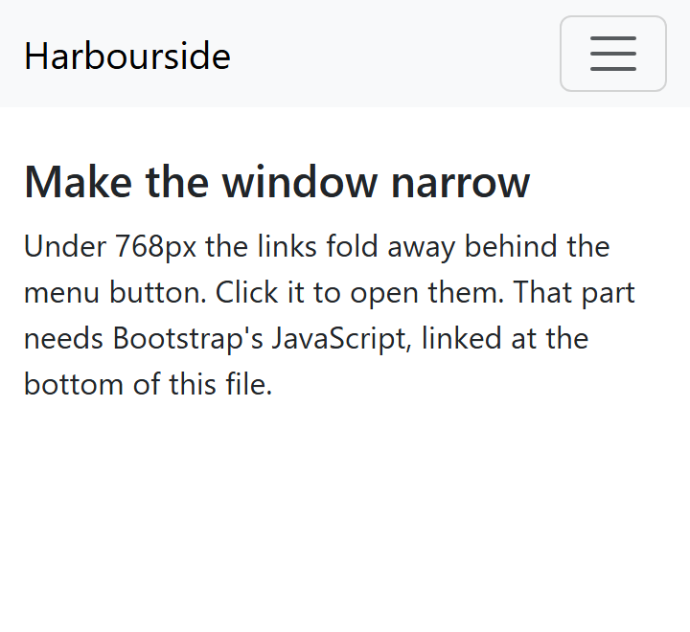
COMPONENTS · EXAMPLE 06
The Navbar
<!-- navbar-expand-md: the full menu from 768px up -->
<nav class="navbar navbar-expand-md bg-body-tertiary" aria-label="Main">
<div class="container">
<a class="navbar-brand" href="#">Harbourside</a>
<!-- data-bs-target: the id of the part to open -->
<button class="navbar-toggler" type="button"
data-bs-toggle="collapse" data-bs-target="#mainNav"
aria-controls="mainNav" aria-expanded="false"
aria-label="Toggle navigation">
<span class="navbar-toggler-icon"></span>
</button>
<div class="collapse navbar-collapse" id="mainNav">
<ul class="navbar-nav ms-auto">
<li class="nav-item">
<a class="nav-link" href="#">Menu</a>
</li>
<li class="nav-item">
<a class="nav-link" href="#">Contact</a>
</li>
</ul>
</div>
</div>
</nav>
​navbar-expand-md: the full menu from md up.
​Under that, a menu button opens it. That needs Bootstrap's JavaScript.
1000PX
360PX
10_CSS_Frameworks/06_navbar_example.html
Notes:
This is the navbar from last year's slides, updated for Bootstrap 5. (The slide skips some of the list items to fit; the file has them all.)
Open 06_navbar_example.html and drag the window narrower. At 767px the links disappear and the menu button (the 'hamburger') shows up. Click it and the links slide open.
The parts:
- navbar-expand-md: when to show the full menu. Change it to -lg and the menu button stays until 992px.
- navbar-brand: the site name or logo.
- navbar-toggler: the menu button. data-bs-toggle="collapse" says what it does, and data-bs-target="#mainNav" says which element it opens. That's the id on the collapse div.
- aria-controls, aria-expanded and aria-label: for screen readers. Bootstrap's JavaScript flips aria-expanded between false and true for you.
- ms-auto on the ul pushes the links to the right (margin-start: auto, the flexbox trick from Week 8).
Comment out the script tag at the bottom and try the button again: nothing happens.

Slide 45
?
POP QUIZ 7
​You copied this menu button from an old tutorial. On a phone, clicking it does nothing. Why?
​Bootstrap 5 renamed them: data-bs-toggle and data-bs-target
A
​A button needs type="submit" to open a menu
B
<button class="navbar-toggler" type="button"
data-toggle="collapse"
data-target="#mainNav">
<span class="navbar-toggler-icon"></span>
</button>
​The navbar needs its own CSS file
C
​Menus only open on a real phone, not in DevTools
D
Vote: hold up 1, 2, 3 or 4 fingers (A to D), or type your letter in the Teams chat. 30 seconds!
Notes:
The navbar code on last year's slides was Bootstrap 4. Students will meet this constantly when they copy from Stack Overflow or old tutorials.

Slide 46
?
POP QUIZ 7: ANSWER
​You copied this menu button from an old tutorial. On a phone, clicking it does nothing. Why?
✓
​Bootstrap 5 renamed them: data-bs-toggle and data-bs-target
B
​A button needs type="submit" to open a menu
C
​The navbar needs its own CSS file
<button class="navbar-toggler" type="button"
data-toggle="collapse"
data-target="#mainNav">
<span class="navbar-toggler-icon"></span>
</button>
D
​Menus only open on a real phone, not in DevTools
Why?
​This is Bootstrap 4 code, from last year's slides. Bootstrap 5's JavaScript only looks for data-bs-.
​The other usual cause: the bootstrap.bundle.min.js script is missing.
Notes:
Answer: A.
Demo it: in Example 06, change data-bs-toggle to data-toggle and save. The button stops working, and there's no error in the Console, which is what makes it hard to find.
The lesson: check the version of anything you copy.

Slide 47
Week 10: CSS Frameworks
Show and Hide by Screen Size
<div class="d-none d-md-block">
Only on screens 768px and wider
</div>
<div class="d-md-none">
Only on screens under 768px
</div>
d-none
Hidden (display: none).
d-md-block
From 768px up: display: block.
container-fluid
Always the full width. container stops growing.
Notes:
From last year's 'Responsive Utilities' slide.
The display classes: d-none is display: none. d-block, d-inline, d-flex and so on set display. Add a breakpoint to make them responsive, and like the grid, each one applies from that size up.
So d-none d-md-block reads: hidden, and then from 768px up, shown as a block. Example 03's badges use this to show one badge at each size.
The opposite, d-md-none: shown on phones, hidden from md up. Handy for a phone-only call button.
Be careful hiding content: if something matters, phone users need it too. Hiding is better for different versions of the same thing.
container-fluid is from the same slide: always the full width, where container stops growing at each breakpoint (max 1320px).

Slide 48
+
Customizing Bootstrap
•
○
+
Your CSS after theirs · Bootstrap 5's variables
•
○
Notes:
Every Bootstrap site looks like Bootstrap until you change it. The question is how.

Slide 49
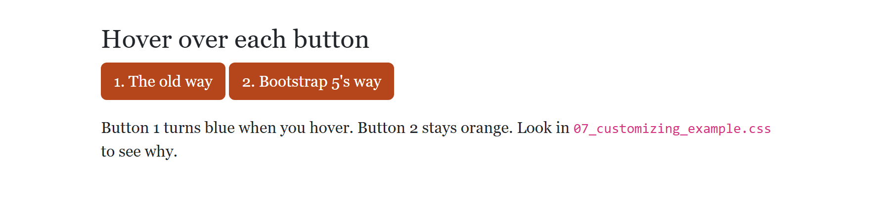
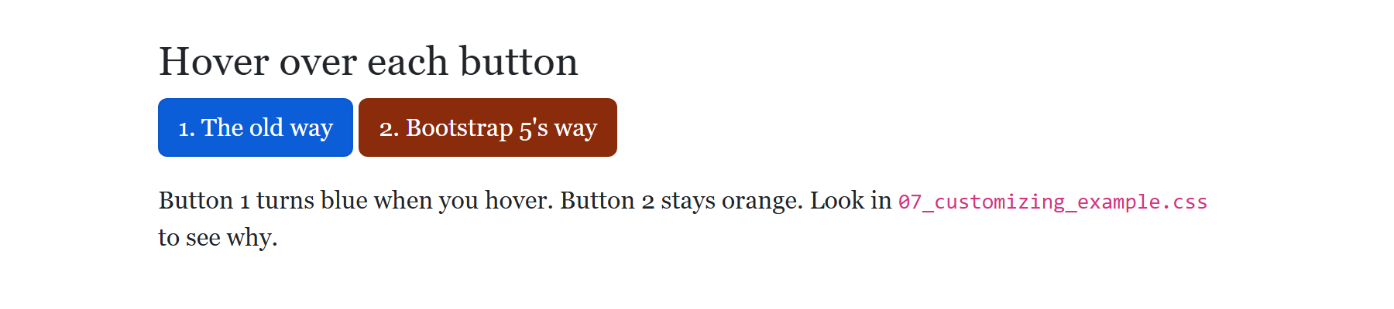
CUSTOMIZING · EXAMPLE 07
/* 0. Same specificity as Bootstrap's, and later,
so ours wins */
body {
font-family: Georgia, "Times New Roman", serif;
}
/* 1. The old way. Looks right until you hover:
Bootstrap's .btn:hover is more specific,
and it puts the blue back. */
.old-way {
background-color: #B5451B;
border-color: #B5451B;
}
/* 2. Bootstrap 5's way: set the button's variables.
All its states (hover too) read these. */
.new-way {
--bs-btn-bg: #B5451B;
--bs-btn-border-color: #B5451B;
--bs-btn-hover-bg: #8A2B0B;
--bs-btn-hover-border-color: #8A2B0B;
--bs-btn-active-bg: #8A2B0B;
--bs-btn-active-border-color: #8A2B0B;
}
Changing a Button's Colour
​Button 1 changes background-color. Hover, and it goes blue.
​Button 2 changes Bootstrap's variables. Every state uses them.
NORMAL
WHILE YOU HOVER
10_CSS_Frameworks/07_customizing_example.css
Notes:
Open 07_customizing_example.html and hover over each button.
Part 0: overriding any rule works the normal way. Bootstrap's body rule and ours tie, ours is later, ours wins. The font is Georgia.
Part 1 is the way from last year's slides (and lots of tutorials). It looks right until you hover: Bootstrap has a .btn:hover rule, which is more specific than ours, and it sets the background to var(--bs-btn-hover-bg). That's still blue. The bottom picture applies that exact rule to both buttons.
Part 2 is how Bootstrap 5.3 wants it done. A Bootstrap button reads all of its colours from variables (custom properties, the --name ones). Set those, and the normal, hover and active states all follow.
Where do the variable names come from? Inspect a button in DevTools: the .btn-primary rule lists them all.
For bigger changes (every primary colour on the site), professional projects use Bootstrap's Sass source. That's beyond this course. Ready-made Bootstrap themes are another option (last year's slides mention buying one); Bootswatch has free ones.

Slide 50
?
POP QUIZ 8
​This is in your CSS, after Bootstrap's. What colour is the button while you hover over it?
​Orange, the same as always
A
​Bootstrap's blue
LAST YEAR'S SLIDE
B
.btn-primary {
background-color: #ff5722;
border-color: #ff5722;
}
​A slightly darker orange
C
​See-through: it has no colour
D
Vote: hold up 1, 2, 3 or 4 fingers (A to D), or type your letter in the Teams chat. 30 seconds!
Notes:
The code is word for word from last year's Customizing Bootstrap slide. Specificity from Week 6.

Slide 51
?
POP QUIZ 8: ANSWER
​This is in your CSS, after Bootstrap's. What colour is the button while you hover over it?
WHAT THE BROWSER DOES
A
​Orange, the same as always
✓
​Bootstrap's blue
C
​A slightly darker orange
D
​See-through: it has no colour
Why?
​Bootstrap's .btn:hover (two classes' worth) beats .btn-primary (one), so its hover rule wins.
​That rule uses var(--bs-btn-hover-bg), which is still blue. Change the variables instead: Example 07, part 2.
Notes:
Answer: B.
The picture is Example 07 with Bootstrap's hover rule applied: button 1 is blue.
Specificity: .btn:hover is a class plus a pseudo-class, so (0,2,0). .btn-primary is (0,1,0). Ours comes later, but specificity is checked first.

Slide 52
Week 10: CSS Frameworks
Where to Look Things Up
Bootstrap's docs
getbootstrap.com/docs/5.3
Layout, Components, Utilities. Copy the HTML, change the words.
Bootstrap's examples
getbootstrap.com/docs/5.3/examples
Whole pages to start from: Album, Pricing, Product, Cover...
W3Schools
w3schools.com/bootstrap5
Short lessons with Try It editors. Check it says bootstrap5.
​Gone since Bootstrap 3: wells (use card) and Glyphicons (use Bootstrap Icons).
Notes:
Nobody memorizes Bootstrap. Professionals have the docs open all the time. Show the docs site quickly: the left menu has Layout (the grid), Content (tables, images), Components and Utilities.
The Examples page has full page templates (Album, Pricing, Checkout, Product, Cover, Carousel...). Last year's activity was to download one and customize it. It's a fast-finisher option today.
The list from last year's slides, updated:
- Grids, tables, images, alerts, buttons, navbar, carousel, modal, tooltip and popover are all still in Bootstrap 5.
- Wells and Glyphicons were Bootstrap 3, and are gone. Use cards instead of wells, and Bootstrap Icons (a separate download, at icons.getbootstrap.com) instead of Glyphicons.
- Tooltips and popovers need one line of JavaScript to turn them on. The docs show it.
W3Schools has a Bootstrap 5 tutorial too. Check the URL says bootstrap5, not bootstrap (which is version 3).

Slide 53
+
Tailwind CSS
•
○
+
Utility-first · the same cards, two ways · which one should you use?
•
○
Notes:
Tailwind is the other kind of framework: no ready-made components, just small classes you combine.

Slide 54
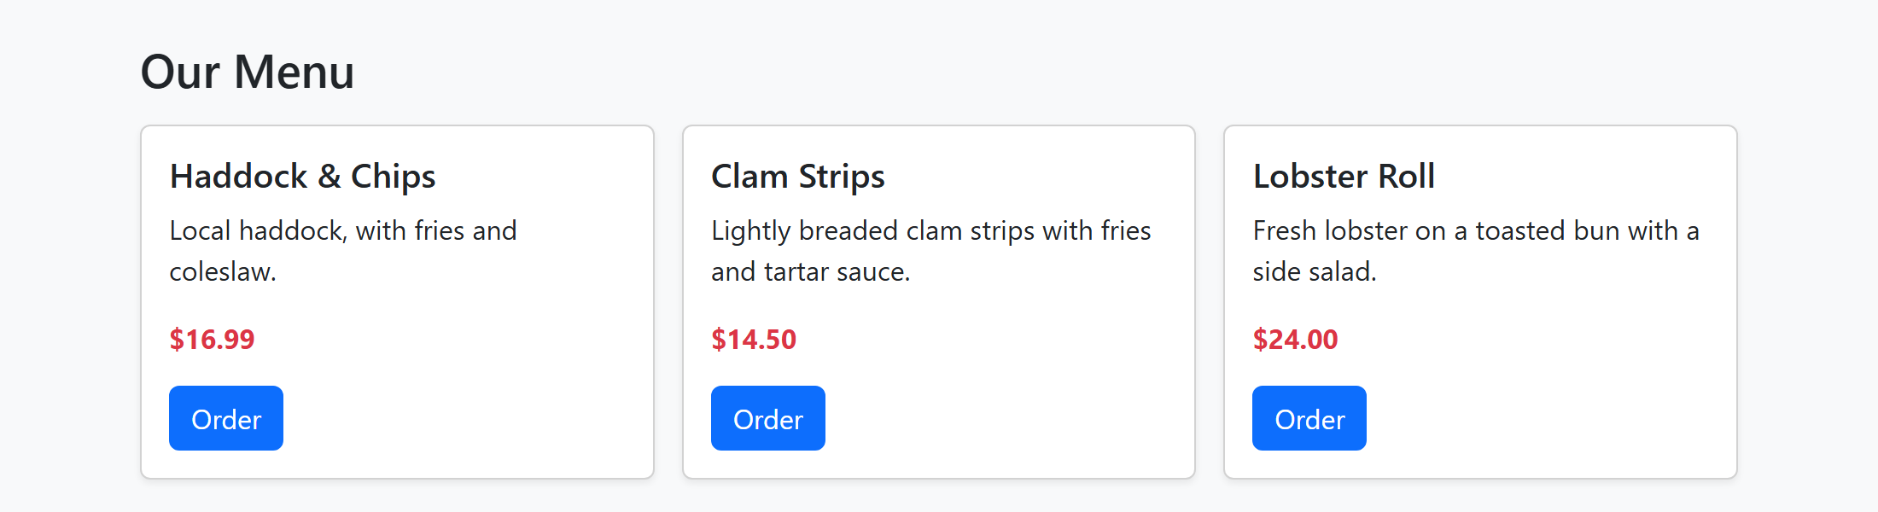
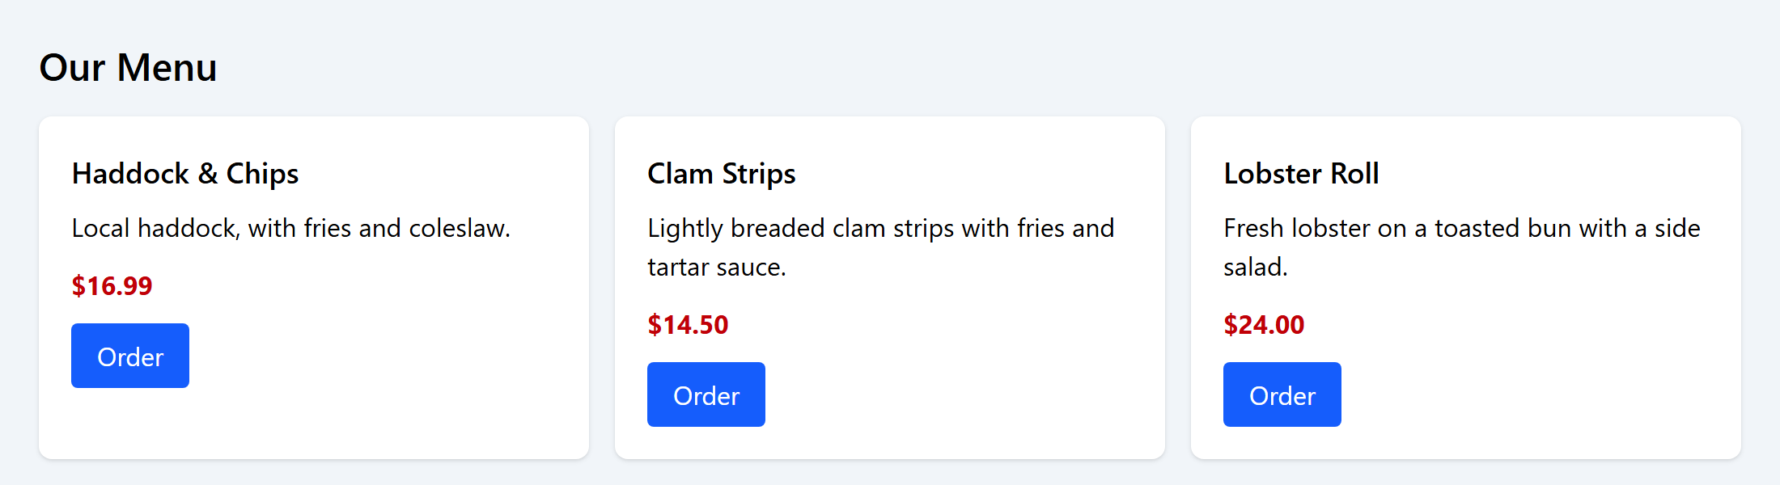
The Same Cards, Two Ways
BOOTSTRAP · EXAMPLE 08
TAILWIND · EXAMPLE 09
<article class="card h-100 shadow-sm">
<div class="card-body">
<h2 class="card-title h5">...</h2>
<p class="card-text">...</p>
<a class="btn btn-primary">Order</a>
</div>
</article>
<article class="bg-white rounded-lg shadow p-5">
<h2 class="text-lg font-semibold">...</h2>
<p class="mt-2">...</p>
<a class="inline-block mt-3 px-4 py-2
rounded bg-blue-600 text-white
hover:bg-blue-700">Order</a>
</article>
RESULT
RESULT
10_CSS_Frameworks/08_bootstrap_cards_example.html
10_CSS_Frameworks/09_tailwind_cards_example.html
Notes:
Examples 08 and 09 are the same three menu cards. Open them side by side.
Bootstrap (left): the card is card, card-body, card-title. Someone else decided what a card looks like, and you get it with a few names.
Tailwind (right): there's no 'card' class. The article gets bg-white (background), rounded-lg (border-radius), shadow (box-shadow) and p-5 (padding). You decide every part.
They look nearly the same. Ask: which HTML would you rather read? Which would you rather change to a totally different look?
Tailwind's HTML is longer, but you rarely need a CSS file. Bootstrap's HTML is shorter, but making it look different takes CSS, like Example 07.

Slide 55
TAILWIND · EXAMPLE 09
Reading Tailwind Classes
​One <script> in the head loads it (the "Play CDN").
​About one CSS property per class: p-5 is padding, rounded-lg is border-radius.
​md:grid-cols-3: a prefix is a media query. hover: is :hover.
<div class="grid gap-4 md:grid-cols-3">
<article class="bg-white rounded-lg shadow p-5">
<h2 class="text-lg font-semibold">Haddock &amp; Chips</h2>
<p class="mt-2">Local haddock, with fries and coleslaw.</p>
<p class="mt-3 font-bold text-red-700">$16.99</p>
<a href="#" class="inline-block mt-3 px-4 py-2 rounded
bg-blue-600 text-white hover:bg-blue-700">Order</a>
</article>
RESULT
10_CSS_Frameworks/09_tailwind_cards_example.html
Notes:
Open 09_tailwind_cards_example.html.
The script tag: Tailwind's 'Play CDN'. It reads the classes on the page and writes the CSS in the browser, as the page loads. It's great for learning and trying ideas. Real projects run Tailwind as a build step, which writes a small CSS file with only the classes the site uses. That's why Tailwind sites end up smaller than Bootstrap ones.
Read the grid line: grid (display: grid), gap-4 (a 1rem gap), md:grid-cols-3 (three columns, from 768px up). Tailwind's md is 768px, same as Bootstrap's, and also min-width: phones first. Below md there's no grid-cols, so it's one column.
On the button: hover:bg-blue-700 is a darker blue on hover. Tailwind puts the state in the class name, which is why there's no hover problem like Example 07's.
The colours are a palette: blue-600 is a mid blue, blue-700 a bit darker. 50 is the lightest, 950 the darkest.
Tailwind's spacing numbers are different from Bootstrap's: p-5 here is 1.25rem (each step is 0.25rem). Same idea, different scale, which is a good reason to check the docs.

Slide 56
?
POP QUIZ 9
​In Tailwind, what does md:grid-cols-3 mean?
​Three columns, but only on medium-sized screens
​Three columns, on screens up to 768px wide
A
B
​Three columns of medium width
​Three columns, on screens 768px wide and wider
C
D
Vote: hold up 1, 2, 3 or 4 fingers (A to D), or type your letter in the Teams chat. 30 seconds!
Notes:
Students who got Pop Quiz 4 should get this. A is the common wrong answer.

Slide 57
?
POP QUIZ 9: ANSWER
​In Tailwind, what does md:grid-cols-3 mean?
​Three columns, but only on medium-sized screens
​Three columns, on screens up to 768px wide
A
B
​Three columns of medium width
​Three columns, on screens 768px wide and wider
C
✓
Why?
​Like Bootstrap, Tailwind is phones first: md: is @media (min-width: 768px).
​It applies from 768px up, including big screens, until a bigger prefix like lg: overrides it.
Notes:
Answer: D.
Check in DevTools: inspect the grid in Example 09 and the rule is inside @media (width >= 48rem). 48rem is 768px.

Slide 58
Week 10: CSS Frameworks
Bootstrap, Tailwind, or Plain CSS?
Bootstrap
Pick it when you need it working fast: menus, forms and pages that look good with little CSS.
Tailwind
Pick it when you have your own design to build, and want it to look like nobody else's.
Plain CSS
Pick it for small sites, or full control with no extra files. And it's what both are made of.
Learn one of each kind, and the rest will look familiar.
Notes:
There's no single right answer, and students will hear strong opinions online.
- Bootstrap: when you need something that works and looks decent quickly, especially with menus, modals and forms. Very common on existing sites, admin pages and internal tools, so you'll likely maintain some at work.
- Tailwind: when you have a design to build, and want it to look like no one else's. Very popular for new projects, and often used with JavaScript frameworks like React. Its build step makes small CSS files.
- Plain CSS: small sites, and anywhere you want full control with no extra files. Also: everything you learn in plain CSS makes both frameworks easier.
Why we demoed these two: they're the most common, they're one of each kind, and between them students will recognize almost any framework they meet.

Slide 59
?
POP QUIZ 10
​Which of these was written with Tailwind CSS?
​class="bg-white rounded-lg shadow p-5"
​class="card h-100 shadow-sm"
A
B
​class="btn btn-primary"
​class="alert alert-warning"
C
D
Vote: hold up 1, 2, 3 or 4 fingers (A to D), or type your letter in the Teams chat. 30 seconds!
Notes:
A last check before the activity.

Slide 60
?
POP QUIZ 10: ANSWER
​Which of these was written with Tailwind CSS?
​class="bg-white rounded-lg shadow p-5"
​class="card h-100 shadow-sm"
✓
B
​class="btn btn-primary"
​class="alert alert-warning"
C
D
Why?
​Each Tailwind class does about one thing: a background, a radius, a shadow, padding.
​card, btn and alert are Bootstrap's named components. (shadow-sm is a Bootstrap utility, but card gives it away.)
Notes:
Answer: A.
It's the card from Example 09. B is the card from Example 08.

Slide 61
+
Harbourside in Bootstrap
•
○
+
Same page, same words · Bootstrap does the layout · Try Its 2 to 7
•
○
Notes:
The big activity. This replaces last year's 'download an example and customize it', which is now a fast-finisher option.
Students take the Harbourside page from Week 7, with all the CSS taken away, and rebuild it with Bootstrap. Each Try It adds one part.

Slide 62
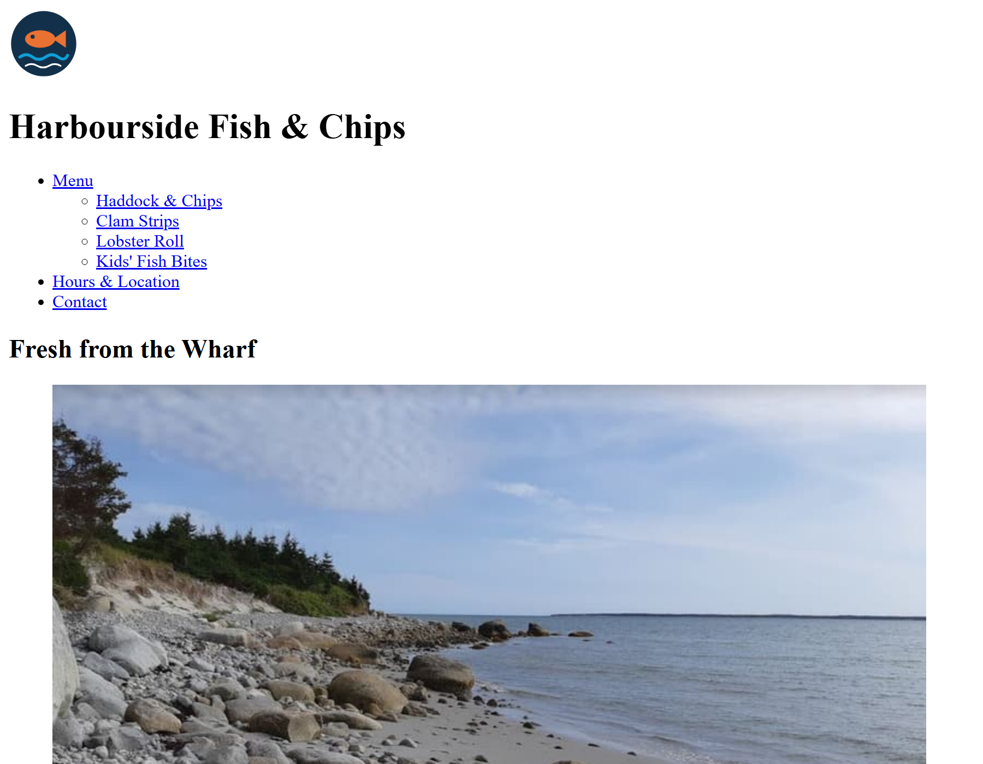
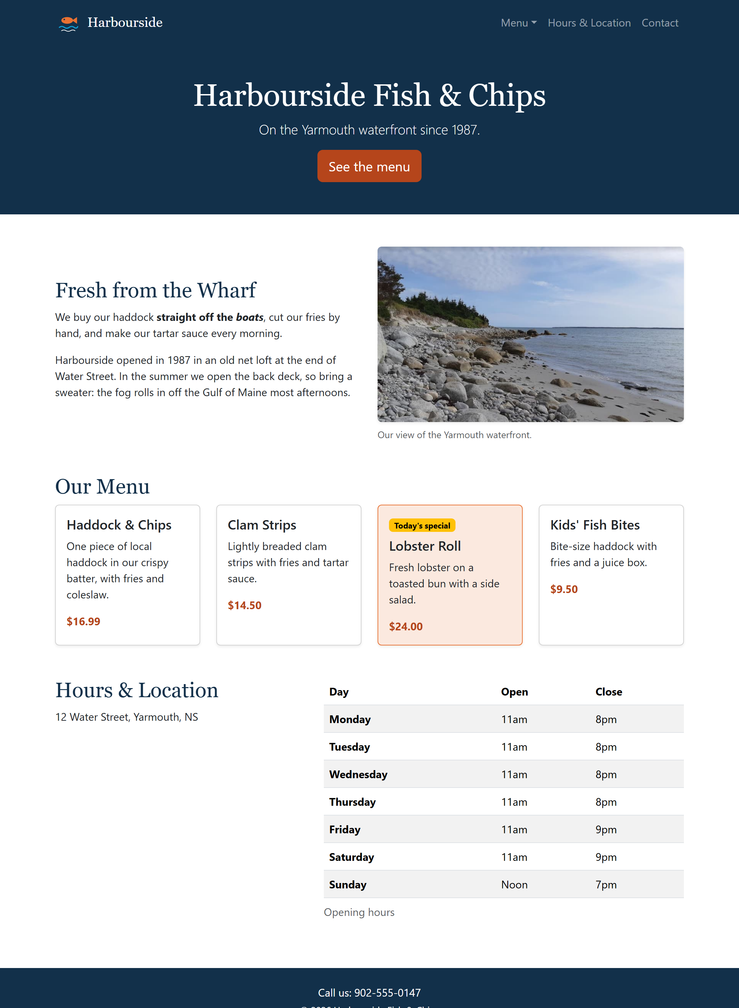
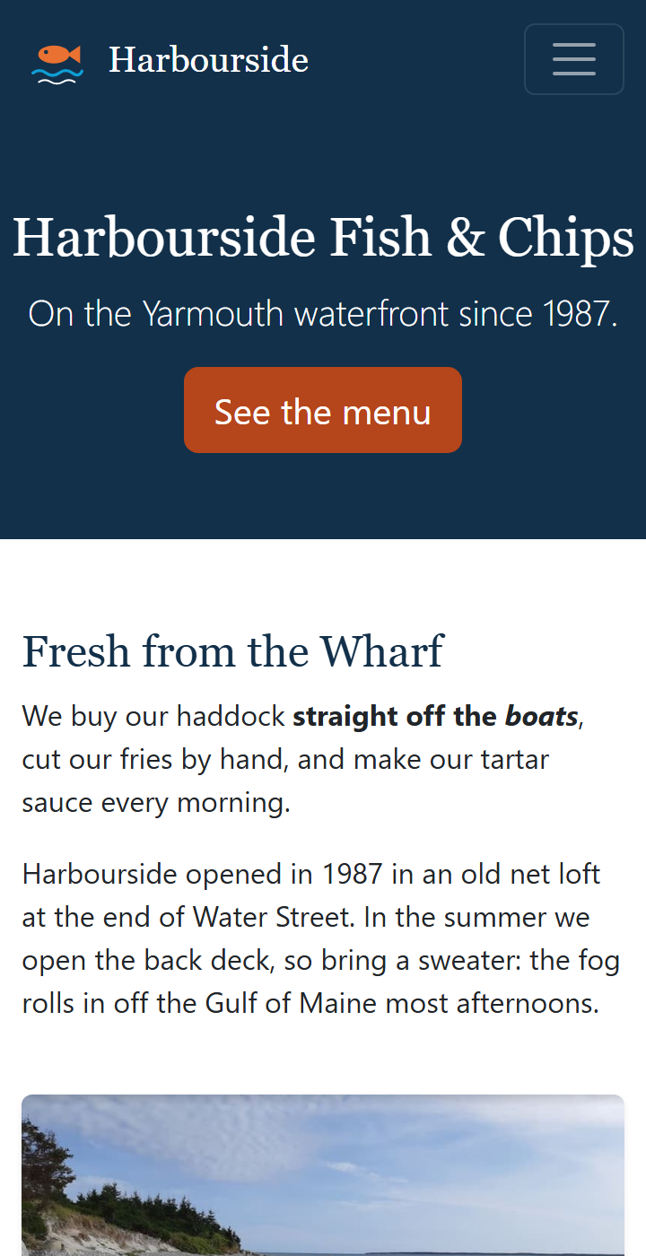
Harbourside, Part 4: Before and After
BEFORE: NO CSS
AFTER: BOOTSTRAP
PHONE
Notes:
Open activity/index.html with Go Live. It's our Harbourside page with no CSS at all: that's the left picture.
By the end of class it looks like the right pictures, and on a phone the menu folds into a menu button.
The plan:
- Try It 2: link Bootstrap and add a container.
- Try It 3: the navbar.
- Try It 4: a banner, and the intro in two columns.
- Try It 5: the menu as cards.
- Try It 6: the hours table and the footer.
- Try It 7: make it look like Harbourside, in style.css.
Every Try It's code is on its slide, and the finished page is in activity/answer/. The comments in index.html say where each Try It goes.
The content and the semantic HTML (header, nav, main, section, article, aside, footer) all stay. Bootstrap only adds classes and a few wrapper divs.

Slide 63
Try It 2: Link Bootstrap (4 min)
1
Open the activity
​activity/index.html with Go Live, and in VS Code.
2
Add the two links
IN THE HEAD, WHERE THE TRY IT 2 COMMENT IS
​Bootstrap's first, then style.css. Save: the fonts change right away.
<link rel="stylesheet" href="https://cdn.jsdelivr.net/npm/bootstrap@5.3.8/dist/css/bootstrap.min.css">
<link rel="stylesheet" href="style.css">
<!-- further down -->
<main class="container my-5">
3
Add a container
​<main class="container my-5">: centred, with space above and below.
​Watch the page as you save: it changes before you've added a single other class.
Notes:
Bootstrap's base styles (its 'Reboot') change the page as soon as it's linked: a modern font, no margin on the body, nicer tables. Point that out.
my-5: margin on the top and bottom (y), size 5 (3rem).
Check everyone has the link right before moving on: if Bootstrap didn't load, nothing else today works.

Slide 64
Try It 3: The Navbar (10 min)
1
Delete the old parts
REPLACES THE LOGO AND THE OLD <NAV>
​The <img> logo and the whole <nav>. Keep the <h1> for now.
<nav class="navbar navbar-expand-md bg-harbour"
data-bs-theme="dark" aria-label="Main">
<div class="container">
<a class="navbar-brand d-flex align-items-center gap-2" href="#">
<img src="images/logo.svg" width="40" height="40" alt="">
Harbourside
</a>
<button class="navbar-toggler" type="button"
data-bs-toggle="collapse" data-bs-target="#mainNav"
aria-controls="mainNav" aria-expanded="false"
aria-label="Toggle navigation">
<span class="navbar-toggler-icon"></span>
</button>
<div class="collapse navbar-collapse" id="mainNav">
<ul class="navbar-nav ms-auto">
<li class="nav-item dropdown">
<a class="nav-link dropdown-toggle" href="#menu" role="button"
data-bs-toggle="dropdown" aria-expanded="false">Menu</a>
<ul class="dropdown-menu">
<li><a class="dropdown-item"
href="#haddock">Haddock &amp; Chips</a></li>
<!-- ...and the other three, the same way -->
</ul>
</li>
<li class="nav-item"><a class="nav-link" href="#hours">Hours &amp; Location</a></li>
<li class="nav-item"><a class="nav-link" href="#contact">Contact</a></li>
</ul>
</div>
</div>
</nav>
2
Paste the navbar
​In the header, where they were.
3
Add the script
​Bootstrap's JavaScript just before </body>, like Example 01.
4
Test it
​Make the window narrow. Does the menu button open? Does the Menu dropdown work?
Notes:
The code is on the slide, but it's long: students can copy it from activity/answer/index.html. The slide leaves out three of the dropdown items to fit; the answer file has them all. Careful: the answer file's image paths start with ../ because it's one folder deeper. In activity/index.html it's images/logo.svg.
New things since Example 06:
- bg-harbour is our own class (it's already in style.css): navy.
- data-bs-theme="dark" tells Bootstrap the background is dark, so the links and the menu button turn light.
- The logo goes inside the navbar-brand. d-flex align-items-center gap-2 is flexbox from Week 8, as classes.
- The Menu item is a dropdown: dropdown-toggle on the link, dropdown-menu on the list, dropdown-item on each link. data-bs-toggle="dropdown" makes it open. It needs the script too.
The usual problems: the script is missing (nothing opens), or the id on the collapse div doesn't match data-bs-target.

Slide 65
Try It 4: A Banner and Two Columns (8 min)
1
Make the banner
​Replace the <h1> with the banner div, under the navbar.
THE H1 BECOMES A BANNER; THE INTRO BECOMES A ROW
2
Make the intro a row
<div class="bg-harbour text-white text-center py-5">
<h1 class="display-5">Harbourside Fish &amp; Chips</h1>
<p class="lead">On the Yarmouth waterfront since 1987.</p>
<a class="btn btn-harbour btn-lg" href="#menu">See the menu</a>
</div>
<section class="intro row g-4 align-items-center mb-5">
<div class="col-md-6">
<h2>Fresh from the Wharf</h2>
<p>...</p> <p>...</p>
</div>
<div class="col-md-6">
<figure class="figure mb-0">
<img src="images/harbour.jpg" width="800" height="458"
class="figure-img img-fluid rounded shadow-sm"
</figure>
</div>
</section>
​Add row g-4 align-items-center to the intro section.
3
Two columns
​The words in one col-md-6, the figure in another.
4
Fit the photo
​img-fluid is max-width: 100% from last week.
Notes:
The banner: display-5 is one of Bootstrap's big heading sizes, lead is the bigger paragraph from Example 01. btn-harbour is a class we make in Try It 7. Until then the button has no colour, which is fine.
The intro: the section itself becomes the row. Two col-md-6 divs: words first, photo second. On a phone they stack, with the words on top.
align-items-center lines the two columns up in the middle (flexbox, Week 8). g-4 is the gap.
img-fluid on the photo: it's Bootstrap's version of last week's img { max-width: 100%; height: auto; }. figure, figure-img and figure-caption style the figure.
The slide skips the alt text and the figcaption to fit: keep them, from the original.

Slide 66
Try It 5: The Menu as Cards (10 min)
1
Wrap the cards in a row
​<div class="row g-4"> around all four articles.
INSIDE <SECTION ID="MENU">, UNDER THE H2
2
A column for each card
​col-sm-6 col-lg-3: 1 across, 2 from sm, 4 from lg.
<div class="row g-4">
<div class="col-sm-6 col-lg-3">
<article id="haddock" class="card h-100 shadow-sm">
<div class="card-body">
<h3 class="card-title h5">Haddock &amp; Chips</h3>
<p class="card-text">...</p>
<p class="price mb-0">$16.99</p>
</div>
</article>
</div>
<!-- ...the same for the other three -->
<!-- In the lobster roll's card-body: -->
<span class="badge text-bg-warning mb-2">Today's special</span>
</div>
3
Make each one a card
​Add card to the article, and a card-body div inside it.
4
Today's special
​Add the badge to the lobster roll.
Notes:
Each article keeps its id (for the dropdown links) and its class="special". h-100 makes every card the full height of its column, so they line up even with different amounts of text. shadow-sm adds a light shadow.
class="card-title h5" on the h3: the right heading level, at a smaller size.
The column classes: count them at each size. Under 576px, no class applies, so full width. sm (576px+): 6 of 12, so 2 across. lg (992px+): 3 of 12, so 4 across.
Check with the device toolbar at 360px, 700px and 1100px.

Slide 67
Try It 6: The Table and the Footer (6 min)
1
Make the aside a row
​The address in col-md-5, the table in col-md-7.
THE ASIDE, THEN THE FOOTER
2
Style the table
<aside id="hours" class="row g-4">
<div class="col-md-5">
<h2>Hours &amp; Location</h2>
<p>12 Water Street, Yarmouth, NS</p>
</div>
<div class="col-md-7">
<div class="table-responsive">
<table class="table table-striped">
...
</table>
</div>
</div>
</aside>
<footer id="contact" class="bg-harbour text-white text-center py-4">
<p class="mb-1">Call us: 902-555-0147</p>
<p class="small mb-0">&copy; 2026 Harbourside Fish &amp; Chips</p>
</footer>
​table table-striped, inside a table-responsive div.
3
Style the footer
​Navy, white text, centred, with padding.
Notes:
table: Bootstrap's table style (padding, lines between rows). table-striped: every second row shaded. Others to try: table-hover, table-bordered, table-sm.
table-responsive: if the table is wider than the screen, it scrolls sideways inside its own box, instead of the whole page scrolling. We did this by hand in Week 7 with the table-wrap div.
The footer reuses bg-harbour. text-center centres the text, py-4 is padding on the top and bottom. mb-1 and mb-0 tidy up the paragraph margins.
The caption shows under the table: Bootstrap puts captions at the bottom. Add caption-top to the table to move it.

Slide 68
Try It 7: Make It Yours (8 min)
1
Open style.css
ADD TO STYLE.CSS, UNDER THE TRY IT 7 HEADING
​It's linked after Bootstrap, so a tie goes to us.
/* 1. Headings in Georgia, like the old site */
h1, h2, .navbar-brand {
font-family: Georgia, "Times New Roman", serif;
}
h2 {
color: #12304A;
}
/* 2. Prices in our orange-red */
.price {
color: #B5451B;
font-weight: bold;
}
/* 3. and 4.: the special, and .btn-harbour
(copy them from answer/style.css) */
2
Add the rules on the right
​Georgia headings, orange-red prices, the special, our button.
3
Hover the banner button
​It should stay orange-red: we set the variables, like Example 07.
4
Make it yours
​Change a colour, a font, or a Bootstrap class. Anything you like.
​Bootstrap's rule still winning? Inspect it in DevTools. It may be more specific, like .btn:hover.
Notes:
This is what turns a Bootstrap page into Harbourside. The whole file is about 40 lines, compared with about 300 lines in Week 9's style.css. That's the trade-off in one number.
The special: .special sets background-color and border-color. Bootstrap's .card rule uses the same specificity (one class), so ours wins because it's later.
.btn-harbour sets the button variables, so the hover and active colours are ours too. Orange-red (#B5451B) and not the logo's lighter orange (#E97132): white text on the lighter orange is too low contrast to read easily.
Fast finishers: make the navbar stick to the top (sticky-top on the nav), add a card-img-top photo to a card, or swap btn-harbour for a btn-outline-light.

Slide 69
Class Activity: Submit Harbourside
Finished early?
Your page should have:
✓
A navbar that folds into a menu button
Last year's activity
​Download one of the Bootstrap examples (getbootstrap.com/docs/5.3/examples) and make it yours: a heading, some text, an image.
✓
The menu as cards in a responsive grid
✓
Your own colours in style.css
Try Tailwind
Then:
​Rebuild the menu cards in a new file with Tailwind, using Example 09 as a guide.
1
​Take two screenshots: wide, and at phone width (Ctrl + Shift + M).
Stuck?
2
​Drop them in the box on Week 10 Brightspace.
​activity/answer/ has the finished page.
Notes:
This replaces last year's activity (download a Bootstrap example and customize it), which is now the fast-finisher option.
Students take the screenshots with the device toolbar, so the phone width shows. Its menu (the three dots on the toolbar) has 'Capture screenshot', and 'Capture full size screenshot' gets the whole page.
Check that the Week 10 Brightspace submission box is set up before class.
Tailwind version: for students who want a challenge, rebuild the menu cards with Tailwind's Play CDN, using Example 09 as a guide. Don't link Bootstrap and Tailwind in the same page: their classes clash (both have p-3, for example).

Slide 70
Week 10: CSS Frameworks
Week 10 Recap
Class 1:
  A framework is CSS someone else wrote. It's still CSS underneath.
  Bootstrap's CSS first, yours after it. Rows have 12 columns.
  col-md-4: a third, from 768px up. text-bg-*, p-3, mb-2.
Class 2:
  Components: btn, alert, card, navbar (which needs the JavaScript).
  Customize with your own CSS, and Bootstrap 5's --bs- variables.
  Tailwind: small utility classes, with md: and hover: prefixes.
Coming up:
  The Week 10 quiz on Brightspace: 10 questions, like the pop quizzes.
Notes:
If students remember three things from this week: a framework is still CSS underneath, Bootstrap's grid is 12 columns with min-width breakpoints, and to change Bootstrap's look you put your CSS after it (and use its variables for buttons).
The Week 10 quiz on Brightspace is 10 questions, built from today's and last class's pop quizzes.
Then the last slide: the one-sentence summary.

Slide 71
+
Write a one-sentence summary of what we did this week.
•
○
+
One sentence, in your own words.
•
○
Notes:
Give everyone a minute. They can write it on paper or post it in the Teams chat. Ask two or three people to read theirs out.
Listen for whether anyone mentions that Bootstrap is built on flexbox and media queries. If nobody does, say it: it's the main idea that connects this week to the last three.

