Slide 1
WEBD 1000
Week 9, Class 1:
  Float: wrapping text around a photo, and the clearfix.
Week 9: Responsive Web Design
Notes:
Welcome back! We didn't get to float last class, so we're picking it up today.
Float is the old layout tool that's still the best way to wrap text around a photo. It's the third layout tool after flexbox and grid.

Slide 2
Attendance and a Quick Check-in
OUTLOOK
TEAMS
✓
Are you checking your school Outlook email?
✓
Are you signed into Teams?
TEAMS
BRIGHTSPACE
✓
Are you following our Teams channel and General chat?
✓
Are you following the Content on Brightspace?
Notes:
Take attendance while everyone checks these four things.
While you do, have students git pull, open activity/index.html in 09_Float_CSS with Live Server (Try Its 1 to 6 are already done), and open 15_float_text_wrap_example.html in the same folder.

Slide 3
Week 9: Responsive Web Design
Week 9, Class 1: Overview
Title: Float
Agenda:
  Float: wrapping text around a photo
  Collapsing parents: the clearfix and display: flow-root
  Harbourside, Part 3: Try It 7, float the photo
Wrap
→
Collapse
→
Fix
Text around a photo
Why the box disappears
display: flow-root
Notes:
Carried forward from Week 8, Class 2. Rough plan for this part: about 15 minutes.
- Examples 15 and 16
- Pop Quiz 1
- Try It 7 (5 min)
The examples and the Harbourside page are in the 09_Float_CSS folder.
Try It 7 builds on Try It 5 (the page layout with grid). The Harbourside page in activity/ has Try Its 1 to 6 already done, so everyone starts from the same place.

Slide 4

+
Float
•
○
+
Text around a photo · the clearfix · the old way to make columns
•
○
Notes:
Float is the oldest of the three. It was made for one job: letting text flow around an image, like in a newspaper or a magazine. In the 2000s and early 2010s, people also used it to build whole page layouts, because there wasn't anything better. That took a lot of hacks.
Today, use grid and flexbox for layout, and float for its original job. But you'll still meet floats in older code, so it's worth knowing how they behave.

Slide 5

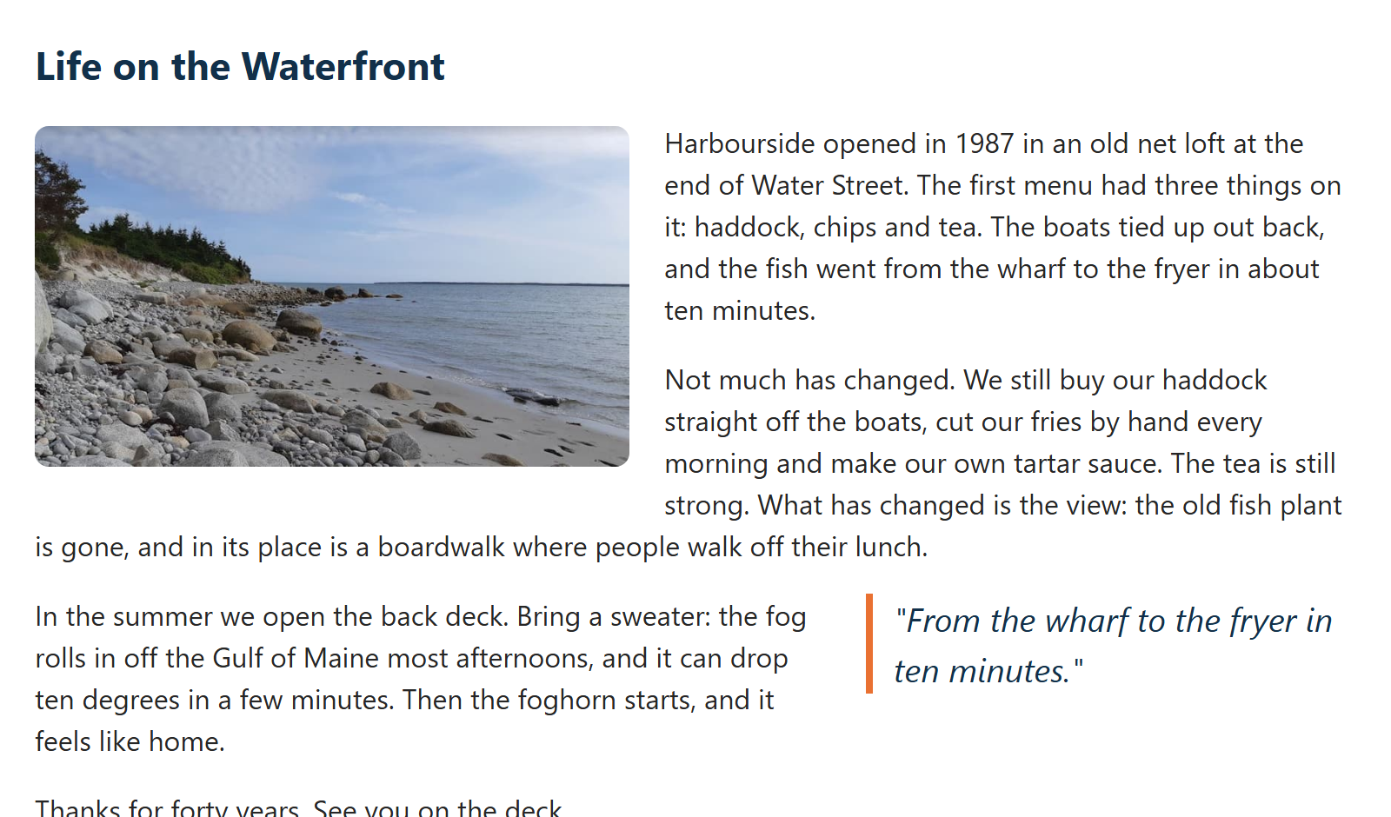
FLOAT 1 · EXAMPLE 15
Wrapping Text Around a Photo
/* 1. Photo on the left, text flows around it */
.photo {
float: left;
width: 45%;
height: auto;
margin: 4px 20px 10px 0;
border-radius: 8px;
}
/* 2. A pull quote floats to the right */
.pull-quote {
float: right;
width: 35%;
margin: 0 0 10px 20px;
padding-left: 12px;
border-left: 4px solid #E97132;
color: #12304A;
font-size: 1.2rem;
font-style: italic;
}
​float: left: the photo moves to the left, and the text flows around its right side.
​Give it a width and a margin on the side the text is on.
RESULT
09_Float_CSS/15_float_text_wrap_example.css
Notes:
Open 15_float_text_wrap_example.html and resize the window.
The photo floats to the left of its paragraph; the text wraps around it, and when the text gets below the photo it goes back to full width. That's the one thing flexbox and grid can't do: they put things side by side in boxes, they don't wrap text around things.
The pull quote floats to the right, the same way. Pull quotes are a magazine idea: a short, eye-catching quote from the article.
The margins matter: margin-right on the left-floated photo (and margin-left on the right-floated quote) keeps the text from touching them.
Width as a percentage keeps it responsive: the photo is always 45% of the article.

Slide 6
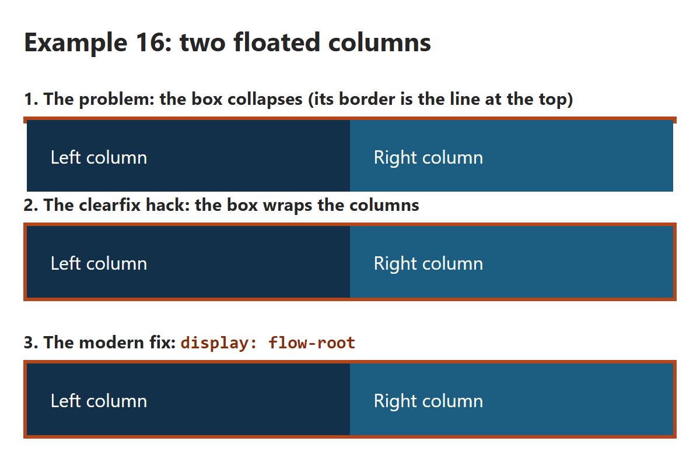
FLOAT 2 · EXAMPLE 16
/* 1. The old way to make columns: float them */
.float-left {
float: left;
width: 50%;
padding: 20px;
background-color: #12304A;
color: white;
}
.float-right {
float: right;
width: 50%;
padding: 20px;
background-color: #1B5E82;
color: white;
}
/* 2. The clearfix: an empty last child, below both floats */
.clearfix::after {
content: "";
clear: both;
display: table;
}
/* 3. One line does the same job today */
.flow-root {
display: flow-root;
}
Floats and the Clearfix
​Floats don't count towards their parent's height. Only floats inside? The box collapses.
​The clearfix hack, or today's one-liner: display: flow-root.
RESULT
09_Float_CSS/16_float_clearfix_example.css
Notes:
Open 16_float_clearfix_example.html. This is the 'Float for layouts' and 'Clearfix hack' code from the original deck, side by side.
Demo 1: two floated 50% columns inside a box with an orange border. The box has nothing else inside, and floats are taken out of the normal flow, so the box has a height of 0. Its border is the thin orange line at the top, and the columns hang out below it. The next heading even tries to wrap around them.
Demo 2: the clearfix. ::after adds an empty element at the end of the box (a pseudo-element from Class 9), and clear: both makes it go below both floats. The box has to stretch down to hold it, so it wraps the columns. You'll see this in a lot of older code.
Demo 3: display: flow-root does the same job in one line, with no hack. Use this one.
And the third option: don't use floats for columns at all. Two columns are one line of grid or flexbox, and those containers always wrap their items.
box-sizing: border-box at the top: without it, 50% plus the padding is more than half, and the right column drops below the left one.

Slide 7
A clearfix is a small CSS trick that stops a box from collapsing when everything inside it is floated.
The problem
Think of a box as a cardboard box that grows to fit whatever's inside. Normally, if you put two columns in a div, the div stretches around them.
Floating an element takes it out of the normal flow, so its parent no longer counts its height. It's as if the items are hovering above the box instead of sitting in it. If the box holds only floats, it thinks it's empty and shrinks to a height of 0.
You can see this in Demo 1 of Example 16: the orange border squashes into a thin line, and the columns hang out below it. The next heading even tries to wrap around them.
The fix
Floats don't stretch the box, but normal elements do. So if you put one normal element at the very bottom, below the floats, the box has to stretch down to hold it, and that wraps the floats too.
You could add an empty <div> by hand, but CSS can add one for you:
.clearfix::after {
content: "";
clear: both;
display: table;
}
.clearfix::after creates a pretend element as the last thing inside the box, so you don't have to change the HTML.
content: "" gives it no text, but ::after doesn't appear at all without this line.
clear: both is the key part. It means "don't sit beside any floats, go below them." That's the "clear" in clearfix.
display: table makes the pretend element a proper box, so clear works on it. It stays invisible because it's empty.
The empty element sits under the floats, and the box stretches down to reach it. The box now wraps the columns and the border looks right.
What to use today
.flow-root {
display: flow-root;
}
This one line tells the box to contain its own floats, with no pretend element needed. That's why it's Demo 3 in the example. Use this in new code, but learn the clearfix because you'll still see it in older websites.
You often don't need either one. If you want columns, use flexbox or grid, which wrap their items properly. That's why Try It 7 on the Harbourside page needs no clearfix: .intro is a grid item, and grid items always contain their floats.

Slide 8
?
POP QUIZ 1
​A div holds two floated columns and nothing else. Its border shows up as a thin line above them. Why?
​The border needs a width
​Floats are taken out of the normal flow, so the div thinks it's empty
A
B
​The floats need a z-index
​The columns need display: block
C
D
Vote: hold up 1, 2, 3 or 4 fingers (A to D), or type your letter in the Teams chat. 30 seconds!
Notes:
Straight after Example 16, so this should go well. It checks that students know WHY the clearfix is needed, not just what it is.

Slide 9
?
POP QUIZ 1: ANSWER
​A div holds two floated columns and nothing else. Its border shows up as a thin line above them. Why?
​The border needs a width
​Floats are taken out of the normal flow, so the div thinks it's empty
A
✓
​The floats need a z-index
​The columns need display: block
C
D
Why?
​A floated element doesn't add to its parent's height. Only floats inside = a height of 0.
​Fix it with display: flow-root on the parent (or the older clearfix hack).
​Flex and grid containers don't have this problem: they always wrap their items.
Notes:
Answer: B.
This is the number one reason people moved from floats to flexbox and grid for layout. And floats don't mix with them: float: left on a flex or grid item does nothing at all.

Slide 10
Try It 7: Float the Photo (5 min)
1
Type the CSS on the right
IN STYLE.CSS
​Under Try It 7. Save.
.intro figure {
float: right;
width: 45%;
margin: 0 0 12px 20px;
}
2
The text wraps
​The intro paragraphs flow around the left side of the photo.
3
Play with it
​Try float: left (and swap the margins). Or change the width to 30%.
​No clearfix needed: a grid item always wraps its own floats. On a page with no grid, you'd add display: flow-root.
Notes:
The photo in the intro floats right, at 45% of the intro's width, and the paragraphs wrap around it.
The figure is floated, not the img, so the caption goes with the photo.
Why no collapsing box, after all that? The intro section is a grid item (Try It 5), and a grid item always contains its own floats. If the text is shorter than the photo, the section just grows to fit the photo.
If you swap to float: left, swap the margin too: margin: 0 20px 12px 0, so the space is on the right, where the text is.

Slide 11
Week 9: Responsive Web Design
Float Recap
Recap:
  float: left or right moves an element to the side, and the text flows around it.
  Give a float a width, and a margin on the side the text is on.
  A parent with only floats collapses. Fix it with display: flow-root (or the older clearfix).
  Floats are ignored on flex and grid items. Use flexbox and grid for layout, and float for text.
Notes:
The two things to remember: float is for wrapping text around something, and a parent with only floats inside collapses unless you give it display: flow-root.
For page layout, keep using flexbox and grid.

