Slide 1
WEBD 1000
Class 9:
  Advanced selectors, and making things move with CSS animation.
HTML/CSS Techniques
Notes:
Welcome back! Last class we styled the Harbourside page from scratch: selectors, colour, fonts, the box model and the cascade.
Today has two halves. First, some more powerful selectors, so we can pick out exactly the element we want (and play a quick game). Then the fun part: CSS animation. By the end of class, everyone will have a page full of rolling balls, spinning pinwheels and pulsing boxes.

Slide 2
Attendance
Notes:
Take attendance. While you do, have students git pull and open the 06_Selectors_and_Animation folder in VS Code.

Slide 3
HTML/CSS Techniques
Class 9: Class Overview
Title: Advanced Selectors and CSS Animation
Agenda:
  Advanced selectors, and a game: Name That Selector!
    states · positions · attributes · relationships · parts of an element
  CSS animation: transitions, @keyframes, and lots of demos
  The Animation Playground: four challenges
  Show and tell
Select
→
Animate
→
Play
Pick exactly the element you want
Make it move with @keyframes
Four challenges, lots of motion
Notes:
Rough plan: 5 min intro, about 35 min of selectors (five quick examples and a game), about 30 min on animation concepts with demos, then about 40 min in the Animation Playground, and 10 min of show and tell at the end.
The selector half is quicker and lighter than last class: no Try Its, just examples to open and poke at in DevTools. Save the energy for the playground.

Slide 4
HTML/CSS Techniques
Before We Start: Get the Code
1. Pull this week's examples
git pull
New folder: 06_Selectors_and_Animation (examples 01–12, and the activity folder).
2. Open each example with Live Server as we go
Animations only move in a real browser, so open them! Change a number, save, and watch what happens.
3. Keep DevTools handy
F12 → Elements → Styles shows which rule picked each element. There's an Animations panel too (later).
Notes:
Examples 01–05 are selectors, 06–12 are animation. Every example is a single file with its CSS in a <style> block, so students can open one and change things straight away.
The activity folder has two CSS files. stage.css draws the stages and objects (they shouldn't need to touch it). style.css is theirs, with a heading for each challenge.
Ask students not to open activity/answer until they're stuck.

Slide 5

+
Advanced Selectors
•
○
+
States · positions · attributes · relationships · parts
•
○
Notes:
Last class's selectors (element, .class, #id, groups and descendants) get you a long way. Today's selectors let you pick things out without adding a class to every element: the third row of a table, every link to a PDF, the paragraph right after a heading.
The pace here is quick: one example per selector family, then the game.

Slide 6
HTML/CSS Techniques
Five New Kinds of Selector
Last class:
p
.price
#menu
h1, h2
nav a
:
State
a:hover button:focus-visible
What's happening to it right now
:nth
Position
tr:nth-child(even) li:not(.sold-out)
Where it sits inside its parent
[ ]
Attribute
a[href$=".pdf"] input[type="email"]
What's written inside its tag
> + ~
Relationship
ul > li h2 + p h3 ~ p
Who its parent or neighbours are
::
Part
p::first-letter .new::before
Part of an element, or added content
Notes:
This is the map for the next five slides. Each family has a symbol to look for.
: (one colon) = a pseudo-class. It matches an element in a certain state or position.
[ ] = an attribute selector. It matches by what's inside the HTML tag.
> + ~ = combinators. They match by how elements are related in the HTML.
:: (two colons) = a pseudo-element. It styles a PART of an element, or adds content that isn't in the HTML at all.
You don't need to memorize them. You need to know they exist, so you can look them up (MDN is the best reference).

Slide 7

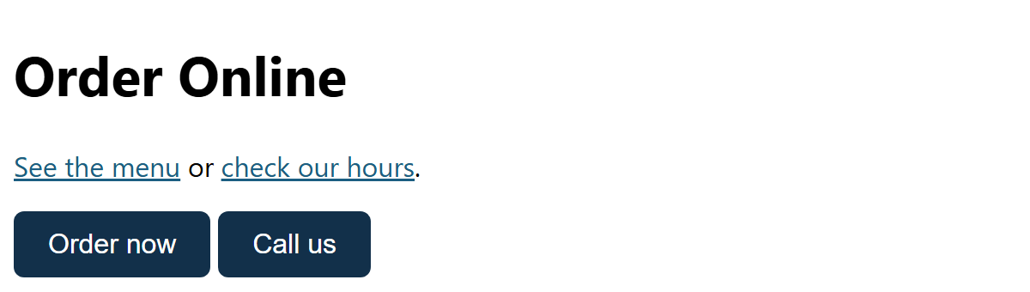
SELECTORS 1 · STATE
body {
font-family: "Segoe UI", Arial, sans-serif;
}
/* A pseudo-class (:) styles an element in a certain STATE */
a:link { color: #1B5E82; } /* not visited yet */
a:visited { color: #A02B93; } /* already visited */
/* Mouse over it */
a:hover {
background-color: #FBE9DF;
}
/* Tabbed to with the keyboard: never remove this! */
a:focus-visible,
button:focus-visible {
outline: 3px solid #E97132;
outline-offset: 3px;
}
button {
font-size: 1rem;
padding: 10px 20px;
border: none;
border-radius: 6px;
background-color: #12304A;
color: white;
}
button:hover { background-color: #1B5E82; }
button:active { background-color: #B5451B; } /* while clicking */
Pseudo-classes: :hover, :focus-visible, :active
​A pseudo-class (one colon) matches an element in a state: :hover mouse over, :active being clicked, :visited link already seen.
​:focus-visible shows where keyboard users are. Never remove the focus outline without replacing it.
RESULT
01_pseudo_classes_example.html
Notes:
Open 01_pseudo_classes_example.html. Hover the links and buttons, click and hold a button (:active), then click in the page and press Tab. The orange outline follows the keyboard.
Accessibility: people who can't use a mouse move around with Tab. If the focus outline is removed (outline: none, sadly common), they have no idea where they are on the page. That fails WCAG 2.4.7 Focus Visible. :focus-visible only shows the outline for keyboard users, so mouse users don't see it on every click. Best of both.
Link order matters (the cascade again): :link, :visited, :hover, :active. Memory trick: LoVe HAte. If :hover comes before :visited, visited links never show their hover colour.
:visited is limited for privacy: browsers only let you change colours, so sites can't detect your browsing history.
DevTools: in Styles, the ':hov' button lets you force a state (hover, focus, active) so you can inspect it without holding the mouse still.

Slide 8
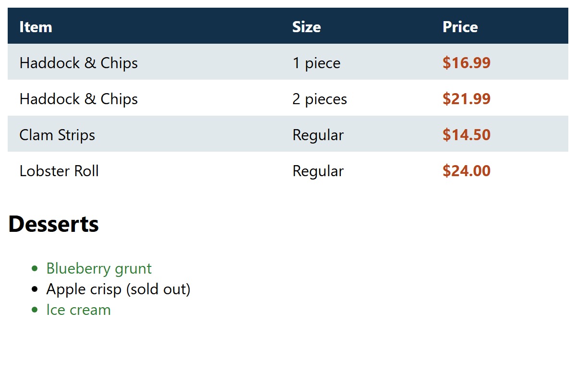
SELECTORS 2 · POSITION
body {
font-family: "Segoe UI", Arial, sans-serif;
}
table {
border-collapse: collapse;
width: 100%;
}
td, th {
padding: 8px 12px;
text-align: left;
}
/* Zebra stripes: every even row */
tr:nth-child(even) {
background-color: #E1E8EB;
}
/* The first row (the header row) */
tr:first-child {
background-color: #12304A;
color: white;
}
/* The last cell in each row */
td:last-child {
font-weight: bold;
color: #B5451B;
}
/* Every li EXCEPT the one with class="sold-out" */
li:not(.sold-out) {
color: #2E7D32;
}
Structural Pseudo-classes
​:first-child / :last-child: the first or last inside its parent.
​:nth-child(even) zebra stripes. Also odd, 3 (the third) or 3n (every third).
​:not(.sold-out): everything except what's in the brackets.
RESULT
02_structural_example.html
Notes:
None of these need a class in the HTML. The browser works out the position for you, so if you add a row to the table, the stripes still alternate correctly. With classes, you'd have to renumber every row by hand.
nth-child counts from 1, not 0 (unlike JavaScript arrays, which students will meet later).
'tr:first-child' targets the header row here because it's the first tr in the table. In a real table you'd use <thead> and <th> (Class 4's accessible table), but this shows the idea.
Try in class: change even to odd, then to 3n, and save. Ask: what would li:nth-child(2) pick?
:not() is handy with lists: 'li:not(:last-child)' adds a border between items but not after the last one.

Slide 9
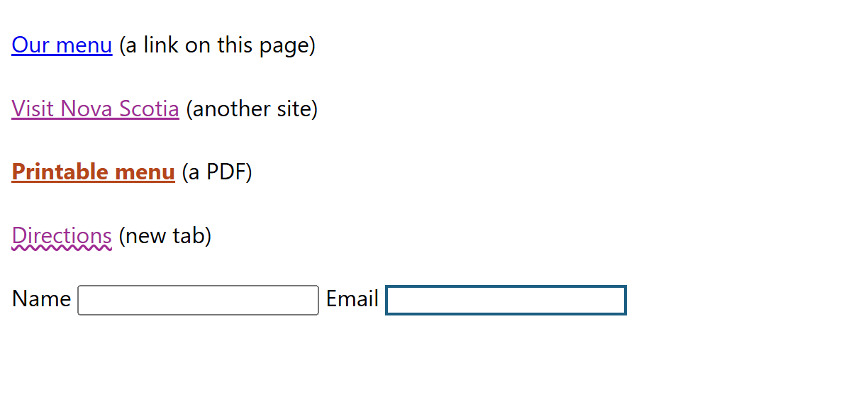
SELECTORS 3 · ATTRIBUTE
body {
font-family: "Segoe UI", Arial, sans-serif;
line-height: 1.8;
}
/* [attr="value"]: an exact match */
input[type="email"] {
border: 2px solid #1B5E82;
}
/* ^= starts with: links that leave our site */
a[href^="https"] {
color: #A02B93;
}
/* $= ends with: links to PDF files */
a[href$=".pdf"] {
color: #B5451B;
font-weight: bold;
}
/* [attr]: has the attribute at all */
a[target] {
text-decoration: underline wavy;
}
Attribute Selectors
​Square brackets match what's inside the tag: [type="email"] is an exact match.
​^= starts with, $= ends with, *= contains. [target] just has the attribute.
​Great for links: show which ones go to another site, or download a PDF.
RESULT
03_attribute_example.html
Notes:
These read the HTML attributes we already write, so again, no extra classes.
Memory trick: ^ is the start of a line and $ is the end in 'regular expressions', which students will see again in programming courses. * means 'anywhere'.
Real uses: a little icon after every external link or PDF link (with ::after, coming up), styling form fields by type, and [aria-current="page"] to highlight the current page in the nav. Our Harbourside nav already has aria-current="page" on the Menu link from Class 4!
Why tell people a link is a PDF? It's an accessibility and usability point: a PDF can be big, and it opens differently from a web page.

Slide 10
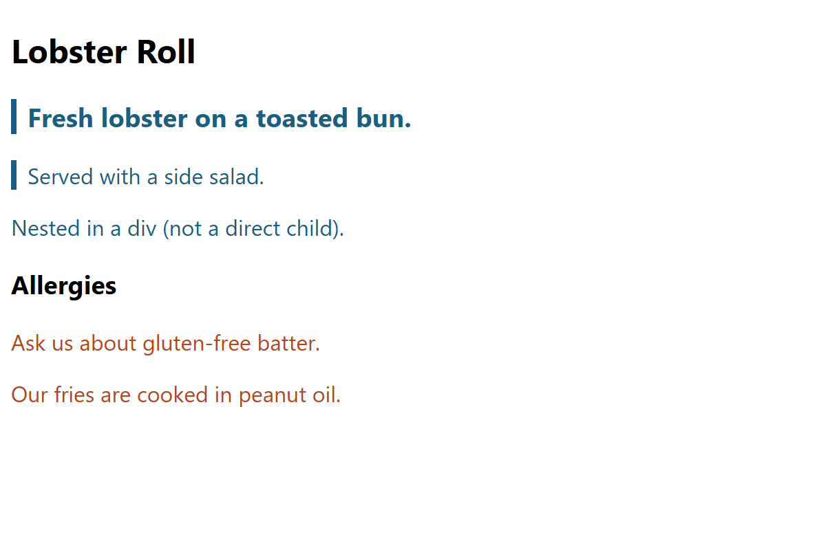
SELECTORS 4 · RELATIONSHIP
Combinators: space, >, +, ~
body {
font-family: "Segoe UI", Arial, sans-serif;
}
/* space = descendant: ANY p inside article (any depth) */
article p {
color: #1B5E82;
}
/* > = child: only p's DIRECTLY inside article */
article > p {
border-left: 4px solid #1B5E82;
padding-left: 8px;
}
/* + = adjacent sibling: the p RIGHT AFTER an h2 */
h2 + p {
font-size: 1.2rem;
font-weight: bold;
}
/* ~ = general sibling: EVERY p after an h3 */
h3 ~ p {
color: #B5451B;
}
​article p (space): any p inside, any depth. article > p: direct children only.
​h2 + p: the p right after an h2. h3 ~ p: every p after an h3 (same parent).
RESULT
04_combinators_example.html
Notes:
Family-tree language: the article is the PARENT of the h2 and the two p's directly inside it. They're CHILDREN of the article and SIBLINGS of each other. The p inside the div is a grandchild (a descendant, but not a child).
Walk through the result:
- All three p's in the article are blue (descendant: any depth).
- Only the first two have the left border. The nested one is inside a div, so it isn't a direct child.
- 'Fresh lobster…' is big and bold: it comes straight after the h2.
- Both p's after the h3 are orange: ~ picks every later sibling, not just the next one.
VS Code tip: hover over any selector in a .css file and it shows a tiny HTML example of what it matches, and its specificity.

Slide 11
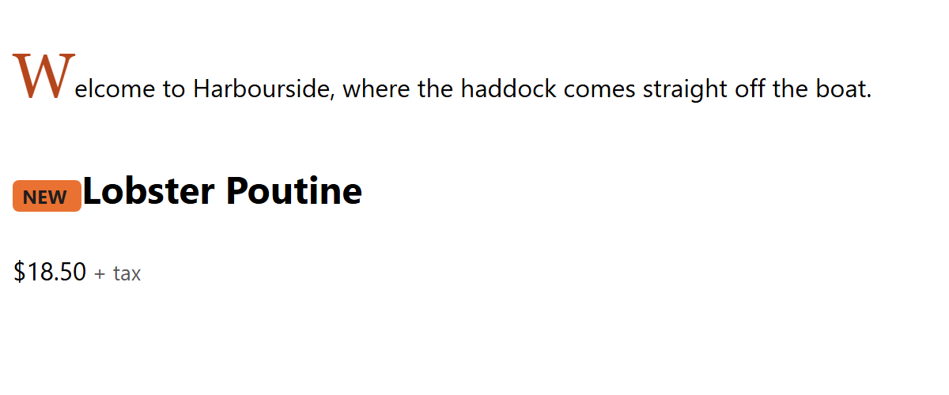
SELECTORS 5 · PART
body {
font-family: "Segoe UI", Arial, sans-serif;
line-height: 1.6;
}
/* A pseudo-element (::) styles PART of an element */
.intro::first-letter {
font-family: Georgia, serif;
font-size: 2.5rem;
color: #B5451B;
}
/* ::before adds content at the start (CSS only, not in the HTML) */
.new::before {
content: "NEW ";
background-color: #E97132;
color: #1E1E1E;
font-size: 0.75rem;
font-weight: bold;
padding: 2px 6px;
border-radius: 4px;
}
/* ::after adds content at the end */
.price::after {
content: " + tax";
color: #595959;
font-size: 0.85rem;
}
/* Text the user highlights with the mouse */
::selection {
background-color: #12304A;
color: white;
}
Pseudo-elements: ::before, ::after
​Two colons = part of an element: ::first-letter, ::first-line, ::selection.
​::before and ::after add content with CSS. They need a content property, even if it's empty: content: "".
RESULT
05_pseudo_elements_example.html
Notes:
Open the example and highlight some text with the mouse to see ::selection.
::before and ::after create a little 'fake' element inside the real one, at the start or end. Without the content property, nothing appears at all. That's the number one bug with these.
What to use them for: decoration. Badges, icons, quote marks, arrows on links. Don't put important information in them: some screen readers read the content, some don't, and it can't be selected or copied.
They're also how a lot of fancy CSS shapes and effects are made, with content: "" and a background colour.
One colon vs two: : is a state (pseudo-class), :: is a part (pseudo-element). Older code sometimes uses one colon for :before. Browsers still accept it, but two is correct.

Slide 12
Game: Name That Selector! (10 min)
1
Every odd row of a table
2
A button while the mouse is over it
3
Every link to a Word file (.docx)
?
?
?
4
Only the li's directly inside .menu
5
The first p right after each h2
6
A ★ before every .favourite
?
?
?
Notes:
Make it a game: teams of 2–3, a minute or two per card (or all six at once with a 6-minute timer). Teams write their answers on paper or in a Teams chat, then reveal on the next slide. One point per correct selector, a bonus point for #6 if they also write the content line.
Answers (also on the next slide):
1. tr:nth-child(odd)
2. button:hover
3. a[href$=".docx"]
4. .menu > li
5. h2 + p
6. .favourite::before { content: "★ "; }
Tiebreaker: 'Every button except .cancel' → button:not(.cancel)
Accept reasonable alternatives: e.g. #1 could be tr:nth-child(2n+1), and #2 could include :focus-visible too (a nice touch).

Slide 13
Name That Selector: Answers
1
Every odd row of a table
2
A button while the mouse is over it
3
Every link to a Word file (.docx)
tr:nth-child(odd)
button:hover
a[href$=".docx"]
4
Only the li's directly inside .menu
5
The first p right after each h2
6
A ★ before every .favourite
.menu > li
h2 + p
.favourite::before
Notes:
Go through each one and ask a team that got it right to explain it.
#6 needs the content property to actually show the star:
.favourite::before { content: "★ "; }
Tiebreaker answer: button:not(.cancel).
Celebrate the winning team, then move on to the fun part: animation.

Slide 14
+
Let's Make Things Move!
•
○
+
transform · transitions · @keyframes · a ball, a race and a car
•
○
Notes:
Animation is the fun part of CSS, and it's used everywhere: buttons that react when you hover, loading spinners, things that fade in as the page loads.
The plan: first the transform property (how to move, spin and resize things), then transitions (a smooth change on hover), then @keyframes (animations that run on their own). Lots of demos, then the Animation Playground.

Slide 15
HTML/CSS Techniques
Your Moving Toolkit: transform
Move it
Spin it
translate(x, y)
rotate(deg)
→
translateX(60px)
rotate(45deg)
Resize it
Combine them
scale(n)
spaces between
→
scale(1.5)
translateX(40px) rotate(20deg) scale(1.2)
Notes:
Almost every animation uses transform. It moves, spins or resizes an element without changing the page layout: the other elements don't get pushed around, the element is just drawn somewhere else.
translate(x, y) moves. Positive x goes right, positive y goes DOWN (screen coordinates start at the top left, unlike in maths class).
rotate() spins, in degrees: 360deg is one full turn. Positive is clockwise.
scale() resizes: 1 is normal, 2 is double, 0.5 is half. scale(1.3, 0.7) stretches wide and squashes flat. That's how cartoon bounces are made.
Combine them in one transform, separated by spaces. Two transform declarations on the same element don't add up: the second replaces the first (the cascade again).
Why transform and not margin or width? The browser can animate transform and opacity very smoothly (on the graphics card). Animating margin, width or top makes the browser redo the whole page layout every frame, which can stutter.

Slide 16
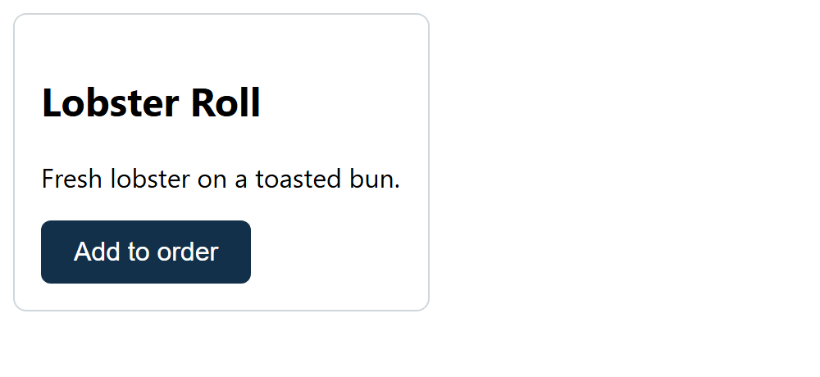
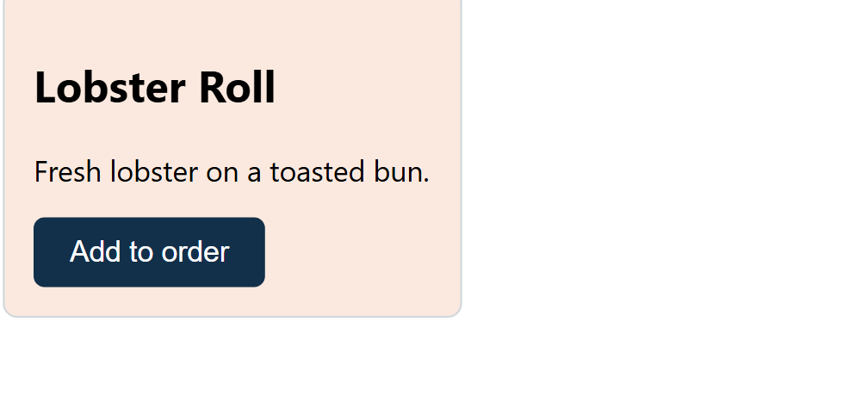
ANIMATION 1 · TRANSITIONS
body {
font-family: "Segoe UI", Arial, sans-serif;
}
.card {
width: 220px;
padding: 16px;
border: 1px solid #D0D7DB;
border-radius: 8px;
background-color: white;
/* WHAT to animate, HOW LONG, and the speed curve */
transition: transform 0.3s ease, background-color 0.3s ease;
}
/* The END state: the transition fills in the in-between */
.card:hover {
transform: translateY(-10px) scale(1.05);
background-color: #FBE9DF;
}
button {
font-size: 1rem;
padding: 10px 20px;
border: none;
border-radius: 6px;
background-color: #12304A;
color: white;
transition: background-color 0.5s;
}
button:hover {
background-color: #B5451B;
}
Transitions: Smooth Changes
​Without transition, a :hover change snaps instantly. With it, the browser fills in the in-between.
​Put transition on the normal rule, so it animates both ways: on and off.
​A transition needs a trigger (like hover) and has only two states: start and end.
NORMAL
:HOVER
06_transition_example.html
Notes:
Open 06_transition_example.html and hover the card. Then comment out the transition line, save, and hover again: it snaps. That's the whole difference.
transition: [property] [duration] [timing];
'transition: all 0.3s' works too, but naming the properties is clearer and avoids surprises.
Where to put it: on the normal rule (.card), not on .card:hover. If it's only on the hover rule, it animates when you mouse over, but snaps back when you leave.
Good durations for UI: 0.15s to 0.4s. Longer feels sluggish.
This ties back to Selectors 1: transitions are what make :hover and :focus feel polished. Next: what if we want something to move all by itself, or with more than two steps? That's @keyframes.

Slide 17
HTML/CSS Techniques
@keyframes: Describe It, Then Play It
@keyframes slide
@keyframes slide {
from { transform: translateX(0); }
to { transform: translateX(300px); }
}
.ball {
animation: slide 2s ease-in-out infinite;
}
1. Describe it and give it a name
from / to
The start and end (or 0% … 100%)
transform
What changes any CSS that has numbers or colours
animation: slide
2. Play it on an element, using the same name
Read it out loud
2s
"Slide the ball from 0 to 300px, over 2 seconds, easing in and out, forever."
How long one run takes (or 500ms)
infinite
How many times 1 (default), 3, or forever
Notes:
Two steps, every time.
1. Describe the animation with @keyframes and give it a name. from = 0% (the start), to = 100% (the end). Inside each step, ordinary CSS declarations.
2. Play it: put the animation property on the element, using the same name and a duration.
Read it out loud: 'Slide the ball from 0 to 300 pixels, over 2 seconds, easing in and out, forever.'
Transition vs animation:
- A transition needs a trigger (hover, focus) and goes from A to B.
- An animation runs by itself as soon as the page loads, can have as many steps as you like (0%, 25%, 50%…), and can loop forever.
The name is yours to choose: lower case and hyphens, like a class name. The most common bug is a typo, so the name in animation doesn't match the name in @keyframes. CSS fails silently: nothing moves.

Slide 18



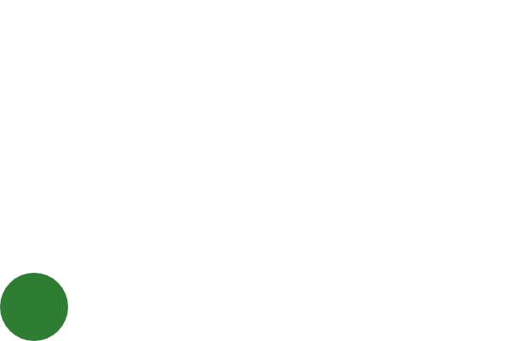
ANIMATION 2 · EXAMPLE 07
body {
margin: 0;
overflow: hidden; /* no scrollbars when the ball reaches the edge */
}
.ball {
width: 80px;
height: 80px;
border-radius: 50%; /* a square with round corners = a circle */
background-color: #E97132;
/* name, duration, speed curve, how many times */
animation: around 4s linear infinite;
}
/* 100vw = the full browser width, 100vh = the full height */
@keyframes around {
0% {
transform: translate(0, 0); /* top left */
}
25% {
transform: translate(calc(100vw - 80px), 0); /* top right */
background-color: #0F9ED5;
}
50% {
transform: translate(calc(100vw - 80px), calc(100vh - 80px));
background-color: #A02B93; /* bottom right */
}
75% {
transform: translate(0, calc(100vh - 80px)); /* bottom left */
background-color: #2E7D32;
}
100% {
transform: translate(0, 0); /* back home */
}
}
A Ball Around the Browser
​border-radius: 50% turns the square into a ball.
​Percentages are checkpoints: 25% of 4s = 1s. The browser animates between them.
​100vw / 100vh = the browser's full width / height. Minus 80px, so the ball stays on screen.
0 s · 0%
1 s · 25%
2 s · 50%
3 s · 75%
07_ball_around_example.html
Notes:
Open 07_ball_around_example.html and resize the browser while it runs: the ball still finds the corners, because the keyframes use vw and vh.
The pictures are the same page, paused at 0, 1, 2 and 3 seconds: the four corners. The colour changes too: you can animate colours as well as positions.
Why 'minus 80px'? translate moves the ball's top-left corner. If it moved the full 100vw, the ball would end up just past the right edge, out of sight.
Try in class (pick one or two):
- Change 4s to 1s. Whoa.
- Change linear to ease-in-out: now it pauses at every corner.
- Delete the 50% step: it cuts diagonally across the screen.
- Add a rotate: transform: translate(…) rotate(360deg) at 100%.
DevTools: More tools → Animations shows a timeline you can slow down to 10% and scrub through.

Slide 19
HTML/CSS Techniques
The animation Properties
animation: around 4s ease-in-out 1s infinite alternate;
name · duration · timing-function · delay · iteration-count · direction
Property | Values | What it does
animation-name | around | Which @keyframes to play
animation-duration | 4s 500ms | How long one run takes
animation-timing-function | linear ease-in-out | The speed curve (next slide!)
animation-delay | 1s | Wait before starting
animation-iteration-count | 3 infinite | How many times
animation-direction | alternate reverse | Ping-pong, or backwards
animation-fill-mode | forwards | Stay on the last frame at the end
Notes:
The shorthand on the left is what we'll use most of the time. Every part has a long-hand property too, which is handy when you only want to change one thing (like Example 08, where only the timing function differs).
The order in the shorthand is flexible, with one rule: the first time value is the duration, and the second is the delay.
iteration-count: a number or infinite.
direction: alternate plays forwards then backwards (ping-pong). reverse plays backwards.
fill-mode: forwards keeps the last keyframe when the animation finishes, instead of jumping back to the start.
delay: a negative delay starts the animation part-way through, handy for making several copies out of step with each other.

Slide 20
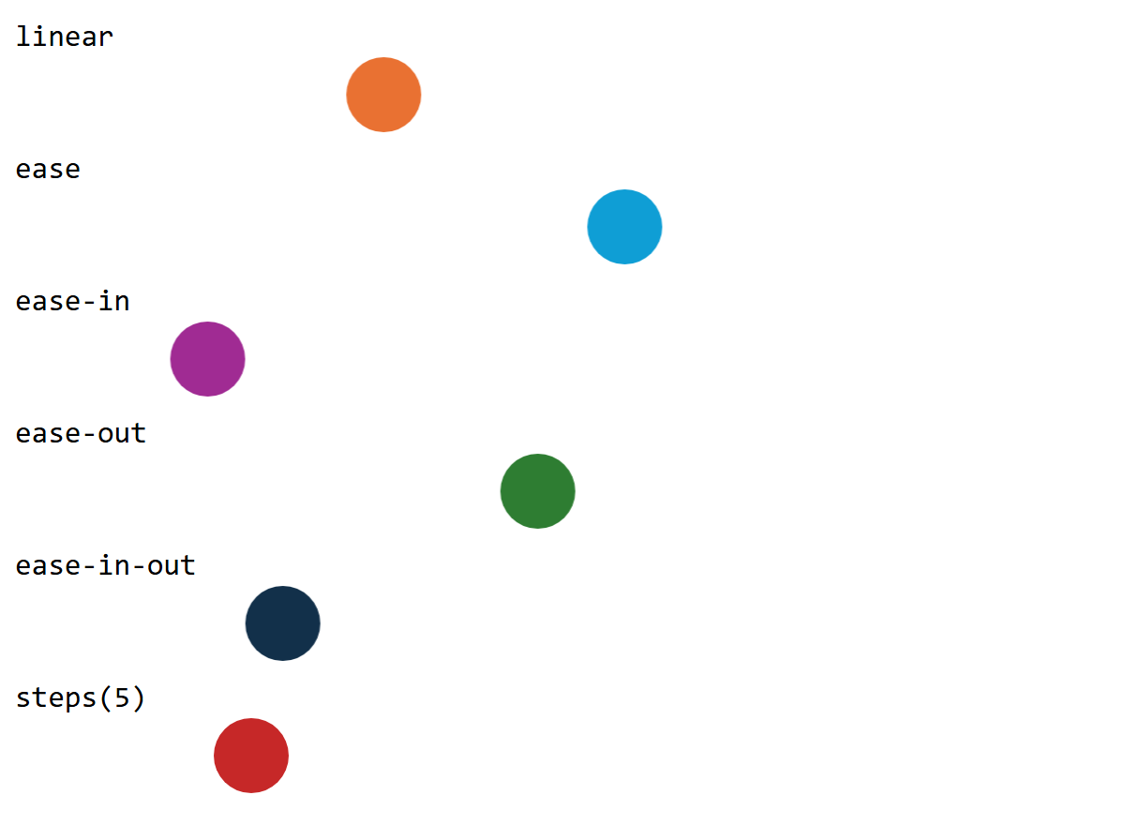
ANIMATION 3 · EXAMPLE 08
body {
font-family: Consolas, monospace;
overflow: hidden;
}
p {
margin: 10px 0 2px;
}
.ball {
width: 40px;
height: 40px;
border-radius: 50%;
/* Same race for everyone: 3 seconds, there and back, forever */
animation: race 3s infinite alternate;
}
@keyframes race {
from { transform: translateX(0); }
to { transform: translateX(calc(100vw - 70px)); }
}
/* Only the speed curve is different. Who wins? */
.linear { animation-timing-function: linear; }
.ease { animation-timing-function: ease; }
.ease-in { animation-timing-function: ease-in; }
.ease-out { animation-timing-function: ease-out; }
.ease-in-out { animation-timing-function: ease-in-out; }
.steps { animation-timing-function: steps(5); }
/* A colour for each runner */
.linear { background-color: #E97132; }
.ease { background-color: #0F9ED5; }
.ease-in { background-color: #A02B93; }
.ease-out { background-color: #2E7D32; }
.ease-in-out { background-color: #12304A; }
.steps { background-color: #C62828; }
The Timing Function Race
​Same distance, same 3 seconds. They all tie! Only the speed along the way is different.
​ease-in starts slow, ease-out ends slow, linear never changes. steps() jumps.
PAUSED AT 1 SECOND
08_timing_race_example.html
Notes:
Before opening it: 'Six balls, same race, same 3 seconds. Which one wins?' Take bets. Then open 08_timing_race_example.html. Spoiler: it's always a tie. They all start and finish together.
The picture is paused at 1 second: ease-out (green) is way ahead because it starts fast; ease-in (purple) is still near the start.
When to use which:
- ease-out: things arriving on screen (a menu sliding in). Feels responsive.
- ease-in: things leaving, and things falling (gravity speeds them up).
- ease-in-out: things going back and forth.
- linear: spinning (so each turn joins smoothly onto the next) and constant motion like a car or conveyor belt.
- steps(): ticking clocks, sprite animations, typewriter effects.
ease is the default if you don't say anything.
Bonus: cubic-bezier.com lets you design your own curve, including ones that overshoot and bounce back.

Slide 21
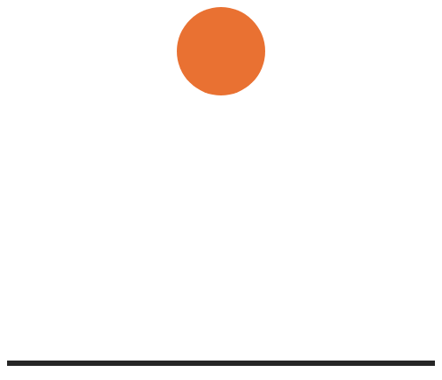
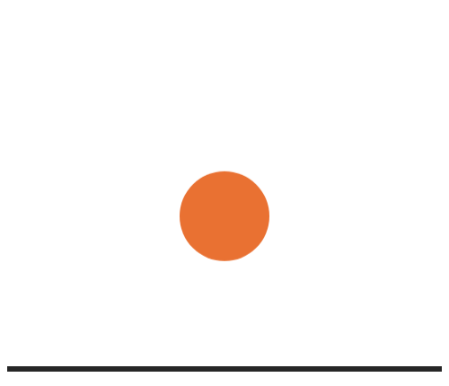
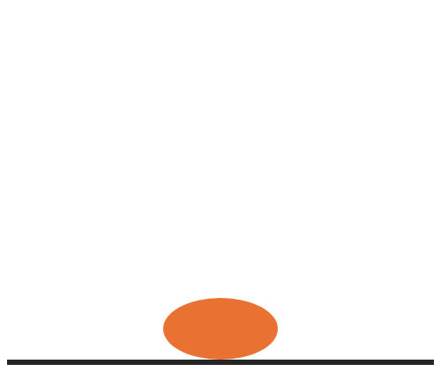
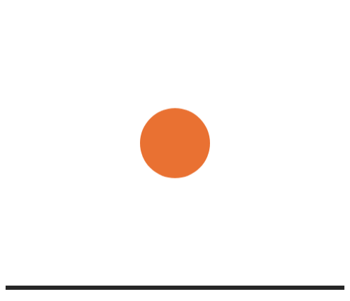
ANIMATION 4 · EXAMPLE 09
.floor {
height: 400px;
border-bottom: 6px solid #262626;
}
.ball {
width: 100px;
height: 100px;
margin: 0 auto;
border-radius: 50%;
background-color: #E97132;
transform-origin: center bottom; /* squash against the floor */
animation: bounce 1.2s infinite;
}
@keyframes bounce {
0% {
transform: translateY(0);
animation-timing-function: ease-in; /* falls faster and faster */
}
45% {
transform: translateY(300px); /* touches the floor */
}
50% {
transform: translateY(300px) scale(1.3, 0.7); /* squash! */
}
55% {
transform: translateY(300px);
animation-timing-function: ease-out; /* slows down going up */
}
100% {
transform: translateY(0);
}
}
A Bouncing Ball (with Squash!)
​A timing function inside a keyframe applies until the next keyframe: ease-in falling, ease-out rising.
​scale(1.3, 0.7) squashes it: wider and flatter. transform-origin keeps it on the floor.
0 s
0.4 s
0.6 s
0.85 s
09_bounce_example.html
Notes:
Open 09_bounce_example.html. This is the most 'real' looking of the demos, and it's because of two tricks animators have used since the first cartoons:
1. Timing. Real things speed up as they fall (ease-in) and slow down as they rise (ease-out). With linear, it looks robotic. Try it: change both to linear and watch.
2. Squash and stretch. For a split second at the bottom, the ball squashes flat. It's only 10% of the animation and you barely notice it, but delete the 50% step and it suddenly feels like a hard plastic ball.
transform-origin: center bottom means 'squash towards the floor'. Without it, the ball squashes towards its middle and floats above the floor for a moment.
Try: change 1.2s to 0.6s (a super ball) or 2.5s (on the moon).

Slide 22

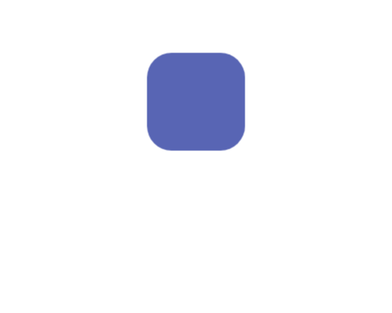
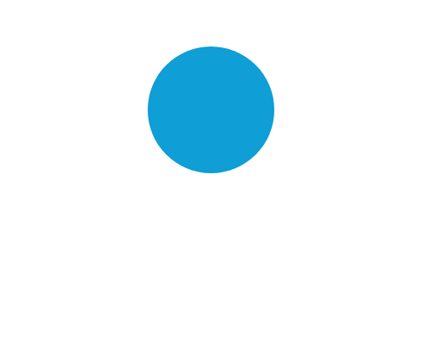
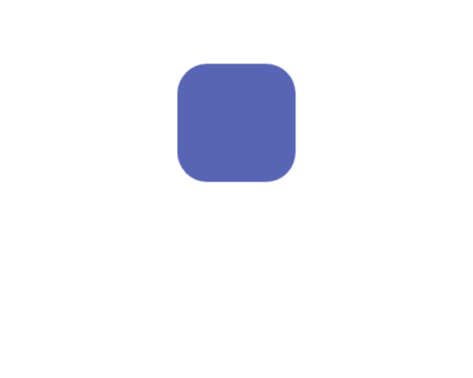
ANIMATION 5 · EXAMPLE 10
A Shape-shifting Square
.square {
width: 100px;
height: 100px;
margin: 80px auto;
background-color: #A02B93;
animation: morph 3s ease-in-out infinite;
}
/* No 0%: it starts from the square's normal style */
@keyframes morph {
50% {
transform: rotate(180deg) scale(1.5);
border-radius: 50%; /* a circle! */
background-color: #0F9ED5;
}
100% {
transform: rotate(360deg); /* one full turn */
}
}
​Only 50% and 100%? The browser uses the element's normal style for the missing steps.
​Animate several things at once: transform, border-radius and background-color.
0 s
0.75 s
1.5 s
2.25 s
10_morph_square_example.html
Notes:
Open 10_morph_square_example.html.
The morph keyframes have no 0%, so the animation starts from the square's normal style: purple, square corners, no rotation. Halfway through it's a big blue circle. At 100% only transform is listed, so border-radius and colour go back to normal, and it has spun one full turn: rotate(360deg) looks exactly like the start, so the loop is seamless.
Try: change scale(1.5) to scale(0.2), or rotate(180deg) to rotate(720deg) at 50%. Swap ease-in-out for linear and see how the 'breathing' feel disappears.

Slide 23
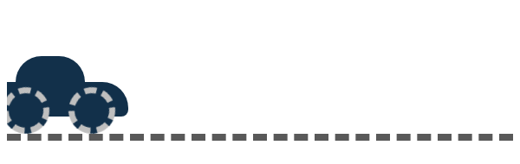
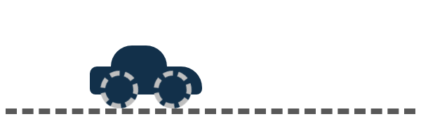
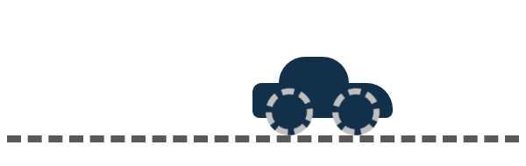
ANIMATION 6 · EXAMPLE 11
.road {
margin-top: 60px;
overflow: hidden; /* hide the car when it's off the road */
border-bottom: 8px dashed #595959;
}
.car {
position: relative; /* the parts are placed inside the car */
width: 160px;
height: 95px;
animation: drive 4s linear infinite;
}
.roof, .car-body, .wheel {
position: absolute;
background-color: #12304A;
}
.roof {
left: 30px; bottom: 55px; width: 80px; height: 35px;
border-radius: 30px 30px 0 0;
}
.car-body {
left: 0; bottom: 20px; width: 160px; height: 40px;
border-radius: 10px 30px 8px 8px;
}
.wheel {
bottom: 0; width: 40px; height: 40px; border-radius: 50%;
border: 7px dashed #BFBFBF; /* dashes show the spin */
animation: spin 0.5s linear infinite;
}
.back { left: 15px; }
.front { right: 15px; }
@keyframes drive {
from { transform: translateX(-200px); } /* off the left edge */
to { transform: translateX(100vw); } /* off the right edge */
}
@keyframes spin { to { transform: rotate(360deg); } }
A Car Made of Boxes
​Four boxes make a car. The car drives and each wheel spins: two animations at once.
​The dashed border is what makes the spin visible. A plain circle spinning looks like it's standing still!
0.9 s
1.6 s
2.4 s
11_car_example.html
Notes:
Open 11_car_example.html.
The .car element drives across the screen, from off the left edge (-200px) to off the right edge (100vw). Each wheel has its own spin animation, and because the wheels are inside the car, they turn AND travel with it.
position: relative / absolute is a sneak peek: it lets us put the roof, body and wheels exactly where we want them inside the car (left, bottom). We'll cover position properly with layout.
Try: make the drive 2s (faster) without changing the spin. It looks like the wheels are skidding! Real animators match the two speeds.
Challenge for fast finishers later: add a sun, a cloud that drifts slower than the car, or headlights with ::before.

Slide 24
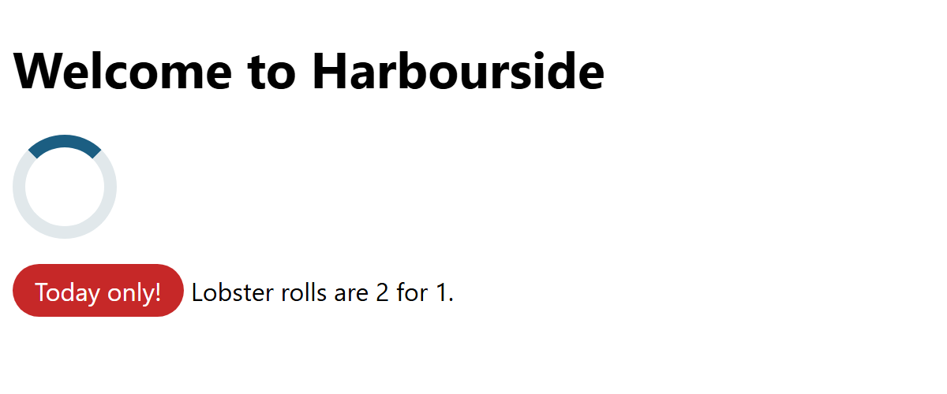
ANIMATION 7 · EXAMPLE 12
/* 1. Fade in and slide up when the page loads (runs once) */
h1 {
animation: fade-up 1s ease-out;
}
@keyframes fade-up {
from { opacity: 0; transform: translateY(30px); }
to { opacity: 1; transform: translateY(0); }
}
/* 2. A loading spinner: a circle with one coloured side */
.spinner {
width: 50px;
height: 50px;
border: 8px solid #E1E8EB;
border-top-color: #1B5E82;
border-radius: 50%;
animation: spin 1s linear infinite;
}
@keyframes spin { to { transform: rotate(360deg); } }
/* 3. A "look at me" pulse */
.badge {
display: inline-block;
padding: 6px 14px;
border-radius: 20px;
background-color: #C62828;
color: white;
animation: pulse 1.5s ease-in-out infinite;
}
@keyframes pulse { 50% { transform: scale(1.15); } }
/* 4. Respect people who turn animations off in their settings */
@media (prefers-reduced-motion: reduce) {
h1, .spinner, .badge {
animation: none;
}
}
Real Websites, and Being Kind
​Real sites use small animations: fade in, loading spinners, a pulse to catch your eye.
​prefers-reduced-motion: some people get dizzy or sick from motion. Turn it off for them.
​Animate transform and opacity (smooth). Never flash more than 3 times a second.
PAUSED AT 0.5 SECONDS
12_real_world_example.html
Notes:
Open 12_real_world_example.html (reload to see the heading fade in).
prefers-reduced-motion: people with vestibular (inner-ear) disorders, migraines or some kinds of epilepsy can feel sick from big moving things. They switch animations off in their operating system: Windows Settings → Accessibility → Visual effects → Animation effects. The @media rule asks 'has this person turned motion off?' and if so, switches our animations off. It's WCAG 2.3.3.
Demo it: turn Animation effects off in Windows, then reload the example: nothing moves. Turn it back on.
IMPORTANT for the playground: if a student's animations don't work AT ALL, check that setting first. Some lab images have it turned off.
Flashing: WCAG 2.3.1 says nothing should flash more than 3 times per second. It can trigger seizures. So no strobing backgrounds, however fun it seems.
Good taste: animation should help the user (show something is loading, draw the eye to a sale) and not get in the way. If everything on a page moves, nothing stands out.

Slide 25
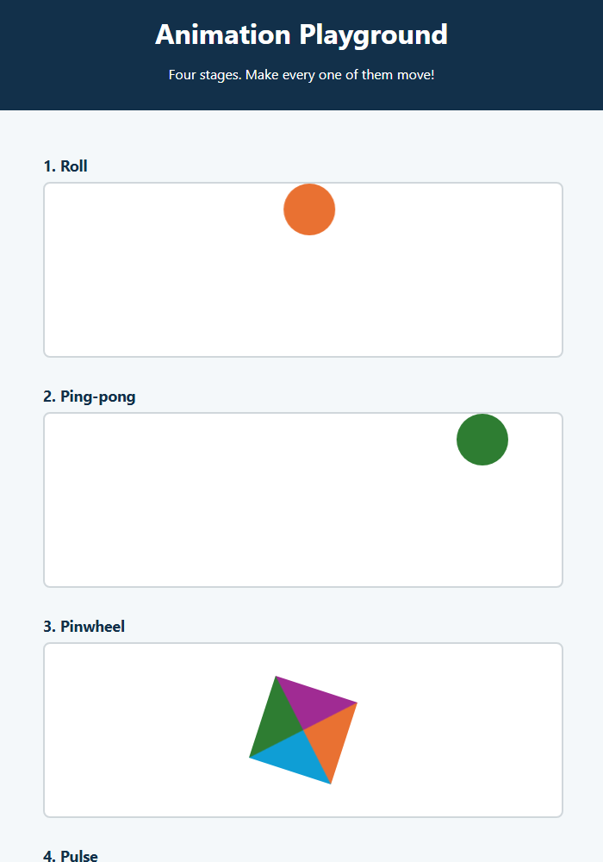
The Animation Playground (40 min)
Four stages. Make them all move!
1
Roll
a ball rolls across
2
Ping-pong
back and forth, forever
3
Pinwheel
spin, spin, spin
4
Pulse
grow and change colour
★
Bonus: Around the Block
if you finish early
Every challenge, the same two steps:
​1. @keyframes describes the move: from … to …
​2. animation plays it on the object.
Notes:
This is the main event, and it's meant to be fun and very doable. Four stages, each with an object that doesn't move yet. Each challenge gives students the full code to type, then asks them to change one thing and watch what happens.
Every challenge uses the same recipe: @keyframes with from and to, then an animation line. By the fourth one, it should feel easy. That's the point.
Fast finishers: the Bonus (Around the Block) uses percentages like Example 07, then 'Make it yours'.
Walk around and celebrate the first person to get each challenge working. The moment something first moves, people cheer.

Slide 26
Try It 1: Roll (8 min)
1
Open activity/index.html with Live Server
IN STYLE.CSS
​Four stages. Nothing moves… yet!
@keyframes roll {
from { transform: translateX(0); }
to { transform: translateX(540px); }
}
#roll {
animation: roll 2s infinite;
}
2
Open activity/style.css
​Find the Challenge 1 heading.
3
Type the code on the right
​Save. The ball rolls!
4
Play with it
​Change 2s to 0.5s. Then try 5s. Which do you like?
​Nothing moving? Check that roll is spelled the same in both places, and that 2s has its s.
Notes:
Do this one together, typing it live. Make sure everyone has a rolling ball before moving on.
Read it out loud: 'Roll from 0 to 540 pixels, over 2 seconds, forever.' Why 540? The stage is 600px wide and the ball is 60px wide, so 540 puts it right at the edge.
The usual problems:
- The name is spelled differently in the two places (roll vs Roll).
- No unit on the duration: '2' does nothing; it must be 2s.
- Nothing moves at all, anywhere, even in the examples: check Windows Settings → Accessibility → Visual effects → Animation effects is On.

Slide 27
Try It 2: Ping-pong (5 min)
1
No new @keyframes needed!
IN STYLE.CSS
​Ping-pong uses the same roll you wrote in Challenge 1.
#ping-pong {
animation: roll 1s infinite alternate;
}
2
Type the code on the right
​Just one rule, under the Challenge 2 heading.
3
Watch the difference
​alternate rolls there… then back. No more jumping!
4
Play with it
​Take out alternate and save. Put it back. Try 0.3s for a fast rally!
​One @keyframes can be used by as many elements as you like.
Notes:
The shortest challenge, and a nice confidence boost.
Compare the two balls: Roll jumps back to the start at the end of each run. Ping-pong rolls back smoothly, because alternate plays the animation forwards, then backwards.
If anyone asks why it slows down at each end: that's the default timing function, ease. Try linear for a robotic ping-pong.

Slide 28
Try It 3: Pinwheel (8 min)
1
New move: rotate
IN STYLE.CSS
​rotate(360deg) is one full turn.
@keyframes spin {
from { transform: rotate(0deg); }
to { transform: rotate(360deg); }
}
#pinwheel {
animation: spin 2s linear infinite;
}
2
Type the code on the right
​Under the Challenge 3 heading. Save. It spins!
3
Why linear?
​It keeps the same speed all the way round. Take it out and see it slow down every turn.
4
Play with it
​Try 720deg, or a faster 0.5s. Whee!
​The pinwheel is just a box with four thick coloured borders and no size. Look in stage.css!
Notes:
Same recipe, a new kind of move. Instead of translateX (move), it's rotate (spin).
The pinwheel trick: a box with width 0 and height 0, and a thick border in four different colours. The borders meet at the corners in diagonal lines, which makes four triangles. Show stage.css if anyone's curious.
linear vs ease: with ease (the default), the pinwheel slows down at the end of every turn and speeds up again, so it looks like it's stuttering. linear keeps it smooth.

Slide 29
Try It 4: Pulse (8 min)
1
New move: scale
IN STYLE.CSS
​scale(1.5) makes it one and a half times bigger.
@keyframes pulse {
from {
transform: scale(1);
background-color: #A02B93;
}
to {
transform: scale(1.5);
background-color: #E97132;
}
}
#pulse {
animation: pulse 1s infinite alternate;
}
2
Change two things at once
​Size and colour, in the same from and to.
3
Type the code on the right
​Under the Challenge 4 heading. Save. It breathes!
4
Play with it
​Pick your own colours. Add border-radius: 50%; to the to step. What happens?
​You can animate colours too, not just movement.
Notes:
The last core challenge. By now the recipe should feel familiar: keyframes with from and to, then an animation line.
New ideas: scale (resize), and changing two properties in the same keyframe. alternate again, so it grows and shrinks smoothly.
The border-radius suggestion turns the square into a circle at the big end. Students love it.
At this point everyone has four things moving on their page. Celebrate that!

Slide 30
Bonus, Make It Yours, Then Submit
★
Bonus: Around the Block
Make it yours
Submit to Brightspace
Copy it in. Percentages are checkpoints: the four corners.
1
​Change the colours
1. Your style.css file
2. A screenshot of your playground
Stuck? Peek at activity/answer/style.css. Then check the names match and every time has an s.
@keyframes around {
0% { transform: translate(0, 0); }
25% { transform: translate(540px, 0); }
50% { transform: translate(540px, 140px); }
75% { transform: translate(0, 140px); }
100% { transform: translate(0, 0); }
}
#around {
animation: around 4s linear infinite;
}
2
​Make something faster or slower
3
​Spin the pinwheel backwards: add reverse
4
​Turn the pulse into a circle
5
​Start the pulse tiny: scale(0.5)
Notes:
For anyone who finishes early, or as homework.
The bonus is Example 07 at playground size: 600 − 60 = 540 across, 200 − 60 = 140 down. Percentages are checkpoints along the way.
What to collect on Brightspace: their style.css, and a screenshot (or a short screen recording: Windows 11's Snipping Tool can record the screen). Anyone who has the four challenges moving has done the job.

Slide 31
Show and Tell!
​Who wants to show off their playground?
​Which animation was your favourite?
​What was your funniest bug?
​Where have you seen animation on a real website this week?
@keyframes = describe it
animation = play it
Notes:
Get two or three students to put their page on the projector. Applaud generously!
Common bugs: the name doesn't match between animation and @keyframes, a missing s on the duration, and @keyframes typed inside another rule.
Real-world animation they've probably seen: loading spinners, the 'typing…' dots in chat apps, notification badges that pulse, buttons that change on hover, menus that slide in on phones.

Slide 32
HTML/CSS Techniques
Cheat Sheet: Selectors
Selector | Matches
a:hover button:active | While the mouse is over it / while it's clicked
:focus-visible | Focused with the keyboard (keep an outline!)
:first-child :last-child | The first / last inside its parent
tr:nth-child(even) | Every even row (also odd, 3, 3n)
li:not(.sold-out) | Every li except .sold-out
input[type="email"] | An attribute with an exact value
a[href^="https"] a[href$=".pdf"] | Starts with / ends with
article > p | Direct children only
h2 + p h3 ~ p | The very next sibling / every later sibling
p::first-letter ::selection | Part of an element
.new::before .price::after | Content added by CSS (needs content: "")
Notes:
Everything from the first half, in one place. It's in the README too.

Slide 33
HTML/CSS Techniques
Cheat Sheet: Animation
Code | What it does
transform: translate(x, y) | Move (also translateX, translateY)
transform: rotate(45deg) | Spin (360deg = one full turn)
transform: scale(1.5) | Resize (scale(1.3, 0.7) = squash)
transition: transform 0.3s ease; | Smooth change between two states (e.g. :hover)
@keyframes name { from {…} to {…} } | Describe an animation (or 0%, 50%, 100%)
animation: name 2s; | Play it: name + duration
linear ease-in ease-out ease-in-out | Timing function: the speed curve
infinite alternate | Loop forever / go there and back
forwards | Stay on the last keyframe at the end
@media (prefers-reduced-motion: reduce) | Turn animations off for those who ask
Notes:
Everything from the second half, in one place. Students can keep this slide open while they finish the playground.

Slide 34
HTML/CSS Techniques
Class Recap and Next Steps
Recap:
  Pseudo-classes (:) match a state or position: :hover, :focus-visible, :nth-child(), :not().
  Attribute selectors [ ] and combinators (> + ~) pick elements without extra classes.
  Pseudo-elements (::) style part of an element, or add content with ::before / ::after.
  transform moves, spins and resizes. transition smooths a change between two states.
  @keyframes describes an animation; the animation property plays it.
  Animate with care: transform and opacity, no flashing, respect prefers-reduced-motion.
Next class:
  Page layout: display, position, and Flexbox.
Notes:
Next class: page layout. We've had sneak peeks of display and position today and last class; next time we look at them properly, then Flexbox for laying out navigation bars and menu cards side by side.

