Slide 1
WEBD 1000
Week 11, Class 1:
  Making Bootstrap look like your site, a look at Tailwind, and Harbourside in Bootstrap.
Week 11: Making Bootstrap Yours
Notes:
Welcome back. Last week was Bootstrap's grid and its components: we turned a wireframe into a layout, then gave it a navbar and cards.
The problem with what we built: it looks like every other Bootstrap site. Today is about fixing that. First, how to change Bootstrap's look with our own CSS. Then a look at Tailwind, the other kind of framework, built for exactly this. Then the big activity: Harbourside, rebuilt with Bootstrap and made to look like Harbourside.
All of it feeds straight into Assignment 4, which needs a Bootstrap site with your own styling.

Slide 2
Attendance and a Quick Check-in
OUTLOOK
TEAMS
✓
Are you checking your school Outlook email?
✓
Are you signed into Teams?
TEAMS
BRIGHTSPACE
✓
Are you following our Teams channel and General chat?
✓
Have you read Assignment 4 on Brightspace?
Notes:
Take attendance while everyone checks these four things.
Assignment 4 is a two-page Bootstrap site. Today's customizing section and Try It 6 are its 'your own styling' requirement, so point that out when you get there.

Slide 3
Is Your Environment Set Up?
GIT
VS CODE
✓
Did you run git pull? You should see an 11_Customizing_Bootstrap_Tailwind folder.
✓
Is the 11_Customizing_Bootstrap_Tailwind folder open in VS Code?
LIVE SERVER
INTERNET
✓
Does activity/index.html open with Go Live? (It has no CSS yet.)
✓
Bootstrap and Tailwind load from the web. Does Example 01 have orange buttons?
Notes:
Help anyone who's stuck now, so they aren't lost during the Try Its.
The Harbourside activity and the Tailwind examples moved here from the Week 10 folder. If someone's git pull complains, they probably edited a file in 10_CSS_Frameworks/activity: they can copy their work somewhere safe and run git stash, then pull again.
activity/index.html is the Harbourside page with no CSS at all, so it should look plain: big logo, bullet-point menu, Times New Roman. That's correct.

Slide 4
Recall: What Did We Do Last Week?
My Site
Home About Contact
1
Linking Bootstrap
​Its CSS in the head, yours after it, its JavaScript at the end.
aside
main
2
The grid
card
card
​A row has 12 columns. col-md-3 + col-md-9: side by side from 768px up.
3
Components
​card, btn, alert, and the navbar, which needs the JavaScript.
4
The docs
Your layout: a wireframe, as a grid, with a navbar and cards.
​Find the component, copy the HTML, change the words.
Notes:
Same as always: 30 seconds with a neighbour, then take answers, then go through the four points.
Then ask: does anyone's layout from last week look like their own site? (No: it looks like Bootstrap, in very loud colours.) That's today's problem.

Slide 5
Week 11: Making Bootstrap Yours
Week 11, Class 1: Overview
Title: Making Bootstrap Yours
Agenda:
  Customizing Bootstrap: your CSS after theirs, and its variables
  Tailwind CSS: the same cards, built the other way
  Bootstrap, Tailwind, or plain CSS?
  Rebuild Harbourside with Bootstrap, make it look like Harbourside, then submit
Customize
→
Compare
→
Build
Your own CSS
Tailwind
Harbourside
Notes:
Rough plan:
- 10 min: check-in, environment, recall, overview
- 10 min: customizing, Example 01, Pop Quiz 1
- 20 min: Tailwind, Examples 02 and 03, Pop Quizzes 2 and 3
- 50 min: Harbourside, Try Its 1 to 6, then submit
- 5 min: recap and the one-sentence summary
The activity is the priority. If time is short, demo Tailwind quickly and skip the 'Which one?' slide.
Pop quizzes: same as always. 30 seconds to think, then hold up 1 to 4 fingers (A to D), or the Teams chat.

Slide 6

+
Customizing Bootstrap
•
○
+
Your CSS after theirs · Bootstrap 5's variables
•
○
Notes:
Every Bootstrap site looks like Bootstrap until you change it. The question is how.

Slide 7

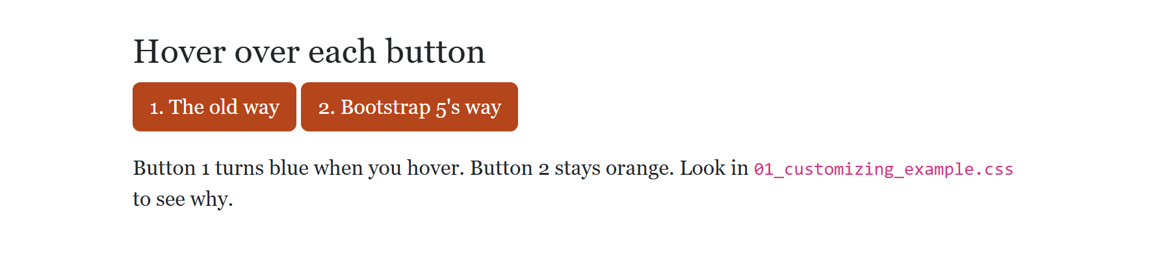
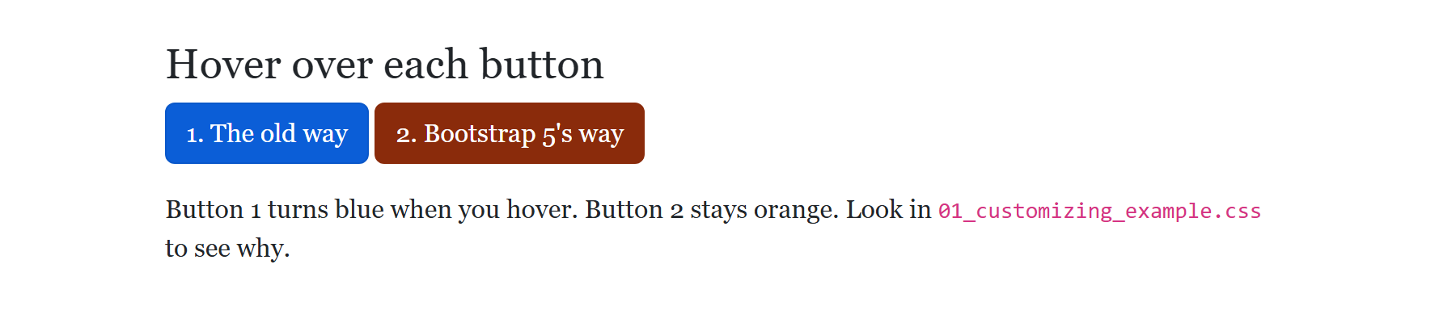
CUSTOMIZING · EXAMPLE 01
/* 0. Same specificity as Bootstrap's, and later,
so ours wins */
body {
font-family: Georgia, "Times New Roman", serif;
}
/* 1. The old way. Looks right until you hover:
Bootstrap's .btn:hover is more specific,
and it puts the blue back. */
.old-way {
background-color: #B5451B;
border-color: #B5451B;
}
/* 2. Bootstrap 5's way: set the button's variables.
All its states (hover too) read these. */
.new-way {
--bs-btn-bg: #B5451B;
--bs-btn-border-color: #B5451B;
--bs-btn-hover-bg: #8A2B0B;
--bs-btn-hover-border-color: #8A2B0B;
--bs-btn-active-bg: #8A2B0B;
--bs-btn-active-border-color: #8A2B0B;
}
Changing a Button's Colour
​Button 1 changes background-color. Hover, and it goes blue.
​Button 2 changes Bootstrap's variables. Every state uses them.
NORMAL
WHILE YOU HOVER
11_Customizing_Bootstrap_Tailwind/01_customizing_example.css
Notes:
Open 01_customizing_example.html and hover over each button.
Part 0: overriding any rule works the normal way. Bootstrap's body rule and ours tie, ours is later, ours wins. The font is Georgia.
Part 1 is the way from last year's slides (and lots of tutorials). It looks right until you hover: Bootstrap has a .btn:hover rule, which is more specific than ours, and it sets the background to var(--bs-btn-hover-bg). That's still blue. The bottom picture applies that exact rule to both buttons.
Part 2 is how Bootstrap 5.3 wants it done. A Bootstrap button reads all of its colours from variables (custom properties, the --name ones). Set those, and the normal, hover and active states all follow.
Where do the variable names come from? Inspect a button in DevTools: the .btn-primary rule lists them all.
For bigger changes (every primary colour on the site), professional projects use Bootstrap's Sass source. That's beyond this course. Ready-made Bootstrap themes are another option (last year's slides mention buying one); Bootswatch has free ones.

Slide 8
?
POP QUIZ 1
​This is in your CSS, after Bootstrap's. What colour is the button while you hover over it?
​Orange, the same as always
A
​Bootstrap's blue
LAST YEAR'S SLIDE
B
.btn-primary {
background-color: #ff5722;
border-color: #ff5722;
}
​A slightly darker orange
C
​See-through: it has no colour
D
Vote: hold up 1, 2, 3 or 4 fingers (A to D), or type your letter in the Teams chat. 30 seconds!
Notes:
The code is word for word from last year's Customizing Bootstrap slide. Specificity from Week 6.

Slide 9
?
POP QUIZ 1: ANSWER
​This is in your CSS, after Bootstrap's. What colour is the button while you hover over it?
WHAT THE BROWSER DOES
A
​Orange, the same as always
✓
​Bootstrap's blue
C
​A slightly darker orange
D
​See-through: it has no colour
Why?
​Bootstrap's .btn:hover (two classes' worth) beats .btn-primary (one), so its hover rule wins.
​That rule uses var(--bs-btn-hover-bg), which is still blue. Change the variables instead: Example 01, part 2.
Notes:
Answer: B.
The picture is Example 01 with Bootstrap's hover rule applied: button 1 is blue.
Specificity: .btn:hover is a class plus a pseudo-class, so (0,2,0). .btn-primary is (0,1,0). Ours comes later, but specificity is checked first.

Slide 10
+
Tailwind CSS
•
○
+
Utility-first · the same cards, two ways · which one should you use?
•
○
Notes:
Tailwind is the other kind of framework: no ready-made components, just small classes you combine.

Slide 11
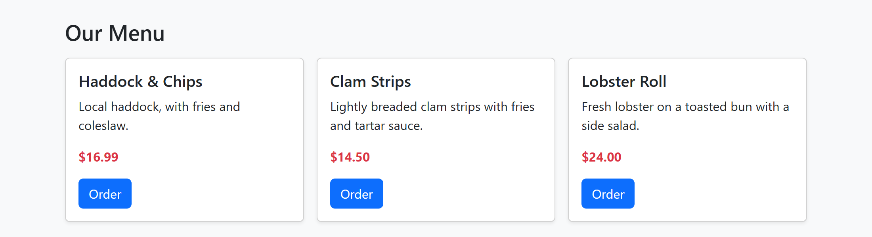
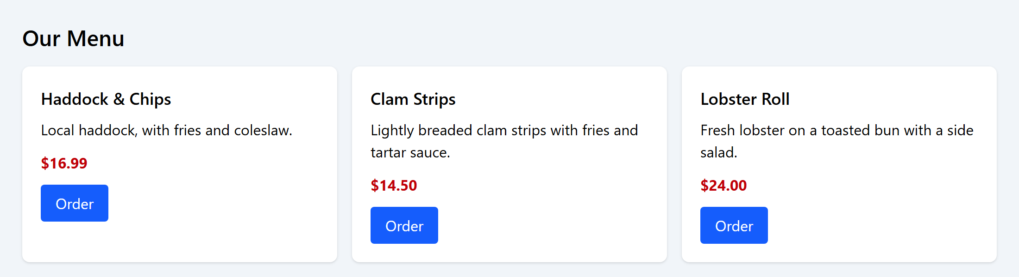
The Same Cards, Two Ways
BOOTSTRAP · EXAMPLE 02
TAILWIND · EXAMPLE 03
<article class="card h-100 shadow-sm">
<div class="card-body">
<h2 class="card-title h5">...</h2>
<p class="card-text">...</p>
<a class="btn btn-primary">Order</a>
</div>
</article>
<article class="bg-white rounded-lg shadow p-5">
<h2 class="text-lg font-semibold">...</h2>
<p class="mt-2">...</p>
<a class="inline-block mt-3 px-4 py-2
rounded bg-blue-600 text-white
hover:bg-blue-700">Order</a>
</article>
RESULT
RESULT
11_Customizing_Bootstrap_Tailwind/02_bootstrap_cards_example.html
11_Customizing_Bootstrap_Tailwind/03_tailwind_cards_example.html
Notes:
Examples 02 and 03 are the same three menu cards. Open them side by side.
Bootstrap (left): the card is card, card-body, card-title. Someone else decided what a card looks like, and you get it with a few names.
Tailwind (right): there's no 'card' class. The article gets bg-white (background), rounded-lg (border-radius), shadow (box-shadow) and p-5 (padding). You decide every part.
They look nearly the same. Ask: which HTML would you rather read? Which would you rather change to a totally different look?
Tailwind's HTML is longer, but you rarely need a CSS file. Bootstrap's HTML is shorter, but making it look different takes CSS, like Example 01.

Slide 12
TAILWIND · EXAMPLE 03
Reading Tailwind Classes
​One <script> in the head loads it (the "Play CDN").
​About one CSS property per class: p-5 is padding, rounded-lg is border-radius.
​md:grid-cols-3: a prefix is a media query. hover: is :hover.
<div class="grid gap-4 md:grid-cols-3">
<article class="bg-white rounded-lg shadow p-5">
<h2 class="text-lg font-semibold">Haddock &amp; Chips</h2>
<p class="mt-2">Local haddock, with fries and coleslaw.</p>
<p class="mt-3 font-bold text-red-700">$16.99</p>
<a href="#" class="inline-block mt-3 px-4 py-2 rounded
bg-blue-600 text-white hover:bg-blue-700">Order</a>
</article>
RESULT
11_Customizing_Bootstrap_Tailwind/03_tailwind_cards_example.html
Notes:
Open 03_tailwind_cards_example.html.
The script tag: Tailwind's 'Play CDN'. It reads the classes on the page and writes the CSS in the browser, as the page loads. It's great for learning and trying ideas. Real projects run Tailwind as a build step, which writes a small CSS file with only the classes the site uses. That's why Tailwind sites end up smaller than Bootstrap ones.
Read the grid line: grid (display: grid), gap-4 (a 1rem gap), md:grid-cols-3 (three columns, from 768px up). Tailwind's md is 768px, same as Bootstrap's, and also min-width: phones first. Below md there's no grid-cols, so it's one column.
On the button: hover:bg-blue-700 is a darker blue on hover. Tailwind puts the state in the class name, which is why there's no hover problem like Example 01's.
The colours are a palette: blue-600 is a mid blue, blue-700 a bit darker. 50 is the lightest, 950 the darkest.
Tailwind's spacing numbers are different from Bootstrap's: p-5 here is 1.25rem (each step is 0.25rem). Same idea, different scale, which is a good reason to check the docs.

Slide 13
?
POP QUIZ 2
​In Tailwind, what does md:grid-cols-3 mean?
​Three columns, but only on medium-sized screens
​Three columns, on screens up to 768px wide
A
B
​Three columns of medium width
​Three columns, on screens 768px wide and wider
C
D
Vote: hold up 1, 2, 3 or 4 fingers (A to D), or type your letter in the Teams chat. 30 seconds!
Notes:
Students who got Week 10's Pop Quiz 4 (col-md-4 on a phone) should get this. A is the common wrong answer.

Slide 14
?
POP QUIZ 2: ANSWER
​In Tailwind, what does md:grid-cols-3 mean?
​Three columns, but only on medium-sized screens
​Three columns, on screens up to 768px wide
A
B
​Three columns of medium width
​Three columns, on screens 768px wide and wider
C
✓
Why?
​Like Bootstrap, Tailwind is phones first: md: is @media (min-width: 768px).
​It applies from 768px up, including big screens, until a bigger prefix like lg: overrides it.
Notes:
Answer: D.
Check in DevTools: inspect the grid in Example 03 and the rule is inside @media (width >= 48rem). 48rem is 768px.

Slide 15
Week 11: Making Bootstrap Yours
Bootstrap, Tailwind, or Plain CSS?
Bootstrap
Pick it when you need it working fast: menus, forms and pages that look good with little CSS.
Tailwind
Pick it when you have your own design to build, and want it to look like nobody else's.
Plain CSS
Pick it for small sites, or full control with no extra files. And it's what both are made of.
Learn one of each kind, and the rest will look familiar.
Notes:
There's no single right answer, and students will hear strong opinions online.
- Bootstrap: when you need something that works and looks decent quickly, especially with menus, modals and forms. Very common on existing sites, admin pages and internal tools, so you'll likely maintain some at work.
- Tailwind: when you have a design to build, and want it to look like no one else's. Very popular for new projects, and often used with JavaScript frameworks like React. Its build step makes small CSS files.
- Plain CSS: small sites, and anywhere you want full control with no extra files. Also: everything you learn in plain CSS makes both frameworks easier.
Why we demoed these two: they're the most common, they're one of each kind, and between them students will recognize almost any framework they meet.

Slide 16
?
POP QUIZ 3
​Which of these was written with Tailwind CSS?
​class="bg-white rounded-lg shadow p-5"
​class="card h-100 shadow-sm"
A
B
​class="btn btn-primary"
​class="alert alert-warning"
C
D
Vote: hold up 1, 2, 3 or 4 fingers (A to D), or type your letter in the Teams chat. 30 seconds!
Notes:
A last check before the activity.

Slide 17
?
POP QUIZ 3: ANSWER
​Which of these was written with Tailwind CSS?
​class="bg-white rounded-lg shadow p-5"
​class="card h-100 shadow-sm"
✓
B
​class="btn btn-primary"
​class="alert alert-warning"
C
D
Why?
​Each Tailwind class does about one thing: a background, a radius, a shadow, padding.
​card, btn and alert are Bootstrap's named components. (shadow-sm is a Bootstrap utility, but card gives it away.)
Notes:
Answer: A.
It's the card from Example 03. B is the card from Example 02.

Slide 18
+
Harbourside in Bootstrap
•
○
+
Same page, same words · Bootstrap does the layout · Try Its 1 to 6
•
○
Notes:
The big activity. This replaces last year's 'download an example and customize it', which is now a fast-finisher option.
Students take the Harbourside page from Week 7, with all the CSS taken away, and rebuild it with Bootstrap. Each Try It adds one part.

Slide 19
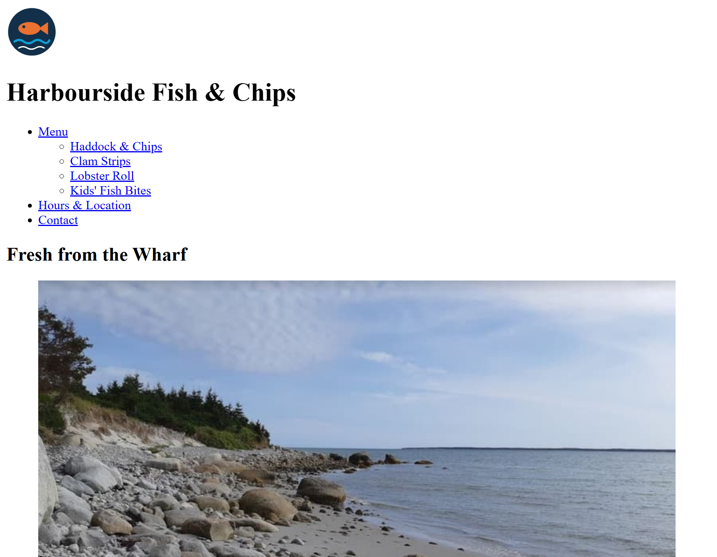
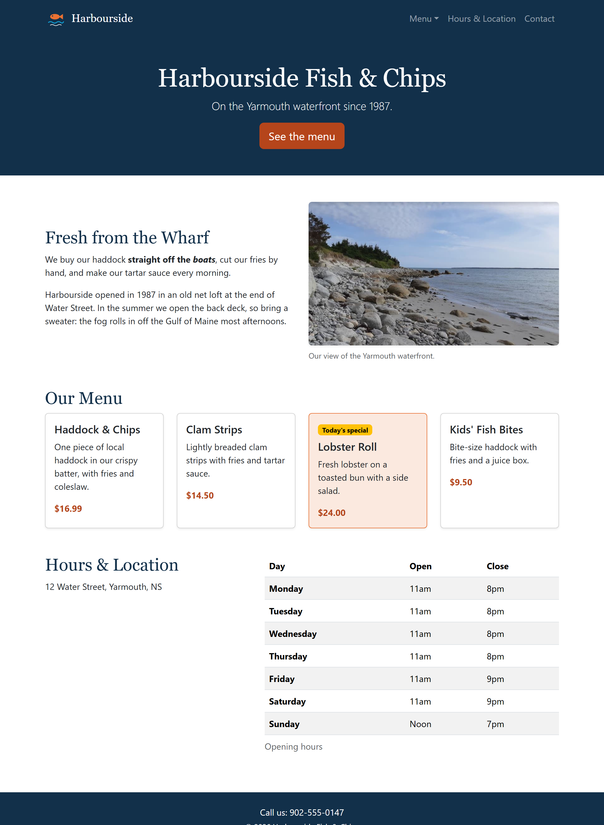
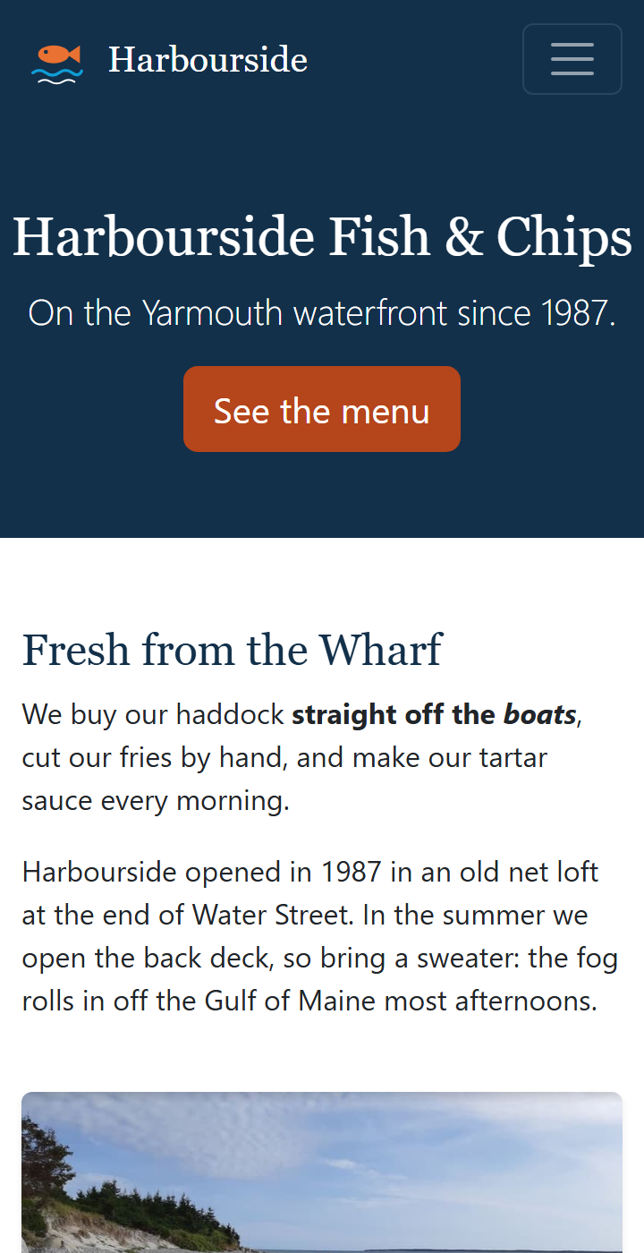
Harbourside, Part 4: Before and After
BEFORE: NO CSS
AFTER: BOOTSTRAP
PHONE
Notes:
Open activity/index.html with Go Live. It's our Harbourside page with no CSS at all: that's the left picture.
By the end of class it looks like the right pictures, and on a phone the menu folds into a menu button.
The plan:
- Try It 1: link Bootstrap and add a container.
- Try It 2: the navbar.
- Try It 3: a banner, and the intro in two columns.
- Try It 4: the menu as cards.
- Try It 5: the hours table and the footer.
- Try It 6: make it look like Harbourside, in style.css.
Every Try It's code is on its slide, and the finished page is in activity/answer/. The comments in index.html say where each Try It goes.
The content and the semantic HTML (header, nav, main, section, article, aside, footer) all stay. Bootstrap only adds classes and a few wrapper divs.

Slide 20
Try It 1: Link Bootstrap (4 min)
1
Open the activity
​activity/index.html with Go Live, and in VS Code.
2
Add the two links
IN THE HEAD, WHERE THE TRY IT 2 COMMENT IS
​Bootstrap's first, then style.css. Save: the fonts change right away.
<link rel="stylesheet" href="https://cdn.jsdelivr.net/npm/bootstrap@5.3.8/dist/css/bootstrap.min.css">
<link rel="stylesheet" href="style.css">
<!-- further down -->
<main class="container my-5">
3
Add a container
​<main class="container my-5">: centred, with space above and below.
​Watch the page as you save: it changes before you've added a single other class.
Notes:
Bootstrap's base styles (its 'Reboot') change the page as soon as it's linked: a modern font, no margin on the body, nicer tables. Point that out.
my-5: margin on the top and bottom (y), size 5 (3rem).
Check everyone has the link right before moving on: if Bootstrap didn't load, nothing else today works.

Slide 21
Try It 2: The Navbar (10 min)
1
Delete the old parts
REPLACES THE LOGO AND THE OLD <NAV>
​The <img> logo and the whole <nav>. Keep the <h1> for now.
<nav class="navbar navbar-expand-md bg-harbour"
data-bs-theme="dark" aria-label="Main">
<div class="container">
<a class="navbar-brand d-flex align-items-center gap-2" href="#">
<img src="images/logo.svg" width="40" height="40" alt="">
Harbourside
</a>
<button class="navbar-toggler" type="button"
data-bs-toggle="collapse" data-bs-target="#mainNav"
aria-controls="mainNav" aria-expanded="false"
aria-label="Toggle navigation">
<span class="navbar-toggler-icon"></span>
</button>
<div class="collapse navbar-collapse" id="mainNav">
<ul class="navbar-nav ms-auto">
<li class="nav-item dropdown">
<a class="nav-link dropdown-toggle" href="#menu" role="button"
data-bs-toggle="dropdown" aria-expanded="false">Menu</a>
<ul class="dropdown-menu">
<li><a class="dropdown-item"
href="#haddock">Haddock &amp; Chips</a></li>
<!-- ...and the other three, the same way -->
</ul>
</li>
<li class="nav-item"><a class="nav-link" href="#hours">Hours &amp; Location</a></li>
<li class="nav-item"><a class="nav-link" href="#contact">Contact</a></li>
</ul>
</div>
</div>
</nav>
2
Paste the navbar
​In the header, where they were.
3
Add the script
​Bootstrap's JavaScript just before </body>, like Week 10's Example 01.
4
Test it
​Make the window narrow. Does the menu button open? Does the Menu dropdown work?
Notes:
The code is on the slide, but it's long: students can copy it from activity/answer/index.html. The slide leaves out three of the dropdown items to fit; the answer file has them all. Careful: the answer file's image paths start with ../ because it's one folder deeper. In activity/index.html it's images/logo.svg.
New things since Week 10's Example 06 and your layout's navbar:
- bg-harbour is our own class (it's already in style.css): navy.
- data-bs-theme="dark" tells Bootstrap the background is dark, so the links and the menu button turn light.
- The logo goes inside the navbar-brand. d-flex align-items-center gap-2 is flexbox from Week 8, as classes.
- The Menu item is a dropdown: dropdown-toggle on the link, dropdown-menu on the list, dropdown-item on each link. data-bs-toggle="dropdown" makes it open. It needs the script too.
The usual problems: the script is missing (nothing opens), or the id on the collapse div doesn't match data-bs-target.

Slide 22
Try It 3: A Banner and Two Columns (8 min)
1
Make the banner
​Replace the <h1> with the banner div, under the navbar.
THE H1 BECOMES A BANNER; THE INTRO BECOMES A ROW
2
Make the intro a row
<div class="bg-harbour text-white text-center py-5">
<h1 class="display-5">Harbourside Fish &amp; Chips</h1>
<p class="lead">On the Yarmouth waterfront since 1987.</p>
<a class="btn btn-harbour btn-lg" href="#menu">See the menu</a>
</div>
<section class="intro row g-4 align-items-center mb-5">
<div class="col-md-6">
<h2>Fresh from the Wharf</h2>
<p>...</p> <p>...</p>
</div>
<div class="col-md-6">
<figure class="figure mb-0">
<img src="images/harbour.jpg" width="800" height="458"
class="figure-img img-fluid rounded shadow-sm"
</figure>
</div>
</section>
​Add row g-4 align-items-center to the intro section.
3
Two columns
​The words in one col-md-6, the figure in another.
4
Fit the photo
​img-fluid is max-width: 100% from last week.
Notes:
The banner: display-5 is one of Bootstrap's big heading sizes, lead is the bigger paragraph from Week 10's Example 01. btn-harbour is a class we make in Try It 6. Until then the button has no colour, which is fine.
The intro: the section itself becomes the row. Two col-md-6 divs: words first, photo second. On a phone they stack, with the words on top.
align-items-center lines the two columns up in the middle (flexbox, Week 8). g-4 is the gap.
img-fluid on the photo: it's Bootstrap's version of last week's img { max-width: 100%; height: auto; }. figure, figure-img and figure-caption style the figure.
The slide skips the alt text and the figcaption to fit: keep them, from the original.

Slide 23
Try It 4: The Menu as Cards (10 min)
1
Wrap the cards in a row
​<div class="row g-4"> around all four articles.
INSIDE <SECTION ID="MENU">, UNDER THE H2
2
A column for each card
​col-sm-6 col-lg-3: 1 across, 2 from sm, 4 from lg.
<div class="row g-4">
<div class="col-sm-6 col-lg-3">
<article id="haddock" class="card h-100 shadow-sm">
<div class="card-body">
<h3 class="card-title h5">Haddock &amp; Chips</h3>
<p class="card-text">...</p>
<p class="price mb-0">$16.99</p>
</div>
</article>
</div>
<!-- ...the same for the other three -->
<!-- In the lobster roll's card-body: -->
<span class="badge text-bg-warning mb-2">Today's special</span>
</div>
3
Make each one a card
​Add card to the article, and a card-body div inside it.
4
Today's special
​Add the badge to the lobster roll.
Notes:
Each article keeps its id (for the dropdown links) and its class="special". h-100 makes every card the full height of its column, so they line up even with different amounts of text. shadow-sm adds a light shadow.
class="card-title h5" on the h3: the right heading level, at a smaller size.
The column classes: count them at each size. Under 576px, no class applies, so full width. sm (576px+): 6 of 12, so 2 across. lg (992px+): 3 of 12, so 4 across.
Check with the device toolbar at 360px, 700px and 1100px.

Slide 24
Try It 5: The Table and the Footer (6 min)
1
Make the aside a row
​The address in col-md-5, the table in col-md-7.
THE ASIDE, THEN THE FOOTER
2
Style the table
<aside id="hours" class="row g-4">
<div class="col-md-5">
<h2>Hours &amp; Location</h2>
<p>12 Water Street, Yarmouth, NS</p>
</div>
<div class="col-md-7">
<div class="table-responsive">
<table class="table table-striped">
...
</table>
</div>
</div>
</aside>
<footer id="contact" class="bg-harbour text-white text-center py-4">
<p class="mb-1">Call us: 902-555-0147</p>
<p class="small mb-0">&copy; 2026 Harbourside Fish &amp; Chips</p>
</footer>
​table table-striped, inside a table-responsive div.
3
Style the footer
​Navy, white text, centred, with padding.
Notes:
table: Bootstrap's table style (padding, lines between rows). table-striped: every second row shaded. Others to try: table-hover, table-bordered, table-sm.
table-responsive: if the table is wider than the screen, it scrolls sideways inside its own box, instead of the whole page scrolling. We did this by hand in Week 7 with the table-wrap div.
The footer reuses bg-harbour. text-center centres the text, py-4 is padding on the top and bottom. mb-1 and mb-0 tidy up the paragraph margins.
The caption shows under the table: Bootstrap puts captions at the bottom. Add caption-top to the table to move it.

Slide 25
Try It 6: Make It Yours (8 min)
1
Open style.css
ADD TO STYLE.CSS, UNDER THE TRY IT 7 HEADING
​It's linked after Bootstrap, so a tie goes to us.
/* 1. Headings in Georgia, like the old site */
h1, h2, .navbar-brand {
font-family: Georgia, "Times New Roman", serif;
}
h2 {
color: #12304A;
}
/* 2. Prices in our orange-red */
.price {
color: #B5451B;
font-weight: bold;
}
/* 3. and 4.: the special, and .btn-harbour
(copy them from answer/style.css) */
2
Add the rules on the right
​Georgia headings, orange-red prices, the special, our button.
3
Hover the banner button
​It should stay orange-red: we set the variables, like Example 01.
4
Make it yours
​Change a colour, a font, or a Bootstrap class. Anything you like.
​Bootstrap's rule still winning? Inspect it in DevTools. It may be more specific, like .btn:hover.
Notes:
This is what turns a Bootstrap page into Harbourside. The whole file is about 40 lines, compared with about 300 lines in Week 9's style.css. That's the trade-off in one number.
The special: .special sets background-color and border-color. Bootstrap's .card rule uses the same specificity (one class), so ours wins because it's later.
.btn-harbour sets the button variables, so the hover and active colours are ours too. Orange-red (#B5451B) and not the logo's lighter orange (#E97132): white text on the lighter orange is too low contrast to read easily.
Fast finishers: make the navbar stick to the top (sticky-top on the nav), add a card-img-top photo to a card, or swap btn-harbour for a btn-outline-light.

Slide 26
Class Activity: Submit Harbourside
Finished early?
Your page should have:
✓
A navbar that folds into a menu button
Last year's activity
​Download one of the Bootstrap examples (getbootstrap.com/docs/5.3/examples) and make it yours: a heading, some text, an image.
✓
The menu as cards in a responsive grid
✓
Your own colours in style.css
Try Tailwind
Then:
​Rebuild the menu cards in a new file with Tailwind, using Example 03 as a guide.
1
​Take two screenshots: wide, and at phone width (Ctrl + Shift + M).
Stuck?
2
​Drop them in the box on Week 11 Brightspace.
​activity/answer/ has the finished page.
Notes:
This replaces last year's activity (download a Bootstrap example and customize it), which is now the fast-finisher option.
Students take the screenshots with the device toolbar, so the phone width shows. Its menu (the three dots on the toolbar) has 'Capture screenshot', and 'Capture full size screenshot' gets the whole page.
Check that the Week 11 Brightspace submission box is set up before class.
Tailwind version: for students who want a challenge, rebuild the menu cards with Tailwind's Play CDN, using Example 03 as a guide. Don't link Bootstrap and Tailwind in the same page: their classes clash (both have p-3, for example).

Slide 27
Resources
USEFUL LINKS
VIDEOS
Bootstrap 5.3 documentation
Bootstrap Tutorials for Beginners
getbootstrap.com/docs/5.3
thenewboston · YouTube playlist
Layout, Components and Utilities are the sections we use.
A playlist of short videos. Bootstrap 3: the grid's the same, some class names aren't.
Bootstrap examples
Bootstrap 5 Crash Course
getbootstrap.com/docs/5.3/examples
Web Dev Simplified · YouTube
Whole page templates to start from.
The grid, six components and the utilities, in about 70 minutes.
W3Schools Bootstrap 5 tutorial
Should You Use Bootstrap?
w3schools.com/bootstrap5
Web Dev Simplified · YouTube
Short lessons with Try It editors. Check it says bootstrap5.
When a framework helps, and when it gets in the way.
Tailwind CSS documentation
Bootstrap 5 Will Change The Web
tailwindcss.com/docs
Web Dev Simplified · YouTube
Every utility class, with what CSS it writes.
What changed from Bootstrap 4 to 5, and why old code breaks.
Notes:
Everything on this slide is a link: the names, the addresses and the red play buttons.
Useful links:
- Bootstrap's docs: the left menu has Layout (the grid), Content, Forms, Components, Helpers and Utilities. Layout, Components and Utilities are the ones we used.
- Bootstrap's Examples page: whole page templates (Album, Pricing, Checkout, Dashboard...). Download them all as one zip, or view the source of any of them.
- W3Schools: short lessons, each with a Try It editor. Make sure the address says bootstrap5. W3Schools' plain /bootstrap/ tutorial is Bootstrap 3.
- Tailwind's docs, for Examples 02 and 03.
Videos:
- thenewboston (Bucky Roberts): a beginner series, short videos. It's Bootstrap 3, from 2015. The grid works the same way (container, row, 12 columns), but some class names have changed: col-xs-6 is col-6 now, and navbar-default, panels and glyphicons are gone. A good test of what we've learned: spot what's changed.
- Web Dev Simplified (Kyle Cook): the Bootstrap 5 Crash Course covers the grid, six components and the utility classes in about 70 minutes. It's the best match for this week.
- Web Dev Simplified, Should You Use Bootstrap?: the pros and cons, like our 'Bootstrap, Tailwind, or Plain CSS?' slide.
- Web Dev Simplified, Bootstrap 5 Will Change The Web: what changed from Bootstrap 4 to 5. Made in 2020, before 5 was finished, but it explains why old code like data-toggle stops working.

Slide 28
Week 11: Making Bootstrap Yours
Week 11 Recap
Customizing Bootstrap:
  Your style.css after Bootstrap's: when rules tie, yours wins.
  Buttons: set the --bs-btn- variables, so hover and active follow.
  Still losing? Inspect it: Bootstrap's rule may be more specific.
Tailwind:
  Small utility classes, about one CSS property each.
  md: and hover: prefixes: media queries and states in the class name.
Coming up:
  Assignment 4: your own two-page Bootstrap site, with your own styling.
Notes:
If students remember three things: put your CSS after Bootstrap's, change a button's --bs-btn- variables (not its background-color) so hover follows, and Tailwind builds the same things from small classes.
Assignment 4 needs all of this week and last: a navbar, the grid, components, and your own styling in style.css. Harbourside is a good model to copy from.
Then the last slide: the one-sentence summary.

Slide 29
+
Write a one-sentence summary of what we did this week.
•
○
+
One sentence, in your own words.
•
○
Notes:
Give everyone a minute. They can write it on paper or post it in the Teams chat. Ask two or three people to read theirs out.
Listen for whether anyone mentions that Bootstrap is built on flexbox and media queries. If nobody does, say it: it's the main idea that connects this week to the last three.

