Slide 1
WEBD 1000
Week 8, Class 1:
  Flexbox: line things up in a row or a column, and share out the space.
Week 8: Responsive Web Design
Notes:
Welcome back! Last week: navigation menus, tables, and the W3C validators.
This week is all about layout: how to put things side by side, in columns, and in the middle of the screen. Today is Flexbox, the tool for one row or one column of things. Next class is CSS Grid (rows and columns together) and float (text wrapping around a photo).
Today is more interactive than usual: there are pop quizzes all the way through (vote with your fingers, or in the Teams chat), a 'predict the layout' slide, a 'spot the bug', a game, and a playground page where you can change values live.

Slide 2
Attendance and a Quick Check-in
OUTLOOK
TEAMS
✓
Are you checking your school Outlook email?
✓
Are you signed into Teams?
TEAMS
BRIGHTSPACE
✓
Are you following our Teams channel and General chat?
✓
Are you following the Content on Brightspace?
Notes:
Take attendance while everyone checks these four things. Ask for a show of hands on each one; anyone who isn't on Teams or Brightspace yet should sort it out at the break.
While you do, have students git pull and open the new 08_Flex_Grid_CSS folder in VS Code.

Slide 3
Week 8: Responsive Web Design
Week 8, Class 1: Overview
Title: Flexbox
Agenda:
  Flex containers, flex items, and the two axes
  Lining things up: justify-content, align-items, centring
  Wrapping, sizing and order, then two real-world layouts
  Harbourside, Part 3: Try Its 1 to 4, Flexbox Froggy and W3Schools
Learn
→
Try
→
Play
Containers, items, axes
Harbourside, Part 3
Quizzes, a game, a playground
Notes:
Rough plan for the two hours:
- 10 min: check-in, get the code, the 100-second video
- 25 min: the key ideas and Examples 01 to 05, with Pop Quizzes 1 to 3 and the 'predict' slide
- 10 min: the playground (the class drives) and Try It 1
- 20 min: wrapping, sizing and order (Examples 06 and 07), spot the bug, Pop Quiz 4
- 15 min: Examples 08 and 09 (Pop Quiz 5 in between), then Try Its 2 to 4
- 10 min: Flexbox Froggy
- 15 min: W3Schools work time
- 5 min: exit ticket and recap
That's about 110 minutes. If time is short, Froggy can be homework.
Pop quizzes: give everyone 30 seconds to think, then count down and have them hold up 1 to 4 fingers (A to D) all at once, so nobody just copies a neighbour. Or use the Teams chat. Then show the answer slide and ask someone who got it right to explain. Nobody is marked on these: they're there to check understanding and keep energy up.

Slide 4
Week 8: Responsive Web Design
Before We Start: Get the Code
1. Pull this week's examples
git pull
New folder: 08_Flex_Grid_CSS (examples 01–17, playground, activity).
2. Every example is now two files
​01_flex_container_example.html + 01_flex_container_example.css. Open the HTML with Live Server, change the CSS, save, watch.
3. The activity: Harbourside, Part 3
activity/index.html and activity/style.css. Last week's page, ready for a real layout.
Notes:
One new folder: 08_Flex_Grid_CSS. Examples 01 to 09 are Flexbox (today); 10 to 17 are Grid, float and a responsive layout (next class).
New this week: every example is two files, an HTML page and its own stylesheet with the same name. That's how real sites are built (one CSS file linked from the page, like Assignment 2), and it means students can change the CSS without scrolling past the HTML.
The playground folder has two interactive pages: the Flexbox Playground and the Grid Playground. They use a little JavaScript, which students don't need to read.
The activity folder is the Harbourside page from last week (with the answer key's nav, dropdown and hours table), plus three new wrapper elements. This week students only edit style.css. Ask them not to open activity/answer until they're stuck.

Slide 5
Week 8: Responsive Web Design
Flexbox in 100 Seconds
CSS Flexbox in 100 Seconds
Fireship on YouTube · about 2 minutes
https://youtu.be/K74l26pE4YA
Words you'll know by the end of class:
display: flex
main axis
cross axis
justify-content
align-items
flex-wrap
Notes:
A fast, fun overview to start: click the dark box (or the link) to open the video. It's about two minutes.
Don't worry if it goes by too fast. Tell students the goal is just to hear the words once; by the end of class every one of them will make sense, and they'll have used them on a real page.
The Grid video in the same series opens next class.

Slide 6

+
Flexbox
•
○
+
One row or one column · the container and its items · two axes
•
○
Notes:
Before Flexbox (around 2015), putting three boxes side by side, or centring something up and down, took a pile of tricks: floats, clearfixes, negative margins, tables. Flexbox made it a few lines of CSS, and every browser supports it.
We've already used it once: the horizontal menu last week was display: flex and gap. Today we find out what else it can do.

Slide 7
Week 8: Responsive Web Design
Flexbox: The Key Ideas
FLEX CONTAINER (the parent)
item 1
item 2
item 3
CROSS
AXIS
MAIN AXIS (flex-direction: row)
Flex container
The parent: the element with display: flex
Flex items
Its direct children (only those, not grandchildren)
Main axis
The way the items line up. flex-direction sets it
Cross axis
At a right angle to the main axis
justify-content → main axis
align-items → cross axis
Notes:
Four words to learn, and everything else follows.
The flex container is the parent: the element you put display: flex on. Its direct children become flex items. Only the children: grandchildren are not affected (unless their own parent is a flex container too).
The main axis is the direction the items line up in. By default it runs left to right (flex-direction: row). The cross axis is at a right angle to it.
The two pills at the bottom are the most useful thing on this slide: justify-content works along the main axis, and align-items works along the cross axis. When students mix those up (everyone does), send them back to the axes.

Slide 8

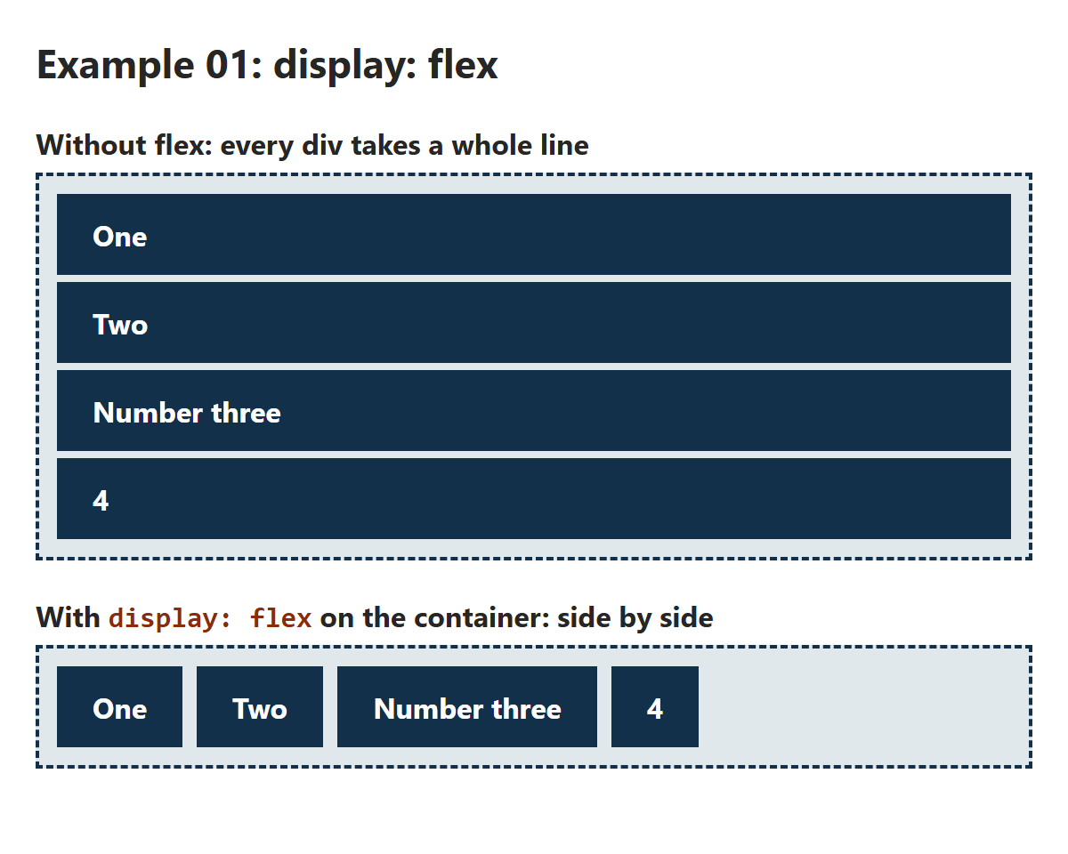
FLEXBOX 1 · EXAMPLE 01
display: flex
/* The container: the parent (dashed outline) */
.container {
background-color: #E1E8EB;
border: 2px dashed #12304A;
padding: 6px;
}
/* The items: the children (navy boxes) */
.item {
background-color: #12304A;
color: white;
font-weight: bold;
padding: 12px 20px;
margin: 4px;
}
/* One line makes .container a flex container,
and its children become flex items */
.flex {
display: flex;
}
​Divs normally stack: each one takes a whole line.
​display: flex on the parent puts its children side by side.
​Each item is only as wide as its content. They stretch to the same height.
RESULT
01_flex_container_example.css
Notes:
Open 01_flex_container_example.html with Live Server, and 01_flex_container_example.css beside it.
The two containers have exactly the same HTML. The only difference is the second one also has the class flex, and .flex has one line: display: flex.
Point out what changed:
- The items sit in a row.
- Each one shrinks to fit its content ('Number three' is wider than '4').
- They're all the same height. That's align-items: stretch, the default (Example 04).
Try it live: delete display: flex and save. Back to a stack. Put it back.

Slide 9
?
POP QUIZ 1
​You want the four cards inside .menu to sit side by side. Where does display: flex go?
​On each card: .menu article
​On .menu, the parent of the cards
A
B
​On the body
​On the h2 above the cards
C
D
Vote: hold up 1, 2, 3 or 4 fingers (A to D), or type your letter in the Teams chat. 30 seconds!
Notes:
First pop quiz: explain the routine. 30 seconds to think, then on 3 everyone holds up 1, 2, 3 or 4 fingers at once (A to D). Or type the letter in the Teams chat.
The answer is B. The most common wrong answer is A, which is worth talking about.

Slide 10
?
POP QUIZ 1: ANSWER
​You want the four cards inside .menu to sit side by side. Where does display: flex go?
​On each card: .menu article
​On .menu, the parent of the cards
A
✓
​On the body
​On the h2 above the cards
C
D
Why?
​display: flex goes on the container: the parent.
​Its direct children (the cards) become flex items and line up in a row.
​On each card, it would line up what's INSIDE each card instead. That's useful too (Example 09), but it doesn't put the cards side by side.
Notes:
Answer: B.
This is the single most common Flexbox mistake: putting display: flex on the things you want to move, instead of on their parent. If it's not working, ask 'which element is the parent?'
On the body (C), the flex items would be the body's children: the header, main and footer. They'd sit side by side, which is not what anyone wants.

Slide 11
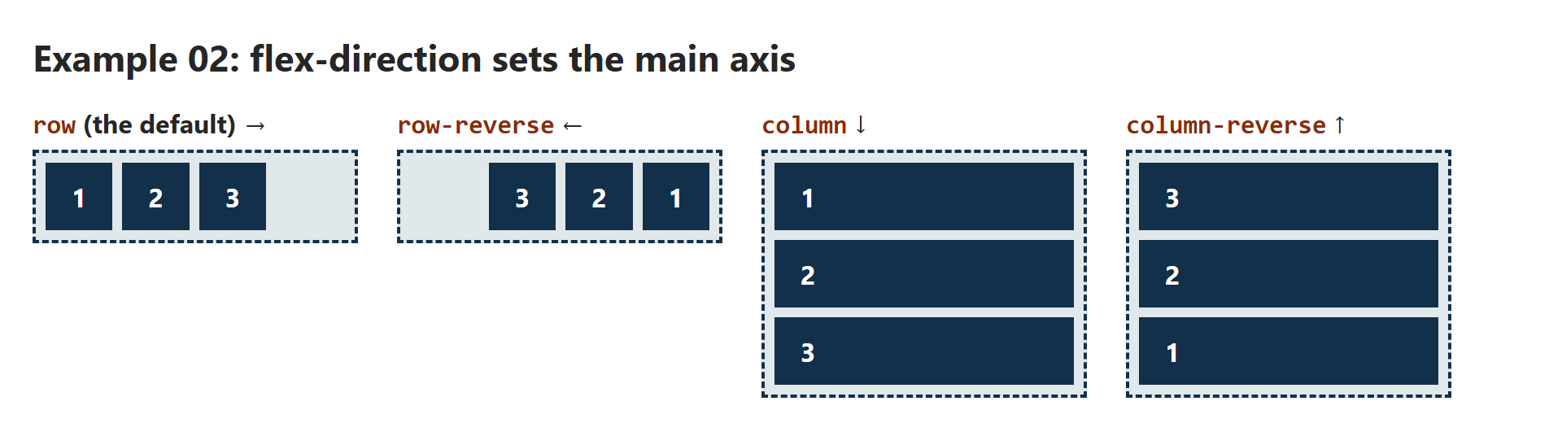
FLEXBOX 2 · EXAMPLE 02
flex-direction
/* The only difference between the four containers */
.row {
flex-direction: row;
}
.row-reverse {
flex-direction: row-reverse;
}
.column {
flex-direction: column;
}
.column-reverse {
flex-direction: column-reverse;
}
​flex-direction sets the main axis: which way the items line up.
​row is the default. column stacks them, but they're still flex items.
​-reverse flips the order on screen. (The HTML order stays the same.)
RESULT
02_flex_direction_example.css
Notes:
Open 02_flex_direction_example.html.
Four containers, same three items, one line different each time.
Why would you want column? A plain div stack is already a column, after all. Because a flex column can do flex things: centre the items, push one to the bottom with an auto margin (Example 09), or switch to row on a wider screen with one line in a media query (next class).
Notice the column items stretch to the full width. That's align-items: stretch again: in a column, the cross axis is left to right, so stretch makes them as wide as the container.
The page itself uses flexbox too: the four demos sit side by side because .demos has display: flex and flex-wrap: wrap.

Slide 12
?
POP QUIZ 2
​A container has flex-direction: column. Which way does the main axis run now?
​Left to right
​Top to bottom
A
B
​Bottom to top
​There's no main axis in a column
C
D
Vote: hold up 1, 2, 3 or 4 fingers (A to D), or type your letter in the Teams chat. 30 seconds!
Notes:
The trap: people learn 'justify-content is horizontal' and 'align-items is vertical'. That's only true for rows.

Slide 13
?
POP QUIZ 2: ANSWER
​A container has flex-direction: column. Which way does the main axis run now?
​Left to right
​Top to bottom
A
✓
​Bottom to top
​There's no main axis in a column
C
D
Why?
​The main axis always follows flex-direction. Column = top to bottom.
​So in a column, justify-content moves things up and down, and align-items moves them left and right.
​(column-reverse would be bottom to top.)
Notes:
Answer: B.
The point to land: the axes turn with flex-direction. justify-content is always the main axis, whichever way that runs. If you set column and justify-content: center doesn't seem to do anything, the container is probably only as tall as its content, so there's no spare room to move in. Give it a height to see it work.

Slide 14
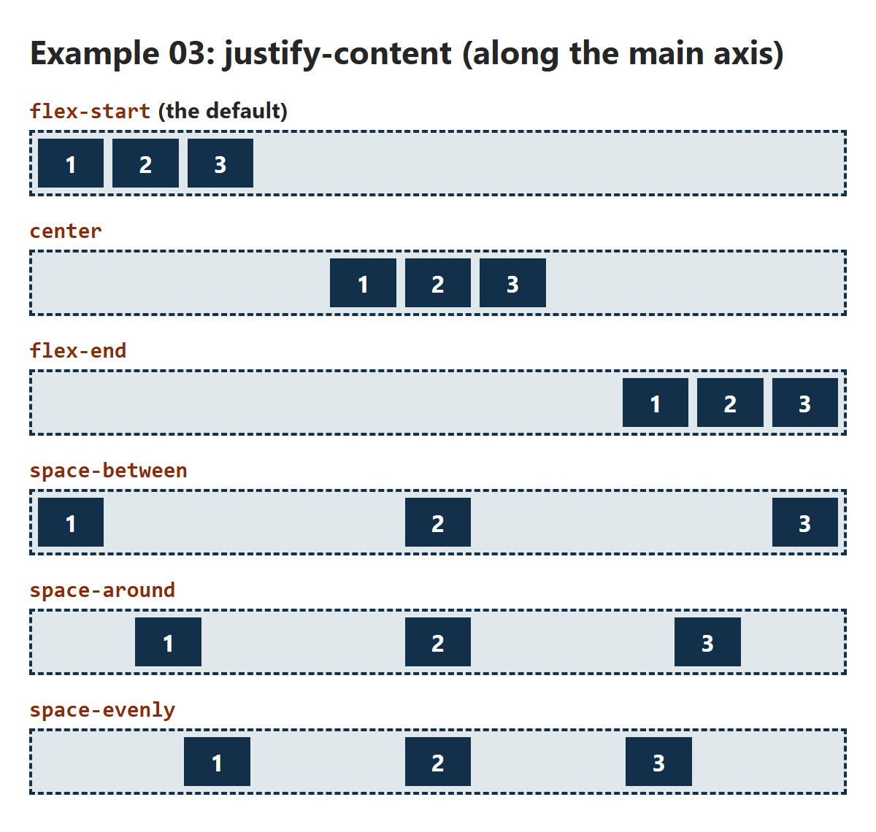
FLEXBOX 3 · EXAMPLE 03
/* Where does the spare space on the main axis go? */
.start {
justify-content: flex-start;
}
.center {
justify-content: center;
}
.end {
justify-content: flex-end;
}
/* First and last items touch the edges */
.between {
justify-content: space-between;
}
/* The same space around each item (half at the ends) */
.around {
justify-content: space-around;
}
/* Every gap is the same, the ends too */
.evenly {
justify-content: space-evenly;
}
justify-content
​Shares out the spare space along the main axis.
​space-between: the ends touch the edges. Great for a logo left, nav right.
RESULT
03_justify_content_example.css
Notes:
Open 03_justify_content_example.html.
The items don't change size: justify-content only decides where the spare space goes.
The three 'space' values are easy to mix up:
- space-between: no space at the ends; equal space between items.
- space-around: every item gets the same space on each side, so the ends get half as much as the gaps between.
- space-evenly: every gap is exactly the same, the ends too.
space-between is the one you'll use most: logo on the left, menu on the right (Try It 1).
The gap of 6px is on every container. gap is extra space between items that justify-content doesn't touch.

Slide 15
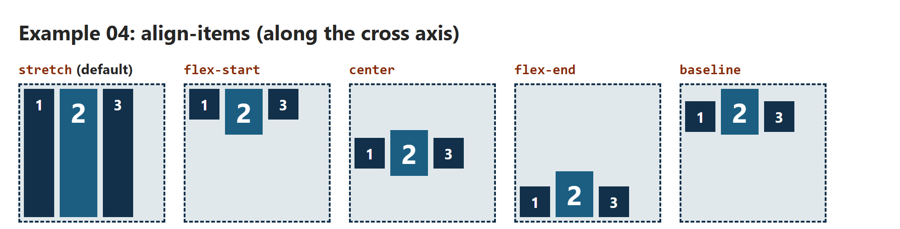
FLEXBOX 4 · EXAMPLE 04
align-items
/* align-items: the cross axis (up and down here) */
.stretch {
align-items: stretch;
}
.start {
align-items: flex-start;
}
.center {
align-items: center;
}
.end {
align-items: flex-end;
}
/* The bottoms of the letters line up */
.baseline {
align-items: baseline;
}
​Places the items on the cross axis (up and down, in a row).
​stretch is the default: that's why flex items are all the same height.
​center lines things up down the middle: icons beside text, a logo beside a menu.
RESULT
04_align_items_example.css
Notes:
Open 04_align_items_example.html. Each container is 140px tall, so the items have room to move up and down.
stretch (the default) explains something students saw in Example 01: flex items in a row are all as tall as the tallest one. Handy for cards of different lengths (Try It 3).
baseline lines up the bottoms of the letters, not the boxes. Look at the big 2: its text sits on the same line as the 1 and 3. Useful when a big heading sits beside small text.
To move just one item, use align-self on that item. It takes the same values. It's in the playground.

Slide 16
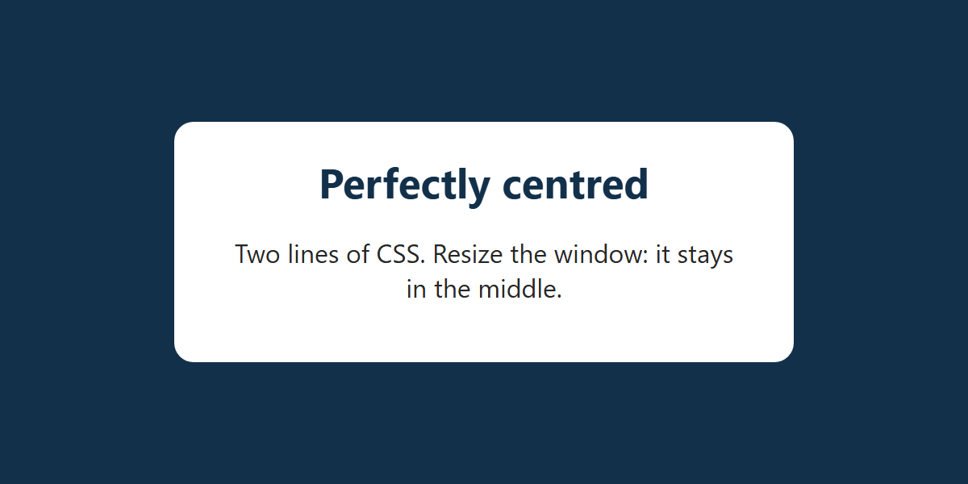
FLEXBOX 5 · EXAMPLE 05
Centre Anything
/* The container fills the window */
.hero {
display: flex;
justify-content: center; /* centre on the main axis (across) */
align-items: center; /* centre on the cross axis (down) */
min-height: 100vh;
background-color: #12304A;
}
/* The card is the only flex item */
.card {
max-width: 320px;
padding: 20px 32px;
border-radius: 12px;
background-color: white;
text-align: center;
}
.card h1 {
color: #12304A;
font-size: 1.6rem;
margin: 0 0 8px;
}
​justify-content: center + align-items: center = the exact middle.
​The container needs height to centre up and down: min-height: 100vh is the whole window.
RESULT
05_centering_example.css
Notes:
Open 05_centering_example.html and resize the window: the card stays in the middle.
Centring something vertically used to be a famous CSS headache (there are jokes about it). With flexbox it's these two lines.
vh = viewport height: 100vh is the full height of the browser window. min-height rather than height, so the hero can still grow if the content is taller than the window (on a phone, say).
Try it live: remove min-height. The navy box shrinks to fit the card, so there's no spare room, and nothing visibly centres up and down. Centring needs space to centre in.

Slide 17
?
POP QUIZ 3
​Which two lines centre a box both ways inside a flex container?
​text-align: center; and vertical-align: middle;
​justify-content: center; and align-items: center;
A
B
​margin: center; and padding: center;
​align-content: middle; and justify-items: middle;
C
D
Vote: hold up 1, 2, 3 or 4 fingers (A to D), or type your letter in the Teams chat. 30 seconds!
Notes:
A quick one, straight after Example 05. Most people should get this.

Slide 18
?
POP QUIZ 3: ANSWER
​Which two lines centre a box both ways inside a flex container?
​text-align: center; and vertical-align: middle;
​justify-content: center; and align-items: center;
A
✓
​margin: center; and padding: center;
​align-content: middle; and justify-items: middle;
C
D
Why?
​justify-content centres along the main axis (across), align-items along the cross axis (down).
​The container needs some height for the up-and-down part: Example 05 uses min-height: 100vh.
​middle isn't a value for either property, and margin: center doesn't exist.
Notes:
Answer: B.
A is a trap: text-align: center does centre text (and inline things) across, and vertical-align works in table cells and inline content. Neither centres a box inside a flex container.
Worth knowing for next class: grid can do it in one line too, with place-items: center.

Slide 19
PREDICT THE LAYOUT
Three Boxes in a Bar
<div class="bar">
<div>A</div>
<div class="tall">B</div>
<div>C</div>
</div>
.bar {
display: flex;
justify-content: space-between;
align-items: center;
height: 120px;
}
.tall {
height: 80px;
}
​Where do A, B and C go, left to right?
​And up and down? B is taller than the others.
​Sketch it, then compare with a neighbour.
YOUR PREDICTION
?
Sketch it on paper first
Notes:
Give everyone a minute to sketch the result on paper (or in a notebook app), then compare with a neighbour. Ask a couple of people to describe theirs before you show the answer.
The things to predict: the horizontal positions (justify-content: space-between) and the vertical ones (align-items: center), with one item taller than the others.

Slide 20
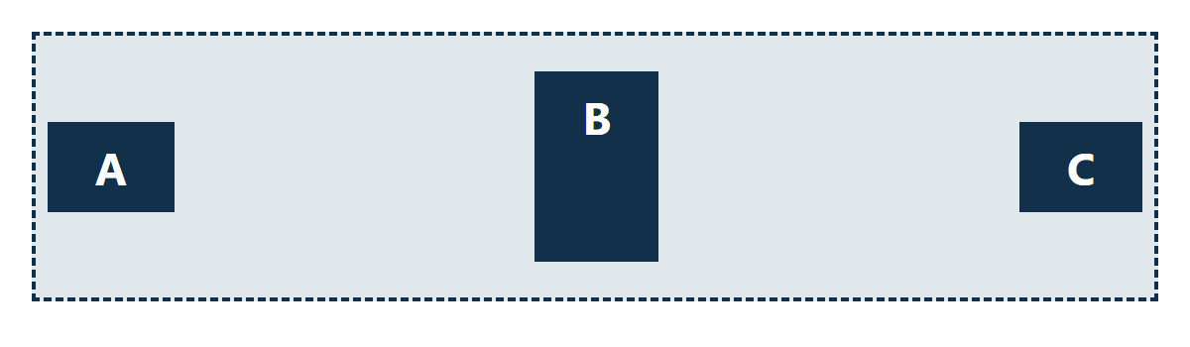
PREDICT THE LAYOUT: ANSWER
Three Boxes in a Bar
<div class="bar">
<div>A</div>
<div class="tall">B</div>
<div>C</div>
</div>
.bar {
display: flex;
justify-content: space-between;
align-items: center;
height: 120px;
}
.tall {
height: 80px;
}
​space-between: A at the left edge, C at the right, B in the middle.
​align-items: center: all three centred up and down, so A and C line up with B's middle.
WHAT THE BROWSER DOES
Notes:
A sits against the left edge, C against the right edge, and B exactly halfway: space-between puts all the spare space in the gaps.
All three are centred vertically in the 120px bar, so the short boxes line up with the middle of the tall one.
What if align-items were left out? Then it's stretch, but B has its own height, so A and C stretch to the full 120px and B stays at 80px at the top. Worth trying in the playground next.

Slide 21
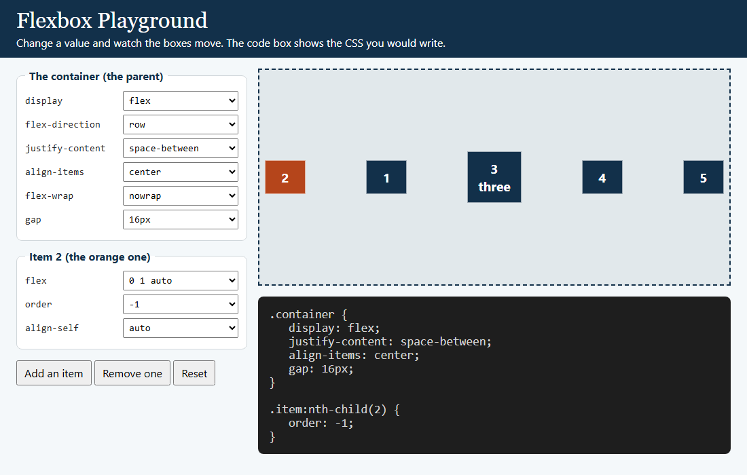
Your Turn to Drive: The Flexbox Playground
OPEN PLAYGROUND/FLEX_PLAYGROUND.HTML
Can you…
1
​Put all the boxes in the exact middle of the stage.
2
​Move box 2 to the front, without touching the HTML.
3
​Make box 2 take up all the spare room.
4
​Add boxes until they run out of room. Then make them wrap onto a second line.
Notes:
Open playground/flex_playground.html on the projector (students can open it too). The class calls out values and you change them. Or give everyone 5 minutes to try the four challenges themselves.
Answers:
1. justify-content: center and align-items: center.
2. Item 2: order: -1.
3. Item 2: flex: 1 (it gets all the spare space, because the others are 0 1 auto).
4. Click 'Add an item' several times: with nowrap they squash. Then flex-wrap: wrap.
The code box only shows properties that are not on their default value, so it shows exactly the CSS you'd need to write. Good to point out.

Slide 22
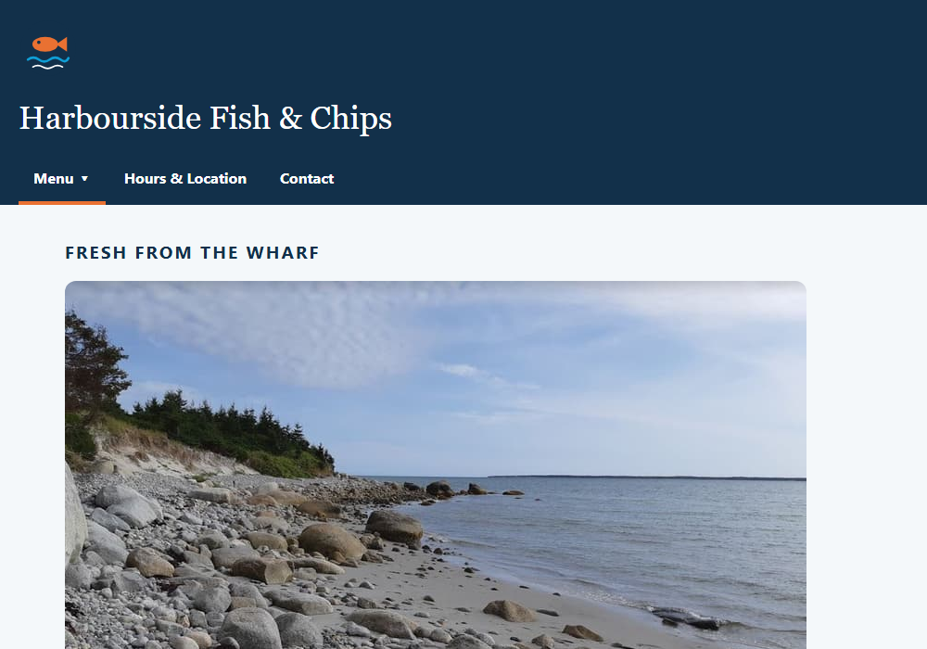
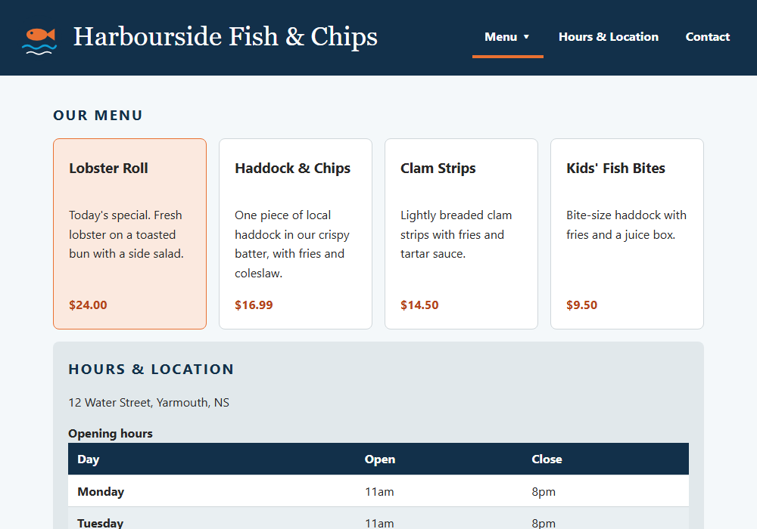
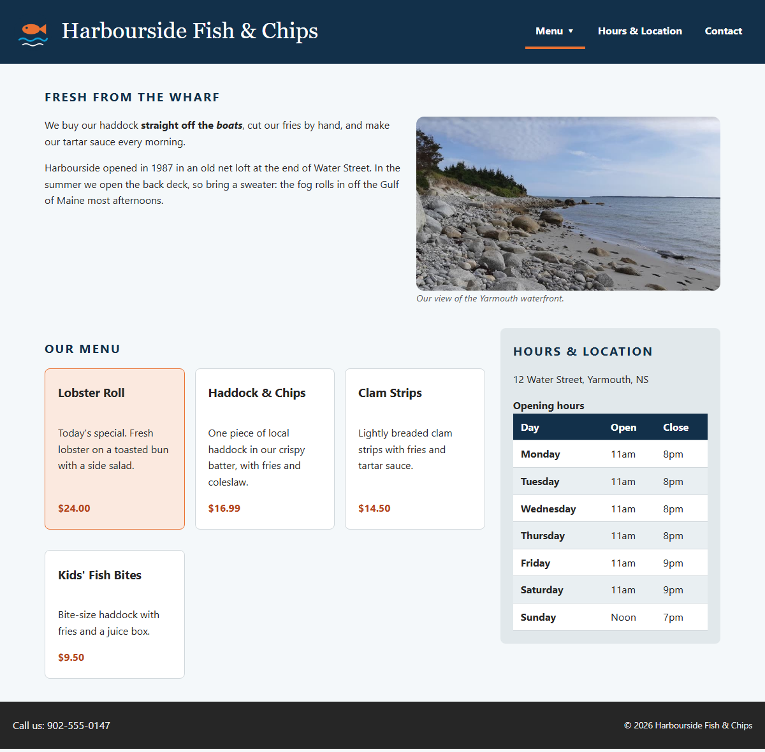
Harbourside, Part 3: This Week's Activity
START
END OF CLASS 1
END OF CLASS 2
1
The header
5
A page layout with grid
Submit after Class 2
2
Menu cards side by side
6
Menu cards with grid
Harbourside: two screenshots, wide and phone-sized.
W3Schools: 5+ "Try it Yourself" screenshots.
Win + Shift + S takes a screenshot.
3
Line up the prices
7
Float the photo
4
Footer + special first
8
On a phone
Notes:
This week's hands-on part: Harbourside, Part 3. The same page as last week, now with a real layout. Four Try Its today (flexbox, in orange), four next class (grid, float and a phone layout, in blue).
The HTML has three new wrappers: a div class="brand" around the logo and the h1, a class="intro" on the first section, and a div class="cards" around the four menu articles. Students don't change the HTML at all this week. Everything goes in style.css, under the heading for each Try It.
Submission (after Class 2): two screenshots of the finished Harbourside page (one at full width and one at phone size), plus at least five screenshots of W3Schools 'Try it Yourself' pages they changed.

Slide 23
Try It 1: The Header (8 min)
1
Open activity/index.html with Live Server
IN STYLE.CSS
​Last week's page. Find the new div.brand around the logo and h1.
.brand {
display: flex;
align-items: center;
gap: 12px;
}
header {
display: flex;
justify-content: space-between;
align-items: center;
flex-wrap: wrap;
padding: 12px 20px;
}
2
Type the CSS on the right
​In style.css, under Try It 1. Save.
3
Two header rules?
​That's fine: the later one adds to the first (and wins any ties).
4
Play with it
​Try justify-content: center, then flex-end. Make the window narrow.
​Two flex containers: .brand lines up the logo and the name; header lines up the brand and the nav.
Notes:
The first Try It: the logo and name side by side, and the menu on the right of the same bar.
.brand { display: flex } puts the logo and h1 in a row; align-items: center lines the logo up with the middle of the text.
header { display: flex } makes the brand div and the nav into flex items. space-between pushes them to opposite ends. flex-wrap: wrap lets the nav drop below the brand when the window is too narrow (we'll come back to that on a phone in Try It 8).
The padding changes from '20px 20px 0' to '12px 20px' so the nav sits nicely in the middle of the bar. The later rule wins, because it comes later in the file and has the same specificity (the cascade, from Class 8).
The dropdown still works: it's positioned against its own li, so the flex layout doesn't affect it.

Slide 24
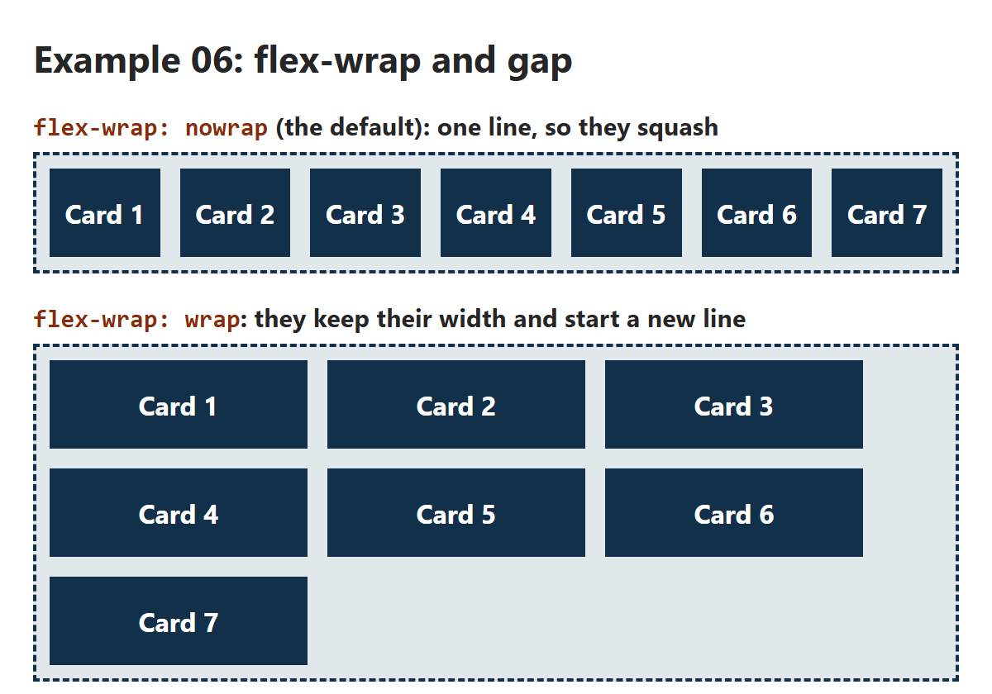
FLEXBOX 6 · EXAMPLE 06
/* gap: space BETWEEN items, never at the edges */
.container {
display: flex;
gap: 12px;
background-color: #E1E8EB;
border: 2px dashed #12304A;
padding: 8px;
}
/* Every card asks to be 140px wide */
.card {
width: 140px;
padding: 16px 8px;
background-color: #12304A;
color: white;
font-weight: bold;
text-align: center;
}
/* The only difference between the two containers */
.nowrap {
flex-wrap: nowrap;
}
.wrap {
flex-wrap: wrap;
}
flex-wrap and gap
​By default flex keeps everything on one line, and squashes the items to fit.
​flex-wrap: wrap: items keep their width and start a new line.
​gap spaces rows and columns, never the outside edges.
RESULT
06_flex_wrap_example.css
Notes:
Open 06_flex_wrap_example.html and make the window narrower and wider.
Every card asks to be 140px wide. In the first container (nowrap, the default), seven cards don't fit, so flexbox shrinks them all. Make the window very narrow and they'll even poke out of the container once they can't shrink any further than their text.
In the second container, flex-wrap: wrap lets them keep their 140px and flow onto new lines, like words in a paragraph.
gap: 12px is the space between the cards, both across and down. Before gap worked in flexbox (around 2021), people used margins, which also added space at the edges and needed fixing. Use gap.

Slide 25
?
SPOT THE BUG
​The photos squash onto one line instead of wrapping. What's wrong?
​width has to be a percentage
A
.gallery {
display: flex;
gap: 12px;
}
.gallery img {
width: 200px;
flex-wrap: wrap;
}
​flex-wrap is on the items. It belongs on the container
B
​wrap isn't a real value: it's flex-wrap: yes
C
​Images can't be flex items
D
Vote: hold up 1, 2, 3 or 4 fingers (A to D), or type your letter in the Teams chat. 30 seconds!
Notes:
Spot the bug: same voting routine. Give them a little longer (45 seconds): they have to read the code.

Slide 26
?
SPOT THE BUG: ANSWER
​The photos squash onto one line instead of wrapping. What's wrong?
A
​width has to be a percentage
✓
​flex-wrap is on the items. It belongs on the container
.gallery {
display: flex;
gap: 12px;
}
.gallery img {
width: 200px;
flex-wrap: wrap;
}
C
​wrap isn't a real value: it's flex-wrap: yes
D
​Images can't be flex items
Why?
​Container properties go on the parent: display, flex-direction, flex-wrap, justify-content, align-items, gap.
​Move flex-wrap: wrap; into .gallery and the photos wrap.
​On an item, flex-wrap is silently ignored. No error!
Notes:
Answer: B.
A useful habit: sort flexbox properties into 'container' (the parent) and 'item' (the children). Container: display, flex-direction, flex-wrap, justify-content, align-items, gap. Item: flex (grow, shrink, basis), order, align-self.
The CSS validator wouldn't catch this one either: flex-wrap is a real property with a real value. It's just on the wrong element. That's why DevTools is worth knowing: it shows a flex-wrap on an img as having no effect (some browsers grey it out with a little 'i' explaining why).

Slide 27
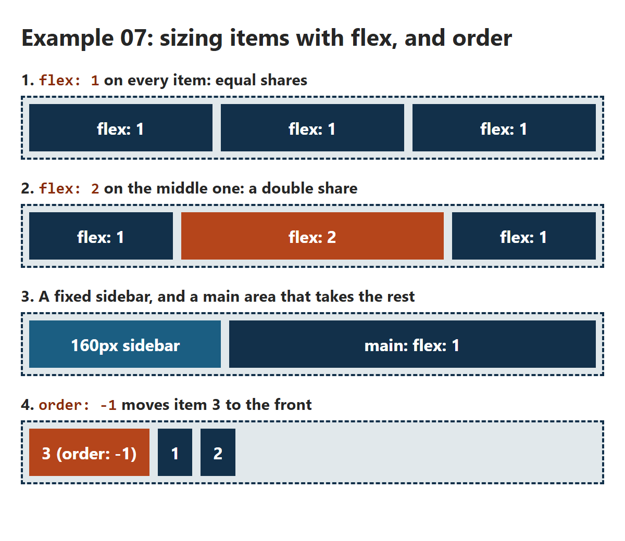
FLEXBOX 7 · EXAMPLE 07
/* 1. flex: 1 = one share each */
.equal .item,
.double .item {
flex: 1;
}
/* 2. Two shares: twice as wide as the others */
.double .big {
flex: 2;
background-color: #B5451B;
}
/* 3. flex: grow shrink basis. Always 160px */
.sidebar {
flex: 0 0 160px;
background-color: #1B5E82;
}
.main {
flex: 1;
}
/* 4. Items start at order: 0. Lower goes first */
.first {
order: -1;
background-color: #B5451B;
}
Sizing Items with flex
​flex: 1 = take one share of the space. flex: 2 = two shares.
​flex: 0 0 160px = grow 0, shrink 0, start at 160px: always exactly 160px.
​order: -1 moves an item first. (Only the look: Tab still follows the HTML.)
RESULT
07_flex_grow_example.css
Notes:
Open 07_flex_grow_example.html. Four demos, top to bottom.
flex is shorthand for three properties: flex-grow, flex-shrink and flex-basis.
- flex-grow: how many shares of the spare space this item gets.
- flex-shrink: how much it gives up when space is short (0 = never shrink).
- flex-basis: its starting size, before growing or shrinking.
flex: 1 is short for 1 1 0%: start from nothing, then share out ALL the space equally. That's why three flex: 1 items are exactly equal, whatever their text.
Demo 3 is the classic sidebar layout: the sidebar is fixed at 160px, and main has flex: 1 so it takes whatever is left. Resize the window: only main changes size.
Demo 4: order. Every item starts at order: 0; lower numbers go first. Accessibility warning: screen readers and the Tab key follow the HTML order, not the visual order. Fine for moving a card around; don't use it to rearrange things people read or Tab through in order.

Slide 28
?
POP QUIZ 4
​Three items: flex: 1, flex: 2 and flex: 1. The container is 800px wide, with no gap or padding. How wide is the middle item?
​200px
​266px
A
B
​400px
​800px
C
D
Vote: hold up 1, 2, 3 or 4 fingers (A to D), or type your letter in the Teams chat. 30 seconds!
Notes:
A little maths. 266px (B) is what you get if you think the middle item is 'one third, plus a bit', and 800px (D) is a guess that 2 means 'twice the container'.

Slide 29
?
POP QUIZ 4: ANSWER
​Three items: flex: 1, flex: 2 and flex: 1. The container is 800px wide, with no gap or padding. How wide is the middle item?
​200px
​266px
A
B
​400px
​800px
✓
D
Why?
​1 + 2 + 1 = 4 shares. 800px ÷ 4 = 200px per share.
​The middle item has 2 shares: 400px. The other two get 200px each.
​(flex: 1 starts every item from 0, so ALL the space is shared out. Add padding and the maths gets fuzzier.)
Notes:
Answer: C, 400px.
If you have time, show it in the playground: set item 2 to flex: 2, and give the others flex: 1 in DevTools (or just eyeball it). Or open Example 07 and use DevTools to measure: hover the middle item in the Elements panel and the width shows on the page.

Slide 30
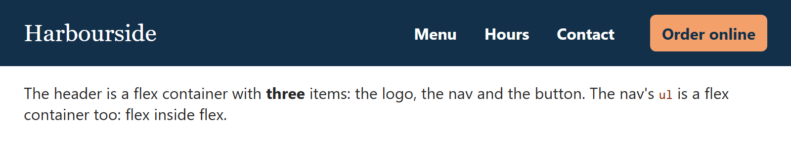
FLEXBOX 8 · EXAMPLE 08
A Flexbox Header
/* 1. Three items in a row, lined up down the middle */
.site-header {
display: flex;
align-items: center;
gap: 24px;
padding: 12px 24px;
background-color: #12304A;
}
/* 2. An auto margin soaks up ALL the free space:
the nav (and the button) go right */
.site-header nav {
margin-left: auto;
}
/* 3. Flex inside flex: the links in a row */
.site-header ul {
display: flex;
gap: 4px;
list-style: none;
margin: 0;
padding: 0;
}
​Three items: the logo, the nav and the button, lined up with align-items: center.
​margin-left: auto on the nav soaks up all the free space, so it's pushed right.
​Flex inside flex: the ul is a flex container too.
RESULT
08_flex_navbar_example.css
Notes:
Open 08_flex_navbar_example.html. Almost every website header looks like this.
The new trick is margin-left: auto. In a flex container, an auto margin takes up all the free space on that side. So the nav (and the button after it) get pushed all the way to the right, and the logo stays on the left.
Why not justify-content: space-between? With three items, space-between would put the nav in the middle, halfway between the logo and the button. margin-left: auto keeps the nav and the button together on the right.
The ul inside the nav has its own display: flex: an element can be a flex item (of the header) and a flex container (for its li's) at the same time.

Slide 31
?
POP QUIZ 5
​margin-left: auto pushed the nav to the right. In a card with flex-direction: column, what will margin-top: auto do to the card's button?
​Centre it in the card
​Push it down to the bottom of the card
A
B
​Remove the space above it
​Nothing: auto margins only work sideways
C
D
Vote: hold up 1, 2, 3 or 4 fingers (A to D), or type your letter in the Teams chat. 30 seconds!
Notes:
This one asks students to reason from what they just saw, rather than remember. Give them the full 30 seconds.

Slide 32
?
POP QUIZ 5: ANSWER
​margin-left: auto pushed the nav to the right. In a card with flex-direction: column, what will margin-top: auto do to the card's button?
​Centre it in the card
​Push it down to the bottom of the card
A
✓
​Remove the space above it
​Nothing: auto margins only work sideways
C
D
Why?
​An auto margin soaks up all the free space on its side.
​In a column, the free space is up and down, so margin-top: auto pushes the button to the bottom.
​Every card's button lines up, however long its text is. That's the next example.
Notes:
Answer: B.
Auto margins work along both axes in flexbox. That's the whole trick in Example 09 and Try It 3.
(D is how auto margins behave in normal block layout, where margin-top: auto does nothing. Flexbox is different, which is part of why it's so useful.)

Slide 33
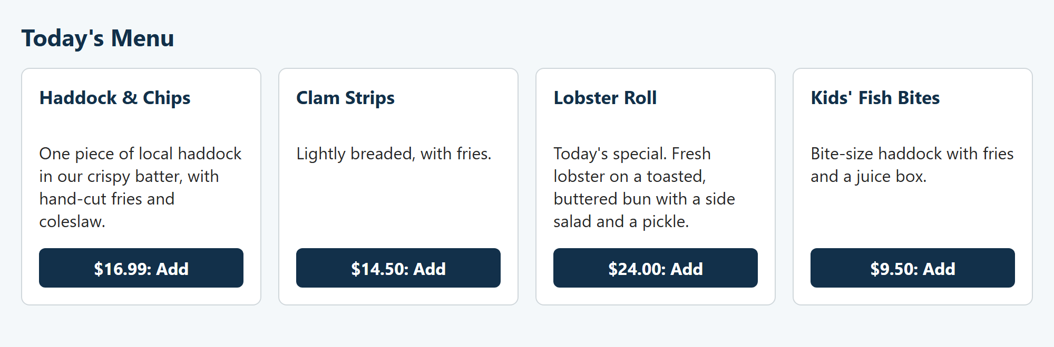
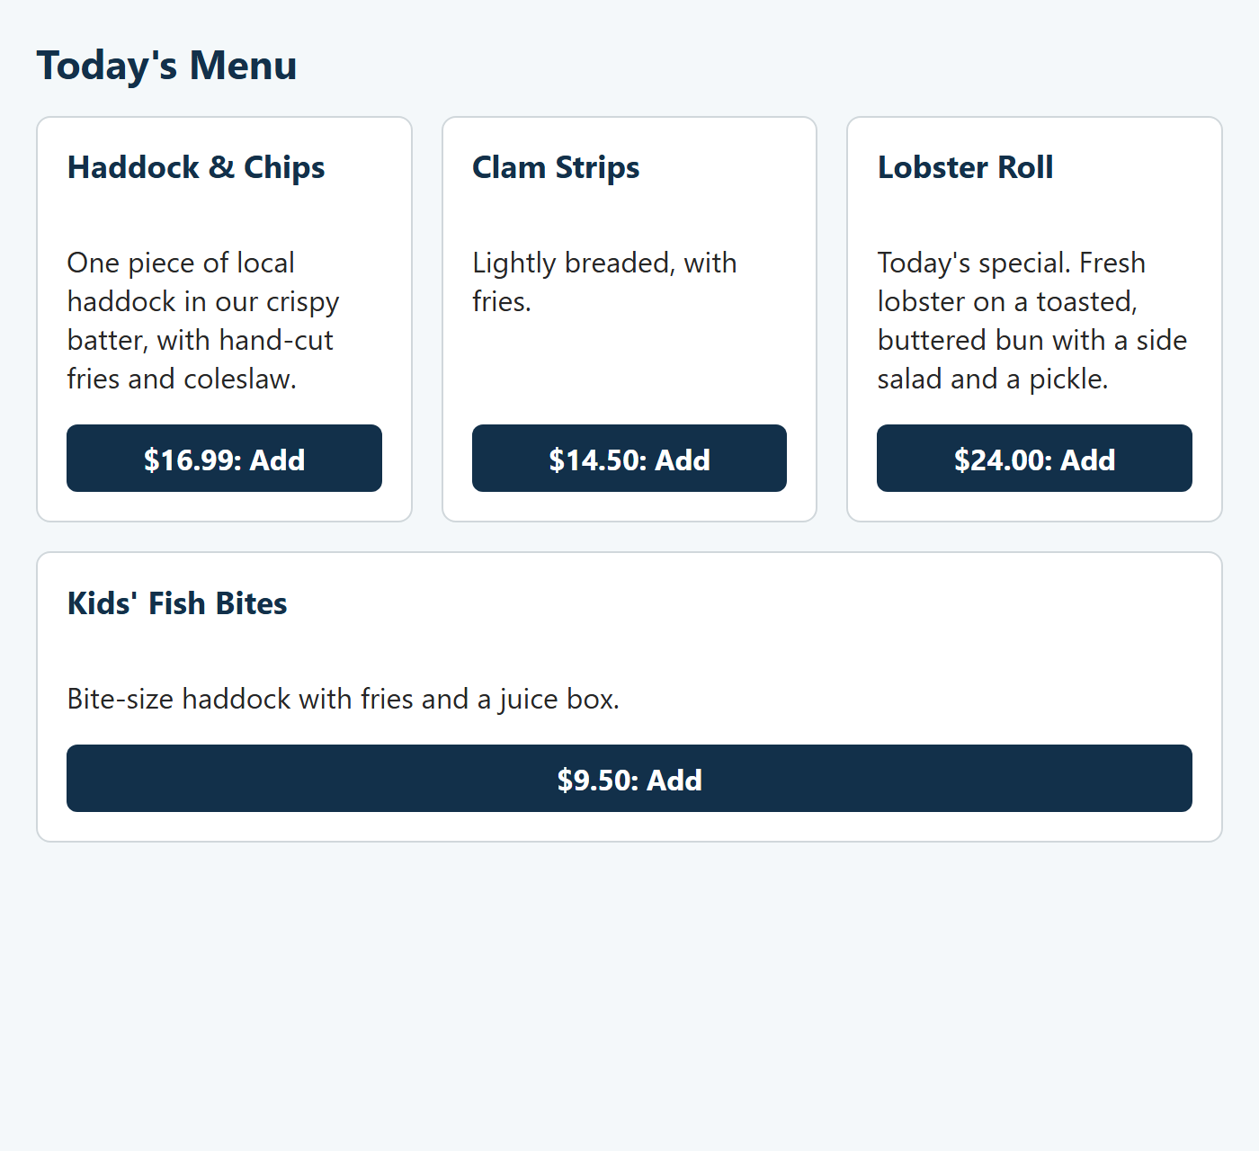
FLEXBOX 9 · EXAMPLE 09
Flexbox Cards
/* 1. The cards side by side, wrapping onto new lines */
.cards {
display: flex;
flex-wrap: wrap;
gap: 16px;
}
/* 2. Grow, shrink, start at 200px.
Each card is ALSO a flex column */
.card {
flex: 1 1 200px;
display: flex;
flex-direction: column;
padding: 0 16px 16px;
border: 1px solid #D0D7DB;
border-radius: 8px;
background-color: white;
}
​flex: 1 1 200px: start at 200px, then grow to fill the row. Fewer fit on a phone.
​Each card is a column flexbox, and margin-top: auto puts every button at the bottom.
WIDE: FOUR ACROSS
NARROWER: WATCH THE LAST CARD
09_flex_cards_example.css
Notes:
Open 09_flex_cards_example.html and resize the window slowly.
.cards is a wrapping flex container. Each card has flex: 1 1 200px: try to be 200px, grow to fill the row, shrink if needed. On a laptop four fit; narrower, three; then two; on a phone, one. No media queries.
Each card is also a flex container with flex-direction: column, and the button has margin-top: auto: the answer to the last quiz. The text is different lengths, but every button lines up along the bottom.
Look at the narrower screenshot: three cards fit on the first line, and the Kids card is alone on the second line, stretched all the way across. That's flexbox being one-dimensional: each line is sized on its own, and flex-grow lets the lonely card fill its line. Sometimes that's what you want; often it isn't. CSS Grid fixes it, next class (and Try It 6).

Slide 34
Try It 2: Menu Cards Side by Side (6 min)
1
Find div.cards
IN STYLE.CSS
​In index.html: a new div around the four menu articles.
.cards {
display: flex;
flex-wrap: wrap;
gap: 16px;
}
.cards article {
flex: 1 1 180px;
margin-bottom: 0;
}
2
Type the CSS on the right
​In style.css, under Try It 2. Save.
3
Make the window narrow
​The cards wrap: four across, then fewer.
4
Play with it
​Change 180px to 300px. How many fit now?
​flex: 1 1 180px = grow, shrink, start at 180px. gap does the spacing now, so margin-bottom: 0.
Notes:
The cards from last week finally sit side by side.
.cards is the container, the articles are the items. The article rule already exists in the Class 8 CSS (#menu article, with the white background and border); this new rule adds the flex sizing and removes the old bottom margin, because gap spaces them now.
At full width (900px main column), four cards fit. Make the window narrower to see them wrap.
Ask: are the prices lined up? No! The descriptions are different lengths, so each price sits at a different height. That's Try It 3.

Slide 35
Try It 3: Line Up the Prices (5 min)
1
Look at the prices
IN STYLE.CSS
​They sit at different heights: the text above each one is a different length.
.cards article {
display: flex;
flex-direction: column;
}
.cards .price {
margin-top: auto;
}
2
Type the CSS on the right
​Under Try It 3. Save.
3
Every price on one line
​The cards were already the same height. Now each price sits at the bottom.
​Same trick as Example 09's button: a column flexbox, then margin-top: auto.
Notes:
Short and satisfying.
The cards are already the same height, because flex items stretch (align-items: stretch, the default). But inside each card, the content sits at the top, so the prices land wherever the text ends.
Making each card a column flexbox and giving the price margin-top: auto pushes it to the bottom of its card. All four prices line up.
A second '.cards article' rule: that's fine, the browser combines it with the one from Try It 2.

Slide 36
Try It 4: The Footer, and Today's Special First (5 min)
1
Type the CSS on the right
IN STYLE.CSS
​Under Try It 4. Save.
footer {
display: flex;
justify-content: space-between;
align-items: center;
flex-wrap: wrap;
}
#menu .special {
order: -1;
}
2
Scroll to the footer
​Phone number on the left, copyright on the right.
3
Look at the menu
​The Lobster Roll special jumped to the front: order: -1.
4
Play with it
​Give #haddock an order: 1. Where does it go?
​order only changes the look. Screen readers and the Tab key still follow the HTML.
Notes:
Two quick ones.
The footer: the same space-between pattern as the header, with flex-wrap so the two lines stack on a narrow phone.
order: -1 puts the special first, because every other card has the default order: 0. In 'play with it', #haddock { order: 1 } sends Haddock to the end: it's now the only card with a higher number than 0.
The accessibility point again: order is fine here because the cards don't have to be read in a particular order. Don't use it for things like the steps of a recipe or form fields.
Checkpoint: that's all four of today's Try Its. Students keep this page for next class (Try Its 5 to 8 build on it).

Slide 37
Game Time: Flexbox Froggy (10 min)
Flexbox Froggy
It's today's CSS
In the game | What it does
justify-content | Moves frogs along the main axis
align-items | Moves them on the cross axis
flex-direction | Which way the row runs
order | Changes one frog's place
align-self | Moves just one frog
flex-wrap | Lets frogs wrap onto new lines
https://flexboxfroggy.com/
Get as far as you can in 10 minutes. Then race a neighbour.
​Type CSS to move each frog onto the lily pad of its colour.
​It starts with justify-content and align-items, then adds flex-direction, order, align-self and flex-wrap.
​Stuck? Click a property name in the instructions to see its values.
Notes:
Flexbox Froggy is a free browser game (no sign-up) by Codepip. Each level gives you a pond with frogs and lily pads, and you type the CSS to put each frog on its lily pad. It uses exactly today's properties.
Suggestion: 10 minutes, then ask who got furthest, and have them show the level they're on. The later levels combine properties (flex-direction with justify-content and align-items) and get tricky.
It's also good homework, and good revision before the next quiz. There's a matching game for Grid next class (Grid Garden), from the same people.

Slide 38
Work Time: W3Schools Flexbox (15 min)
What to do
W3Schools tutorials
1
Open a page on the right
CSS Flexbox
​Read it, top to bottom.
https://www.w3schools.com/css/css3_flexbox.asp
2
Click every "Try it Yourself »"
CSS Flex Container
​The code opens beside the result.
https://www.w3schools.com/css/css3_flexbox_container.asp
3
Change something, then Run
​A different value, a new property, more boxes.
CSS Flex Items
https://www.w3schools.com/css/css3_flexbox_items.asp
4
Screenshot it
​Code and result both showing: Win + Shift + S.
CSS Flex Responsive
https://www.w3schools.com/css/css3_flexbox_responsive.asp
Submit at least 5 screenshots (both classes together) to Brightspace.
Notes:
From the original Week 8 deck: work through the W3Schools Flexbox pages, and do as many 'Try it Yourself' examples as possible. In each one, change the CSS (a different value, a new property, more boxes) and click Run.
Do one together first, on the projector: open CSS Flexbox, click Try it Yourself, change flex-wrap: nowrap to wrap (or change the background colour), click Run, and take a screenshot that shows both the code and the result.
Submission: at least 5 screenshots in total, across this class and next class's Grid pages, uploaded to Brightspace after Class 2. Each screenshot should show code the student changed, not the original.

Slide 39
Week 8: Responsive Web Design
Cheat Sheet: Flexbox
Code | What it does
display: flex | The parent becomes a flex container
flex-direction: row | column | Sets the main axis
justify-content: center | space-between | Places items along the main axis
align-items: stretch | center | Places items on the cross axis
flex-wrap: wrap | Items can move onto new lines
gap: 16px | Space between items (not the edges)
flex: 1 | An item takes a share of the spare space
flex: 0 0 200px | An item stays exactly 200px
order: -1 | Moves an item first (the look only)
margin-left: auto / margin-top: auto | Pushes an item right / down
Notes:
Everything from today in one place. It's in the README too.

Slide 40
Exit Ticket: Quick-fire Flexbox (5 min)
1
Turn a parent into a flex container
2
Spread items to the two ends
3
Line items up down the middle
?
?
?
4
Let items wrap onto a new line
5
Space between items, not the edges
6
Stack the items top to bottom
?
?
?
Notes:
A quick-fire round to finish. Teams of 2 or 3 (or on your own), 3 minutes, write the CSS for each job on paper or in the Teams chat. One point per card. Answers on the next slide.
Answers:
1. display: flex;
2. justify-content: space-between;
3. align-items: center;
4. flex-wrap: wrap;
5. gap: 16px; (any size)
6. flex-direction: column;

Slide 41
Exit Ticket: Answers
1
Turn a parent into a flex container
2
Spread items to the two ends
3
Line items up down the middle
display: flex;
justify-content: space-between;
align-items: center;
4
Let items wrap onto a new line
5
Space between items, not the edges
6
Stack the items top to bottom
flex-wrap: wrap;
gap: 16px;
flex-direction: column;
Notes:
Go through each one quickly. #2 also accepts space-around or space-evenly if they explain it, and #5 accepts any size.
Anyone who got 6 out of 6 is ready for Grid.

Slide 42
Week 8: Responsive Web Design
Class 1 Recap and Next Steps
Recap:
  display: flex goes on the parent. Its children line up along the main axis.
  justify-content works on the main axis, align-items on the cross axis. Both centre = the exact middle.
  flex-wrap and gap for rows of cards. flex: 1 shares out the space. order changes the look only.
  An auto margin pushes an item away: right in a row, down in a column.
Before next class:
  Keep your Harbourside page and your W3Schools screenshots. Finish Froggy if you like!
  Assignment 3 (10%) is due Sunday, November 1: start sketching your "My Portfolio" page.
Next class:
  CSS Grid, float, picking the right tool, and a page that works on a phone.
Notes:
Next class: CSS Grid (rows and columns at the same time), float (text that wraps around a photo), how to choose between them, and a first look at media queries. Try Its 5 to 8 finish the Harbourside layout.
Remind students to keep their Harbourside page, and to keep their W3Schools screenshots: everything is submitted together after next class.

