Slide 1
WEBD 1000
Week 8, Class 2:
  CSS Grid, float, and picking the right layout tool for the job.
Week 8: Responsive Web Design
Notes:
Welcome back! Last class: Flexbox, for lining things up in one row or one column.
Today: CSS Grid, for rows AND columns at the same time (whole page layouts, galleries), then float, the old layout tool that's still the best way to wrap text around a photo. Then we sort out which tool to use when, and finish the Harbourside page so it works on a phone.
Same routine as last class: pop quizzes all the way through, a predict slide, a spot-the-bug, a sorting game and an exit ticket.

Slide 2
Attendance and a Quick Check-in
OUTLOOK
TEAMS
✓
Are you checking your school Outlook email?
✓
Are you signed into Teams?
TEAMS
BRIGHTSPACE
✓
Are you following our Teams channel and General chat?
✓
Are you following the Content on Brightspace?
Notes:
Take attendance while everyone checks these four things.
While you do, have students git pull (in case anything changed), open their Harbourside page from last class with Live Server, and open playground/grid_playground.html.

Slide 3
Week 8: Responsive Web Design
Week 8, Class 2: Overview
Title: CSS Grid and Float
Agenda:
  CSS Grid: columns, fr, spanning, named areas, auto-fit
  Float: wrapping text around a photo, and the clearfix
  Grid, flexbox or float? Picking the right tool
  Harbourside, Part 3: Try Its 5 to 8 (a phone layout too), then submit
Grid
→
Float
→
Choose
Rows and columns
Text around a photo
The right tool for the job
Notes:
Rough plan for the two hours:
- 10 min: check-in, the warm-up quiz, the 100-second video
- 25 min: grid ideas and Examples 10 to 13, with Pop Quizzes 2 and 3, the predict slide and spot the bug
- 10 min: Try It 5, and what happened to the Kids card
- 10 min: auto-fit (Example 14), Pop Quiz 4, Try It 6
- 15 min: float (Examples 15 and 16), Pop Quiz 5, Try It 7
- 10 min: comparing the three, and the sorting game
- 15 min: a responsive layout (Example 17) and Try It 8
- 15 min: Grid Garden or W3Schools grid work time, then submit
- 5 min: exit ticket and recap
About 115 minutes, so Grid Garden can be homework if you're short of time.
Anyone who missed Class 1 can copy Try Its 1 to 4 from activity/answer/style.css first (the CSS between the Try It 1 and Try It 5 headings).

Slide 4
Week 8: Responsive Web Design
Before We Start
1. Pull, just in case
git pull
Today: examples 10–17, and playground/grid_playground.html.
2. Open your Harbourside page from Class 1
Try Its 5 to 8 build on it. Missed Class 1? Copy Try Its 1–4 from activity/answer/style.css.
3. Have your W3Schools screenshots handy
You'll add the grid ones today and submit everything at the end.
Notes:
Students carry on with the page they built last class. If someone missed it, they can copy the Try It 1 to 4 CSS out of activity/answer/style.css, under the same headings in their own style.css.
The Grid Playground works just like the Flexbox one, with one extra: the grid-template-columns box is a text box, so students can type any value they like (try 100px 1fr 100px).

Slide 5
?
WARM-UP
​Flexbox is called "one-dimensional". What does that mean?
​It only works on one element per page
​It lays items out along one axis at a time: a row OR a column
A
B
​It only works left to right
​Only one item can grow
C
D
Vote: hold up 1, 2, 3 or 4 fingers (A to D), or type your letter in the Teams chat. 30 seconds!
Notes:
A warm-up from last class, and a lead-in to today. Same routine: 30 seconds, then fingers or the Teams chat.

Slide 6
?
WARM-UP: ANSWER
​Flexbox is called "one-dimensional". What does that mean?
​It only works on one element per page
​It lays items out along one axis at a time: a row OR a column
A
✓
​It only works left to right
​Only one item can grow
C
D
Why?
​Flexbox handles one line of items at a time. When they wrap, each new line is sized on its own.
​Remember the Kids card in Example 09, alone on its line and stretched across?
​Grid is two-dimensional: rows AND columns line up together. That's today.
Notes:
Answer: B.
This is the key difference between flexbox and grid, and it's today's big idea. Flexbox: content first, one line at a time; each item sizes itself and the line shares out the space. Grid: layout first; you draw the rows and columns, then place the items in them.

Slide 7
Week 8: Responsive Web Design
Grid in 100 Seconds
CSS Grid in 100 Seconds
Fireship on YouTube · about 2 minutes
https://youtu.be/uuOXPWCh-6o
Words you'll know by the end of class:
display: grid
grid-template-columns
fr
gap
grid-column
grid-template-areas
Notes:
The matching video from last class's series. Click the dark box (or the link) to open it. About two minutes.
Again, it's fast. The goal is to hear the words once; by the end of class they'll all be familiar.

Slide 8

+
CSS Grid
•
○
+
Rows and columns · fr · spanning · named areas · auto-fit
•
○
Notes:
CSS Grid is the newest of the three layout tools (all browsers since 2017). It's the first CSS tool that was actually designed for page layout: you draw a grid of rows and columns, then place things in it.
Where flexbox starts from the content ('here are some items, share out the space'), grid starts from the layout ('here are my columns, put the items in them').

Slide 9
Week 8: Responsive Web Design
Grid: The Key Ideas
1
2
3
4
column lines
1
grid-column: 2 / 4
2
a cell
3
row lines
Grid container
The parent: the element with display: grid
Lines
The edges between columns and rows, numbered from 1
Tracks
A column or a row. grid-template-columns sets them
Cells and areas
One box of the grid, or a rectangle of them
Flexbox: a row OR a column
Grid: rows AND columns
Notes:
Grid has a few more words than flexbox.
The grid container is the parent with display: grid; its children are grid items, just like flexbox.
Lines are the most important idea. The edges between columns (and rows) are numbered from 1, starting at the left (and the top). A grid with 3 columns has 4 column lines. Placing items uses line numbers, so the orange item here goes from column line 2 to column line 4: two columns wide.
A track is a single column or row. grid-template-columns sets the column tracks; rows are usually made automatically as needed.
A cell is one box; an area is any rectangle of cells (one or more). Named areas are coming in Example 13.

Slide 10

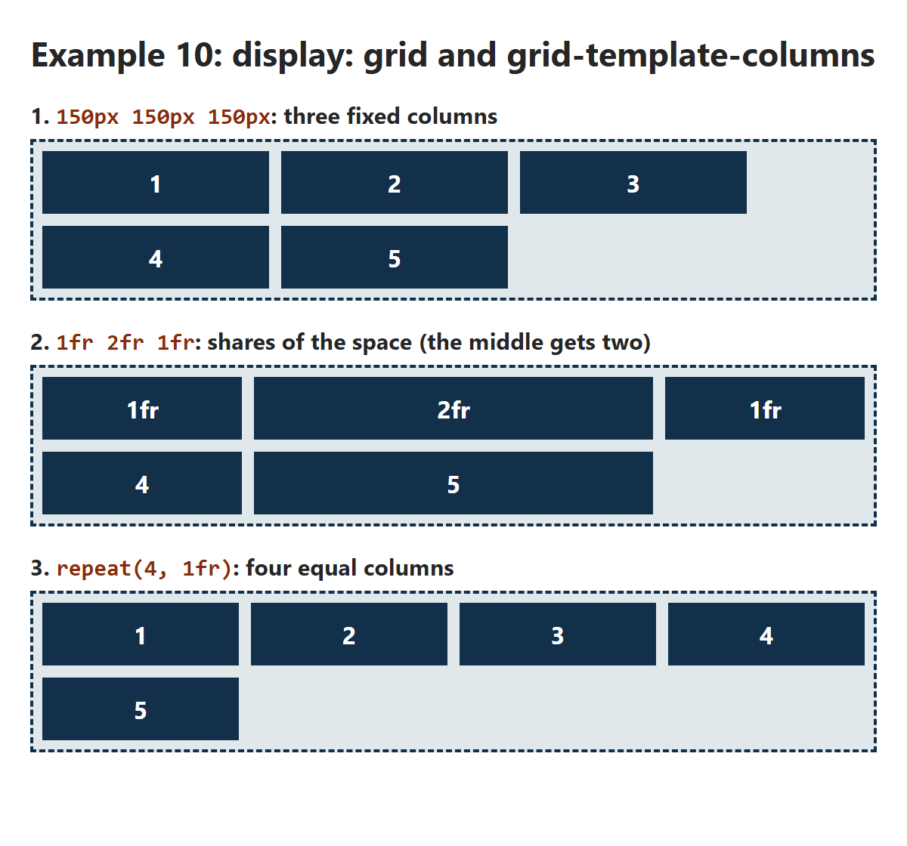
GRID 1 · EXAMPLE 10
/* The grid container. gap works just like in flexbox */
.grid {
display: grid;
gap: 8px;
background-color: #E1E8EB;
border: 2px dashed #12304A;
padding: 6px;
}
.item {
padding: 10px;
background-color: #12304A;
color: white;
font-weight: bold;
text-align: center;
}
/* 1. Fixed widths: the columns never change size */
.fixed {
grid-template-columns: 150px 150px 150px;
}
/* 2. fr = a fraction (share) of the free space */
.shares {
grid-template-columns: 1fr 2fr 1fr;
}
/* 3. repeat(4, 1fr) is short for 1fr 1fr 1fr 1fr */
.four {
grid-template-columns: repeat(4, 1fr);
}
grid-template-columns
​You set the columns; the grid adds rows as it needs them.
​fr = a fraction (share) of the free space, like flex: 1.
​repeat(4, 1fr) is short for 1fr 1fr 1fr 1fr.
RESULT
10_grid_columns_example.css
Notes:
Open 10_grid_columns_example.html.
Three grids, five items each, only grid-template-columns changes.
1. Fixed 150px columns: they never change size, so there's spare space at the right. Items 4 and 5 go onto a second row, automatically.
2. 1fr 2fr 1fr: the space is shared out in 4 parts, the middle column gets 2. Same maths as flex: 2 last class. Resize the window: the columns grow and shrink together, and they stay lined up from row to row (unlike flexbox!).
3. repeat(4, 1fr): four equal columns.
gap works exactly as in flexbox, between rows and columns. You'll still see grid-gap in older code: it's the old name for the same thing.

Slide 11
?
POP QUIZ 1
​grid-template-columns: repeat(3, 1fr) and the grid has 7 items. How many rows does it make?
​1
​2
A
B
​3
​7
C
D
Vote: hold up 1, 2, 3 or 4 fingers (A to D), or type your letter in the Teams chat. 30 seconds!
Notes:
A quick check of 'you set the columns, the rows come for free'.

Slide 12
?
POP QUIZ 1: ANSWER
​grid-template-columns: repeat(3, 1fr) and the grid has 7 items. How many rows does it make?
​1
​2
A
B
​3
​7
✓
D
Why?
​You set the columns; the grid makes as many rows as it needs.
​7 items, 3 per row: two full rows, and item 7 on its own in row 3.
​Item 7 sits in the first column of row 3, just like items 4 and 5 in Example 10.
Notes:
Answer: C, 3 rows.
The rows the grid makes on its own are called the implicit grid. You can set their height with grid-auto-rows (Example 11 uses grid-auto-rows: 64px), or write grid-template-rows to set them yourself.

Slide 13
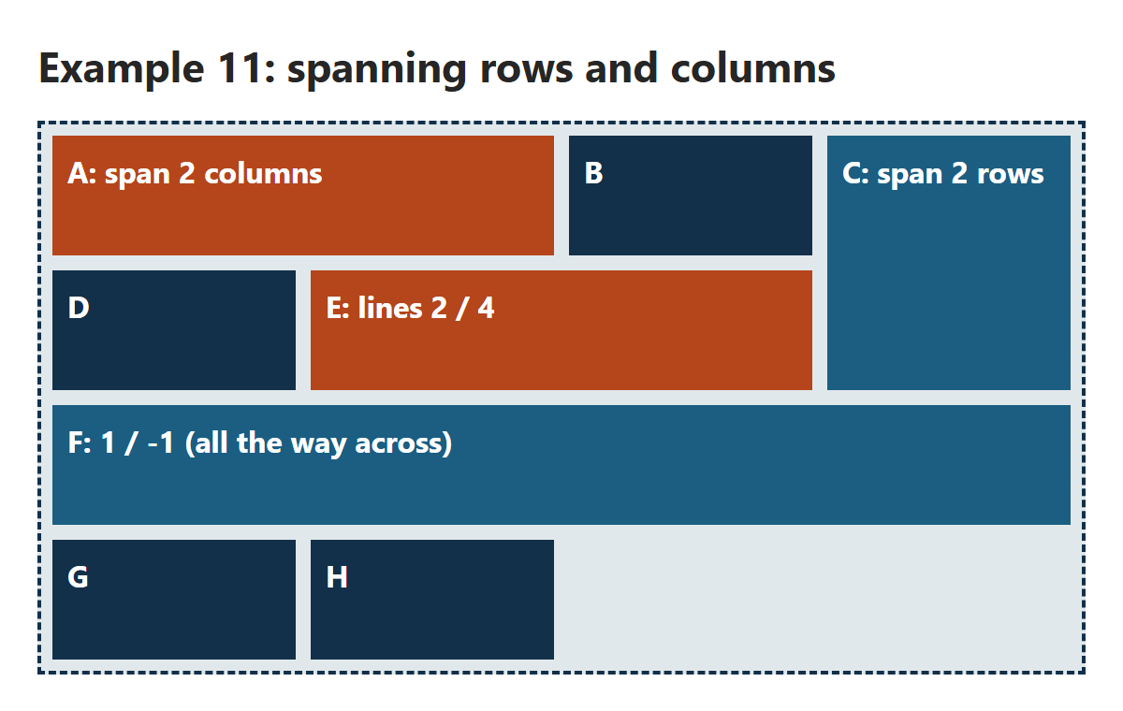
GRID 2 · EXAMPLE 11
/* Four columns. Every row is 64px tall */
.grid {
display: grid;
grid-template-columns: repeat(4, 1fr);
grid-auto-rows: 64px;
gap: 8px;
background-color: #E1E8EB;
border: 2px dashed #12304A;
padding: 6px;
}
.item {
padding: 8px;
background-color: #12304A;
color: white;
font-weight: bold;
}
/* span 2 = two tracks, from wherever it lands */
.a {
grid-column: span 2;
background-color: #B5451B;
}
.c {
grid-row: span 2;
background-color: #1B5E82;
}
/* LINES, not columns: line 2 to 4 = two columns */
.e {
grid-column: 2 / 4;
background-color: #B5451B;
}
/* -1 is the last line, so 1 / -1 is the full width */
.f {
grid-column: 1 / -1;
background-color: #1B5E82;
}
Spanning Rows and Columns
​span 2 = two tracks wide (or tall), from wherever the item lands.
​2 / 4 = from line 2 to line 4. 1 / -1 = the whole width.
RESULT
11_grid_span_example.css
Notes:
Open 11_grid_span_example.html.
Two ways to make an item bigger:
- span: 'take up 2 columns (or rows), starting wherever you'd normally go'. A and C.
- line numbers: 'start at line 2 and end at line 4'. E. Notice the grid fills in around it: D slots into column 1 of row 2, before E.
-1 means the last line, counting from the end. So grid-column: 1 / -1 is the full width, however many columns there are. Very handy for a heading or a banner across a grid (F).
C spans two rows, so the grid flows the other items around it. That's two dimensions at once, something flexbox can't do.
Try it live: change A to span 3 and watch the others move to make room.

Slide 14
?
POP QUIZ 2
​An item has grid-column: 1 / 3. How many columns wide is it?
​1
​2
A
B
​3
​All of them
C
D
Vote: hold up 1, 2, 3 or 4 fingers (A to D), or type your letter in the Teams chat. 30 seconds!
Notes:
THE classic grid trap. Expect a lot of 3s.

Slide 15
?
POP QUIZ 2: ANSWER
​An item has grid-column: 1 / 3. How many columns wide is it?
​1
​2
A
✓
​3
​All of them
C
D
Why?
​The numbers are LINES, not columns. Line 1 is the left edge of column 1.
​From line 1 to line 3 crosses 2 columns.
​The same as grid-column: span 2, when the item starts in column 1.
Notes:
Answer: B, 2 columns.
Go back to the Key Ideas diagram if people are unsure: lines are the edges, numbered from 1, and a 3-column grid has 4 lines.
It's also the first game mechanic in Grid Garden, later today.

Slide 16
PREDICT THE LAYOUT
/* Two columns. Items fill the next free cell */
.grid-container {
display: grid;
grid-template-columns: 1fr 3fr;
grid-template-rows: auto;
gap: 10px; /* older code calls this grid-gap */
}
/* Lines 1 to 3: both columns */
header, footer {
grid-column: 1 / 3;
}
/* Flexbox inside a grid item: the links stacked */
nav {
display: flex;
flex-direction: column;
gap: 6px;
}
<div class="grid-container">
<header>Header</header>
<nav>…</nav>
<main>Main Content</main>
<aside>Sidebar</aside>
<footer>Footer</footer>
</div>
Where Does the Sidebar Go?
​The "Practical Example" from last year's slides: two columns, five items.
​Where do the nav, main, aside and footer land? Sketch it!
YOUR PREDICTION
?
Sketch it on paper first
12_grid_layout_example.css
Notes:
This is the code from the Practical Example slide in the original Week 8 deck, word for word (gap was grid-gap). Ask students to sketch where each part ends up. Most people expect a nice three-part layout with the sidebar on the right.
Give them a minute, have a couple of people describe their sketch, then show the answer.

Slide 17
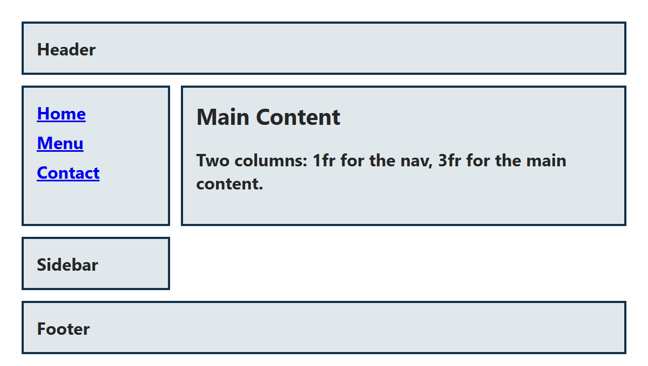
PREDICT THE LAYOUT: ANSWER
/* Two columns. Items fill the next free cell */
.grid-container {
display: grid;
grid-template-columns: 1fr 3fr;
grid-template-rows: auto;
gap: 10px; /* older code calls this grid-gap */
}
/* Lines 1 to 3: both columns */
header, footer {
grid-column: 1 / 3;
}
/* Flexbox inside a grid item: the links stacked */
nav {
display: flex;
flex-direction: column;
gap: 6px;
}
<div class="grid-container">
<header>Header</header>
<nav>…</nav>
<main>Main Content</main>
<aside>Sidebar</aside>
<footer>Footer</footer>
</div>
Where Does the Sidebar Go?
​Items fill the grid in order, one free cell at a time.
​Nav and main fill row 2, so the aside starts row 3, in column 1.
​The fix: name the areas (next).
WHAT THE BROWSER DOES
12_grid_layout_example.css
Notes:
The sidebar ends up on its own row, under the nav, with an empty space beside it.
Why: the grid has 2 columns. The header spans both (1 / 3). Nav and main fill the two cells of row 2. The aside is next in the HTML, so it goes in the next free cell: row 3, column 1. Then the footer spans both columns in row 4.
This is auto-placement: without instructions, grid items go into the next free cell, in HTML order. The fix is to tell each part where to go. The neatest way is named areas: Example 13.
Open 12_grid_layout_example.html to see it in the browser.

Slide 18
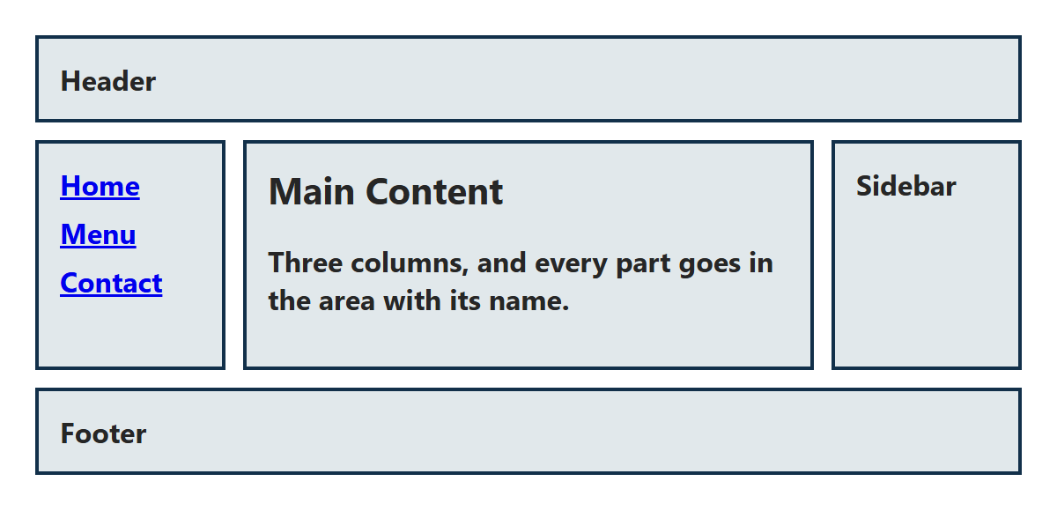
GRID 3 · EXAMPLE 13
Named Areas
/* 1. Draw the layout: one string per row */
.grid-container {
display: grid;
grid-template-columns: 1fr 3fr 1fr;
grid-template-areas:
"header header header"
"nav main aside"
"footer footer footer";
gap: 10px;
}
/* 2. Put each part in its area */
header { grid-area: header; }
nav { grid-area: nav; }
main { grid-area: main; }
aside { grid-area: aside; }
footer { grid-area: footer; }
​grid-template-areas: draw the layout with names, one string per row.
​grid-area: main puts main in the area called main.
​Same HTML as Example 12. Only the CSS changed.
RESULT
13_grid_areas_example.css
Notes:
Open 13_grid_areas_example.html beside Example 12. The HTML is identical.
grid-template-areas is like drawing the layout in your CSS file. Each string is a row; each word is a column. Writing a name twice (header header header) makes that area span those cells. The extra spaces in 'nav main aside' are just to line the words up for us humans.
Then each element is placed with grid-area and its name. The names are made up by you: they don't have to match the element names, but it's easier if they do.
The rules: every row needs the same number of words, and each area has to be a rectangle (no L shapes). Use a . for an empty cell.
This is how most real page layouts are done today, and it makes the phone layout (Example 17) easy: just redraw the areas.

Slide 19
?
SPOT THE BUG
​The main content ends up in a strange spot, outside the layout. Why?
​The rows need commas between them
A
.page {
display: grid;
grid-template-columns: 1fr 3fr;
grid-template-areas:
"header header"
"nav main"
"footer footer";
}
header { grid-area: header; }
nav { grid-area: nav; }
main { grid-area: content; }
footer { grid-area: footer; }
​content doesn't match any name in the template
B
​The template needs a third column
C
​main can't be a grid item
D
Vote: hold up 1, 2, 3 or 4 fingers (A to D), or type your letter in the Teams chat. 30 seconds!
Notes:
Spot the bug: give them 45 seconds to read the code.

Slide 20
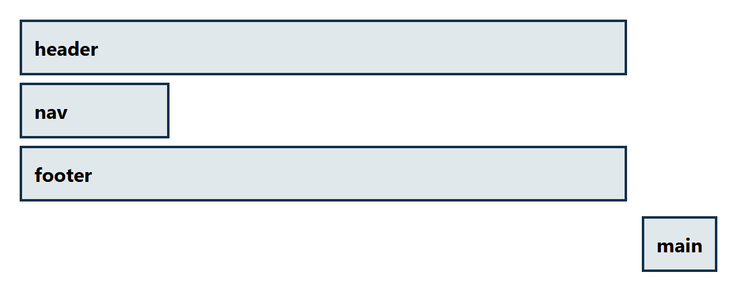
?
SPOT THE BUG: ANSWER
​The main content ends up in a strange spot, outside the layout. Why?
WHAT THE BROWSER DOES
A
​The rows need commas between them
✓
​content doesn't match any name in the template
C
​The template needs a third column
D
​main can't be a grid item
Why?
​You make up the area names, and they have to match exactly.
​There's no area called content, so the browser adds an extra row and column and puts main there.
​Fix: grid-area: main; (or rename the area in the template).
Notes:
Answer: B.
The screenshot is what the browser does: it can't find an area called content, so it puts main in a new row and column after the ones you drew, bottom right, and the empty 'main' cell is left blank.
No error message, of course. DevTools helps here: in the Elements panel, click the 'grid' badge next to the container and the browser draws the grid lines and area names over the page.

Slide 21
Try It 5: A Page Layout with Grid (8 min)
1
Open your Harbourside page
IN STYLE.CSS
​From last class, with Live Server.
main {
max-width: 1100px;
display: grid;
grid-template-columns: 2fr 1fr;
grid-template-areas:
"intro intro"
"menu hours";
gap: 24px;
align-items: start;
}
.intro { grid-area: intro; }
#menu { grid-area: menu; }
#hours { grid-area: hours; }
2
Type the CSS on the right
​In style.css, under Try It 5. Save.
3
Two columns!
​Menu on the left, hours on the right. Make the window wide to see it.
4
Look at the menu cards…
​Something odd happened to one of them. Don't fix it yet!
​align-items: start stops the hours box stretching as tall as the menu.
Notes:
main becomes a grid with two columns (2fr and 1fr) and three named areas. The intro spans both columns; the menu and the hours sit side by side underneath.
max-width goes up from 900px to 1100px so there's room for two columns.
align-items: start: grid items stretch to the height of their row by default (like flex items). Without this, the grey hours box would be as tall as the whole menu column. Try taking it out.
The odd thing: the menu column is narrower now, so only three cards fit on a line, and the Kids card is alone on the second line, stretched all the way across. Next slide.

Slide 22
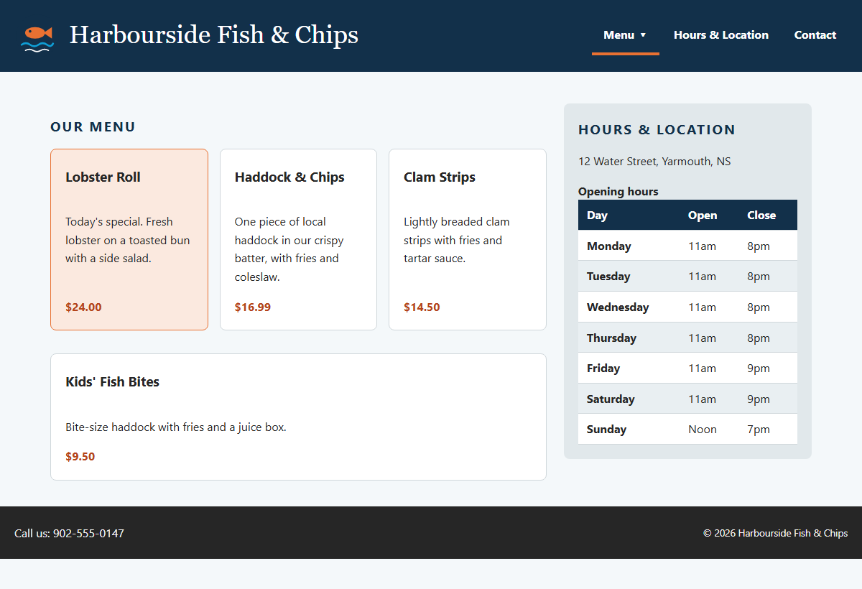
Pause and Think: What Happened to the Kids Card?
AFTER TRY IT 5
Why so wide?
​The menu column is narrower now: only three cards fit on a line.
​Flexbox sizes each line on its own. The Kids card is alone on line 2...
​...and flex: 1 1 180px says "grow to fill the line". So it does.
​We want columns that line up on every row. That's a grid!
Notes:
Ask the class first: why is the Kids card so wide? Give them a minute with a neighbour.
The explanation: the menu column is narrower now (two thirds of the page), so only three 180px cards fit on a line. The Kids card wraps onto a line of its own. Flexbox sizes each line separately, and flex: 1 1 180px says 'grow to fill the line', so it grows to fill the whole line.
That's flexbox being one-dimensional (the warm-up quiz). The fix is to use a two-dimensional tool for the cards: a grid, where every row uses the same columns. That's Try It 6, and it's only two lines.

Slide 23
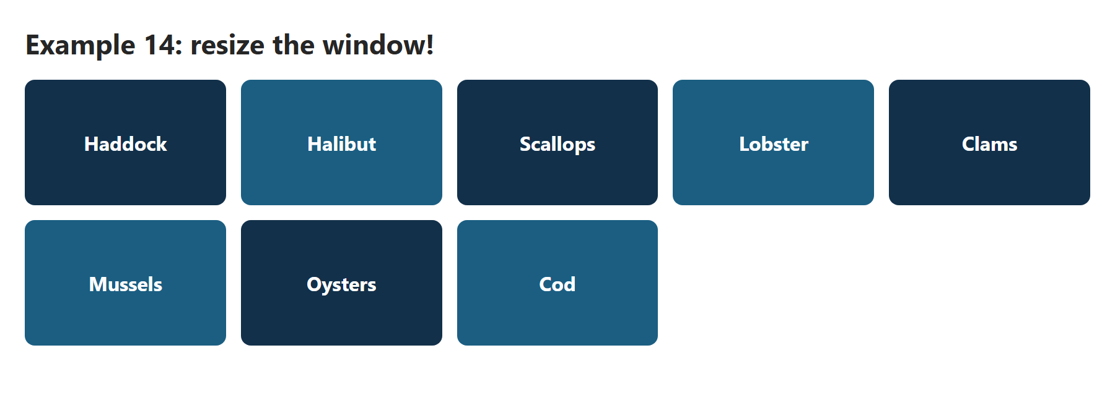
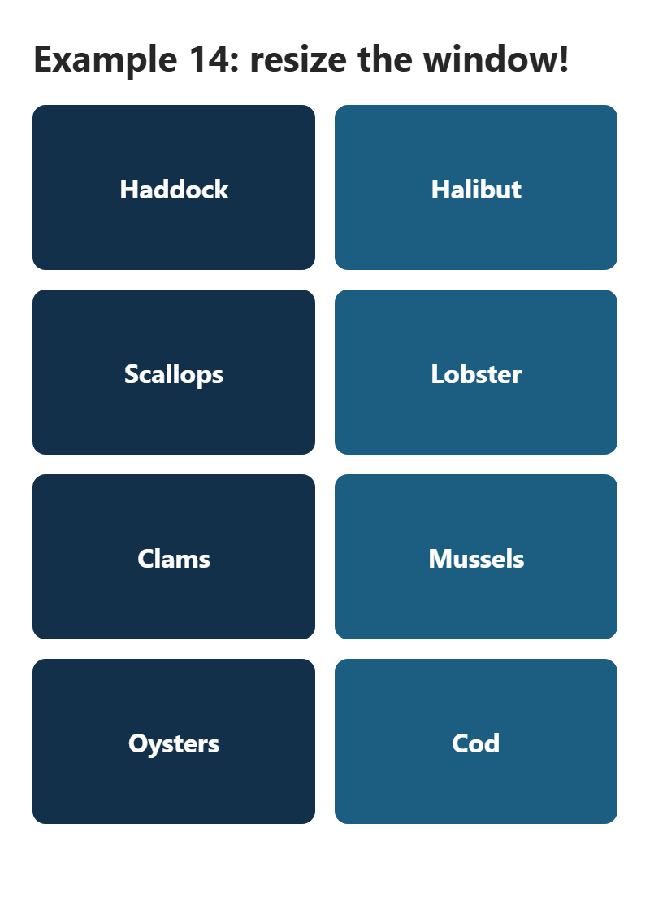
GRID 4 · EXAMPLE 14
auto-fit: No Media Query Needed
/* As many 160px+ columns as fit.
The browser does the maths */
.gallery {
display: grid;
grid-template-columns: repeat(auto-fit, minmax(160px, 1fr));
gap: 12px;
}
.tile {
padding: 40px 10px;
border-radius: 8px;
background-color: #12304A;
color: white;
font-weight: bold;
text-align: center;
}
/* Every second tile a different blue (a Class 9 selector) */
.tile:nth-child(even) {
background-color: #1B5E82;
}
​minmax(160px, 1fr): every column is at least 160px, and they share any spare space.
​auto-fit: as many columns as fit. The browser does the maths.
900PX WIDE: FIVE COLUMNS
400PX: TWO
14_grid_auto_fit_example.css
Notes:
Open 14_grid_auto_fit_example.html and resize the window slowly. The columns drop from five to four to three to two to one, and every tile in every row stays lined up.
Read the line from the inside out:
- minmax(160px, 1fr): a column can't be narrower than 160px, and can grow to a 1fr share.
- repeat(auto-fit, ...): make as many of those columns as fit in the width.
Compare with Example 09 (flexbox cards): there, a card alone on the last line stretched across. Here, every row has the same columns, so the last row's tiles stay the same size. This one line is probably the most useful thing in today's class.
(auto-fill is almost the same: the difference only shows when there are fewer items than columns. auto-fit stretches the items to fill the row; auto-fill keeps empty columns.)

Slide 24
?
POP QUIZ 3
​repeat(auto-fit, minmax(200px, 1fr)) in a grid 700px wide, with no gap. How many columns?
​2
​3
A
B
​4
​7
C
D
Vote: hold up 1, 2, 3 or 4 fingers (A to D), or type your letter in the Teams chat. 30 seconds!
Notes:
More maths, but easy maths. 4 (C) is what you get by rounding 3.5 up.

Slide 25
?
POP QUIZ 3: ANSWER
​repeat(auto-fit, minmax(200px, 1fr)) in a grid 700px wide, with no gap. How many columns?
​2
​3
A
✓
​4
​7
C
D
Why?
​How many 200px columns fit in 700px? Three (3 × 200 = 600). A fourth would need 800px.
​Then 1fr shares out the spare 100px: three columns of about 233px.
​Make the window 800px or wider and a fourth column appears.
Notes:
Answer: B, 3 columns.
With a gap, there's a little less room: three 200px columns and two 16px gaps need 632px, still fine in 700px. The browser always does this sum for you, every time the window changes size.

Slide 26
Try It 6: Menu Cards with Grid (5 min)
1
Type the CSS on the right
IN STYLE.CSS
​Under Try It 6. Save.
.cards {
display: grid;
grid-template-columns:
repeat(auto-fit, minmax(180px, 1fr));
}
2
The Kids card is fixed
​It stays in the first column, the same width as the others.
3
Still lined up?
​The prices still line up, and the special is still first: order works in grid too.
4
Make the window narrow
​3, 2, then 1 column. No media query.
​Try It 2's flex: 1 1 180px is now ignored: grid items are sized by the grid, not by flex.
Notes:
Two lines replace the flexbox from Try It 2. The later .cards rule wins for display (grid beats flex because it comes later), and gap: 16px from Try It 2 still applies, because gap works in both.
Now every row uses the same three columns, so the Kids card sits in column 1 at the same width as the others.
What still works from Class 1:
- Try It 3: each card is still a column flexbox with the price at the bottom. Grid items stretch to the height of their row, like flex items.
- Try It 4: order: -1 still puts the special first. order works on grid items too.
The flex: 1 1 180px line from Try It 2 is now ignored, because the articles aren't flex items any more. Students can leave it or delete it.

Slide 27
+
Float
•
○
+
Text around a photo · the clearfix · the old way to make columns
•
○
Notes:
Float is the oldest of the three. It was made for one job: letting text flow around an image, like in a newspaper or a magazine. In the 2000s and early 2010s, people also used it to build whole page layouts, because there wasn't anything better. That took a lot of hacks.
Today, use grid and flexbox for layout, and float for its original job. But you'll still meet floats in older code, so it's worth knowing how they behave.

Slide 28
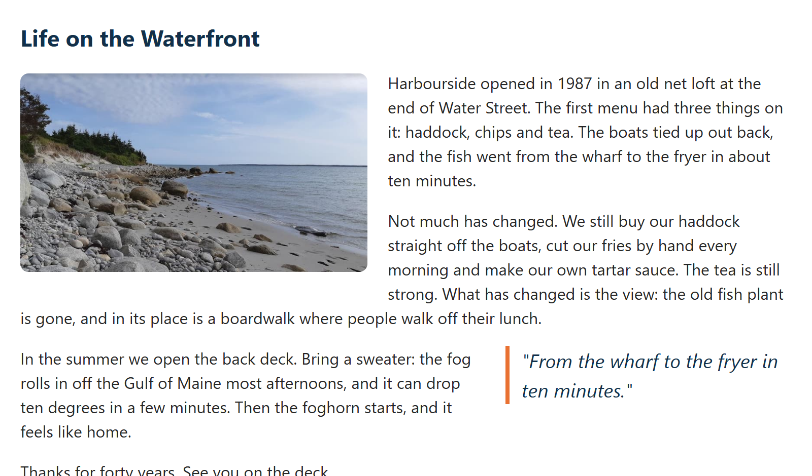
FLOAT 1 · EXAMPLE 15
Wrapping Text Around a Photo
/* 1. Photo on the left, text flows around it */
.photo {
float: left;
width: 45%;
height: auto;
margin: 4px 20px 10px 0;
border-radius: 8px;
}
/* 2. A pull quote floats to the right */
.pull-quote {
float: right;
width: 35%;
margin: 0 0 10px 20px;
padding-left: 12px;
border-left: 4px solid #E97132;
color: #12304A;
font-size: 1.2rem;
font-style: italic;
}
​float: left: the photo moves to the left, and the text flows around its right side.
​Give it a width and a margin on the side the text is on.
RESULT
15_float_text_wrap_example.css
Notes:
Open 15_float_text_wrap_example.html and resize the window.
The photo floats to the left of its paragraph; the text wraps around it, and when the text gets below the photo it goes back to full width. That's the one thing flexbox and grid can't do: they put things side by side in boxes, they don't wrap text around things.
The pull quote floats to the right, the same way. Pull quotes are a magazine idea: a short, eye-catching quote from the article.
The margins matter: margin-right on the left-floated photo (and margin-left on the right-floated quote) keeps the text from touching them.
Width as a percentage keeps it responsive: the photo is always 45% of the article.

Slide 29
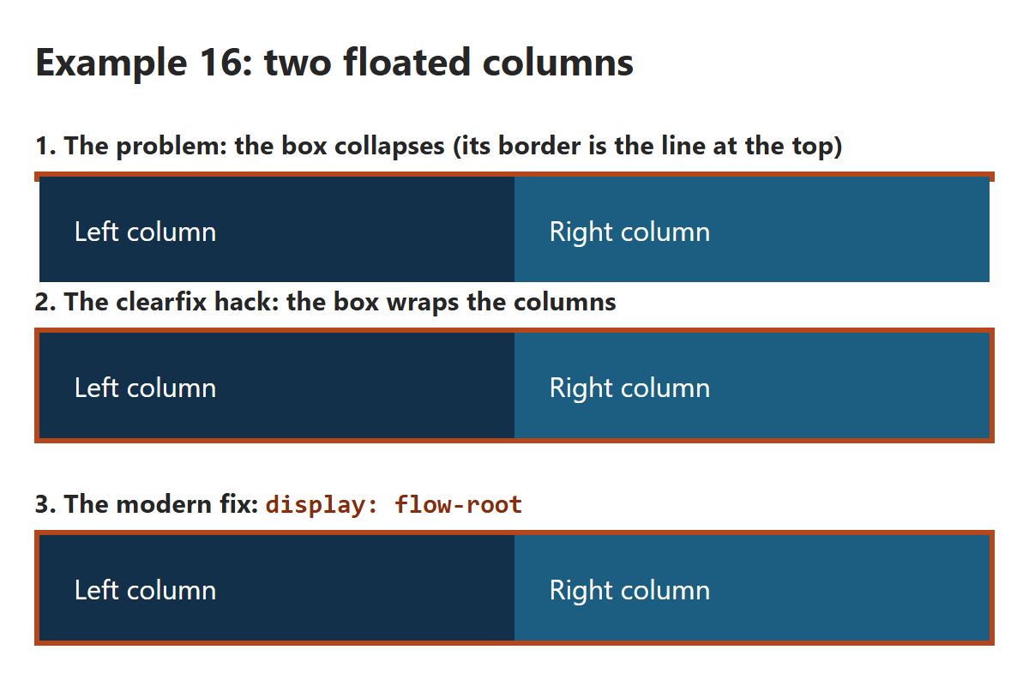
FLOAT 2 · EXAMPLE 16
/* 1. The old way to make columns: float them */
.float-left {
float: left;
width: 50%;
padding: 20px;
background-color: #12304A;
color: white;
}
.float-right {
float: right;
width: 50%;
padding: 20px;
background-color: #1B5E82;
color: white;
}
/* 2. The clearfix: an empty last child, below both floats */
.clearfix::after {
content: "";
clear: both;
display: table;
}
/* 3. One line does the same job today */
.flow-root {
display: flow-root;
}
Floats and the Clearfix
​Floats don't count towards their parent's height. Only floats inside? The box collapses.
​The clearfix hack, or today's one-liner: display: flow-root.
RESULT
16_float_clearfix_example.css
Notes:
Open 16_float_clearfix_example.html. This is the 'Float for layouts' and 'Clearfix hack' code from the original deck, side by side.
Demo 1: two floated 50% columns inside a box with an orange border. The box has nothing else inside, and floats are taken out of the normal flow, so the box has a height of 0. Its border is the thin orange line at the top, and the columns hang out below it. The next heading even tries to wrap around them.
Demo 2: the clearfix. ::after adds an empty element at the end of the box (a pseudo-element from Class 9), and clear: both makes it go below both floats. The box has to stretch down to hold it, so it wraps the columns. You'll see this in a lot of older code.
Demo 3: display: flow-root does the same job in one line, with no hack. Use this one.
And the third option: don't use floats for columns at all. Two columns are one line of grid or flexbox, and those containers always wrap their items.
box-sizing: border-box at the top: without it, 50% plus the padding is more than half, and the right column drops below the left one.

Slide 30
?
POP QUIZ 4
​A div holds two floated columns and nothing else. Its border shows up as a thin line above them. Why?
​The border needs a width
​Floats are taken out of the normal flow, so the div thinks it's empty
A
B
​The floats need a z-index
​The columns need display: block
C
D
Vote: hold up 1, 2, 3 or 4 fingers (A to D), or type your letter in the Teams chat. 30 seconds!
Notes:
Straight after Example 16, so this should go well. It checks that students know WHY the clearfix is needed, not just what it is.

Slide 31
?
POP QUIZ 4: ANSWER
​A div holds two floated columns and nothing else. Its border shows up as a thin line above them. Why?
​The border needs a width
​Floats are taken out of the normal flow, so the div thinks it's empty
A
✓
​The floats need a z-index
​The columns need display: block
C
D
Why?
​A floated element doesn't add to its parent's height. Only floats inside = a height of 0.
​Fix it with display: flow-root on the parent (or the older clearfix hack).
​Flex and grid containers don't have this problem: they always wrap their items.
Notes:
Answer: B.
This is the number one reason people moved from floats to flexbox and grid for layout. And floats don't mix with them: float: left on a flex or grid item does nothing at all.

Slide 32
Try It 7: Float the Photo (5 min)
1
Type the CSS on the right
IN STYLE.CSS
​Under Try It 7. Save.
.intro figure {
float: right;
width: 45%;
margin: 0 0 12px 20px;
}
2
The text wraps
​The intro paragraphs flow around the left side of the photo.
3
Play with it
​Try float: left (and swap the margins). Or change the width to 30%.
​No clearfix needed: a grid item always wraps its own floats. On a page with no grid, you'd add display: flow-root.
Notes:
The photo in the intro floats right, at 45% of the intro's width, and the paragraphs wrap around it.
The figure is floated, not the img, so the caption goes with the photo.
Why no collapsing box, after all that? The intro section is a grid item (Try It 5), and a grid item always contains its own floats. If the text is shorter than the photo, the section just grows to fit the photo.
If you swap to float: left, swap the margin too: margin: 0 20px 12px 0, so the space is on the right, where the text is.

Slide 33
Week 8: Responsive Web Design
Grid, Flexbox or Float?
Flexbox
Grid
Float
One dimension: a row OR a column
Two dimensions: rows AND columns
Text wraps around it
Use for: Nav bars, buttons, centring, the inside of a card
Use for: Page layouts, galleries, card grids
Use for: A photo in an article. Old layouts
​They work together: grid for the page, flexbox inside its parts, float for a photo in the text.
​Don't mix float with flex or grid on the same items: floats are ignored on flex and grid items.
Notes:
This is the comparison from the original deck (Comparing CSS Grid, Flexbox and Float, and the Flexbox and Grid advantages slide), as one picture.
Flexbox: one dimension. Great for a row of things that share out space: nav bars, toolbars, buttons, the inside of a card, and centring.
Grid: two dimensions. Great when things need to line up in rows AND columns: page layouts, galleries, card grids, forms.
Float: text wrapping around something. And legacy code.
They're not rivals: real pages use all three. Example 17 is grid for the page, flexbox for the nav, and float for the photo.
One rule from the best practices: don't mix float with flex or grid on the same items. Floats are ignored on flex and grid items, which is confusing to debug.
Positioning (position: absolute) is the fourth tool, from the dropdown menu last week. It's for things that sit on top of the page (dropdowns, badges, pop-ups), not for layout: absolute elements don't take up space, so they don't adapt to the screen.

Slide 34
Game: Grid, Flexbox or Float? (5 min)
Grid
Flexbox
Float
1
Logo on the left, links on the right, in a header
2
A whole page: header, sidebar, main and footer
3
Text that wraps around a photo in an article
Grid? Flexbox? Float?
Grid? Flexbox? Float?
Grid? Flexbox? Float?
4
A photo gallery where the columns line up
5
A message in the exact middle of a box
6
Each card's button at the bottom of the card
Grid? Flexbox? Float?
Grid? Flexbox? Float?
Grid? Flexbox? Float?
Notes:
Teams of 2 or 3. For each job, pick the best tool: Grid, Flexbox or Float. Write down six answers (1 to 6), or post them in the Teams chat. 3 minutes, then the answers are on the next slide. One point each.
Answers:
1. Flexbox
2. Grid
3. Float
4. Grid
5. Flexbox (grid also works: display: grid; place-items: center. Give the point.)
6. Flexbox

Slide 35
Grid, Flexbox or Float: Answers
1
Logo on the left, links on the right, in a header
2
A whole page: header, sidebar, main and footer
3
Text that wraps around a photo in an article
Flexbox
Grid
Float
One row: space-between, or margin-left: auto.
Rows and columns together: grid-template-areas.
The one job float is still the best at.
4
A photo gallery where the columns line up
5
A message in the exact middle of a box
6
Each card's button at the bottom of the card
Grid
Flexbox
Flexbox
Every row has the same columns: repeat(auto-fit, …).
justify-content + align-items: center. (Grid can too.)
A column flexbox + margin-top: auto.
Notes:
Go through them and accept a good argument for another answer. Number 5 especially: grid's place-items: center centres too. And a header could be a grid with two columns (1fr auto), though flexbox is more usual.
The rule of thumb: one direction → flexbox. Two directions, or things that must line up → grid. Text wrapping → float.

Slide 36
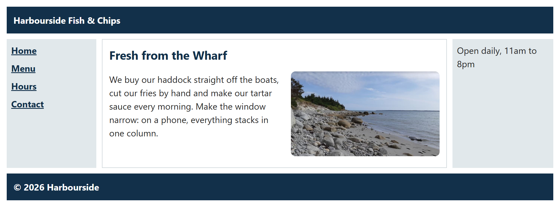
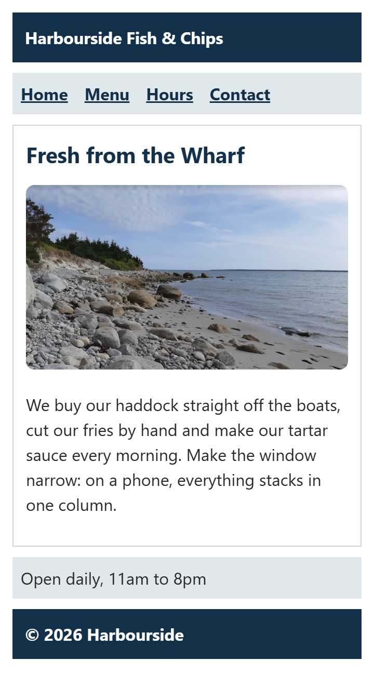
LAYOUT · EXAMPLE 17
/* 1. Phones first: one column, in reading order */
.page {
display: grid;
gap: 10px;
grid-template-areas:
"header"
"nav"
"main"
"aside"
"footer";
}
/* 3. Wider than 700px: three columns, links stacked, photo floated */
@media (min-width: 700px) {
.page {
grid-template-columns: 160px 1fr 180px;
grid-template-areas:
"header header header"
"nav main aside"
"footer footer footer";
}
nav ul {
flex-direction: column;
}
.photo {
float: right;
width: 45%;
margin: 0 0 8px 16px;
}
}
A Layout for Every Screen
​Phones first: one column. Then @media (min-width: 700px) redraws the grid.
​Grid for the page, flexbox for the links, float for the photo.
WIDE
A PHONE (360PX)
17_responsive_layout_example.css
Notes:
Open 17_responsive_layout_example.html and make the window narrow, then wide. At 700px the whole layout changes.
A media query is a set of rules that only apply when a condition is true. @media (min-width: 700px) { ... } means 'only when the window is at least 700px wide'.
The idea is 'mobile first': write the simple one-column layout for phones first, then add the extra columns for bigger screens. Inside the media query, the grid gets three columns and new areas, the links turn into a column, and the photo floats.
The HTML never changes: only the CSS. That's the point of keeping them separate.
This is the start of responsive design, which is next class's topic: more about media queries, breakpoints and images.
The code is long, so it's in a small font: students should open the .css file to read it properly.

Slide 37
Try It 8: On a Phone (8 min)
1
Type the CSS on the right
IN STYLE.CSS
​At the very end of style.css, under Try It 8. Save.
@media (max-width: 700px) {
main {
grid-template-columns: 1fr;
grid-template-areas: "intro" "menu" "hours";
}
.intro figure {
float: none;
width: auto;
margin: 0 0 16px;
}
header h1 {
font-size: 1.6rem;
}
nav ul {
flex-wrap: wrap;
}
}
2
Be a phone
​F12, then Ctrl + Shift + M. Pick a phone, or drag to 360px.
3
One column
​Intro, menu, hours stack up. The photo stops floating.
4
Take your two screenshots
​One full width, one phone-sized. Then submit!
​Why last? If two rules tie, the later one wins. A media query doesn't make a rule stronger.
Notes:
This one uses max-width instead of Example 17's min-width: the page is already built for wide screens, so we add rules for narrow ones. Both are fine; next class covers the difference properly.
Inside the media query, at 700px wide or less:
- main goes back to one column, with the three areas stacked.
- The photo stops floating and goes full width (width: auto).
- The big h1 gets smaller, so 'Harbourside Fish & Chips' fits.
- The nav links wrap as whole links instead of squashing.
Why it has to be last in the file: the media query's rules have the same specificity as the rules they replace (main, .intro figure ...). If two rules tie, the later one wins. If the media query were above Try It 5, Try It 5's rules would win, even on a phone. A media query doesn't add any specificity.
The DevTools device toolbar (Ctrl + Shift + M) is the easiest way to test. Pick 'iPhone SE' or similar, or drag the width.

Slide 38
Week 8: Responsive Web Design
Best Practices for Layout
Consistency:
  The same layout on every page, from one shared stylesheet.
Responsiveness:
  Check every page at phone width (Ctrl + Shift + M). Media queries do the rest.
One job, one tool:
  Flexbox in one direction, grid in two, float for text wrapping. Don't mix float with flex or grid on the same items.
Comments:
  Say what each layout rule is for: /* Two columns: menu and hours */
Separate files:
  HTML for the content, an external stylesheet for the look.
Notes:
From the original deck's Best Practices slide, with a little more detail.
Consistency: the same layout (header, nav, footer) on every page, from one shared stylesheet. That's Assignment 2's lesson.
Responsiveness: always check at phone width (360px) in the device toolbar. A layout that only works on your laptop isn't finished.
The right tool: flexbox for one direction, grid for two, float only for wrapping text. Don't put float on flex or grid items: it's ignored.
Comments: a short comment above each layout rule ('Two columns: menu and hours') saves a lot of time later, for you and your teammates. Every example this week has them.
And separate files: HTML for content, one CSS file for the look. Every example this week does that.

Slide 39
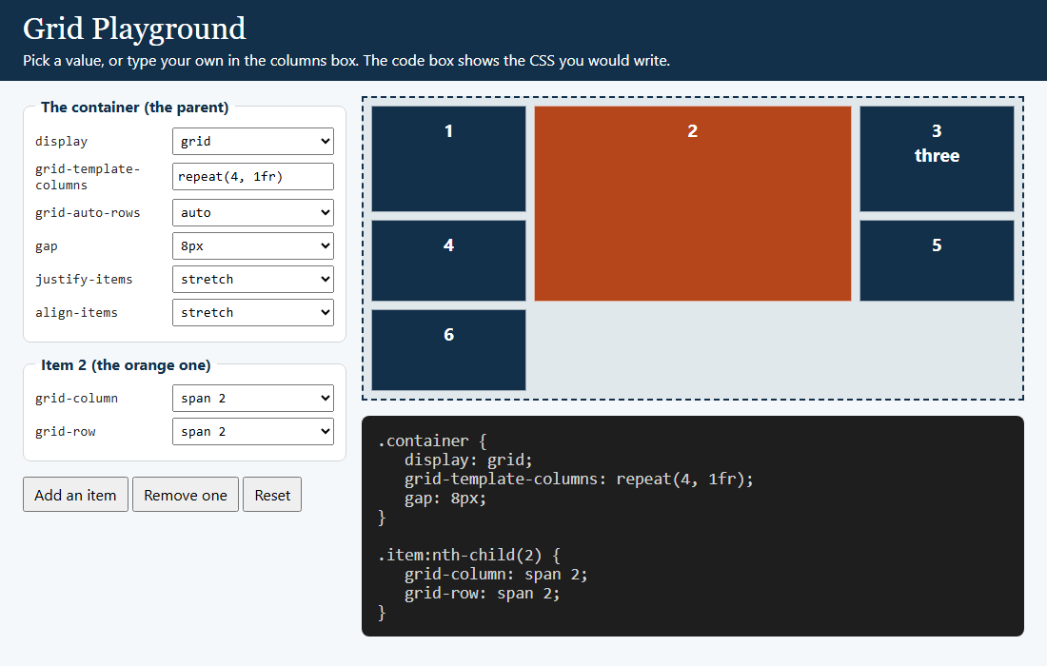
Your Turn to Drive: The Grid Playground
OPEN PLAYGROUND/GRID_PLAYGROUND.HTML
Can you…
1
​Make four equal columns.
2
​Make box 2 go all the way across.
3
​Make box 2 two rows tall, and two columns wide.
4
​Type your own columns: try 100px 1fr 100px. What happens when you resize?
Notes:
If there's time before work time, do this with the class driving (or let students try it themselves).
Answers:
1. grid-template-columns: repeat(4, 1fr).
2. Item 2: grid-column: 1 / -1.
3. Item 2: grid-column: span 2 and grid-row: span 2 (the screenshot shows this, with repeat(4, 1fr)).
4. The two 100px columns stay the same and the middle one stretches: the classic 'sidebars and content' layout.
The columns box is a text box, so anything goes: try repeat(auto-fit, minmax(150px, 1fr)) and resize the window, or a typo, to see that the browser just ignores a value it doesn't understand.

Slide 40
Game Time: Grid Garden (10 min)
Grid Garden
It's today's CSS
In the game | What it does
grid-column-start | The line a patch starts on
grid-column-end | The line it ends on
grid-column: 2 / 4 | Both at once
span 2 | Two tracks wide
grid-row | The same, for rows
grid-area | Rows and columns in one line
https://cssgridgarden.com/
Water the garden: get as far as you can in 10 minutes.
​Write CSS to water the right patch of the garden (and nothing else).
​It starts with grid-column-start and grid-column-end, then grid-column, grid-row and grid-area.
​Line numbers count from 1, and negative numbers count from the end: just like Example 11.
Notes:
Grid Garden is Flexbox Froggy's sibling, from the same people (Codepip). Free, no sign-up. Each level is a garden with a patch to water; you write grid placement CSS to cover exactly that patch.
The early levels are all about line numbers: a great follow-up to Pop Quiz 3 (grid-column: 1 / 3 is two columns, not three).
If time is short, make it homework and go straight to work time.

Slide 41
Work Time: W3Schools Grid (15 min)
What to do
W3Schools tutorials
1
Open a page on the right
CSS Grid Layout Module
​Read it, top to bottom.
https://www.w3schools.com/css/css_grid.asp
2
Click every "Try it Yourself »"
CSS Grid Container
​The code opens beside the result.
https://www.w3schools.com/css/css_grid_container.asp
3
Change something, then Run
​A different value, a new property, more boxes.
CSS Grid Item
https://www.w3schools.com/css/css_grid_item.asp
4
Screenshot it
​Code and result both showing: Win + Shift + S.
Submit at least 5 screenshots (both classes together) to Brightspace.
Notes:
Same as last class, now with the Grid pages: read each page, open the 'Try it Yourself' examples, change something, Run, and screenshot the code and the result.
Students need at least 5 screenshots in total across both classes (flexbox and grid together).
Good ones to change: the grid-template-columns values, gap, and the grid-column / grid-row of one item.

Slide 42
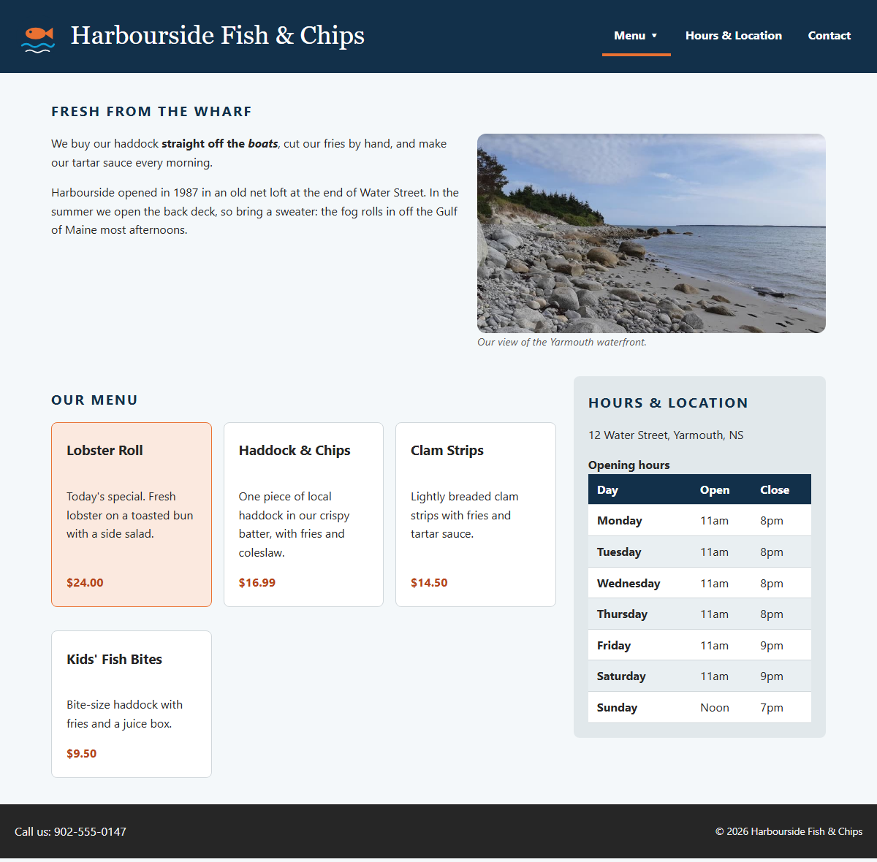
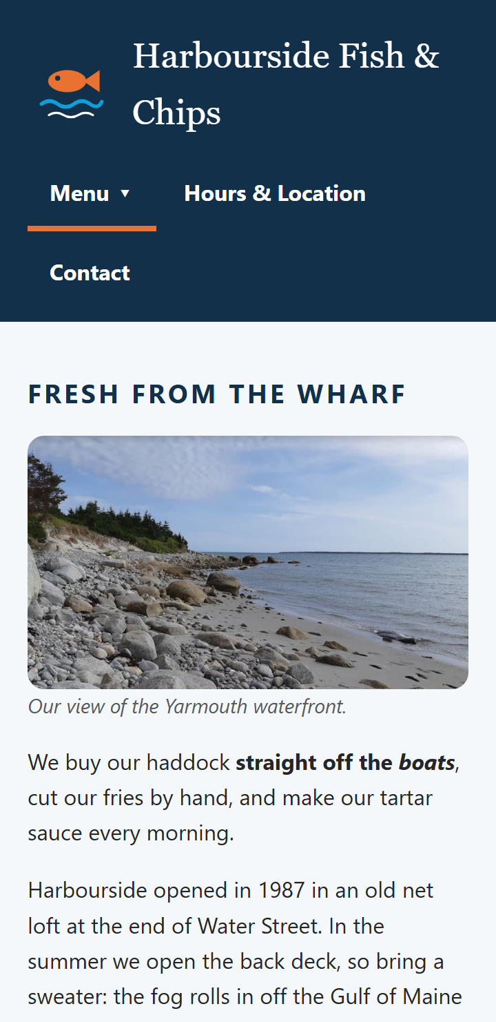
Submit: Harbourside, Part 3 and Your W3Schools Screenshots
1. FULL WIDTH
2. PHONE
On Brightspace
1. Harbourside, full width
2. Harbourside, phone width (Ctrl + Shift + M)
3. 5+ W3Schools "Try it Yourself" screenshots, with your changes
Win + Shift + S takes a screenshot.
Stuck? activity/answer/
Notes:
Everything from both classes goes on Brightspace in one submission (participation):
1. A screenshot of the finished Harbourside page at full width.
2. A screenshot at phone width (the device toolbar, Ctrl + Shift + M).
3. At least five W3Schools 'Try it Yourself' screenshots, each one with code the student changed.
The Harbourside screenshots are this week's version of the original deck's class activity ('create a web page layout using CSS Grid or Flexbox, and experiment with float'): the page uses all three.
Students who finish early: the 'Make it yours' ideas. A different auto-fit minimum (try 240px), a third column for the hours box on very wide screens, the intro photo floated left, or rounded corners on the hours table.

Slide 43
Week 8: Responsive Web Design
Assignment 3: Show Off Your Layout
Rubric row | For a 4 | Like this week's
HTML Structure | Semantic: header, nav, main, section, footer. Valid HTML. | Examples 12, 13, 17
CSS Usage | Flexbox or grid doing a real job: a nav, cards, a page layout | Ex 08, 09, 13, 14 · Try Its 1–6
Responsiveness | Wraps or reflows at 360px: auto-fit, flex-wrap, a media query, viewport meta | Ex 14, 17 · Try It 8
Code Quality | A comment on each layout rule, one external style.css, both validators | Every example
​Due Sunday, November 1, 11:59 pm · 10% · a ZIP with your HTML and CSS (and images) on Brightspace.
​Idea: a My Portfolio page with a card for each of your courses, in a repeat(auto-fit, minmax(200px, 1fr)) grid.
Notes:
Assignment 3 (10%, due Sunday, November 1 at 11:59 pm): a small page, written by hand (no WYSIWYG editor), that shows they can lay things out with Flexbox or Grid. A single page is fine. The suggestion is a 'My Portfolio' page that starts with the courses they're taking this term; they can reuse content from Assignment 2. Hand-in: the HTML and CSS in a ZIP on Brightspace.
The table maps each rubric row (all four are out of 4) to what we did this week:
- HTML Structure: semantic elements (header, nav, main, section or article, footer), like Examples 12, 13 and 17. Run the W3C validator (Class 11).
- CSS Usage: flexbox or grid doing a real layout job. A nav bar (Example 08), cards (09, 14) or a page layout (13). 'Effective' means the layout does something useful, not just display: flex on one div.
- Responsiveness: 'works well on all devices'. flex-wrap or auto-fit, images with max-width: 100%, the viewport meta tag (it's in every example's head), and ideally one media query (Example 17, Try It 8). Check it at 360px with Ctrl + Shift + M.
- Code Quality: a comment on each layout rule (like every example this week), one external style.css, and both validators.
A nice idea for the course list: one card per course in a repeat(auto-fit, minmax(200px, 1fr)) grid, with each card a column flexbox. That covers grid, flexbox and responsiveness in about 15 lines.

Slide 44
Week 8: Responsive Web Design
Cheat Sheet: Grid and Float
Code | What it does
display: grid | The parent becomes a grid container
grid-template-columns: 1fr 2fr | The columns (fr = a share of the space)
repeat(3, 1fr) | Three equal columns
repeat(auto-fit, minmax(200px, 1fr)) | As many columns as fit
grid-column: 1 / 3 or span 2 | Line 1 to line 3: two columns wide
grid-template-areas + grid-area | Draw the layout with names
float: left | right | Text wraps around the element
display: flow-root | The parent wraps its floats
@media (max-width: 700px) { … } | Rules for narrow screens only
Notes:
Everything from today in one place. It's in the README too.

Slide 45
Exit Ticket: Quick-fire Grid and Float (5 min)
1
Three equal columns
2
An item all the way across
3
Put main in the area called "main"
?
?
?
4
As many 200px columns as fit
5
Wrap text around a photo
6
Stop a box collapsing around floats
?
?
?
Notes:
Same as last class: teams of 2 or 3, 3 minutes, write the CSS for each job. One point per card.
Answers:
1. grid-template-columns: repeat(3, 1fr); (1fr 1fr 1fr is fine too)
2. grid-column: 1 / -1;
3. grid-area: main;
4. grid-template-columns: repeat(auto-fit, minmax(200px, 1fr));
5. float: left; (or right)
6. display: flow-root; (the clearfix is fine too)

Slide 46
Exit Ticket: Answers
1
Three equal columns
2
An item all the way across
3
Put main in the area called "main"
grid-template-columns: repeat(3, 1fr);
grid-column: 1 / -1;
grid-area: main;
4
As many 200px columns as fit
5
Wrap text around a photo
6
Stop a box collapsing around floats
repeat(auto-fit, minmax(200px, 1fr))
float: left;
display: flow-root;
Notes:
Go through them quickly and accept the alternatives in the notes on the previous slide.

Slide 47
Week 8: Responsive Web Design
Class 2 Recap and Next Steps
Recap:
  Grid is two-dimensional: you set the columns, the rows come as needed. fr shares out the space.
  Lines are numbered from 1: grid-column: 1 / 3 is two columns. Name areas to draw a layout.
  repeat(auto-fit, minmax(…)) makes a responsive grid with no media query.
  Float wraps text around a photo. A parent with only floats collapses: display: flow-root.
  Flexbox for one direction, grid for two, float for text. They work together.
This week:
  Submit the Harbourside screenshots (wide + phone) and 5+ W3Schools screenshots.
  Assignment 3 (10%): due Sunday, November 1 at 11:59 pm.
Next class:
  Advanced responsive design: media queries, breakpoints and images.
Notes:
Next class: advanced responsive design techniques. More media queries, breakpoints, mobile-first CSS, and responsive images. Example 17 and Try It 8 were a first taste.
Make sure the Harbourside screenshots (wide and phone) and the five or more W3Schools screenshots are on Brightspace.

