Slide 1

A LECTURE PRESENTATION
Acute Rheumatic Fever
& Rheumatic Heart Disease
PRESENTED BY
FACULTY OF DENTISTRY
Ibrahim Alshahrani
2110301
Khalid Baslom
1811030
Osama Alomari
2110316
Reference: Kumar P J. Clinical Medicine. 10th ed. W B Saunders; 2021. p. 544–545.

Slide 2

Definition & Overview
What is ARF?
2–4
WEEKS
Acute Rheumatic Fever (ARF) is an immune-mediated inflammatory disorder caused by Group A Streptococci, occurring 2–4 weeks after an upper respiratory tract infection (pharyngitis) or skin infection.
after strep infection
5–15
YEARS
Affects: heart • skin • joints • CNS
peak age affected
Key features:
Polyarthritis, chorea, or carditis (alone or combined)
Subcutaneous nodules and erythema marginatum
Repeated attacks → permanent valve damage = RHD
<5%
CHRONIC
persists > 6 months
Acute Rheumatic Fever & RHD

Slide 3

Etiology & Risk Factors
CAUSE & PATHOGENESIS
RISK FACTORS
Group A Streptococcus
Age 5–15 years
Peak incidence; rare under 4 or after 18
Triggers an abnormal autoimmune reaction through molecular mimicry — cell-wall M proteins resemble cardiac myosin and other host tissues.
Family history
Of rheumatic fever or RHD
Malnutrition
Strep infection
Weakened host defenses
1
Overcrowding
2
Molecular mimicry
Increased strep transmission
3
Autoimmune attack
Low socioeconomic status
Predisposes to recurrent strep infections
Acute Rheumatic Fever & RHD

Slide 4





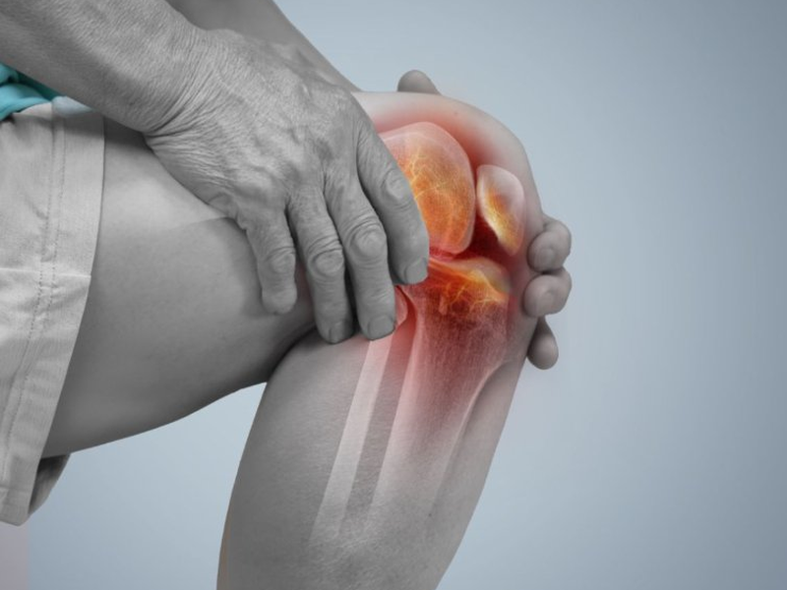
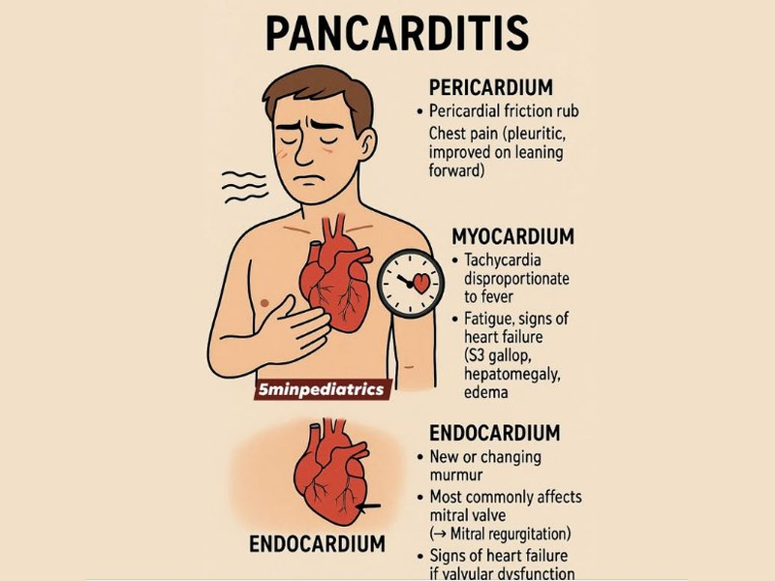
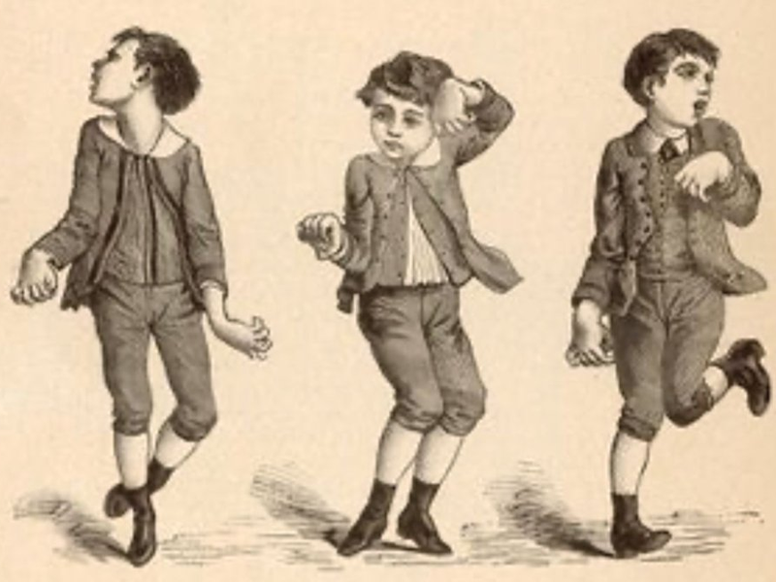
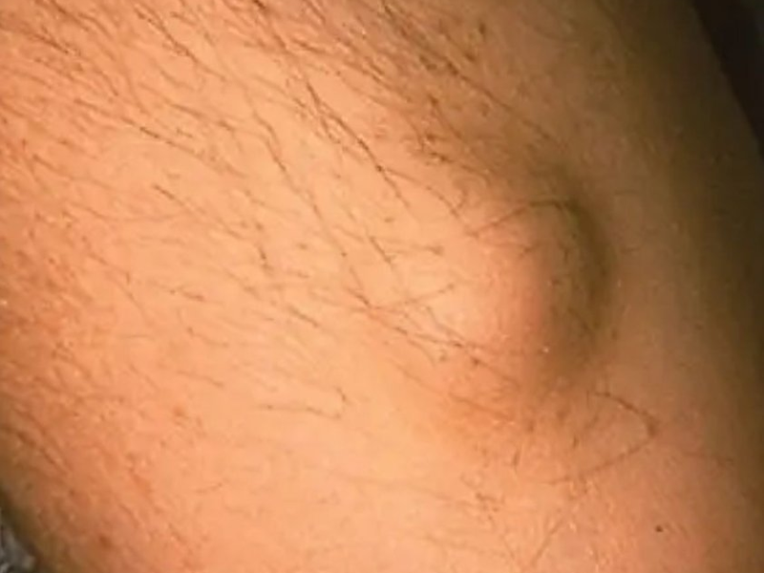
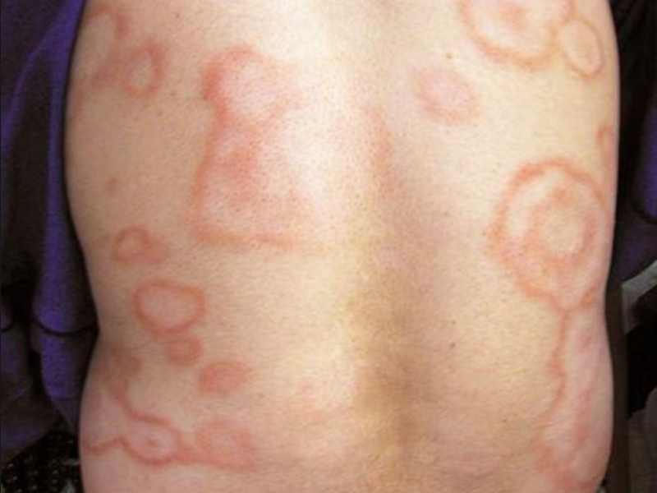
Major Clinical Manifestations
Clinical features begin 2–3 (up to 5) weeks after streptococcal infection
92%
30–60%
10–30%
0–8%
< 2%
Arthritis
Pancarditis
Sydenham's Chorea
Subcutaneous Nodules
Erythema Marginatum
Earliest & most common. Migratory polyarthritis of large joints. Resolves in 4–6 wks without damage.
Chest pain, dyspnea, edema, palpitations, new murmurs. Risk of permanent valve damage.
Late onset (≥ 6 mo). Purposeless movements; disappears in sleep. Mostly females.
Painless, firm, 0.5–2 cm. Over extensor surfaces & bony prominences. Linked to severe carditis.
Highly specific. Transient pink rash with raised edges on trunk & proximal limbs.
Acute Rheumatic Fever & RHD

Slide 5

Diagnosis — Jones Criteria
Diagnosis requires: 2 major OR 1 major + 2 minor PLUS evidence of recent streptococcal infection
MAJOR CRITERIA
MINOR CRITERIA
STREP EVIDENCE
J – Joint involvement (polyarthritis)
O – ♥ (carditis / myocarditis)
N – Nodules (subcutaneous)
E – Erythema marginatum
S – Sydenham's chorea
Fever
Arthralgia
Elevated ESR / CRP
Prolonged PR interval (ECG)
Leukocytosis
Previous rheumatic fever
Positive throat culture for Group A Strep
Elevated ASO titer (> 200 U/mL)
History of scarlet fever
Other serological assay for streptococci
Acute Rheumatic Fever & RHD

Slide 6

Investigations
No single laboratory test confirms ARF — diagnosis is clinical, supported by labs.
LABORATORY
IMAGING & ECG
CBC
↑ WBC (12,000–20,000/µL)
ECG
Prolonged PR interval (minor criterion)
ESR & CRP
Elevated (acute inflammation)
Chest X-ray
Throat swab culture
Positive for Group A β-hemolytic strep
Cardiomegaly, pulmonary congestion
Echocardiography
ASO titer
Elevated; > 200 U/mL is positive
Cardiac dilatation, valve abnormalities — gold standard for carditis
Blood cultures
To rule out infective endocarditis
Acute Rheumatic Fever & RHD

Slide 7

Treatment
ACUTE ATTACK
CURRENT INFECTION
PREVENTION
Bed rest
Procaine penicillin
Primary
Especially with carditis
First-line antibiotic
Single IM benzathine penicillin for strep pharyngitis
Aspirin / NSAIDs
For arthritis, fever
Erythromycin / Clarithromycin
Secondary
If penicillin-allergic
Benzathine penicillin G 1.2 M units IM every 3–4 weeks
Prednisolone
Moderate–severe carditis; taper 25%/wk after 2–3 wks
Eradicate strep
Duration
Treat heart failure
From throat / skin
Until age 20 or ≥ 10 yrs after last attack
& arrhythmias as needed
Sydenham's chorea: anticonvulsants (valproate, carbamazepine) or neuroleptics (haloperidol); withdraw gradually after 1 month symptom-free.
Acute Rheumatic Fever & RHD

Slide 8
Rheumatic Valvular Lesions
> 50% of patients with carditis develop chronic rheumatic valvular disease 10–20 years later — predominantly affecting the mitral and aortic valves
MS
MR
AS
AR
Mitral Stenosis
Mitral Regurgitation
Aortic Stenosis
Aortic Regurgitation
Most common rheumatic lesion
Severe when orifice ≤ 1 cm²
↑ LA pressure → pulmonary HTN
Atrial fibrillation common
Most common in children & adolescents
LA dilatation, little ↑ in pressure
↑ stroke volume → LV enlargement
'Pounding' of the heart
Obstructed LV emptying
Compensatory LV hypertrophy
Relative myocardial ischemia
Angina, arrhythmias, LV failure
Symptoms occur late
'Pounding' due to large LV
Frequent angina pectoris
Dyspnea with LV dysfunction
Acute Rheumatic Fever & RHD

Slide 9





Dental Care in ARF / RHD
Why dental care matters: dental procedures can cause bacteremia → ↑ risk of infective endocarditis in patients with valvular damage
Antibiotic Prophylaxis
Oral Hygiene Education
Anticoagulation Caution
Recommended before invasive dental procedures in at-risk RHD patients
All patients should receive education and routine dental assessment
Many RHD patients are anticoagulated — consult physician before treatment
Local Anesthesia
Conscious Sedation
Coordinated Care
Treatment can be done under LA in consultation with the cardiologist
Nitrous oxide acceptable if cardiac function is good and physician approves
Always communicate with the patient's physician before invasive work
Acute Rheumatic Fever & RHD

Slide 10
Thank You
?
Any questions?
REFERENCES
DISCUSSION
1. Kumar P J. Clinical Medicine. 10th ed. London: W B Saunders; 2021. p. 544–545.
Lecture by: Dr. Hanaa Elsayed Abozeid — Assistant Professor of Internal Medicine
Acute Rheumatic Fever & Rheumatic Heart Disease

