Slide 1
THE ORAL MEDICINE QUARTERLY
EDITION N° 17
VOL. 03 — 2025/26
3RD BDS
Case
BY
Ibrahim
STUDY
Alshahrani
ON ORAL CAVITY IN DISEASE
DENTAL STUDENT · THIRD YEAR
THIS ISSUE'S CASE
ACADEMIC N°
“Mild pain, upper back
right, while eating.”
2110301
INSIDE
→ Patient profile & complaint
→ Diagnostic workup & imaging
→ Phased management plan
PATIENT: M. HANASH · M140426001 · 45 YRS · MALE

Slide 2
THE INDEX
CASE PRESENTATION
Contents
Overview
A 45-year-old salesman presents with localized food impaction pain. We trace the workup from history through the panoramic radiograph to the phased treatment plan.
I
The Patient
02
VII
Dental Chart
08
II
The Complaint
03
VIII
Diagnosis
09
III
History
04
IX
Investigations
10
IV
General Examination
05
X
Radiographic Evidence
11
V
Extra-Oral Findings
06
XI
Final Diagnosis
13
VI
Intra-Oral Examination
07
XII
Treatment Plan
14
IBRAHIM ALSHAHRANI · 2110301 · M. HANASH · M140426001
PAGE 01 / 16

Slide 3
THE PATIENT
CASE PRESENTATION
M
PATIENT FILE
eet our subject.
M140426001
NAME
Mr. Mohammed Hanash
A 45-year-old salesman from Al-Mahjar, Jeddah — originally from Yemen, residing here for 13 years — presents to the clinic with a localized, mild pain in the upper back right tooth, brought on by eating.
AGE
45 years
SEX
Male
OCCUPATION
45
13
01
02
Salesman
RESIDENCE
Al-Mahjar, Jeddah
ORIGIN
YEARS OLD
YEARS IN KSA
COMPLAINT
TEETH
Yemen · 13 yrs in KSA
IBRAHIM ALSHAHRANI · 2110301 · M. HANASH · M140426001
PAGE 02 / 16

Slide 4
THE COMPLAINT
CASE PRESENTATION
“
THE CHIEF COMPLAINT
Mild pain in the upper
back right tooth,
while eating.
— THE PATIENT, IN HIS OWN WORDS
HISTORY OF PRESENT ILLNESS
The patient reports that the discomfort in his upper back right tooth began some time after a restoration was placed on that same tooth — though he is unable to recall exactly when the procedure was done. Since then, the pain has surfaced only while eating, when food becomes lodged in the tooth; once the impacted food is dislodged, the discomfort settles almost immediately. There is no spontaneous pain, no lingering ache, and no reactivity to cold or hot stimuli. He denies any swelling, mobility, or bleeding. The complaint has been intermittent, never severe, and has not interfered with sleep or daily work.
IBRAHIM ALSHAHRANI · 2110301 · M. HANASH · M140426001
PAGE 03 / 16

Slide 5
HISTORY
CASE PRESENTATION
Four
A complete medical, dental, family and social profile — the contextual lens through which we view the presenting complaint.
histories.
I
MEDICAL HISTORY
II
DENTAL HISTORY
No known medical history to date.
Restorations on upper right and upper left back teeth.
III
FAMILY HISTORY
IV
SOCIAL HISTORY
Mother diagnosed with hypertension.
Brushes from time to time with poor technique (horizontal scrubbing). No flossing or mouthwash use. Frequent sweet tea throughout the workday.
IBRAHIM ALSHAHRANI · 2110301 · M. HANASH · M140426001
PAGE 04 / 16

Slide 6
GENERAL EXAMINATION
CASE PRESENTATION
General
The patient appears generally well, with no acute distress.
appearance.
All vital signs within normal range.
01
MENTAL STATUS
02
BUILD & NOURISHMENT
03
GAIT
Conscious, alert, and oriented to time, place and person.
Average build, well nourished and well groomed.
Steady and well-coordinated. No apparent distress.
04
SKIN & MUCOSA
05
COOPERATION
06
HYDRATION
Normal colour. No pallor, cyanosis, icterus, or clubbing.
Cooperative and communicative throughout the examination.
Well hydrated. Lips and oral mucosa appear moist.
VITAL SIGNS
PULSE 84 bpm · RESPIRATORY RATE 16 / min · TEMPERATURE Afebrile
IBRAHIM ALSHAHRANI · 2110301 · M. HANASH · M140426001
PAGE 05 / 16

Slide 7
EXTRA-ORAL FINDINGS
CASE PRESENTATION
On the
A complete extra-oral examination, by region.
outside.
All findings within normal limits.
01
FACIAL SYMMETRY
02
HEAD, EYES & NOSE
03
SKIN & NAILS
Bilaterally symmetrical.
No abnormality detected.
No abnormality detected.
04
TMJ
05
LYMPH NODES
06
LIPS & PERIORAL TISSUE
No swelling, clicking, deviation, tenderness, trismus, or hypermobility.
Not palpable.
No swelling, lesions, or asymmetry.
IBRAHIM ALSHAHRANI · 2110301 · M. HANASH · M140426001
PAGE 06 / 16

Slide 8
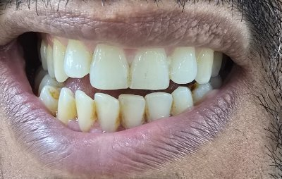
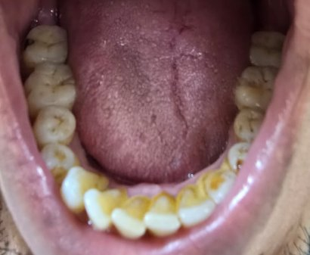
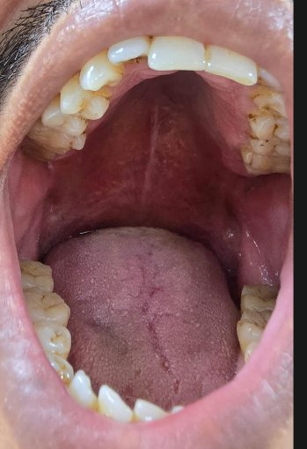
INTRA-ORAL EXAMINATION
CASE PRESENTATION
In the mouth.
Three clinical views — anterior, lower occlusal, and open mouth.
PLATE II
PLATE III
PLATE IV
ANTERIOR
LOWER OCCLUSAL
OPEN MOUTH
ON THE GINGIVA
ORAL HYGIENE
SOFT TISSUES
Coral pink · scalloped · stippled. Mild marginal inflammation on lower anteriors.
Generalized plaque and calculus, most prominent on lower anterior lingual surfaces. Mild extrinsic staining.
Labial · buccal mucosa · floor · vestibule · tongue · palate · tonsils — all unremarkable.
IBRAHIM ALSHAHRANI · 2110301 · M. HANASH · M140426001
PAGE 07 / 16

Slide 9
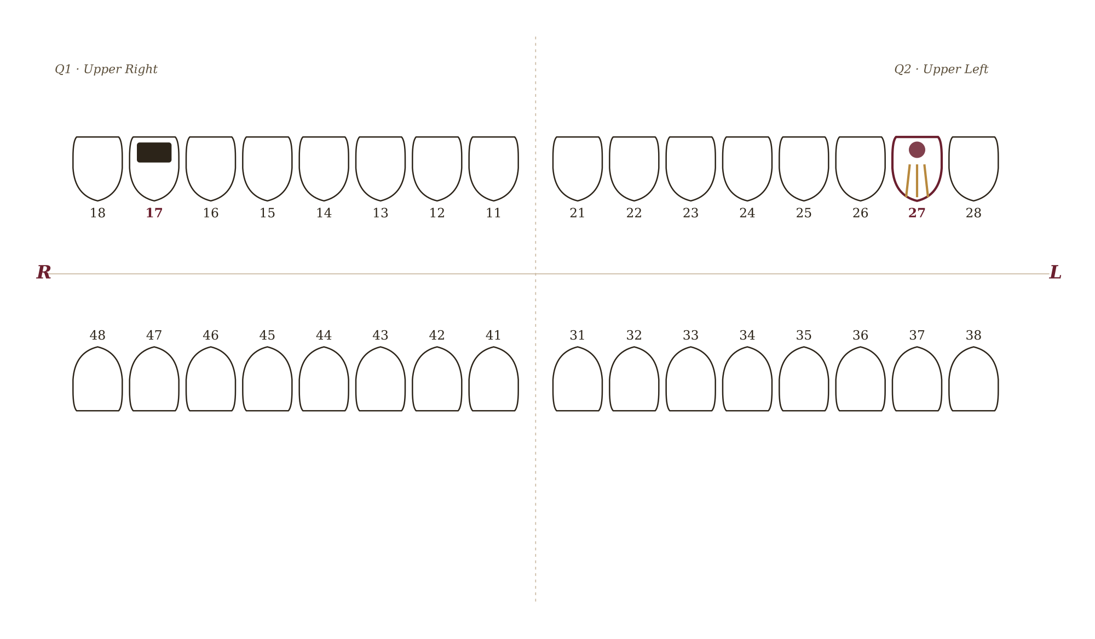
DENTAL CHART
CASE PRESENTATION
The chart.
Two teeth of clinical interest highlighted: tooth 17 with an existing restoration, and tooth 27 — previously root canal treated, now showing recurrent caries.
FDI TWO-DIGIT NOTATION
EXISTING RESTORATION
ROOT-CANAL FILL
CARIES / LESION
Tooth 17
Tooth 27
Tooth 27
IBRAHIM ALSHAHRANI · 2110301 · M. HANASH · M140426001
PAGE 08 / 16

Slide 10
DIAGNOSIS
CASE PRESENTATION
Two
A provisional reading from clinical findings, set against likely differentials.
readings.
PROVISIONAL
DIFFERENTIAL
I
TOOTH 27
I
Secondary Caries
Deep caries on a previously root canal treated tooth.
Recurrent decay beneath or adjacent to existing restoration.
II
TOOTH 17
II
Defective Restoration
Over-contoured restoration with food impaction.
Marginal breakdown or open margin of the previous filling.
IBRAHIM ALSHAHRANI · 2110301 · M. HANASH · M140426001
PAGE 09 / 16

Slide 11
INVESTIGATIONS
CASE PRESENTATION
The workup.
From the panoramic radiograph forward.
I
Panoramic Radiograph (OPG)
DONE
Performed · 14/04/2026
II
Intra-Oral Periapical (IOPA)
DONE
For teeth 17 and 27
III
Clinical Tests
INDICATED
Percussion, palpation, vitality testing
IV
Laboratory Investigations
N/A
Not applicable to this case
IBRAHIM ALSHAHRANI · 2110301 · M. HANASH · M140426001
PAGE 10 / 16

Slide 12
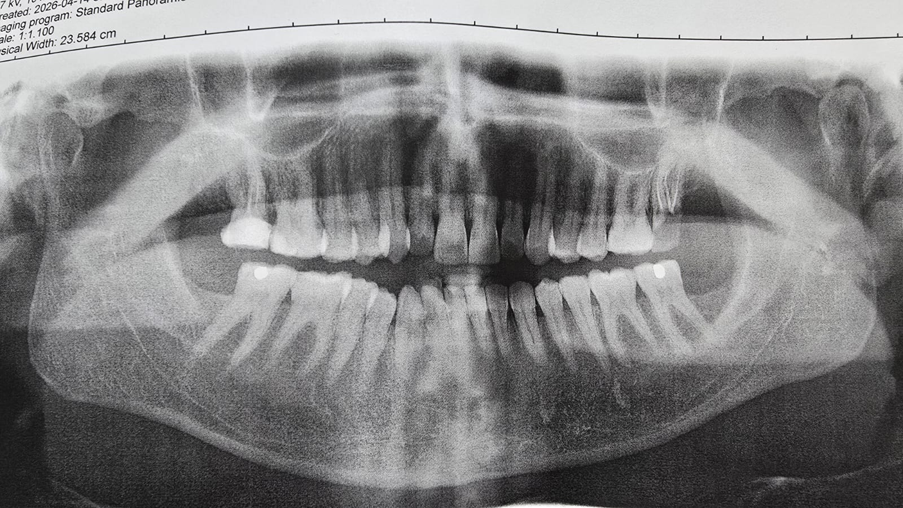
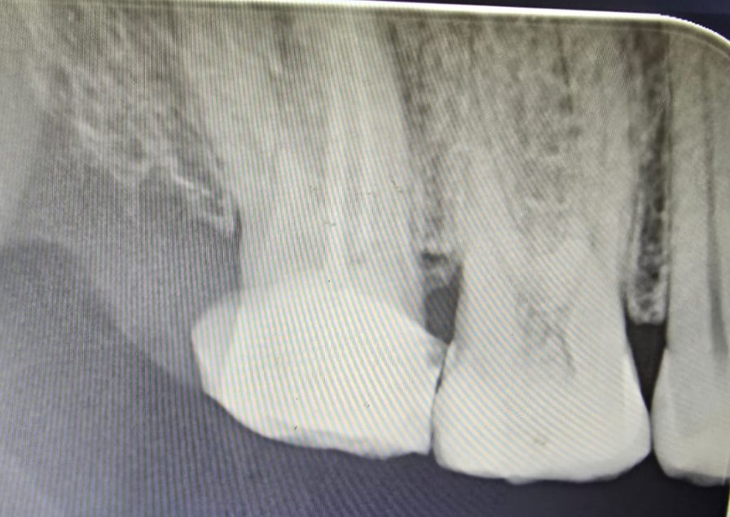
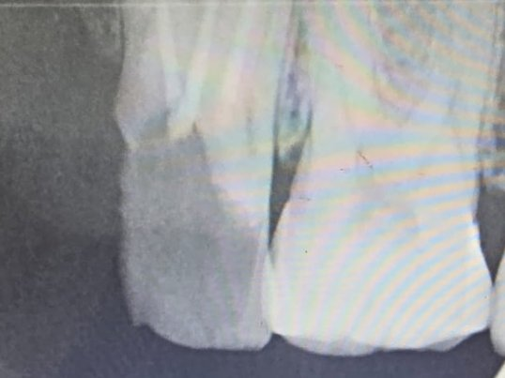
RADIOGRAPHIC EVIDENCE
PLATE I
Imaging.
14 / 04 / 2026
PLATE II · IOPA — TOOTH 17
PLATE I
Panoramic Radiograph (OPG)
PLATE III · IOPA — TOOTH 27
IBRAHIM ALSHAHRANI · 2110301 · M. HANASH · M140426001
PAGE 11 / 16

Slide 13
RADIOGRAPHIC FINDINGS
CASE PRESENTATION
Reading the
films.
17
UPPER RIGHT SECOND MOLAR · OPG + IOPA
Large radiopaque coronal restoration extending close to the pulp horn. IOPA shows over-contoured restoration with possible mesial overhang and incipient mesial bone loss.
RESTORATION
27
UPPER LEFT SECOND MOLAR · OPG + IOPA
Radiopaque material visible within the pulp canals — consistent with previous root canal treatment. IOPA shows coronal radiolucency, suggestive of recurrent caries beneath the existing restoration.
RCT · CARIES
—
GENERAL FINDINGS · OPG
Maxillary sinuses clear bilaterally. Mandibular condyles symmetrical. No obvious cysts, fractures, or periapical lesions elsewhere in the dentition.
UNREMARKABLE
IBRAHIM ALSHAHRANI · 2110301 · M. HANASH · M140426001
PAGE 12 / 16

Slide 14
FINAL DIAGNOSIS
CASE PRESENTATION
Confirmed.
17
I.
Over-contoured restoration
with food impaction causing pain.
27
II.
Deep caries
on a previously root canal treated tooth.
IBRAHIM ALSHAHRANI · 2110301 · M. HANASH · M140426001
PAGE 13 / 16

Slide 15
TREATMENT PLAN
CASE PRESENTATION
The plan,
Phased management from preventive care through definitive restoration to long-term maintenance.
in four acts.
ACT ONE
ACT TWO
ACT THREE
ACT FOUR
I
II
III
IV
Emergency &
Preventive
Disease
Control
Definitive
Restorative
Maintenance
& Follow-up
Oral hygiene instructions, scaling and polishing.
17 — correction of restoration. 27 — caries removal & RCT assessment.
27 — re-RCT and crown if RCT failed. Otherwise, restoration and full coverage crown.
Periodic recall to monitor restorations and overall oral health.
IBRAHIM ALSHAHRANI · 2110301 · M. HANASH · M140426001
PAGE 14 / 16

Slide 16
THE ORAL MEDICINE QUARTERLY
— END OF CASE PRESENTATION
Thank
you.
ACKNOWLEDGEMENTS
01 Dr. Syed Mukith
02 Dr. Sajda Gajdhar
03 Dr. Vanaja Reddy
IBRAHIM ALSHAHRANI · 2110301 · PATIENT: M. HANASH · M140426001 · 3RD BDS · 2025/26

