Slide 1

Organizing and Analyzing Online Orders

Slide 2
Goals
Create a database which stores the information of the online orders
Streamline the storage and minimize storage space
Modify the data within the SQL server instead of downloading and doing it in VSCode
Add more data to create more insightful analysis, but also challenge myself more
Find potential groups of consumers to expand into

Slide 3
Data
Data sourced from Brazilian E-Retailer olist (Details are anonymized, otherwise real)
Wanted to get real data so I could actually analyze and get real information for potential future uses unlike the Northwind Traders dataset
Downloaded from Kaggle
Over 100k orders

Slide 4
Tools
PowerBI to analyze the data without having to manually write all the code, not to mention it gets all the relations right off the bat.
DBSchema to manipulate database
PostgresSQL because it’s easiest DB system I had to deal with, especially concerning PowerBI connections

Slide 5
Analysis: Potential Expansions
One metric I’m using for potential expansions is using GDP per Customer(GDPCu), which indicates the amount of the economy is left on the table. Long story short, the higher the , the more potential reach there is into the market.
However the biggest shortfall is it doesn’t account for population size, so a micro market with massive upside potential is not going to be as attractive
Doesn’t account for factors as to *why* there even is such a high GDPCu
Another metric I’m using is GDP per TotalOrderPrice(We’ll refer to it as amount paid)(GDPAP), or the amount spent per GDP of a province. This one focuses more on the money itself than the customer base.
The shortfalls are also the same as GDPCu
What I’m planning to do to narrow down which potential market is which is calculate those 2 values for each province, get their linear variance score, and add them up together for a final undersaturation score.

Slide 6
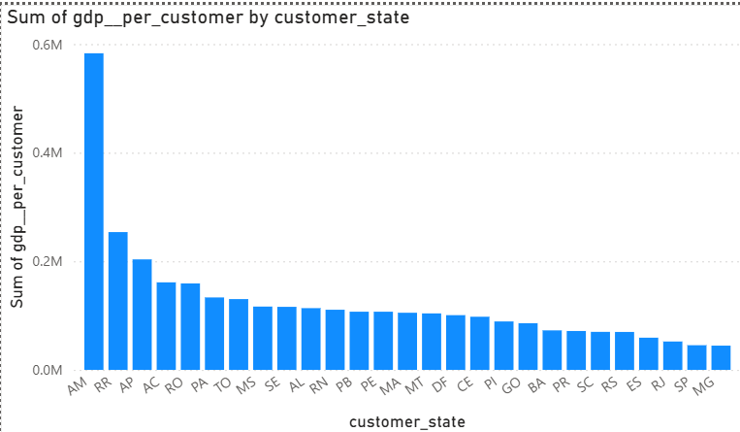
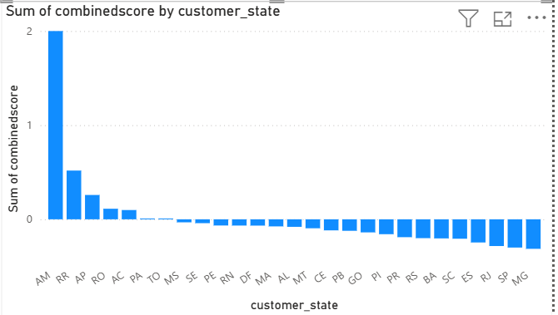
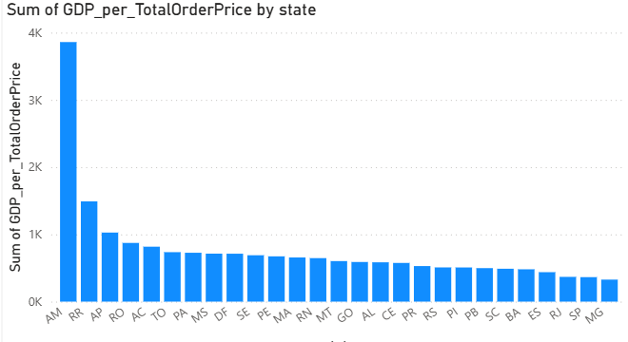
Potential Expansions (Cont)
As we can see the most undersaturated markets based on the GDPCu and GDPAP metrics are provinces in the Amazon Region, which isn’t exactly known for ease of transport. However, what’s particularly interesting is the Amazonas(AM) Province is extremely higher than the rest.
Provinces I think we should target; AM, DF, PE, and RN
Why I didn’t immediately choose the other top scorers in undersaturation is because small population size and Amazon factor

Slide 7
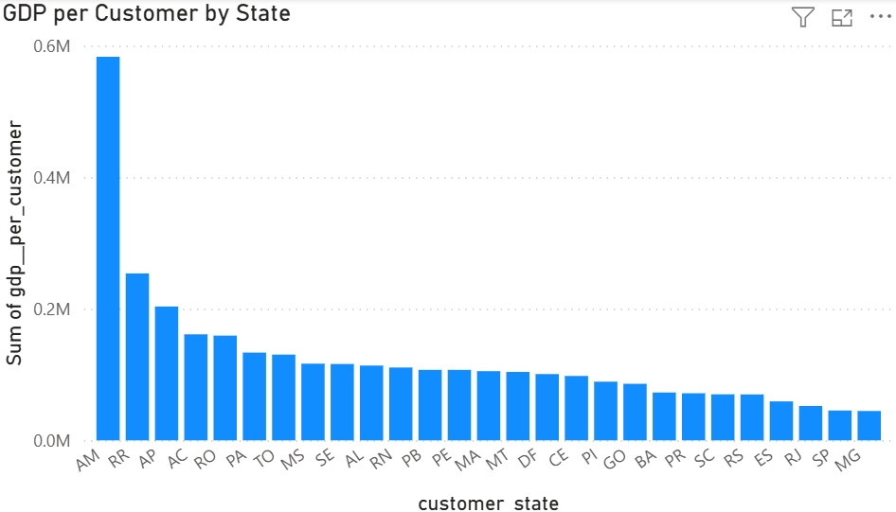
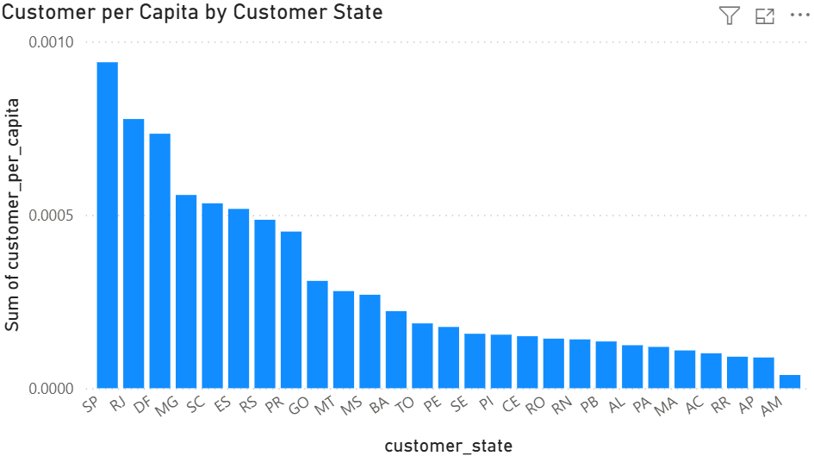
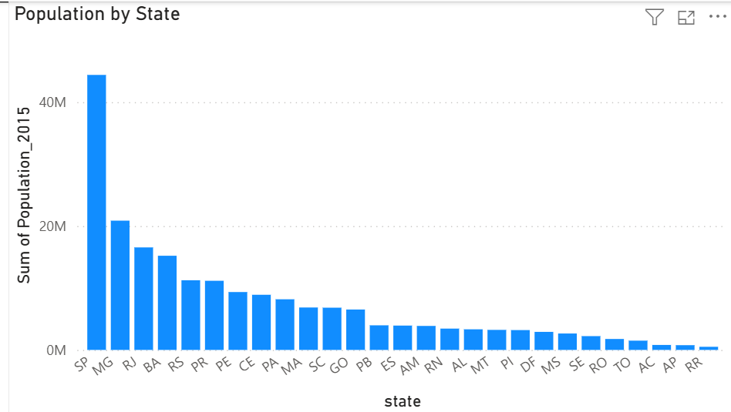
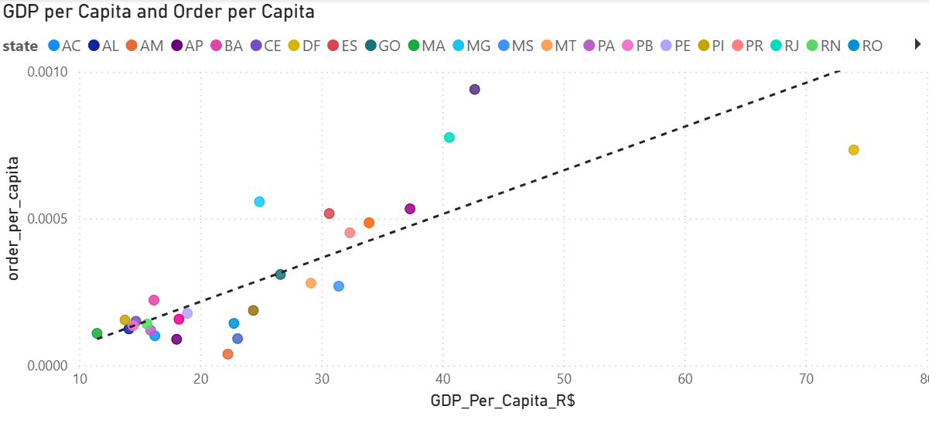
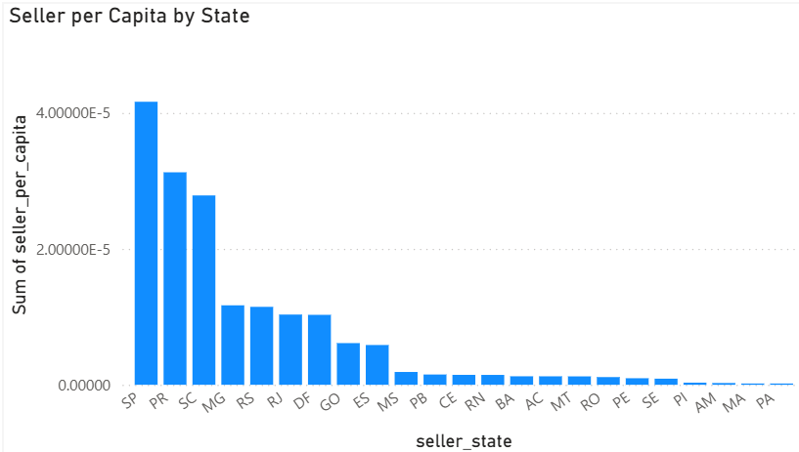
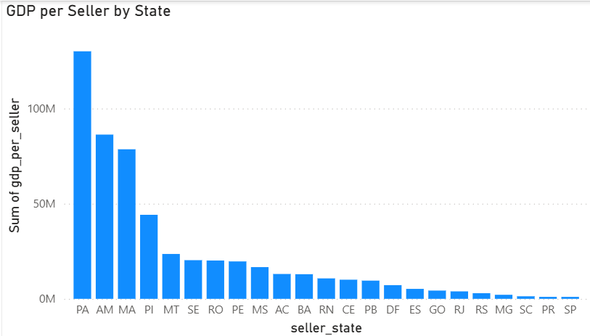
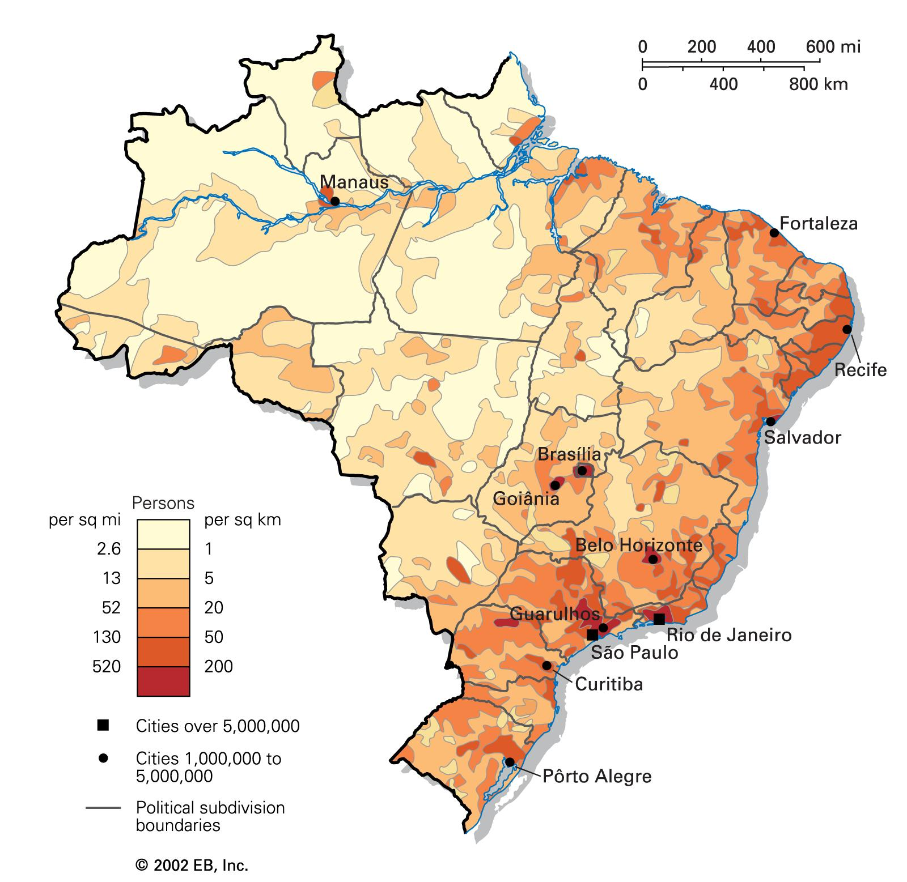

Amazonas (AM)
Reasons for expansion:
By far largest GDPCu and GDPAP
By far lowest Customer per Capita
Half of population concentrated in city of Manaus
Population not tiny
Orders per Capita in relation to the GDP per capita is especially low
Challenges
Because it’s an Amazon province, it’s infrastructure will be quite weak, which is especially a challenge for building distribution centers/
The concentration of sellers in Amazonas is abysmal; It’s bottom 3 in sellers per capita and top 3 in GDP per seller (GDPS)
Moves:
Dump all focus on Manaus
Somehow incentivize more sellers in that region
Market more to attract customers

Slide 8
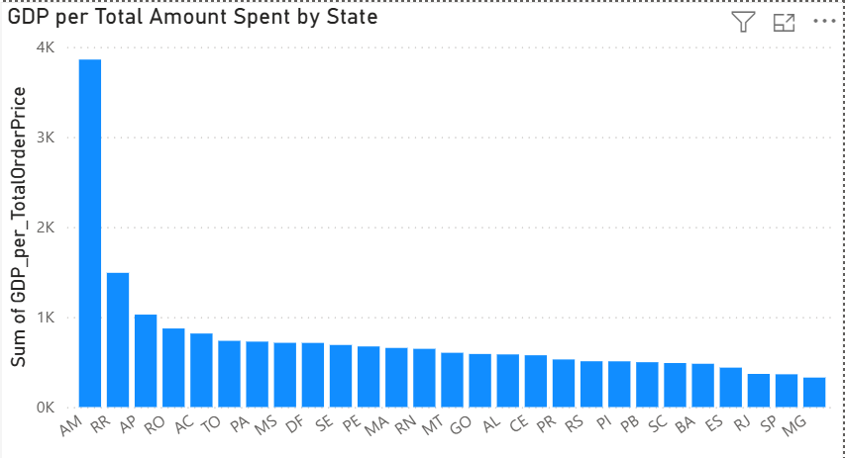
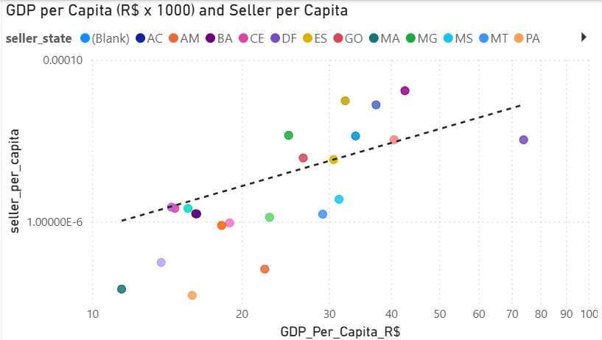
Distrito Federal (DF)
Reasons for expansion:
Somewhat undersaturated when using GDPAP metric
It’s a city, which means better infrastructure already provided
Moderate population size
Closer to main population centers of Brazil, so orders are easier to reach
Seller Per Capita relatively low to GDP per capita trend.
Orders per Capita in relation to GDP per capita is quite below the trend
Challenges
Not much apparent
It’s GDP per capita is an outlier, so it might end up bucking stat trends
Moves:
Customer concentration is good, so awareness isn’t necessarily the problem, perhaps we need to incentivize them to order more
Incentivize more sellers

Slide 9
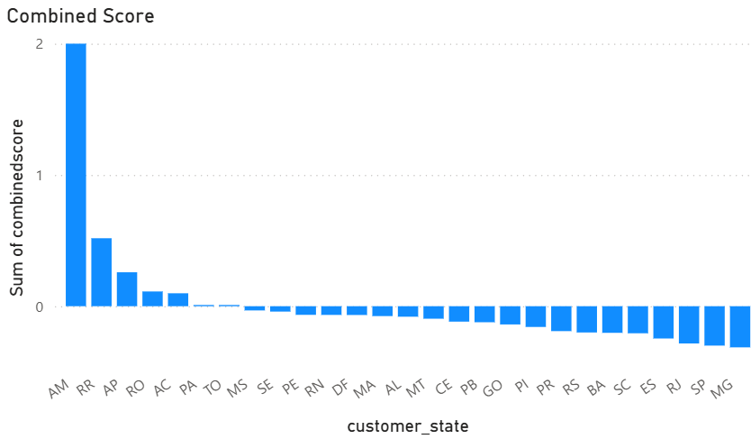

Pernambuco (PM) and RIO Grande do norte (RN)
Reasons for expansion:
Somewhat high undersaturation score
Large population
In populated region, so reach to everyone else is quite good
Challenges:
Known to be poor region, so infrastructure likely to have shortfalls
Seller per capita in region pretty low
Moves:
Incentivize more sellers in region

Slide 10
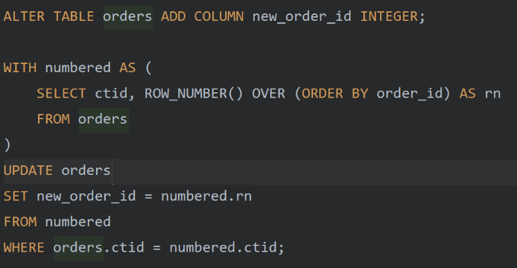

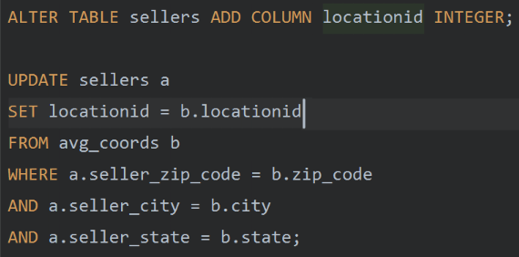
How I modified the data
Simplified the IDs from a 20 something character long text to an integer for data compression
Reduced the zip codes to integers for data compression
Gave location ID for combinations of zip code, city, and state because I found some zip codes to be in more than one city. Took the location information from a geolocation table and put it in an avg_coords table to be a reference. As of now there isn’t real use, I just wanted to give myself a challenge to play with data.
Added state population and GDP tables for deeper analysis because it wasn’t part of the olist dataset and those 2 data values are the most basic fundamentals for analyzing states and populations

Slide 11
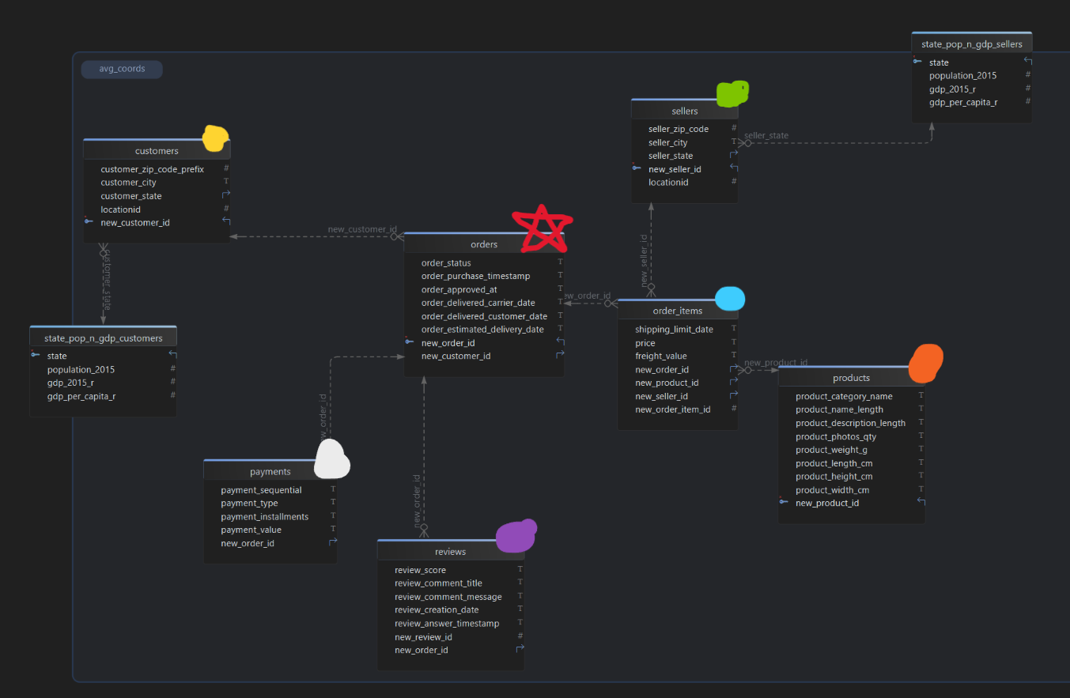
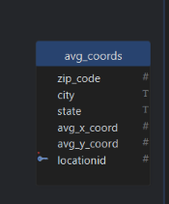
Data Organization
Orders are the core of this data (Red Star)
Customers and Sellers have their own State GDP and Population tables to prevent data loop
Sellers are connected to order items instead of orders because that is how the data started out as
There is the Avg Coords table as reference for the locationIDs. No real use for it.

Slide 12
Challenges and solutions to this project
PowerBI is a great tool to relate data and also create new tables on the fly, but it’s terrible at keeping things organized. Basically I ended up creating a lot of new tables, but the data pile was growing too large to be able to effectively keep track of.
I broke the project down into multiple PowerBI files as a workaround. Not great, but better than having this hard to organize data dump.
Connecting to DB isn’t always reliable. I started off with using MySQL but long story short, I couldn’t connect it to PowerBI because the connector wouldn’t work, so I ended up switching to PostGres and didn’t have any major issues.

