Slide 1
Android Network Sniffer
Team SSP19/2B
Kan KarJun Alvin 5709659
Liao Weisheng Wilson 6212591
Nyein Soe 5710959
Supervisor
Mr. Premarajan P

Slide 2
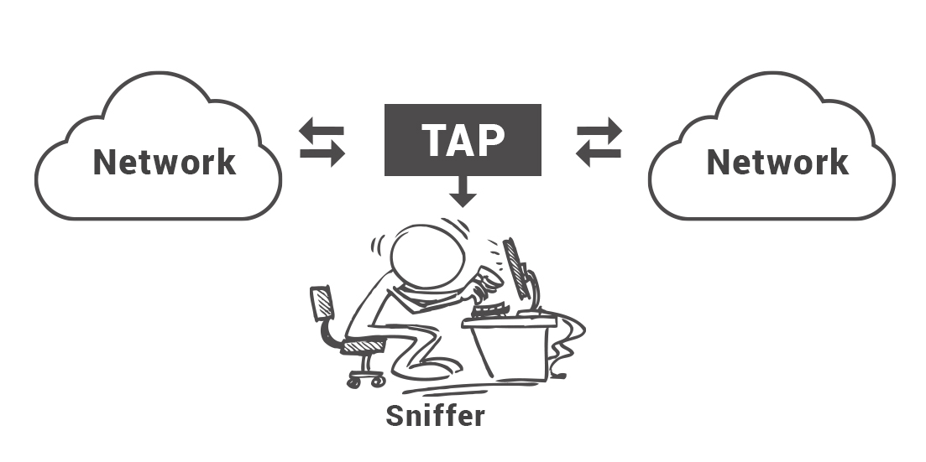
Introduction
How does it work?
Packet sniffers work by intercepting and logging network traffic that they can 'see' via the wired or wireless network interface that the packet sniffing software has access to on its host computer.
All networks use “packets” to send data and each packet includes:
Destination address
Number of packets
Reassembly order
Source address

Slide 3
Goals / Purposes
Capturing packets
Recording and analyzing traffic
Decrypting packets and displaying in clear text
Converting data to readable format
Showing relevant information (eg. IP, protocol, host or server name)

Slide 4
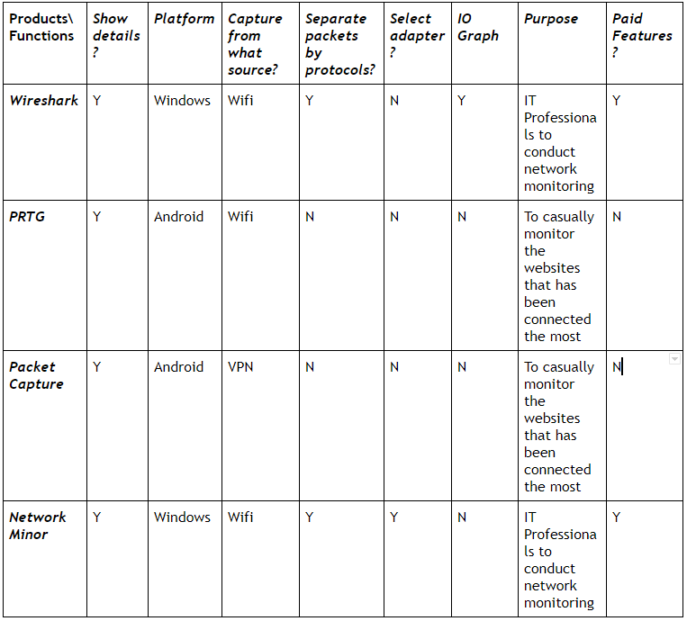
Market Research and Comparison

Slide 5


Considerations
Non-Functional requirements
Security Requirements - Rooting of the android devices. The application can only run on rooted devices.
- Only the authorized department can provide these devices.
Software Quality Attributes - aimed to make the program for the IT department so that any IT professionals or even interns in such field will be able to use this program.

Slide 6

Functionalities
Core functions
Device Scan
Port Vulnerability Check
Packet Sniff
Other functions
Network Tools
Data export

Slide 7
Functional Requirements/Functionalities (Summary)
Main Menu
Network connection
Gather background resources
Function
Sub Function
Sub Function

Slide 8
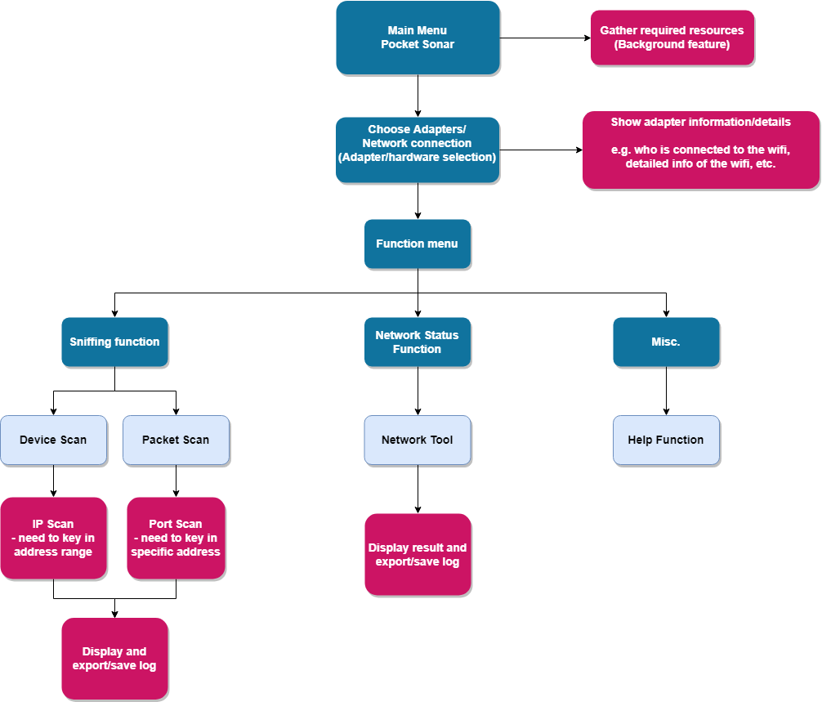

Slide 9

Risk Assessments
 | Impact Type | Proposed management plan
1 | Program not responding or frozen | - refresh the program by closing and restarting it. - stop some of the background processes - wait for the program to respond
2 | Not properly rooted for the android device | - Provided resources on the website itself and at the same time the guidances are included in the user manual
3 | Wrong address input | - This risk solely depends on the users. To prevent this from happening, we will be providing guidance information and examples on how to key in the IP address.

Slide 10
Why use our application?

Slide 11

Conclusion
Learning objective
Understanding the usage and application of network sniffing
Using a developer tool to create an actual application
Proper project planning and design
-Developer Platform
Android Studio
JAVA
Linux

Slide 12


Product Usage Demonstration

Slide 13


