Slide 1
The World Of Internet gaming
Miguel Mejia, Mathew Rivera

Slide 2
The Internet
Created in January 1st, 1983
The internet created a way for the world to be more connected
Because of this invention now people can’t ever be bored while playing a game. Now we can play with friends from across the world!

Slide 3
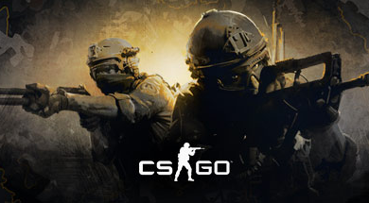

Slide 4
This is one of the best examples of how the internet has affected me, this gamed called “Counter-Strike: Global Offensive”. In this game, two teams (sometimes from around the globe) face off and try to either stop the planting of the bomb (if you’re on the Counter-Terrorists) or Plant the bomb and destroy the bomb site (Terrorists)

Slide 5
Conclusion
Without the invention of the internet, I wouldn’t be able to make friends from half way around the world and interact with people I never thought I would have before. With the internet I can explore worlds I wouldn’t have seen before and at the same time have fun with my friends.

