Slide 1
T5o10 Data Science Bootcamp
Albraa Baghdadi

Slide 2
INTRODUCTION
Missing appointment happens a lot and sometimes affect businesses that depend on appointments to complete the service such as Hospitals. In this project we will build a model based on our dataset to predict the probability of the patient to miss the appointment.
The benefit of this model that the hospital could predict the probability of the patient to miss the appointment and then increase number of appointment for that day.

Slide 3
DATASET INFORMATION
PatientId​
AppointmentID​
Age​
Gender ​
Scheduled Day ​
Appointment Day​
Neighborhood​
Scholarship​
Hypertension​
Diabetes​
Alcoholism​
Handicap​
SMS_received​
No-show
The dataset is provided by Kaggle and contains more than 100000+ records with 14 features

Slide 4
DATA CLEANING
Typo
 | PatientId | AppointmentID | Gender | ScheduledDay | AppointmentDay | Age | Neighbourhood | Scholarship | Hipertension | Diabetes | Alcoholism | Handcap | SMS_received | No-show
0 | 29872499824296 | 5642903 | F | 2016-04-29T18:38:08Z | 2016-04-29T00:00:00Z | 62 | JARDIM DA PENHA | 0 | 1 | 0 | 0 | 0 | 0 | No
1 | 558997776694438 | 5642503 | M | 2016-04-29T16:08:27Z | 2016-04-29T00:00:00Z | 56 | JARDIM DA PENHA | 0 | 0 | 0 | 0 | 0 | 0 | No
2 | 4262962299951 | 5642549 | F | 2016-04-29T16:19:04Z | 2016-04-29T00:00:00Z | 62 | MATA DA PRAIA | 0 | 0 | 0 | 0 | 0 | 0 | No
3 | 867951213174 | 5642828 | F | 2016-04-29T17:29:31Z | 2016-04-29T00:00:00Z | 8 | PONTAL DE CAMBURI | 0 | 0 | 0 | 0 | 0 | 0 | No
4 | 8841186448183 | 5642494 | F | 2016-04-29T16:07:23Z | 2016-04-29T00:00:00Z | 56 | JARDIM DA PENHA | 0 | 1 | 1 | 0 | 0 | 0 | No

Slide 5
DATA CLEANING
Change No to "0" and Yes to "1"
 | PatientId | AppointmentID | Gender | ScheduledDay | AppointmentDay | Age | Neighbourhood | Scholarship | Hipertension | Diabetes | Alcoholism | Handcap | SMS_received | No-show
0 | 29872499824296 | 5642903 | F | 2016-04-29T18:38:08Z | 2016-04-29T00:00:00Z | 62 | JARDIM DA PENHA | 0 | 1 | 0 | 0 | 0 | 0 | No
1 | 558997776694438 | 5642503 | M | 2016-04-29T16:08:27Z | 2016-04-29T00:00:00Z | 56 | JARDIM DA PENHA | 0 | 0 | 0 | 0 | 0 | 0 | No
2 | 4262962299951 | 5642549 | F | 2016-04-29T16:19:04Z | 2016-04-29T00:00:00Z | 62 | MATA DA PRAIA | 0 | 0 | 0 | 0 | 0 | 0 | No
3 | 867951213174 | 5642828 | F | 2016-04-29T17:29:31Z | 2016-04-29T00:00:00Z | 8 | PONTAL DE CAMBURI | 0 | 0 | 0 | 0 | 0 | 0 | No
4 | 8841186448183 | 5642494 | F | 2016-04-29T16:07:23Z | 2016-04-29T00:00:00Z | 56 | JARDIM DA PENHA | 0 | 1 | 1 | 0 | 0 | 0 | No

Slide 6
DATA CLEANING
Remove the records with > 0 Age
 | PatientId | AppointmentID | Gender | ScheduledDay | AppointmentDay | Age | Neighbourhood | Scholarship | Hipertension | Diabetes | Alcoholism | Handcap | SMS_received | No-show
0 | 29872499824296 | 5642903 | F | 2016-04-29T18:38:08Z | 2016-04-29T00:00:00Z | 62 | JARDIM DA PENHA | 0 | 1 | 0 | 0 | 0 | 0 | No
1 | 558997776694438 | 5642503 | M | 2016-04-29T16:08:27Z | 2016-04-29T00:00:00Z | 56 | JARDIM DA PENHA | 0 | 0 | 0 | 0 | 0 | 0 | No
2 | 4262962299951 | 5642549 | F | 2016-04-29T16:19:04Z | 2016-04-29T00:00:00Z | 62 | MATA DA PRAIA | 0 | 0 | 0 | 0 | 0 | 0 | No
3 | 867951213174 | 5642828 | F | 2016-04-29T17:29:31Z | 2016-04-29T00:00:00Z | 8 | PONTAL DE CAMBURI | 0 | 0 | 0 | 0 | 0 | 0 | No
4 | 8841186448183 | 5642494 | F | 2016-04-29T16:07:23Z | 2016-04-29T00:00:00Z | 56 | JARDIM DA PENHA | 0 | 1 | 1 | 0 | 0 | 0 | No

Slide 7
DATA CLEANING
Change the type to date type
 | PatientId | AppointmentID | Gender | ScheduledDay | AppointmentDay | Age | Neighbourhood | Scholarship | Hipertension | Diabetes | Alcoholism | Handcap | SMS_received | No-show
0 | 29872499824296 | 5642903 | F | 2016-04-29T18:38:08Z | 2016-04-29T00:00:00Z | 62 | JARDIM DA PENHA | 0 | 1 | 0 | 0 | 0 | 0 | No
1 | 558997776694438 | 5642503 | M | 2016-04-29T16:08:27Z | 2016-04-29T00:00:00Z | 56 | JARDIM DA PENHA | 0 | 0 | 0 | 0 | 0 | 0 | No
2 | 4262962299951 | 5642549 | F | 2016-04-29T16:19:04Z | 2016-04-29T00:00:00Z | 62 | MATA DA PRAIA | 0 | 0 | 0 | 0 | 0 | 0 | No
3 | 867951213174 | 5642828 | F | 2016-04-29T17:29:31Z | 2016-04-29T00:00:00Z | 8 | PONTAL DE CAMBURI | 0 | 0 | 0 | 0 | 0 | 0 | No
4 | 8841186448183 | 5642494 | F | 2016-04-29T16:07:23Z | 2016-04-29T00:00:00Z | 56 | JARDIM DA PENHA | 0 | 1 | 1 | 0 | 0 | 0 | No

Slide 8
DATA CLEANING
Drop
 | PatientId | AppointmentID | Gender | ScheduledDay | AppointmentDay | Age | Neighbourhood | Scholarship | Hipertension | Diabetes | Alcoholism | Handcap | SMS_received | No-show
0 | 29872499824296 | 5642903 | F | 2016-04-29T18:38:08Z | 2016-04-29T00:00:00Z | 62 | JARDIM DA PENHA | 0 | 1 | 0 | 0 | 0 | 0 | No
1 | 558997776694438 | 5642503 | M | 2016-04-29T16:08:27Z | 2016-04-29T00:00:00Z | 56 | JARDIM DA PENHA | 0 | 0 | 0 | 0 | 0 | 0 | No
2 | 4262962299951 | 5642549 | F | 2016-04-29T16:19:04Z | 2016-04-29T00:00:00Z | 62 | MATA DA PRAIA | 0 | 0 | 0 | 0 | 0 | 0 | No
3 | 867951213174 | 5642828 | F | 2016-04-29T17:29:31Z | 2016-04-29T00:00:00Z | 8 | PONTAL DE CAMBURI | 0 | 0 | 0 | 0 | 0 | 0 | No
4 | 8841186448183 | 5642494 | F | 2016-04-29T16:07:23Z | 2016-04-29T00:00:00Z | 56 | JARDIM DA PENHA | 0 | 1 | 1 | 0 | 0 | 0 | No

Slide 9
DATA CLEANING
Extract new features from appointment day and scheduled day columns
 | Gender | ScheduledDay | AppointmentDay | Age | Neighbourhood | Scholarship | Hypertension | Diabetes | Alcoholism | Handicap | SMS_received | No_show | Weekday | Weekend | Number_of_days
0 | F | 2016-04-29 18:38:08 | 2016-04-29 00:00:00 | 62 | JARDIM DA PENHA | 0 | 1 | 0 | 0 | 0 | 0 | 0 | 1 | 0 | 0
1 | M | 2016-04-29 16:08:27 | 2016-04-29 00:00:00 | 56 | JARDIM DA PENHA | 0 | 0 | 0 | 0 | 0 | 0 | 0 | 1 | 0 | 0
2 | F | 2016-04-29 16:19:04 | 2016-04-29 00:00:00 | 62 | MATA DA PRAIA | 0 | 0 | 0 | 0 | 0 | 0 | 0 | 1 | 0 | 0
3 | F | 2016-04-29 17:29:31 | 2016-04-29 00:00:00 | 8 | PONTAL DE CAMBURI | 0 | 0 | 0 | 0 | 0 | 0 | 0 | 1 | 0 | 0
4 | F | 2016-04-29 16:07:23 | 2016-04-29 00:00:00 | 56 | JARDIM DA PENHA | 0 | 1 | 1 | 0 | 0 | 0 | 0 | 1 | 0 | 0
5 | F | 2016-04-27 08:36:51 | 2016-04-29 00:00:00 | 76 | REPÚBLICA | 0 | 1 | 0 | 0 | 0 | 0 | 0 | 1 | 0 | 2

Slide 10
DATA CLEANING
Extract AgeGroup from Age column
 | Gender | ScheduledDay | AppointmentDay | Age | Neighbourhood | Scholarship | Hypertension | Diabetes | Alcoholism | Handicap | SMS_received | No_show | Weekday | Weekend | Number_of_days | day | AgeGroup
0 | F | 2016-04-29 18:38:08 | 2016-04-29 00:00:00 | 62 | JARDIM DA PENHA | 0 | 1 | 0 | 0 | 0 | 0 | 0 | 1 | 0 | 0 | Friday | Adult
1 | M | 2016-04-29 16:08:27 | 2016-04-29 00:00:00 | 56 | JARDIM DA PENHA | 0 | 0 | 0 | 0 | 0 | 0 | 0 | 1 | 0 | 0 | Friday | Adult
2 | F | 2016-04-29 16:19:04 | 2016-04-29 00:00:00 | 62 | MATA DA PRAIA | 0 | 0 | 0 | 0 | 0 | 0 | 0 | 1 | 0 | 0 | Friday | Adult
3 | F | 2016-04-29 17:29:31 | 2016-04-29 00:00:00 | 8 | PONTAL DE CAMBURI | 0 | 0 | 0 | 0 | 0 | 0 | 0 | 1 | 0 | 0 | Friday | Kid
4 | F | 2016-04-29 16:07:23 | 2016-04-29 00:00:00 | 56 | JARDIM DA PENHA | 0 | 1 | 1 | 0 | 0 | 0 | 0 | 1 | 0 | 0 | Friday | Adult

Slide 11
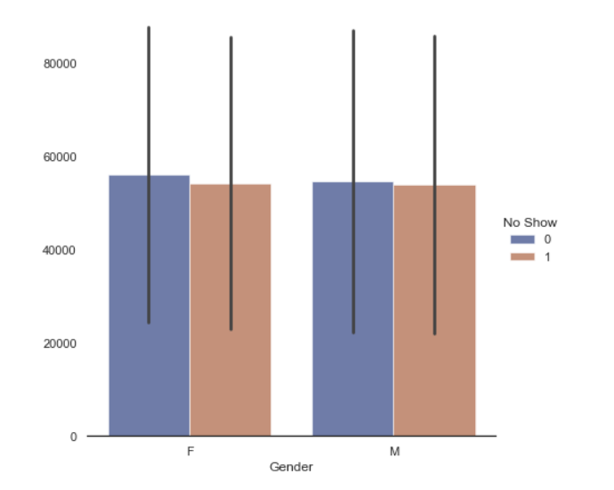
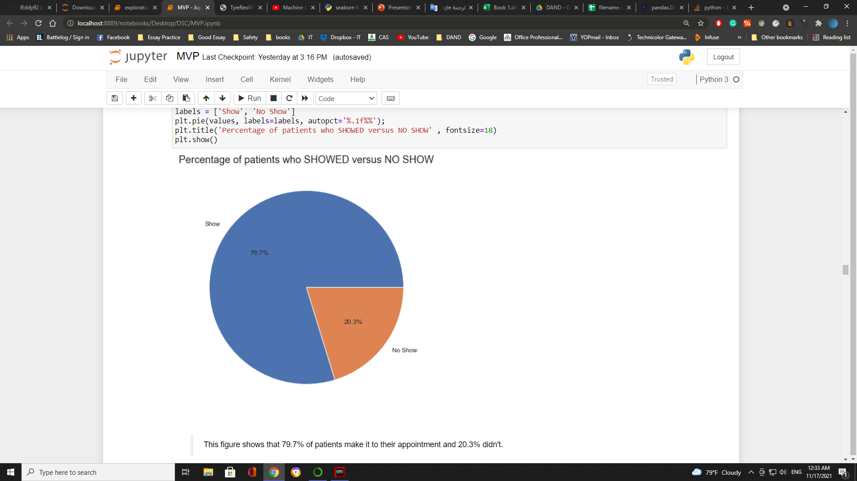
DATA ANALYST

Slide 12
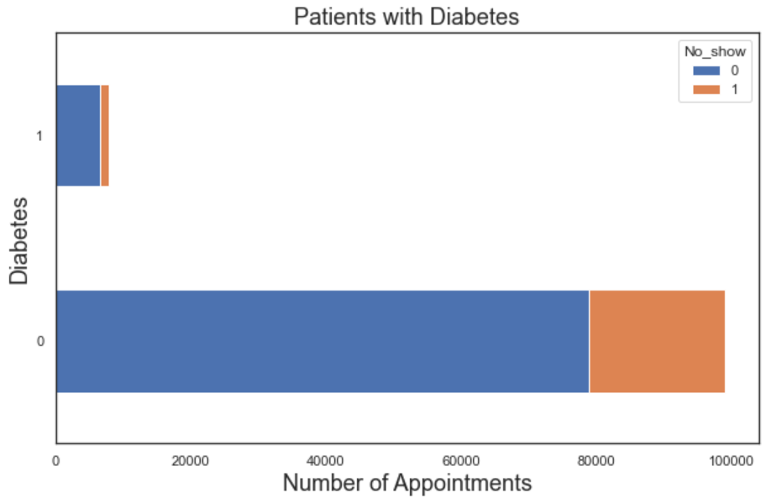
DATA ANALYST
The graph shows that patients with diabetes are more likely to make it to their appointment. that means patients with diabetes have a high chance to attend their appointment.

Slide 13
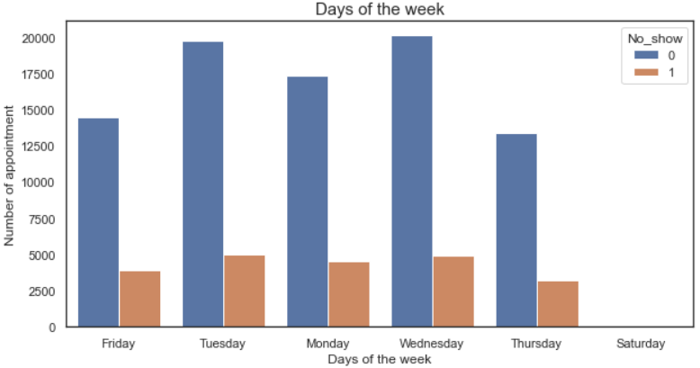
DATA ANALYST

Slide 14
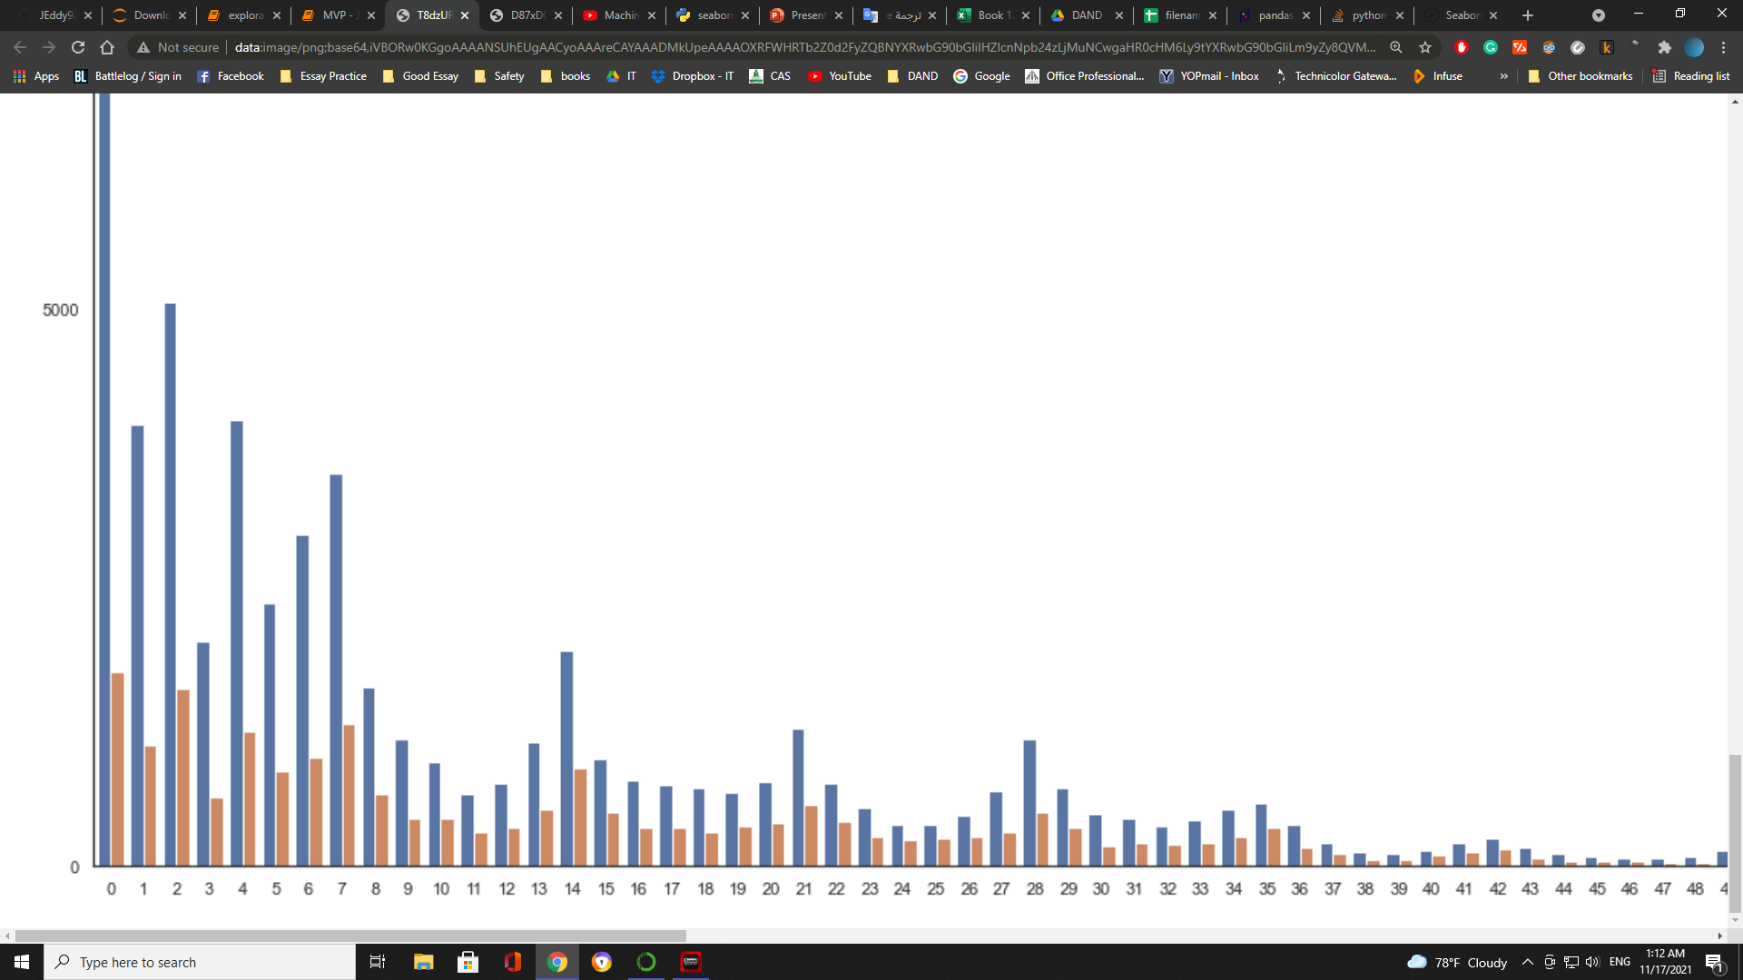
DATA ANALYST
Appointments
Number of days

Slide 15
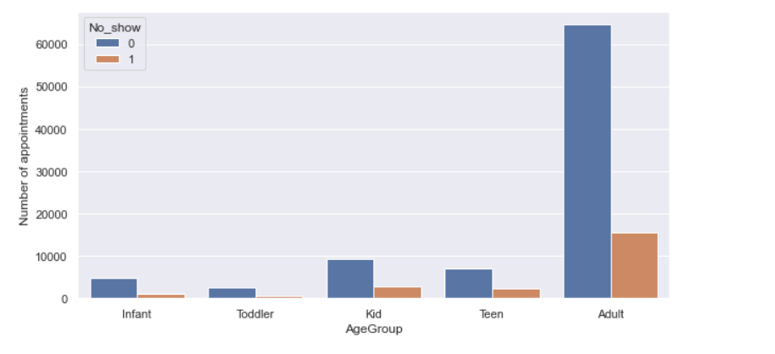
DATA ANALYST

Slide 16
DATA MODLING
Logistic regression, the categorical columns are extracted to binary by the get_dummies function. and the entire training dataset of 100,000 records was split into 80/20 train vs. Test. And the score is 0.80
 | Scholarship | Hypertension | Diabetes | Alcoholism | Handicap | SMS_received | F | M | Infant | Toddler | Kid | Teen | Adult | Friday | Monday | Saturday | Thursday | Tuesday | Wednesday
0 | 0 | 1 | 0 | 0 | 0 | 0 | 1 | 0 | 0 | 0 | 0 | 0 | 1 | 1 | 0 | 0 | 0 | 0 | 0
1 | 0 | 0 | 0 | 0 | 0 | 0 | 0 | 1 | 0 | 0 | 0 | 0 | 1 | 1 | 0 | 0 | 0 | 0 | 0
2 | 0 | 0 | 0 | 0 | 0 | 0 | 1 | 0 | 0 | 0 | 0 | 0 | 1 | 1 | 0 | 0 | 0 | 0 | 0
3 | 0 | 0 | 0 | 0 | 0 | 0 | 1 | 0 | 0 | 0 | 1 | 0 | 0 | 1 | 0 | 0 | 0 | 0 | 0
4 | 0 | 1 | 1 | 0 | 0 | 0 | 1 | 0 | 0 | 0 | 0 | 0 | 1 | 1 | 0 | 0 | 0 | 0 | 0

Slide 17
DATA MODLING
Decision tree
we include neighborhood columns to enhance the score by using the LabelEncoder() function, and the score increased by 1%. And the score is 0.81
 | Scholarship | Hypertension | Diabetes | Alcoholism | Handicap | SMS_received | Neighbourhood_n | AgeGroup_n | Weekday_n
0 | 0 | 1 | 0 | 0 | 0 | 0 | 39 | 0 | 4
1 | 0 | 0 | 0 | 0 | 0 | 0 | 39 | 0 | 4
2 | 0 | 0 | 0 | 0 | 0 | 0 | 45 | 0 | 4
3 | 0 | 0 | 0 | 0 | 0 | 0 | 54 | 2 | 4
4 | 0 | 1 | 1 | 0 | 0 | 0 | 39 | 0 | 4

Slide 18
CONCLUSION
In conclusion, And after testing the models It seems that our models are always predicting that the patient will attend the appointment. Furthermore, the data was gathered in a short time span. The model could be improved if we added more features such as :
Forecast factors like weather and temperature
Social factors such as marital status and employment status
Hospitals location
The clinic name

Slide 19
Thanks

