Slide 1
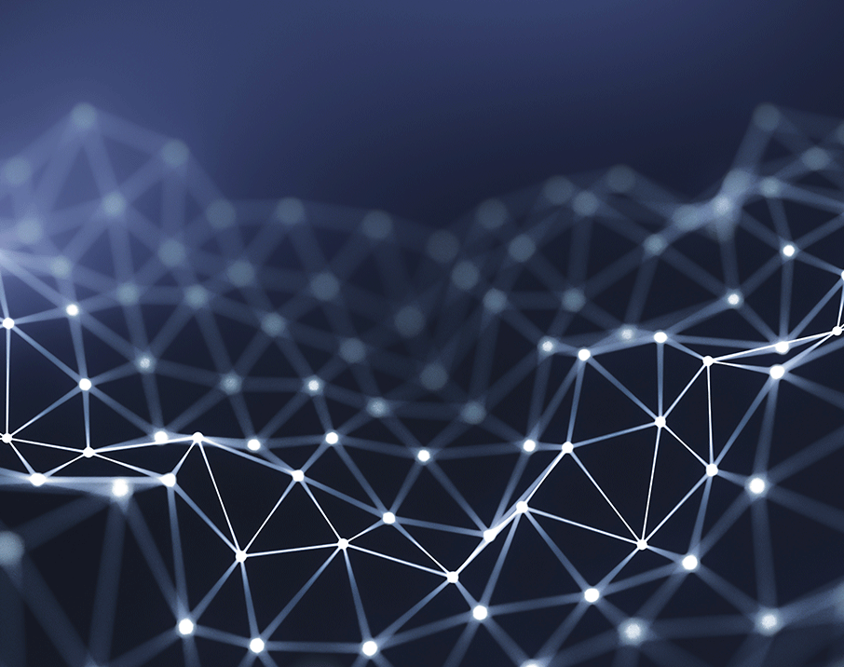
Computer Vision Project
Flower Classification
Mert, Marcel, Jakob, Justin, Nico

Slide 2
Agenda
Progress of models
Additional techniques
Best Result
What worked, what didn‘t
What did we learn?

Slide 3
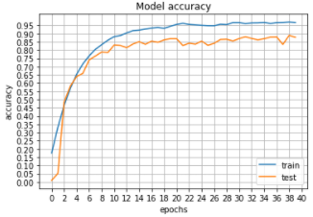
What we achieved
Test Accuracy: 89.9%
Training time: 2h

Slide 4
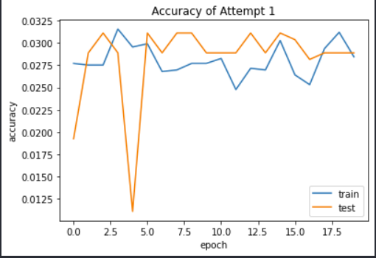

Attempt 1: Very simple CNN
3 blocks of Conv2D + MaxPool2D (16 Filters 3x3)
Flatten
2 Dense Layer ReLU + 1 Dense layer softmax
Total params: $\sim$ 2.275.000

Slide 5
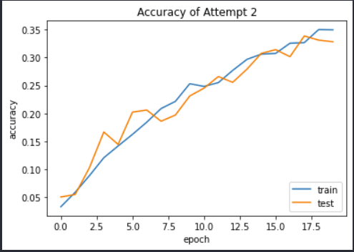

Attempt 2: More Layers
Test Accuracy: 32.5%
6 blocks of Conv2D + MaxPool2D (16 Filters 3x3)
Flatten
1 Dense Layer ReLU + 1 Dense layer softmax
Total params: $\sim$ 36.500

Slide 6
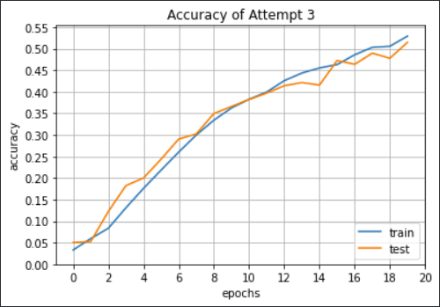
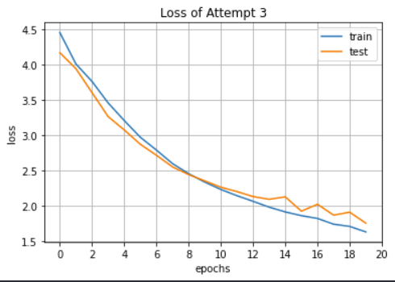

Attempt 3: Increasing Filters
Test Accuracy: 51%
6 blocks of Conv2D + MaxPool2D
More Filters after each block
Flatten, 1 Dense ReLU + 1 Dense Softmax
Total params: $\sim$190.000

Slide 7
Stuck at 50% - How to proceed?
Batch Normalisation
Transposed Convolution
Seperable Convolution
Global Average Pooling

Slide 8
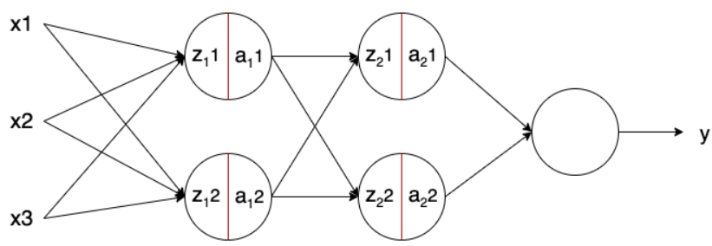


Batch Normalization
Normalization possibility: $x_{normalized}=\left(\frac{x− m}{s}\right)$
Normalize batches inside network (between the layers)
$z^{N}=\left(\frac{z− m_{z}}{s_{z}}\right)$
Avoid overfitting, increase speed & stability
$$z=g\left(ω,x\right); z^{N}=\left(\frac{z− m_{z}}{s_{z}}\right)∙ γ+ β; a=f(z^{N})$$

Slide 9
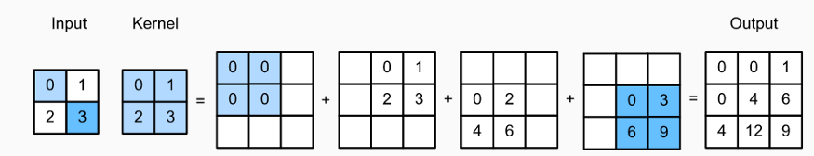
Transposed Convolution
Standard Convolution: down-sampling
Transposed Convolution: up-sampling

Slide 10
Separable Convolution
Keras uses depthwise seperable convolution
spatial as well as depth dimensions
Kernel is split into 2 smaller ones:
Kernel 1 does depthwise convolution
Kernel 2 does pointwise convolution

Slide 11
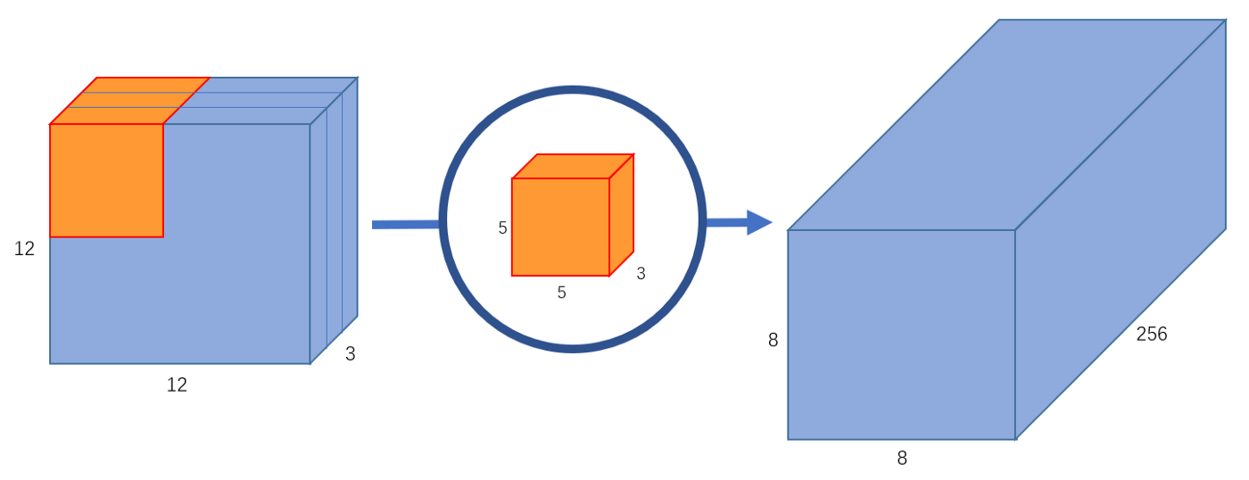
Separable Convolution – Example Starting Point
Normal Convolution with 8x8x256 output

Slide 12
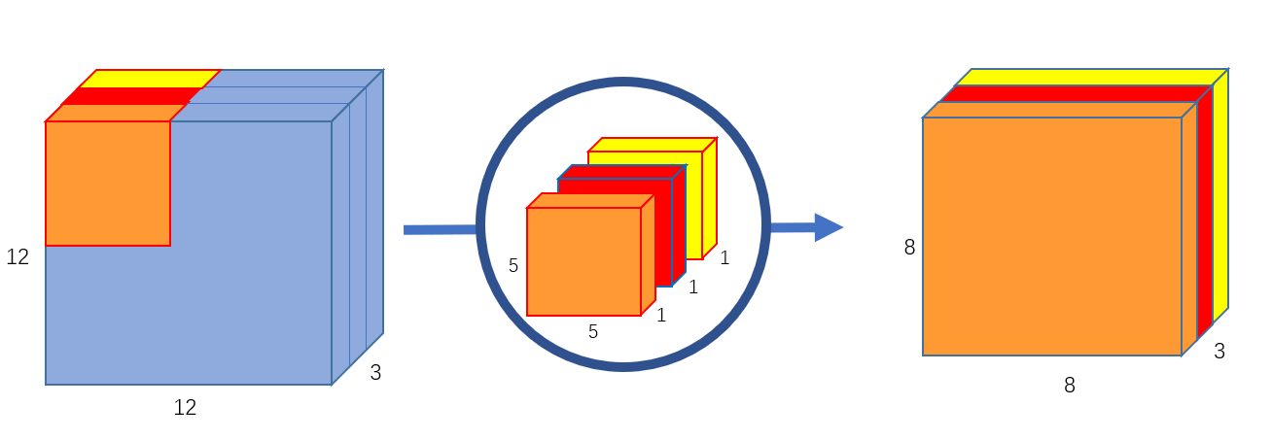
Separable Convolution – Example Part 1: Depthwise Convolution
Each 5x5x1 kernel iterates 1 channel, getting the scalar products of every 25 pixel group → 8x8x1 image

Slide 13
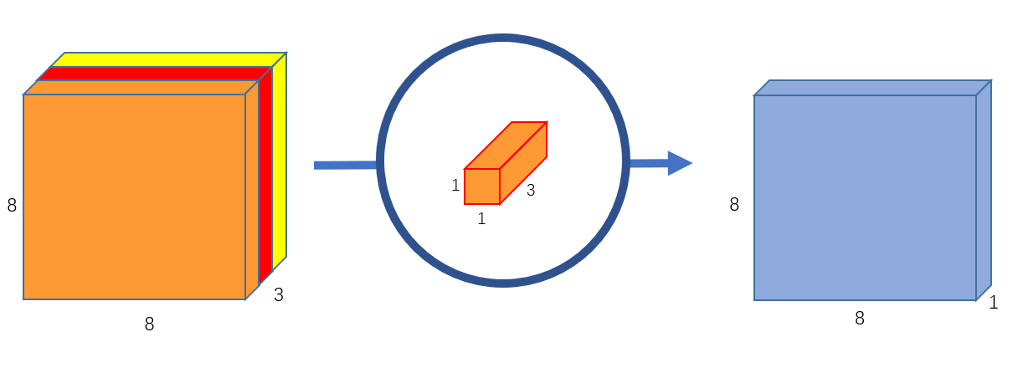
Separable Convolution – Example Part 2: Pointwise Convolution
Uses a 1x1 kernel with depth of however many channels the input image has→ Iterate 1x1x3 over input image to receive 8x8x1

Slide 14
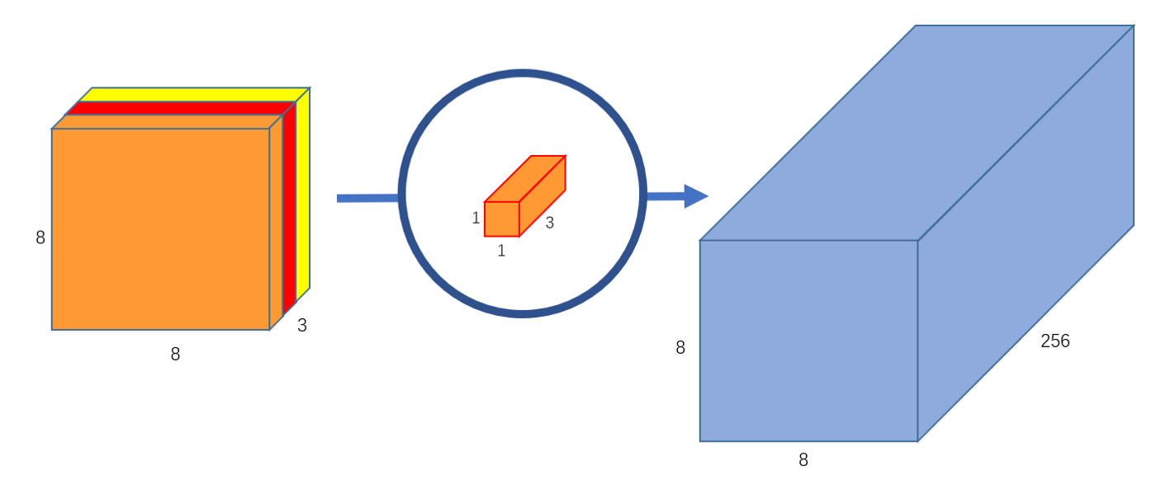
Separable Convolution – Example Final
Normal Conv.:
256x3x5x5x8x8=1.228.800 multiplications
Seperable Conv. | operation | multipli.
Depthwise Conv. | 3x5x5x8x8 | 4,800
Pointwise Conv. | 256x1x1x3x8x8 | 49.152
Total |  | 52.952
Create 256 1x1x3 kernels that output a 8x8x1 image each to get a final image of shape 8x8x256

Slide 15
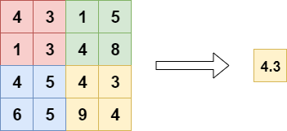
Global Average Pooling
Generate one feature map for each category of classification task
Replace fully-connected layers
Avg. of each feature map → fed directly into softmax
Benefits:
more native to convolution
overfitting avoided

Slide 16
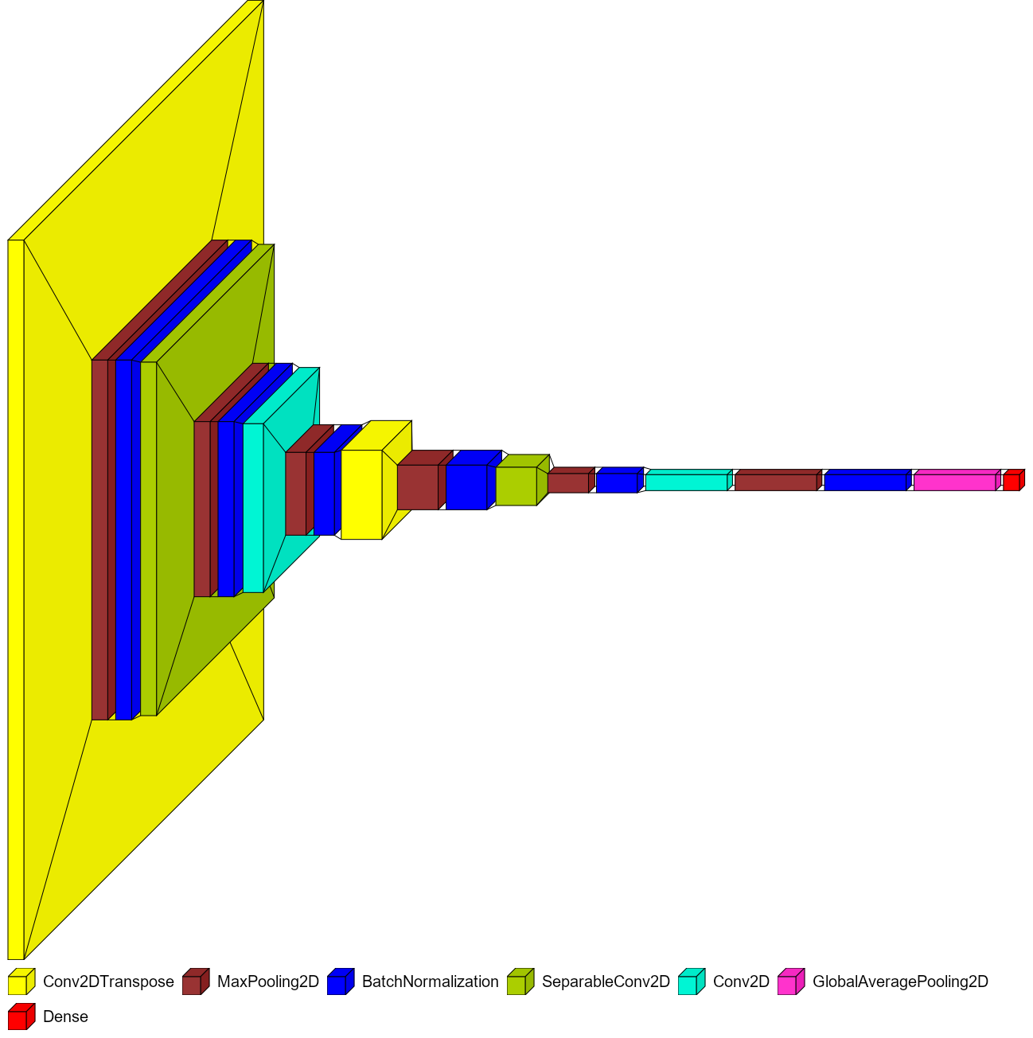
Best Model: Architecture

Slide 17
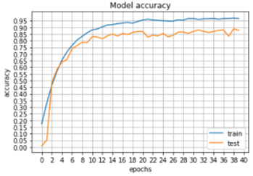

Attempt 4: Best Result
Test Accuracy: 89.9%
64 – 1024 Filters
Total params: $\sim 6.600.000$
Batch size: 26
Input size: 224, 224

Slide 18
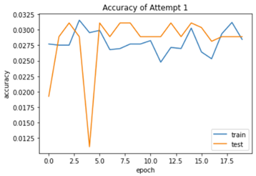
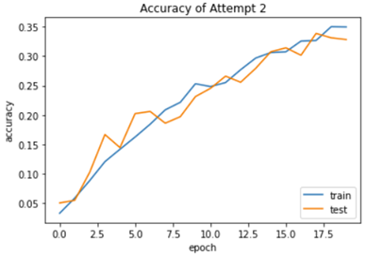
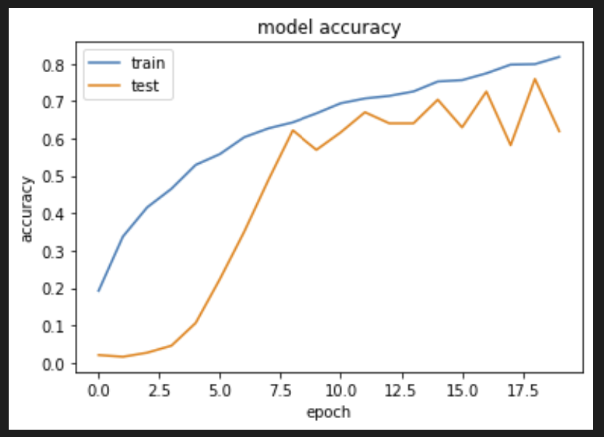
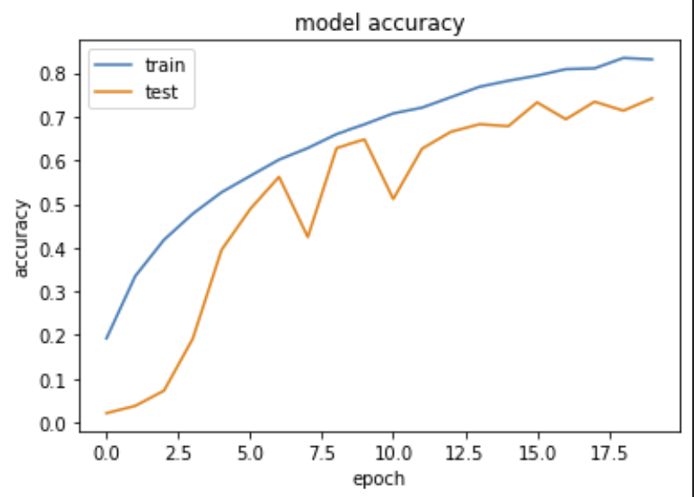
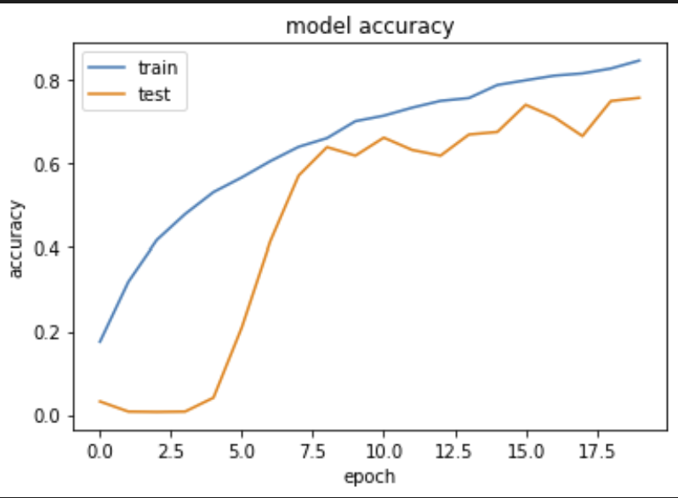
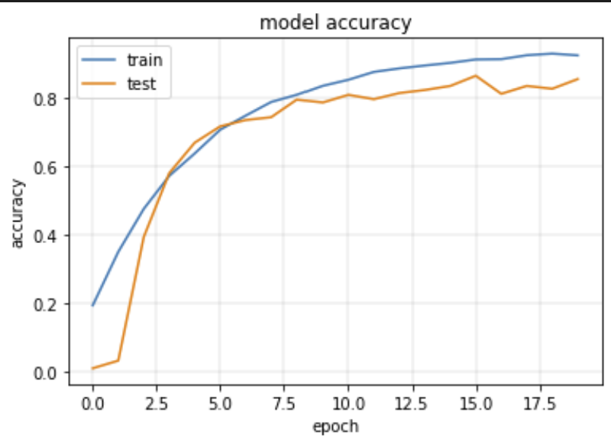
Process

Slide 19
What worked, what didn´t
Worked:
Global Average Pooling
Convolutional Transpose
Batch Normalization
Didn´t work:
Multiple dense layers
Dropout
Sticking to one Convolution Type

Slide 20
What did we learn?
Layers not filters
Mixing Convolution Types
Training takes time ☹
Python ☺

Slide 21
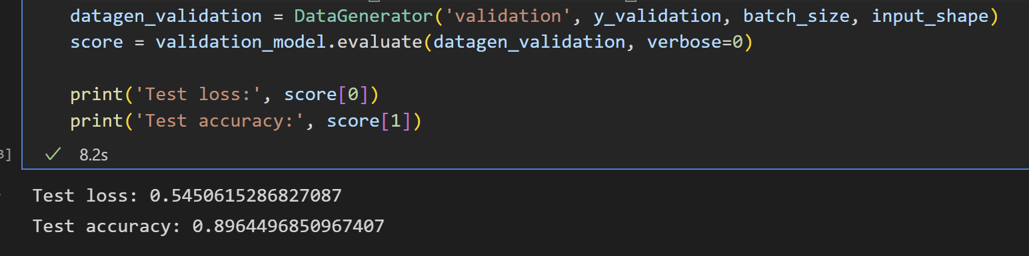
Result

Slide 22
Thank you for your attention!

