Slide 1
ESP32-S3 / FreeRTOS
GROW SYSTEM V0.2
Grow Automation System Prototype
From measurements to an integrated control system
Measurement
Control
Observability
GROW SYSTEM V0.2 / ESP32-S3 · FreeRTOS
EN / 01
Notes:
GROW SYSTEM V0.2 is the second prototype of a grow automation system. Its purpose is to bring environmental measurements, equipment control and observation of device behaviour into one platform. It uses ESP32-S3 and FreeRTOS. This presentation follows the transition from collecting telemetry to controlling lighting and a pump, and then explains how that behaviour can be assessed. The important result is the coordinated operation of the parts, rather than any single feature. This is an experimental platform for testing hardware and architectural choices. It is not presented as a finished commercial product or as proof of agronomic performance. We will begin with the practical problem, then examine the device, control architecture and possible future directions.
[50 s; total planned delivery 640 s]
Sources: docs/device-overview-en.md; corresponding GROW_SYSTEM_V0.2_Technical_Overview_EN.pdf.

Slide 2
Automation supports the operator
Small and medium farms: less routine, more control
01
Less repetitive manual work
European practice
IRRISMA · Greece
02
More predictable resource use
7–10% less water
≈5% higher cotton yield
03
Consistent response + oversight
WATERBEE
21% average water savings
up to 44% in individual trials
04
Data for analysis and decisions
These are external results, not a GROW SYSTEM forecast.
Outcomes depend on crop, equipment and conditions.
EU CAP Network · IRRISMA | European Commission CORDIS · 283638
GROW SYSTEM V0.2 / ESP32-S3 · FreeRTOS
EN / 02
Notes:
For a small farm, automation is primarily a tool that supports the operator. Repeated observations and actions can be performed consistently, while accumulated data can inform decisions. An additional layer of oversight can help identify deviations, but does not itself guarantee safety. The European examples on this slide report measurable effects in specific irrigation projects. IRRISMA compares water use and cotton yield with conventional plots, while WATERBEE reports demonstration trial outcomes. These examples explain the wider motivation; they do not predict our device's performance. Their percentages cannot be transferred to GROW SYSTEM because crops, equipment and operating conditions differ. Drawing our own conclusions requires measurements after the complete system is installed. The immediate objective is therefore a controllable, observable platform for experiments.
[65 s; total planned delivery 640 s]
Sources: EU CAP Network — IRRISMA: https://eu-cap-network.ec.europa.eu/good-practice/smart-water-management-system-improve-crop-yield-while-using-less-water_en
European Commission CORDIS — WATERBEE project 283638: https://cordis.europa.eu/project/id/283638/reporting
Accessed 2026-11-04. External context only; not GROW SYSTEM performance.

Slide 3
From telemetry to automation
V0.2 is the second prototype in an ongoing development cycle
V0.1
Monitoring and data acquisition
ESP32-S3 → sensors → telemetry → database
V0.2
Testing a complete control system
Sensors + actuators
FreeRTOS + automation
Blynk + diagnostics
An experimental platform, not a final product specification
GROW SYSTEM V0.2 / ESP32-S3 · FreeRTOS
EN / 03
Notes:
The project's evolution has two stages. V0.1 addressed monitoring: an ESP32-S3 controller acquired sensor readings, collected telemetry and supported storage in a database. We do not attribute actuator functions to that stage. V0.2 adds the complete path from measurements and commands to equipment action. It introduces actuators, separate FreeRTOS tasks, an automatic lighting cycle, Blynk and runtime diagnostics. This is the second prototype, rather than the final feature list of a future product. Its role is to test possible hardware, control and user interaction choices together. Current decisions can therefore be evaluated and revised based on testing. The next slide shows the physical components that form this experimental platform and how their roles relate to each other.
[55 s; total planned delivery 640 s]
Sources: docs/device-overview-en.md; corresponding GROW_SYSTEM_V0.2_Technical_Overview_EN.pdf. Project history / future directions: user-approved presentation brief.

Slide 4
The device: functional zones
Power and logic are arranged in separate functional zones
SENSORS
ACTUATORS
HTU21 · temperature / humidity
Capacitive soil sensor
HC-SR04 · water level
LDR · light measurement
ESP32-S3
Pump through MOSFET
Light: PWM → 0–10 V
LOCAL INTERFACE
5 V / 3.3 V · logic
4 buttons
OLED · 128 × 64
12 V · power section
Structural diagram; separation does not imply galvanic isolation
GROW SYSTEM V0.2 / ESP32-S3 · FreeRTOS
EN / 04
Notes:
The ESP32-S3 sits at the centre of the device. On the left are the measurement components: HTU21 for air temperature and humidity, a capacitive soil sensor, HC-SR04 for estimating water level, and an LDR for relative light measurement. Four buttons and an OLED provide the local interface. On the right are the pump, switched through a MOSFET module, and lighting control through PWM to 0–10 V conversion. The pump is manually controlled in the current version. The 12 V power section and 5 V / 3.3 V logic section form separate functional zones. That does not imply galvanic isolation. This is a structural view, not a wiring schematic. The grow light's power requirements are separate from its 0–10 V control input.
[60 s; total planned delivery 640 s]
Sources: docs/device-overview-en.md; corresponding GROW_SYSTEM_V0.2_Technical_Overview_EN.pdf.

Slide 5
One decision point
Tasks produce events; control_task owns actuator state
sensor_task
input_task
Drivers
Event
queue
control_task
Light FSM
Pump state
time_task
ramp_task
Hardware
network_task
Safe state snapshots
display_task · Network telemetry · HTTP /api/state
Module counters → HTTP /api/diagnostics · read-only
GROW SYSTEM V0.2 / ESP32-S3 · FreeRTOS
EN / 05
Notes:
The central architectural rule is a single logical owner of actuator state. The five tasks on the left handle measurements, button presses, time, brightness step timing and network commands. They produce events and place them in one application queue. The control task then makes decisions sequentially, updates the pump state and lighting state machine, and calls drivers. A sensor task or network handler therefore does not independently change a hardware output. The lower path serves observation: the OLED, network telemetry and HTTP obtain consistent state snapshots. Module diagnostic counters are exposed separately through a read-only interface. Follow the two different flows in the diagram: commands towards equipment, and published data towards readers. This structure makes simultaneous local and remote actions easier to reason about.
[80 s; total planned delivery 640 s]
Sources: docs/device-overview-en.md; corresponding GROW_SYSTEM_V0.2_Technical_Overview_EN.pdf.

Slide 6
Lighting makes automation concrete
Current test configuration · AUTO + valid local time
DAWN
06:00 · rise → 60%
IDLE
Hold current level
DUSK
20:00 · fall → 0%
Step: 5 percentage points every 10 min
LIGHT_S · commanded level
LIGHT_A · LDR measurement
AUTO · enables phase control
MOD · current phase
Buttons and Blynk remain available during ramps. LDR is measurement-only.
GROW SYSTEM V0.2 / ESP32-S3 · FreeRTOS
EN / 06
Notes:
The lighting cycle makes the architecture concrete. With AUTO enabled and valid local time, DAWN is associated with 06:00 and DUSK with 20:00. Brightness changes by five percentage points on events from an independent ten-minute timer, with a morning target of sixty percent. The first step is not necessarily exactly ten minutes after AUTO is enabled. IDLE holds the current level without an automatic ramp. LIGHT_S is the system-commanded brightness, whereas LIGHT_A is a relative LDR measurement, not lux. MOD identifies the current phase. Buttons and Blynk remain usable during a ramp. The LDR does not close a feedback loop: its reading does not correct PWM. A manual adjustment does not cancel an active ramp's direction before its endpoint is reached.
[75 s; total planned delivery 640 s]
Sources: docs/device-overview-en.md; corresponding GROW_SYSTEM_V0.2_Technical_Overview_EN.pdf.

Slide 7
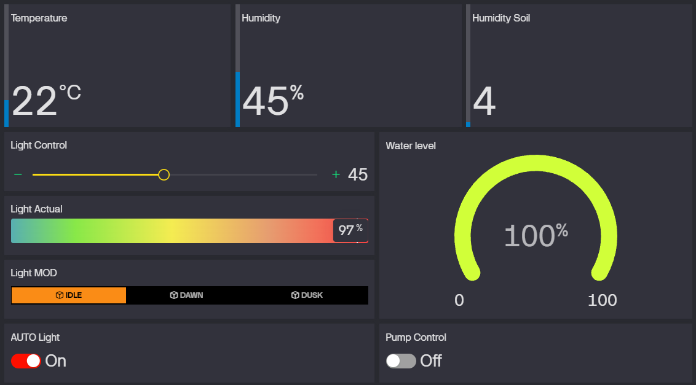
Remote interface, shared control logic
Blynk: telemetry, pump, LIGHT_S / LIGHT_A, AUTO, MOD and water
Blynk commands → event queue → control_task → drivers
GROW SYSTEM V0.2 / ESP32-S3 · FreeRTOS
EN / 07
Notes:
This is the actual current Blynk interface. The upper part shows temperature and humidity measurements; below are commanded and measured light, automation state, water level and pump control. The displayed values illustrate the interface and are not a test report. LIGHT_S and LIGHT_A can differ because one is a command and the other is an LDR reading. The key architectural point appears beneath the screenshot: remote commands enter the same event queue as local commands. Blynk does not switch GPIO directly. Both physical buttons and the remote interface therefore use one decision model. This is not a tutorial on configuring the cloud service. The relevant capabilities are observing state and providing another entry point into the shared control path.
[55 s; total planned delivery 640 s]
Sources: docs/device-overview-en.md; corresponding GROW_SYSTEM_V0.2_Technical_Overview_EN.pdf. Actual project screenshot: docs/assets/blynk-dashboard.png; displayed values are illustrative, not validation evidence.

Slide 8
How do we assess stability?
Observability after functional implementation
Sensors and connectivity
Queue and deadlines
Memory and control
Sensor errors
Blynk / Wi-Fi
Overflows
Task deadline misses
Heap / stack margins
Control / ramp counters
/api/state
/api/diagnostics
ESP32
PC_collector
CSV
Analysis
Infrastructure ready for a 48–72 h test
The earlier CSV with incomplete peripherals is not full-system validation.
A separate report follows growbox assembly and representative testing.
GROW SYSTEM V0.2 / ESP32-S3 · FreeRTOS
EN / 08
Notes:
Once the functions work, a separate question remains: how do we detect problems and assess extended operation? The device tracks sensor errors, Blynk request results, Wi-Fi reconnections, queue overflows and task deadline misses. It also exposes heap metrics, stack margins and control and ramp counters. Two read-only HTTP endpoints provide state and diagnostics. A PC collector retrieves that information and stores CSV for later analysis. The infrastructure is ready for a forty-eight to seventy-two hour endurance test, but a complete-system test is still ahead. The earlier CSV run with incomplete peripherals cannot substitute for that validation. A separate technical report should follow installation of the complete system in the growbox and testing under representative operating conditions.
[70 s; total planned delivery 640 s]
Sources: docs/device-overview-en.md; corresponding GROW_SYSTEM_V0.2_Technical_Overview_EN.pdf.

Slide 9
V0.2 delivers an integrated architecture
A working physical prototype brings five functions together
GROW SYSTEM V0.2
Measurement
Control
Automation
Remote operation
Diagnostics
Sensor architecture
Buttons + OLED
Lighting cycle
Blynk
HTTP + PC collector
From a collection of sensors to a coordinated system
Functions implemented; full endurance validation is still ahead
GROW SYSTEM V0.2 / ESP32-S3 · FreeRTOS
EN / 09
Notes:
The result of this stage is a working physical prototype with a shared architecture. The five parts on the slide are measurement, local control with OLED feedback, an automatic lighting cycle, remote operation through Blynk, and diagnostics with a PC collector. Their value comes from interaction: measurements and commands follow a clear path, decisions are concentrated in one place, and state is visible to both users and analysis tools. The transition from V0.1 is therefore more than adding another sensor or screen. A collection of data sources has become a control system. Implemented functions are still distinct from demonstrated long-term reliability in a complete growbox. Representative testing is the next practical step; possible product directions appear on the final slide.
[50 s; total planned delivery 640 s]
Sources: docs/device-overview-en.md; corresponding GROW_SYSTEM_V0.2_Technical_Overview_EN.pdf.

Slide 10
Two development directions
GROW SYSTEM
PROFESSIONAL / GREENHOUSE
HOME / COMPACT
Configurable kits and modular expansion
Project-specific turnkey installations
Sensors · irrigation · light · climate · zones
One pot or a small plant zone
Controller · environment and soil sensors
Light · watering · manual controls
Simple remote service
Future LLM: analysis and recommendations
Above deterministic actuator control
Future concepts, not finished products
Small enough to experiment.
Structured to scale.
GROW SYSTEM V0.2 / ESP32-S3 · FreeRTOS
EN / 10
Notes:
Future development has two possible directions. For small and medium greenhouse businesses, a modular system could offer configurable kits, expansion and project-specific turnkey installations with different sensors, irrigation, lighting, climate equipment and monitored zones. Once the deterministic foundation is stable, an analytical LLM module could be explored. It might examine historical and current data, identify abnormal trends, support quality control, forecasts and crop-specific recommendations. It must not replace low-level deterministic actuator control. The home branch instead reduces size and scope to one pot or a small plant zone, with basic sensors, light, watering, manual controls and a simple remote service. These are development concepts, not promised products. V0.2 is small enough for experimentation while already structured around principles that can scale.
[80 s; total planned delivery 640 s]
Sources: docs/device-overview-en.md; corresponding GROW_SYSTEM_V0.2_Technical_Overview_EN.pdf. Project history / future directions: user-approved presentation brief.

