Slide 1
Game Database Project
Group 8
Ariel Cabrera
George Suarez
Phap Bui (Dragon)
Yousef Jarrar

Slide 2
Background – Why did we choose this?
We wanted to bring our passion to life
We noticed that there aren’t many video game databases out there.
Currently there are a few available is: IGDB, OGSR, TGDB
In the future, we wanted a web app that made the database look prettier
This would include a small subscription – directed towards the upkeep of the database.

Slide 3
Background – Part B
Our database team is geared to provide expansive information to the end-user at a small cost.
We understand the meaning of reading/studying all the information about a game before it becomes released
This includes after the fact; This includes information about certain sound tracks, publishers, developers, etc…
Creating a central hub allows ease of access to all those looking to read up on certain video games.

Slide 4
Entities
Game
Platform
gameMode
Developer
Available
Publishers
InvCount
Genre
Themes
Description
Customer
Perspective
Rating

Slide 5

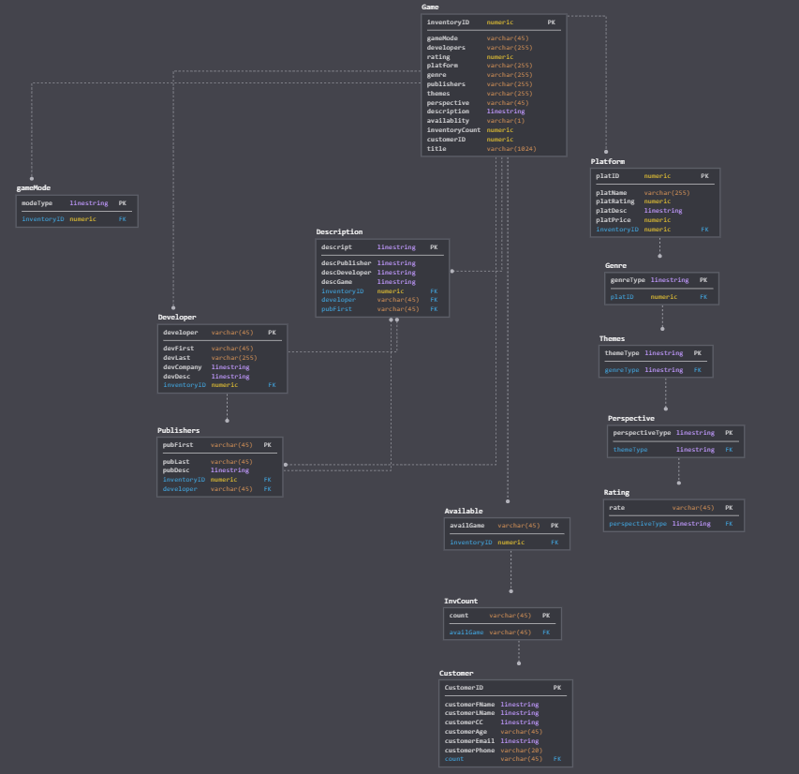
Entity Relationship Diagram

Slide 6
CREATE STATEMENT
CREATE TABLE Game
(
InventoryID number(10,0) NOT NULL ,
gameMode varchar2(20) NOT NULL ,
Developers varchar2(20) NOT NULL ,
Rating number(10,0) NOT NULL ,
Platform varchar2(20) NOT NULL ,
Genre varchar2(20) NOT NULL ,
Publishers varchar2(20) NOT NULL ,
Themes varchar2(20) NOT NULL ,
Perspective varchar2(20) NOT NULL ,
Description varchar2(255) NOT NULL ,
Availablity varchar2(1) NOT NULL ,
InventoryCount number(10,0) NOT NULL ,
CustomerID number(10,0) NOT NULL ,
title varchar2(20) NOT NULL,
PRIMARY KEY (inventoryID)
);

Slide 7
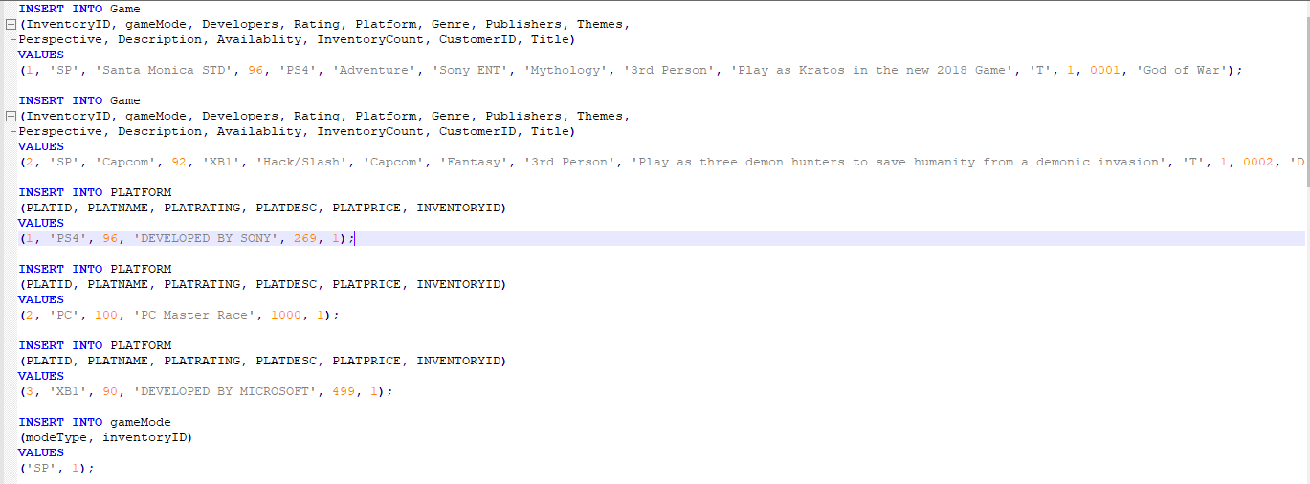
INSERT STATEMENT

Slide 8
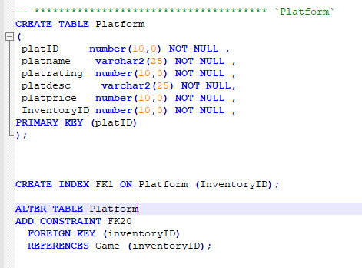
ALTER STATEMENT + INDEXING

Slide 9
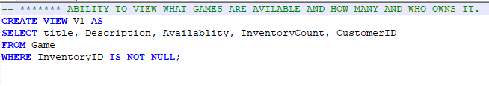
VIEWS STATEMENT

Slide 10
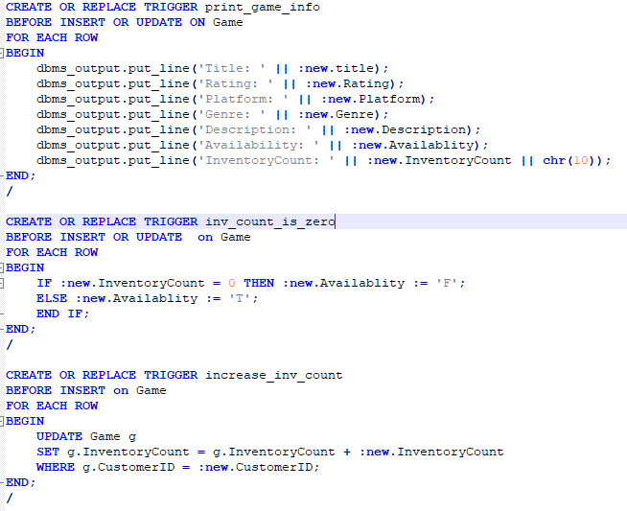
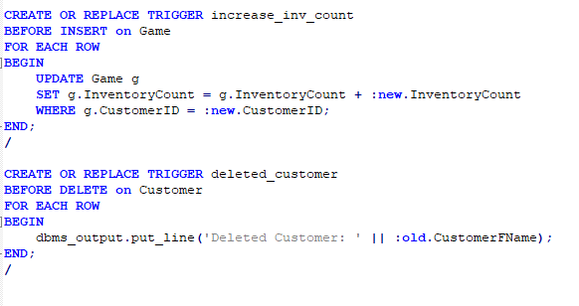
TRIGGERS

Slide 11
SELECT STATEMENT
SELECT CUSTOMERFNAME, CUSTOMERLNAME, CUSTOMERAGE FROM CUSTOMER;

Slide 12

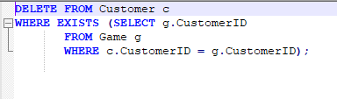
UPDATE/DELETE STATEMENTS

